Slide 1

感恩遇见，相互成就，本课件资料仅供您个人参考、教学使用，严禁自行在网络传播，违者依知识产权法追究法律责任。
更多教学资源请关注
公众号：溯恩高中英语
知识产权声明

Slide 2



自律方得自由，网课更需坚守
Self-discipline can bring real freedom,and learning online calls for perseverance.
——浙江省常山一中 吴俊峰

Slide 3
Contents
01
Self-discipline and freedom
02
Why is self-discipline important？
03
Tips on develping self-discipline
04
How to improve the online lessons
05
Views on your online learning

Slide 4
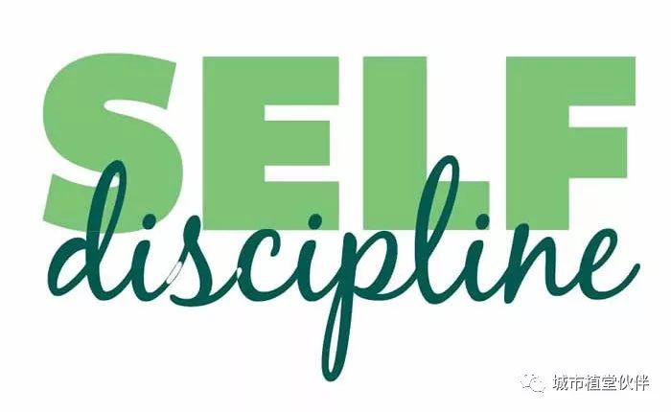
warming up
what is self-discipline?
Do you think you are a self-disciplined person? Why or why not?
Do you think it is important to be self-disciplined? Why?
Do you intend to be a more self-disciplined person? Share us with your plan.

Slide 5
01
Learning
Self-discipline and freedom
There is a saying that the true freedom is not doing whatever you want, but to be self-disciplined. What do you think is the relationship between freedom and self-discipline？

Slide 6
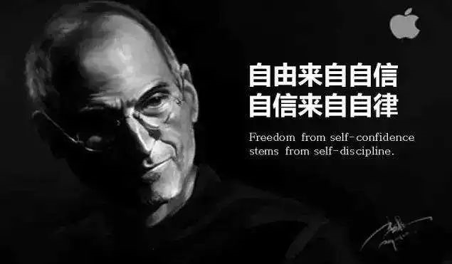
What is the relationship between freedom and self-discipline？
Keeping self-discipline, you will keep freedom.

Slide 7
Learning: Self-discipline can bring real freedom
Self-disciplined people are not all outstanding people. But nearly all outstanding people are self-disciplined people. Some of them keep reading every day. Some of them never get late.
The real difference between an elite and the ordinary people is that an elite can manage himself. And that's where their success comes from.
自律的人不一定都优秀，但优秀的人基本都是自律的。他们之中，有的人坚持每天看书，有的人坚持从不迟到。一个真正的精英与普通人的不同，就是他能够管住自己。而他们的成功就来源于此。
elite /eɪˈliːt/ n. 精英；精华；中坚分子

Slide 8
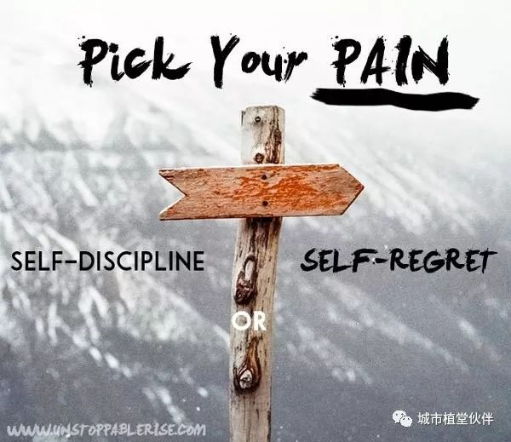
Learning: Self-discipline can bring real freedom
What people call self-management is in fact self-discipline. If you want to get slim, you need to manage your appetite. If you want to succeed, you need to manage your heart.
自律，其实就是自我管理。想要减肥，就得把自己的嘴巴管住。想要成功，就得把自己的心管住。
appetite /ˈæpɪtaɪt/ n. 食欲；嗜好

Slide 9
Learning: Self-discipline can bring real freedom
So set your goal and write down your reasons for them. Establish a list for your daily work and life, and execute them out without mercy. This is not sacrificing your freedom. This is freedom. Only in self-discipline can you stop being a slave of all the trivial things in your life. Only in self-discipline can you truly own your future.
☞☞
定个目标，并写下原因吧。每天为自己的工作和生活列出一个清单，然后毫不留情地执行它。这并不是牺牲自由，这恰恰就是自由。只有在自律当中，你才能不成为生活中琐碎的奴隶。只有在自律中，你才拥有未来。
execute /ˈeksɪkjuːt/ vt. 实行；执行
trivial /ˈtrɪviəl/ adj. 不重要的，琐碎的；琐细的
☞ Record a video or audio reading fluently in English , and then send the video or audio to you friends.

Slide 10
02
Reading, listening, speaking
Why is self-discipline important
Do you think it is important to be self-disciplined? Why?

Slide 11

Reading, listening, speaking
Why is Self-Discipline Important？

Slide 12
Reading, listening, speaking
Why is Self-Discipline Important？
If you have been following this channel for a while you might get the idea that I like structure. And I do. I love productivity,
, and I try to be . When some people hear, they think that it's boring. They equate a disciplined life of structure . Before I get into my thoughts on the topic I want to tell you a story.
organzation, order
as disciplined as possible
to feelings of entrapment
如果你看这频道有一阵子了，你可能会发现我不只喜欢做事有结构性而且也确实做得到。我做事喜欢有效率、有组织性、有先后顺序，我也很努力地当个自律的人。有些人一听到自律，就会觉得很乏味。他们把自律的生活当作是一种情感上的束博。在我发表自己对自律的看法前，我想先告诉你们一个故事。
productivity /ˌprɒdʌkˈtɪvəti/ n. 生产力；生产率；生产能力
equate /ɪˈkweɪt/ vt. 使相等；视为平等 vi. 等同
entrapment /ɪnˈtræpmənt/ n. 诱捕；圈套；截留

Slide 13
Reading, listening, speaking
Why is Self-Discipline Important？
So its a hot sunny day out and there is this bee and her name is Bertha. Bertha by her hive with some other bees. Just . Like the other bees, Bertha may have some aspirations doing great things one day. I can't really say. Bees probably don't have that ability to think those kind of thoughts. Suddenly a bear starts her hive. The bear is hungry for some honey and bee eggs. In an attempt to save her hive, Bertha .
is buzzing
relaxing and having a good time
to approach
stings the bear
在某一个天气炎热的日子，有一只叫Bertha的蜜蜂。Bertha在她的蜂窝附近和其他蜜蜂嗡嗡叫，轻松快乐地玩耍。Bertha像其他蜜蜂一样也有着远大的抱负。其实也不能这样说啦! 蜜蜂应该不会想那么多。突然，有只熊慢慢开始走向她的蜂窝。这只熊肚子饿了，想吃些蜂蜜和蜂蛹。Bertha为了拯救她的蜂窝，去叮了那只熊。
buzz /bʌz/ v. 发出嗡嗡声；发出蜂鸣声

Slide 14
Reading, listening, speaking
Why is Self-Discipline Important？
But its skin is once she tries to pull her sting out she dismembers herself and dies. The sad part about the story is that Bertha . Through years of evolutionary wiring she is evolved to . It's a biological reaction to . She has no idea that her sting will
，and that she will die. If she she
, she and saved her own life.
so thick that
had no choice
sting threats
dangerous situation
get stuck
had known
would have died
might have flown away
但熊的皮肤太厚了，当她试着把针拔出来时，她自己肢解死掉了。这个故事悲伤的地方在于Bertha毫无选择权。多年的生物演化使她本能性地去叮敌人。这是对危险状况的本能反应。她完全不知道自己的针会卡在敌人身上，而且自己还会死。如果他知道这么做会致死的话，她可能早就飞走活下来了。
dismember /dɪsˈmembə(r)/vt. 肢解，割断手足；分割
evolutionary /ˌiːvəˈluːʃənri/ adj. 进化的；发展的---evolve /ɪˈvɒlv/ vt. 发展；进化

Slide 15
Reading, listening, speaking
Why is Self-Discipline Important？
Bees are prisoners of their own biology. Unlike bees, humans have the ability to override their biology. Through Self-Discipline. Lets say that someone to be in a deep and loving relationship. To that they love. And have a healthy body. Along each step of that journey they , such as porn, junk food or video games.
has long-term desires
create a meaningful career
are tempted by short term pleasures
蜜蜂被自己的生物本能限制住。而人们不像蜜蜂，我们有能力不被本能控制住。而那能力就是自律。举例来说: 有一个人想要来一段海枯石烂的感情。想要有意义而且自己又喜欢的工作。想要有健康的身体。而在达到这些目标的路上，每一步都会被短暂的快乐给诱惑，像是a片、垃圾食物、电玩。
override /ˌəʊvəˈraɪd/ vt. 推翻；超驰控制
tempt /tempt/ vt. 诱惑

Slide 16
Reading, listening, speaking
Why is Self-Discipline Important？
Deep down they really want the life that comes in the long term. Yet they keep succumbing to . The only difference between these two positions is Self-Discipline. We're luck that as humans we have the ability to practice Self-Discipline. It gives us what we truly want in life and allows us , or
around us. And I think that is a pretty amazing and powerful thought.
short-term pleasures
the freedom to achieve
to break free of the biological
societal cages
内心深处，人们想要的人生都是需要长期自律才能达到的，但他们还是会屈服于短暂的快乐。短暂快乐和长期幸福的人生，两者的差别就是在于有没有自律。我们人类很幸运的有能力去培养自律。自律带给我们自由，让我们达成人生目标，让我们不受生物本能还有群体控制。而我觉得自律一种很神奇而且又有力量的思想。
succumb /səˈkʌm/ vi. 屈服；被压垮 societal /səˈsaɪətl/ adj. 社会的

Slide 17
Reading, listening, speaking
Why is Self-Discipline Important？
But it's not so simple. Companies our ,
and use this against us by using supernormal stimuli. An example of supernormal stimuli is junk food. Our ancestors fat and salty food, because it was so at the time. But now companies have genetically engineered food to include more than ever before in order to .
are aware of
natural
biological reactions
were wired to seek out and enjoy
rare
fats and salts
make us desire it even more
但自律也不是很简单的事。企业发现我们的生物本能反应，然后利用这点给我们"超常刺激"。"超常刺激"的其中一个例子就是垃圾食物。我们的祖先偏向去找又油又咸的食物来享用，因为当时很少这种东西。但现在企业利用这点把食物改造，让他们比起以前有更多的油脂和盐分，让我们更想吃。
stimuli /'stɪmjʊlaɪ/ n. 刺激；刺激物；促进因素（stimulus的复数）
genetically /dʒəˈnetɪkli/ adv. 从遗传学角度；从基因方面

Slide 18
Reading, listening, speaking
Why is Self-Discipline Important？
Social Media and the internet is another form of supernormal stimuli. Humans are biological wired to seek out novelty. For our ancestors, novelty could lead to more knowledge about the world, which could lead to which helped us . It has its .
as a whole
more wisdom
thrive as a species
usefulness
社群媒体跟网络也是另一种"超常刺激"。人类被赋予寻找新奇事物的本能。对我们的祖先来说，新奇的东西会让他们更了解着个世界，这让他们更有智慧，也让人类得以兴旺。这是有用处的能力。
novelty /ˈnɒvlti/ n. 新奇；新奇的事物----novel adj. 新奇的 n. 小说
thrive /θraɪv/ vi. 繁荣，兴旺；茁壮成长

Slide 19
Reading, listening, speaking
Why is Self-Discipline Important？
However the internet to take advantage of this desire for novelty by showing you more novelty than you can ever . Every page more pages, with more novelty. And every video to a video with even more novelty. Video games do the same thing.
has been designed
dream of
links out to
然而，网络就是利用我们对于新事物的渴望去设计的，网络让我们看到连作梦都想不到的新奇事物。每一个页，都有更多的连结，带领我们探索更多新事物。一部一部影片给我们更多的惊奇。电玩也是一样的道理。

Slide 20
Reading, listening, speaking
Why is Self-Discipline Important？
Some evolutionary psychologists believe that video games, like first-person shooters and massively multiplayer open role-playing games, imitate environments that will the ones that our ancestors navigated in the past but supernormal versions of them. Yet we can get greater feelings of
in video games .
be similar to
accomplishment
with a lot less work
有些演化心理学家认为，电玩游戏，像是第一人称射击游戏(以玩家的视角进行)和在线多人角色扮演游戏，就是揣摩了我们的祖先在以前在探索新事物的环境，但是已经远远超越于祖先寻找新东西的刺激。我们可以轻松地在电玩中得到满满的成就感。
massively /ˈmæsɪvli/ adv. 大量地；沉重地
imitate /ˈɪmɪteɪt/ vt. 模仿，仿效；仿制
navigate /ˈnævɪɡeɪt/ v. 导航；航行，驾驶；找到正确的应对方法

Slide 21
Reading, listening, speaking
Why is Self-Discipline Important？
The advent of on the screen in video games is that companies are aware that it will . So not only are we sabotaged by our own biology. But we are being targeted by cooperation's seeking to us and
.
constant achievements
showing up
good evidence
motivate players to keep playing
take advantage of
make a profit
在电玩世界，目标达成的通知接连不断地出现在屏幕上，这就明确证明出，企业知道这会让玩家有动力继续玩。我们不只被自己的生物本能控制。还被企业利用我们的本能去占便宜。
advent /ˈædvent/ n. 到来；出现
sabotage /ˈsæbətɑːʒ/ v. 妨害；蓄意破坏
target /ˈtɑːɡɪt/ n. 目标；靶子 v. 把...作为目标

Slide 22
Reading, listening, speaking
Why is Self-Discipline Important？
, you and I are not like the bee, because we are not cased by our own biology. With Self-Dicipline — We can live the life . We have the choice !
On the plus side
we truly want
to be free
从好处来看，你跟我，我们不像蜜蜂被自己的本能控制。只要有自律，我们就可以活出自己想要人生。我们可以选择拥有自由！
case n. 情况；实例；箱vt. 包围；把…装于容器中

Slide 23
03
Thinking
Tips on developing self-discipline
It's a difficult time but also offers a good opportunity for all students to challenge and develop themselves. To be more competitive in the future, students have to learn how to acquire knowledge actively and how to manage themselves.
And self-discipline is the magic power that makes a person virtually unstoppable! What behaviors support self-discipline?

Slide 24
To develop self-discipline, follow these steps:
Self-discipline is an essential quality, and it's a key differentiator between people who are successful in life and those who aren't. It is what enables us to do high-quality work, even when we're tired. It helps us to stay professional, even when we're not feeling great. Make sure that you develop it!
step5
Monitor your progress.
5
step4
4
Replace old habits.
step3
3
Identify obstacles.
step2
2
Find your motivation.
step1
Choose a goal.
1

Slide 25
5 Ways to Develop Self-Discipline
01. Have a good sleep早睡早起
A good sleep makes you energetic enough to deal with the work and study. It also has been shown to improve problem-solving skills and enhance memory performance.
Most Importantly SLEEP! SLEEP! SLEEP! most of us are sleeping late than we used to do when attending the offline classes. Sleep early and wake up early so that you can be more productive in class.

Slide 26
5 Ways to Develop Self-Discipline
02. Make a study plan 制定学习计划
If you try for everything at once you will not be able to achieve desired results as the task will look intimidating and might lead to failure and a disappointment.
A study plan is an effective way to help you navigate through your whole semester, and hold you accountable for your own learning outcomes. Study plans are particularly important for online students, since you need to have self-discipline and determination to complete your studies without the constant reminders of an instructor.
intimidate /ɪnˈtɪmɪdeɪt/vt. 恐吓，威胁；胁迫
intimidating adj. 使人望而生畏的态度；令人紧张不安的；令人胆怯的
accountable adj. 有责任的；有解释义务的；可解释的

Slide 27
5 Ways to Develop Self-Discipline
03. Know Your Weakness 了解自己的弱点
We all have weaknesses. Whether they're snacks such as potato chips or chocolate chip cookies, or technology such as Facebook or the latest addictive game app, they have similar effects on us.
Acknowledge your shortcomings, whatever they may be. Too often people either try to pretend their vulnerabilities don't exist or cover up any pitfalls in their lives. Own up to your flaws. You can't overcome them until you do.
vulnerability /ˌvʌlnərəˈbɪləti/n. 易损性；弱点
pitfall /ˈpɪtfɔːl/ n. 陷阱，圈套；缺陷；诱惑
Own up to your flaws 承认你的缺点---own up to 承认；承认错误，坦白
flaw /flɔː/ n. 瑕疵，缺点；裂缝，裂纹

Slide 28
5 Ways to Develop Self-Discipline
04. Take a break & reward yourself 适当放松及奖励自己
Give yourself something to be excited about by planning a reward when you accomplish your goals. Just like when you were a little kid and got a treat for good behavior, having something to look forward to gives you the motivation to succeed.
Anticipation is powerful. It gives you something to obsess over and focus on, so you're not only thinking of what you are trying to change. And when you achieve your goal, find a new goal and a new reward to keep yourself moving forward.
anticipation /ænˌtɪsɪˈpeɪʃn/ n. 预料，预期；预感；预知；盼望，希望
obsess /əbˈses/ v. 使痴迷，使迷恋；使心神不宁

Slide 29
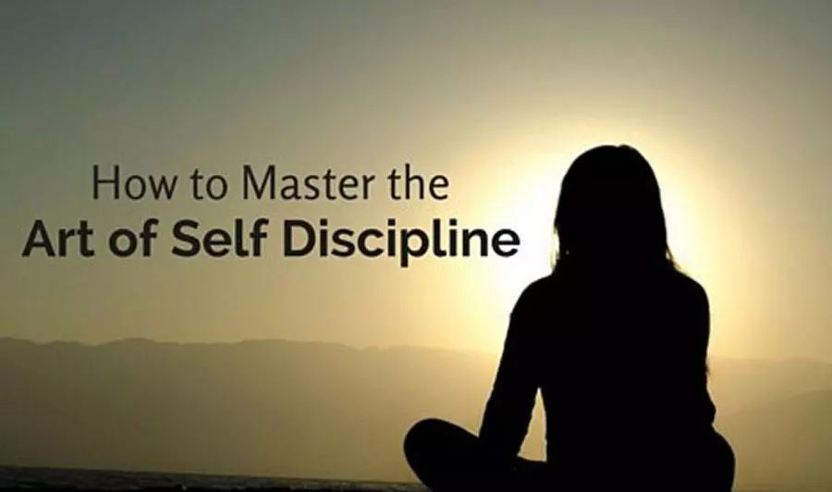
5 Ways to Develop Self-Discipline
05. Remove Temptation 消除诱惑
Like the saying goes, “out of sight, out of mind.” It may seem silly, but this phrase offers powerful advice. By simply removing your biggest temptations from your environment, you will greatly improve your self-discipline.
If you want to eat healthier, don't buy junk food. If you want to improve your productivity at work, turn off notifications and silence your cell phone. The fewer distractions you have, the more focused you will be on accomplishing your goals. Set yourself up for success by ditching bad influences.
notification /ˌnəʊtɪfɪˈkeɪʃn/ n. 通知；通告
distraction /dɪˈstrækʃn/ n. 分心；干扰；分神
ditch /dɪtʃ/ v. 掘沟，修渠；摆脱，抛弃，丢弃

Slide 30
Make sure that the goal you set is SMART
Choose just one goal that you want to focus on to develop your self-discipline.
Attainable
Measurable
Relevant
SMART Goal
Specific
Time-bound

Slide 31
Time Management Techniques
Create a reasonable study schedule and stick to it.
Identify your time wasters (social media, purposeless web browsing) and vow not to participate when you should be studying.
Break large projects into smaller, more manageable tasks.
Do one thing at a time; research shows that multitasking slows you down and may even lower your IQ temporarily.

Slide 32
04
Thinking and practising
How to improve the efficiency of online lessons
What are the differences between offline and online for you?
How do you keep your learning efficiency as in the classroom during the online learning period?
When having the lessons online, did you encounter any problems? If so, how did it being solved?

Slide 33
Dry humor about online lessons
世界上最遥远的距离，不是生与死，而是你在屏幕前，却不回答我的问题。
The furthest distance in the world is not life and death, but that you are in front of the screen and don't answer my question.
一生至少应该有一次，为了上网课而忘掉自己。
You should have at least once in your life and forget yourself for online lessons.
Online lessons
我不再沉湎于过去。今天，我在此时此地，如此日复一日，这就叫完美。
I no longer indulge in the past. Today, I am here and now, day after day, this is called perfect.
曾经有一个清晰的世界在我眼前，我没有珍惜，直到我带上了眼镜。
There used to be a clear world before my eyes, and I didn't cherish it until I put on my glasses.

Slide 34
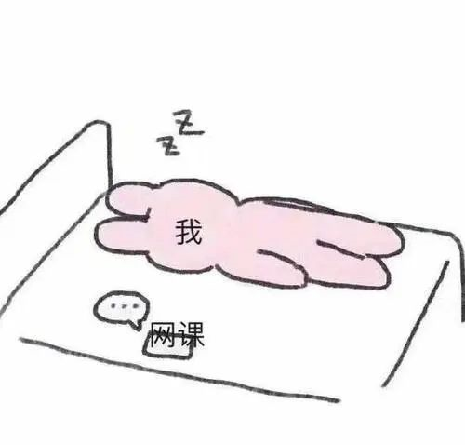
Dry humor about online lessons
When you were still sleeping in the quilt and rubbing your sleepy eyes, your teacher and classmates were already quietly going online as you didn't know. In the bell that continues ringring to remind you of signing up the class, or in the teacher's sixty-second voice, you helplessly picked up the phone, switched on the computer, and faced the teacher whose voice is cadenced behind the screen, continuing the unfinished dream of last night.
当你还窝在被窝里揉搓着惺忪睡眼的时候，你的老师和同学们早已背着你悄然上线。在一片此起彼伏的签到提醒铃声中，亦或是在老师的六十秒语音里，你无奈的拿起手机，打开电脑，对着屏幕后面抑扬顿挫的老师，继续昨晚那个未竟的美梦。

Slide 35

Dry humor about online lessons
In order to concentrate the students' attention, the teachers also tried their best. In the online class they call the roll, and design class sign-in system. Even there is a kind of wake-up service enforced by classmates. The possibilities are limited only by imagination.
而老师为了集中学生的注意力也使出了浑身解数。课堂在线点名，上下课签到制度。甚至还有一种同学强制叫醒服务。只有你想不到，没有我做不到。

Slide 36
Do three things regularly to be a the online learner
Any reputable teacher will encourage students to communicate
Communicate with
your teachers.
02
Self-Motivation and the Online Learner
You can't look for course updates, contribute to class discussions, or complete assignments if you don't at least join in to your online classroom. Get in the habit of doing so regularly.
01
Join in
Ask for help
when you need it
03
Open communication helps you develop a rapport with teachers and pave the way if you have questions down the line. Don't be afraid to ask for help.

Slide 37
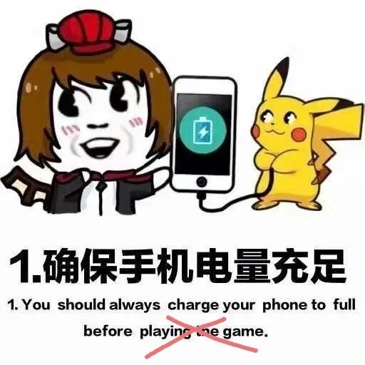
How to improve the efficiency of online lessons
When broadcasting live, many teachers require students to prepare the things they need before going online, and actively participate in class discussions. Not only do you have to clean up your appearance and mood, but you also have to tidy your desktop, neaten the documents you need in time.
The most important thing is to keep your phone and computer fully charged, and sometimes it doesn't matter if your internet speed isn't fast, just keep your brain active.
许多老师在直播时要求同学们在上网课前把该准备的东西准备好，上课时主动参与课堂讨论。学习需要仪式感。不仅要把仪容和心情收拾好，还要把桌面收拾好，将要用到的文件及时整理好，随用随拿。最重要的是，保持手机和电脑电量充足，有时候网速不积极也没关系，你的大脑保持积极状态就可以了。

Slide 38
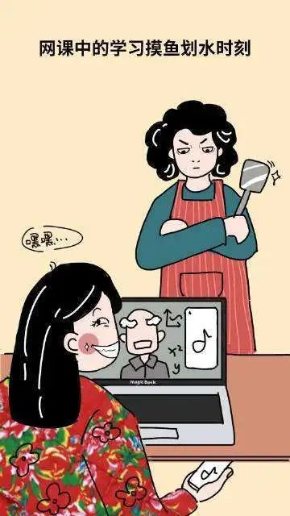
How to improve the efficiency of online lessons
Learning needs concentration and self-control. When you have onlion class and play the phone at the same time, neither can you get a good entertainment experience, nor can you be fully absorbed in classroom learning. Especially when the mobile phone and computer are at hand, and the network speed is so fast, you will be tempted to click on other apps. If you can't control your own hands, uninstall those softwares that distract you.
学习需要专注自制。一边学习一边玩手机,既不能得到很好的娱乐体验,也不能充分吸收课堂知识。尤其是手机和电脑都在手边，且网速流畅到飞起的时候，则更会情不自禁点开其它软件。如果实在控制不来自己的手，不妨先卸载那些让你分心的软件。

Slide 39

How to improve the efficiency of online lessons
Learning requires self-discipline. Stick with reasonable and strict schedule. Don't get up a few minutes before class, or stay up until midnight. The power of habit is strong. Bringing the holiday schedule to the class period will not only cause low learning efficiency, but it will also harm physical health in the long run. Only by arranging time properly and balancing work and rest can you do more with less.
学习需要自律心。保持良好的作息时间。切不可在上课前几分钟起床，或者晚上熬到凌晨才睡。习惯的力量是强大的。把假期的作息带到上课时期，不仅会造成学习效率低下，长此以往，还会有损身体健康。合理安排时间,劳逸结合，才能事半功倍。

Slide 40

How to improve the efficiency of online lessons
As a kid, I thought it was cool to wear glasses. When I grow up, I know that it is a lifelong injury and a lifelong pain. Staring at the screen for a long time will do great damage to your eyes, especially in the dark and in front of small screen. It's advisble to relax your eyes during the break time, doing eye exercises.
小时候，认为戴眼镜很酷。长大了，才知道那是一生的伤，一世的痛。劝诫各位，一直盯着屏幕对眼睛损害极大，尤其是在光线暗，屏幕小的情况下。在课间适当放松眼睛，或者做眼保健操也是不错的选择。

Slide 41
05
Viewing and writing
Views on your online learning
How do you feel about online learning for now?

Slide 42

Voices about online lessons
This outbreak has physically isolated students from their teachers, and from each other. As a teacher, I'm working with my colleagues and my students more closely than ever, trying to use modern technology to shorten our physical distances.
With the help of DingTalk Cloud-Classroom , an application designed to facilitate “learner-centered” learning, we managed to overcome numerous technical barriers, and redesigned our teaching curriculum to make online learning a pleasure. The teaching reform is a brave effort made jointly by the staff as well as students and is believed to be a revolution.
facilitate /fəˈsɪlɪteɪt/ vt. 促进；帮助；使容易
curriculum /kəˈrɪkjələm/ n. 课程
Mr. Woodpecker, a high school teacher in Zhejiang

Slide 43
Voices about online lessons
I have experienced ever close ties with my students since I turned my writing class online amid the novel coronavirus outbreak. I'm teaching like an internet celebrity – trying to engage my audience with everything I could do .
In addition to online discussion, in-class exercise and presentation, I talked about my travel experience, favorite snacks with a class of “gossip-chasing” students, who also shared their daily lives during the epidemic. My young daughter sometimes came in front of the camera, greeting her big brothers and sisters.
amid/əˈmɪd/ prep. 在……过程中；在……气氛中
celebrity /səˈlebrəti/ n. 名人；名声
Dr. Angela Mak , a college English teacher

Slide 44

Voices about online lessons
Through online interaction, we have learned how different sectors combine artificial intelligence, cloud computing and 5G technology to upgrade their services.
With the postponing the back-to-school day and starting classes as scheduled, both teachers and students were adapting to this new practice, but problems such as unstable network connection and lack of self-discipline also emerged.
I was surprised to see many introverted classmates express their views more freely online, and I felt closer to teachers when they were joked about.
postpone /pəˈspəʊn/ vi. 延缓，延迟
introverted /ˈɪntrəvɜːtɪd/ adj. 内向的
Li Xiao, a ninth-grade student

Slide 45
Voices about online lessons
More and more students are aware now that internet makes learning much more available than ever before. And electronic products are not just for work or entertainment, it's also for learning. You can learn anything you want from the internet anytime and anywhere.
As students, we should put efforts in study and planning our future for ourselves. Without self-discipline, we are not able to concentrate on study, or things we should do. Video games can be a lure, TV program can be a lure. In this case, to show we are self- disciplined, we should arrange our time wisely, we should do the fitness challenge regularly in order to keep a fit body.
lure /lʊə(r)/ n. 诱惑；饵；诱惑物 vt. 诱惑；引诱
Liu Yan, a fifth-grade primary school student

Slide 46
Voices about online lessons
When studying online, all students are faced with a new challenge - How to learn effectively at home without teachers' supervision.
For a real curve wrecker, the quality of self-discipline is more important than IQ.
For people who are self-disciplined, quarantine is an opportunity to improve themselves because they make the most of their time to learn or work even when no one is pushing.
So I cleaned up the study and rearrange the furniture just like in classroom to force myself focusing on the preparation for the Gaokao.
supervision /ˌsuːpəˈvɪʒn/ n. 监督，管理
curve wrecker 成绩好的学霸
quarantine /ˈkwɒrəntiːn/ n. 检疫隔离期；隔离
Lu Zuwang, a senior 3 student

Slide 47

Writing
假定你是李华，你的英国朋友Tom因Covid-19疫情要在家上网课，特向你咨询网课的相关情况。请根据以下要点用英语给他写一封电子邮件：
1.上课感受；
2.注意事项；
3. 表达鼓励。
注意：
1. 词数80左右；
2. 可以适当增加细节，以使行文连贯。

Slide 48

Thank you!
By constant self-discipline and self-control, you can develop greatness of character.”
– Grenville Kleiser, Inspirational Book Writer
不断的自律及自我控制可以培养出非凡的性格。
– 葛弗尔‧克莱什尔 (励志作家)

