Slide 1

感恩遇见，相互成就，本课件资料仅供您个人参考、教学使用，严禁自行在网络传播，违者依知识产权法追究法律责任。
更多教学资源请关注
公众号：溯恩高中英语
知识产权声明

Slide 2
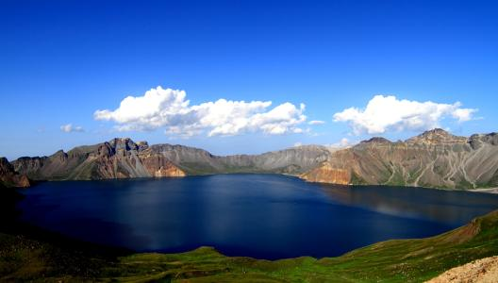
M6U5 Using language
The Lake of Heaven
Reading & writing

Slide 3
Pre-reading
A quiz about Changbaishan
Changbaishan is named after a great poet.
Changbaishan was formed after volcano eruptions.
Tianchi lies on the top of Chabaishan with an altitude of
more than 2000 meters.
Tianchi is the largest crater lake in China and the deepest
mountain lake around the world.
The best time to visit Tianchi is in winter.

Slide 4

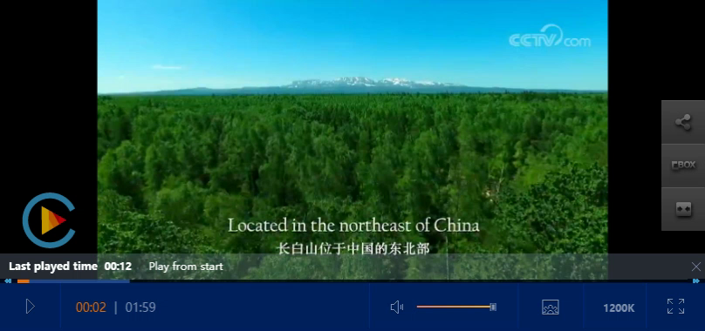

Get the background
Changbaishan is named after a great poet.
Changbaishan was formed after volcano eruptions.
Tianchi lies on the top of Chabaishan with an altitude of over 2000 meters.
Tianchi is the largest crater lake in China and the deepest mountain lake around the world.
The best time to visit Tianchi is in winter.
iconic scenery
after mid-July

Slide 5
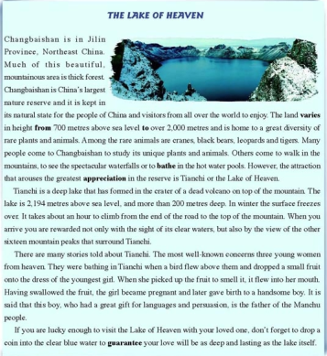

Read for operation (写作目的)
This article is written to ___________
a tourist
attraction
introduce a place
explain an opinion
compare and contrast two places
argue for and against a position
If I'd like to introduce a place...
What aspects to cover?
How to organize the details?

Slide 6

Read for content
para.1
What has the writer introduced about Changbaishan?
How does the writer lead to the following paragraph?
Order
Location
Changbaishan is in JilinProvince, Northeast China. Much of this beautiful mountainous area is thick forest. Changbaishan is China's largest nature reserve and it is kept in its natural state for the people of China and visitors from all over the world to enjoy. The land varies in height from 700, meters above, sea level to over 2, 000 meters and is home to a great diversity of rare plants and animals. Among the rare animals are cranes, black bears, leopards and tigers. Many people come to Changbaishan to study its unique plants and animals, Others come to walk in the mountains, to see the spectacular waterfalls or to bathe in the hot water pools. However, the attraction that arouses the greatest appreciation in the reserve is Tianchi or the Lake of Heaven.
Changbaishan is in JilinProvince, Northeast China. Much of this beautiful mountainous area is thick forest. Changbaishan is China's largest nature reserve and it is kept in its natural state for the people of China and visitors from all over the world to enjoy. The land varies in height from 700, meters above, sea level to over 2, 000 meters and is home to a great diversity of rare plants and animals. Among the rare animals are cranes, black bears, leopards and tigers. Many people come to Changbaishan to study its unique plants and animals, Others come to walk in the mountains, to see the spectacular waterfalls or to bathe in the hot water pools. However, the attraction that arouses the greatest appreciation in the reserve is Tianchi or the Lake of Heaven.
The geographic features of Changbaishan
position(地位)
height
rare species
the tourist attractions of Changbaishan
people's aim of visiting
the most attraction
Use the linking sentence(s) to
make sure of the coherence
between paragraphs.

Slide 7
Read for content
para.2
However, the attraction that arouses the greatest appreciation in the reserve is Tianchi or the Lake of Heaven.
general
Why is the lake called “the Lake of Heaven”?
Considering the above-mentioned disadvantages, is Tianchi worth visiting?
Tianchi is a deep lake that has formed in the crater of a dead volcano on top of the mountain. The lake is 2, 194 meters above sea level, and more than 200 meters deep. In winter the surface freezes over. It takes about an hour to climb from the end of the road to the top of the mountain. When you arrive you are rewarded not only with the sight of its clear waters, but also by the view of the other sixteen mountain peaks that surround Tianchi.
Tianchi is a deep lake that has formed in the crater of a dead volcano on top of the mountain. The lake is 2, 194 meters above sea level, and more than 200 meters deep. In winter the surface freezes over. It takes about an hour to climb from the end of the road to the top of the mountain. When you arrive you are rewarded not only with the sight of its clear waters, but also by the view of the other sixteen mountain peaks that surround Tianchi.
Tianchi is a deep lake that has formed in the crater of a dead volcano on top of the mountain. The lake is 2, 194 meters above sea level, and more than 200 meters deep. In winter the surface freezes over. It takes about an hour to climb from the end of the road to the top of the mountain. When you arrive you are rewarded not only with the sight of its clear waters, but also by the view of the other sixteen mountain peaks that surround Tianchi.
Tianchi is a deep lake that has formed in the crater of a dead volcano on top of the mountain. The lake is 2, 194 meters above sea level, and more than 200 meters deep. In winter the surface freezes over. It takes about an hour to climb from the end of the road to the top of the mountain. When you arrive you are rewarded not only with the sight of its clear waters, but also by the view of the other sixteen mountain peaks that surround Tianchi.
Tianchi is a deep lake that has formed in the crater of a dead volcano on top of the mountain. The lake is 2, 194 meters above sea level, and more than 200 meters deep. In winter the surface freezes over. It takes about an hour to climb from the end of the road to the top of the mountain. When you arrive you are rewarded not only with the sight of its clear waters, but also by the view of the other sixteen mountain peaks that surround Tianchi.
Tianchi is a deep lake that has formed in the crater of a dead volcano on top of the mountain. The lake is 2, 194 meters above sea level, and more than 200 meters deep. In winter the surface freezes over. It takes about an hour to climb from the end of the road to the top of the mountain. When you arrive you are rewarded not only with the sight of its clear waters, but also by the view of the other sixteen mountain peaks that surround Tianchi.
position
specific
height/depth
iconic scenery
a natural
landscape
time consumption
Use transition words to connect ideas.

Slide 8
Read for content
para.3
What is the main idea of this paragraph?
What is the connection between the Manchu people and Tianchi?
There are many stories told about Tianchi. The most well-known concerns three young women from heaven. They were bathing in Tianchi when a bird flew above them and dropped a small fruit onto the dress of the youngest girl. When she picked up the fruit to smell it, it flew into her mouth. Having swallowed the fruit, the girl became pregnant and later gave birth to a handsome boy. It is said that this boy, who had a great gift for languages and persuasion, is the father of the Manchu.
There are many stories told about Tianchi. The most well-known concerns three young women from heaven. They were bathing in Tianchi when a bird flew above them and dropped a small fruit onto the dress of the youngest girl. When she picked up the fruit to smell it, it flew into her mouth. Having swallowed the fruit, the girl became pregnant and later gave birth to a handsome boy. It is said that this boy, who had a great gift for languages and persuasion, is the father of the Manchu.
a cultural
landscape

Slide 9
Read for content
para.4
If you are lucky enough to visit the Lake of Heaven with your loved one, don't forget to drop a coin into the clear blue water to guarantee your love will be as deep and lasting as the lake itself.
If you are lucky enough to visit the Lake of Heaven with your loved one, don't forget to drop a coin into the clear blue water to guarantee your love will be as deep and lasting as the lake itself.
If you are lucky enough to visit the Lake of Heaven with your loved one, don't forget to drop a coin into the clear blue water to guarantee your love will be as deep and lasting as the lake itself.
a wish
What's advised to do when we reach the Lake of Heaven?
What's the meaning of dropping a coin into Tianchi?

Slide 10

Read for structure
introduction
Para.1 The introduction of _________
Changbaishan
Body
Para.2 The introduction of _________
Para.3 ________ about Tianchi
Tianchi
Stories
The article is developed in the order of _______
How to organize the details
space
conclusion
Wish
Para.4 ________ to guarantee love

Slide 11
Read for writing
Dear Li Hua,
In our last letter I introduced my school as well as the beautiful sightseeing places in the neighborhood to you. And you once told me that the place you studied is a real heaven. So I can't wait to learn more about your school. Would you please tell me more about it, such as its main geographic features and the most attractive scenic spot around it ?
Looking forward to your reply email!
Sincerely yours,
Joe
A letter of introducing a scenic spot

Slide 12

structure
content
Order
Greeting
1. The pleasure of introducing the school.
the location
the position
height
rare species
people's aims of visiting
the most attraction
depth
stories
wish
...
general
2. The main geographic
features of the school and
the most attractive scenic
spot.
Body
space
Ending
3. Best wishes and the hope
of his visiting someday.
specific

Slide 13
Use the linking sentence(s) to
make sure of the coherence between paragraphs.
writing tips
Use transition words to connect ideas.
Use logical order to develop the article

Slide 14
Read for language
Words/expressions you may use:
引人入胜的
由...到...不等
是...的家园
据说...
最能激起人们欣赏欲望的是...
...要...多少时间
不仅可以看到清澈的湖水还可以看到...
最著名的是关于...
如果你有幸...别忘了...
spectacular
vary from...to...
be home to
it is said that ...
the attraction that arouses the greatest appreciation ...is ...
it takes about ...to....
be rewarded not only with the sight of its clean waters, but also by the view of...
the most well-known concerns...
if you are lucky enough to...don't forget to...

Slide 15
Dear Joe,
Knowing that you are interested in my school, I'm more than pleased to introduce it.
Located beside the Baima Lake, Chunhui high school is widely-known for its profound cultural background and breathtaking scenery, which attracts people throughout the country. But among all the attractions, Baima Lake is the most spectacular. With a horse-like shape, placid crystal water and picturesque views within sight, it is a perfect place to have fun and soothe our pressure of daily study.
If you have the chance to visit it, you are sure to have a good time. Looking forward to your coming.
Yours sincerely,
Li Hua

Slide 16

homework
1. Retell the introduction of the Lake of Heaven
2. Complete and polish your writing.

Slide 17

The end

