Slide 1

感恩遇见，相互成就，本课件资料仅供您个人参考、教学使用，严禁自行在网络传播，违者依知识产权法追究法律责任。
更多教学资源请关注
公众号：溯恩高中英语
知识产权声明

Slide 2


Spring
台州市东启高复学校 张立春
绍兴市嵊州市高级中学 尹 娟

Slide 3
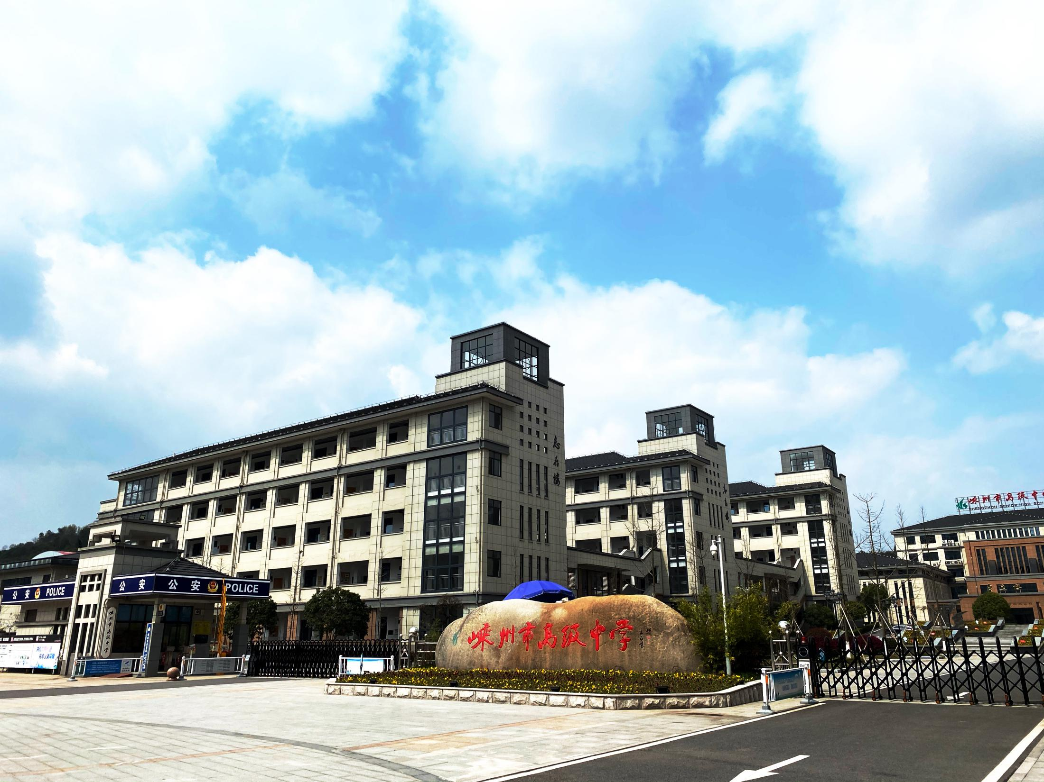
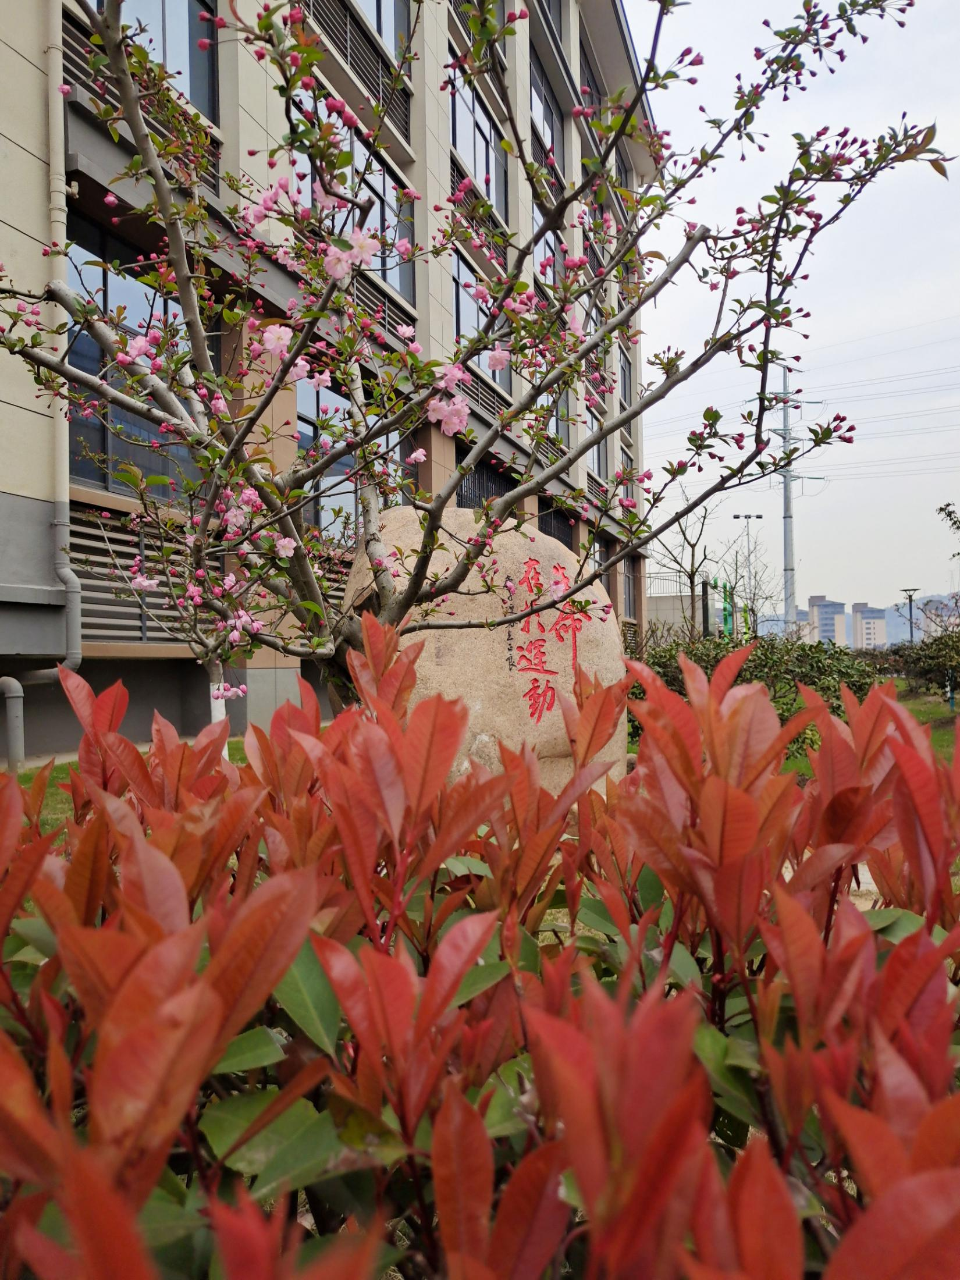
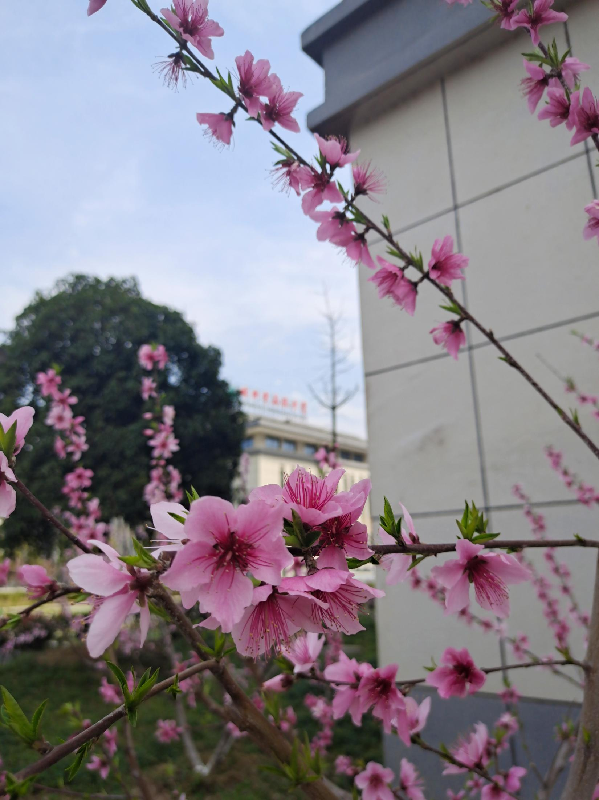
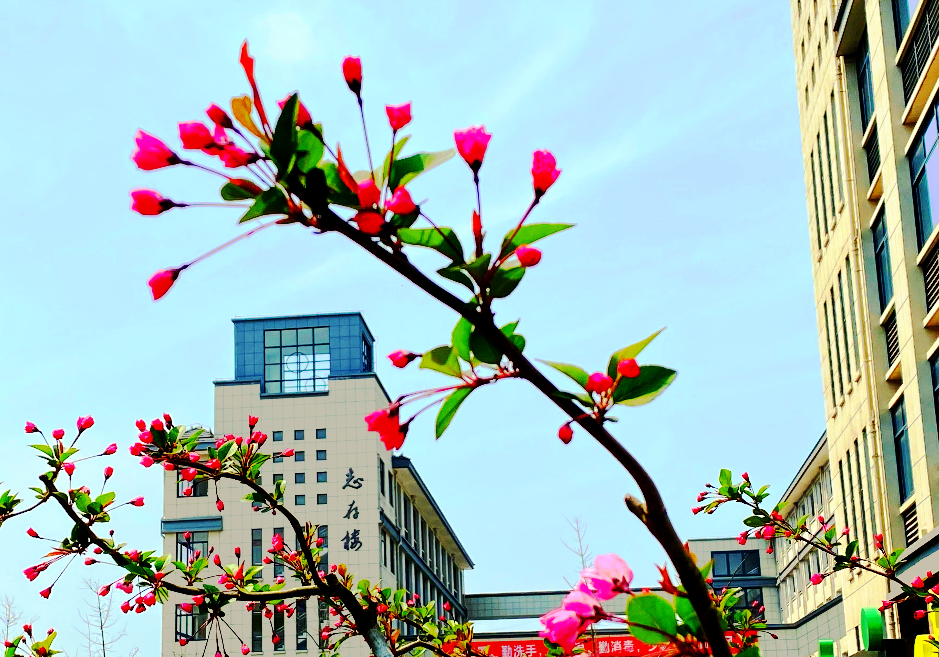
The spring in the school

Slide 4
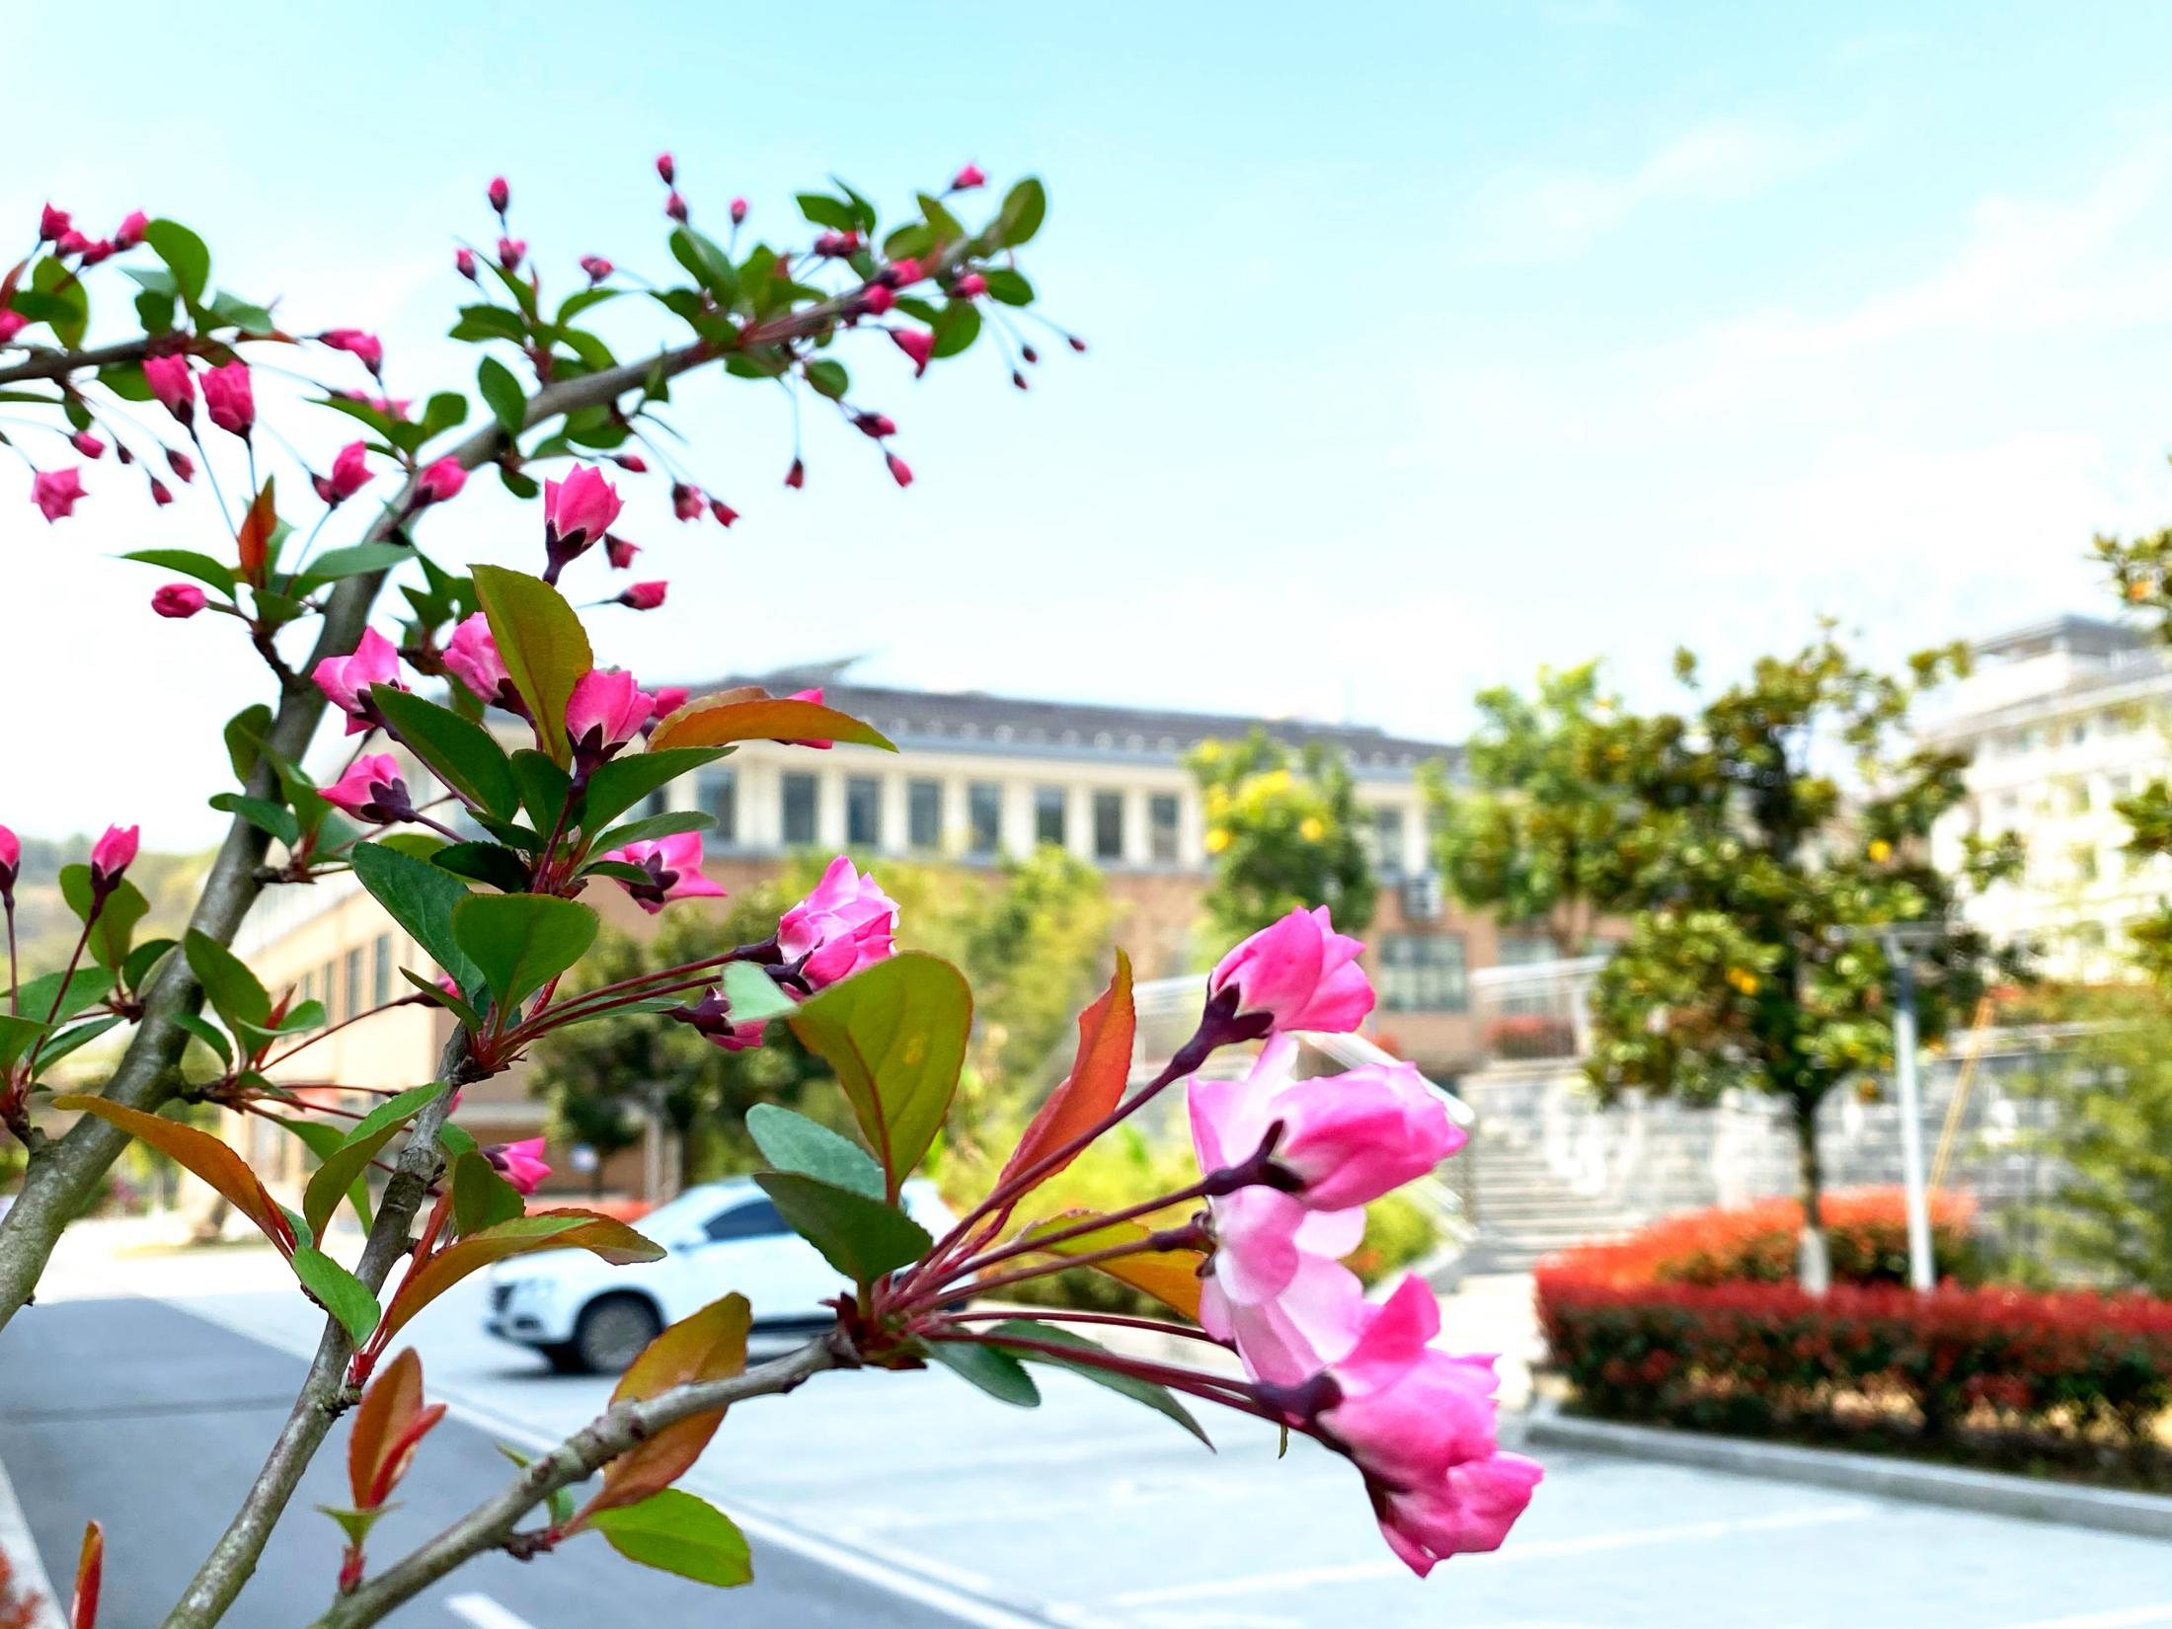
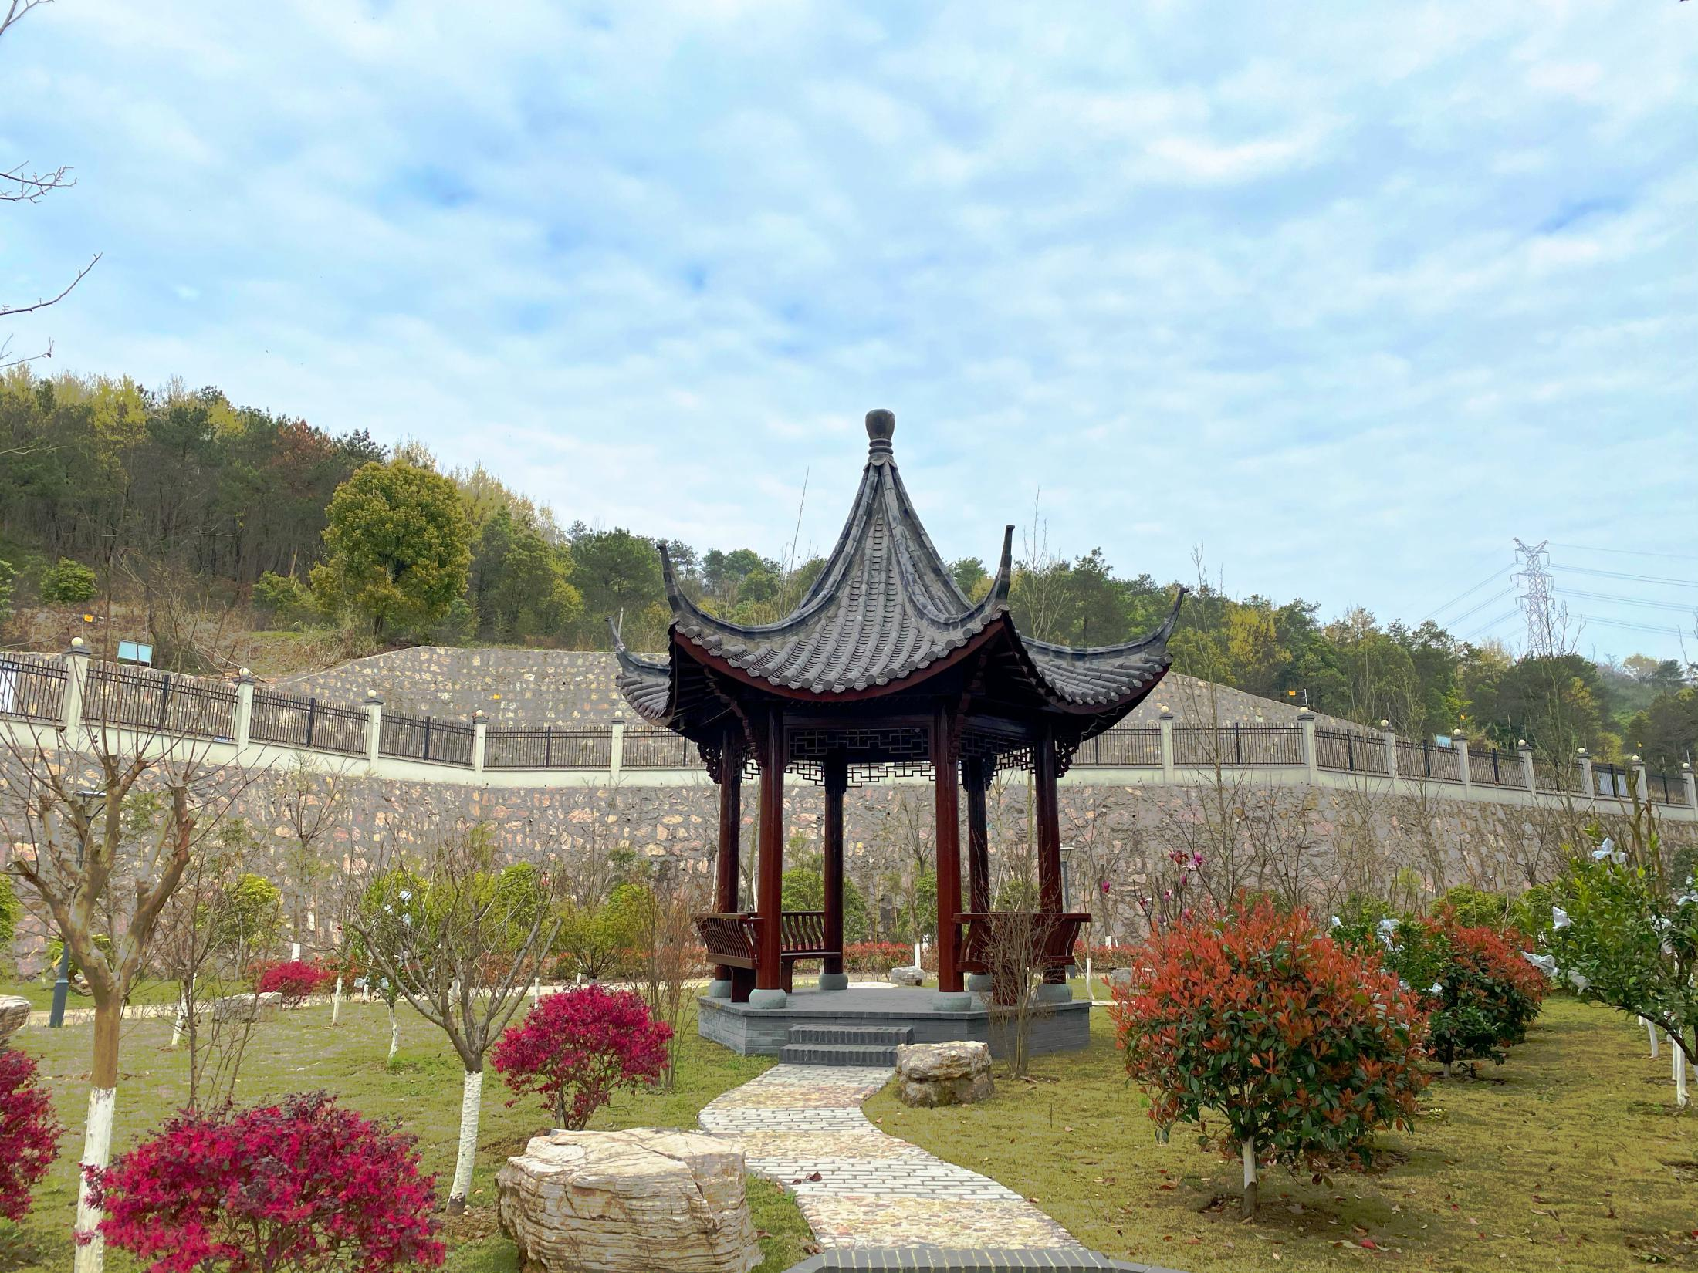
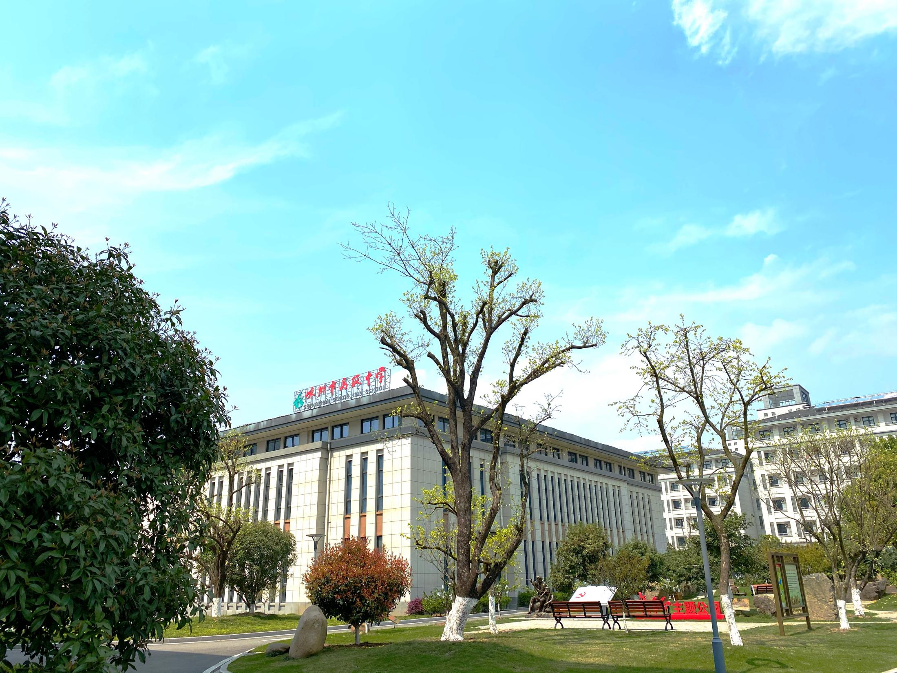
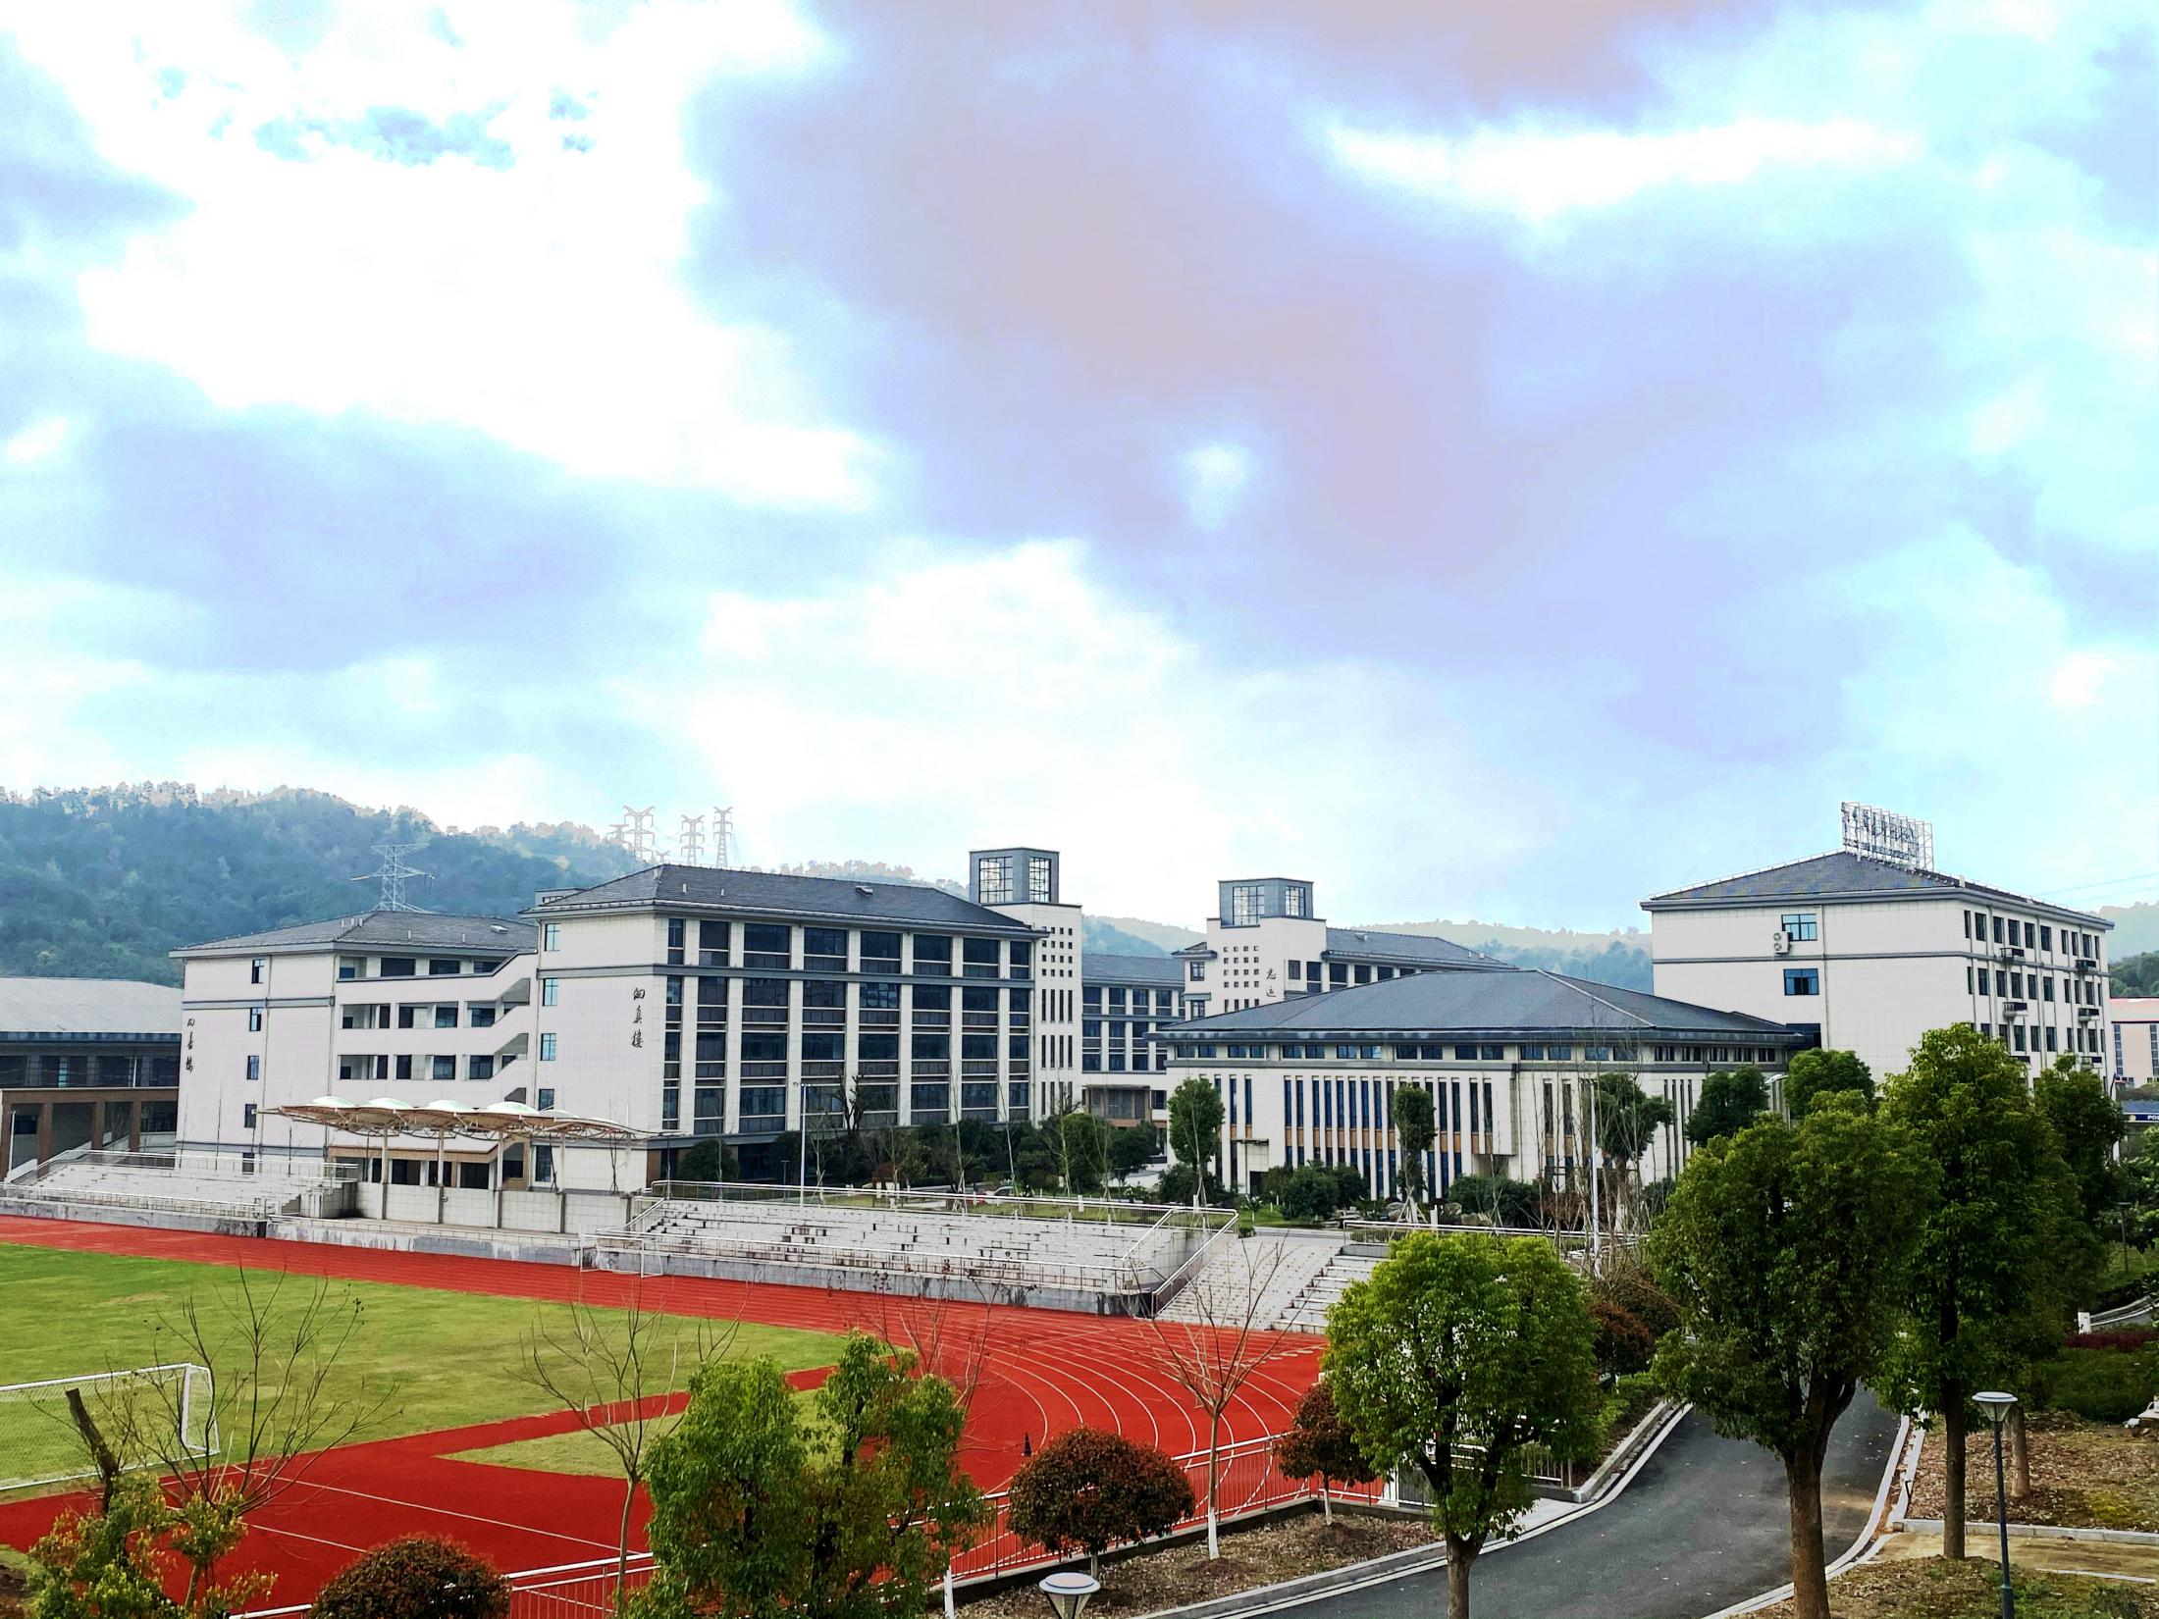

Slide 5
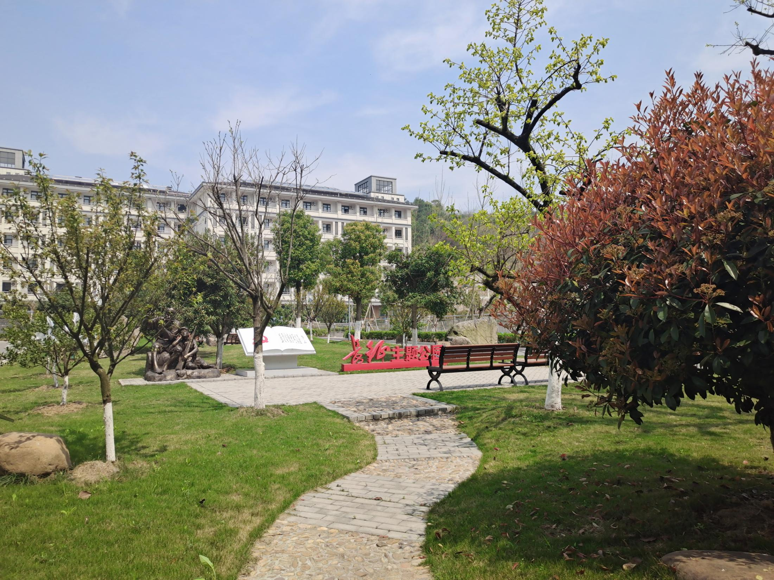
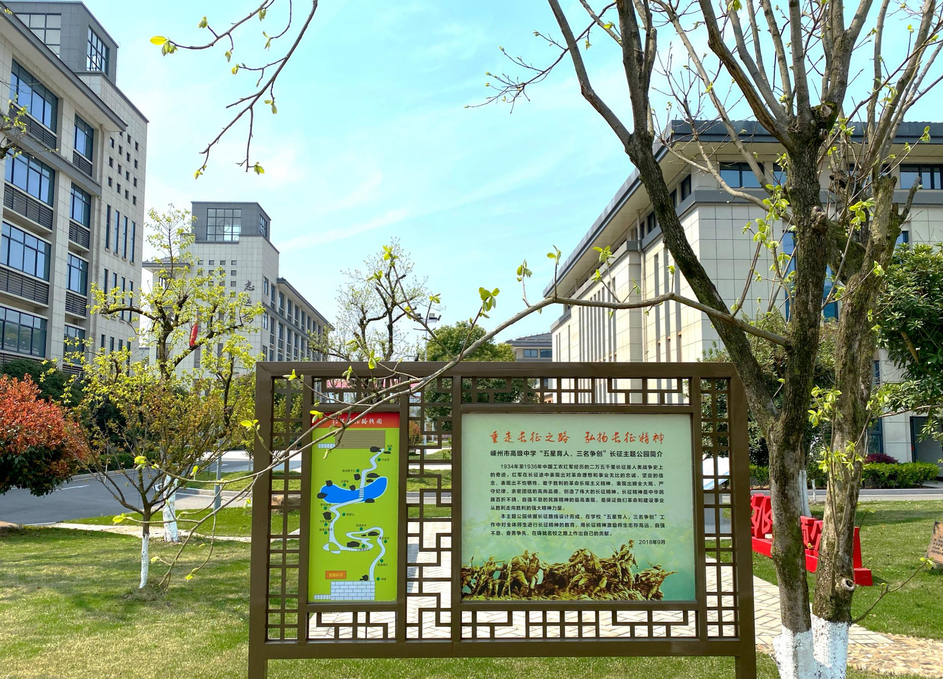
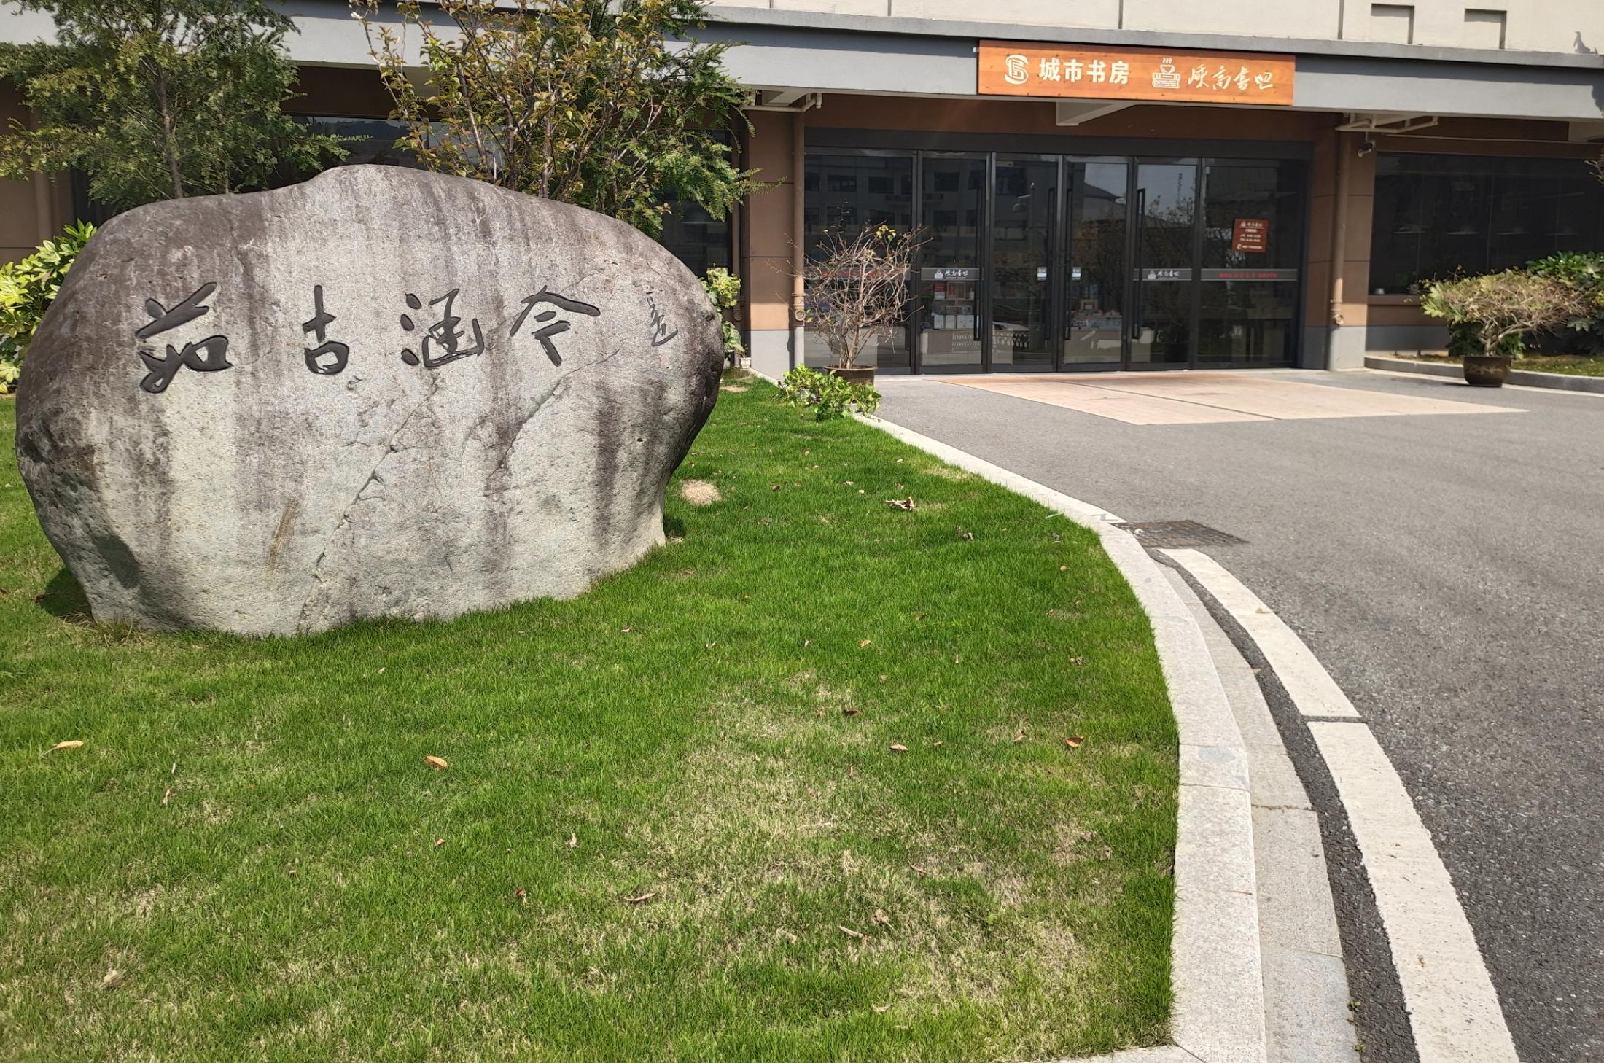

Slide 6
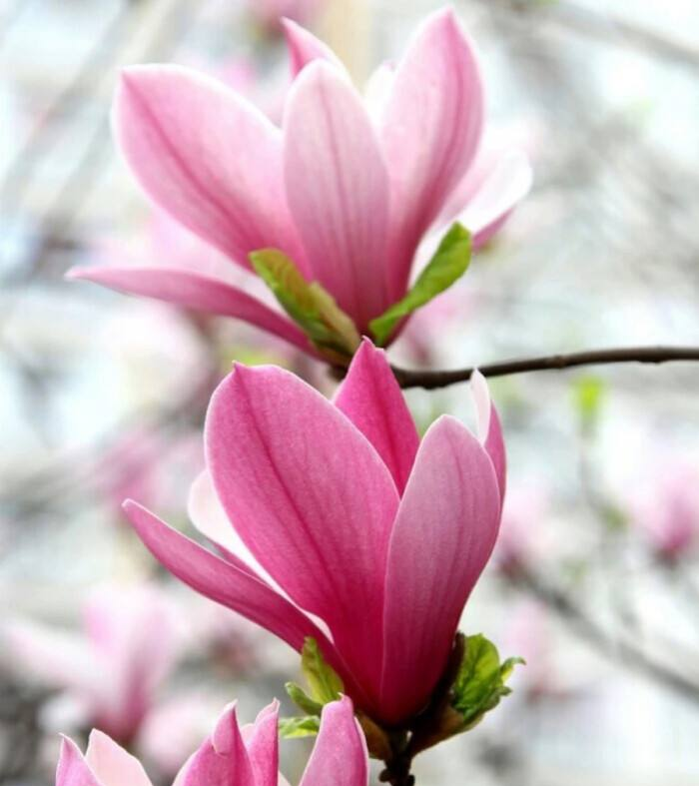
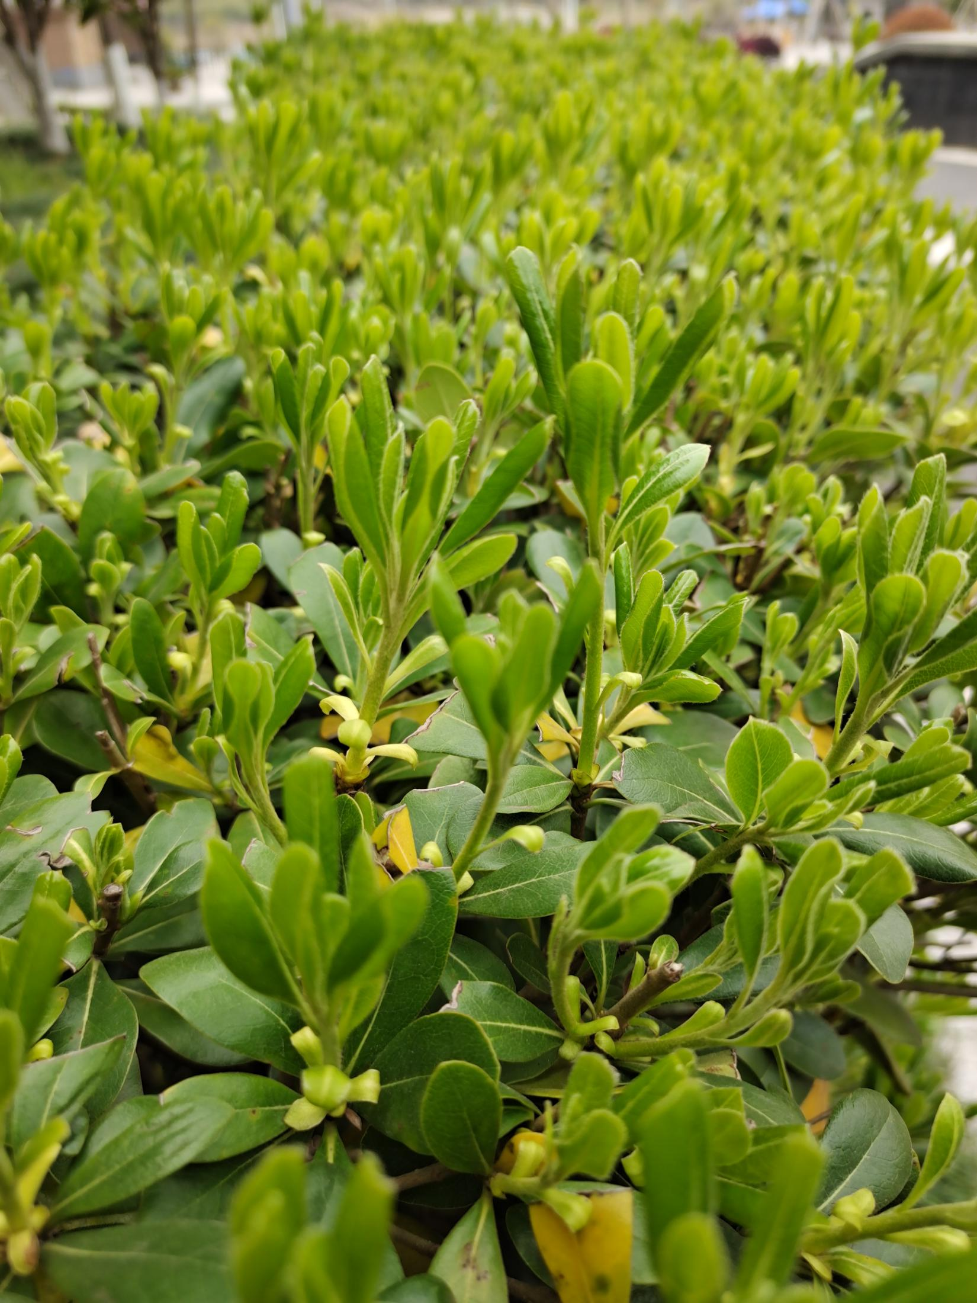
The spring in my eyes
The magnolia flowers are elegantly blooming. They are in full bloom.
The bushes are burgeoning and the tender shoots are competing against others.

Slide 7
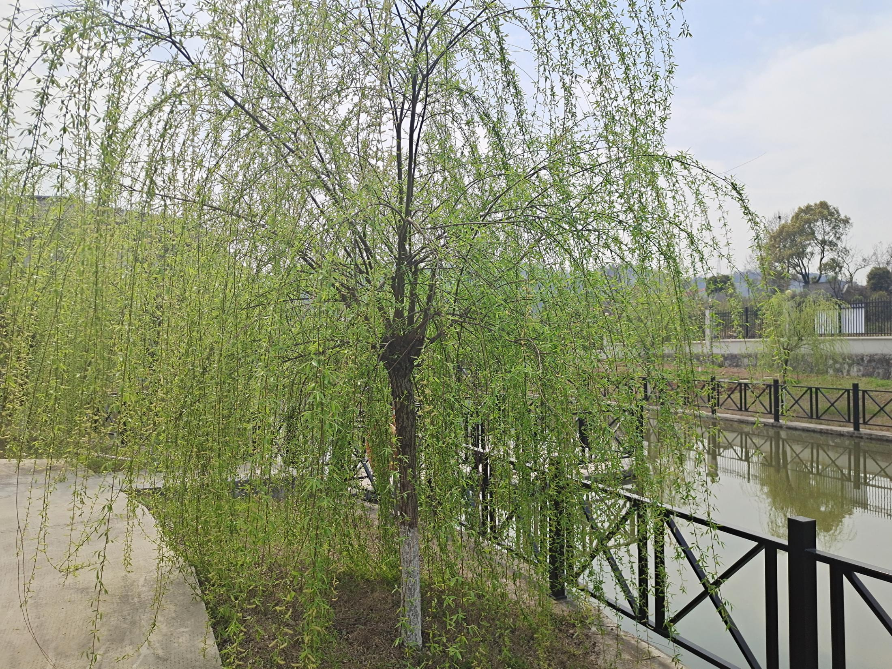
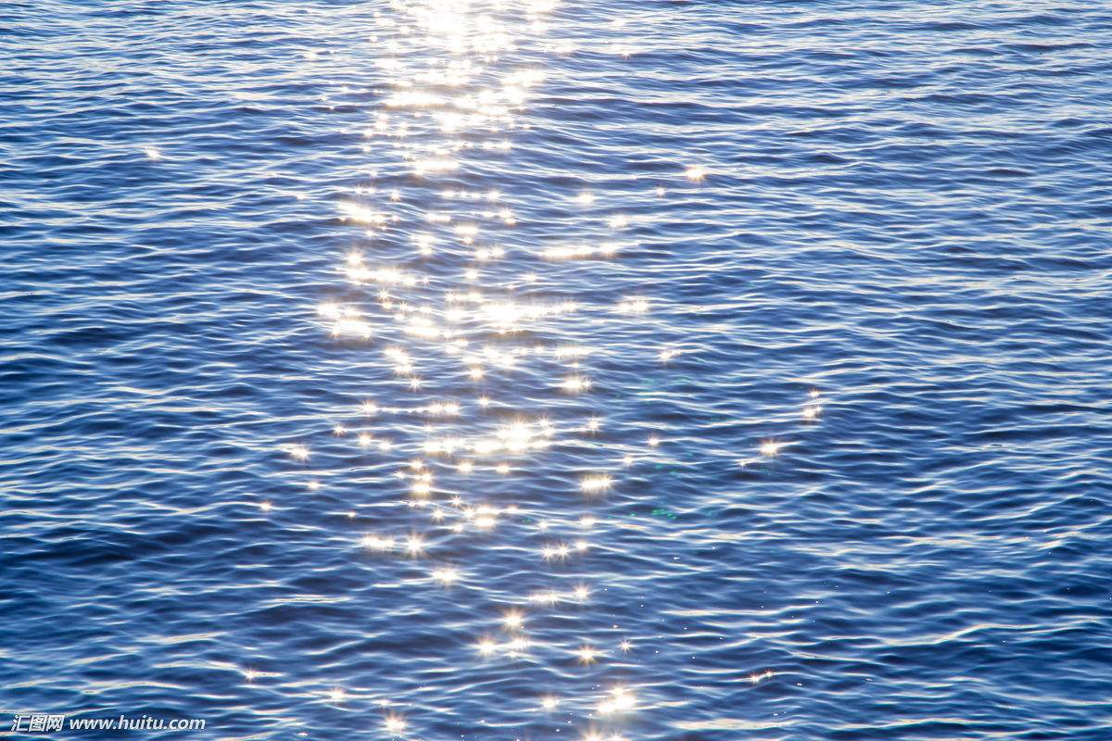
The spring in my eyes
The willow branches are swaying gracefully in the wind.
The warm and gentle spring breeze is stroking the lake and the gleaming ripples are charming.

Slide 8
The beauty of the school and the elegance of the spring are beyond my description. Let's appreciate the graceful and gorgeous spring in some literary works.

Slide 9
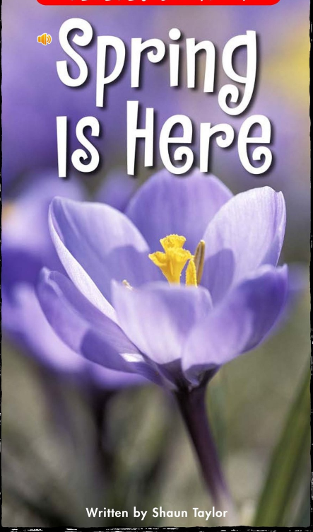
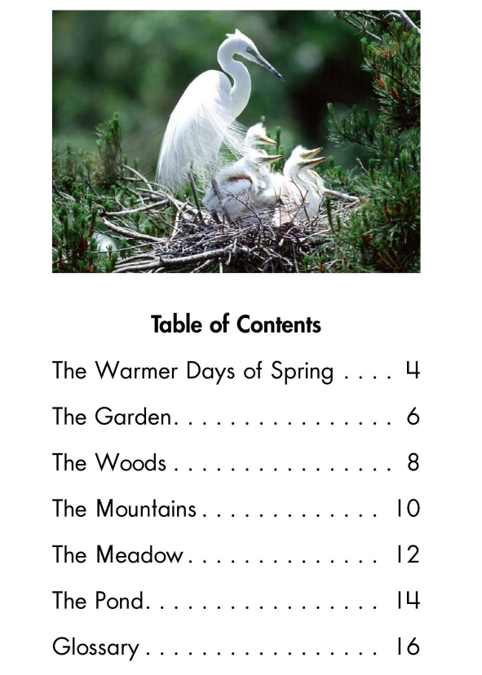
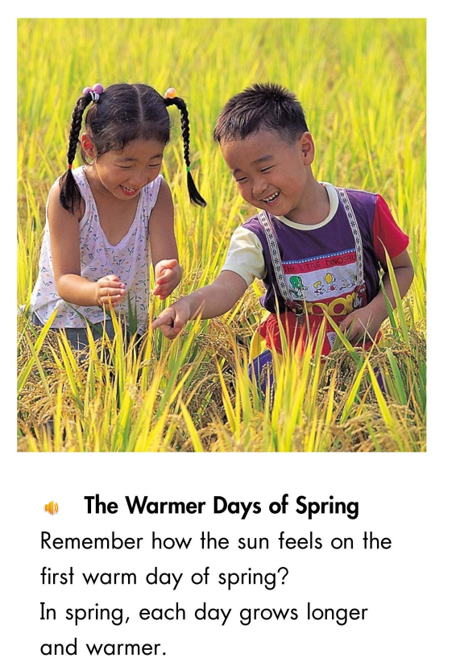
The spring in children's eyes

Slide 10
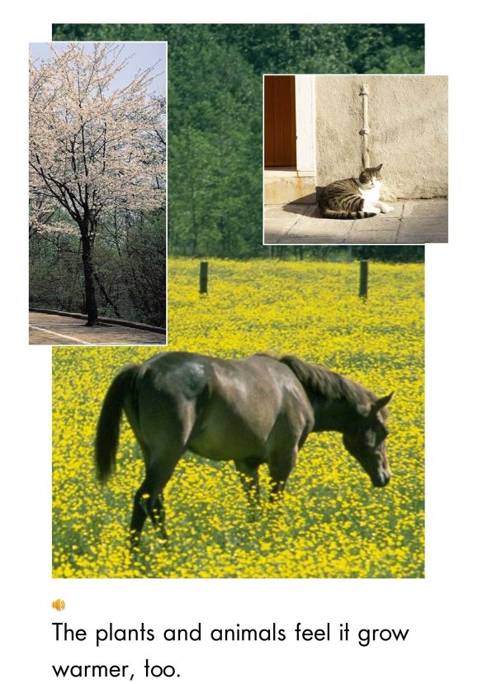
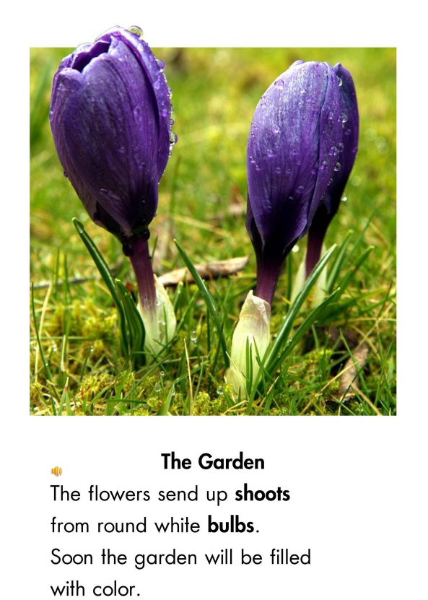
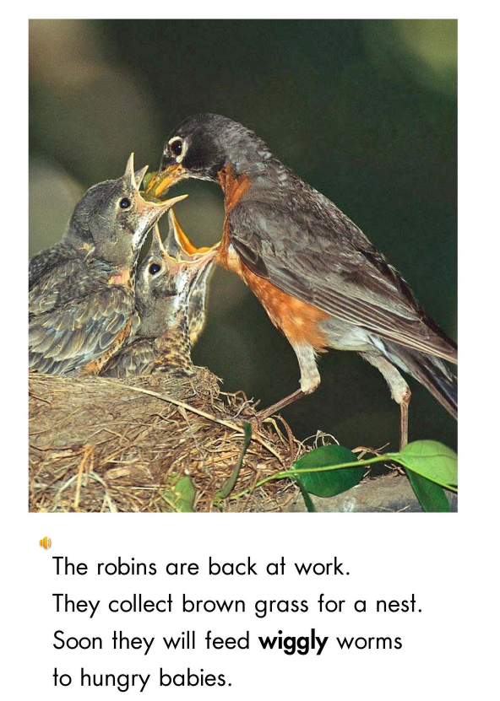
The spring in children's eyes

Slide 11
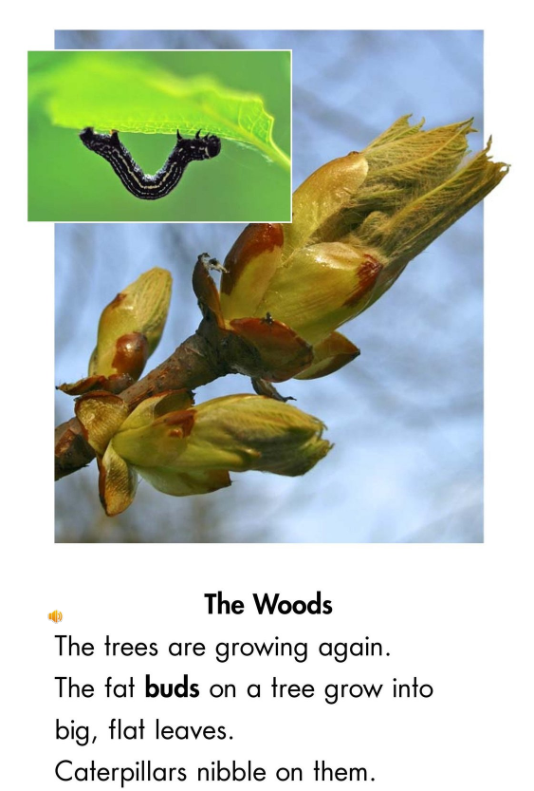
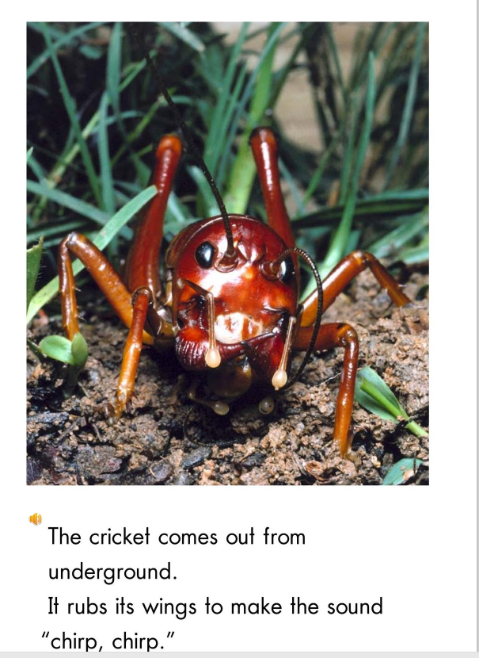
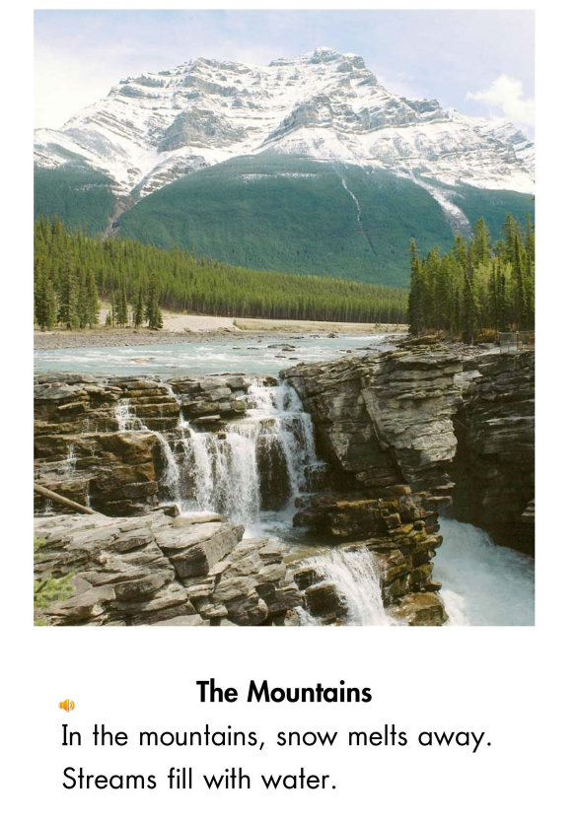
The spring in children's eyes

Slide 12
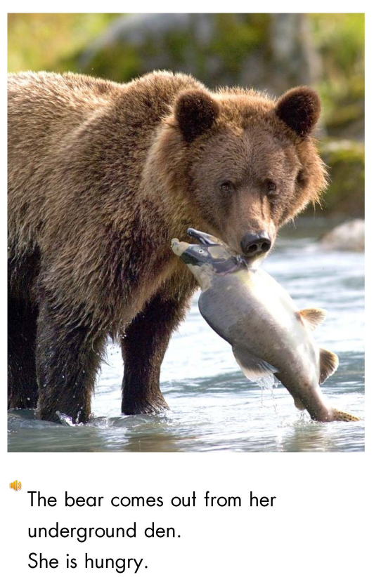
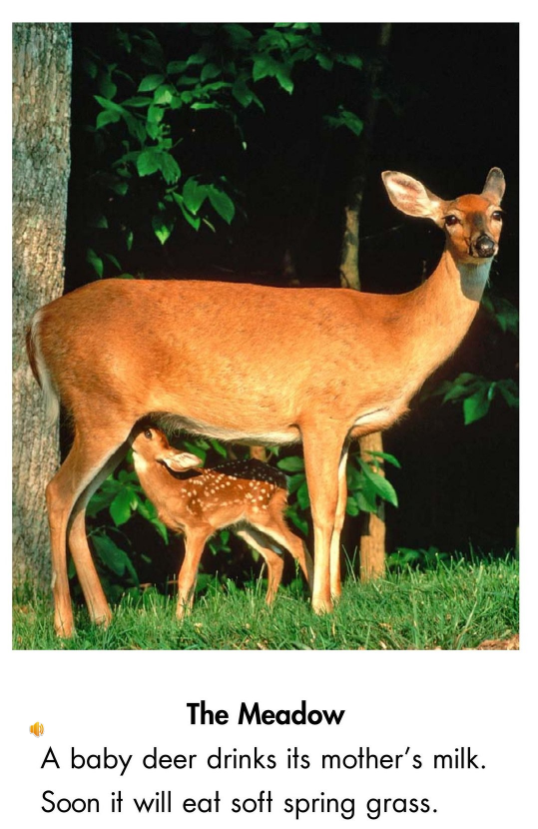
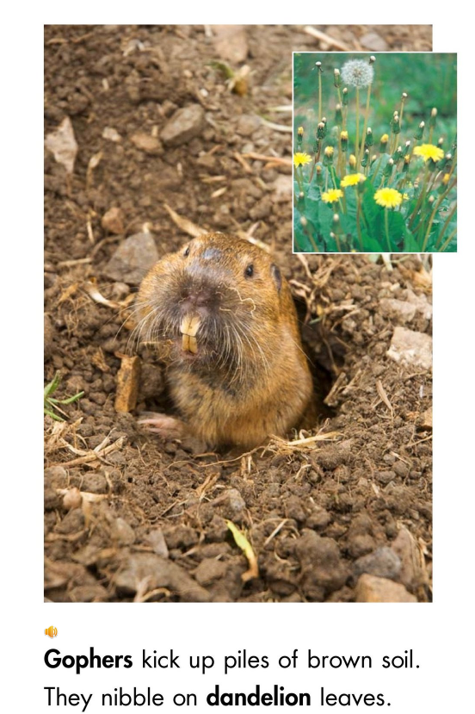
The spring in children's eyes

Slide 13
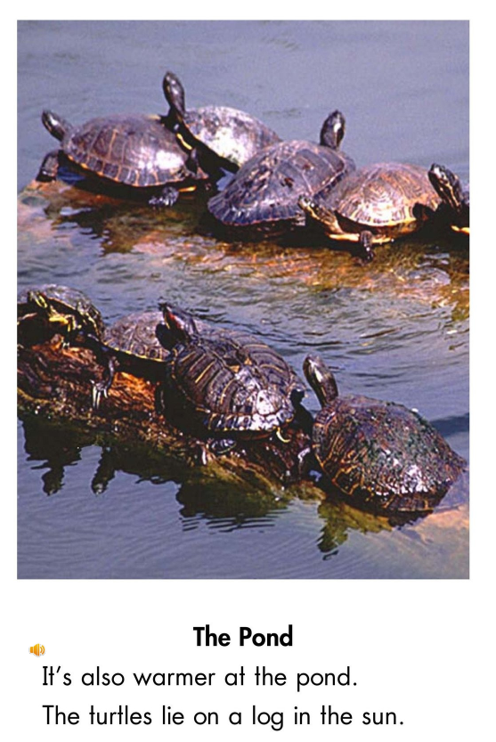
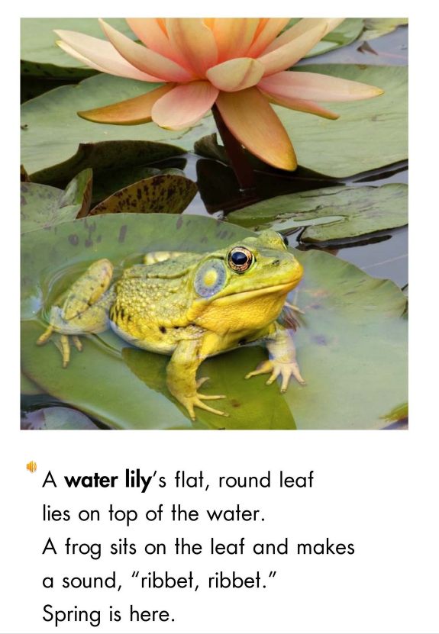
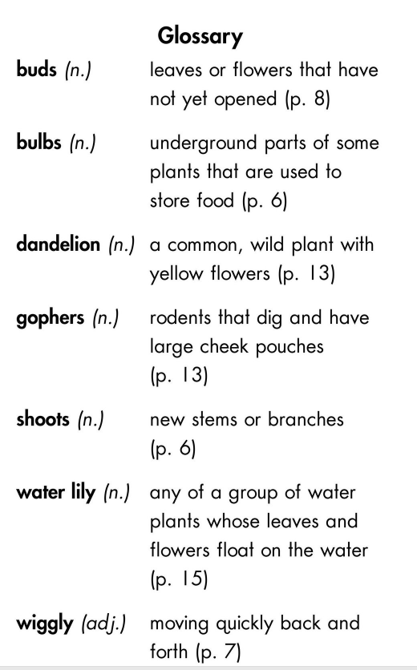
The spring in children's eyes

Slide 14
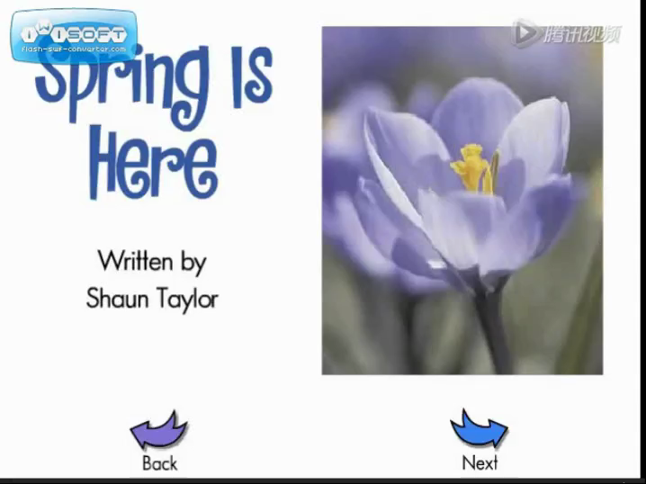
The spring in children's eyes

Slide 15
The spring in the marvellous description
It was beautiful spring weather, but neither dogs nor humans were aware of it. Each day the sun rose earlier and set later. It was dawn by three in the morning, and twilight lingered till nine at night. The whole long day was a blaze of sunshine. The ghostly winter silence had given way to the great spring murmur of awakening life. This murmur arose from all the land, fraught with the joy of living. It came from the things that lived and moved again, things which had been as dead and which had not moved during the long months of frost. The sap was rising in the pines. The willows and aspens were bursting out in young buds. Shrubsand vines were putting on fresh garbs of green. Crickets sang in the nights, and in the days all manner of creeping, crawling things rustled forth into the sun. Partridges and woodpeckers were booming and knocking in the forest. Squirrels were chattering, birds singing, and overhead honked the wild-fowl driving up from the south in cunning wedges that split the air.
Glossary: twilight ( /ˈtwaɪlaɪt/黄昏); linger( /ˈlɪŋɡə(r)/徘徊); blaze(/bleɪz/火焰) ; fraught(/frɔːt/充满……的);
sap(/sæp/植物的汁液); aspen (/ˈæspən/白杨) ; garb( /ɡɑːb/服装); creep( /kriːp/爬行);
crawl(/krɔːl/爬行); rustle(/ˈrʌsl/发出沙沙声); partridge (/ˈpɑːtrɪdʒ/)鹧鸪 ;
woodpecker( /ˈwʊdpekə(r)/)啄木鸟; Squirrel(/ˈskwɪrəl/)松鼠; honk(/hɒŋk/) 盎盎地鸣叫
wild-fowl ( /faʊl/)野雁; cunning (/ˈkʌnɪŋ/) 精巧的; wedge(/wedʒ/) 人字形

Slide 16
那是明媚的春天，可是无论狗或者人都没有注意到。太阳一天比一天升得更早和落得更迟。早晨三点钟就露出曙光，夜里九点钟黄昏还未消逝。漫长的一天里阳光璀璨。阴森可怕的冬之沉寂已经让位于复苏了生命的伟大的春之喧阗。这种喧嚣声发自大地各处，洋溢着生之喜悦。它发自又生意盎然和移动的东西，这些东西在冰天雪地的漫长岁月里，曾经象死了一样，并且一动都不动。松树树于里的汁液升起来了。杨、柳发出了嫩芽。灌木和葛藤披上了绿色新装。夜里蟋蟀在叫，白天有各种各样爬的，蠕动的东西沙沙地爬进阳光里。鹧鸪和啄木鸟在森林里咕咕地和笃笃地敲。松鼠在嘁嘁喳喳地啁啾，鸟在歌唱，头顶上野雁在盎盎地鸣叫,它们从南方飞来，排成精巧的人字形划破天空。

Slide 17
The spring in the marvellous description.
Spring Scenery
It's hard to resist the beauty of a fresh spring day. The air is crisp, and the sun feels like warm hug.
（春天真是很难叫人抗拒啊。空气很清新，太阳照在身上暖洋洋的，就像有人抱着一样。）
As spring comes, everything on earth comes to life. After an overnight's raining, the trees and flowers seem to wear their new clothes. Birds are chanting in trees. Butterflies keep dancing in flowers. All these elements form an elegant spring life.
（春天来了，万象更新。一夜春雨，树木鲜花都像穿上了新衣服。鸟儿在枝头欢唱。蝴蝶在花丛中翩翩跳舞。所有这些自然元素构成了优雅的春天生活。）
Glossary: crisp(/krɪsp/)清新的，脆的；新鲜的；易碎的
chant( /tʃɑːnt/)唱歌；反复地唱歌

Slide 18
The spring in the marvellous description.
Everything is coming to life. Feeling the warm sunshine, enjoying the beautiful scenery, listening to the wonderful music, drinking the new tea, my mood is perfect and I have nothing else to desire. Spring is the most fantastic season in the year.
（万物充满了勃勃生机。感受温暖的阳光，欣赏美丽的风景，聆听美妙的音乐，喝着新做的茶叶，我的心情是完美的，我没有别的欲望。春天是一年中最美妙的季节。）
In the spring when the rains have passed and before the long hot days of summer have come, the country about Winnesburg is delightful. The town lies in the midst of open fields, but beyond the fields are pleasant patches of wood-lands.
（在春天，当雨季已经过去，漫长炎热的夏天还没有到来，在这季节交替的时间，温斯堡城外的乡野生机岸然。小城的四周是开阔的田野，田地外可见一片片赏心悦目的林地。）

Slide 19
The spring in the marvellous description.
Watching the ice melting, I know the whole earth is being rejuvenated from the winter. A variety of flowers come out to show their beauty and bring us fragrance. It is a feast for our eyes and souls. The yellow grass suddenly turn green. The young leaves grow on the branches. The swallows fly back home with the greeting of spring.
（看着冰渐渐融化，我知道整个地球正在重新焕发活力。各种各样的花争先恐后地绽开笑脸，香气袭人。真是一场眼睛和灵魂的盛宴。枯草渐渐变绿。树枝上长出了嫩叶。带着春天的问候，燕子飞回了家。）
As spring comes, everything is in a rush. Swallows are busy with building their nests; frogs are busy with breeding their offspring; little grass is busy with growing up; seeds are busy with sprouting. And the farmers are busy with their farm work. Look, how hard they are working in their field! So there s no doubt that they will reap a good harvest through their hard work.
（春天来了，一切都很匆忙。燕子忙着筑巢；青蛙忙于繁衍后代；小草欣欣向荣；种子竞相发芽。农民们正热火朝天地干着他们的农活。看，他们是多么努力地在田野上工作啊！所以毫无疑问，通过他们的努力他们会有一个很好的收成。）
Glossary: rejuvenate(/rɪˈdʒuːvəneɪt/) 使更新；使恢复精神；fragrance( /ˈfreɪɡrəns/)香味，芬芳；
offspring(/ˈɒfsprɪŋ/) 后代，子孙； sprout/spraʊt/ 使发芽；使萌芽
reap(/riːp/) 收获，获得；收割

Slide 20

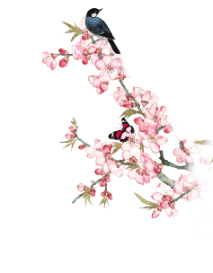
The spring in masterpieces
Early Spring Spring drew on, she was indeed already come; the frosts of winter had ceased; its snows were melted, its cutting winds ameliorated... a greenness grew over those brown beds, which, freshening daily, suggested the thought that Hope traversed them at night, and left each morning brighter traces of her steps. Flowers peeped out amongst the leaves: snow-drops,crocuses , purple auriculas, and golden-eyed pansies.
—Charlotte Bronte: Jane Eyre
Glossary: cease( /siːs/停止)； ameliorate(/əˈmiːliəreɪt/改善)； freshen( /ˈfreʃn/精神饱满)；
traverse([travɛrs]穿过) ；peeped out(/piːp/露出) ； snow-drops(雪花莲) ；
crocus (/ˈkrəʊkəs/番红花）； auricula（/ɔː'rɪkjʊlə/报春花）；pansie( /ˈpænzi/紫罗兰）

Slide 21

The spring in masterpieces
From every hill slope came the trickle of running water, the music of unseen fountains. All things were thawing , bending, snapping . The Yukon was straining to break loose the ice that bound it down. It ate away from beneath; the sun ate from above. Air-holes formed, fissures sprang and spread apart, while thin sections of ice fell through bodily into the river. And amid all this bursting, rending , throbbing of awakening life, under the blazingsun and through the soft-sighing breezes, like wayfarersto death, staggered the two men, the woman, and the huskies.
--- Jack London: Call of the Wild
Glossary: trickle( /ˈtrɪkl/细流); thaw (/θɔː/冰雪融化); snap( /snæp/劈啪作响); The Yukon (/ˈjuːkɒn/育空河); strain(/streɪn/竭力); fissure([fisy:r]裂缝);
amid (/əˈmɪd/在……过程中) ; rend( /rend/碎裂); throb( /θrɒb/跳动) ;
blazing(/ˈbleɪzɪŋ/耀眼的); wayfarer(/ˈweɪfeərə(r)/旅人); stagger(/ˈstæɡə(r)/蹒跚)

Slide 22
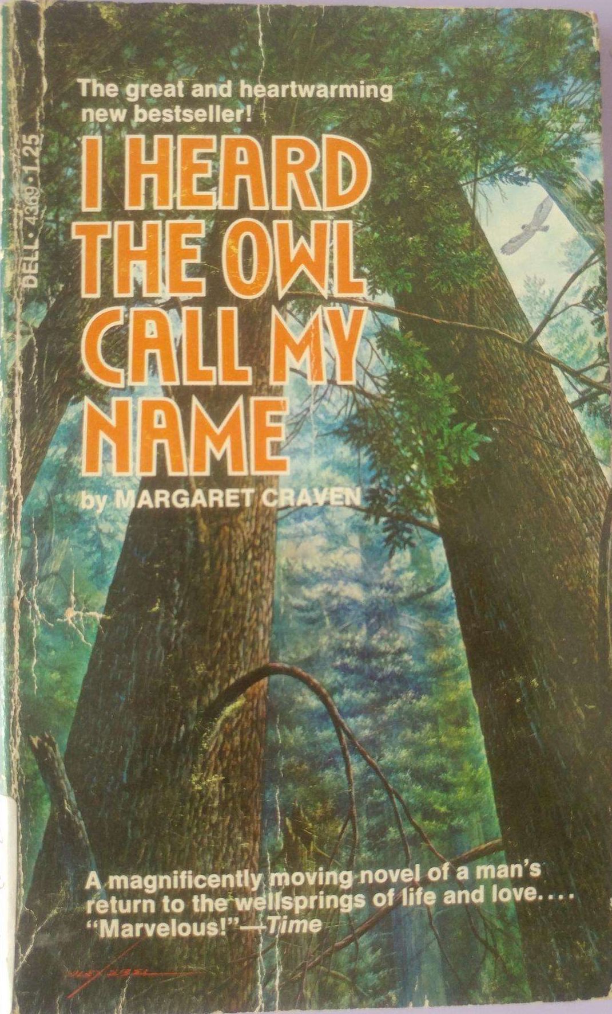
The spring in masterpieces
With the Advent of Spring With spring the leaden skies broke, the winds lightened, the rains softened, and the eagles and the robins returned to the village. High in the skyways wild geese called exultantly on their first early passages back from the south, the wise old crow cawed over the river, his wings flapping loosely and slowly, and the sleek black raven who stayed all year, nested in the tall alders.
With spring the first buds began to swell, and the fresh green needles of the spruce. The bracken and the fern reached out the tips of tender fronds, the devil's club put out small new leaves for the deer to nibble, and the bears emerged from their dens, thin, blinking in the light.
---Margaret Craven; I Heard the Owl Call My Name
Glossary: advent( /ˈædvent/到来); leaden( /ˈledn/ 沉闷的); skyways (/'skaiwei/ 航线);
exultantly(/ig'zʌltəntli/欢快的) ; crow(/krəʊ/乌鸦); sleek( /sliːk/圆滑的)
raven (/ˈreɪvn/大乌鸦); alder(/ˈɔːldə(r)/赤杨木); spruce( /spruːs/云杉);
bracken(/ˈbrækən/蕨菜) ; fern(/fɜːn/蕨菜); frond(/frɒnd/蕨菜的叶);
emerge(/ɪˈmɜːdʒ/出现)

Slide 23

The spring in masterpieces
…telephone wires, fence posts, their song clear with ineffable exuberance that startled and deepened the prairie silence-each quick and impudent climax of notes leaving behind it a vaster, emptier prairie world. The sky was ideal blue.Crows called; farmers, impatient as though it were the only spring left in the world to them, burning with the hope that this one would not be another dry year，walked out to their implements, looked them over and planned their seeding - barley here, oats there, wheat there, summer fallow there. ——W.O.Mitchell: Who Has Seen the Wind
Glossary: ineffable(/ɪnˈefəbl/难以形容的); exuberance(/ɪɡˈzjuːbərəns/感情洋溢的言行);
startled(/ˈstɑːtl/使惊奇); prairie(/ˈpreəri/大草原); impudent (/ˈɪmpjədənt/鲁莽的)
implements(/'ɪmplɪm(ə)nt/器具); barley(/ˈbɑːli/大麦）;oats(/əʊt/燕麦);
fallow ( /ˈfæləʊ/夏季休耕)

Slide 24

The spring in masterpieces
The snow melted away, except in hollowsand shaded copses, where it lingered in dirty, sponge-like patches. The thaw laid bare the warm, damp earth that had had a good winter's rest and was full of fresh sap, of a renewed craving for motherhood. A light vapour wreathed above the black fields, filling the air with the smell of thawed earth, that fresh, subtle, heady smell of spring which you distinguish among hundreds of other smells even in town.
--- Alexander Kuprin Olesya
Glossary: hollow( /ˈhɒləʊ/ 洞穴); copse(/kɒps/ 小灌木丛); linger(/ˈlɪŋɡə(r)/逗留);
sponge-like(/spʌndʒ/ 海绵样的) ; patch(/pætʃ/补丁); thaw (/θɔː/ 融雪)
sap(/sæp/ 精力); wreathe(/riːθ/环绕)

Slide 25
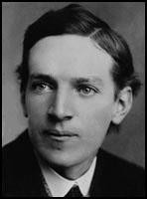
The spring in masterpieces
In Early Spring
Springtime! You dressed by the light of dawn and the good old sun was shining over the sea as you went to your day's work. As if ashamed for the suffering his absence had caused you, he gave double measure and the snows melted, and little rivers ran from every hillside,and in sheltered corners you saw green things stickingtheir timid heads from the ground.
——Upton Sinclair: Boston
Upton Sinclair
Glossary: hillside(/ˈhɪlsaɪd/山坡); timid (/ˈtɪmɪd/羞怯的)

Slide 26
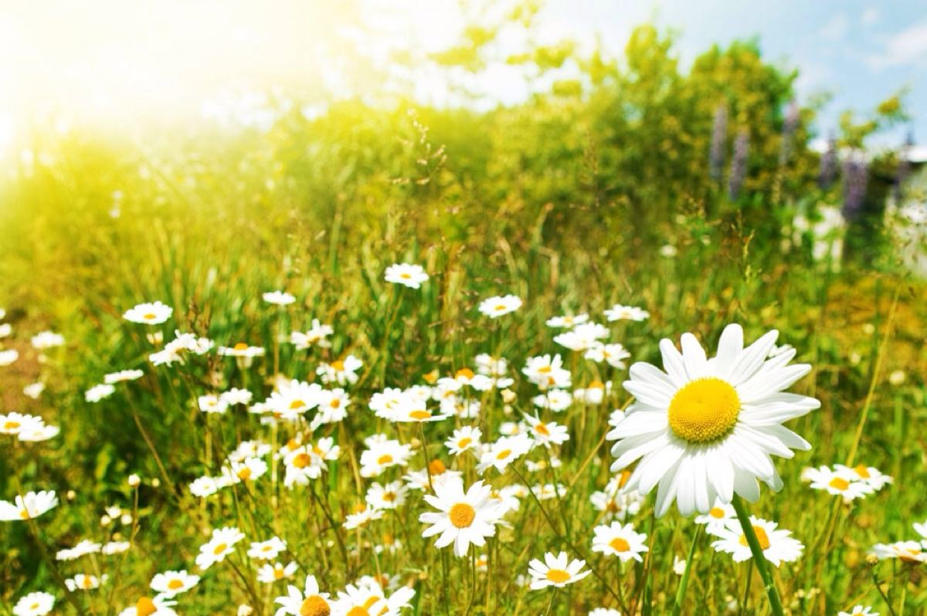
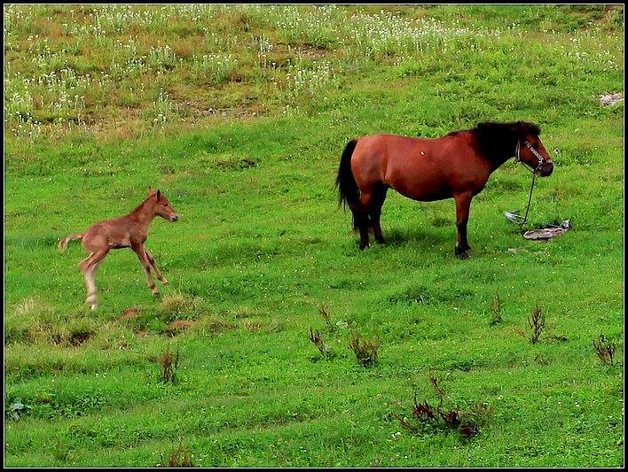
The spring in masterpieces
Early Spring in the Country
In the space of the last three days the aspect of the country had changed; the green flame had quickened in the hedgerows ; the last drifts of blackthorn had vanished like thawing snows beneath a sun that flooded the foxy gorses and king-cup hollows with gold; lambs basked in the fields, as white as new-blown daisies, under a pale blue, cuckoo-haunted sky, and timid foals trotted clumsily to the shelter of their mothers' swishing tails as the van rolled past···
---Francis Brett Young: The Redlakes
Glossary: hedgerow (/ˈhedʒrəʊ/灌木篱墙); blackthorn(/ˈblækθɔːn/黑刺李);
vanished (/ˈvænɪʃ/消失) ; gorse( /ɡɔːs/金雀花); king-cup(驴蹄草) ;
basked(/bɑːsk/晒太阳); cuckoo-haunted(/ˈkʊkuː/布谷鸟)
(/ˈhɔːntɪd/反复出现的); foals(/fəʊl/驹); trotted( /trɒt/小跑); swishing(/swɪʃ/甩动着的); van(/væn/货车)

Slide 27
What are the colors of spring in your eyes?
Spring is one thing that must be experienced!
To feel it, to value it, to embrace it, and to appreciate it!

Slide 28
Thank you!

