Slide 1

感恩遇见，相互成就，本课件资料仅供您个人参考、教学使用，严禁自行在网络传播，违者依知识产权法追究法律责任。
更多教学资源请关注
公众号：溯恩高中英语
知识产权声明

Slide 2
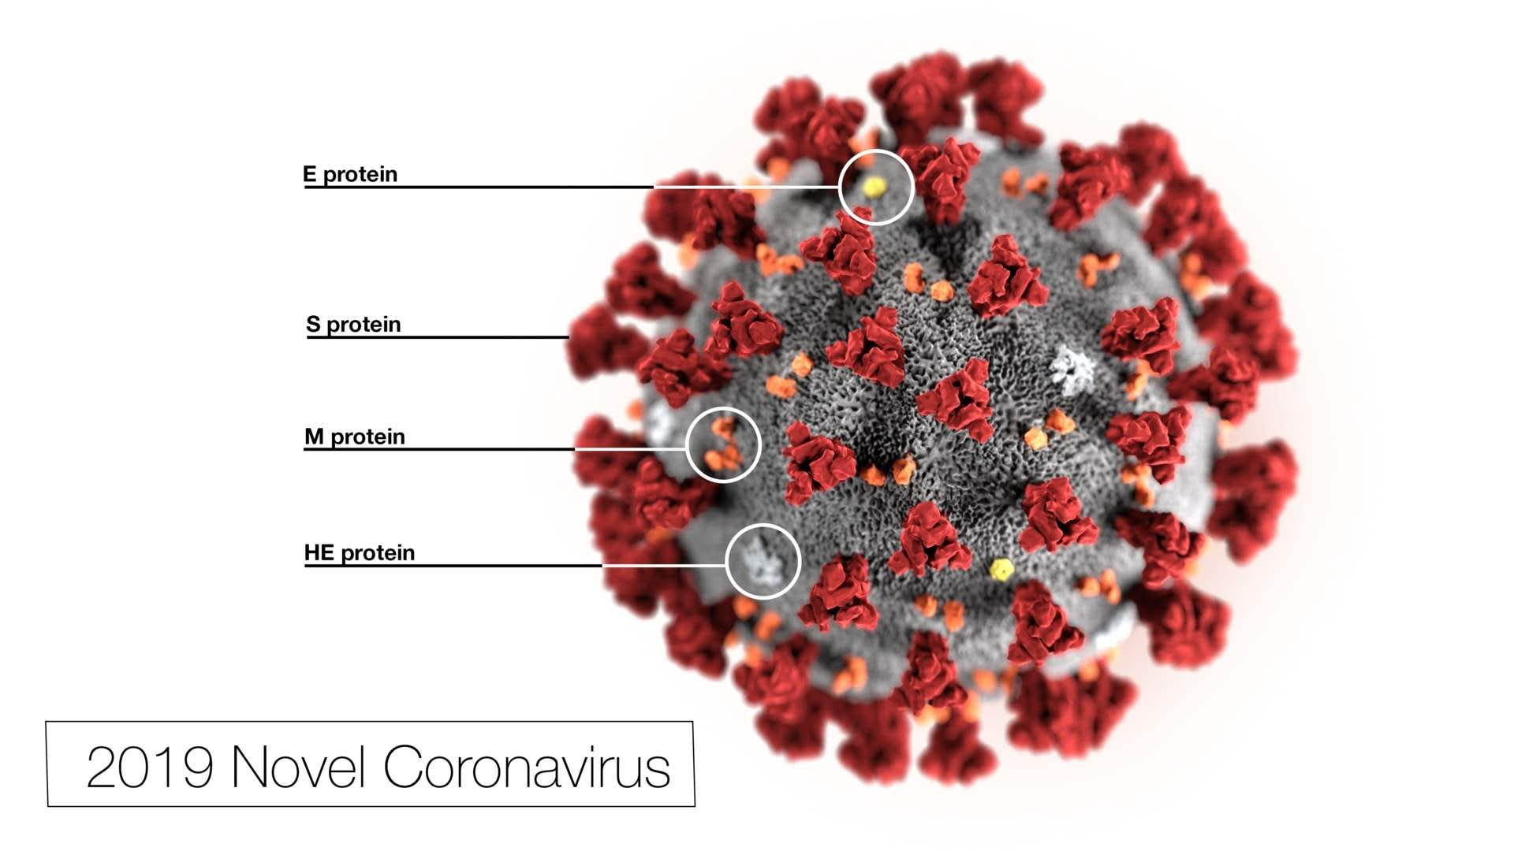

Slide 3
Novel coronavirus (2019-nCoV)
COVID-19

Slide 4

假如你是李华，最近中国抗击新冠肺炎的新闻传遍全球。你的美国网友Tom写email询问情况。请给他回复一封email，谈谈预防疾病以及防止病毒传播的简单方法(如勤洗手戴口罩等)，并阐述理由。
×
Person:
to “you”
Pattern:
a pure advice letter
an email providing information and some advice
Dear Tom,
Para 1: Writing purpose and related background
Para 2: Ways to prevent and their reasons
(at least 3 including washing hands and wearing masks)
Para 3: Hope for the future(Tom’s health)
Yours,
Li Hua

Slide 5
Para.1
Inform Tom of the present situation
adjectives to describe this virus.
terrible
severe
horrible
disastrous
awful
infectious
dreadful
deadly
sentences to describe this virus.
1. The virus is very terrible because it can transmit from human to human.
2. The virus is so dreadful that tens of thousands of people have been infected.
3. So deadly is the virus that numerous people have lost their lives.
4. It's true that many people are infected with coronavirus
in China and we are doing our best to fight the disease.

Slide 6
Para. 1
Writing purpose
Now I’m writing to offer you daily useful tips.
I am writing to tell you to take useful measures to prevent yourself from being infected.
3. Here are some small but useful tips for you.
4. Here are some suggestions to prevent infection.

Slide 7
Para. 1
Combine current situation with writing purpose
1. Given that the COVID-19 is getting more and more serious, I am writing to remind you to pay more attention.
2. I am sure you’ve heard about the outbreak of COVID-19, a high-infectious virus that could cause severe pneumonia and transmit from person to person. So I am writing to you urgently to inform you of the necessary ways to protect yourself.
3. I am writing to tell you the present situation that thousands of people have been infected and numerous people have lost their lives. Therefore, you are supposed to take useful measures to prevent yourself from being infected.

Slide 8
Para.2
Ways of preventing disease and virus transmission
1. Wash your hands frequently and properly .
2. Wear masks outdoors .
3. Stay at home .
4. Strengthen your immune system and exercise regularly.
5. Never eat wild game meat 野味 .
6. Cover your coughs and sneezes with tissue.
7. Drink more hot boiled water.
8. Wear safety goggles.
9. Keep a balanced diet.
10. …

Slide 9
Wash hands
1. First and foremost, it’s necessary for you to tidy your hands thoroughly, especially before eating and after going to the toilet, which can be an effective method to prevent yourself from developing the pneumonia.
2. Remember to wash hands frequently and properly, which can not only help you develop good living habits, but also keep you from the virus.
3. It’s of great significance to wash your hands frequently, properly and thoroughly. Only by doing so could the virus be got rid of totally.

Slide 10
Wear masks
1. Wearing masks is one of the best ways to avoid the virus entering the bodies through mouths or noses as the deadly virus goes around by coughing, sneezing and touching.
2. It’s of great importance to wear masks for the virus is spread by infected people’s coughing and sneezing.
3. You’d better attach great importance to wearing a surgical or N95 mask when going to public areas, since it can protect you well.

Slide 11
Other ways
1. Last but not least, proper exercise is a good choice, for it strengthens your body and improves the immune system.
2. It goes without saying that you are supposed to work out regularly to strengthen your immune systems, which is considered as a matchless weapon.
3. Building up body is also a great way of preventing you from being infected, as well as keeping an optimistic attitude towards this “campaign”.
4. You are supposed to do some indoor exercise aiming to strengthen your immune system and reduce the risk of being infected.

Slide 12
Para.3
Hope
1. There are numerous heroes against the virus, protecting others’ lives, so I firmly believe everything will go smoothly some day! Thanks you for your concern !
2. Under no circumstances will we lose heart to defeat the virus. Wish you all the best !
3. We can’t be too careful to prevent infection. I bet we will win this campaign in the end with everyone’s effort. Hope everything goes well!
4. I strongly believe we will win the long campaign thoroughly in the near future. May you be in good health.
5. A people united can move mountains. Thus I hold the strong belief that China will get through the difficulty. Wish you good health!

Slide 13
Find some disadvantages
Dear Tom,
It's true that many people are infected with coronavirus in China and we are doing our best to fight the disease.
As the dangerous virus spreads widely, it is important for us to take steps to reduce the risks of being infected. Due to the great possibility of human-to-human transmission, it will be dangerous to gather in crowded places. Thus you must avoid going to public places. If have to, then do not forget to wear face masks and goggles as well. Ensure that there is always fresh air in the house because the coronavirus is mainly spread by droplet transmission. Finally, take exercise properly and keep a balance diet.
Hopefully, my advice will be of some help to you. I believe that we will win this fight against the horrible virus in the near future.
Yours
Li Hua
misuse the “person”
use improper tone
miss a conjunction
miss the main point
wash hands???
Attention!!!
Use unnecessary sentence and phrase

Slide 14
Writing sample
Dear Tom,
It’s true that many people are infected with coronavirus in China and we are doing our best to fight the disease.
To prevent you _______________(infect), some measures could be taken. Firstly, due to droplet transmission, it’s better to wear face ________(mask) when not at home. Secondly, you are supposed to wash your hands_____________(frequent), ____ it can kill the virus scattered. In addition, you’d better stay ________(indoor) to avoid some _____________(necessary) contact. Last but not least, it’s also _____ essential idea to exercise more to______________(strong)your body, ________ could boost the immune system.
Hopefully, the epidemic will be _______ control soon. Thank you for your concern.
Yours,
Li Hua
being infected
masks
frequently
for
indoors
unnecessary
an
strengthen
which
under

Slide 15
Thank you!

