Slide 1

感恩遇见，相互成就，本课件资料仅供您个人参考、教学使用，严禁自行在网络传播，违者依知识产权法追究法律责任。
更多教学资源请关注
公众号：溯恩高中英语
知识产权声明

Slide 2
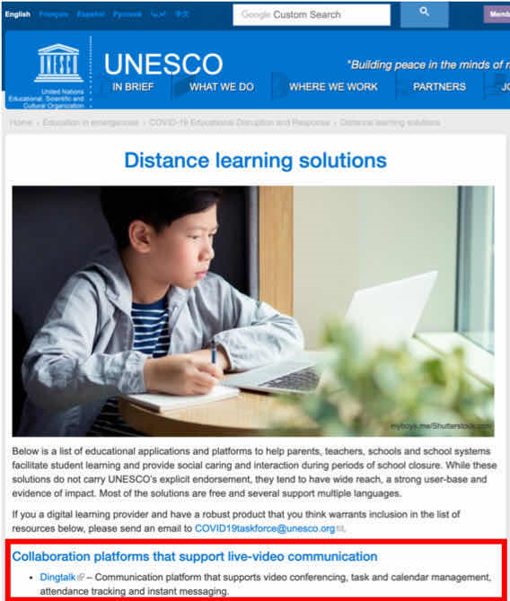
NOTICE

Slide 3
假定你是学生李华，因新型冠状病毒肺炎疫情还未得到有效控制，教育部宣布延期开学，有可能推迟到4月20日，请你写一封英文通知发布在校园网上。要点如下：
1. 严禁学生假期到校。
2. 远程教育、在线心理辅导。
3. 如有调整，另行通知。
参考词汇：教育部 Ministry of Education
活动式书面通知+
Part 3 ：号召
布告式书面通知
1. 标题: 要在正上方写上Notice或大写NOTICE
2. 正文: Part 1:发布通知的原因or目的+通知的事件
Part 2: 通知的具体要求(要点+注意事项)
3. 落款: 落款写在右下角(可以是个人，也可以是单位)
Notice
段首空两格写正文
Li Hua

Slide 4
Vocabulary
假定你是学生李华，因新型冠状病毒肺炎疫情还未得到有效控制，教育部宣布延期开学，有可能推迟到4月20日，请你写一封英文通知发布在校园网上。要点如下：
1. 严禁学生假期到校。
2.（实施）远程教育、在线心理辅导。
3. 如有调整，另行通知。
参考词汇：教育部 Ministry of Education

Slide 5
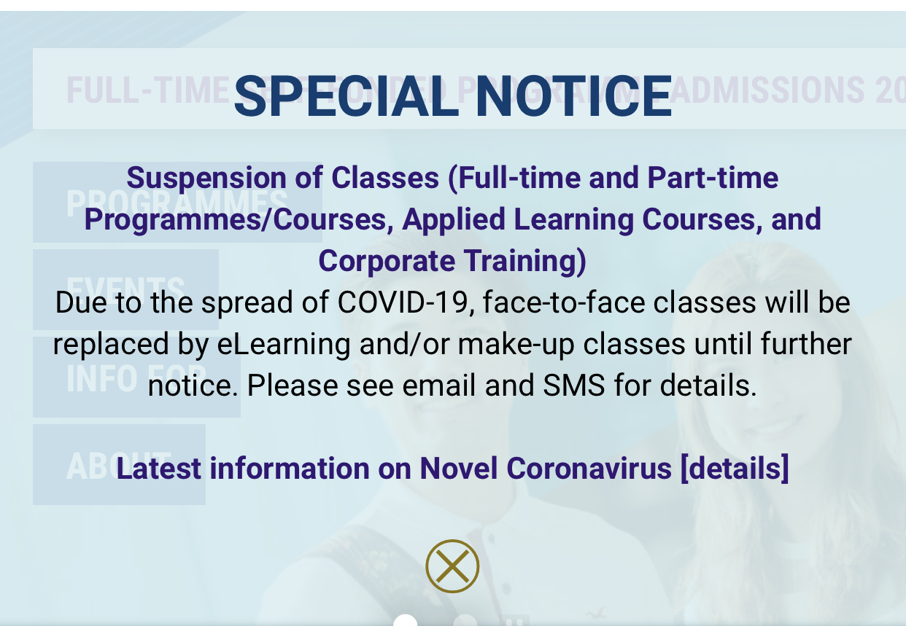
延期

Slide 6
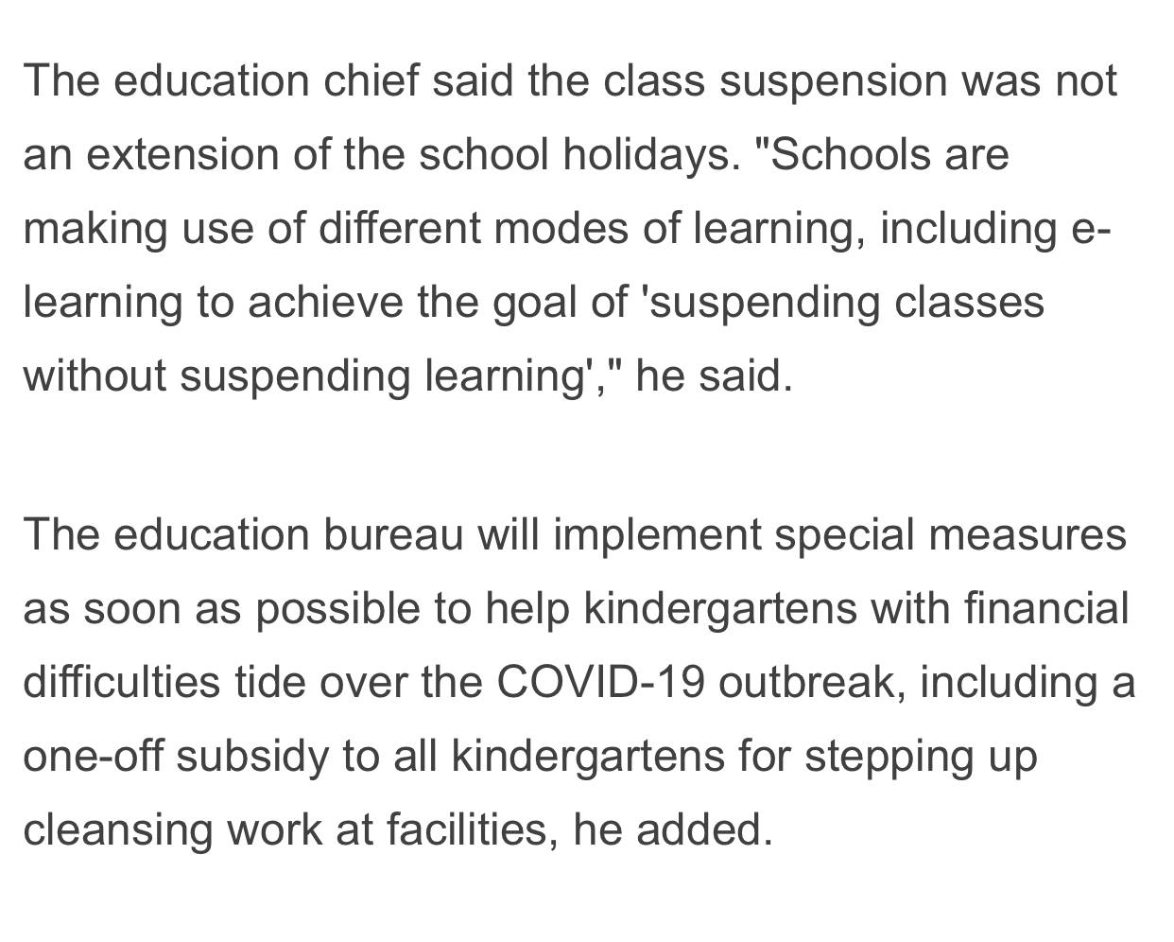
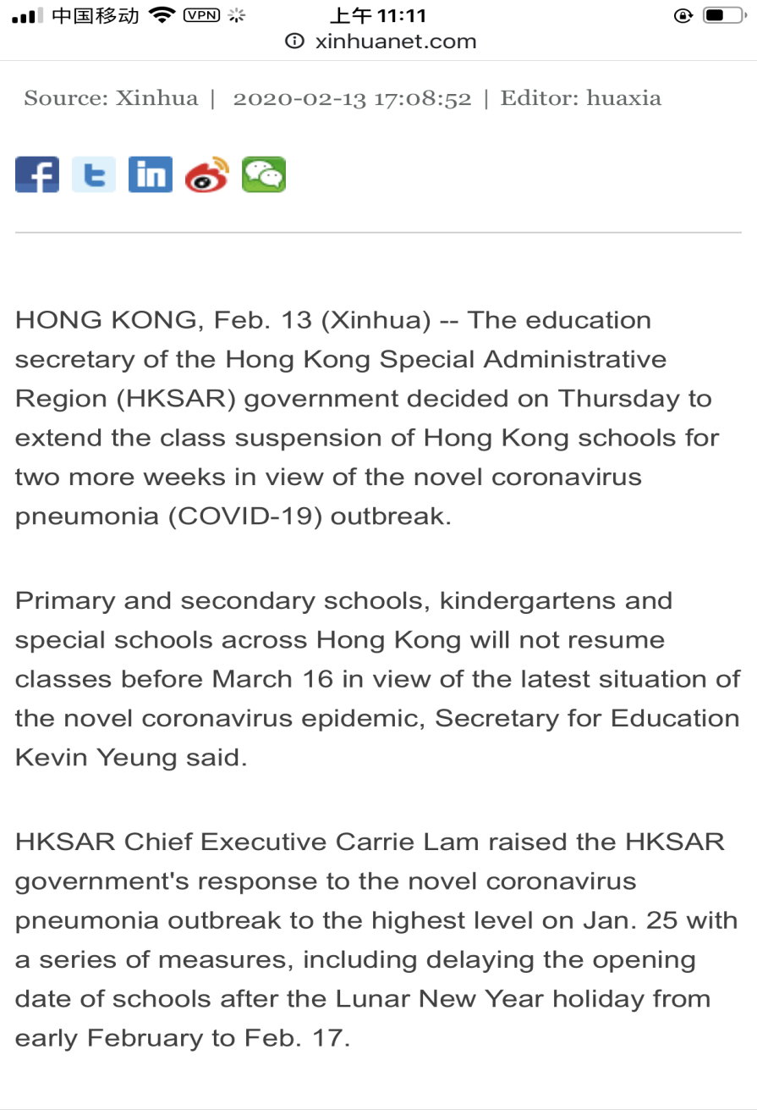
停课不停学
复课
class resumption
postpone
put off
suspend
延迟开学

Slide 7
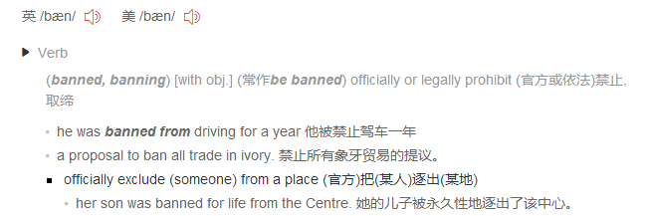
严禁
ban sb. from doing
prohibit sb. from doing
forbid sb. to do
not allowed/ permitted
ban

Slide 8
实施
conduct
launch
carry out
online classes
be arranged
be organized
be offered
online classes

Slide 9
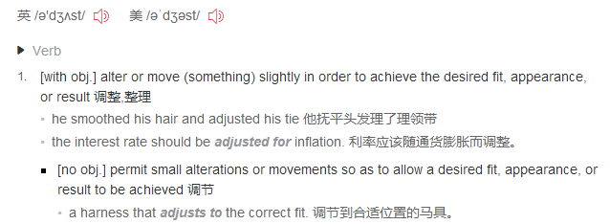
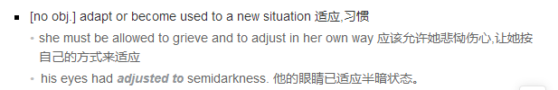
调整
adjust
make some adjustments
if there is any adjustment/change
adjust/adapt (oneself) to (doing) sth.
适应于
adjust adapt adopt
调整/调节/适应
适应/ 改编( adapt from a novel)
收养/采纳(adopt various methods)

Slide 10
1. 延迟上课
2.停课不停学
3. 复课
4. 基于目前的形势
5. 严禁
6. 实施远程教育
7. 心理辅导
8. 密切关注
9. 调整
10. 最新的安排
11. 进一步的通知
suspend / delay/postpone/ put off the classes; class suspension
suspending classes without suspending learning
resume classes/ class resumption
according to/ in view of/due to/owing to/because of / based on the current/present/latest situation
ban/prohibit/forbid sth. strictly
conduct /launch/carry out /arrange/organize
e-learning /web-based/online classes/
distance education
psychological guidance/counseling/consulting
pay close attention to
adjust / make some adjustments
the latest arrangement
further notice/ announcement

Slide 11
Purpose
因新型冠状病毒肺炎疫情还未得到有效控制，教育部宣布
延期开学，有可能推迟到4月20日。
suspend; suspension
Since the coronavirus still hasn’t been under control, it is announced by Ministry of Education that the day we go back to school may be delayed to April 20 or even later.
As the terrible epidemic of COVID-19 has not been effectively contained, Ministry of Education has declared the postponement of the start of school until April 20.
According to the decision of Ministry of Education, the opening of the school will be put off to April 20 due to the uncontrolled epidemic caused by COVID-19.
Owing to the fact that the epidemic hasn’t been controlled completely,
Ministry of Education has made the announcement regarding postponing the new semester opening date until 20th April.

Slide 12
Requirement 1:
严禁学生假期到校
During this period of time, everyone is not allowed/
permitted to go to school.
Most importantly, any arrival to school during the holiday is strictly forbidden.
To contain the epidemic, students are banned from going to school during such a crucial period.
The act of returning to school is strictly prohibited no matter how emergent your excuse is.

Slide 13
(实施)远程教育、
在线心理辅导
Requirement 2:
Distance education as well as online psychological guidance will be arranged / organized /offered by school to help students acquire knowledge at home.
Besides, school will launch/ conduct/ carry out online classes for students, during which time psychological counseling will be in progress.

Slide 14
Requirement 3:
如有调整，另行通知
Any adjustment will be notified later.
1. Any adjustment will be informed ahead of time.
2. You will be informed later if there is any adjustment/change.
3. In case of adjustment, please wait until further notice.
Attention!
全文时态主要为一般现在时和一般将来时;
常采用被动语态或“please＋祈使句”表示要求;
一般用第二、三人称。(不要自称 I；保持人称统一)
注意字数 (应用文要求80-100词)
All the students are expected to ...
Everyone is required/requested to …
Please remember to …
Don't forget to...

Slide 15

____is known to all, prevention and control of the COVID-19 is ____ top priority at present. According to the ____________(announce)of Ministry of Education, the new semester opening date _____(be)postponed, __________(possible) until April 20, during_____
time, students are not allowed to go to school. Everyone __________(require)to work out regularly and keep healthy. Distance education, including online psychological_________(guide), will be organized during the absence of school. Please take __ seriously. If there is any change, you will _________________
(inform)ahead of time.
Li Hua
Notice
As
the
announcement
will be
possibly
which
is required
guidance
it
be informed

Slide 16
Writing sample
Notice
According to the announcement of Ministry of Education, the new term opening date may be further postponed until April 20th based on the development of the epidemic. Before that, students are not allowed to go to school, during which period schools are making full use of various modes of web-based learning to achieve the goal of suspending classes without suspending learning. Meanwhile, online psychological guidance is accessible/available as well.
For the resumption of classes, please pay close attention to the further announcement by Ministry of Education.
Li Hua

