Slide 1

感恩遇见，相互成就，本课件资料仅供您个人参考、教学使用，严禁自行在网络传播，违者依知识产权法追究法律责任。
更多教学资源请关注
公众号：溯恩高中英语
知识产权声明

Slide 2
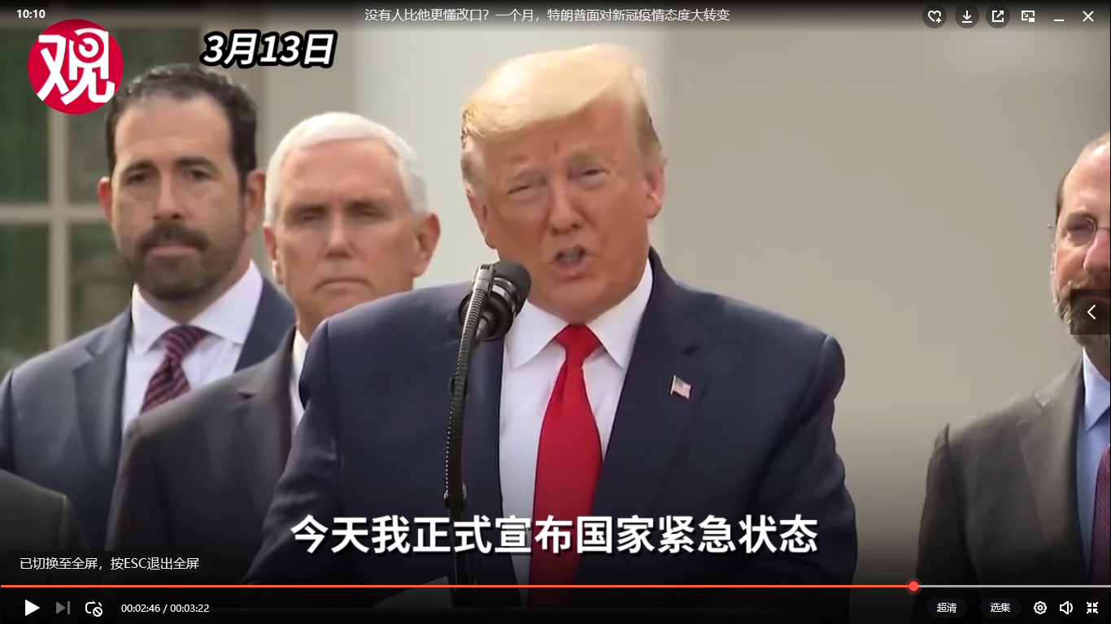
Lead-in：Play a video
dramatic changes
戏剧性改变
/drəˈmætɪk/

Slide 3
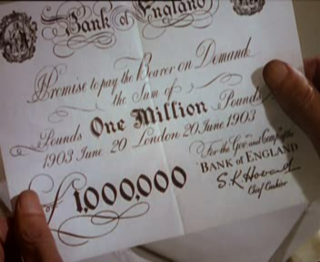
Unit 3 Using language
The Million Pound Bank-Note
—— 浙江省常山一中 吴小华

Slide 4
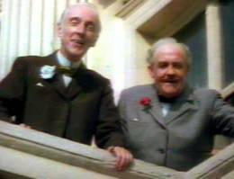
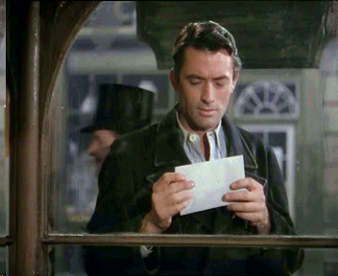
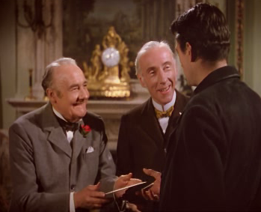
Act One, Scene 3
wealthy
bet
In Scene 3, two old and ______ brothers made a ___. They wanted to see if a jobless and __________stranger could ______for a month in London. So they chose _____ and gave him an __________ with a bank-note in it.
penniless
survive
Henry
envelope

Slide 5
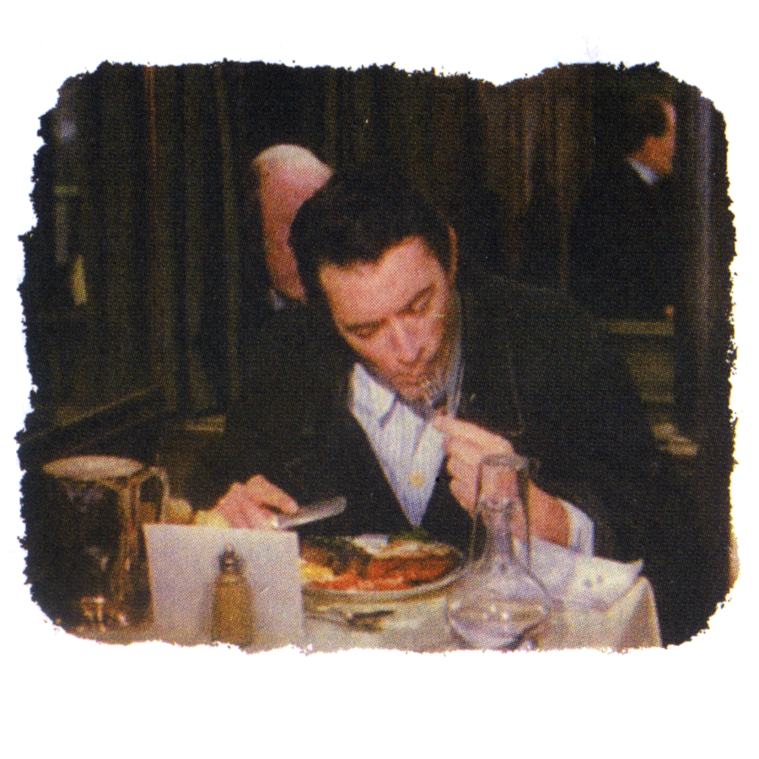
Act I Scene 4
The Million Pound Bank Note
at the restaurant
where?

Slide 6
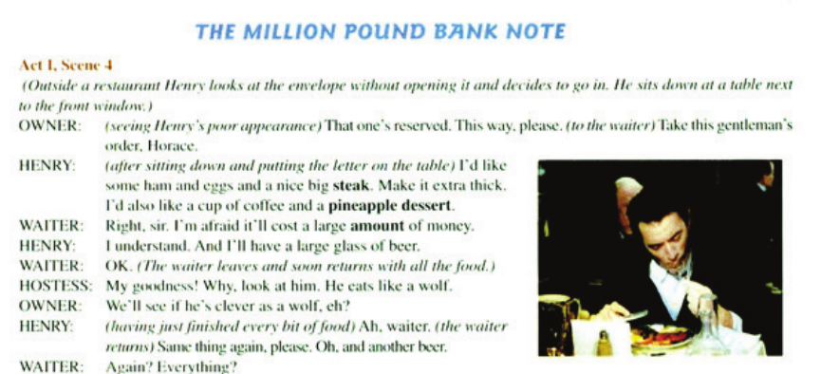
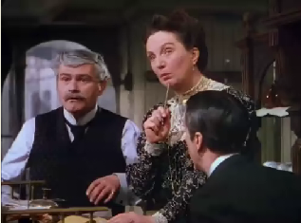
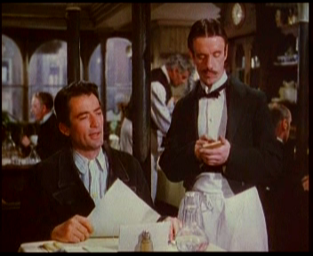
Characters：
owner
Henry
waiter
hostess

Slide 7
Prediction
WHAT would happen to Henry at the restaurant?

Slide 8
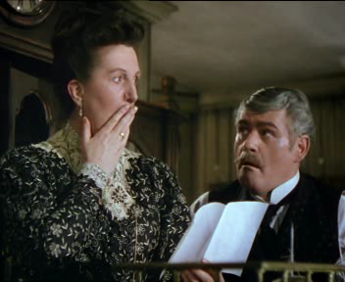
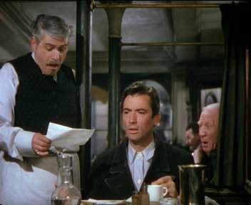
Detailed-reading
Try to find out how Henry was treated and pick out the sentences expressing
their attitudes towards Henry.
Waiter
Hostess
Owner

Slide 9

the waiter's attitudes towards Henry...
start
0
100
20
8
3
2
0
9
7
6
5
4
1
10
80
Watch your time!
40
How time flies!
60
2分钟倒计时
Waiter

Slide 10
Before seeing the banknote...
After seeing the banknote...
I'm afraid it’ll cost
___________________
a large amount of money.
Again, _________?
everything
shocked
(in a _____ manner) ______________________________?
rude
What's there to
wait for
Waiter

Slide 11
the hostess's attitudes towards Henry...
start
0
100
20
8
3
2
0
9
7
6
5
4
1
10
80
Watch your time!
40
How time flies!
60
2分钟倒计时
Hostess

Slide 12
Before seeing the banknote...
After seeing the banknote...
scream
poor?
But he’s ________.
in rags
My goodness!
Why, look at him.
He eats like a
______.
And you put him in
the ______ of the
restaurant!
back
wolf
hungry?
Go and see him
___________!
at once
Hostess

Slide 13
the owner's attitudes towards Henry...
start
0
100
20
8
3
2
0
9
7
6
5
4
1
10
80
Watch your time!
40
How time flies!
60
2分钟倒计时
Owner

Slide 14
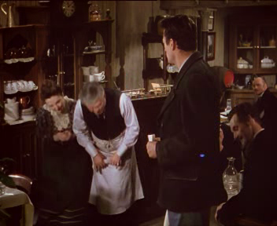
Before seeing the banknote...
After seeing the banknote...
what?
insincere
reserved
I’m so ______sir, so sorry，but I cannot change this bank note.
That one’s _______.
sorry
Well, it's well-known that...Well, we'll have to _________________ .
doubtful
take a chance
ridiculous可笑的
/rɪˈdɪkjələs/
Now perhaps if you pay the bill I can ________________.
impolite/
rude
We are so very glad that you even entered our _____ eating place.
What kind of person is the owner?
help the other customers
Owner
little
flattering奉承的
It’s for us to thank you, from the bottom of my______!
Just having you sit here is a great ______! Forget the bill.
honor
heart
respectful
恭敬的
bow

Slide 15
Further understanding
sudden, very great and often surprising
突然的；巨大的；令人吃惊的
The dramatic change of the attitude
?
Rude
Respectful
the unjust or prejudicial treatment of different kinds of people or things 差别对待；歧视
discrimination
& prejudice
≠
equality

Slide 16
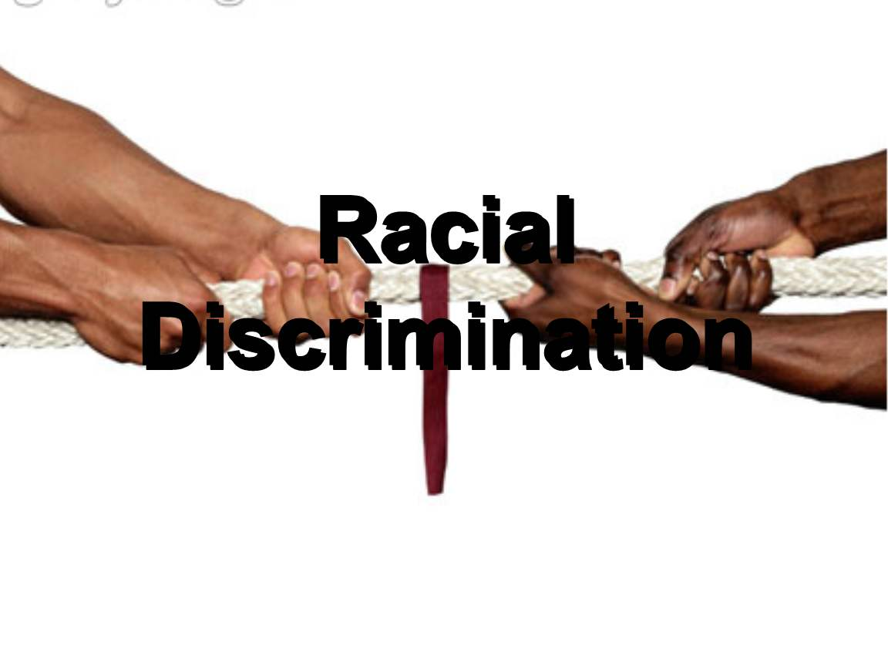
Further thinking
Does discrimination still exist today?
Gender discrimination
Employment discrimination
Racial discrimination
Racial discrimination

Slide 17
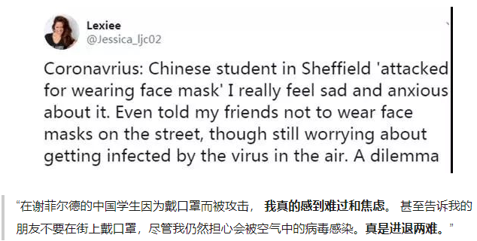
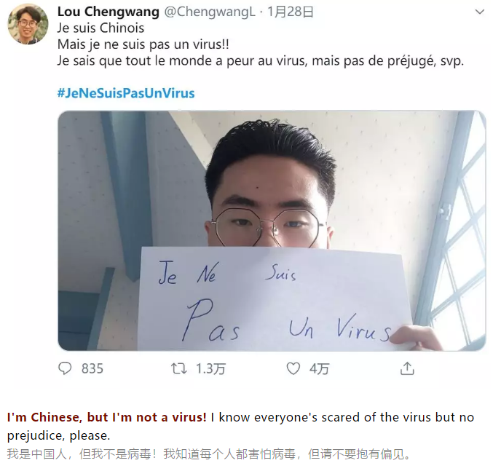

Slide 18
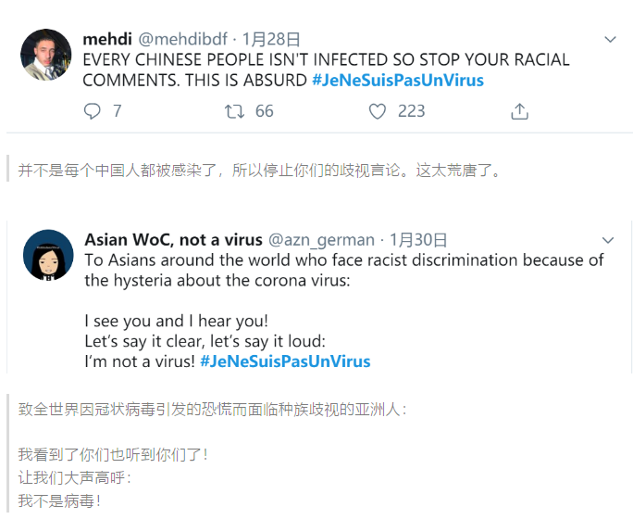
absurd：
arousing amusement;
ridiculous
可笑的；荒唐的

Slide 19

2020年第6期德国《明镜》周刊封面图
Feb.1, 2020
"Releasing such a picture does nothing to the outbreak, but only causes panic, mutual blaming and even racist discrimination. We despise such a move," the Chinese embassy said on its official website.
The embassy said global challenges need to be addressed globally, and that German media shares the same responsibility as everyone.
当地时间1日，中国驻德国大使馆就此表明立场称，制造恐慌、相互指责、甚至种族歧视毫无益处，我们对此表示鄙视。全球性挑战需要全球共同应对。希望德有关媒体也与各方一起共同承担起责任来。

Slide 20
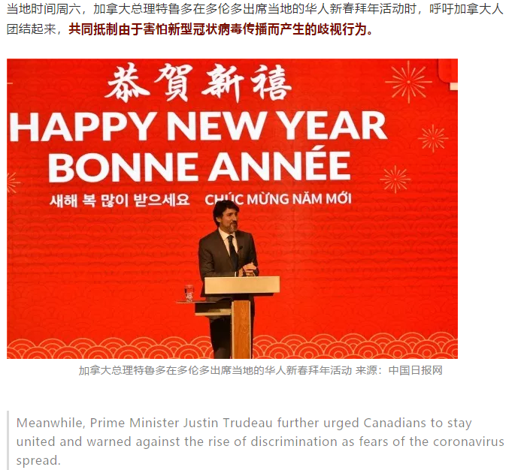
Meanwhile, Prime Minister Justin Trudeau further urged Canadians to stay united and warned against the rise of discrimination as fears of the coronavirus spread.
当地时间周六，加拿大总理特鲁多在多伦多出席当地的华人新春拜年活动时，呼吁加拿大人团结起来，共同抵制由于害怕新型冠状病毒传播而产生的歧视行为。
特鲁多说：“加拿大没有任何地方可以容忍由于恐惧和错误信息而产生的歧视！这从来都不是加拿大人所支持的。”
"There is no place in our country for discrimination driven by fear or misinformation," Trudeau said at a Lunar New Year celebration at a banquet hall in Toronto on Saturday. "This is not something Canadians will ever stand for."

Slide 21
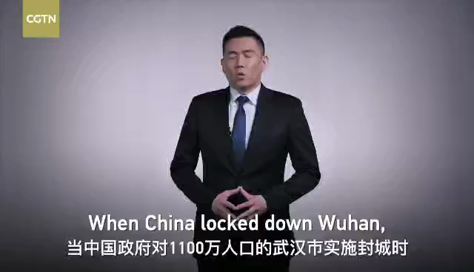

Slide 22
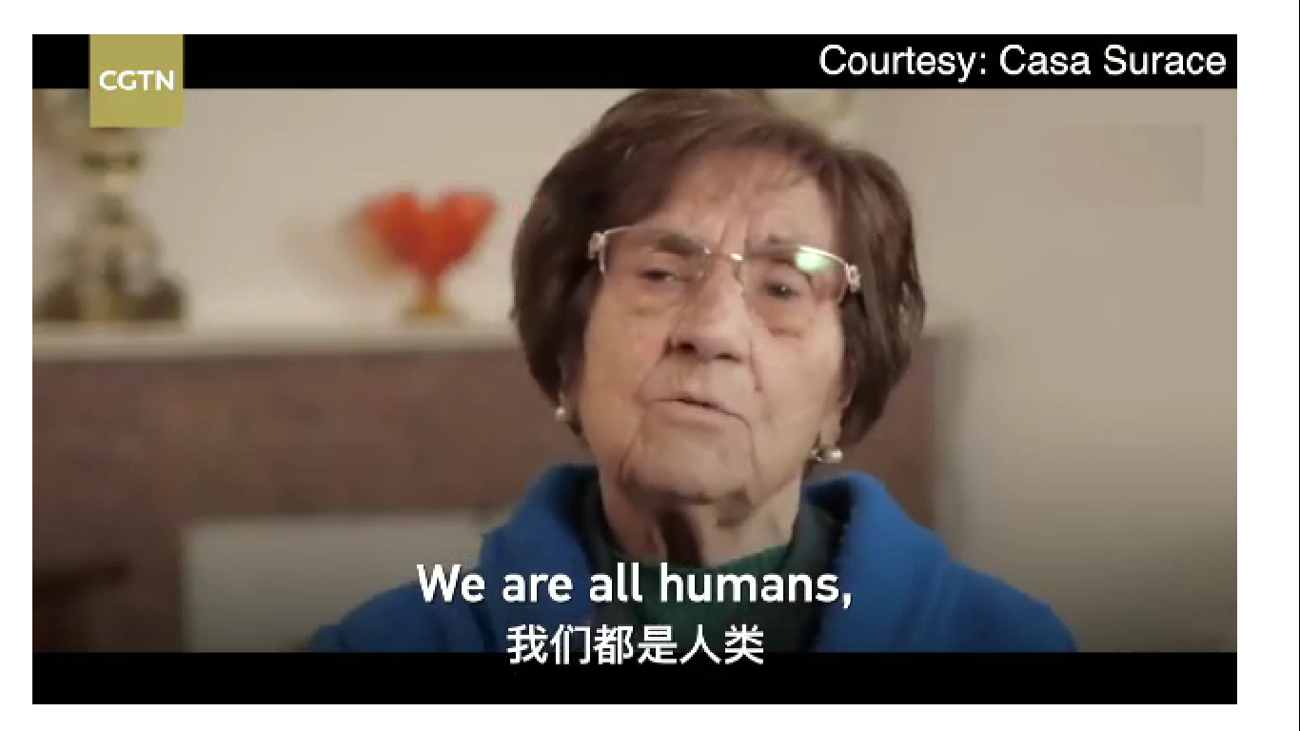
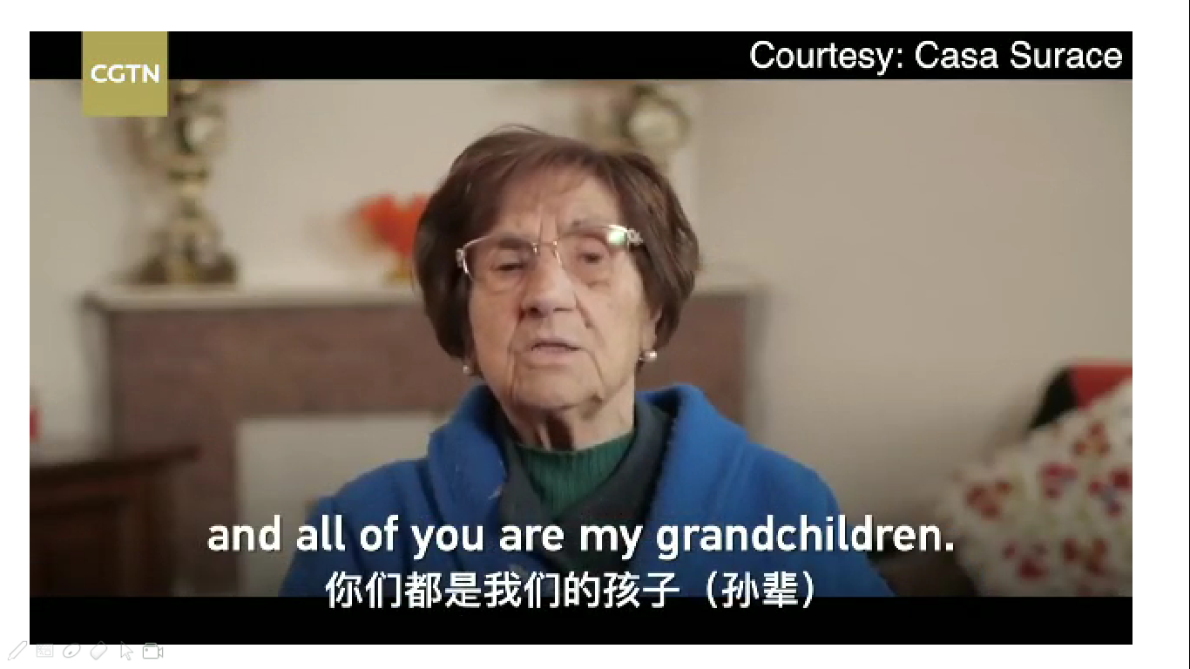
Further discussion
WHAT is your attitude towards racist discrimination?

Slide 23
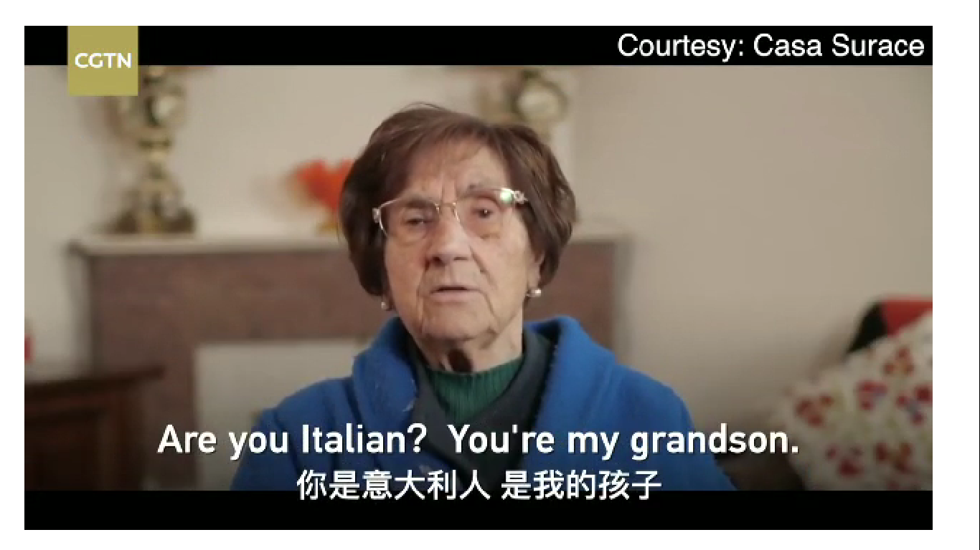
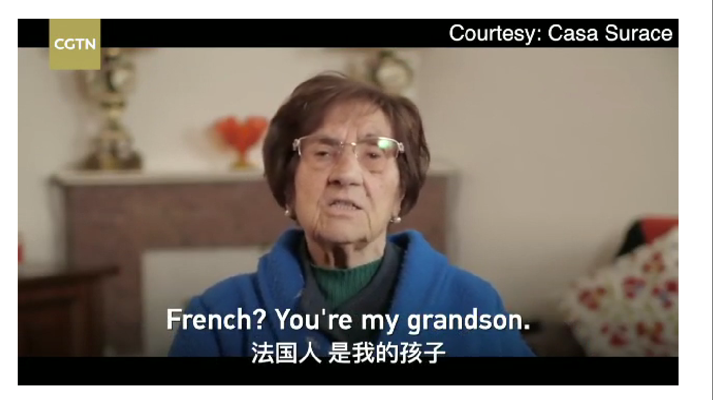
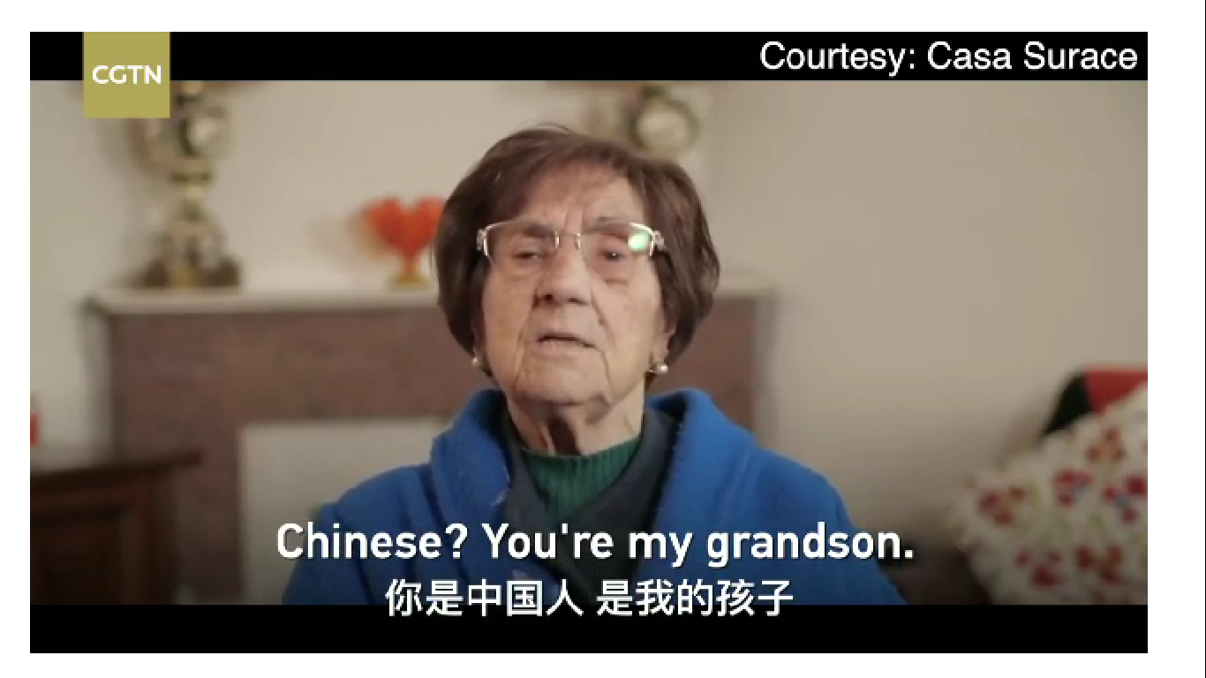
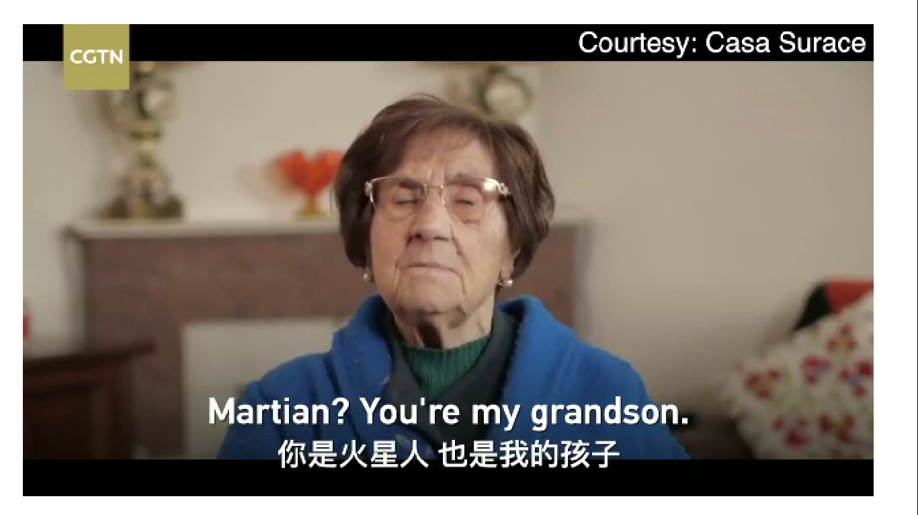

Slide 24

Virus respects no borders.
病毒无国界

Slide 25

Assignment
目前，新型冠状病毒开始肆虐全球，国外疫情形势尤为严峻；假定你是李华，你的英国朋友Jacy正居家隔离，请你给此时处于焦虑的他写一封英文慰问信。内容包括：
1. 提供帮助的关心；
2. 反对歧视的态度；
3. 战胜疫情的信心；
注意：①词数100左右；
②可以适当增加细节，以使行文连贯。
参考词汇：型冠状病毒 novel corona virus
疫情 epidemic

Slide 26
Possible version
Dear Jacy,
Hearing you are under quarantine at home, I'm extremely concerned about your situation and willing to extend a helping hand at any time.
As is known to all, China has taken most effective prevention and control measures to curb the virus' quick spread, but signs of discrimination have surfaced in other parts of the world against Chinese. Actually, our efforts bought precious time for the world to prepare for the pandemic. Still fortunately, some countries are working closely with China to fight the novel coronavirus outbreak and will not tolerate any racial discrimination. More importantly, discrimination of any kind is undoubtedly heartrending and hurtful for people.
In such difficult times, we must stand together in solidariy and cooperation, and stay optimistic and confident. Remember, we won't be far away if you need any help!
Yours genuinely,
Li Hua

Slide 27

THANK YOU!

