Slide 1

感恩遇见，相互成就，本课件资料仅供您个人参考、教学使用，严禁自行在网络传播，违者依知识产权法追究法律责任。
更多教学资源请关注
公众号：溯恩高中英语
知识产权声明

Slide 2


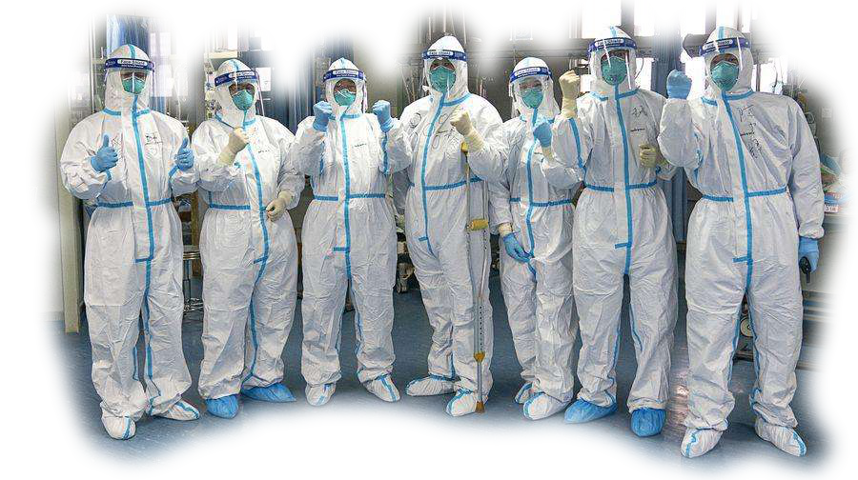

台州市第一中学 周 媚
台州市第一中学 陈泓静

Slide 3
假定你是李华，你所在高中学校要征集一封英文感谢信，以致意奋战在抗击新型冠状病毒肺炎第一线的医护人员，请你根据下列要点写一封信用于投稿:
1. 表达谢意； 2. 个人感受； 3. 表达信心。
Dear medical workers,
Para 1: Writing purpose--show your appreciation
Para 2: Detailed reasons of your thanks
(要点2：personal feelings about…)
Para 3: Express your gratitude again and show your confidence/hope.(要点3)
Yours sincerely, Li Hua

Slide 4

1. thank/appreciate/acknowledge (正式) sb.
2. be grateful to/thankful to/be appreciative of
3. express/convey/ show/extend one’s thanks/gratitude/appreciation to sb. for sth.

Slide 5

1. I am writing this letter to thank you for …
I am writing to express/convey/show /extend my sincere/heartfelt/ cordial/ deepest thanks/ gratitude/ appreciation to you for …
3. I am dropping these few lines to show my cordial appreciation for what you have done.

Slide 6

The qualities of medical workers
heroic, brave, courageous, fearless, devoted, dedicated, selfless, unselfish, responsible, professional, diligent, …
The acts of medical workers
1. sacrifice time, family even life
2. accompany/treat/ cure/comfort/save/rescue
/attend/protect patients
3. show love and sympathy for. …
4. do medical research
Personal
feelings of
The influence of medical workers
1. set an example for
2. encourage more and more volunteers/followers
3. give us more confidence
4. confirm one’s resolution to be a medical worker
5. …

Slide 7
1. You stood out without a second thought, regardless of the strong desire for a happy reunion with family during the Spring Festival.
2. I feel greatly touched when hearing you spare no effort to/ make every effort to treat and look after the patients day and night.

Slide 8
1. It’s because of your selfless devotion/dedication that the epidemic has been controlled effectively.
2. Your strong sense of responsibility deserves to be highly appreciated/ is well worth praising .
3. This special Spring Festival has witnessed your strength and strong willpower.

Slide 9
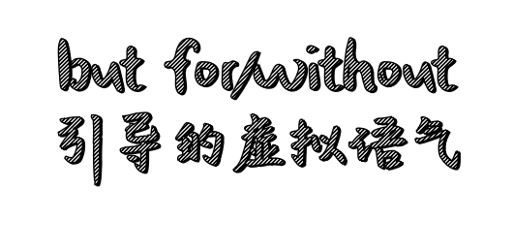
1. I can’t imagine how terrible the city would be but for your work.
2. But for your unreserved help and tender care, I can’t imagine how severe the situation would be!
3. But for your help, patients would not have recovered so quickly .
4. Without your devoted care and selfless contribution, the situation wouldn't have been controlled in such a short time.

Slide 10
Advanced sentences
1. _____________________________________________________________________
(是你们耐心的照顾和不断的鼓励) improve their health and fuel their desire to live.
2. __________________________________________ (让我印象最深刻的是) you comfort the patients gently when they are at a loss.
3. You are always professional and responsible when everyone turns to you for help, ____________________________________________________________________.
(这大大的感动了我)
4._______________________________________________________________________________________________,(当病人失去信心时， 你们总是用微笑鼓励他们） which helps us to cultivate a positive attitude towards difficulties(有助于我们对困难养成积极的态度).
It is your patient care and constant encouragement that
What impresses me most is that
which greatly moves/ touches/ affects me
You never fail to cheer people up with your smiles when
they are discouraged

Slide 11

1.Again, millions of thanks for what you have done.
2.Please accept my sincere thanks again for... Good luck and stay well!
3.Again, I would like to express my sincere thanks to you!
May you be in good health.
4.My gratitude is beyond words/description. / Words fail to express my deepest gratitude .Best wishes to you!
5.Sincere thanks again for what you have done. Wish you a healthy and happy life!

Slide 12

I’m firmly convinced / I firmly believe that with your help and effort, the day when we win is approaching.
2. With your hard work, undoubtedly,/there's no doubt that we will go through the trouble sooner or later.
3. Under no circumstances will we be knocked down by
the virus. I am confident / I bet that everything will be
fine in the near future with our joint effort!
4. We share the strong belief/ hold the firm belief that we will go through this difficult time with everyone’s support.

Slide 13
Dear medical workers,
I am writing to express my sincere gratitude to you for your _________(fight)against the COVID-19. Since the outbreak of the virus, you____________(work)in the front line for nearly a month, rescuing people from all walks of life. But for your _________(devote) care and selfless contribution, the situation ____________(would) have been controlled in such___ short time. Your moving dedication, _______ prevents the dreadful condition from getting _______, is _______________(doubt) worth appreciation !
_______(word) fail to express our thanks to you. Now everything is going into the right track gradually, so I am sure we will win the fight. Remember, we are always ______ you!
Yours，
Li Hua
fighting
have worked
devoted
wouldn’t
a
which
worse
undoubtedly
Words
with

Slide 14

Dear medical workers，
On behalf of my school, I would like to express the sincerest gratitude to you all for your devotion and sacrifice in the battle against the COVID-19.
In this epidemic situation, it is you who/that, regardless of the shortage of equipment and the potential of infection, desperately rescue those infected but struggling for life. It is also you who build up our confidence to defeat it. It is you who deserve all admiration and love!
Such few words can't fully convey our thanks for your
irreplaceable contribution. I hold the firm belief that with our joint efforts China will win the battle and make a quick recovery.
Good luck and stay well!
Yours sincerely,
Li Hua

