Slide 1

感恩遇见，相互成就，本课件资料仅供您个人参考、教学使用，严禁自行在网络传播，违者依知识产权法追究法律责任。
更多教学资源请关注
公众号：溯恩高中英语
知识产权声明

Slide 2

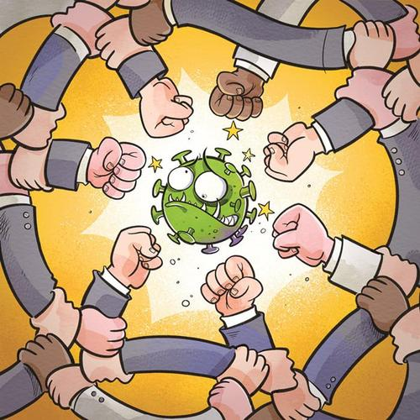
An Appeal letter
台州市第一中学 周媚 陈泓静

Slide 3


假定你是学生会主席李华，当前新型冠状病毒肆虐，疫情蔓延全国，甚至波及全球，对我们的学习生活造成很大影响。请你围绕 “从小事做起，共战疫情” 这一主题，给
全校学生写一封英文倡议书。要点如下：
1. 倡议的原因和目的； 2. 倡议的具体内容； 3. 发出倡议。
we
现在时、将来时
Proposal(标题可不写)
Dear fellow students/friends/schoolmates/…,
Para 1: writing purpose and present problem
(Why do you want to write it?)
Para 2: specific content and measures
(What do you want to be done and how?)
Para 3: a call to action
(what you want the readers to do)
Students’ Union
March 2nd, 2020 (可不写)

Slide 4
Para 1: how to express “appeal”
In order to…, I sincerely appeal to /call on/call for sb. to do …
2. I strongly advocate that sb. (should) do…
3. With/For the purpose of…, I’d like to call your attention to the importance of…
4. Recently, there exists a problem/ phenomenon that…, which leads to many bad effects. So it’s(high) time that we did…

Slide 5
The outbreak of COVID-19 spreads throughout the whole country even the world, affecting our lives and causing many problems.
I am Li Hua，president of students union, the epidemic situation we are faced with now severely threatens our lives and survival, thus we should start from little things to overcome the difficulty.（马戈穹)
The COVID-19 has made its way across China, and even stretches around the world, which poses a great impact on our life and study. In order to fight against the virus, all of us are supposed to do as follows.(王盛宇）
Nowadays, sweeping across the whole country and even involving the world, the COVID-19 has posed a great threat to all of us. So I would like to advocate that some small but irreplaceable measures should be taken. （陶越越）

Slide 6

Para 2: detailed advice (at least two)
We are supposed/required/expected to…
We had better do/ ought to…
It is suggested/advised that …
It’s a good choice to do…
It is advisable to do…
It would be wise if…
It’s of great importance/significance to do…
Immediate measures should be taken to do…

Slide 7
First and foremost, all of us should attach great importance to staying at home. It’s the most effective way to help get the epidemic under control.
Additionally, wear face masks when outdoors due to the droplet transmission.（林一）
If possible, we could do some volunteering/voluntary work for our community. （王梦婷 ）
Above all, everyone ought to raise our awareness of self-protection. In addition, it’s of great significance to wash hands regularly, which can resist the transmission of virus effectively. Last but not least, moderate exercise proves to be a good choice, as it strengthens our body.（阮家培 ）

Slide 8

Para 3: appeal (again)
（ appeal to; call on /for; advocate…/It’s high time sb did…）
1. Let’s join together to fight …
2. Let’s take responsibility for ourselves and others. Let’s take action now!
3. Let’s make every effort/ spare no effort to overcome the difficulties.
4. Only if we take effective steps to deal with this problem now can we…
5. Only in this way can we make a great success.

Slide 9

I hereby appeal to every one of us to do some small bits to go through this hard time.（俞心瑶）
Let‘s start right now and spare no effort to do a little every day, every hour and every minute. （徐林泽）
Let’s act hand in hand as every small act is meaningful to the world. （洪海涛）

Slide 10
Find 10 improper expression
Hello, I am Li Hua. As the president of students’ union, I have the duty to remind you of the epidemic situation we are faced with now. Nowadays, the coronavirus has infected thousands of people nationwide and even spread all over the world, which affects every aspect of our lives. So I’m writing to call on everyone to pay attention to it, starting from small things.
Above all, you are supposed to stay at home because being
responsible for yourselves and others is the principle. Second, we are required to tidy our hands thoroughly before meals and after toilet, which greatly lowers the risk of infection. Lastly, try focusing on school work.
Wish you all the best.
Yours,
Li Hua
Student Union
Students’ Union
Student Council
Student Association

Slide 11
Dear fellow students,
Nowadays, the coronavirus has infected thousands of people nationwide and even spread all over the world, which affects
every aspect of our lives. We hereby call on every one of us to
pay attention to it, starting from small things.
Above all, we are supposed to stay at home because being
responsible for ourselves and others is the principle. Second, we are required to tidy our hands thoroughly before meals and after toilet, which greatly lowers the risk of infection. Lastly, try to
Work out regularly. I am convinced that we’ll win the fight against
the virus,
Student Union

Slide 12
Dear fellow students,
Nowadays, the dreadful Covid-19_________(rage), even spreading rapidly across the world, causing a global disaster which _________
(terrible) affects our study and life. For the purpose of containing the epidemic and getting everything back on the right track soon, we ought to make ________ (effort) from now on.
Obviously, we can’t be too careful to protect____________(us). Above all, we’d better wear masks while going out. Additionally, washing our hands properly and frequently is also ____ effective way to avoid ____________(develop)this acute pneumonia. Last but not least, it’s wise to employ our time to learn something________(use).
We shouldn’t fail___________(shoulder) our responsibility at such a crucial point. As a saying goes, “In unity there is_________(strong)”. Let’s take action hand in hand and heart to heart. I hold the firm belief ______the victory belongs to us.
Student Union
is raging
terribly
efforts
ourselves
an
developing
useful
to shoulder
strength
that

Slide 13
Writing Sample
Dear schoolmates,
Over the past few months, the COVID-19 has made its way around China, even spreading all over the world. It has a strong impact on our life and study. Faced with such crisis, we should respond actively to ease the serious condition. So all students had better do as follows.
First of all, stay at home and don’t go out unless necessary, which is beneficial to ourselves and others. Second, do wear protective masks outdoors and wash hands as often as possible, which can reduce the risk of being infected. Most importantly, everyone ought to have a positive attitude towards the fight against the disease.
My dear friends, there may be a long way to go for us. Let's work hand in hand to overcome anxiety and do some bits. And we have faith in the fact that we will win soon.
Students’ Union

Slide 14

Designed by Silva
THANK YOU

