Slide 1

感恩遇见，相互成就，本课件资料仅供您个人参考、教学使用，严禁自行在网络传播，违者依知识产权法追究法律责任。
更多教学资源请关注
公众号：溯恩高中英语
知识产权声明

Slide 2
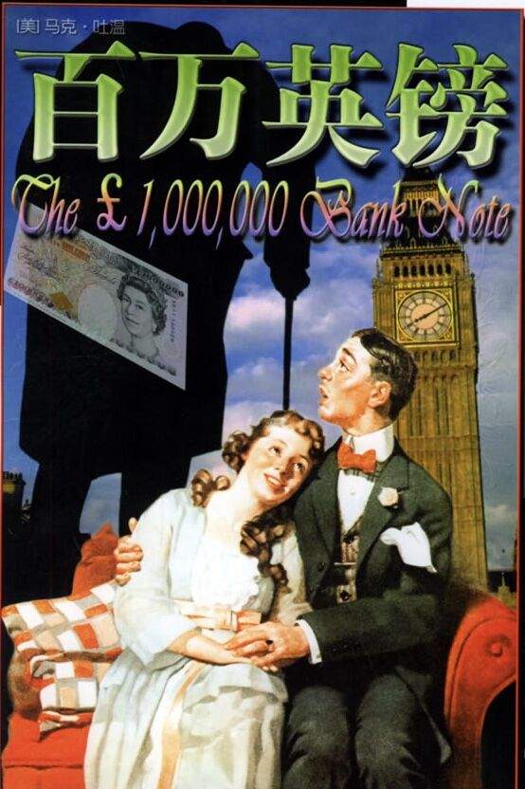
Unit 3
The Million Pound Bank Note
浙江省龙泉一中 范纯乐/潘珊珊

Slide 3

Twain =two
Mark Twain =the water is two fathoms deep
Real Name: Samuel Langhorne Clemens
Pen Name: Mark Twain

Slide 4
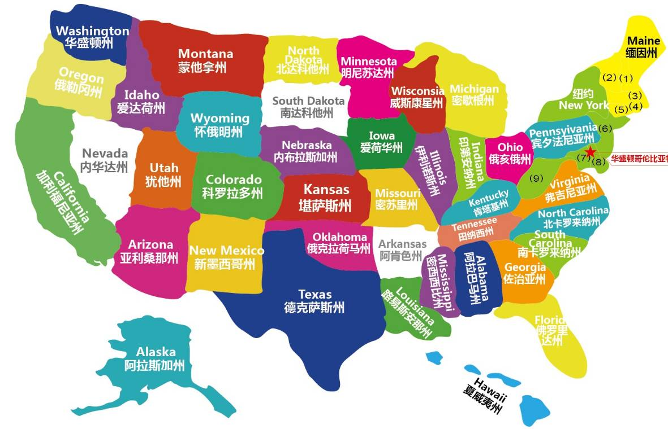

Slide 5
Inference: His various experiences provide him with abundant writing opportunities, which is of great benefit to his writing career.
2. He was brought up in
4. He worked as a reporter
1. He was born in
3. He worked as an editor
5. He worked as a correspondent

Slide 6
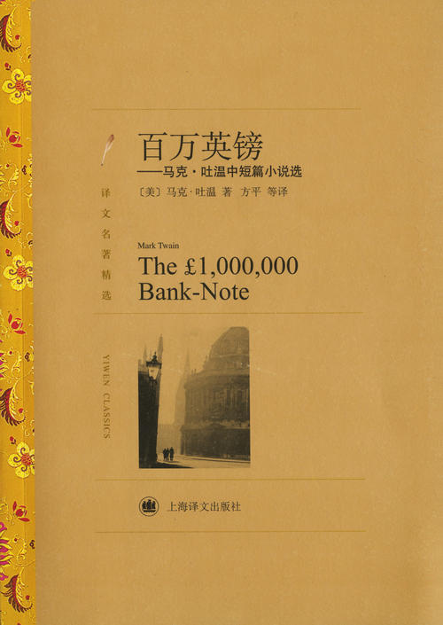
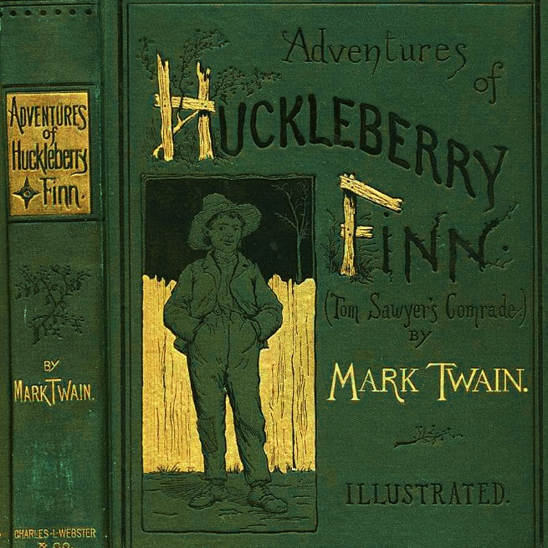
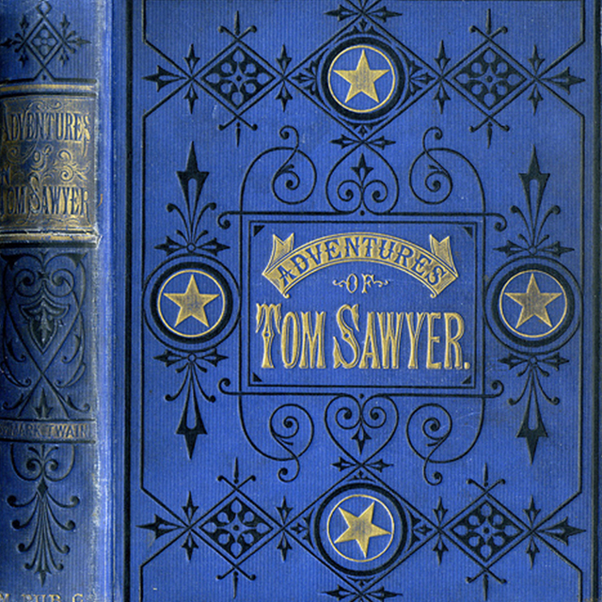
Mark Twain’s masterpieces
a play adapted from the short story

Slide 7
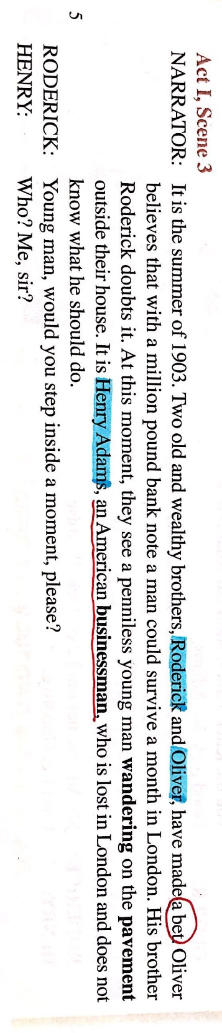
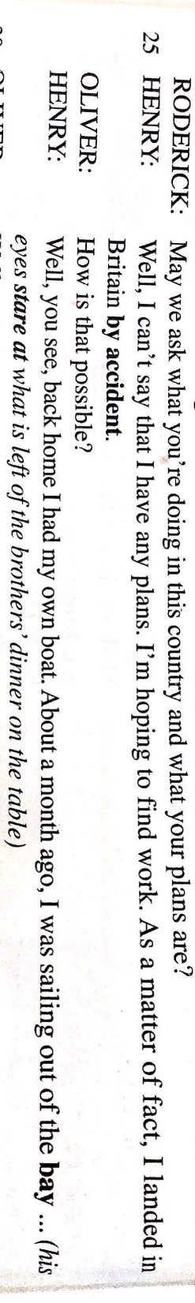
Read for Information
1.What is the writing style of this passage ?
2.Can you find something special that is different from other texts you have learnt before?
3.Can you tell some text features of the screenplay?
Act:幕
Scene:景
stage directions:舞台说明
aside:旁白
lines:台词
characters:人物

Slide 8
Read for Details
Aside:
What information can you get from the aside?
What is the trigger of the conflict?
What can we infer about Henry according to the narrator ?
The background of the play. (when, where, who,what)
The bet makes the conflict arise.
He is penniless and aimless, feeling hopeless.

Slide 9
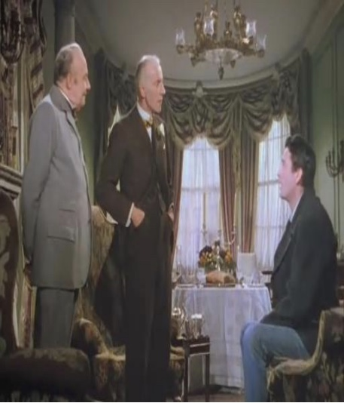
Read for Details
Read the passage carefully and answer the following questions.
1.What questions did Roderick and Oliver ask?
2.What kind of person do the two brothers want to find according to these questions?
a foreigner
a penniless man
You’re an American?
How well do you know London?
What are you doing in this country ?
What are your plans?
How is that possible?
What sort of work did you do in America?
How much money do you have?

Slide 10
Read for Details
1.Why do the two brothers choose Henry to make the bet?
It was his first visit to London so nobody knew him.
He had no money so he would have to rely on the bank
note.
...
2.What kind of person is Henry according to the passage?
honest
hardworking
polite
straightforward...
3.How do you know ? (find some supporting details)

Slide 11
RODERICK: Young man, would you step inside a moment, please?
HENRY: Who? Me, sir?
RODERICK: Yes, you.
OLIVER: Through the front door on your left.
HENRY: (A servant opens a door) Thanks.
SERVANT: Good morning, sir. Would you please come
in? Permit me to lead the way, sir.
OLIVER: (Henry enters) Thank you, James. That will be all.
RODERICK: How do you do, Mr... er...?
HENRY: Adams. Henry Adams.
OLIVER: Come and sit down, Mr. Adams.
HENRY: Thank you.
RODERICK: You're an American?
HENRY: That's right, from San Francisco.
RODERICK: How well do you know London?
HENRY: Not at all, it's my first trip here.
RODERICK: I wonder, Mr. Adams, if you'd mind us asking a few questions.
HENRY: Not at all. Go right ahead.
RODERICK: May we ask what you're doing in this country and what your plans are?
HENRY: Well, I can't say that I have any plans. I'm hoping to find work. As a matter of fact, I landed in Britain by accident. OLIVER: How is that possible?
HENRY: Well, you see, back home I had my own boat. About a month ago, I was sailing out of the bay ... (his eyes stare at what is left of the brother's dinner on table)
OLIVER: Well, go on.
HENRY: Oh, yes. Well, towards nightfall I found myself carried out to sea by a strong wind. It was all my fault. I didn't know whether I could survive until morning. The next morning I'd just about given myself up for lost when I was spotted by a ship.
OLIVER: And it was the ship that brought you to England.
HENRY: Yes. The fact is that I earned my passage by working as an unpaid hand, which accounts for my appearance. I went to the American embassy to seek help, but ... (The brothers smile at each other.)
RODERICK: Well, you mustn't worry about that. It's an advantage.
HENRY: I'm afraid I don't quite follow you, sir.
RODERICK: Tell us, Mr. Adams, what sort of work did you do in America?
HENRY: I worked for a mining company. Could you offer me some kind of work here?
RODERICK: Patience, Mr. Adams. If you don't mind, may I ask you how much money you have?
HENRY: Well, to be honest, I have none.
OLIVER: (happily) What luck! Brother, what luck! (claps his hands together)
HENRY: Well, it may seem lucky to you but not to me! On the contrary, in fact. If this is your idea of some kind of joke, I don't think it's very funny. (Henry stands up to leave) Now if you'll excuse me, I think I'll be on my way.
RODERICK: Please don't go, Mr. Adams. You mustn't think we don't care about you. Oliver, give him the letter.
OLIVER: Yes, the letter. (gets it from a desk and gives it to Henry like a gift) The letter.
HENRY: (taking it carefully) For me?
RODERICK: For you. (Henry starts to open it) Oh, no, you mustn't open it. Not yet. You can't open it until two o'clock.
HENRY: Oh, this is silly.
RODERICK: Not silly. There's money in it. (calls to the servant) James?
HENRY: Oh, no. I don't want your charity. I just want an honest job.
RODERICK: We know you're hard-working. That's why we've given you the letter. James, show Mr. Adams out.
OLIVER: Good luck, Mr. Adams.
HENRY: Well, why don't you explain what this is all
about?
RODERICK: You'll soon know. (looks at the clock) In
exactly an hour and a half.
SERVANT: This way, sir.
RODERICK: Mr. Adams, not until 2 o'clock. Promise?
HENRY: Promise. Goodbye.
honest
polite
HENRY: I worked for a mining company. Could you offer me some kind of work here?
hard working
HENRY: Well, to be honest, I have none.
direct/ straightforward...
HENRY: Well, it may seem lucky to you but not to me! On the contrary, in fact. If this is your idea of some kind of joke, I don't think it's very funny. (Henry stands up to leave) Now if you'll excuse me, I think I'll be on my way.
HENRY: Thank you.
HENRY: Not at all, it's my first trip here.
HENRY: Well, I can't say that I have any plans
HENRY: Oh, this is silly.
HENRY: Oh, no. I don't want your charity. I just want an honest job.
HENRY: Yes. The fact is that I earned my passage by working as an unpaid hand, which accounts for my appearance. I went to the American embassy to seek help, but ... (The brothers smile at each other.)

Slide 12
RODERICK: Young man, would you step inside a moment, please?
HENRY: Who? Me, sir?
RODERICK: Yes, you.
OLIVER: Through the front door on your left.
HENRY: (A servant opens a door) Thanks.
SERVANT: Good morning, sir. Would you please come
in? Permit me to lead the way, sir.
OLIVER: (Henry enters) Thank you, James. That will be all.
RODERICK: How do you do, Mr... er...?
HENRY: Adams. Henry Adams.
OLIVER: Come and sit down, Mr. Adams.
HENRY: Thank you.
RODERICK: You're an American?
HENRY: That's right, from San Francisco.
RODERICK: How well do you know London?
HENRY: Not at all, it's my first trip here.
RODERICK: I wonder, Mr. Adams, if you'd mind us asking a few questions.
HENRY: Not at all. Go right ahead.
RODERICK: May we ask what you're doing in this country and what your plans are?
HENRY: Well, I can't say that I have any plans. I'm hoping to find work. As a matter of fact, I landed in Britain by accident. OLIVER: How is that possible?
HENRY: Well, you see, back home I had my own boat. About a month ago, I was sailing out of the bay ... (his eyes stare at what is left of the brother's dinner on table)
OLIVER: Well, go on.
HENRY: Oh, yes. Well, towards nightfall I found myself carried out to sea by a strong wind. It was all my fault. I didn't know whether I could survive until morning. The next morning I'd just about given myself up for lost when I was spotted by a ship.
OLIVER: And it was the ship that brought you to England.
HENRY: Yes. The fact is that I earned my passage by working as an unpaid hand, which accounts for my appearance. I went to the American embassy to seek help, but ... (The brothers smile at each other.)
RODERICK: Well, you mustn't worry about that. It's an advantage.
HENRY: I'm afraid I don't quite follow you, sir.
RODERICK: Tell us, Mr. Adams, what sort of work did you do in America?
HENRY: I worked for a mining company. Could you offer me some kind of work here?
RODERICK: Patience, Mr. Adams. If you don't mind, may I ask you how much money you have?
HENRY: Well, to be honest, I have none.
OLIVER: (happily) What luck! Brother, what luck! (claps his hands together)
HENRY: Well, it may seem lucky to you but not to me! On the contrary, in fact. If this is your idea of some kind of joke, I don't think it's very funny. (Henry stands up to leave) Now if you'll excuse me, I think I'll be on my way.
RODERICK: Please don't go, Mr. Adams. You mustn't think we don't care about you. Oliver, give him the letter.
OLIVER: Yes, the letter. (gets it from a desk and gives it to Henry like a gift) The letter.
HENRY: (taking it carefully) For me?
RODERICK: For you. (Henry starts to open it) Oh, no, you mustn't open it. Not yet. You can't open it until two o'clock.
HENRY: Oh, this is silly.
RODERICK: Not silly. There's money in it. (calls to the servant) James?
HENRY: Oh, no. I don't want your charity. I just want an honest job.
RODERICK: We know you're hard-working. That's why we've given you the letter. James, show Mr. Adams out.
OLIVER: Good luck, Mr. Adams.
HENRY: Well, why don't you explain what this is all
about?
RODERICK: You'll soon know. (looks at the clock) In
exactly an hour and a half.
SERVANT: This way, sir.
RODERICK: Mr. Adams, not until 2 o'clock. Promise?
HENRY: Promise. Goodbye.
RODERICK: Young man, would you step inside a moment, please?
HENRY: Who? Me, sir?
puzzled/curious
RODERICK: Tell us, Mr. Adams, what sort of work did you do in America?
HENRY: I worked for a mining company. Could you offer me some kind of work here?
hopeful
angry/annoyed
HENRY: Well, it may seem lucky to you but not to me! On the contrary, in fact. If this is your idea of some kind of joke, I don't think it's very funny. (Henry stands up to leave) Now if you'll excuse me, I think I'll be on my way.
Henry's feelings changed as the story developed. What does he say or do? How does he feel?
unhappy/irritated
OLIVER: Good luck, Mr. Adams.
HENRY: Well, why don't you explain what this is all
about?
interested/curious
RODERICK: Mr. Adams, not until 2 o'clock. Promise?
HENRY: Promise. Goodbye.

Slide 13
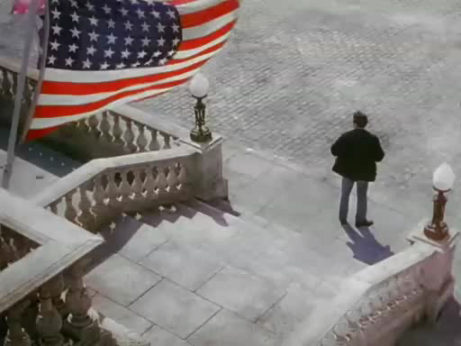
Read for Plot
Enjoy the video.

Slide 14
Read for Plot
Change the play into a story with the following information.
The elements of a story
When: in the summer of 1903
Where:in London
Who : Henry, Roderick&Oliver
What: wander round the street, be carried out to...,
be spotted by...,earned his passage...
Why : make a bet
How: give him a letter

Slide 15
Read for Plot
Continuation Writing:
Suppose that you are invited to write a short story of Scene 4. Can you predict what would happen to Henry with a million pound bank note ? ( 150 words)
Para.1:
Outside a restaurant Henry looked at the envelope without opening it and decided to go in.________________________ __________________________________________________
__________________________________________________
__________________________________________________
Para.2:
When the clock struck two, he opened the letter,surprised to find it was a million pound bank note.____________________ __________________________________________________
What would happen at the restaurant? What kind of
food would Henry order?
How was Henry treated at first?
How was he treated after he opened the envelope?

Slide 16
Possible version:
Para.1:
Outside a restaurant Henry looked at the envelope without opening it and decided to go in. He strutted inside and directly sat down at the table next to the front window. Observing poor Henry from head to toe,the owner asked the waiter to take him to the corner and take his order. Hardly wait to eat, he ordered some ham, eggs and a big steak together with a large glass of beer. Then the waiter left and soon returned with all the food. Eating like a wolf, Henry asked for more of the same. The owner and the waiter hesitated but served the food eventually. After the meal, they urged Henry to pay the bill, but Henry still needed to wait for a while.
Para.2:
When the clock struck two, he opened the letter, surprised to find it was a million pound bank note. The owner and the waiter were shocked but not sure whether it was genuine. They couldn't believe Henry who was in rages could be so rich. After the note was proved to be real,the owner thanked Henry again and again for his coming to his little eating place and even asked Henry to forget the bill. As Henry left,the owner, the hostess and the waiter all bowed together.

Slide 17
Assignment:
Choose one of them according to your own level.
LevelA:Try to act the play out by imitating the pronunciation and intonation of the character.
LevelB:Write and polish the story.

