Slide 1

感恩遇见，相互成就，本课件资料仅供您个人参考、教学使用，严禁自行在网络传播，违者依知识产权法追究法律责任。
更多教学资源请关注
公众号：溯恩高中英语
知识产权声明

Slide 2
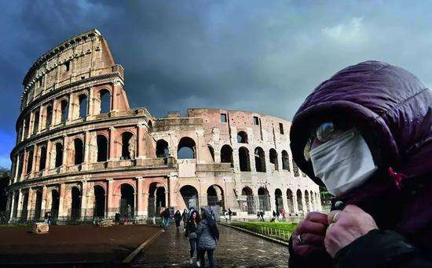
A letter of comfort
台州市第一中学 周 媚
台州市第一中学 陈泓静

Slide 3



Definition
A letter of comfort is a sign of concern that one shows to the reader. The letter should be having your sincere wishes and deep concern about the reader.
While writing, the stress should be laid on the positive side, not the disease, you should make the person believe that with his own will power and others’ help and comfort, he could defeat the bad situation.
You should end your letter reassuring (使 …安心) the reader that you really care about him and send him your best wishes.

Slide 4

1. 表示关心和同情。
2. 进行安慰提供帮助。
3. 表达愿望和祝福。

Slide 5
Dear Friend,
I just heard from Aunt Jackie that you have been under the weather with the flu for the past week, and I wanted to let you know how sorry I am to hear this. I hope you get completely well very soon and that you will rest as much as possible in the meantime. Also, please let me know if you need anything, such as if you need me to run errands(跑腿) or go to the grocery store for you. I can also come over and cook meals for you or do anything you need me to do. I will be very happy to help in any way I can.
Please give me a call to let me know what I can do to help. In the meantime, take good care of yourself. You are in my daily thoughts and prayers.
Sincerely,
Jack
concern
wishes
help
help
help
wishes

Slide 6
Dear Adam,
I am very sorry to hear that you have had to be hospitalized due to a ruptured appendix(阑尾破裂). It must be quite a harrowing(悲痛的) experience for you, and my heart goes out to you and your family in this difficult time.
I understand that hospitals are not the most fun of places, but I have heard great things about the Haley Medical Hospital, and I am sure you are well looked after. However, a hospital is a hospital; people at the oddest of hours may visit you, and the food is probably not as great as you would like it to be. But the good thing is that you are on the road to recovery and will be home very soon.
While you have been away, all of us at the office have missed you immensely. Work is not as much fun as it was with you and we are all praying hard for you to recover fully and return to work soon. I understand that you may not be entirely up to visitors so I will call before I visit you to find out what time is suitable.
Please let me know if there is anything I can do to help you while you are indisposed(不舒服). I will be happy to be of any assistance.
Get well soon!
Sincerely yours,
James
sympathy/concern
comfort
comfort
help
wishes

Slide 7
假定你是高三学生李华，你的同学王平去意大利探亲因新型冠状病毒肺炎疫情迅速扩散，他有发热症状而暂时滞留意大利。高考在即，请你代表全班同学给此时处于焦虑和担心中的他写一封英文慰问信。要点如下：
1. 对其表示关心和同情。 2. 对其表示安慰并提供帮助。
3. 表达愿望和祝福。
参考词汇： 意大利：Italy
人称： I/we
Dear Wang Ping,
Para 1: explain the situation & show your concern and sympathy
Para 2: convey your comfort/encouragement
& offer practical help
Para 3: express your sincere wishes
Yours truly,
Li Hua
study
health

Slide 8


Words and expressions
关心
1. I’m writing to express my sincere concern(n.) about ...
2. All of us are concerned(adj.) about ...
3. It concerns(v.) us a lot that…
同情
1. have/show sympathy for…
2. convey one’s sympathy to sb. …
3. Please accept my deepest sympathy.
be sympathetic to：sympathize with
帮助
1. If you want me to do anything for you, do not hesitate to let me know.
2. If I can be of any assistance to you, contact me at once.
3. I would be delighted to do you a favor to the best of my ability.
4. We won’t be far away if you need any help.
5. Feel free to turn to us no matter how difficult it is.
6. We are eager to give you a hand in any way we can.

Slide 9


Beginning: concern and sympathy
1. I am (deeply) sorry /shocked /sad/upset to hear that...
2. I totally couldn’t believe that...
3. It’s a profound shock to hear the tragic news that…
4. Knowing your situation, I feel terribly upset/sorry about...
5. Learning /Knowing that... I am writing to express my deepest sympathy/care/concern to you.

Slide 10

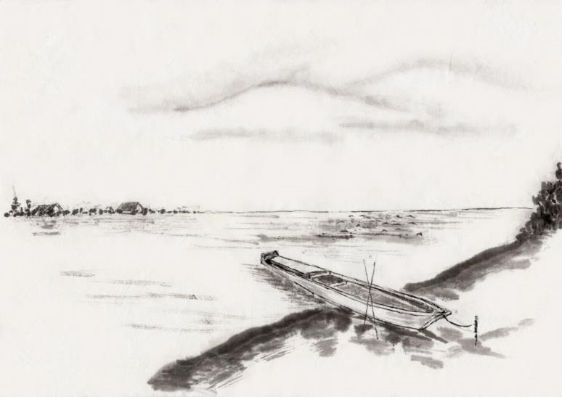
Learning that you are trapped in Italy because you are feverish, where the epidemic is very serious. On behalf of our class, I’d like to convey our heartfelt care and concern to you. （吴毅航，陈柯烨 ）
Knowing that you have been stuck in Italy due to the fever while the epidemic is spreading over the world rapidly, I’m writing to express the sincerest concern to you on behalf of the whole class. （杨易铮/余定睿 ）
Knowing that during your visit to Italy/ your stay in Italy , you’ve caught /had a fever, where the coronavirus has just made its way around. Now I’m writing to show my cordial sympathy and concern to you on behalf of the whole class.（陈杰）

Slide 11


Body: comfort/encouragement & help
In fact, everyone will have one of those terrible experiences while your situation isn’t as bad as you think at all.
I can imagine how difficult it must be for you, and I want to let you know you have my full support.
Thinking about your present situation, we cannot wait a minute to make every bit of our effort to help you.

Slide 12

1. However, don’t be too anxious about your fever since the whole world has _______________________ _____________________ (不遗余力) keep the virus under control , and it’s not the only symptom of the COVID-19. Probably you have just caught a cold. （徐煜衡）
spared no effort to /
made every effort to
around the corner/approaching
2. College Entrance Exam _________________________________ _______________(临近), we all understand your deep________（anxious）. However, don’t worry too much, for we can give you make-up lessons online. (王易知)
/drawing near
anxiety
arrival
3. Your suspended _______ (arrive) won’t influence your study as we are all willing to offer dedicate help. (牟城昊)

Slide 13


4. Virus and distance won’t separate our hearts, so never feel lonely and depressed since we will _______________________________________ (陪你一起) all the time. (杨易铮)
keep you company /
accompany you
hold a firm/strong belief
5. Please __________________________(保持坚定的信念)that you can overcome all the difficulties instead of being __________(secure)or depressed, for modern medicine will surely help you recover. (吴凌龙)
insecure
6. _____________________________(保持积极的态度)is also a powerful form of therapy.
Keeping a positive attitude
7. It‘s true that __________________________________________
(态度决定一切). So you should never give up no matter what happens.
attitude decides/determines everything

Slide 14

Ending: wishes
We hope you will have a swift/speedy and complete recovery.
Hopefully, you can get through the difficulty and make a full recovery soon.
I am convinced that you will recover soon and embrace a happy life again.
We are praying for you every day, hoping you will get well/ be back to your feet soon.
We are looking forward to your return.
Your return is highly expected.
I would like to send you our best wishes.
Words fail to convey our heartfelt wishes to you.
I am crossing my fingers for you.

Slide 15

Dear Wang Ping,
Hearing the news you ___________________(trap)in Italy with high temperature, our hearts sink and we are _______________ (concern)about your safety.
Owing to the fact _______ virus attacks Italy critically at ___ rapid speed, it’s of great _______________(significant) that you should take considerate care of ________（you ) and let go of anxiety. As somebody _______(put)it, “ Body is the capital of revolution.” Meanwhile, it’s appropriate __________(review)the text comprehensively and make an adequate preparation ______
the coming entrance exam. We are with great pleasure to offer instant assistance. ________________, don’t hesitate to call us when you need help.
Our heartfelt thoughts and prayers are always with you. May you have a quick recovery.
Yours sincerely,
Li Hua
have been trapped
concerned
that
a
significance
yourself
puts
to review
for
Therefore/Thus

Slide 16

Dear Wang Ping,
Knowing that you are delayed in Italy, I am really getting upset about it. So are our classmates. I'm writing to convey our concern to you on behalf of the class.
Word came that Italy is in bad condition due to the spreading COVID-19. However, dear friend, there's no sense worrying about it too much. You are supposed to stay optimistic. After all, you merely have a bit of fever. College Entrance Examination is around the corner, you know. So precious is time that we can't afford to waste it. As scheduled, our online classes are held regularly. All of the classmates have access to the Internet courses wherever you are. It is convenient for us to study, isn't it?
Is there anything I can do for you? Feel free to contact me. I sincerely expect that you can make a quick recovery and return to normal.
Yours,
Li Hua

Slide 17



Thank You:)
Designed By Ryan

