Slide 1

感恩遇见，相互成就，本课件资料仅供您个人参考、教学使用，严禁自行在网络传播，违者依知识产权法追究法律责任。
更多教学资源请关注
公众号：溯恩高中英语
知识产权声明

Slide 2
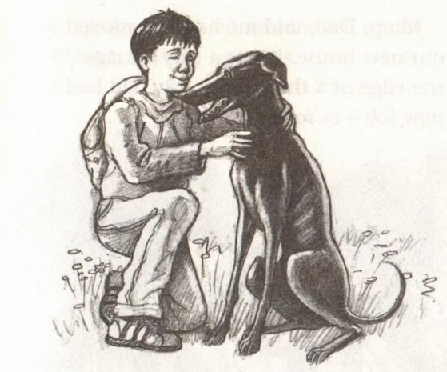
Black Dan

Slide 3
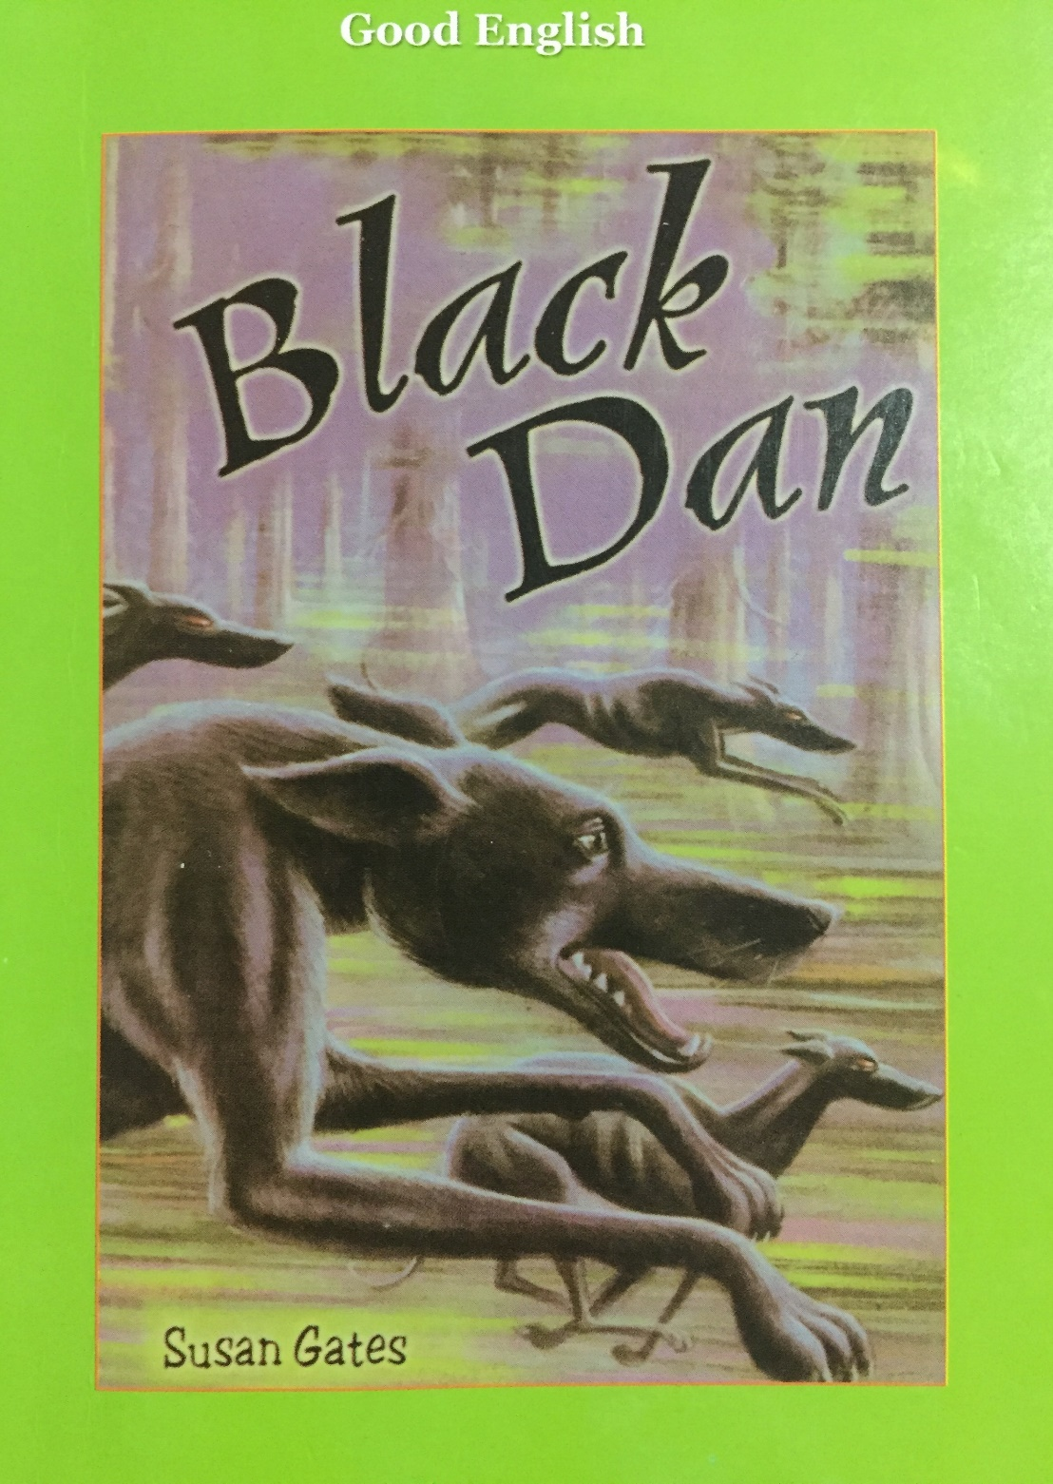
The writer:
Susan Gates (English)
Susan Gates is best known as the author of children’s books, like Dangerous Trainers, Waiting for Goldie, Black Dan, The Wolf Cupboard, Viridian, etc. She has won the Sheffield Book Award(谢菲尔德图书奖) and been short-listed for both the Carnegie Medal(卡内基奖章) and the Guardian Children’s Fiction Prize(卫报儿童小说奖).

Slide 4
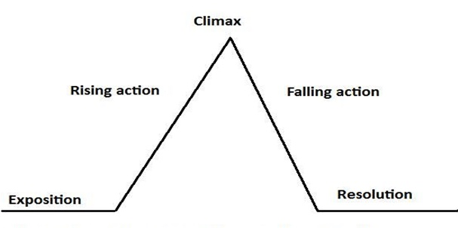
Plot analysis
Chapter1 Black Dan the Seventh
Chapter2 Fiery eyes
Chapter3 That dog should be dead
Chapter4 The howling
Chapter5 Surrounded
Chapter6 The old mine
Chapter7 In the forest
Chapter5
Chapter234
Chapter6
Chapter1
plot
Chapter7

Slide 5
Exposition
main characters
Chapter1 Black Dan the Seventh
setting
In the forest
Stevie
Black Dan
keep
Dad replaced Old Billy to become a forest warden.
Get rid of…
Old Billy
In an old folk’s home

Slide 6
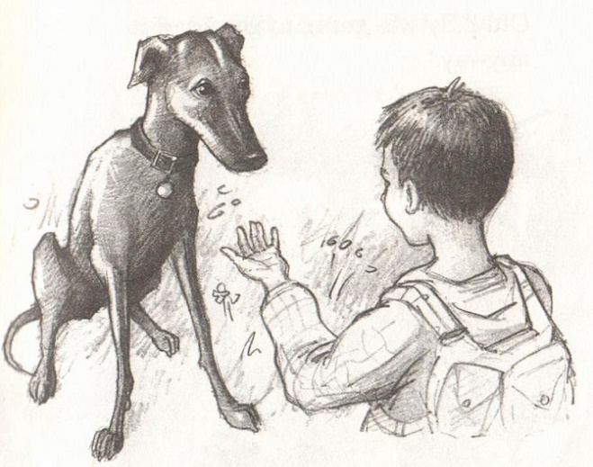
Exposition
Chapter1 Black Dan the Seventh
—main characters/setting
/suspense
Why does the writer mention “he trembled all over”, “The dog trembled” ?
Set a suspense/The beginning of the conflict.
indifferent
What can you infer from the following sentences:
The forester shrugged. “Well, I don’t know who else will want it. It’s past its best. It’s not winning races any more. Old Billy was going to get rid of it anyway.”
…
“Dad, Dad,” I pleaded. I tugged at his arm. “I want this dog.
I really, badly, want him.”
cruel
kind/sympathetic
Bring out people’s characters by contrast.

Slide 7
Rising action
Chapter2 Fiery eyes
more suspense
What did Stevie hear and see?
What did Dan react when hearing the howling?
Heard: (Weird noises) | Trees creaked/rustled/groaned Owl hooted Dogs howled: terrible, lonely, creepy
Saw | Dan’s unusual action Six red, fiery eyes
He went crazy.
His paws were raking at the wood. He was desperate to get out there…
Then shivered and whimpered in my arms.

Slide 8
Rising action
Chapter3 That dog should be dead
cruel
more suspense
What did the forester tell Stevie?
What did Stevie say to Dan ?
Then he laughed, a cruel sort of laugh. “He had a lucky escape, that dog,” he said. “The very day he was rushed to hospital, Old Billy was going to get rid of him.”
“What, you mean give him away?”
Six Black Dans were poisoned by Old Billy because they couldn’t win the race.
innocent
treat Dan
as a friend
“Don’t worry,” I said to my Black Dan. “You’re alive. Old Billy didn’t take you into the forest. And now you’re mine.”
comfort
Bring out people’s characters through what they do or say.

Slide 9
Rising action
Chapter3 The howling
more suspense
What was the howling like?
What did Black Dan do when hearing the howling?
It was such a dreary, lonesome sound. Like the end of the world had come.
simile
Howled back
Nosed the door open
Shot down the stairs
Flew past me like an arrow
Headed straight for the forest
Vanished into the trees
specific verbs
&
simile
Illustrate a vivid scene by rhetorical devices and specific verbs.

Slide 10
Climax
Chapter5 Surrounded
Why did Stevie go out to look for Black Dan?
What did he hear in the pitch black?
How did Stevie do when surrounded?
Of course I didn’t have a choice, did I? I had to go looking for him. I had to go after my dog.
reliable responsible
I could hear my own breathing. It sounded really loud.
Click, click, click. It was my teeth, chattering.
onomatopoeia
scared
I was frozen up — I couldn’t move. But my mind was suddenly clear as an ice cube.
helpless
contrast
simile
I was shaking like I had rubber bones. But I got some strength from somewhere. I shouted into the dark.
brave
You can’t outrun greyhounds. But I ran anyway, bashing into bushes, falling down, staggering to my feet, running on.
Illustrate a vivid scene by rhetorical devices.

Slide 11
Falling action
Chapter6 The old mine
Why did Stevie get into the old min? Was it a safe place?
How did Black Dan save Stevie?
What happened to the ghost dogs at last?
onomatopoeia
Then, clang, I crashed into an iron grill. “Get in!” my brain screamed at me. “Hide! Hide! Get inside!”
But Dad once told him it was a death-trap, for there were many shafts.
repetition
He dragged Stevie back, stopping him from falling down the shaft. Also, Dan stood by his side, barking to the ghost dogs, scaring them off.
Black Dan:
faithful, brave
metaphor
simile
They sort of shrivelled away. Their burning eyes shrunk to red pinpricks. Then they just vanished, like genies sucked back into a bottle.
Illustrate a vivid scene by rhetorical devices.

Slide 12
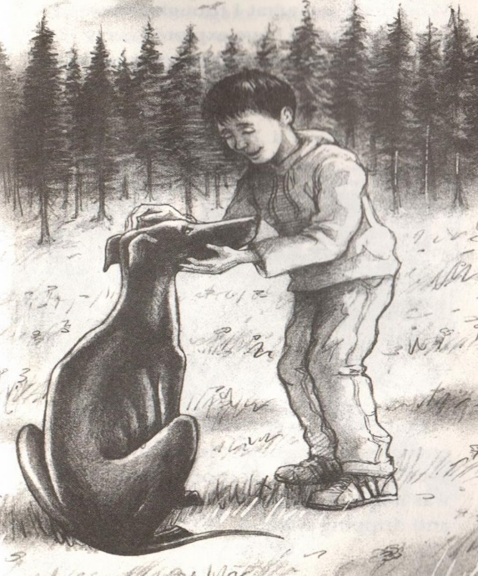
Resolution
Chapter7 In the forest
What did Stevie do when he found Black Dan heading towards the forest?
What was the forest like?
He went after him, hobbling as fast as he could, crashing through branches, calling his name, …
onomatopoeia
peaceful,
pleasant
personification
Little birds were twittering. Sunlight was dancing all around us. It felt like our forest.
enjoy themselves
Create a pleasant atmosphere through surroundings.

Slide 13
Theme analysis
Why do you think Black Dan headed for the forest?
Did parents know what happened?
It is likely that he wanted to check whether it was safe for Stevie. Or maybe he wondered whether the ghost dogs were still waiting for him.
Probably they didn’t know, because Stevie never told them.
Do you think the ghost dogs were real?
It doesn’t matter whether the ghost dogs were real or not. The author just wants to show us a kind boy and a faithful dog helped each other to overcome the great panic with their bravery.

Slide 14
Language appreciation
How to create a frightening atmosphere?
Sight
Hearing
I could see red eyes and black greyhound shapes, creeping up on me.
I saw something, black at the mine entrance….There were red eyes, burning in the darkness.
I crouched there, watching their red eyes come nearer, nearer.
I could see their slinky shapes, blacker than blackness, sliding down the tunnel towards me.
They came rushing in – eyes blazing, teeth snapping.
Terrible, lonely howls like children lost in the night and crying for their mother. (simile)
It was such a dreary/creepy, lonesome sound. Like the end of the world had come.(simile)
Click, click, click. It was my teeth, chattering.(onomatopoeia)
I couldn’t hear anything. Except my own heart thudding away. And the drip, drip, drip of water on the mine walls.(onomatopoeia)

Slide 15
Language appreciation
How to create a frightening atmosphere?
Feeling
Surroundings
I could feel the hairs on my neck doing Mexican waves.
My spine felt like one big icicle.(simile)
I could feel my skin crawling.
I could feel its teeth, tagging at my jeans.
Straight away, my stomach clenched up tight.
The forest was like a dark, wild wood .(simile)
Crunch, crunch. That was pine needles under my feet.(onomatopoeia)
It was pitch dark inside.

Slide 16
Language appreciation
What did Stevie and Black Dan do when feeling scared?
He was curled up on my rug, trembling in his sleep.
Black Dan’s ears started twitching like mad. Suddenly, his eyes shot open. He leaped up and ran to the bedroom door. He began scratching at it, frantic to get out. He was making little yelping noises.
I grabbed him. He struggled a bit. Then shivered and whimpered in my arms.
Black Dan trembled and huddled up close to me.
But I ran anyway, bashing into bushes, falling down, staggering to my feet, running on.
Panic took over. I just ran like a hunted animal. (simile)
I crawled the other way, scrabbling at the rocks with my hand. Then suddenly, my hands were clutching at thin air!
I rolled into a ball like a hedgehog and covered my head with my hands.

Slide 17
Practice
Choose one of the topic to write a short passage to describe what you would see, hear or think and how you would feel if you were in such a situation.
1. It was pitch dark one night and you happened to be in a forest alone. When you were controlled by panic you saw dim light in the distance.
2. One afternoon, you stayed home alone. There was a sudden power failure when a rainstorm came. You felt so scared that you didn’t know what to do.

Slide 18
One possible version
1. It was pitch dark one night and you happened to be in a forest alone. When you were controlled by panic you saw dim light in the distance.
It was pitch dark in the forest. Hearing the weird noises, I felt my skin crawling. The wind howled around trees, like children lost in the night and crying for their mother. Click, click, click. It was my teeth, chattering. Suddenly, I saw a beam of light glowing in the distance. I went rushing towards it. Then I jammed on the brakes. My spine felt like a big icicle when I figured out what it was. Without thinking, I ran like a hunted animal, bashing into bushes, falling down, staggering to my feet and running on.

Slide 19
One possible version
2. One afternoon, you stayed home alone. There was a sudden power failure when a rainstorm came. You felt so scared that you didn’t know what to do.
There was a sudden power failure. I parted my bedroom curtains a tiny crack. It was darker than darkness outside. The lightning was flashing in the sky while the thunder was roaring, which made me feel sick and shivery. I yanked the curtains shut, curled up on the bed. However, it couldn’t prevent panic creeping into my bones. Straight away, my stomach clenched up tight. My brain was like a scribble. Before I could think straight, the door was pushed open. Seeing Mom coming back, I sobbed with relief.

Slide 20
Thank you!

