Slide 1


感恩遇见，相互成就，本课件资料仅供您个人参考、教学使用，严禁自行在网络传播，违者依知识产权法追究法律责任。
更多教学资源请关注
公众号：溯恩高中英语
知识产权声明

Slide 2
Share love with you！
嵊州市高级中学 尹 娟

Slide 3







Say hello!
01
Give a nod of greeting!
02
How do you greet
your teachers?
Smile!
03
Give a hug!
04

Slide 4
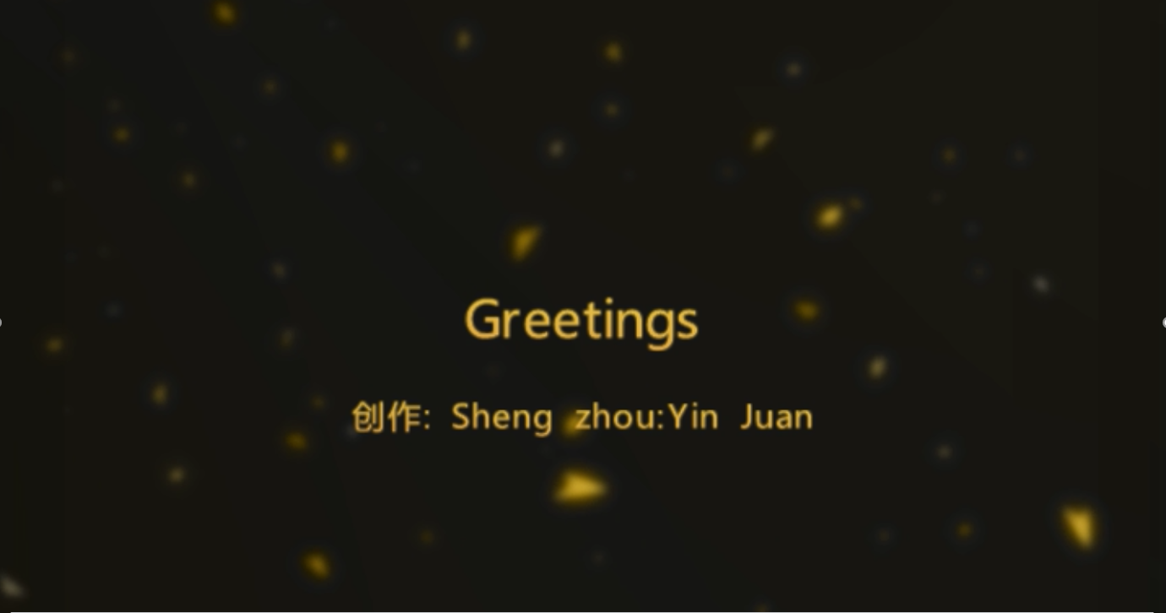
Greetingg视频

Slide 5


has a gift of memory & enthusiasm.
is “called to teach”.
experiences lots of stories...
A teacher

Slide 6
Para1
Q: What is the author’s opinion about teachers?
(What can teachers do?)
a
can “see” into student’s future
b
can predict success
Teachers
1
have a gift of sight
2
have a gift of touch
Greater

Slide 7
Para2:
The background information about the author.
in the fifties
When
in a poor African American neighborhood
Where
Background
information
no elementary school;
at our parents' insistence
Why
I & Ms Victoria Hunter
Who
How
?

Slide 8
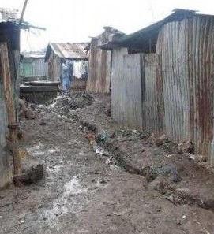
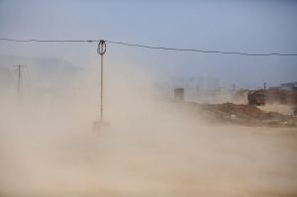
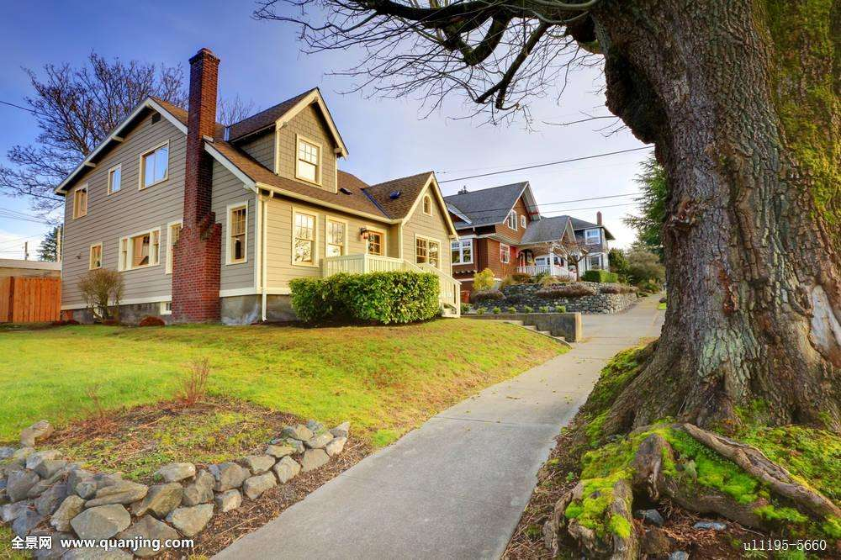
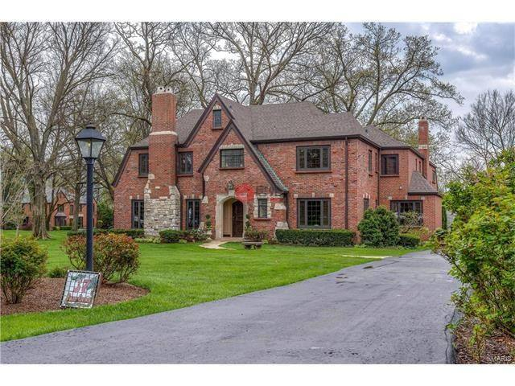
a poor African American neighborhood
Fair Oaks Elementary School

Slide 9
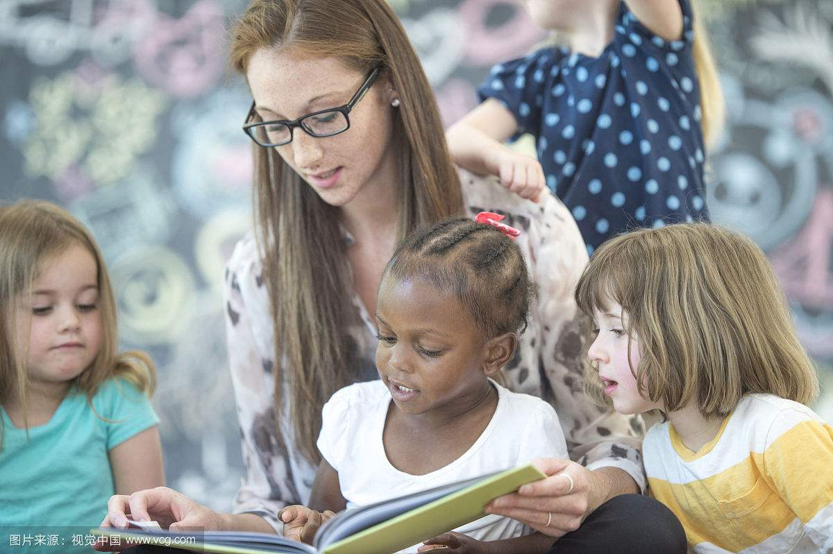
had a huge influence on my life
It was at Fair Oaks, in a sixth grade English class, that I met Ms. Victoria Hunter.

Slide 10
Para3
Q: What did Ms. Hunter do during reading periods?
walk around
During reading periods, she would _____________ the room, ________ our desks,____________ us for a second or two, and then _________ us. Without _______ anything to us (nothing could break the silence of reading periods), she would _______ two fingers lightly on our throats and _________ them there for seconds.
Teachers touch the throat of students to check for sub-vocalization (默读), which slows down the reading speed.
stop at
stand over
touch
saying
place
responsible
experienced
hold

Slide 11
Para3
Q: What did the author do at that time?
During silent reading period, ______________________________. I _____________ the material I was reading and _________ her to place her fingers lightly on my throat.
I did what Ms. Hunter told us to do
kept my eyes on
serious
respectful
curious
waited for

Slide 12
Para4
Read para4 and find out what the author did and thought.
raise to see
observation
One day
confused
I was confused
Do & think
reflection
sit up straighter
Several days later
adjustment
watch again
?
Do & think
raise my head higher
improvement
mystery

Slide 13
The understanding of the mystery of touch.
Para5
Q: What did Ms Hunter touch the author with?
Why did Ms Hunter touch the author ?
with her hands
my throat
touch
with her belief
my heart
demand the best
motivate
let teachers know
I am convinced that she touched me because she could “see” me in the future.

Slide 14
Para5-6
Q: What miracles did the touch create?
Be the best student
Earn graduate degree in...
Earn a Ph.D
01
03
05
miracles
......
02
04
Finish at the top of
Study at Stanford University

Slide 15

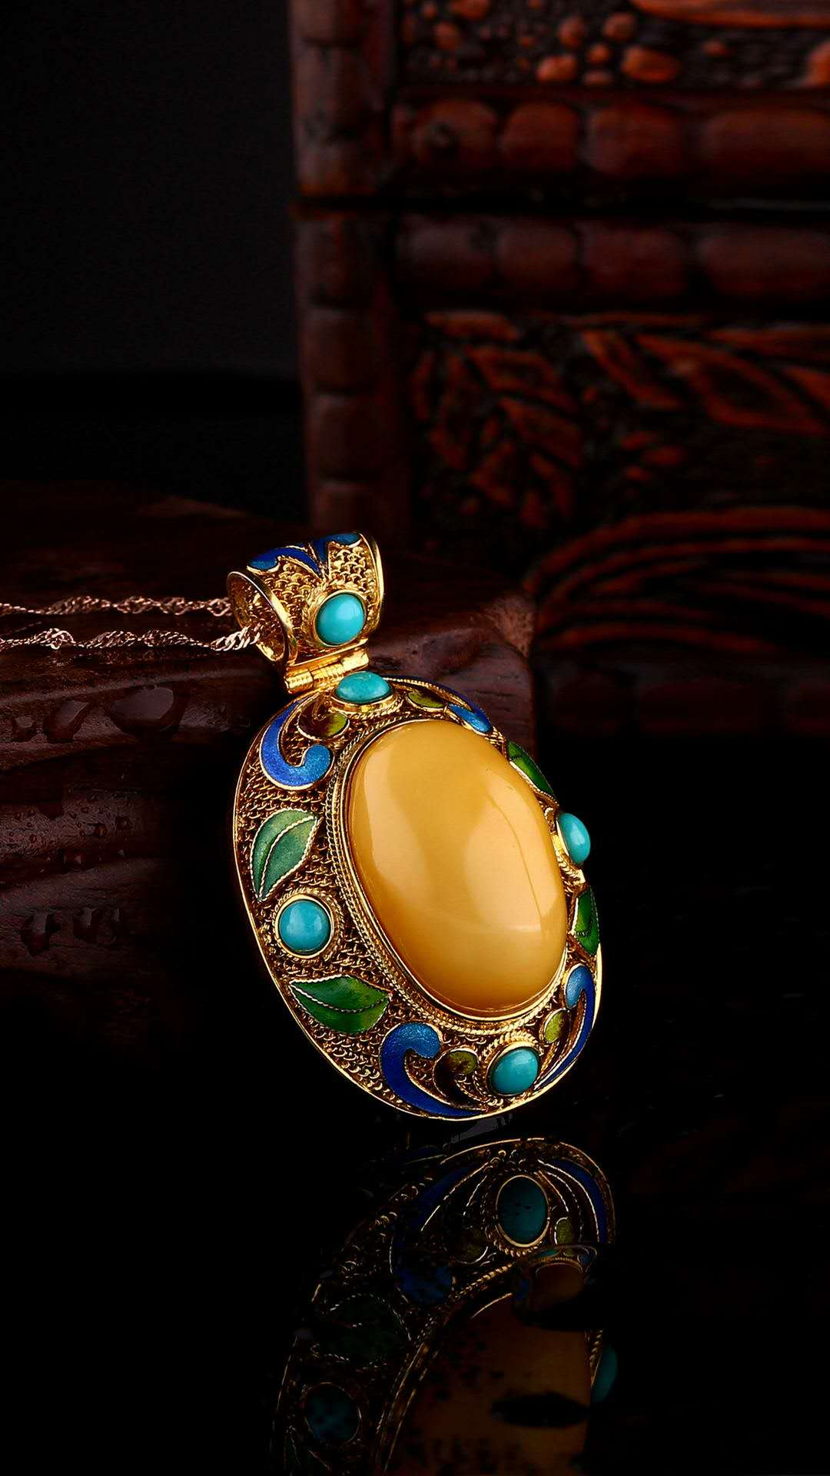
Para6
Q: What did the author receive from Ms. Hunter?
What did it refer to?
touch
love
inspiration
motivation
encouragement

Slide 16

Can you give an appropriate title?
has a gift of touch
has a huge influence on my life
2
3
's touch
4
I am convinced that she touched me because she could “see” me in the future.
1
A teacher
Her touch creates my miracles.

Slide 17
Further thinking
Discuss with your classmates and talk about a teacher that influences you most.

Slide 18
Thank you!

