Slide 1
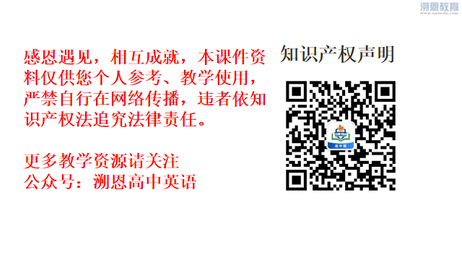

Slide 2
Extra Good Luck
嵊州市高级中学 尹娟

Slide 3

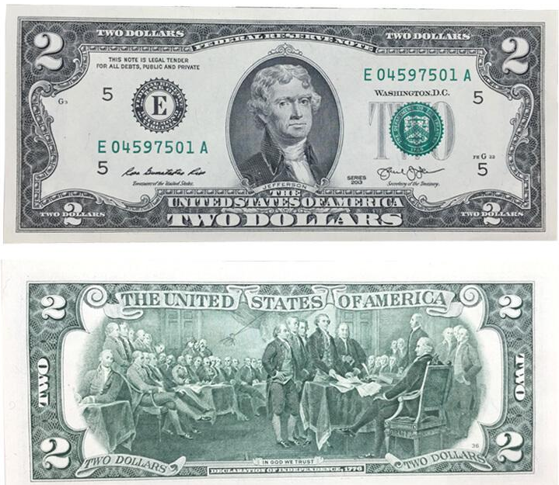

Extra Good Luck

Slide 4
Background Information (Para 1-3)
When
Who
Why
...
Try to figure out the elements of the story & get the background information.
What
How

Slide 5
Background Information (Para 1-3)
Each time I felt I had a crisis on my hands, I would reach for my two dollar bill and set it on the table. I would stare at it for several hours and could always come up with a solution.
courage
wisdom
power
patience
persistence

Slide 6
Detailed Information (Para 4)
Question
Did the author have advantages over the other applicants for applying for the job?
The author
VS
The other applicants

Slide 7
Detailed Information (Para 4)
The author
VS
The other applicants
advantage in age
inexperience
were younger
applied for my first job
elegance in appearance
shortcoming in age
were very well dressed
was thirty years old
was impeccable in
introverted personality
perfection
was very shy
The thought of being interviewed for a job was scary...
better experience
inner hesitation
better qualified
abundant qualification
the length of their resumes
disadvantages
VS
advantages
Analyse the detailed information and make contrast if necessary.

Slide 8
Detailed Information (Para 5)
Question
What makes the auhor feel she is qualified for the job?
honest & sincere
value every chance
I really needs this job and there is nothing I cannot do.
As I exited her office, I turned around and said...
confident
confident
I learn quickly and can be a very productive member of the team.
promising
I thanked her and went home ...
polite
Read between lines & analyse the implied meaning.
Tomorrow would be another day.
optimistic

Slide 9
Prediction (Para 6)
That evening as I was getting ready for bed, I received a phone call from Mrs. Martin.
that evening
Character
Time
I & Mrs. Martin
Tense
in Gina's house/
on the phone
simple past
Result/Logical development
Place
she succeeded.

Slide 10
Prediction (Para 6)
Character coherence
1
(协调性,一致性)
Time coherence
2
Tense coherence
3
4
Place coherence
Pay special attention to the various coherence of the passage.
5
Logical/Theme coherence

Slide 11
Appreciation (Para 6)
That evening as I was getting ready for bed, I received a phone call from Mrs. Martin. “Gina,” she said, “you were not the most qualified applicant, but you have so much confidence in yourself that we decided to give you a chance to prove yourself.” I screamed out loud, jumping all over the room in disbelief. I could hear Mrs. Martin laughing in the background and suddenly I realized that Mrs. Martin was still on the line. “Thank you Mrs. Martin, you will not regret this decision,” I said and hung up the phone.
Questions
Beth got excited, and skipped and sang with joy.
Chills run up and down my spin.
Waves of electricity wash over my body.
He pumped up for the exciting news.
Jane looks like she was on cloud nine.
I’m really stoked that they chose me for the team.
What was the result ?
How did Gina feel about the result ?
How can we describe “excited” besides “scream out loud, jumping…”
excited
surprised
polite
Try to show rather than tell when trying to describe something.
confident

Slide 12
Prediction & Discussion (Para 7)
I got my wallet and took out my two dollar bill.
Character coherence
1
Time coherence
2
Place coherence
3
4
Tense coherence
Logical/Theme coherence
5
What extra good luck did mother give to her?

Slide 13
Prediction & Discussion (Para 7)
Discussion
Logical/Theme coherence
What extra good luck did mother give to her?
confidence
patience
courage
honesty
wisdom
power
persistence
optimism

Slide 14
Conclusion & thinking
Try to show rather than tell when trying to describe something.
Pay special attention to the various coherence of the passage.
Read between lines & analyse the implied meaning.
Analyse the detailed information and make contrast if necessary.
Try to figure out the elements of the story & get the background information.

Slide 15
Homework (Writing)
Try to continue the story with the given sentence and make a logical end.

Slide 16
THANKS

