Slide 1

感恩遇见，相互成就，本课件资料仅供您个人参考、教学使用，严禁自行在网络传播，违者依知识产权法追究法律责任。
更多教学资源请关注
公众号：溯恩高中英语
知识产权声明

Slide 2

写作微技能
The Power of Dash
破折号的妙用
浙江省常山县第一中学
洪 笑 英

Slide 3
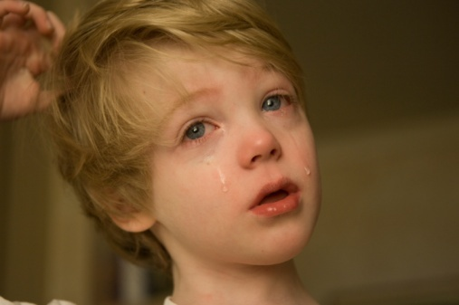
vocabulary
The boy was weeping.
01
Polish language
grammar
Polish language
Having failed the exam, the boy
was weeping sadly.
02
03
special sentence pattern
It was his failure in the exam that made the boy weeping sadly.
04
punctuation 标点符号
The boy was weeping sadly — he failed the exam again.

Slide 4

01
Functions

Slide 5
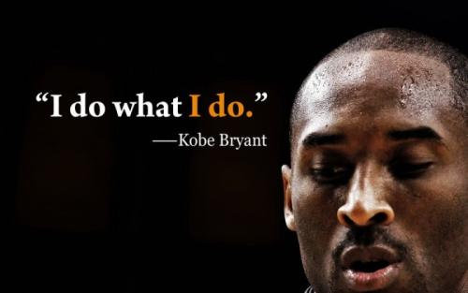
*1. 附加解释说明 ； * 2. 表示说话者态度和观点； * 3. 表特别强调； * 4. 列举分类事项； *5. 总结分类事项
Everything negative— pressure, challenges— is all an opportunity for me to rise.
such as

Slide 6
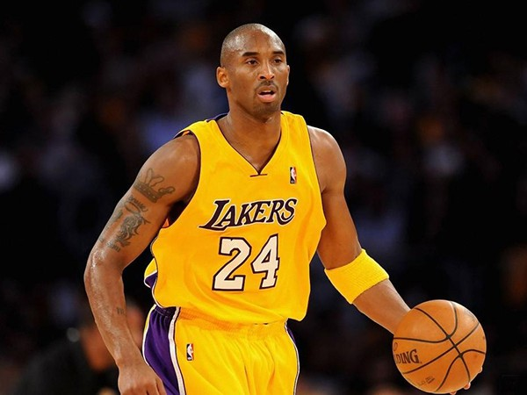
*1. 附加解释说明 ； * 2. 表示说话者态度和观点； * 3. 表特别强调； * 4. 引出分类事项； *5. 总结分类事项
Kobe Bryant is a really huge person, a role model and an idol—he is a legend across the world.
in conclusion

Slide 7
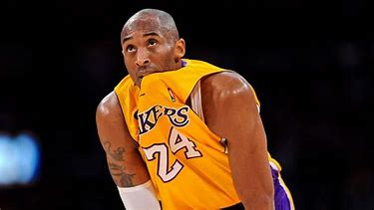
*1. 附加解释说明 ； * 2. 表示说话者态度和观点； * 3. 表特别强调； * 4. 引出分类事项； *5. 总结分类事项
I can't believe how fast 20 years went by. This is absolutely crazy ... and to be standing at center court with you guys, my teammates behind me, appreciating the journey that we've been on — we've been through our ups, been through our downs. I think the most important part is we all stayed together throughout.
—— Kobe Bryant

Slide 8
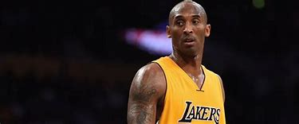
*1. 附加解释说明 ； * 2. 表示说话者态度和观点； * 3. 表特别强调； * 4. 引出分类事项； *5. 总结分类事项
We are completely devastated by the sudden loss of my adoring husband, Kobe — the amazing father of our children; and my beautiful, sweet Gianna — a loving, thoughtful, and wonderful daughter, and amazing sister to Natalia, Bianka, and Capri.
——Bryant's wife Vanessa

Slide 9
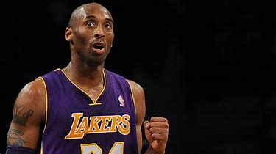
*1. 附加解释说明 ； * 2. 表示说话者态度和观点； * 3. 表特别强调； * 4. 引出分类事项； *5. 总结分类事项
Kobe was also an amazing dad who loved
his family deeply — and took great pride in his
daughter's love for the game of basketball.
—Michael Jordann

Slide 10
02
Effects

Slide 11
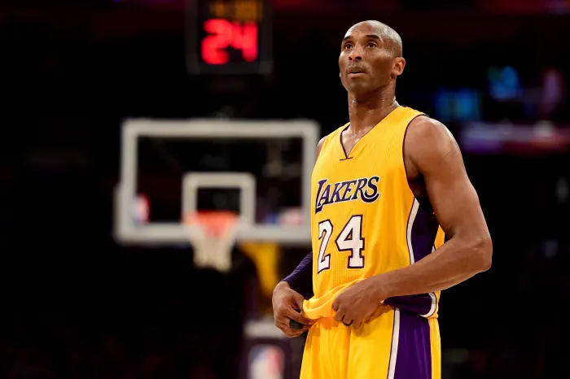



concise,closely-linked, clearly-structured, highlighted，eye-catching
简洁，衔接，层次清晰，强化，醒目
Effects :
Everything negative — pressure, challenges— is all an opportunity for me to rise.
Everything negative, such as pressure, challenges, is all an opportunity for me to rise.

Slide 12
03
Application

Slide 13

1.Place dashes where necessary
1. Words can't describe the pain I am feeling. I loved Kobe
because he was like a little brother to me.
1. Words can't describe the pain I am feeling. I loved Kobe
because he was like a little brother to me.
— he was like a little brother to me.
Michael Jordan's speech in Kobe's memorial
2. I took great pride as I got to know Kobe Bryant that he was just trying to be a better person and to be a better basketball player.
2. I took great pride as I got to know Kobe Bryant that he was just trying to be a better person and to be a better basketball player.
— a better basketball player.
– he knows how to
3. I'm pretty sure Vanessa and his friends all can say the same thing. He knows how to get to you in a way that affects you personally, even though he's being a pain in the ass.
3. I'm pretty sure Vanessa and his friends all can say the same thing. He knows how to get to you in a way that affects you personally, even though he's being a pain in the ass.
get to you in a way that affects you personally, even though he's being a pain in the ass.
4.It was a nuisance (麻烦事) , if I can say that word, but that nuisance turned into love over a period of time.
4.It was a nuisance (麻烦事) , if I can say that word, but that nuisance turned into love over a period of time.
– if I can say that word –

Slide 14
2. Use dashes in practical writing
用于表列举
（202003名校协作体）应用文写作：假定你是李华，你的外籍朋友 Mr Brown 对中国文化很感兴趣，请给他写一封邮件，邀请他来参加浙江非物质文化遗产(non-material cultural relics)展览活动。内容包括： 1．写信目的； 2．时间、地点； 3．活动内容。
Arranged in Zhejiang Museum on Saturday, February 28th in 2020, the exhibition will showcase (展示) various non-material cultural relics, （silk making, paper cutting seal engraving） .
such as silk making, paper cutting, seal engraving (篆刻) and so on.
ranging from silk making, paper cutting to seal engraving (篆刻).
— silk making, paper cutting and seal engraving.

Slide 15

3. Use dashes in summary writing
作次要点，用于表强调
（202003名校协作体）概要写作：In addition to this, there’s the fact that we all now connect so deeply with technology, particularly with our phones. The more we stare at our screens, the less we talk to other people directly. All too often we accept the images of people that social media provides us with. Then we feel we know enough about a person not to need to engage further with them.
Furthermore, intimate exposure to technology, phones in particular, will mislead us into accepting people’s virtual images online rather than have a deep insight into them.
Furthermore, intimate exposure to technology — phones in particular — will mislead us into accepting people’s virtual images online rather than have a deep insight into them.

Slide 16
作次要点，用于表解释说明
概要写作：If you take a look at the best-selling books in the UK these days, it is almost certain that there will be a lot of autobiographies in that list. Bill Clinton, Nelson Mandela and actor Michael J Fox have all written them. An autobiography is the story of a person's life, written by that person. It is usually a very famous person who might tell us all about their childhood, how they became famous and any other interesting things that have happened in their lives.
An autobiography is very popular in the UK.
Autobiographies—stories written by famous people about themselves—are popular in the UK.

Slide 17
4. Use dashes in continuation writing
用于表强调
“But you will be a beautiful narrator,” Mom said. She reminded me of how fluently I could deliver my part at home. It was at that time that I understood that maybe I was more suitable for a role backstage like a narrator. From then on, I practiced my lines heart and soul with my mother at lunch time for weeks. And the performance approached ultimately. Standing backstage, nervousness came flooding in me. What encouraged me to overcome it was the inspiration from the beautiful yellow dandelions. The performance that night was eventually a big success. Hearing the thunderous applause, I took pride in my role and firmly believed that even a dandelion had its own beauty.
Hearing the thunderous applause, I took pride in my role and firmly believed that every flower—even a dandelion— had its own beauty.

Slide 18
用于表解释说明
Para 1: The bird dropped like a rock, one wing falling heavily behind as it fell. I heard it thump into the dirt. Before lowering the gun, I realized what I’d done. I’d killed my first animal.“Oh no,”My stomach was tied in knots and I prayed, “Oh God, please don’t let it be dead.” The bird lay there with blood streaming from its beak, feathers large and small scattered about. I reached out and rolled it over, but its head drooped lifelessly to the side. After burying it, I hurried home, hiding my BB gun in the closet.
Before lowering the gun, I realized what I’d done —— I’d killed my first animal.

Slide 19

5. Appreciate the usage of dashes in the textbooks
A NEW DIMENSION OF LIFE (M7U3 Using Language)
I’m sitting in the warm night air with a cold drink in my hand and reflecting on the day – a day of pure magic!
The first thing I became aware of was all the vivid colors surrounding me – purples, reds, oranges, yellows, blues and greens.
The corals were fantastic – they were shaped like fans, plates, brains, lace, mushrooms, the branches of trees and the horns of deer.
And I also loved the small fish that clean the bodies of larger fish – I even saw them get inside their mouths and clean their teeth!

Slide 20
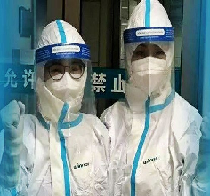
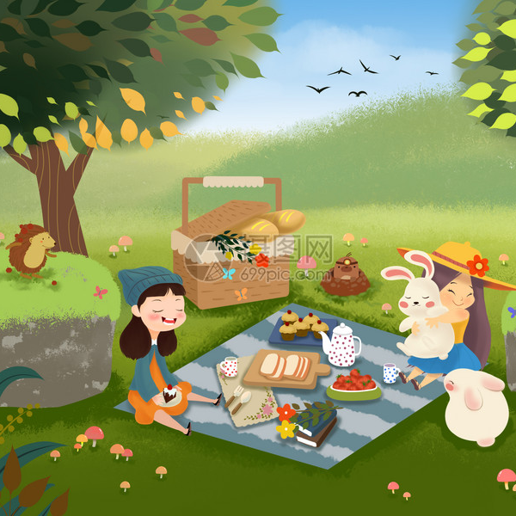
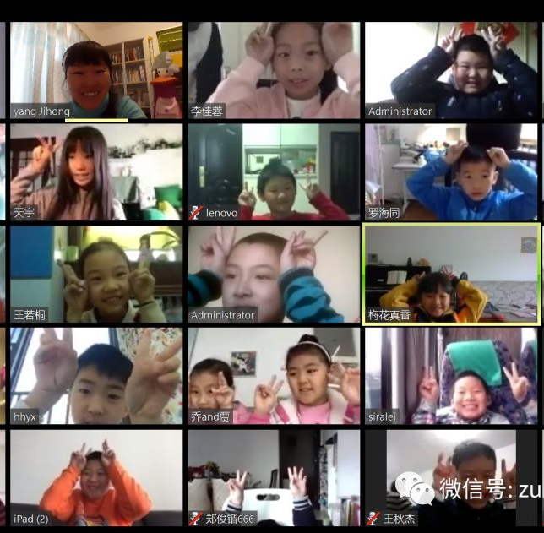
6. Create your own version using dashes
2. 写一段话感谢所有为这场抗疫取得最终胜利做出贡献的人。
1. 写一段话致敬偶像科比。
3. 写一段话描述美好春日与朋友或家人郊游的所见、所闻、所感。
4. 写一段话描述网课期间你的所见、所闻、所感。

Slide 21
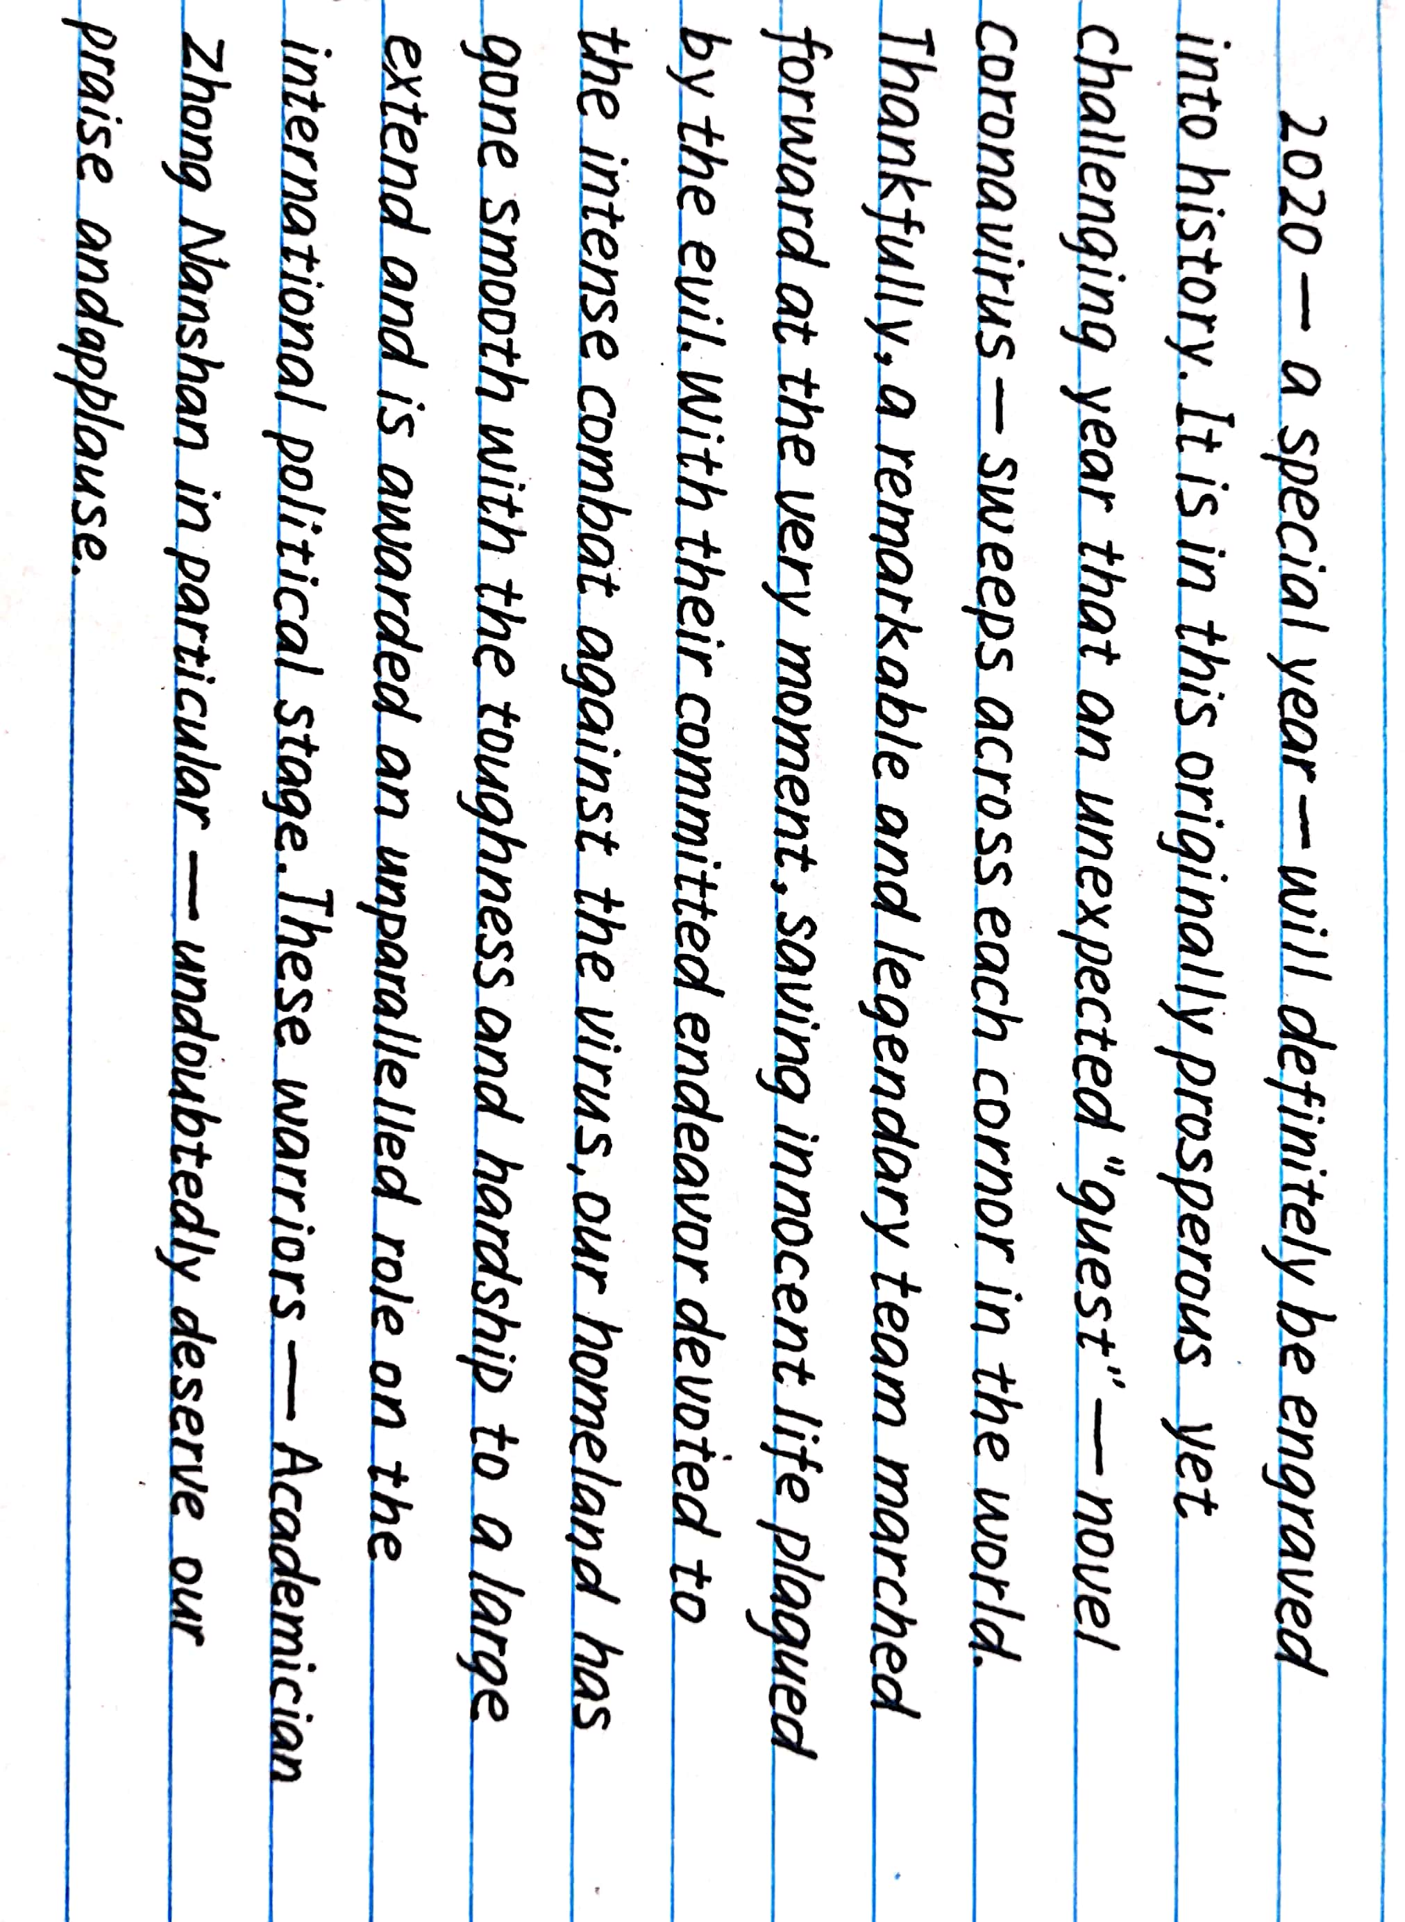

Samples:

Slide 22
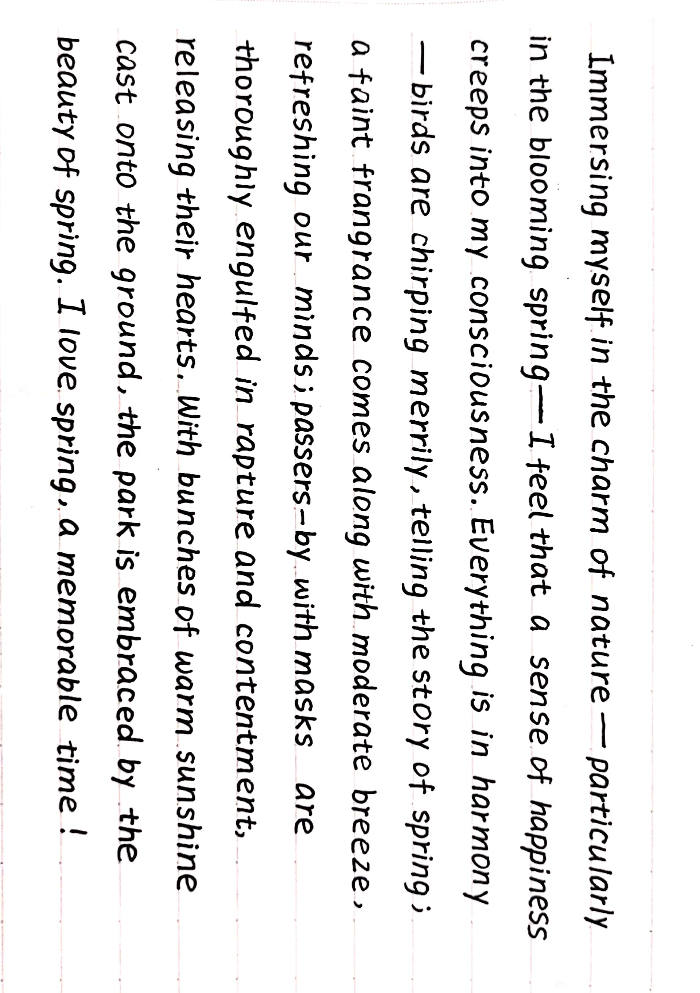


Slide 23
Owing to the COVID-19 outbreak, online learning has sprung up at home and abroad. But the drawbacks of cloud teaching—distracted attention, sharply impaired vision and low learning efficiency—can be seen clearly. In order to welcome a turning point of life—the college entrance examination, we must fight against all the odds and challenge ourselves because if you can’t suffer from self-discipline, you have to suffer form mediocrity.

Slide 24
06
Arrangement：Polish your writing
1. 写一段话致敬偶像科比。
2. 写一段话感谢所有为这场抗疫取得最终胜利做出贡献的人。
3. 写一段话描述美好春日与朋友或家人郊游的所见、所闻、所感。
4. 写一段话描述网课期间你的所见、所闻、所感。

Slide 25

We will succeed —— and that success will belong to every one of us.
--- Queen Elizabeth II

Slide 26
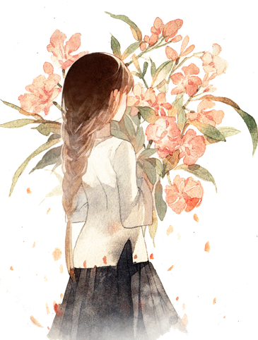
Thank you!

