Slide 1


感恩遇见，相互成就，本课件资料仅供您个人参考、教学使用，严禁自行在网络传播，违者依知识产权法追究法律责任。
更多教学资源请关注
公众号：溯恩高中英语
知识产权声明

Slide 2
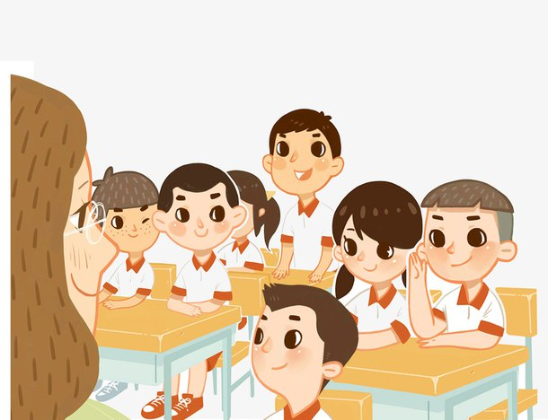
We are back to school！

Slide 3
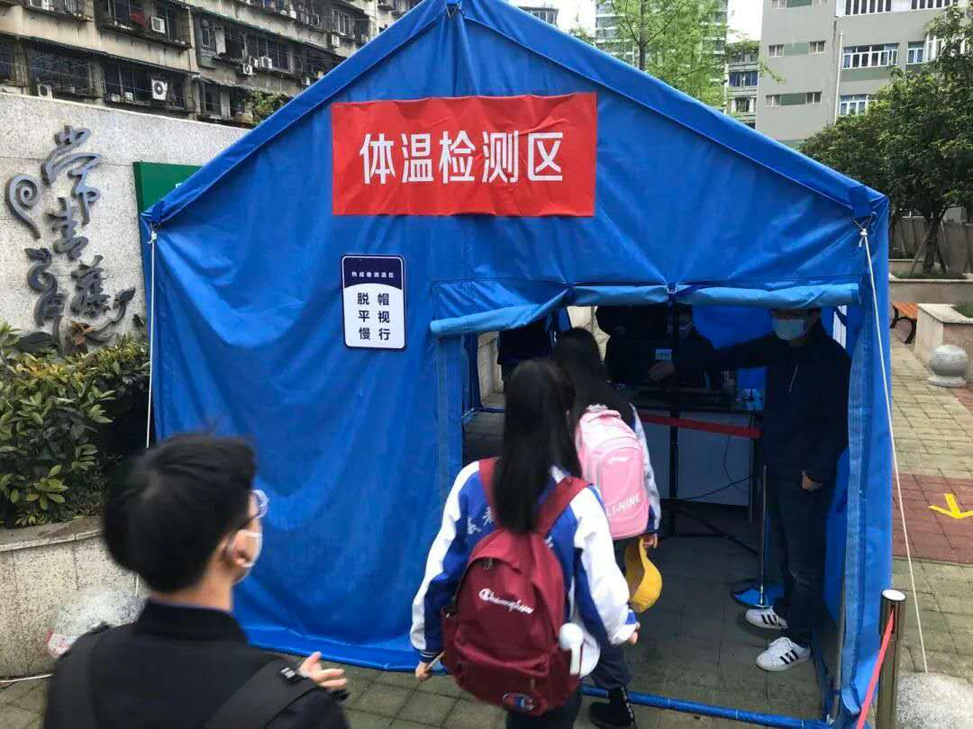
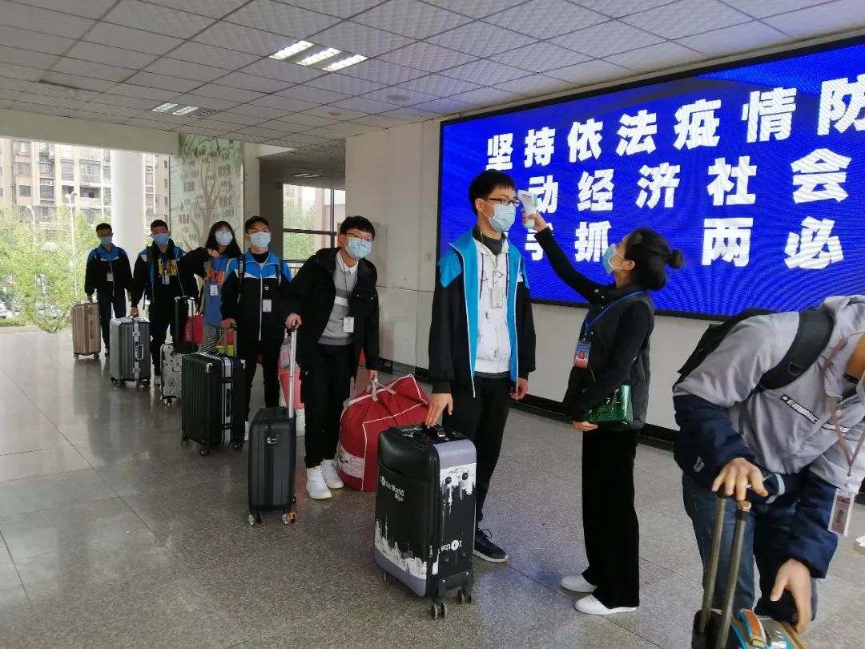
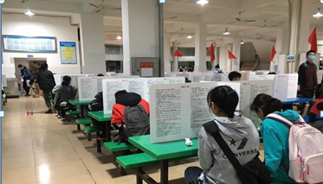
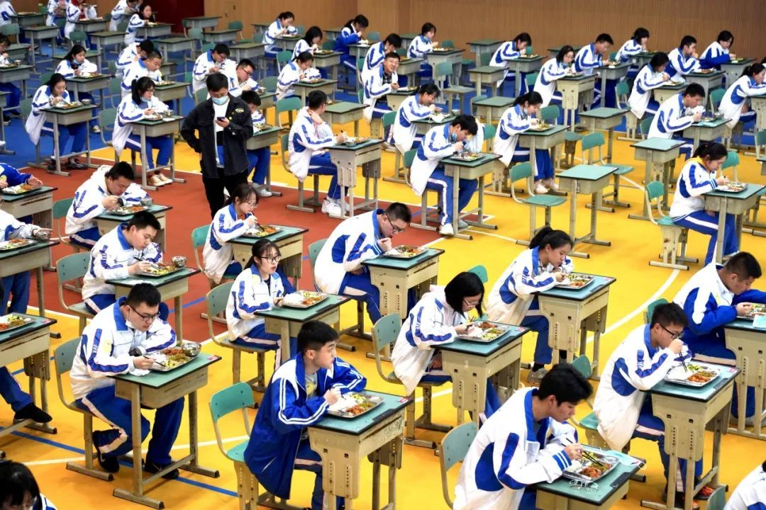
protective measures
in school

Slide 4
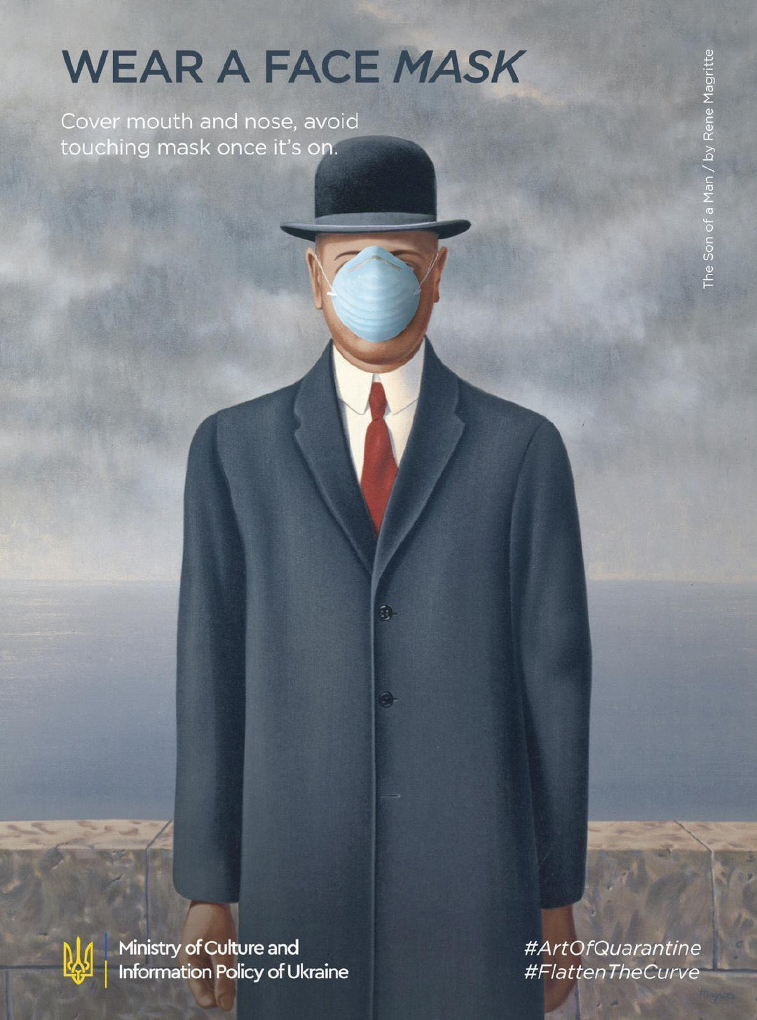
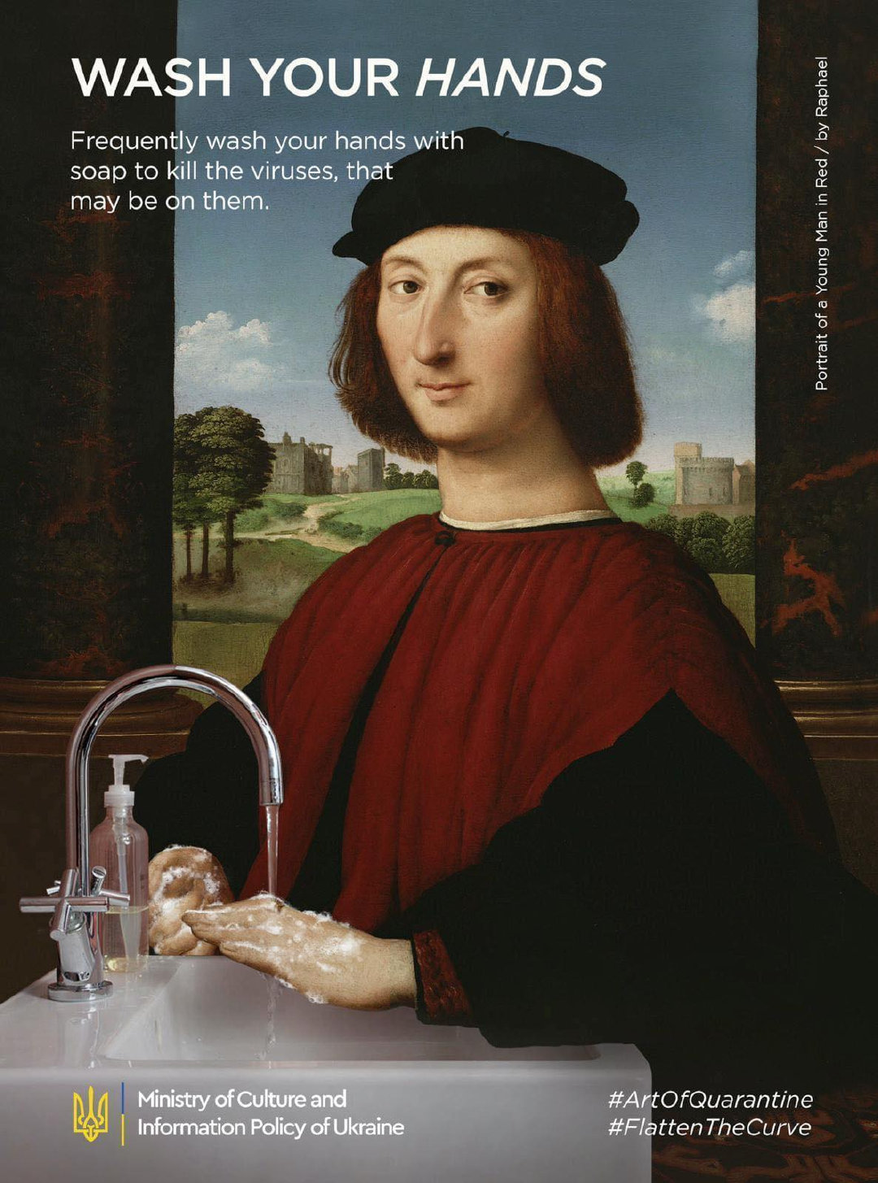
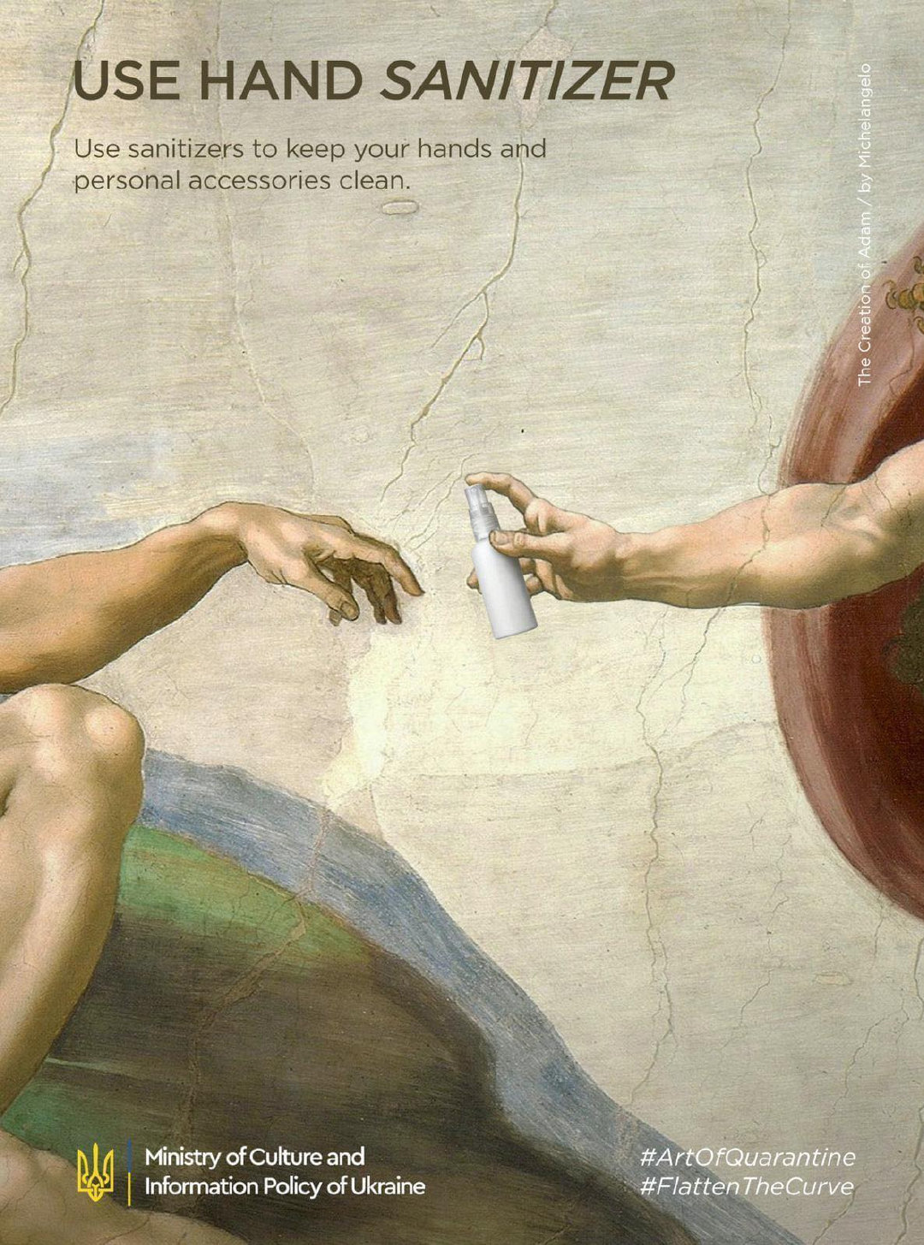

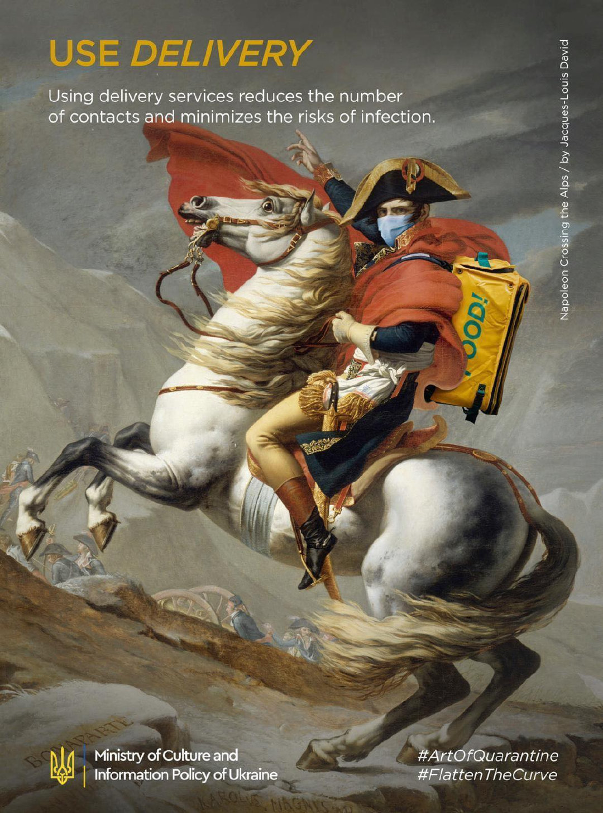
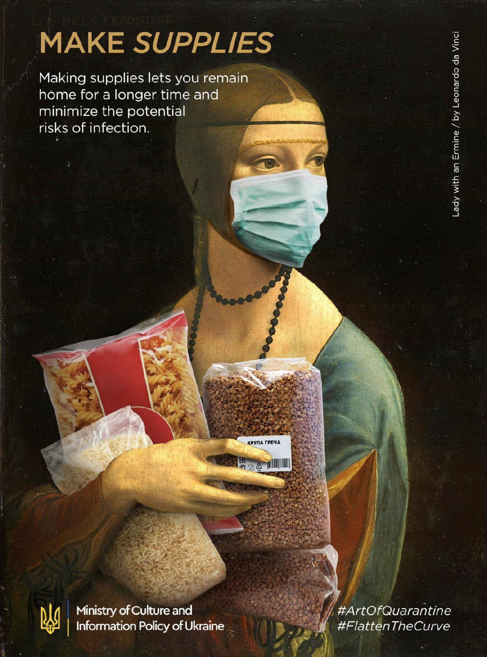
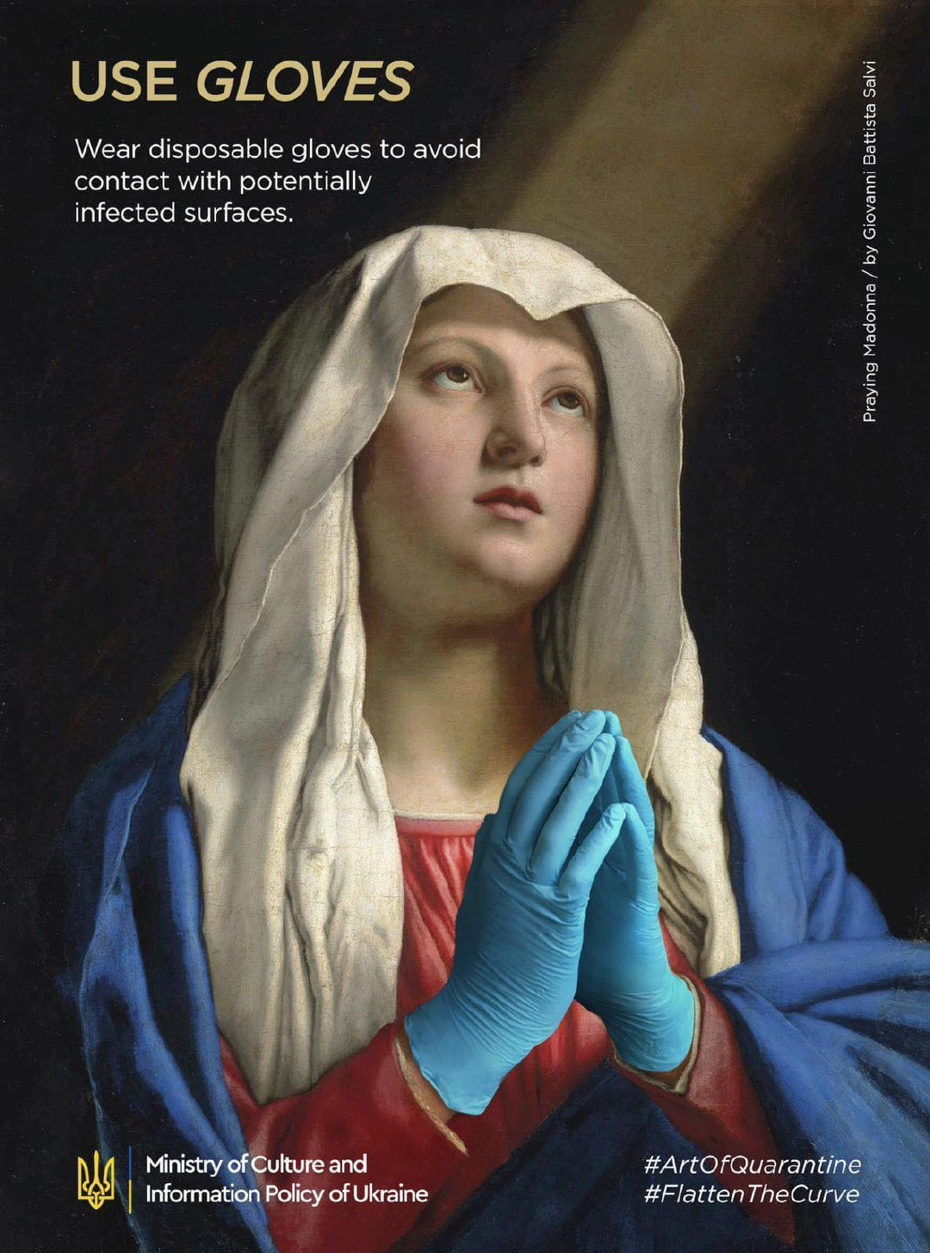
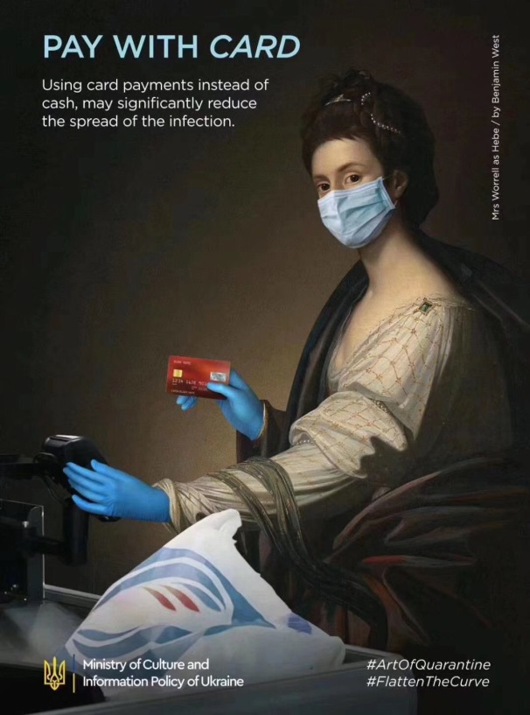

Slide 5
The Ministry of Education has set three conditions for school resumption, namely, the epidemic is _________________(得到基本控制)where the schools are located, schools are capable of___________________(疫情防控), and safeguarding the __________________
(卫生安全)of teachers and students.
“Our head teacher has reminded us to______________(戴口罩), do disinfection(消毒) and _____________________(量体温)when we go to school, and my parents have prepared masks, hand sanitizer(洗手液) and a thermometer(体温计) for me," said Chen.
Dong Yaping, _______ daughter will attend Gaokao this year, said she is confident that students will be safe in the school, ________ each class will be divided into two smaller groups and each dormitory accommodate no more than four boarding students to reduce cross-infection risks.
"My daughter has been moved by the medical workers' stories in the fight against the epidemic and learned to love our country more, _______ I think is more important than only performing well academically," said Dong.
under basic control
epidemic prevention
health and safety
wear masks
take body temperature
whose
where
which

Slide 6
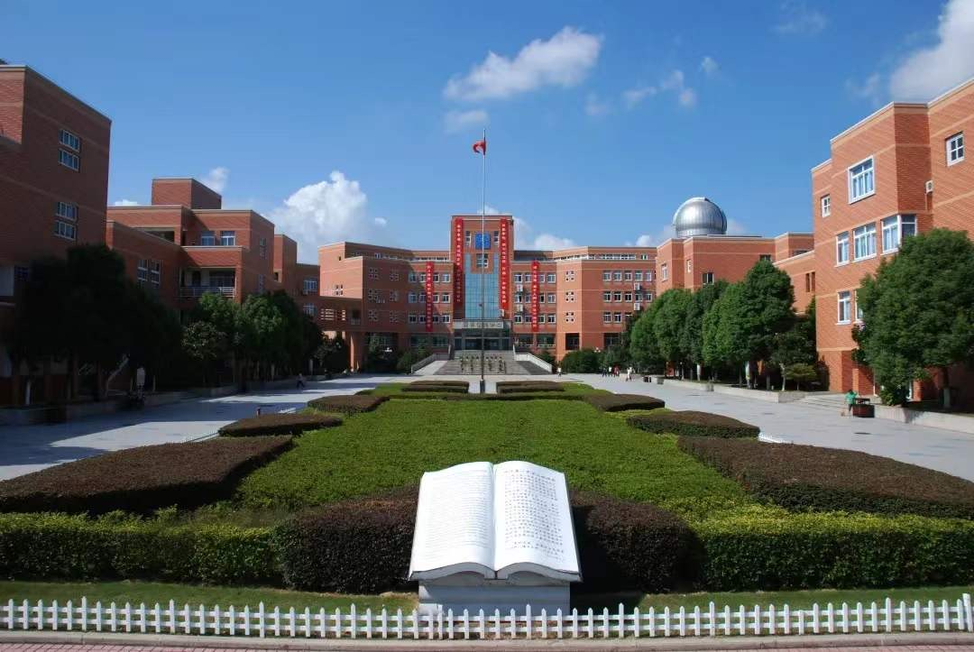
How do you feel when back to school?
excited
Why?

Slide 7
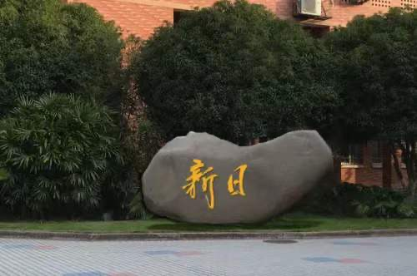

Slide 8
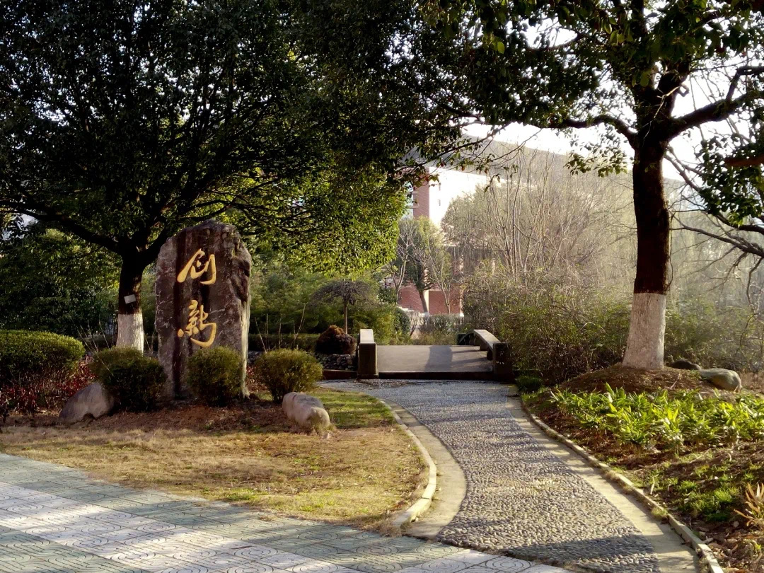

Slide 9
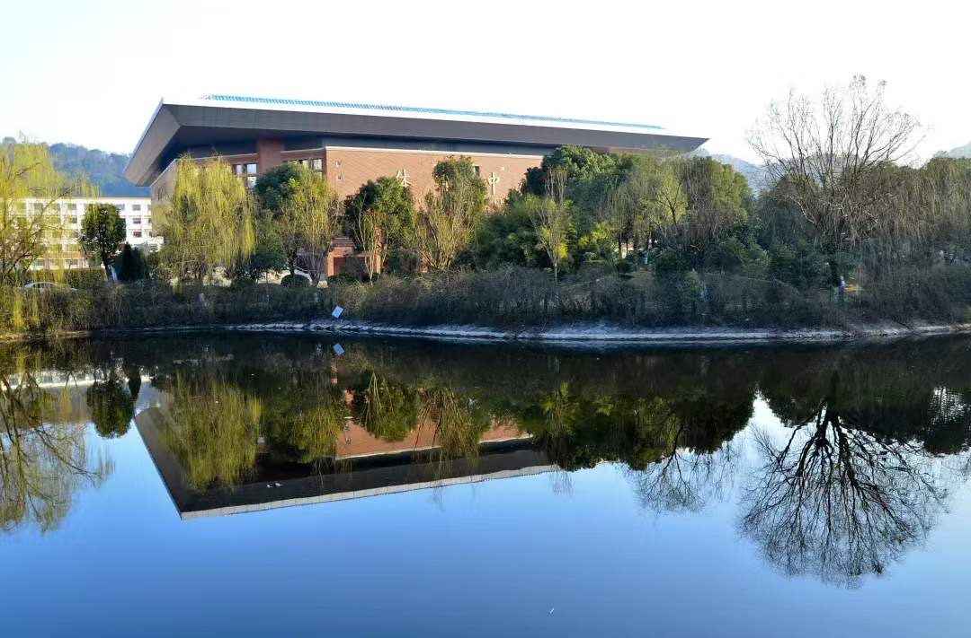

Slide 10
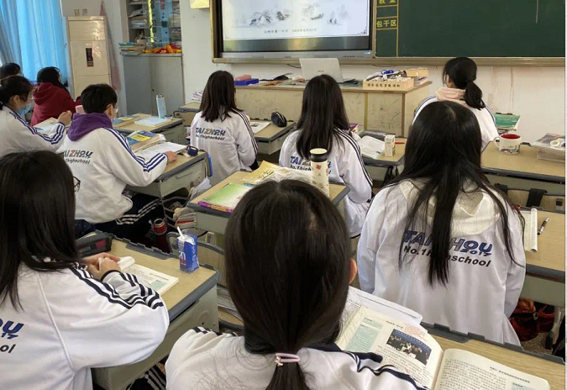

Slide 11



Slide 12

We should be full of thanks to the Party, the government, the school and people who have made sacrifices for us.

Slide 13
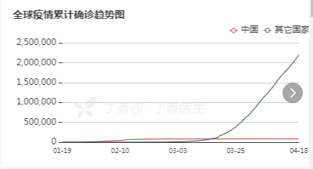
How about epidemic situations
in other countries?

Slide 14
America

Slide 15
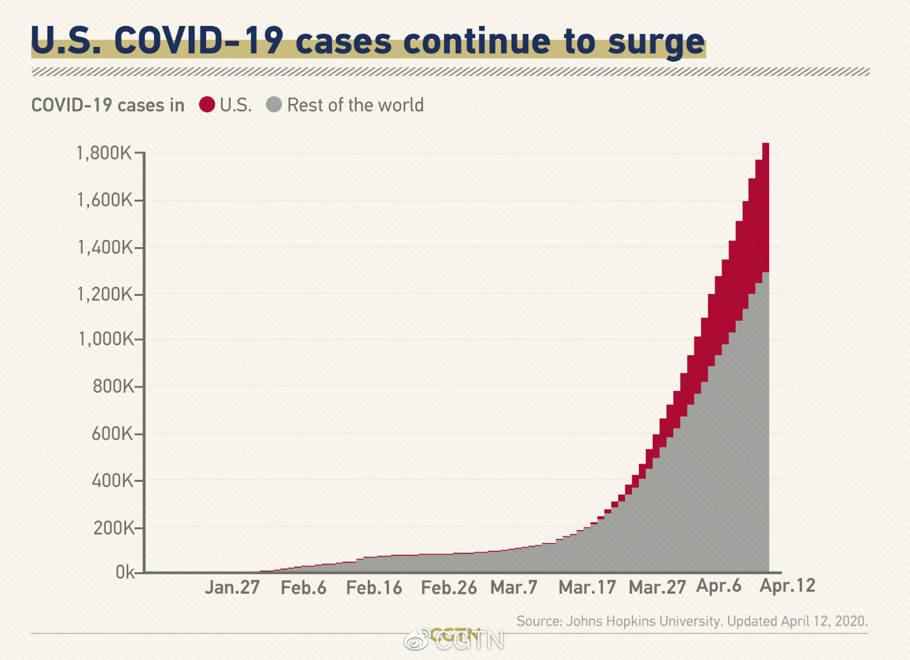

Slide 16

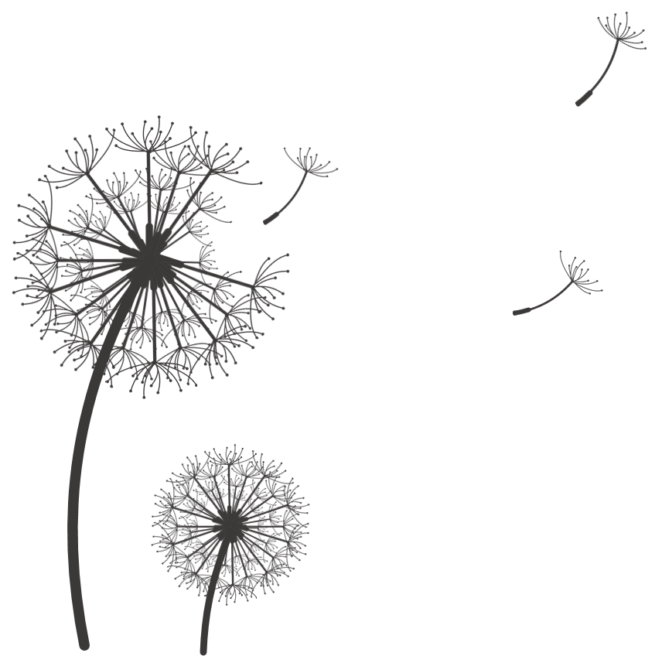
synonym
repetition
Self-quarantine. Self-isolation. Social distancing. Phrases that many of us never used before now roll off our tongue in daily conversation.A new vocabulary to define a new reality. A hard, cold reality.
From my diary, many of you know the current situation. Graduations, weddings, and funerals are postponed.
You know about COVID-19 and you know there's a lot we don't know about it.
You know about the action we've taken to combat it — and you know how the action disrupts your daily life.
Many of you are out of work. Businesses, large and small, are shut across the state. The companionship we normally lean on to get through difficult times -- a hug from a grandparent, a coffee with a friend, or a laugh with a co-worker – was forced out of reach.Vacant streets. Deserted classrooms. Empty seats.
synonym
--An American’s diary
depression/loneliness

Slide 17
Britain

Slide 18
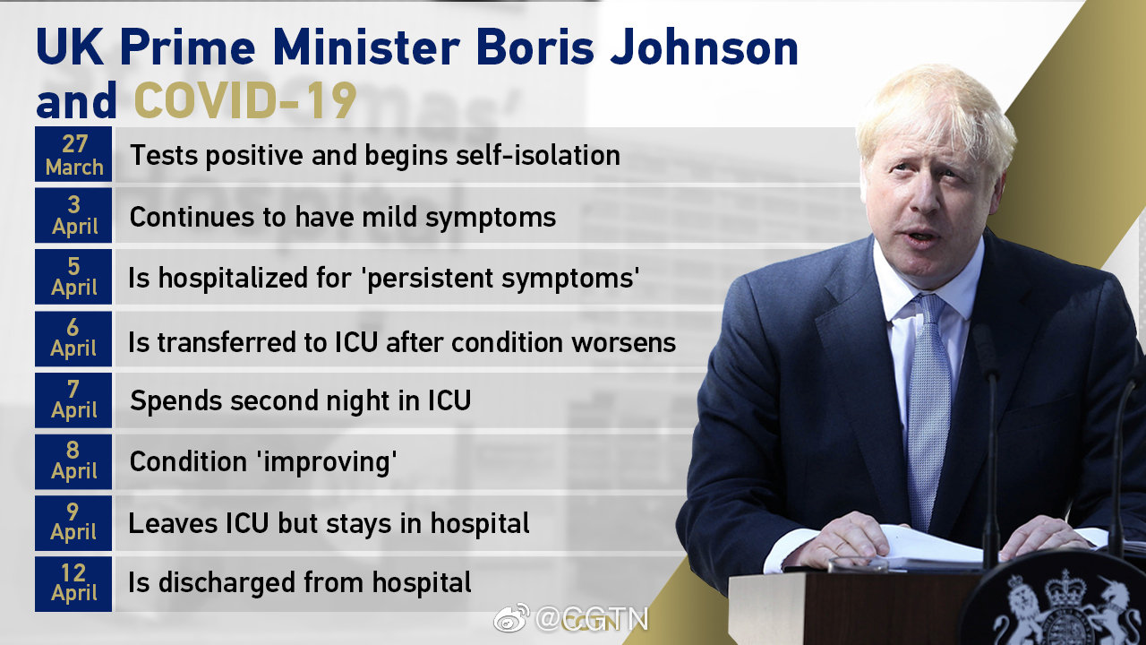

Slide 19
Good afternoon. It's hard to find the words to express my debt—but before I come to that I want to thank everyone in the entire UK for the effort and the sacrifice you 1. (make) and are making.
I thank you because so many millions and millions of people 2. this country have been doing the right thing—millions going through the
hardship of self-isolation—3. (faith), patiently, with thought and care for others as well as for 4. (they).
I want to pay my own thanks to the utterly brilliant doctors, leaders in their fields, men and women, but several of them for some reason called Nick, who took some crucial 5. (decide) a few days ago for 6. I will be grateful for the rest of my life. I want to thank the many nurses, men and women, whose care has been so 7. (astonish).
have made
across
faithfully
themselves
decisions
which
astonishing
That is why we will defeat this coronavirus and defeat it together. We will win because our NHS is the beating heart of this country. It is 8. best of this country. It is
9._________________ (conquer). It 10. (power) by love. So thank you from me, and from all of us.
the
unconquerable
is powered
National Health Service, 即英国国家医疗服务体系

Slide 20
Spain

Slide 21
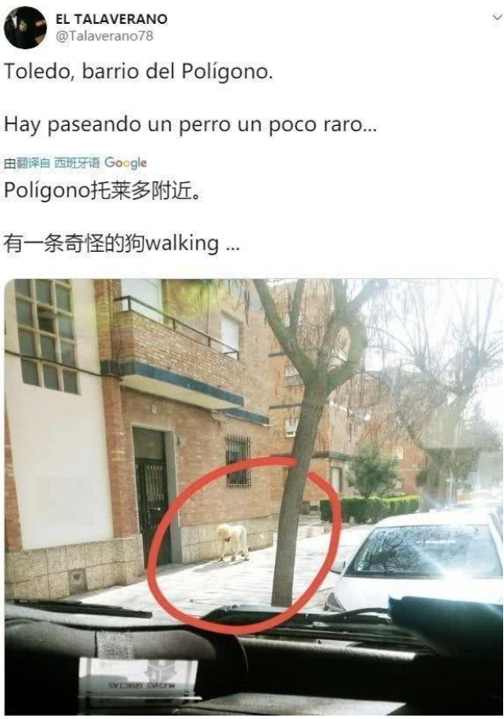
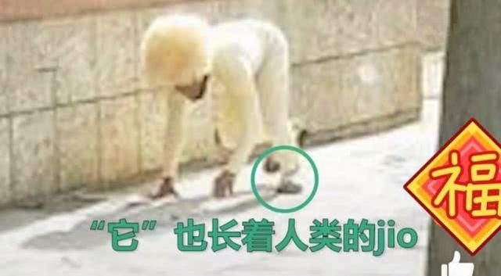
What has happened?
Can you guess?
The government has assured residents they may walk their pets, so long as they observe social distancing measures such as keeping 1m apart from other members of the public.
SO
Spaniards begin renting out their dogs so others under coronavirus lockdown can take walks “without getting fined”.

Slide 22
Italy

Slide 23
Fill in the blanks with verbs:
study
“ I at the University of Ferrara. I am in the first year of kinesiology
(运动学).The university on Saturday Feb 21st, and we started classes on 23rd. Consequently the lessons online the following week on Monday or Tuesday. I have to go to Google classroom. We have a page to us, and we can it with our credentials(凭证). Everyday new material is uploaded. Teachers every day uploaded pre-_________ lessons, so we have the video with the teacher explaining. Teachers also presentations to the university’s website, so each one of us can __________ them. We also have books, which I luckily bought already, because libraries are also closed, so I couldn’t have _________ them now. I haven’t been outside for a week, not even for a walk or anything. So I some exercise in the terrace(阳台).
closed
started
dedicated
access
recorded
uploaded
download
got/ gotten
did

Slide 24
Thank you!
Don't take everything we own for granted, but cherish it and be grateful.

