Slide 1


感恩遇见，相互成就，本课件资料仅供您个人参考、教学使用，严禁自行在网络传播，违者依知识产权法追究法律责任。
更多教学资源请关注
公众号：溯恩高中英语
知识产权声明

Slide 2
Food is the paramount necessity of the people.
民以食为天。

Slide 3
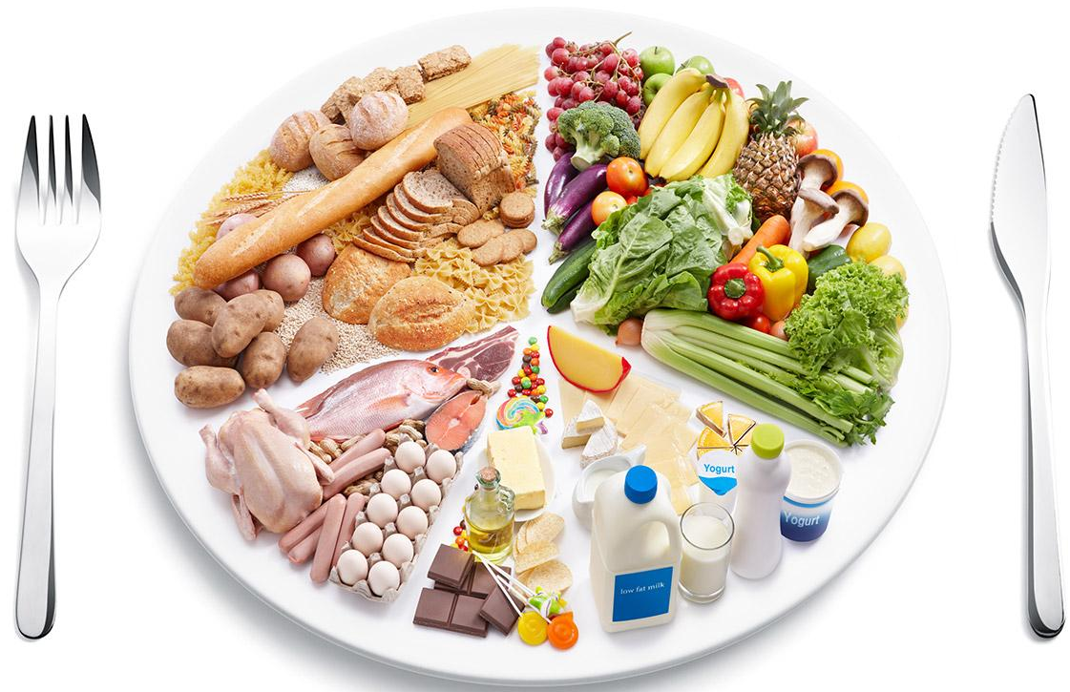
nutritious

Slide 4
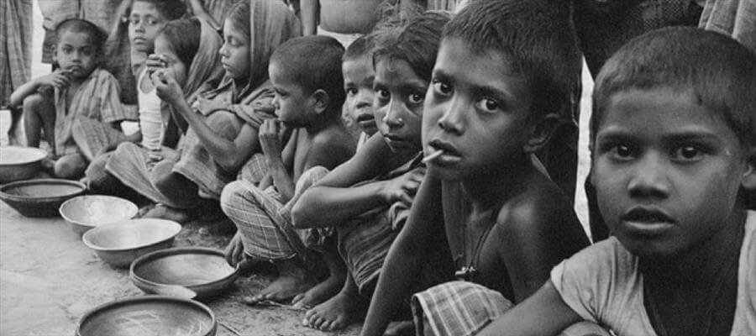
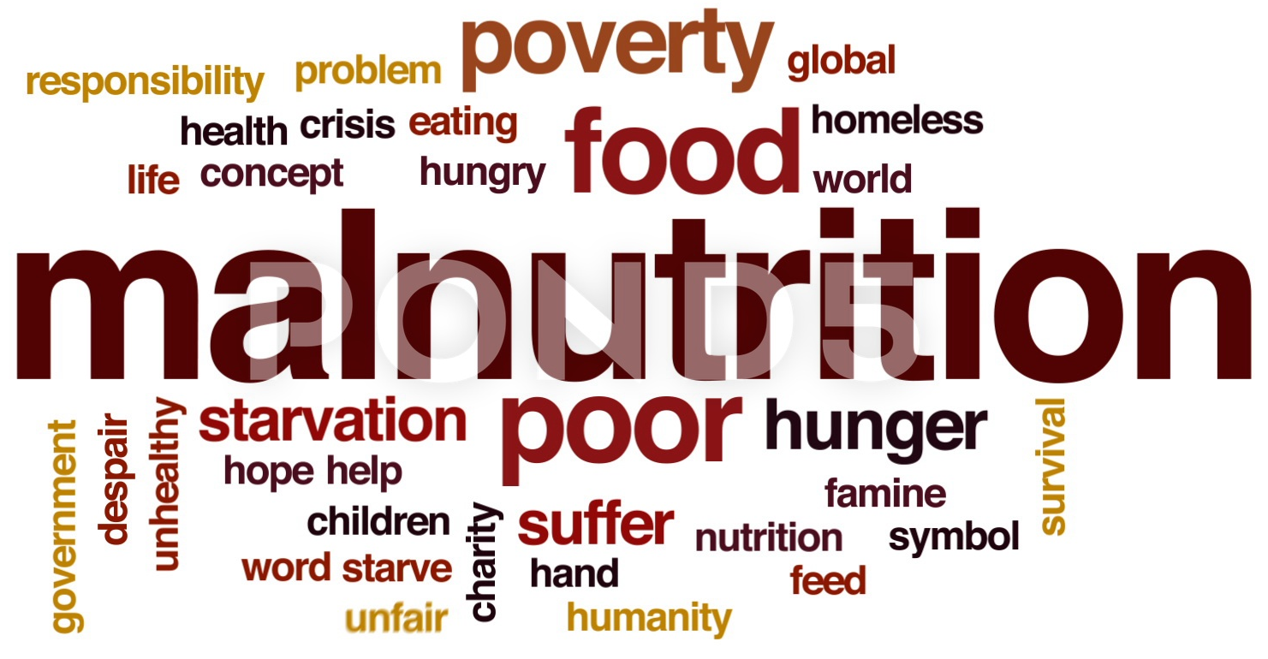
malnutrition
Lacking nutritious food, people in poor areas suffer from malnutrition.

Slide 5
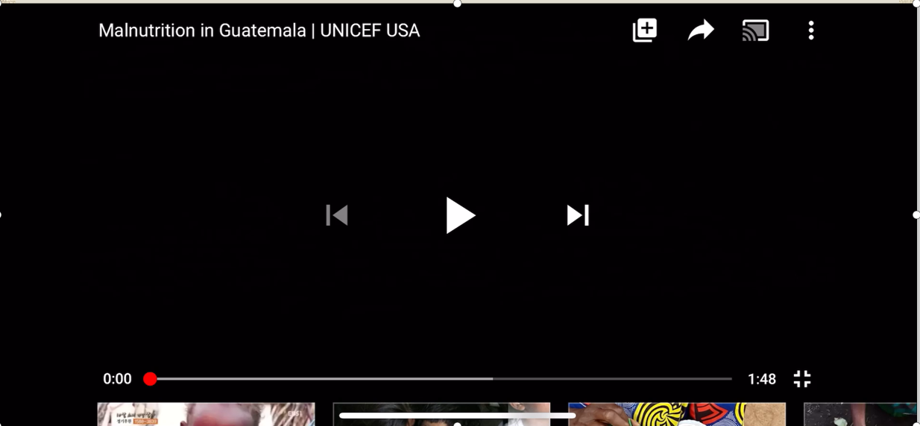
Malnutrition in Guatemala (危地马拉)

Slide 6
Zero Hunger

Slide 7

Para. 1
challenges
821 million;
one in nine
lead to
hunger
suffering and poor health
malnutrition
slow progress
(in education and employment)
one in three
Notes:
How many people exactly suffer from hunger?

Slide 8
Para. 2
What did global community do in 2015?

Slide 9
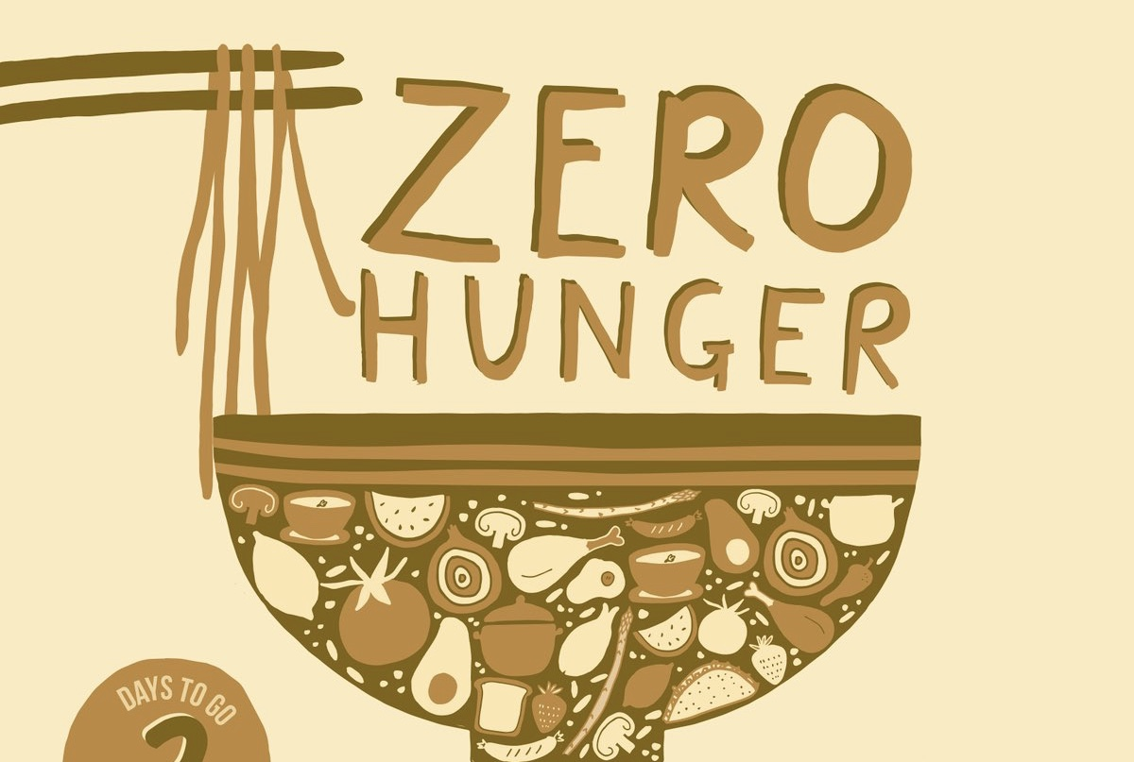


Para. 2
challenges
efforts
what WFP did
aim
end hunger
Goal 2: zero hunger
achieve food security
pledge to
improve nutrition
promote sustainable agriculture
humanitarian food assistance
(provide nutritious food to those in urgent need)
meanwhile
keep saving the same lives each year
(address the root causes of hunger)
complementary programmes
The ability to recover from misfortune or change.
build the resilience of communities

Slide 10
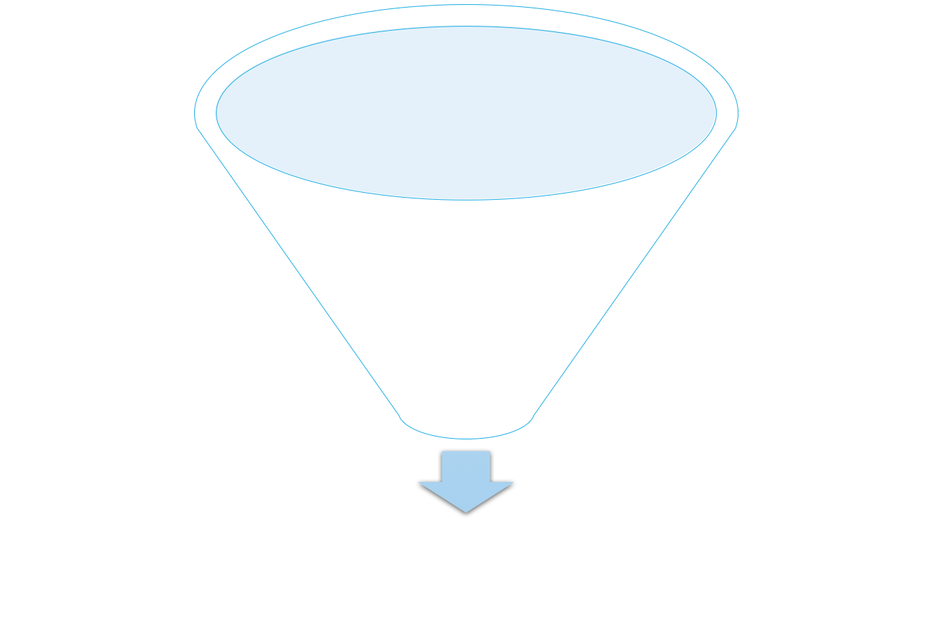
Para. 3
challenges
efforts
progress
216 million fewer hungry people
collaborate
civil society organizations
signal word
governments
But
there is still a long way to go
citizens
private sector

Slide 11
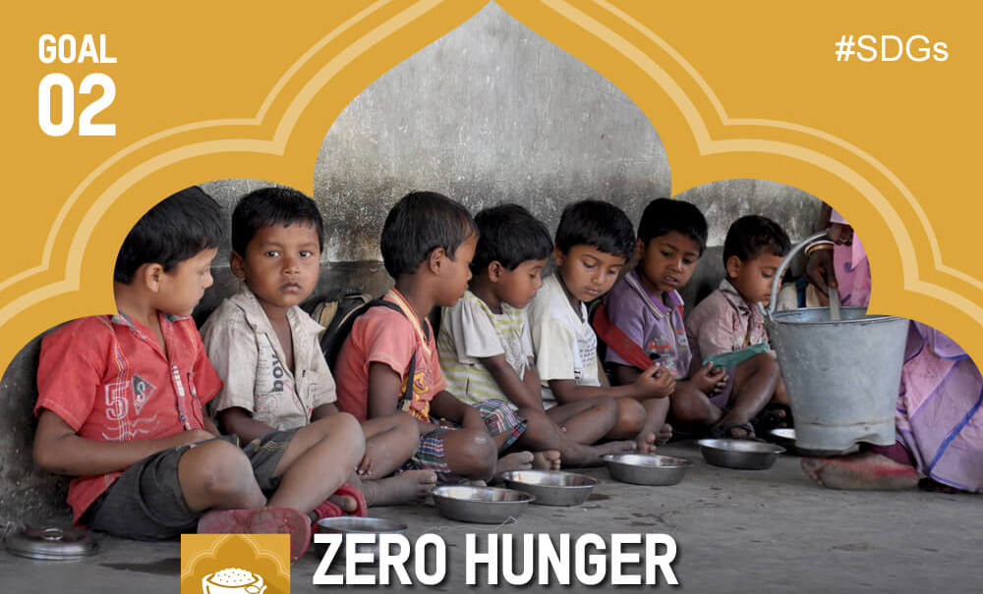
challenges
collaborate
?
efforts
progress

Slide 12
lasting
solutions
challenges
efforts
progress
collaborate

Slide 13
lasting
solutions
challenges
efforts
progress
collaborate
What solutions can you think of to achieve zero hunger?

Slide 14

Our vision: five steps to Zero Hunger

Slide 15

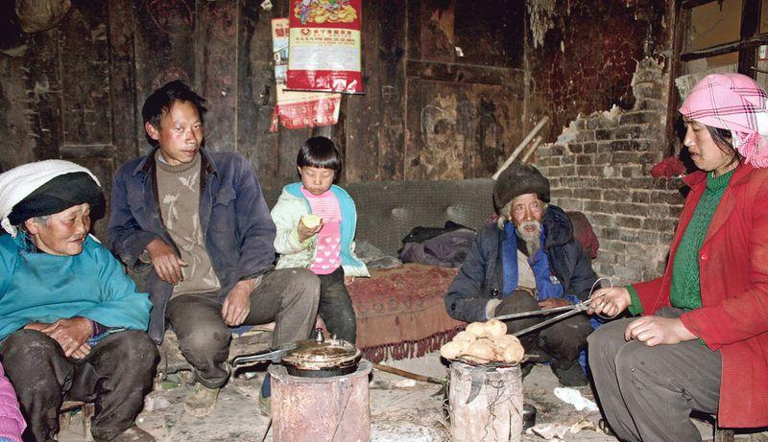
Step 1: Put the furthest behind first
the most vulnerable/the poorest in remote areas
Notes:
描述

Slide 16
Step 1: Put the furthest behind first

Slide 17
Huamao Village, Zunyi, Guizhou Province
expand social protection schemes

Slide 18
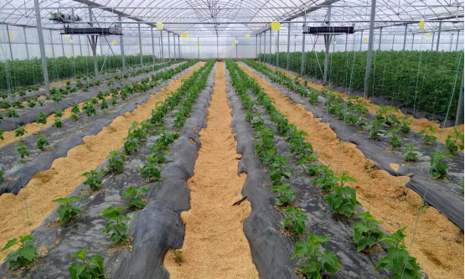
agricultural garden

Slide 19
economic growth
government
generate new jobs
jump-start local economy
create incremental demand
raise purchasing power
expand social protection schemes

Slide 20
Step 1: Put the furthest behind first
If we want to achieve zero hunger, first of all, we should take the situation of the most vulnerable into consideration.

Slide 21
Zero Hunger
Put the furthest behind first
Step 1:
the most vulnerable

Slide 22
Is it easy for the vulnerable to make a better life only with farm produce?

Slide 23
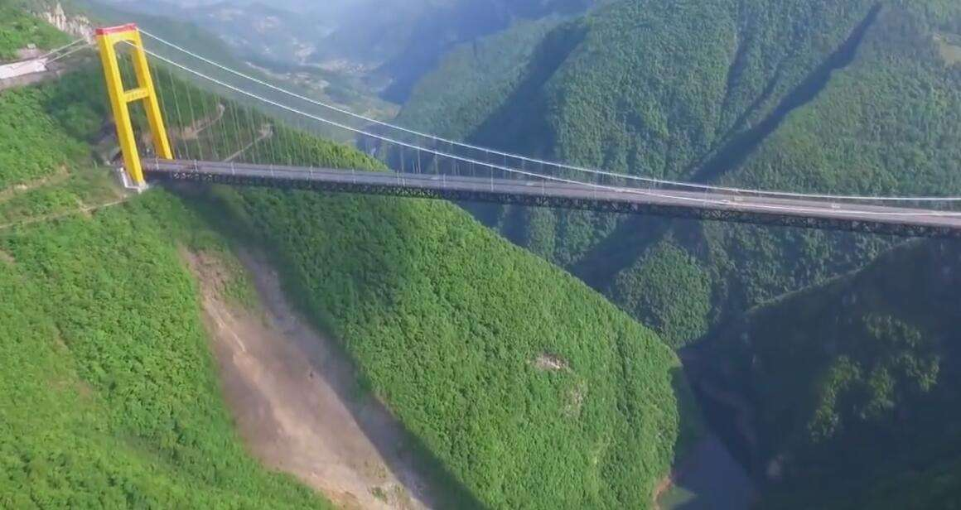
roads
bridges
trains
rural infrastructure
storage
electrification
Notes:
But is that enough?

Slide 24

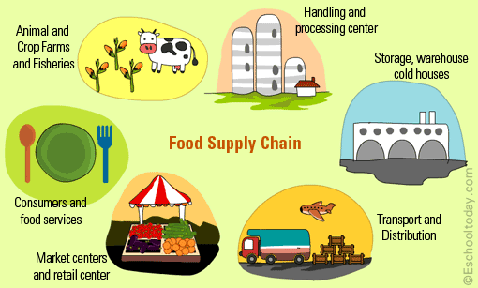
farm
storage
food supply chain
market
transport

Slide 25
Step 1: ___________________________
Put the furthest behind first
to make it possible or easier for something to follow
Step 2: ___________________________
Pave the road from farm to market
farm
market

Slide 26
Zero Hunger
food supply chain
Pave the road from farm to market
Step 2:
the most vulnerable

Slide 27
Step 3: ____________________________
farm
storage
food supply chain
market
transport

Slide 28
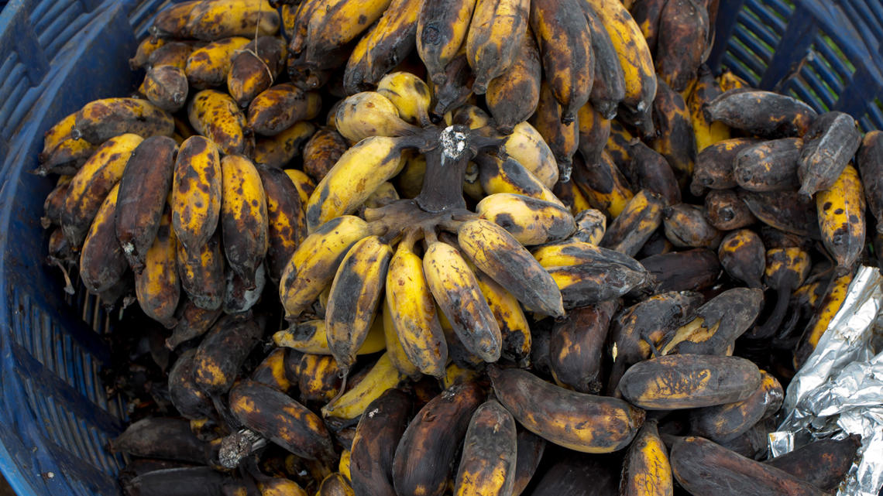
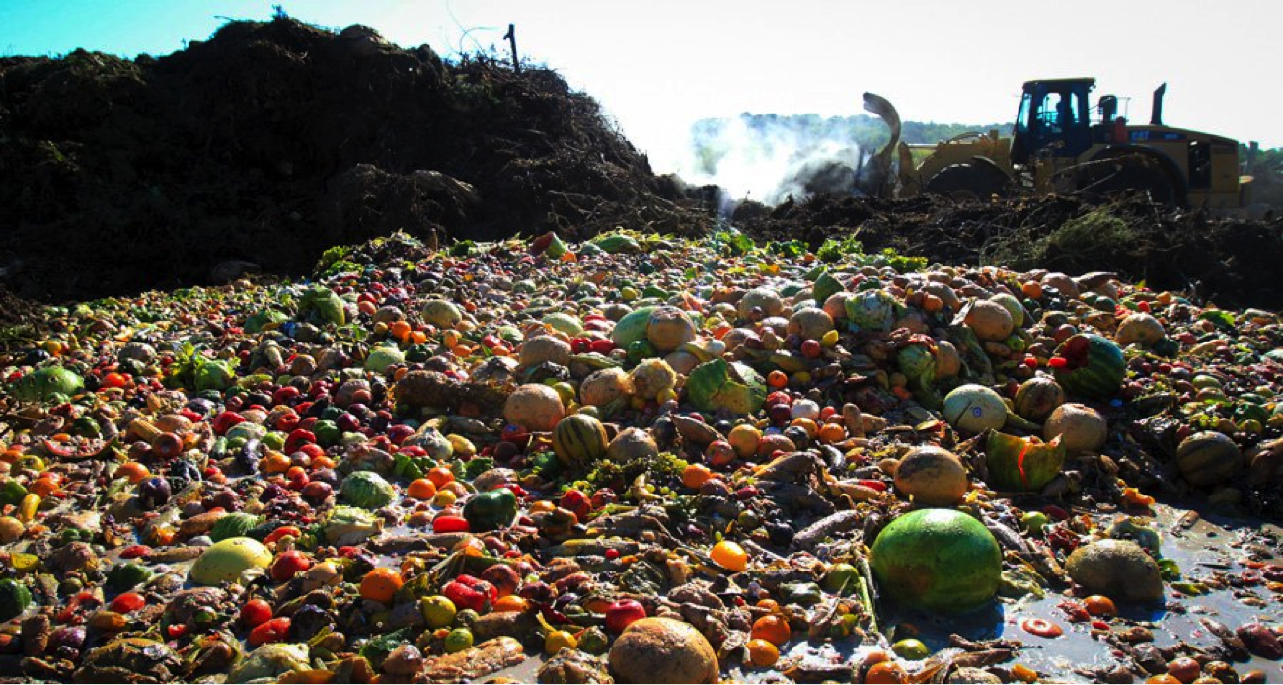
in developing countries
crops go unused or unprocessed
poor storage
poor transportation
wasted
Notes:
If farmers’ food cannot be transported to the market, what would happen? Food rot,

Slide 29
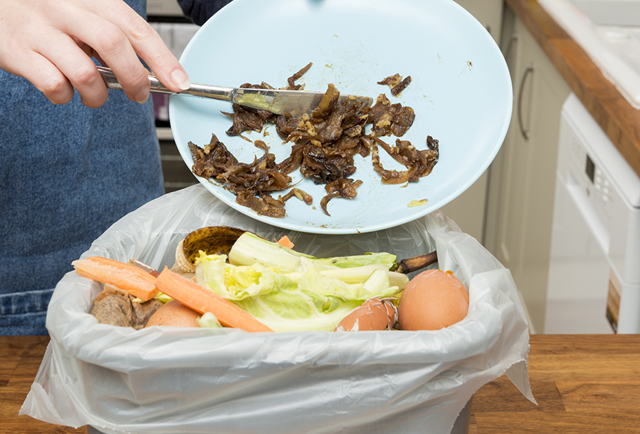
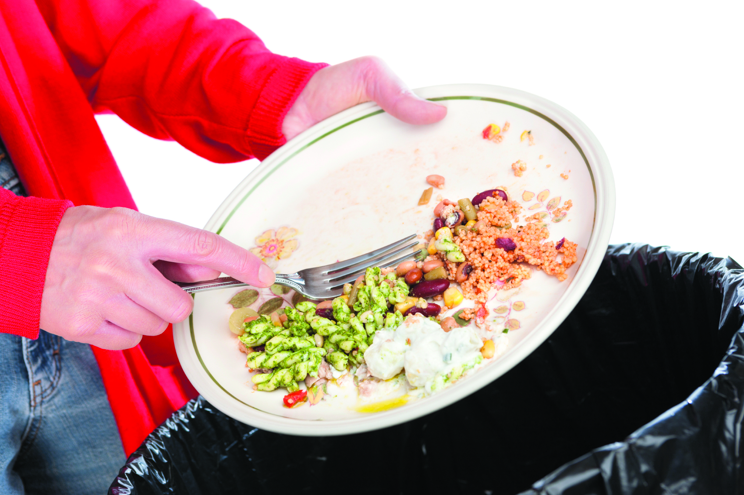
in developed countries
food is often wasted on the plate

Slide 30
Step 1: _____________________________
Put the furthest behind the first
Step 2: _____________________________
Pave the road from farm to market
Step 3: _____________________________
Reduce food waste
Notes:
If farmers’ food cannot be transported to the market, what would happen? Food rot,

Slide 31
Zero Hunger
food supply chain
quantity
the most vulnerable
Step 3:
Reduce food waste

Slide 32
Encourage a sustainable variety of crops
Step 4: ____________________________________
Step 5: Make nutrition a priority, starting with a child’s first 1000 days
1. What do we eat as staple food(主食) ?
2. What if the climate doesn’t allow the growing of those crops any longer?
3. How can we ensure a child’s healthy development and when is the key period?

Slide 33
Encourage a sustainable variety of crops
Step 4: ____________________________________
Step 5: Make nutrition a priority, starting with a child’s first 1000 days
What do we eat as staple food(主食) ?
What if the climate doesn’t allow the growing of those crops any longer?
rice
soy
explore and identify a more diverse range of crops
corn
wheat
famers:
tools and skills
community:
educate
Notes:
among those foods, which do we eat every day?
Imagine, what if one day,

Slide 34
Encourage a sustainable variety of crops
Step 4: ____________________________________
Step 5: Make nutrition a priority, starting with a child’s first 1000 days
How can we ensure a child’s healthy development and
when is the key period?
Ensure children and nursing mothers to have access to the required nutrition foods, particularly in the first 1000 days.
Notes:
among those foods, which do we eat every day?
Imagine, what if one day,

Slide 35
Zero Hunger
food supply chain
quantity
the most vulnerable
Step 4: Encourage a sustainable variety of crops
variety

Slide 36
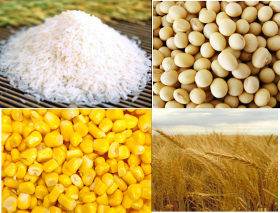
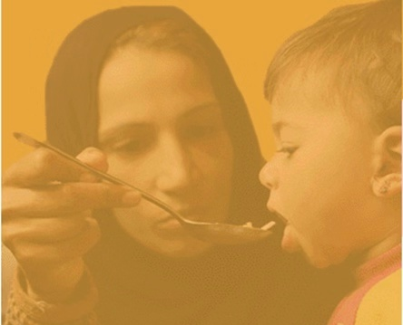

Zero Hunger
People
Food
food supply chain
quantity
the most vulnerable
Step 5: Make nutrition a priority, starting with a child’s first 1000 days
variety
children
quality
nursing mothers

Slide 37
Creative Thinking
Pick out one subtitle or make up one by yourself.
Write a short paragraph by using the new words we have learnt today.

Slide 38
Support small farmers with advanced technology
Most African farmers are less productive than a US farmer was 100 years ago. It is agreed that supporting and training farmers is the priority to future food security. To promote sustainable and durable farming skills, governments, organizations and scientists can collaborate to provide a combination of aid, education in high-tech methods such as better rice planting and irrigation, and the introduction of better seeds and fertilizer could spark a green revolution in Africa.

Slide 39
An end to malnutrition in all its forms
Malnutrition is both a driver and an outcome of poverty and inequality. Undernutrition can also lead to hidden hunger, wasting and stunting, which causes irreversible damage to both individuals and society. This should be supported by a multi-sectoral approach which includes nutrition-sensitive health care, water, sanitation, education, agriculture, social protection and specific nutrition interventions, coupled with initiatives that enable empowerment of women.

Slide 40
Thank you!

