Slide 1

感恩遇见，相互成就，本课件资料仅供您个人参考、教学使用，严禁自行在网络传播，违者依知识产权法追究法律责任。
更多教学资源请关注
公众号：溯恩高中英语
知识产权声明

Slide 2
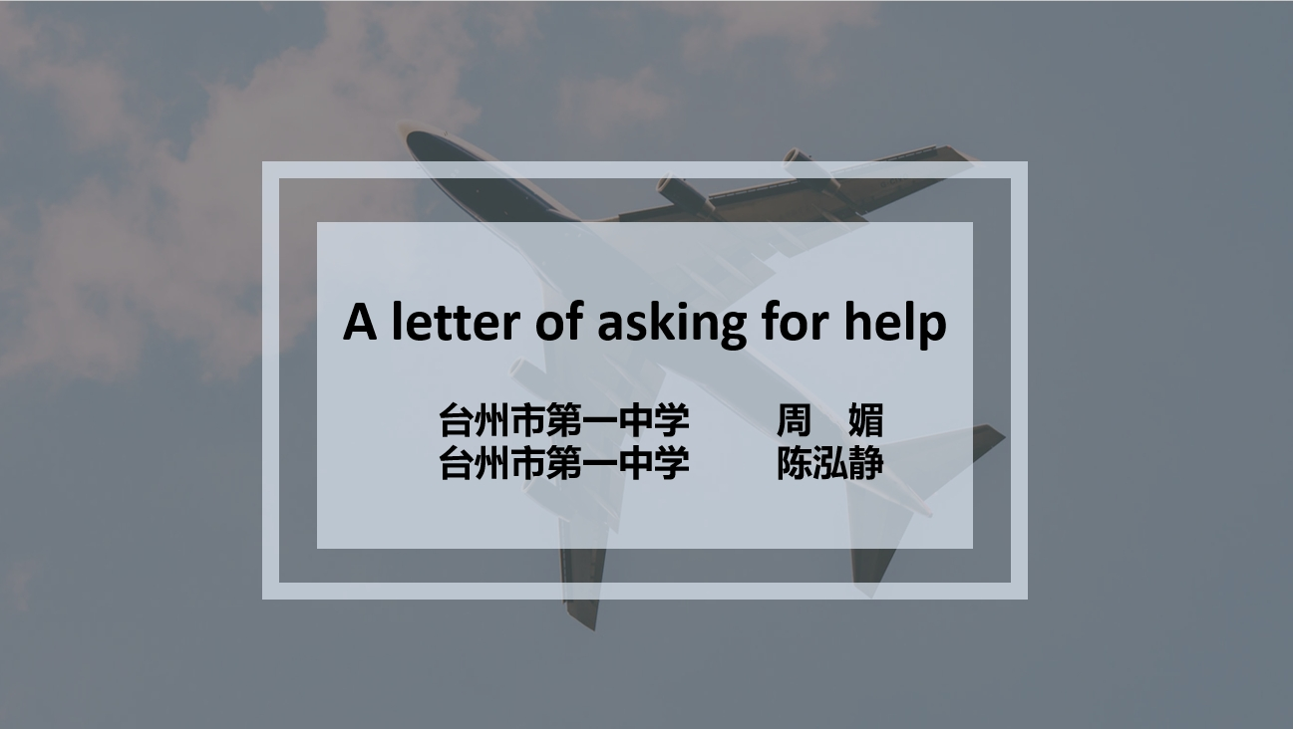
A letter of asking for help
台州市第一中学 周 媚
台州市第一中学 陈泓静

Slide 3



How to ask for help
Thank your helper.
Tell the person you're looking for a favor.
Word your request for a favor carefully.
B
A
_______. The sooner you mention your intentions, the better. It's simple - all you need to say is something like, "I was wondering if I could ask you a favor" within your first few sentences.
C
_______A good regulation is to offer your sincere gratitude. Remember that this person has no obligation to grant your favor. Your thanks doesn't have to be too complicated, maybe a small but heartfelt "Thank you" is enough.
_______ Explain the facts of the situation. Then, without hesitation, explain what help you need from this person. Don't allow any chance of misunderstanding. Always get to the point and make it as specific as possible.

Slide 4
A letter of asking for help
假如你是留学生李华，因英国新冠疫情严峻而打算回国，但目前所有个人回国航班都已取消，请给中国驻英国大使馆写一封信，要点如下：
1. 自我介绍，请求帮忙顺利回国；
2. 求助大使馆告知包机航班的相关信息(如航班号、时间等)；
3. 咨询回国的注意事项(如何防护、隔离).
参考词汇：隔离 quarantine
Chinese Embassy 中国大使馆
ambassador /æmˈbæsədə(r)/ 大使
求助信
Dear ambassador/Sir or Madam/(To whom it may concern),
Part 1: state background+ writing purpose--ask for help
Part 2: express your request for a favor carefully/ in detail
（flight information and dos and don’ts for return）
Part 3: close the letter politely
Sincerely yours,
Li Hua

Slide 5

Part 1: Purpose
1. I’m writing (this letter) to you to ask/seek for your help/assistance.
2. I’m writing to ask you a favor /ask you to do me a favor.
3. I’m writing(to you) in search of your guidance.
4. Unluckily / Unfortunately, I ’m encountering / faced with difficulties/ having trouble in doing ..., I wonder if you could help me with ...
5. I’ m sorry to disturb you but I have no alternative but to turn to you .
6. I desperately need your help. Please give me a hand in such a crucial situation.

Slide 6
Part 1: Background + Purpose
nternational
I am Li Hua, an i____________student who wants to return to China in view of the severe epidemic. Unfortunately, most of the individual flights are canceled because of the increasing imported cases. I’m writing to ask for your a__________to return to homeland smoothly. （王一鸣、胡彦哲、俞心瑶）
ssistance
I’m Li Hua, a student presently studying a______ in England. Sadly learning that all the routine flights have been canceled, so I have no alternative but to t_____ to you for help as COVID-19 is spreading rapidly. （王梦婷、周逸飏）
broad
urn
I’m Li Hua, a 16-year-old o______ student in Britain. As far as I know, all flights to China have been cancelled I due to the serious epidemic here and I have no idea how to return to China. So I’m writing to you to ______for help from you （罗一茗、洪芊语、陈沂璟）
versea
seek
xchange
I’m Li Hua, an e________student. I’m very sorry to trouble you but owing to the deadly epidemic and cancelation of the flights back to China, I have no choice but to ask you to give me a h_____ so that I can go back to China. （杨曦皓）
and
tudying
My name is Li Hua, a Chinese student s________ in the UK. Due to the cancelation of all regular flights, I’m dropping these few lines in s______ of your guidance, hoping to go back to China successfully. （黄琪斐、洪宇琪）
earch

Slide 7
Part 2: How to ask for information
疑问句
1. If possible, may I ask …?
2. Would you please tell me the specific information of…
3. Could you manage to give me some constructive guidance on …?
陈述句
1. I wonder if you could inform me of …
2. I’d like to know…
3. Please allow me to enquire about…

Slide 8

Part 2: Flight Information
航班号
航班表
包机
出发时间
到达时间
flight number
flight schedule/timetable
chartered plane/flight
departure time
arrival time
6. 登机时间
7. 登机口
8. 供餐
9. 每周一班
10. 预订机票
boarding time
boarding gate
serve meals
one flight per/every/each week/
book/reserve a plane/an air ticket
make an airline reservation
票价
are
What is the air f____ ?
What is the p____of the ticket?
How much should I _____for the ticket?
How much will it c____me to take/board the flight?
How much does the airplane company _______ for the ticket?
I’d like to know the e________ of the flight.
rice
pay
ost
charge
xpense

Slide 9
Part 2: Information + Dos and Don’ts
If possible, could you please tell me the information about the chartered flight, such as number, time and so on. By the way, I wonder if there’s anything that I should pay attention to on my way home, like protection and segregation. （陈坤、应昂蔚、邱俊渊）
Nothing could be better if you could offer me detailed information about the chartered flight, including flight number ,time and cost . Moreover, it would be highly appreciated if you could provide me with some essential notes on protection and self-isolation.
（王铭基、王昱翔）
Would you mind telling me if there are any flights available? Meanwhile, it will be of great help if you tell me the precautions I need to take , for example, how to protect myself and quarantine(v.). （王梦婷、尹沁于、周逸飏）
I sincerely hope that you could offer me some relevant information about the chartered flight, along with flight number, schedule, etc. In addition, it couldn’t be nicer of you to provide me with the tips that lay emphasis on self-protection and quarantine(n.).
（陆之滢、蔡彬倩）

Slide 10

Part 3: Ending (appreciation could be included)
1. Words fail to express my heartfelt thanks if you can spend a little precious time replying to my letter. （叶丁铖，尹沁于）
2. I would be very appreciative/grateful/thankful if you could reply to me as soon as possible. （陈柯烨）
3. I would highly appreciate your timely/ prompt reply. （徐伟强）
4. Your timely/prompt reply to my letter would be highly appreciated.（一茗)（一芯）
5. Looking forward to your timely/earliest/prompt reply. （鱼米）

Slide 11
Writing Sample 1
Dear Sir or Madam,
I'm Li Hua, a student presently studying abroad in England. As the virus is spreading here, I'm eager to go back to China, which is almost impossible owing to the fact that all the individual flights have been canceled. So I have no choice but to trouble you to help me return to China .
I wonder if you could inform me of some information about the chartered flights, such as flight number, time and cost. By the way, could you please tell me some points I need to pay attention to like protection and quarantine on my way home?
I would be delighted for your timely assistance. Looking forward to your reply.
Yours,
Li Hua
(written by a senior student: Lisa)

Slide 12
Writing Sample 2
Dear Sir/Madam,
I’m Li Hua, a Chinese oversea student in UK. Due to the rapid spread of the coronavirus in UK, I've arranged to fly back in several days, but the administration has shut down all the flights to China, which brings me into a dilemma. Therefore, I’m writing to seek for your help.
Could you please inform me of the relevant information of the chartered flight in the next few weeks, such as flight number, time and so on? Additionally, I’d like to know dos and don’ts of the coming trip, like protective measures and process of quarantine, in which case I could be fully prepared.
Looking forward to your early reply.
Sincerely yours,
Li Hua
(written by a college student : Anne)

Slide 13
Writing Sample 3
To whom it may concern,
I am Li Hua, a college student studying in Britain. As the coronavirus is going viral here, I eagerly want to go back home. Nevertheless, all commercial flights to China have been cancelled, which makes my return impossible. Therefore, I am asking for your favor to help me who is obliged to stay here under such a horrible circumstance.
Hence, if possible, could you please send me detailed information about the flight, such as flight number, boarding date, departure time and what we should do during the travel to protect myself. What's more, I have learned that China has already taken the virus under control. So I'd also like to know the necessary steps we ought to take once arriving at the domestic airport and how the quarantine will be going on .
Your prompt reply to my letter would be highly appreciated.
Yours sincerely,
Li Hua
(written by a graduate: Scarlet)

Slide 14
Writing Sample 4: Fill in the Blanks
Dear honorable ambassador,
I am Li Hua, ___ oversea Chinese student studying in UK_________(present). As you know, the epidemic situation of coronavirus is severe here . I think it’s a better decision to return to China ._________, all the flights back ___________________
(cancel). So I’m writing this letter to bother you to help me go back home smoothly.
First of all, could you please keep me ________(inform) of the related information about the chartered flight, _______ will really help me out, such as flight number, __________(depart) time, the ticket price and so on? Moreover, is it convenient of you to let me know something significant on the plane in advance, _____ instance, how to protect and quarantine myself from others?
I would appreciate ___ if you could give me a hand and I am looking forward to your __________(early)reply.
Yours faithfully,
Li Hua
an
presently
However
have been cancelled
informed
which
departure
for
it
earliest
(Written by a graduate : Victoria)

Slide 15

Writing Model
Dear__________,
My name is ______. I have met much difficulty in__________. Faced with / Facing so much difficulty, I have to turn to you for help.
Firstly, would you like to ___________ so that / in order that ______? In the meanwhile / Meanwhile, ___________. Also, I would like you to _____________.
I’m sure that I can ________ with your help. / I will be much appreciated if you help me to ________.
Thank you for your time.
Yours truly,
Li Hua

Slide 16
Thank you!
--Designed by Celeste

