Slide 1

感恩遇见，相互成就，本课件资料仅供您个人参考、教学使用，严禁自行在网络传播，违者依知识产权法追究法律责任。
更多教学资源请关注
公众号：溯恩高中英语
知识产权声明

Slide 2
2020年4月衢、湖、丽三地市
读后续写讲评
Fortune Cookie Friends
浙江省衢州第一中学 徐荣仙

Slide 3
Mei Mei frowned as she helped her mother and father set out the cooking supplies in the shiny steel kitchen. Her family had just moved here from San Francisco, having bought a small restaurant, which was set to open in the next few days.
“Moving here was a stupid idea. I have lost all my friends in San Francisco. What should I do now?” Mei Mei grumbled, mostly to herself.
“What’s that?” Her mother asked, opening a box and lifting out several pots and a wok.
“Nothing,” Mei Mei mumbled. The girl had been complaining about the move, but her parents had made the decision and were now too busy getting ready for the grand opening to listen to her complaints.
The first few days at her new school hadn’t been easy, either. She found it hard to talk to people she didn’t know, and it seemed like the students hadn’t even noticed her. Mei Mei sighed and got back to washing dishes.
On the day of the grand opening, Mei Mei’s parents were all smiles, welcoming customers into the restaurant, brightly decorated in gold and red. Even Mei Mei was in a good mood as she rushed around, seating guests, handing out menus, and pouring tall glasses of water. This was a big day for her family.
At one of the tables sat a family with two daughters who were about Mei Mei’s age. As she filled their glasses, Mei Mei realized the twins were in her class. Mei Mei ducked her head down so her long hair covered her face, and she turned away from the table.
Mei Mei’s mother found her soon after, in the kitchen loading the dishwasher.
“Honey, what are you doing back here? We need you out front with the customers.”

Slide 4

Paragraph1:
“Mom, I don’t want to be out there!”_________________________________________
_______________________________________________________________________
_______________________________________________________________________
Paragraph2:
Mei Mei put a handful of cookies into a small plate and left the kitchen._________________________________________________________________
_______________________________________________________________________

Slide 5
读 后 续 写
【文章大意】梅梅不愿意搬到新的地方，因为这里同学、朋友都不熟悉。父母在新的城市开一个小饭店，梅梅非常不乐意地在店里帮忙。开业那天，本来心情较好的她突然发现她的同学也来她爸妈的饭店吃饭，于是她不想去服务。后来在妈妈的鼓励下她改变了想法，端起盘子向同学走去。

Slide 6
【写作指导】Paragraph1的开头是“妈妈，我不想去外面餐厅”。结合上文的信息，我们得知，梅梅本来对于搬到新的城市心里就不舒服，现在又发现同学出现在她帮忙的地方。由此可推测，此刻她的心情是矛盾的，心里非常不情愿。而根据下文第二段的段首我们得知，在这中间妈妈和梅梅肯定进行了积极的交流，导致梅梅改变原来的不愿意的情绪。
情感线索：抵触→矛盾→接受

Slide 7
【写作指导】Paragraph2的开头是“梅梅把一些饼干放在小碟子里，然后离开厨房”。结合上文说明她已经被妈妈说服了。那么接下来描写的是梅梅离开厨房时的忐忑，鼓足勇气向同学走去，以及后来见面时的心理动态或者场景描写。
情感线索：忐忑→斗争→淡定→惊喜（开心）

Slide 8
Tip1:Analyze the material
⑴. Type of writing ___________
⑵. In what order is the material developed?
⑶. Three elements (要素) for a narrative:
Character
Setting
Plot
Narrative 记叙文
unwilling; upset;unhappy; resitant
Emotion
sequence
embarrassed; hesitant; timid
calm; surprised; amazed; excited; happy
MeiMei, Mum, the twins
In the restaurant

Slide 9
Read for General Idea
What's the main idea of the given passage?
MeiMei and her family moved to a new city.
Her family opened a restaurant in the city, and MeiMei was required to help in it.
She came across her classmates in the restaurant.

Slide 10
Was she willing to move to the new city?
Mei Mei frowned as she helped her mother and father set out the cooking supplies in the shiny steel kitchen.
“Moving here was a stupid idea. I have lost all my friends in San Francisco. What should I do now?” Mei Mei grumbled, mostly to herself.
“Nothing,” Mei Mei mumbled. The girl had been complaining about the move, but …
Extremely Unwilling
Did she get along well with her new school life?
The first few days at her new school hadn’t been easy, either. She found it hard to talk to people she didn’t know, and it seemed like the students hadn’t even noticed her. Mei Mei sighed and got back to washing dishes.
Challenging

Slide 11

How did she feel in
the new city?

Slide 12
A Sharp Contrast
bright
On the day of the grand opening, Mei Mei’s parents were all smiles, welcoming customers into the restaurant, brightly decorated in gold and red. Even Mei Mei was in a good mood as she rushed around, seating guests, handing out menus, and pouring tall glasses of water. This was a big day for her family.
At one of the tables sat a family with two daughters who were about Mei Mei’s age. As she filled their glasses, Mei Mei realized the twins were in her class. Mei Mei ducked her head down so her long hair covered her face, and she turned away from the table. dar
dark

Slide 13
Work Out Possible Plots in Paragraph1?
How did she feel when she saw her classmates in the restaurant?
What did her mum do?
Did she change her idea?

Slide 14
Work Out Possible Plots in Paragraph2?
How did she feel when she walk towards her classmates?
How did her classmates react to her appearance as a waitress in the restaurant?
What is the possible ending?
A. They became good friends.
B. She was laughed at in public.
C. ...
Which ending do you prefer? Why?

Slide 15
Tip2: Analyze the possible plots
Find out the key words showing the development of the plot.
meet or not??
Climax
unwilling
nervous
conflict
calm
smile, brightly, good, big
confident
upset
not easy, hard, not notice
echo
excited/happy/amazed
willing
unwilling
frown, grumble,mumble, complaint
Beginning
Ending

Slide 16
Examples of expressing embrassement
Her face flushed / burned with embarrassment.
She had a slight frown on her face.
She felt her cheeks burning with shame.
Color rushed / flooded / rose to her cheeks when she realized she was being watched
Examples of expressing excitement
3.A ripple of excitement / happiness ran through them.
4.Their laughter echoed / lingered in the restaurant.
5.His eyes twinkled / sparkled with pleasure.
6.She wore a shining smile on her face.
7.Her smile lit up the restaurant.

Slide 17
Tip3: Pay attention to the tone
Avoid being too sad or sacred

Slide 18
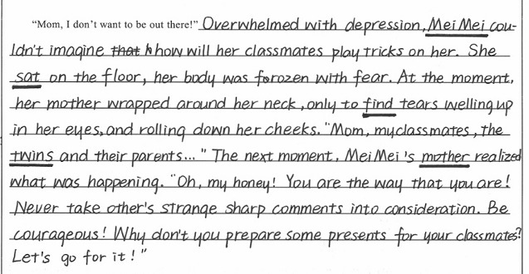
The twins are not tigers.

Slide 19
Tip4: Pay attention to the cohension

Slide 20
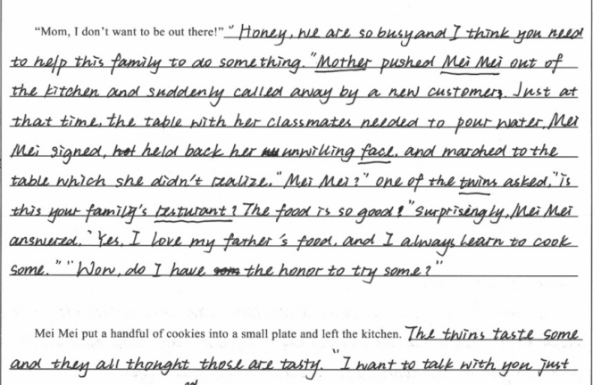
点评：
1. 根据第二段的段首，第一段MeiMei应该没有离开厨房，她在厨房里徘徊，犹豫，而该篇第一段母亲没有给女儿思考的空间，也没有和女儿进行沟通，直接把她推了出去。这两个地方都与文章的整体谋篇布局衔接不够。
2. 根据上文MeiMei 的心理动态，她对她同学的位置是非常清晰的，不会出现不知不觉走到那个位置，此处衔接也欠妥。

Slide 21
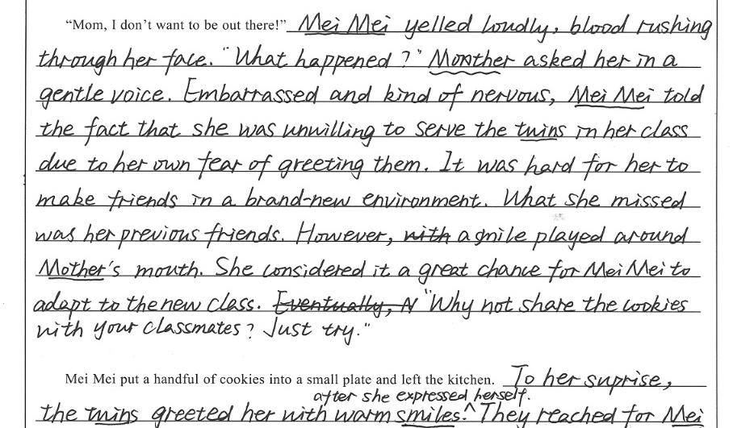
第一段段末与文章第二段有衔接，但是跳跃太快，缺乏MeiMei的思想改变过程

Slide 22
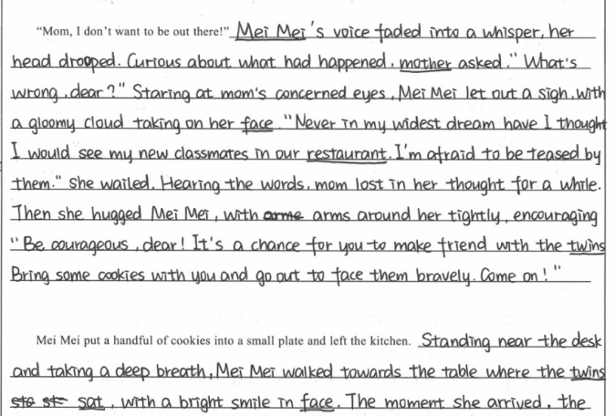
natural

Slide 23
Tip5: Try to plan an appealing ending

Slide 24
Appealing Endings?
√
合情合理，出人意料
√
寓情于景，情景交融
√
设置悬念，留白想象空间
√
合理推断，拔高立意
√
情感真挚，激发共鸣

Slide 25
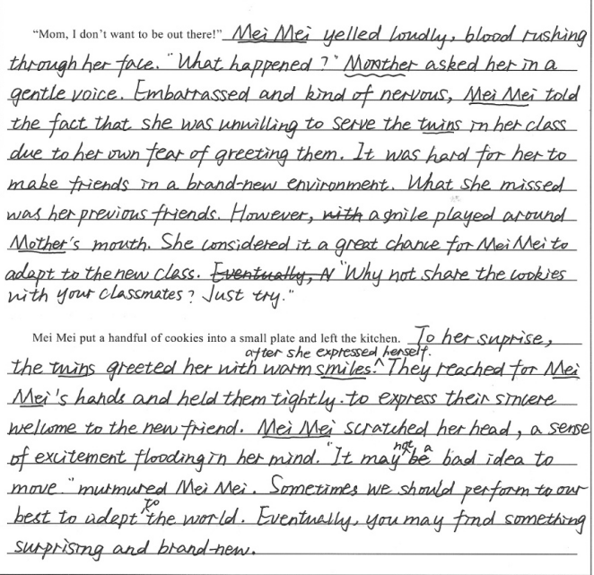
点评：
1.该篇文章在呼应和布局上比较到位。第一段塑造了一个智慧的母亲的形象。当MeiMei诉说不能适应新的环境的时候母亲马上发现 问题并借机培养MeiMei的适应环境的能力。
2. 第二段，同学的热情，MeiMei的小尴尬，得到同学认可的小喜悦都自然的呈现在读者面前。以及作者在最后又画龙点睛的利用brand-new和第一段进行呼应。使文章的整个线条非常流畅，舒服。

Slide 26
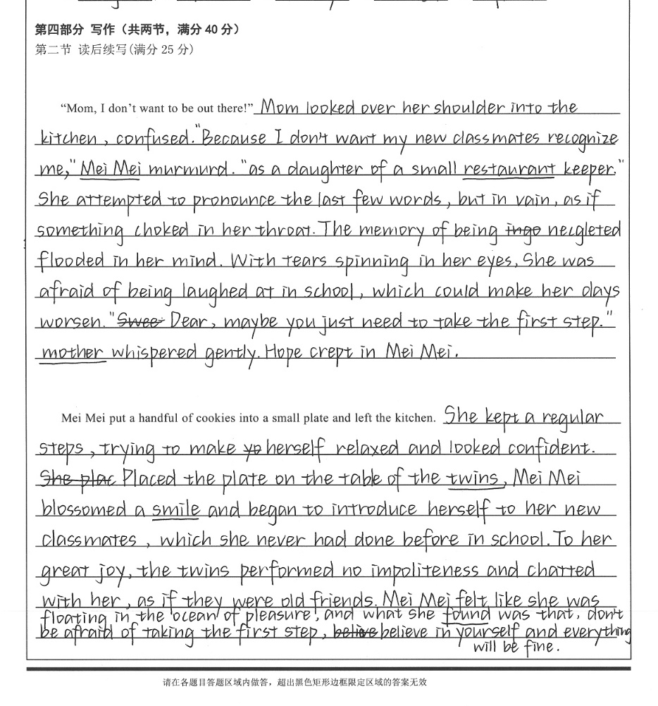
点评：该篇文章在构思结尾的使用也注意到了与第一段进行一个简单的呼应，把小作者的那种心理变化过程非常巧妙的串联在一起。
to
utter
neglected
worse
呼应
naturally

Slide 27
The Original Ending of
“Fortune Cookie Friends”
by RV Staff Writer J.C.

Slide 28
“Mom, I don’t want to be out there. There are kids from school!”
“So?” her mother asked. “That’s good! Go take them some fortune cookies and say hello!” She clucked her tongue disapprovingly at Mei Mei and disappeared out of the kitchen. Mei Mei frowned. She grabbed a handful of fortune cookies that they gave out after every meal, but first she tore open a wrapper and cracked a cookie open for herself. She popped a sweet, crunchy piece in her mouth, and absently read the paper fortune it held. “Many friends are found with a single smile,” it read. Mei Mei put a handful of cookies into a small tray and left the kitchen.
Mustering up her courage, Mei Mei approached the table where the twins and their parents were finishing their meal. She placed the cookies down, and bravely looked the girls in the eyes. She smiled. “Thanks so much for coming to our restaurant! I hope you liked everything,” Mei Mei said. “Ooh, fortune cookies, I love these!” One of the girls exclaimed, reaching for the tray. The other sister looked closely at Mei Mei. Then her eyes lit up with recognition. “Hey! You’re that new girl in our class, right? Isn’t your name Mei Mei?”

Slide 29
Sampes from students

Slide 30
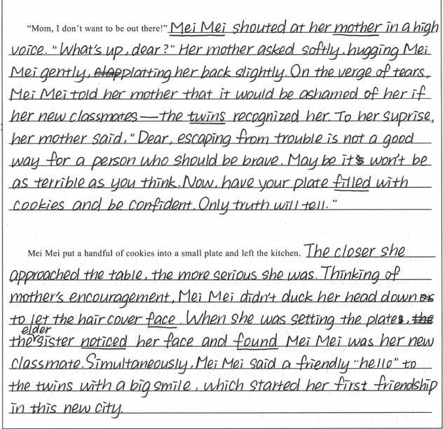

Slide 31
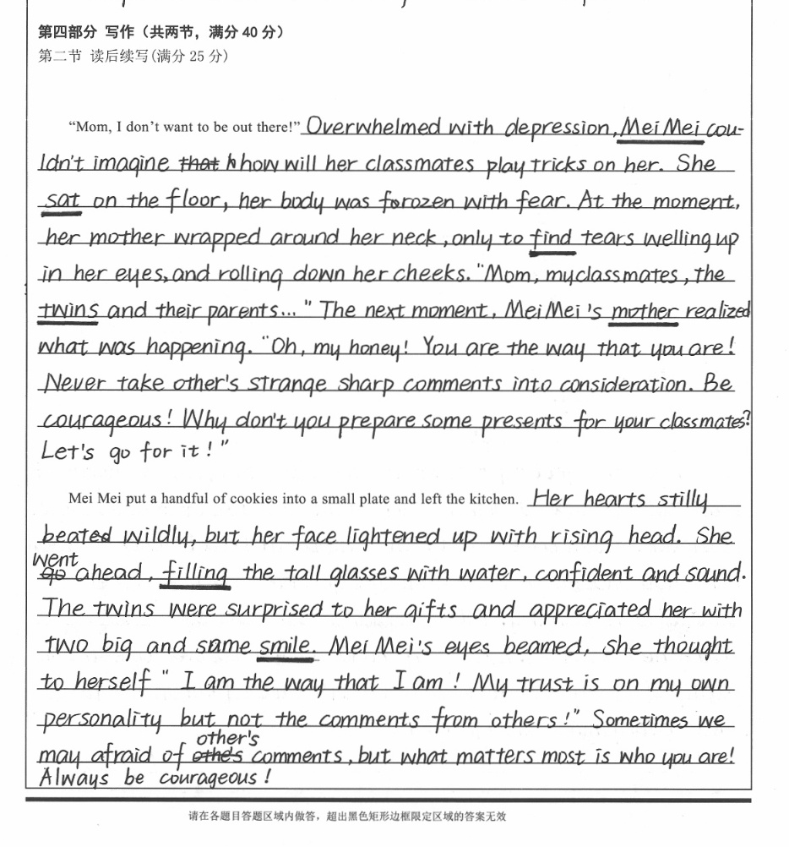

Slide 32
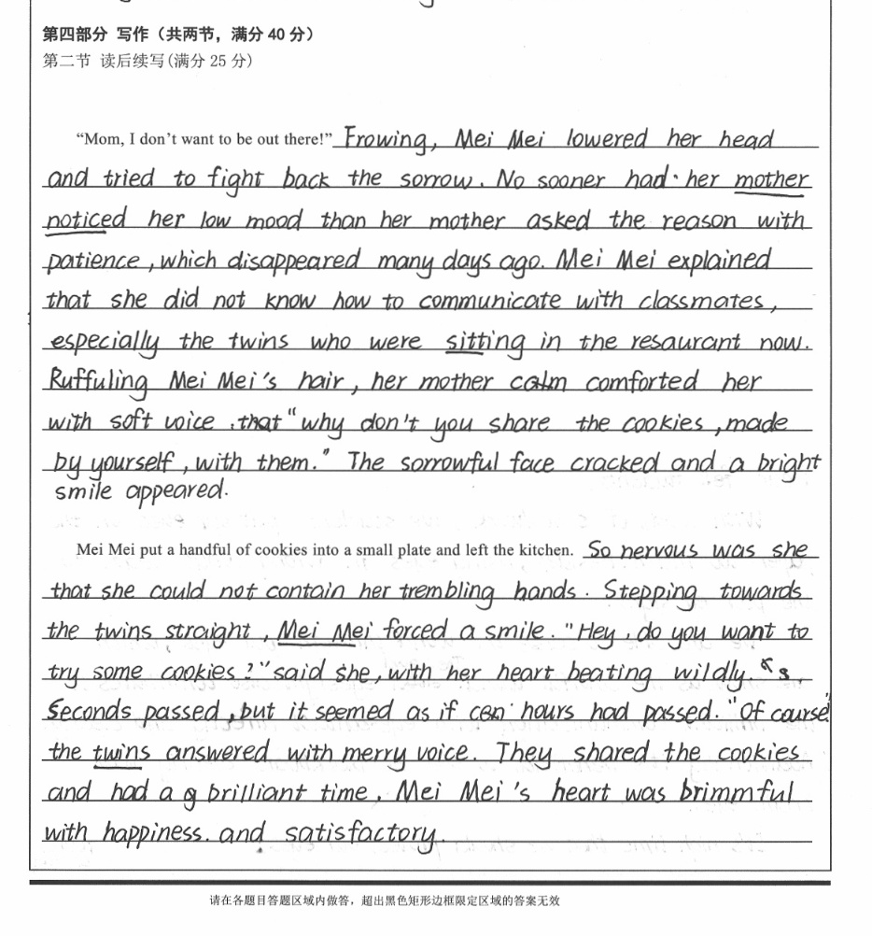

Slide 33


