Slide 1

感恩遇见，相互成就，本课件资料仅供您个人参考、教学使用，严禁自行在网络传播，违者依知识产权法追究法律责任。
更多教学资源请关注
公众号：溯恩高中英语
知识产权声明

Slide 2

A letter of appeal
Quzhou Zi Gang High School
Fang Hui

Slide 3




play

Slide 4

Practical writing
appeal
A letter of

Slide 5
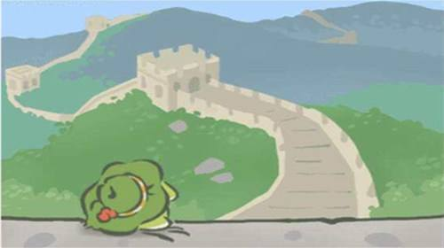
main menu
n e w
continue
ranking
tips

Slide 6

最近，某国际学校很多学生犹豫由于用眼过度或用眼不当，视力下降很快。假如你是该校学生李华，请你用英文向全校同学发起以“爱护眼睛”为主题的倡议书，内容包括：
1.用眼存在的问题
2.爱护眼睛的意义
3.提出倡议
注意：
1.词数80左右
2.可适当增加细节，以使行文连贯

Slide 7


衔接词
好词佳句
布局谋篇
审题

Slide 8
最近，某国际学校很多学生犹豫由于用眼过度或用眼不当，视力下降很快。假如你是该校学生李华，请你用英文向全校同学发起以“爱护眼睛”为主题的倡议书，内容包括：
1.用眼存在的问题
2.爱护眼睛的意义
3.提出倡议
注意：
1.词数80左右
2.可适当增加细节，以使行文连贯
体裁格式
明确对象
审题
理清要点
阐明语言

Slide 9
审题
体裁格式
Dear fellow students,
Li Hua
（Apr.27th,2020）
A letter of appeal
最近，某国际学校很多学生由于用眼过度或用眼不当，视力下降很快。假如你是该校学生李华，请你用英文向全校同学发起以“爱护眼睛”为主题的倡议书，内容包括：
1.用眼存在的问题
2.爱护眼睛的意义
3.提出倡议
注意：
1.词数80左右
2.可适当增加细节，以使行文连贯
明确对象
Students in the school
You or we?
全校同学
理清要点
阐明语言
写信目的
倡议书
Formal or informal?
Differences between appeal and proposal!
How to make an appeal?
用眼过度-后果
保护眼睛-意义
希望决心-呼吁

Slide 10

写信目的
用眼过度-后果
布局谋篇
cause
effect
具体措施-呼吁
保护眼睛-意义
Do not always roughly divide your passage into 3 parts.
It is advisable to outline your passage in accordance with logical sequence.

Slide 11

写信目的/后果
overuse of eyes
use eyes too much
excessive or improper use of eyes
Be occupied with online study for such a long time
……
Come straight to the point
最近，某国际学校很多学生由于用眼过度或用眼不当，视力下降很快。
因
用眼过度
因
果
Suffer from poor eyesight
give us vision loss
Impair one’s eyesight
Fall; decline; drop (quickly/dramatically/sharply…)
……
视力下降
due to
account for
result in
on account of
Seeing that…
Since/for
Thus
therefore……
Recently , many students suffer from poor eyesight due to excessive or improper use of eyes. Thus, I’m advocating “Protect Our Eyes”.
Seeing that recently many students’ eyesight declines quickly due to the overuse of eyes, I’m advocating “Protect Our Eyes”.
Advocate
Call for
Fly the flag for
Be quite vocal about
Give voice to
……
请你用英文向全校同学发起以“爱护眼睛”为主题的倡议书
果
发起倡议

Slide 12

保护眼睛-意义
呼吁-具体措施
Eyes are windows to the soul. Good eyesight gives us a new and more accurate view of the world and also enables us to enjoy the beauty in sight.
We need to develop a good habit , such as reading in proper light and often watching out of the window vision or green plants.
Eyes are windows to the soul.
The eye is the index of the heart.
..give us a new and more accurate view of the world.
..enable us to enjoy the beauty in sight…
To develop/form a good habit:
Ease the tension by stretching or relaxing oneself with one’s eyes closed.
Read in proper light
Look into the distance after long-time study…
It is advised/suggested that…
Be required/supposed to
It would be better that…
It is urged that…
Often watch out of the window vision or green plants
Read and write every 50minutes to rest our eyes
Sitting upright when reading
......
Maximize the characteristics of the letter of appeal:
Focus on calling for action
Begin the sentence with the detailed actions, not only the fixed sentence pattern, especially featuring a letter of advice.

Slide 13

好词佳句
Take care of your eyes and embrace the light.
Take care of your eyes. The world waits for you to discover!
Love your eyes , love your life , and keep your life healthy.
Science with eyes, without infinite!
See well, live well!
Choose one for your ending!

Slide 14
衔接词/句
Recently , many students suffer from poor eyesight due to excessive or improper use of eyes. Thus, I’m advocating “Protect Our Eyes”.
Eyes are windows to the soul. Good eyesight gives us a new and more accurate view of the world and also enables us to enjoy the beauty in sight.
We need to develop a good habit , such as reading in proper light and looking into the distance after long-time study.
See well, live well!
Good eyesight not only can give us a new
and more accurate view of the world but also enable us to enjoy the beauty in sight.
So we
So only when we form a good habit of protecting eyes, such as doing regular eye-exercises or reading in right light, can we really enjoy our life.
Let’s take action immediately!
Don’t hesitate it to act at once!
It ‘s high time that…
Call for action strongly
Use particular sentence pattern to highlight your appeal!

Slide 15
One possible version:
Dear fellow students,
Currently, many students suffer from poor eyesight due to excessive or improper use of eyes. Thus, I’m advocating “Protect Our Eyes”.
Eyes are the window to the soul. Good eyesight not only can give us a new and more accurate view of the world but also enable us to appreciate the beauty in sight . Anyway , only when we form a good habit of protecting eyes, such as doing regular eye-exercises or reading in right light, can we really enjoy our life.
See well, live well. So don’t hesitate to act at once!
Li Hua

Slide 16

Draw a conclusion

Slide 17
The features of the letter of appeal
Aiming at the mass
Be clear of your object
Uncertain reaction
Be practical
openness
Be sincere and passionate
Arouse resonance to the full extent

Slide 18
Main parts of the letter of appeal
Dear fellow students,
Currently, many students suffer from poor eyesight due to excessive or improper use of eyes. Thus, I’m advocating “Protect Our Eyes”.
Eyes are the window to the soul. Good eyesight not only can give us a new and more accurate view of the world but also enable us to appreciate the beauty in sight . Anyway , only when we form a good habit of protecting eyes, such as doing regular eye-exercises or reading in right light, can we really enjoy our life.
See well, live well. So don’t hesitate to act at once!
Li Hua
The purpose
The content
The requirements/proposal
The ending

Slide 19
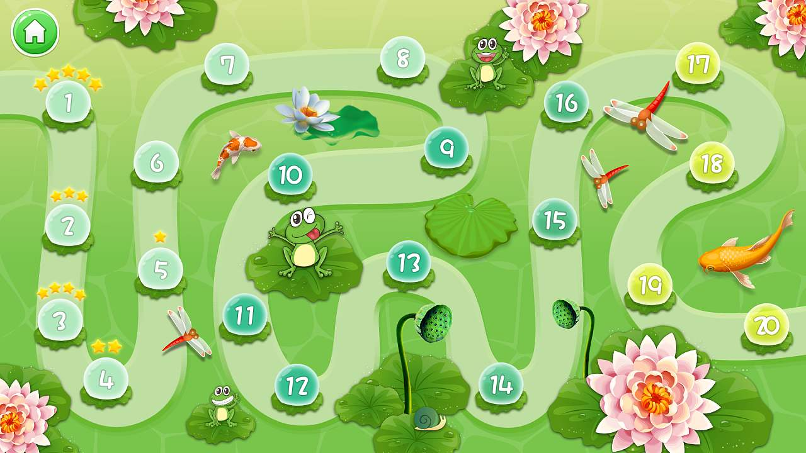

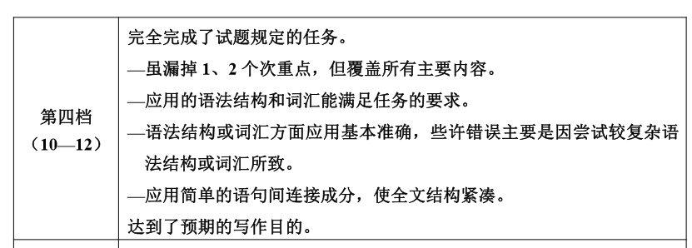
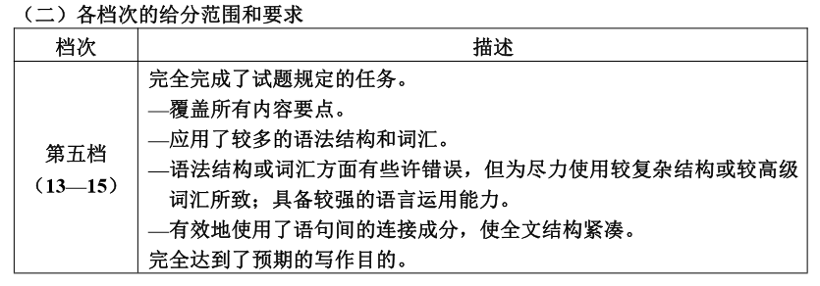



Slide 20
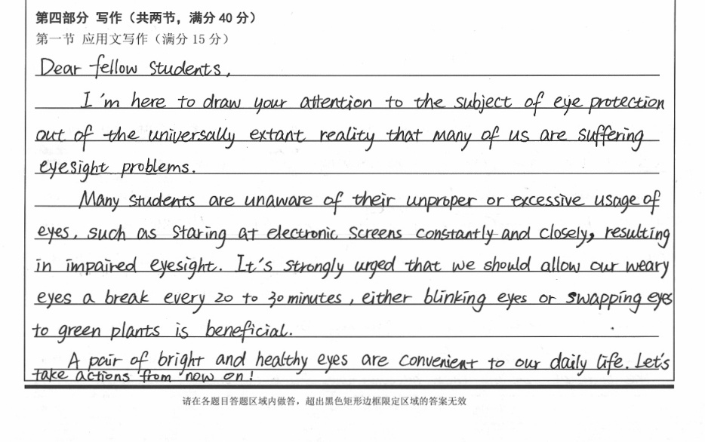
Higher- level representation
It is +adj +that
gerundial phrase

Slide 21
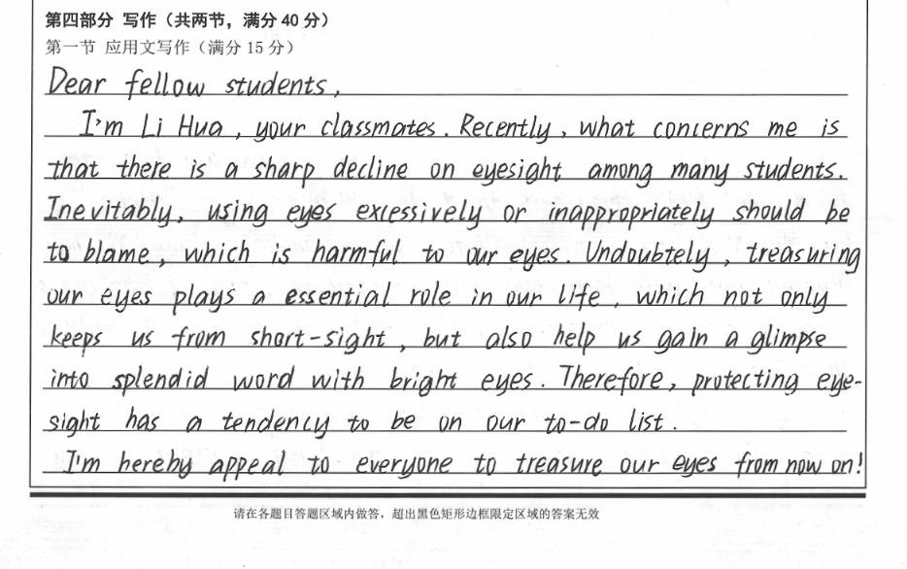
Subject clause
Accurate adj/adv
attributive clause
Proper phrases

Slide 22
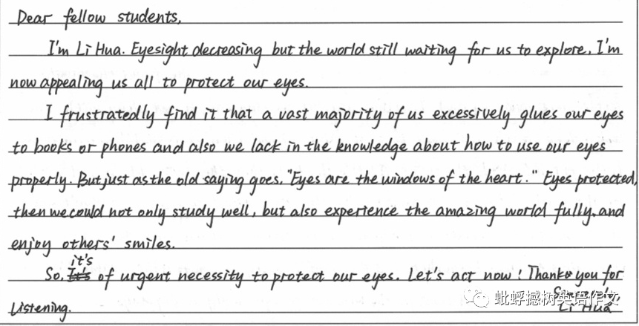

Slide 23

Tips

Slide 24
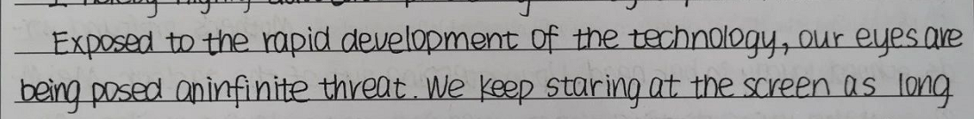
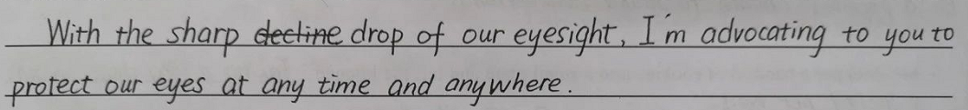
Make use of structures with participles to develop sentences.
Make use of structures with “with” to develop sentences.
Make use of structures with “it” to develop sentences.
Make use of specific clauses, accurate adj/adv and etc.

Slide 25
为了配合学校开展垃圾分类工作，学生会向全校学生发出了“垃圾分类，从我做起”的倡议。 假如你是学生会主席李华，请你用英语写一封倡议书，内容包括：
垃圾分类的意义
2. 垃圾分类的做法
3. 呼吁全体学生参加

Slide 26



