Slide 1

感恩遇见，相互成就，本课件资料仅供您个人参考、教学使用，严禁自行在网络传播，违者依知识产权法追究法律责任。
更多教学资源请关注
公众号：溯恩高中英语
知识产权声明

Slide 2


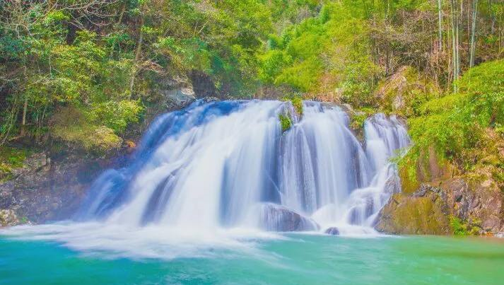

A Welcome Letter
DESIGNES BY Sliva
DESIGNES BY sliva
台州市第一中学 周 媚
台州市第一中学 陈泓静

Slide 3

sample letters of welcome
On behalf of the school’s Student Union, I heartily welcome you to our school.
In the coming week, you are scheduled to explore more about the splendid Chinese culture through some specific classes and co-curricular activities. Being a country of great traditions, its cooking skills are outstanding. Hence, we’ll arrange for you to learn some Chinese cooking skills. Meanwhile, a competition organized at the end will allow you to display how skilled you are at using chopsticks.
I highly encourage you to get involved and have an enjoyable stay in China.
It’s a great opportunity for me to welcome you as a guide during these days.
For your stay in Ningbo, I’ll arrange for you to visit some of the most famous places of interest here, like Tianyi Square, Tianyi Pavilion and Dongqian Lake. Meanwhile, I'll also take you to taste some of the delicious local food. I bet you’ll have a most enjoyable week.
Would you please tell me some information about your flight so that I can pick you up at the airport? Looking forward to seeing you again.

Slide 4


The first paragraph must be a welcome; one that reveals your excitement of the person's arrival.
Build the body of the letter with 3 or more points.
Don’t forget to express your sincere wishes.
Be brief and expressive without being overly dramatic.

Slide 5

假如你是李华，得知在疫情得到控制之际，本市大力恢复旅游行业。你作为志愿者给所有游客写一封信，要点如下：1. 表示欢迎；
2. 介绍本地风景、文化等；
3. 提醒游客们依然要注意防控。
欢迎信
第二人称：you
Dear Sir or Madam/distinguished visitors/travellers/tourists,
Part 1: state background & express your welcome(purpose)
Part 2: introduce sights and culture & remind of prevention
Part 3: show your wish
Yours truly,
Li Hua

Slide 6
Part 1 : express “welcome”
1. I’m writing to warmly/ cordially / sincerely/ heartily welcome (v.) you to our city.
2. On behalf of our city, I’d like to extend express/convey my heartfelt
/warmest welcome (n.) to you.
3. You are warmly welcome (adj.) to our city.
4. Welcome (adj.) to our city! We are delighted/pleased to see you as a guest.
5. We are proud that you have chosen our city as your priority.

Slide 7

Part 1 : state background+purpose
I’m writing to express our welcome to you--all the visitors--to our city. As the epidemic has been under control, our city, aiming at__________________(恢复旅游业), has reopened many scenic spots. (金烨)
restoring the tourism
Since the epidemic has been contained, I’d like to extend my warm and sincere welcome to you . Your arrival is certain to help _____________(促进旅游业) in our city. (陈博)
boost tourism
I’d like to convey my sincerest welcome to you on behalf of all the volunteers. I hope you can have fun to the fullest after the epidemic has been controlled and the tourism industry ______________(已被恢复). (李奕臻)
has been resumed
making a quick recovery
Epidemic controlled, tourism is now_____________________(正在快速恢复中). Accordingly, you’re now warmly welcome to our city. (余定睿)

Slide 8
Part 2 : introduce sights+culture
First and foremost, you will gain a feast for eyes with satisfaction while visiting Taizhou as there are various scenic spots for you to select. What’s more, Taizhou is also a good place to experience the culture of historical accumulation. (林曦)
Taizhou is a historical city where you can enjoy the amazing ocean, taste delicious seafood and visit the Linhai Great Wall. Additionally, there are a lot of unique cultural heritages such as Taizhou Luantan, which is known as a wonderful feast for eyes and ears. (俞心瑶)
Speaking of the well-known tourist spots of Taizhou City, Shenxianju is a must-go, which is prestigious for its enchanting mountain view. Besides, Ziyang Old Street is also well worth visiting for the cultural traditions related to it. (王一鸣)
It is superb landscape and distinctive customs that make Taizhou a remarkable city. One of the most attractive spots is Baiyun mountain, from where you will have a stunning bird view of the whole city. Standing in the center is Harmony park ,whose cultural atmosphere may leave you a deep impression. In brief, you will be drowned in various charming sights. (张鱼米)
Shengxianju is recommended to those who is desperate for fresh air and picturesque scenery . Moreover, the historical and traditional culture based on the War of Liberation is also popular.
(洪宇琪)

Slide 9
Part 2 : introduce more points
Moreover, Taizhou is widely known for its delicious snacks, let alone tasty fried shrimps and shibingtong. (王铭基)
Besides, Taizhou is also located by sea, which makes it possible for you to have a seafood feast. (陈沂璟)
What’s more, it’s generally acknowledged that Taizhou is famous for its seafood. Never will you forget its charm once you taste it.
(陈杰）
By the way, the people here will also definitely impress you with their kindness and hospitality. (胡彦哲)

Slide 10


Part 2 : use advanced phrases
picturesque scenery/gorgeous landscape/attractive places of interest
offer a feast for eyes and broaden one’s horizons
enjoy the beautiful nature and refresh one’s spirits
ancient architecture/ magnificent museums/ historical heritage
provide an important platform for cultural learning
act as easy access to profound and splendid cultural relics
have a better command of Taizhou conventional culture
harmonious atmosphere /hospitable people…
feel the vigorous charm of the city and kindness from local people

Slide 11
Part 2 : remind visitors
However, it’s still sensible to pay attention to precautions in case of the rebound of epidemic. (徐伟强)
Furthermore, please never forget to wear masks and keep a safe distance from each other during your stay in our city. (陈奕凯)
In addition, due to the incompletely contained epidemic situation, please don’t forget to protect yourself. (陶越越)
More importantly, you’d better attach great importance to the prevention measures, like wearing masks and keeping away from others. (林一)
Last but not least, I remind you to treat the epidemic seriously, which means that you still need to take preparatory measures. (林浩)

Slide 12

Part 3 : convey wishes
1. Hopefully, you can enjoy your stay here. (应昂蔚)
2. I sincerely hope you’ll have a pleasant visit in Taizhou. (虫虫)
3. Wish you an delightful/enjoyable and unforgettable trip here. (国王)
4. I bet you’ll have a most enjoyable time/have fun here. (芊语)
5. Don’t miss the opportunity to enjoy yourself in Taizhou. (王文杰)

Slide 13
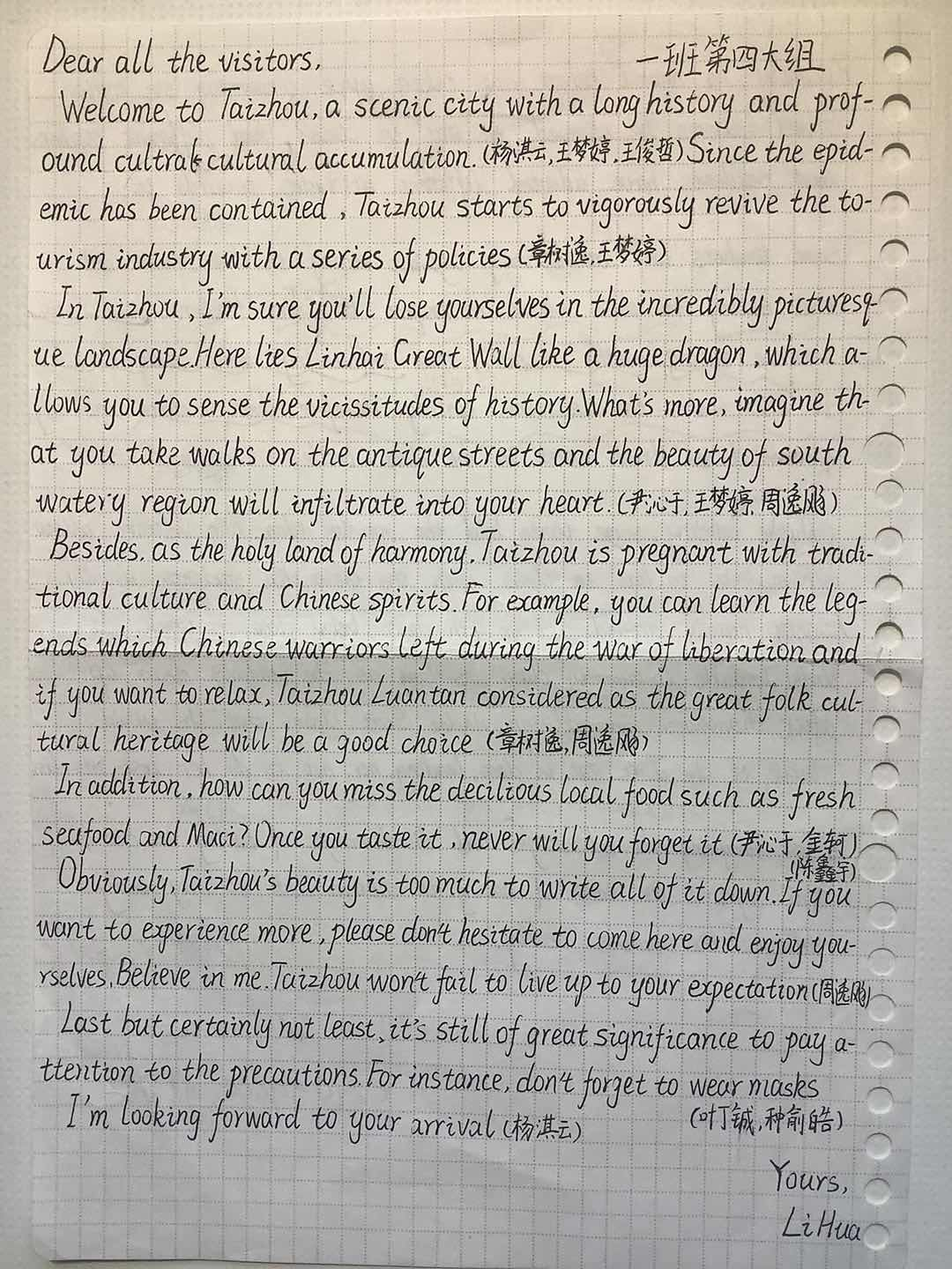

students’ composition
too long
too complicated
--bad impression
Para 1: welcome
and background
Para 2: sights
divide one word into improper two parts
Para 3: culture
Para 4: more points
Para 5: conclusion
Para 6: precaution
How to make it brief, practical and understandable?
Para 7: wish

Slide 14

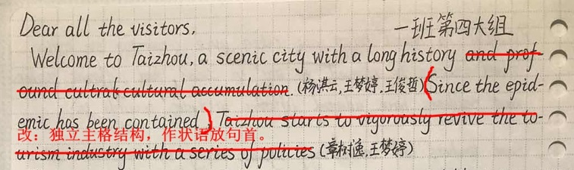
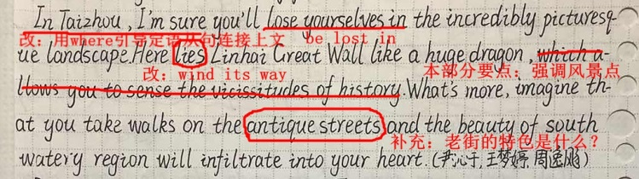
开头要简洁
Dear visitors,
Epidemic contained, welcome to Taizhou, a scenic city with a long history, where
you’ll be lost in the incredibly picturesque landscape. The Great Wall in Linhai, like a huge dragon, winds its way from east to west. As well, in Jiaojiang, Haimen ancient street is lined with shops of all kinds, in which you can buy varieties of local souvenirs.
where

Slide 15



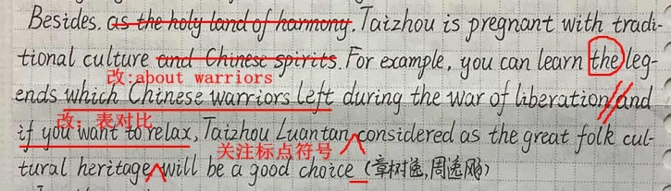

Besides, Taizhou is pregnant with traditional culture. For example, you can learn lots of legends about warriors during the war of liberation. While for relaxation, Taizhou Luantan, considered as the great folk cultural heritage, will be a good choice. In addition, how can you miss the delicious local food such as seafood and maci? Once you taste it, never will you forget it.

Slide 16


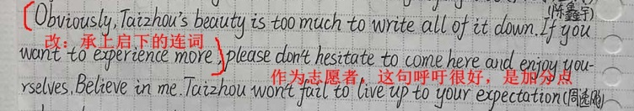


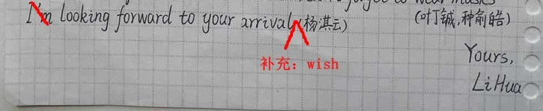
therefore
Therefore, please don’t hesitate to come here. Believe in me. Taizhou won’t fail to live up to your expectation.
Last but certainly not least, it’s still of great significance to pay attention to the precautions. For instance, don’t forget to wear masks.
Looking forward to your arrival and I bet you will have an enjoyable time.

Slide 17
Dear visitors,
Epidemic contained, welcome to Taizhou, a scenic city with a long history, where you’ll be lost in the incredibly picturesque landscape. The Great Wall in Linhai, like a huge dragon, winds its way from east to west. As well, in Jiaojiang, Haimen ancient street is lined with shops of all kinds, in which you can buy varieties of local souvenirs.
Besides, Taizhou is pregnant with traditional culture. For example, you can learn lots of legends about warriors during the war of liberation. While for relaxation, Taizhou Luantan, considered as the great folk cultural heritage, will be a good choice. In addition, how can you miss the delicious local food such as seafood and maci? Once you taste it, never will you forget it. Therefore, please don’t hesitate to come here. Believe in me. Taizhou won’t fail to live up to your expectation.
Last but certainly not least, it’s still of great significance to pay attention to the precautions. For instance, don’t forget to wear masks.
Looking forward to your arrival and I bet you will have an enjoyable time.
Yours sincerely,
Li Hua
选择一个例子
The Great Wall in Linhai, like a
huge dragon, winds its way from east to west.
in Jiaojiang, Haimen ancient
street is lined with shops of all kinds, in which you can buy varieties of local souvenirs
选择一个例子
you can learn lots
of legends about warriors during the war of liberation
for relaxation, Taizhou
.
整句
去掉
直接写出措施
可选择一部分
(184 words)

Slide 18

Writing sample 1
Dear visitors,
Epidemic contained, welcome to Taizhou, a scenic city with a long history, where you’ll be lost in the incredibly picturesque landscape. The Great Wall in Linhai, like a huge dragon, winds its way from east to west.
Besides, Taizhou is pregnant with traditional culture. For example, Taizhou Luantan, considered as the great cultural heritage, will be a good choice for relaxation. In addition, how can you miss the delicious local food such as seafood and maci? Once you taste it, never will you forget it.
Last but certainly not least, it’s still of great significance to wear masks outdoors.
I bet you will have an enjoyable time.
Yours sincerely,
Li Hua
(99 words)

Slide 19
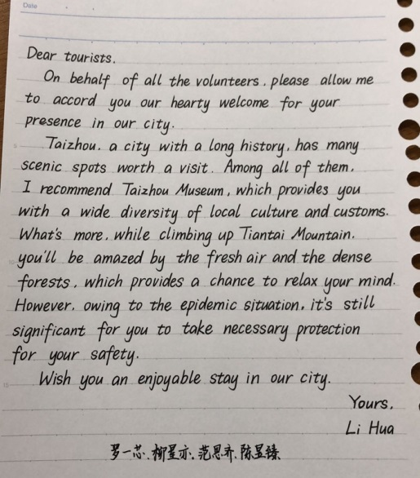
Advantages:
1. correct structure
2. advanced phrases and sentences
3. good handwriting
Improvement:
1. lack of background
2. accord--show
presence--arrival
3. add one more point
19分

Slide 20
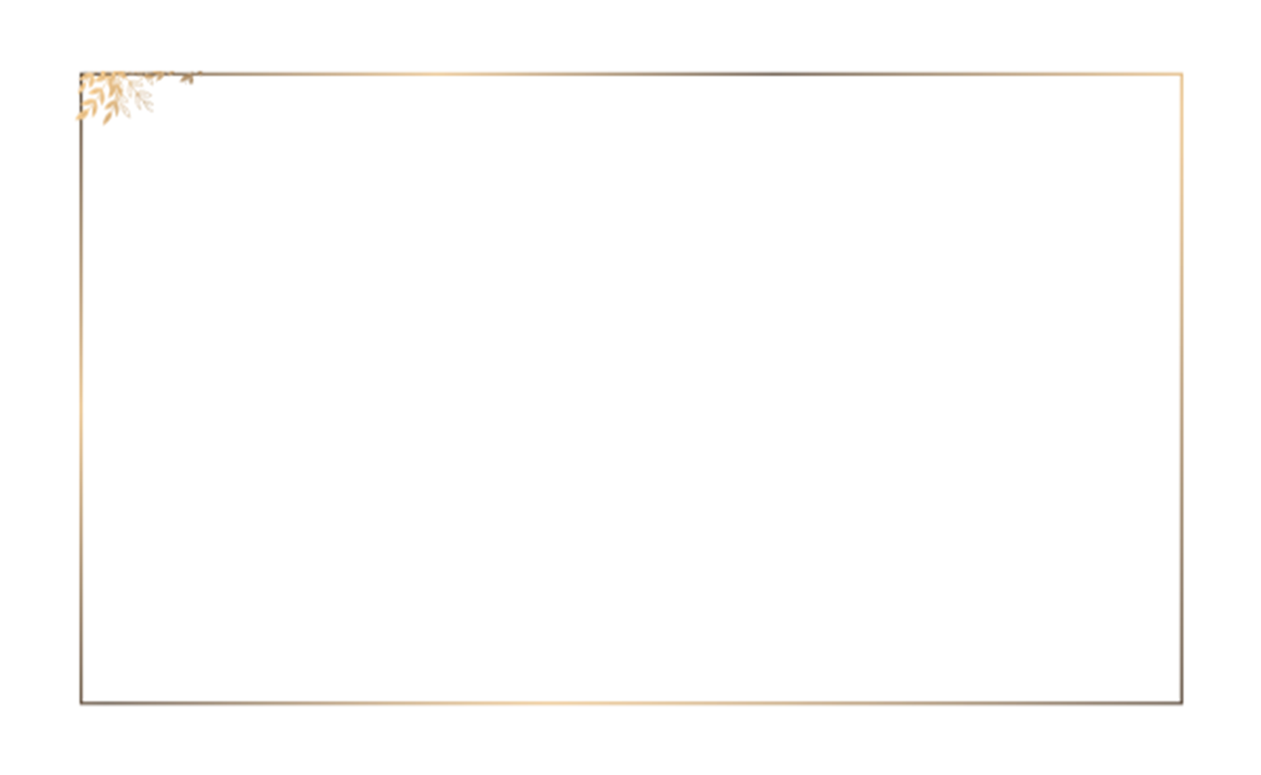
Writing sample 2
Dear tourists,
On behalf of all the volunteers, please allow me to show you our hearty welcome for your arrival in our city after the epidemic is nearly controlled.
Taizhou, a city with a long history, has many scenic spots worth a visit. Among all of them, I recommend Taizhou Museum, which provides you with a wide diversity of local culture and customs. What's more, while climbing up Tiantai Mountain, you'll be amazed by the fresh air and the dense forests, which provides a chance to relax your mind. Then, how about tasting some special local food such as maixia?
By the way, owing to the present situation, it's still significant for you to take necessary protection for your safety.
Wish you an enjoyable stay in our city.
Yours,
Li Hua

Slide 21
Writing sample 3
Dear tourists,
As the COVID-19 is _______ basic control in Taizhou, it’s _________(suit)to travel around and enjoy scenery. Now let me express my warm welcome to you all and give a brief____________(introduce).
Taizhou is ____ city with many places of interest. After _________(climb)up Baiyun mountain, you can not only breathe fresh air________(free), _______ overlook the whole city. In Haimen old street, you can appreciate _______ the city used to be as well as traditional food. But during your trip, keep cautious for the possible risk of getting _________(infect)with the corona virus. If you have suspicious symptoms, please tell me and quarantine ________(you) as soon as possible.
I hope you can stay safe and have a pleasant trip here.
Yours,
Li Hua
under
suitable
introduction
a
climbing
freely
but
what
infected
yourself

Slide 22

Writing sample 4
Dear Sir or Madam,
As the COVID-19 is becoming better contained, it’s much safer to take a trip. Thus, you are warmly welcome to travel in our city, Taizhou. Located in the southern part of Zhejiang Province, Taizhou is a favorably-situated city, which is the home to fish and rice, where you can taste the best seafood and specialties. Seeing the winding rivers and lofty mountains as well as enjoying the gentle breeze and glowing sunshine here can lessen your depression from quarantine at home. Taizhou also boasts a wonderful glass carving museum, which can not only broaden your horizons but also help you get a better understanding of our local culture. However, it’s still highly recommended that you should wear your masks to prevent virus exposure.
Looking forward to your visiting.
Yours,
Li Hua

Slide 23


THANK YOU
DESIGHNED BY SLIVA

