Slide 1

感恩遇见，相互成就，本课件资料仅供您个人参考、教学使用，严禁自行在网络传播，违者依知识产权法追究法律责任。
更多教学资源请关注
公众号：溯恩高中英语
知识产权声明

Slide 2
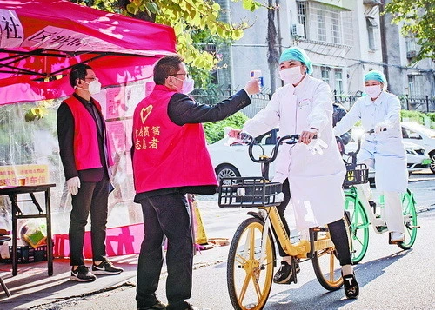
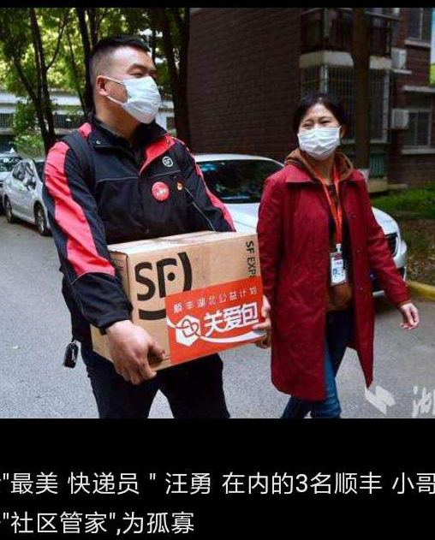
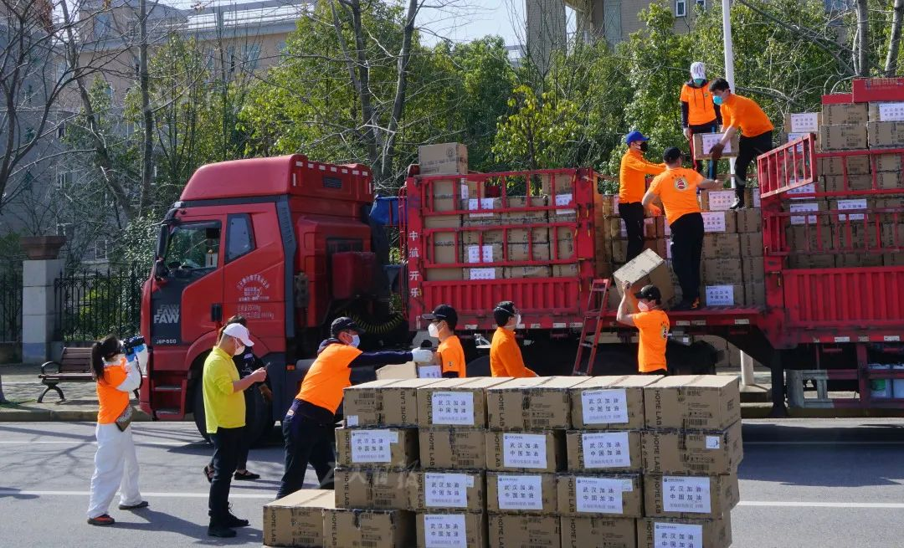

Slide 3
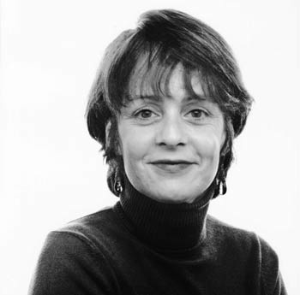
Unit 4 Sharing
A Letter Home
邱赛仙
浙江省衢州第三中学

Slide 4
Step1
Viewing and thinking
Look at the pictures and answer the following questions:
1. How many aspects of life have been introduced ?
2. How would you describe their way of life? (in pairs)

Slide 5
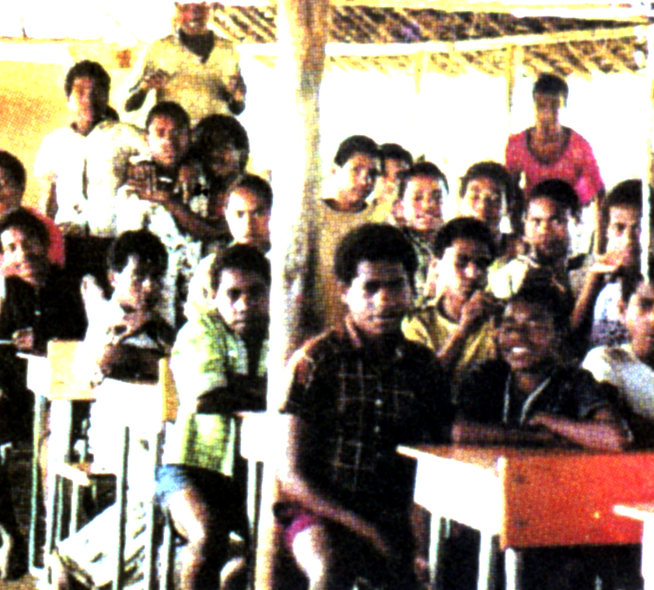
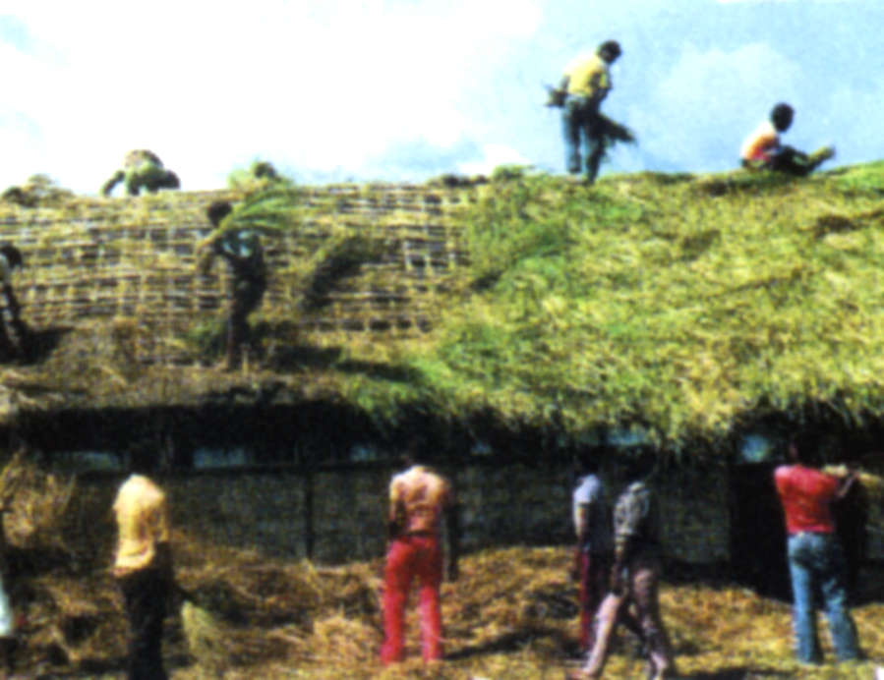
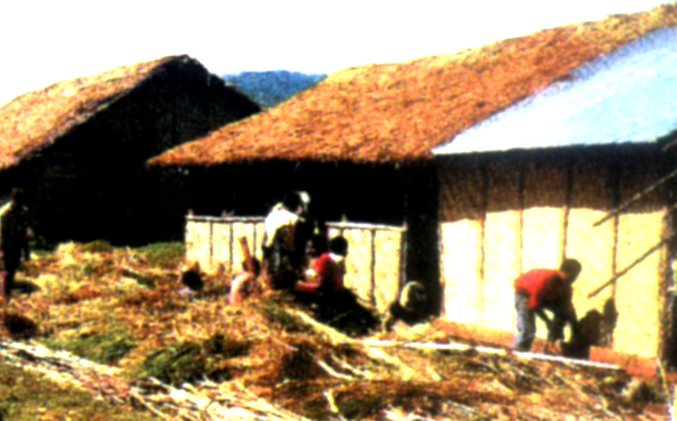
2 Students putting new
grass on classroom roofs
1 My class
school life
3 Building a new science lab

Slide 6
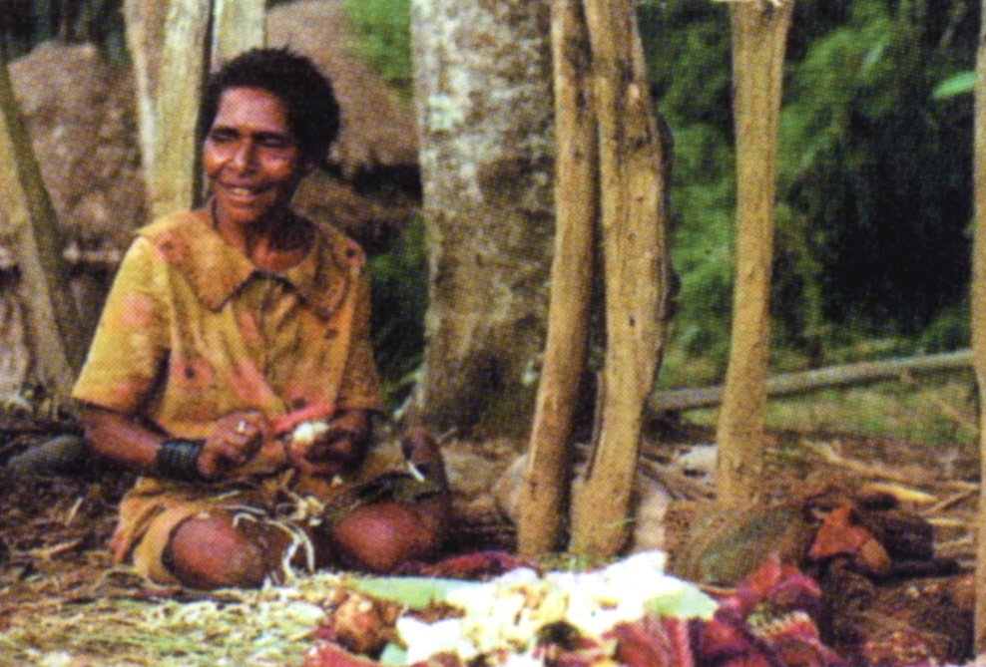
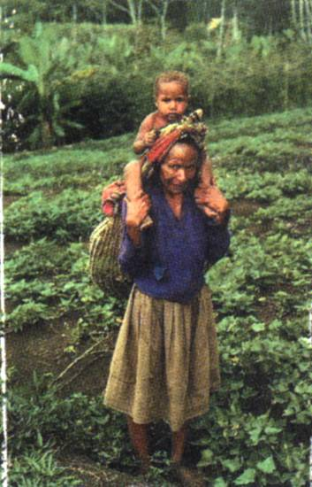
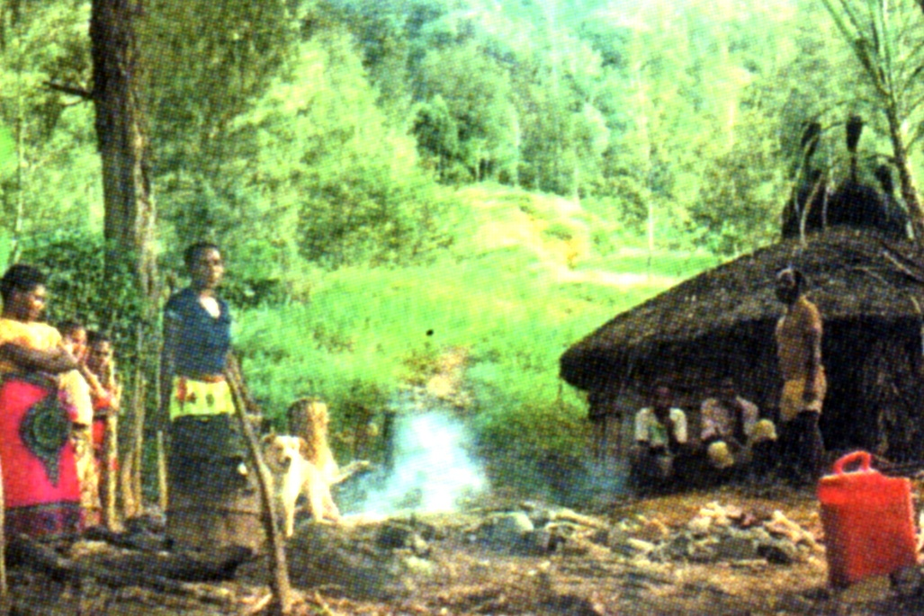
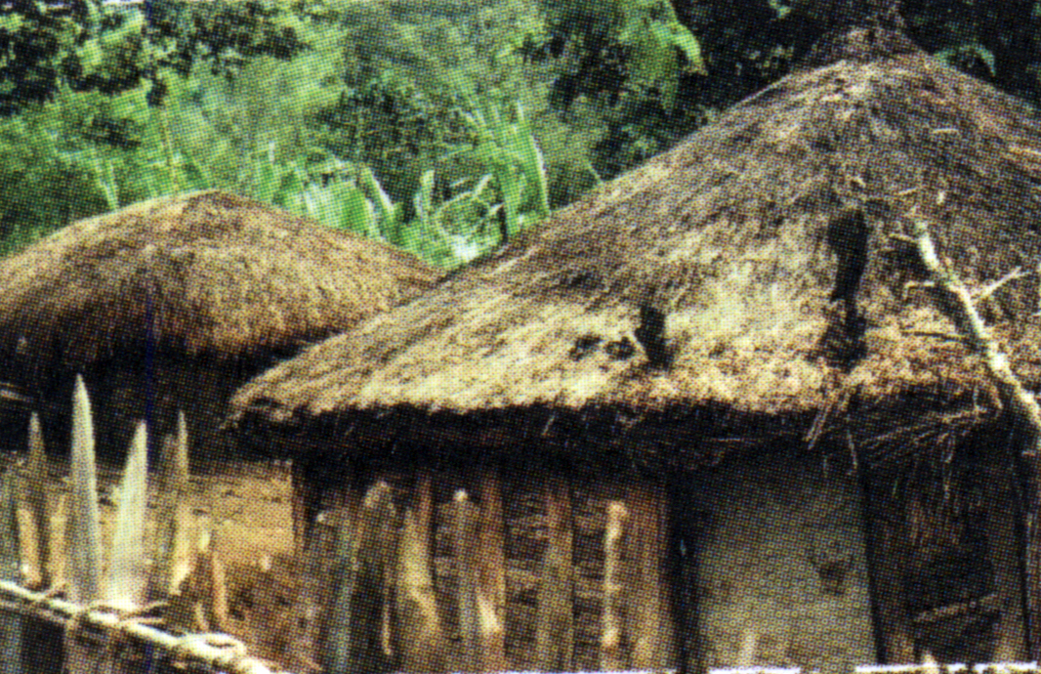
Village life

Slide 7
1. Their school life is uncomfortable:
no walls, no glass in the windows, no air-conditioner,no science lab ,maybe no computers, no telephones or none of the modern facilities
The roof of the classroom is held up by a pole.
The students themselves make the repairs.
2. Their village life is inconvenient :
The roads are muddy.
The houses are low and small.
The food is simple in varieties and tastes.

Slide 8
Step2
Reading and checking
1.What is their school life like?
2.What do you think of Jo and her students?

Slide 9
a bush school
no electricity or water
a muddy track
no textbooks
no equipment
walk two hours
school life
the boys
the teacher
eager to learn
curious
creative
confused
optimistic
diligent
devoted
imaginative

Slide 10
Step3
Predicting and reading
1.What will be included in your article if you are to introduce your town or village to a stranger?
2.Read the next few paragraphs and find out the way the author introduced the village.

Slide 11
surroundings
language
house modeling
village life
belief
traditional food
----
possessions

Slide 12
mountain, ridge, steep path,valley
surroundings
two and a half hours away
It is by a river at the bottom of a valley. It has steep slopes
all around it.

Slide 13
with grass sticking out of the top of the roof,
men's
round, not rectangular, no windows, small doorways,
floor covered with fresh grass
houses modeling
women's
Q:What can we infer from the differences between men's and women's houses?

Slide 14
traditional food
cooking method
staple food
what can we infer ?
Hot stones are placed in an oil drum, then vegetables are placed in the drum, covered with banana leaves and steamed.
sweet potato,
corn and greens, banana leaves, peanuts
They live on agricultural produce.
It is a tribal village in a developing country.
The country is located in the tropical zone.

Slide 15
possessions
one broom,
a few tin plates and cups,
a couple of pots,
oil drum
the grill
Q: What strikes you most in comparison with your own life ?

Slide 16
belief
The villagers believe in evil spirits.
They believe that leftover food attract evil spirits
so they dry it out in the can over the fire.
Then the can is thrown out of the hut.
Q: What do you think of their faith in evil spirits?

Slide 17
Greetings:
shook hands with all the villagers.
everyone seemed to be a relative of Tombe's.
“ieee ieee”
language
body language
farewell:
many goodbyes and firm handshakes
Q: What can we know from the way they greeted Jo?

Slide 18
Step4
Reading and thinking
the purpose of the letter
1. What are the first and the last two paragraphs for?
the feeling of the visit to the village

Slide 19
Step4
Reading and thinking
2.What can you read beyond the words from paragraph1?
Jo is doing voluntary far away from home.
The village is in a remote area.
Dear Rosemary,
Thanks for your letter, which took a fortnight to arrive. It was wonderful to hear from you. I know you’re dying to hear all about my life here, so I’ve included some photos which will help you picture the places I talk about.
The village is quite different from their hometown.

Slide 20
Jo was overwhelmed by the kindness and hospitality of the villagers.
Mentally
Jo felt honored to experience the culture.
Jo was devoting herself to the voluntary work.
We left the village the next morning after many goodbyes and firm handshakes. My muscles were aching and my knees shaking as we climbed down the mountain towards home. That evening I fell happily into bed. It was such a privilege to have spent a day with Tombe’s family.
It’s getting late and I have to prepare tomorrow’s lessons and do some paperwork. Please write soon.
Physically
Jo is tired with muscles aching and knees shaking.

Slide 21
Step5
Telling and viewing
1.Which country is the village in ?
2.Who are Jo and Rosemary?

Slide 22
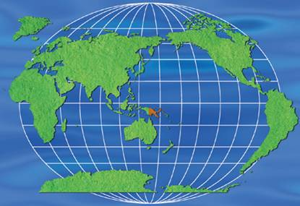
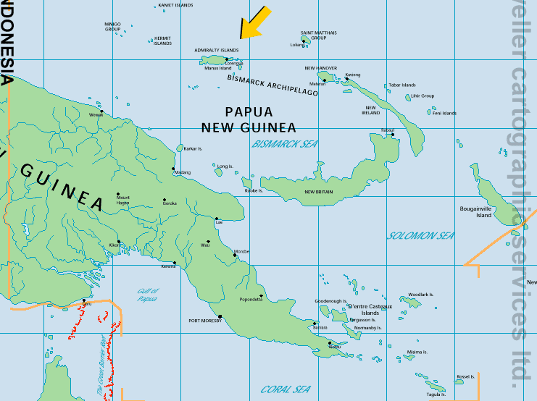
Independent State of Papua New Guinea
Location: situated to the north of Australia
Population: about 5.7 million

Slide 23
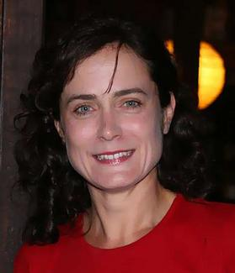
Jo, a young Australian woman of
Australian Volunteers International,
has worked as a volunteer teacher in
Papua New Guinea for two years.
Rosemary, a friend of Jo in Australia
is dying to know all about Jo’s life at
Papua New Guinea.

Slide 24
Assignment
discussion leader
interviewer
Reading Circles
connector
language master

Slide 25
Interviewer:
Suppose you are Rosemary , please prepare the questions you have for Jo in the reply to the letter.
Discussion leader:
Work in groups of four to choose a topic for your group to discuss.
Connector:
Compare the villagers' life with your own life and talk about what you can do for them as a volunteer.
Language master：
Pick out the language you find challenging or useful and try to relate them to what you have learned.

