Slide 1

感恩遇见，相互成就，本课件资料仅供您个人参考、教学使用，严禁自行在网络传播，违者依知识产权法追究法律责任。
更多教学资源请关注
公众号：溯恩高中英语
知识产权声明

Slide 2
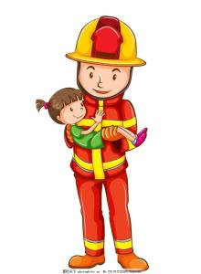
读后续写
Surrell, the Great “Firefighter”
浙江省天台中学 汤杰礼

Slide 3
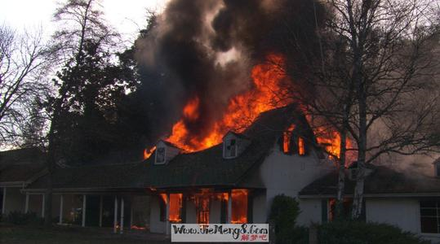
Lead-in Prediction
Surrell, the Great “Firefighter”
porch

Slide 4
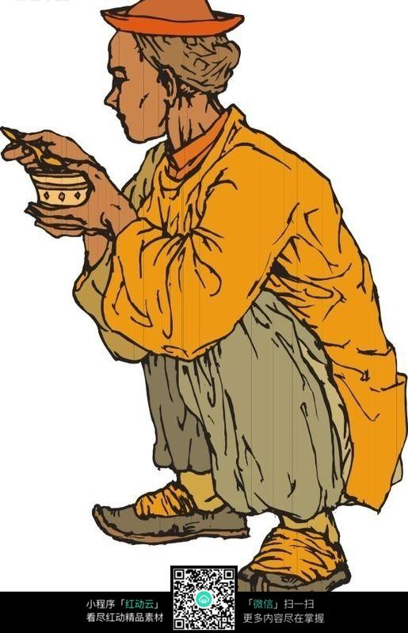
Lead-in Prediction
A firefighter?
Great?
Surrell

Slide 5
Basic elements for a story
step1. Read for basic information
Surrell’s neighbor’s home, the second floor, hospital
having a dinner at home
when
where
Surrell, Tiara, Tiara’s Grandmother and Tiara’s relatives
how
A story
who
why
Fire broke out in Surrell’s neighbor’s house when he was having a dinner at home. Tiara was trapped on the 2nd floor. Surrell dashed into the burning house to save her.
The house was on fire and Tiara’s grandmother and her relatives were crazily at a loss
Fire broke out and Tiara was trapped on the second floor
what

Slide 6

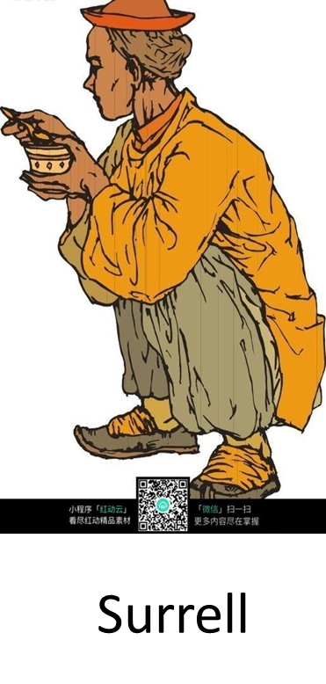
Interpretation of the Text文本解读
Reading for the relationship of the characters
neighbors
Tiara

Slide 7
Reading for the plot developments.
he saw two women(Tiara’s grandmother and aunt) and a girl(Tiara’s cousin) crazily at a loss on their porch.
desperately frightened
“The baby’s inside there!” one of the women cried.
worried
Surrell, then 64, instinctively(本能地) ran inside.
brave and fearless
… like running into “a bucket of black paint”. The thick smoke caused Surrell to walk blindly around, burned his eyes, and made it impossible for him to breathe. He felt his throat and lungs burned, and every blink stung(蛰) his eyes.
hard to rescue
Tip1: Pay more attention to the use of n., v., adj. & adv.

Slide 8

Step.2 Read for creation
✔
读后续写（满分25分）
阅读下面短文，根据所给情节进行续写，使之构成一个完整的故事。
注意：
所续写短文的词数应为150左右；
应使用5个以上短文中标有下划线的关键词语；
续写部分分为两段，每段的开头语已为你写好；
续写完成后，请用下划线标出你所使用的关键词语。
☚

Slide 9
Reading the first sentences of the two continued paragraphs for creation
Taking a deep breath, he went in a second time.______ ____________________________________________
____________________________________________
Surrell woke up in the hospital a couple of days later.__ ____________________________________________
____________________________________________
Taking a deep breath, he went in a second time.______ ____________________________________________
____________________________________________
Surrell woke up in the hospital a couple of days later.__ ____________________________________________
____________________________________________
Tip2: reverse thinking 逆向思维
woke up in the hospital a couple of days later
went in a second time.
What had happened to Surrell?

Slide 10

Read the first sentences for inferring
Para. 1
Taking a deep breath, he went in a second time.
Raise questions about the development.
(actions, words, feelings, thoughts ...)
Q1: Did Surrell succeed in saving Tiara? How?
Q2: What had happened to Surrell? And what about Tiara?
Q3: What might be Tiara’s grandmother and her relatives’ reaction?
Para. 2
Surrell woke up in the hospital a couple of days later.

Slide 11
Read the first sentences for inferring
Para. 2
Surrell woke up in the hospital a couple of days later.
*Raise questions about the development.
(actions, words, feelings, words ...)
Q1. What did Surrell find when he woke up? What did he ask firstly?
Q2. What might Tiara/Tiara’s grandmother have said and done in the hospital when she/they went to visit Surrell?
Q3. What might be Surrell’s reaction to Tiara’s/Tiara’s grandmother’s gratitude?
Tip3: The two given sentences can give us some hints on the plot development.

Slide 12
Step.2 Reading the underlined words for creation
Choosing the underlined key words
Characters | Surrell, Tiara
Time and places | hospital, outside, the second floor
Plot development | uncle, smoke, burned, lungs, dangerous
第二节：读后续写（满分25分）
阅读下面短文，根据所给情节进行续写，使之构成一个完整的故事。
注意：
所续写短文的词数应为150左右；
应使用5个以上短文中标有下划线的关键词语；
续写部分分为两段，每段的开头语已为你写好；
续写完成后，请用下划线标出你所使用的关键词语。
Notes:
①人物类中的“Surrell与Tiara”是本文主人公。故事情节的发展自始至终都是围绕着作者“Surrell”与Tiara之间展开，所以Surrell, Tiara都是必选词汇。Surrell与Tiara是邻居，Surrell对可爱、礼貌、乖巧的Tiara很是喜欢，于是不顾一切地冲进火海救护Tiara。Surrell在救护中受伤，Tiara和她的家人心存感恩，在医院一直守护Surrell，一直到他苏醒。这故事情节反映了邻里之间互爱互助，关系和谐的社区生活。
②时空类中的hospital, outside和the second floor是故事情节发展至高潮的必需地点。Surrell冲进火海，将Tiara抱出外面，可他自己却受伤送进医院抢救。因此，hospital, outside和the second floor在续写故事中都可以定为必选词汇。
③故事情节发展类中的uncle, smoke, burned, lungs, dangerous都是故事情节的发展与推进词汇，uncle称谓体现了Surrell与Tiara 之间的亲密关系，smoke增添了Surrell救护Tiara的难度，burned交代了Surrell在救护中可能被烧伤某一人体部位，lungs是Surrell救护Tiara前身体不适部位，而他却在身体不适的情况下义无反顾地冲进火海救护Tina，体现了他的无畏和勇敢，dangerous是当时救护时的处境，但故事的发展可以通过其他形式的渲染，而不必直接点出危险的处境。因此，下划线uncle, smoke, burned, lungs等词都可以定为续写的必选或可选词汇。

Slide 13
What condition and emotions might be described?
Paragraph 1: Taking a deep breath, he went in a second time. The house was full of smoke. He ran in the dark, and finally made it to the second floor. He could hardly breathe. “Tiara, where are you?” he cried. All he could hear was the sound of burning wood. Then a screaming cry, calling Uncle Surrell, came. He quickly crawled toward the sound. Finally, he touched something. It was Tiara. He pulled her on his back and said, “I’ve got you.” He ran out of the burning house, but he fell on the ground of the porch.
点评：内容完整，前后连贯，但是语言平铺直叙，缺少细节描写。
Showing is more powerful than telling.

Slide 14
How to show dangerous surroundings
Surrell didn’t see the black smoke or flames shooting from the windows of his neighbors’ home.
They heard someone screaming, “The house is on fire!”
Entering the burning house was like running into “a bucket of black paint”. The thick smoke caused Surrell to walk blindly around, burned his eyes, and made it impossible for him to breathe. He felt his throat and lungs burned, and every blink stung(蛰) his eyes.
Tip4: We can show dangerous surroundings by using ______, ______, ______, _______, and _______________.
adj.
adv.
actions
words
figures of speech

Slide 15
How to show nervous emotions
He saw two women and a girl crazily at a loss on their porch.
“Where is Tiara?” he asked desperately.
“The second floor,” her aunt shouted back.
He uttered a little prayer, “Well, God, this is it. You got to help me, because I’m not coming out without that little girl.”
Tip5: We can show dangerous surroundings by using ______, ___________, ______, _______, and ________.
adv.
prep. phrases
actions
words
thoughts

Slide 16
Polish the following sentences:
1. The smoke was heavy, and he walked blindly on the second floor and calling Tiara over and over again.
The smoke made it impossible for him to see the surround-ings and he felt his way on the second floor, calling Tiara his lovely girl desperately and repeatedly.
2. He pulled Tiara toward him and carried her in the arms and said, “I’ve got you.”.
He pulled Tiara toward him and hugged her tight and said, “Uncle’s got you.”.
3. Seeing Surrell, Tiara’s grandmother cried and thanked him.
Seeing Surrell, Tiara’s grandmother couldn’t hold back her tears of gratitude.

Slide 17
Create the story
Para. 1
Taking a deep breath, he went in a second time.
Para. 2
Surrell woke up in the hospital a couple of days later
feelings?
actions?
words?
……?
Showing is more powerful than telling.

Slide 18
A possible version 1
Para. 1
Taking a deep breath, he went in a second time. The house was full of heavy smoke. The smoke made it impossible for him to see the surroundings and he just felt his way, calling Tiara his lovely girl repeatedly. “Tiara, where are you?” he cried desperately. But all he could hear was the popping of burning wood. Just at moment, a soft but hopeful voice came. “Uncle, Surrell, I’m in my bedroom.” Without thinking twice, he dashed towards the bedroom, crashed into the door, pulled the little girl up and carried her outside. That was the last thing he remembered.

Slide 19
A possible version 1
Para. 2
Surrell woke up in the hospital a couple of days later. As he woke up, what he firstly cared about was Tiara’s safety. Hearing Tiara was all right, he smiled, coughing and nodding. Having suffered severe burns, he spent another two weeks in the hospital. Tiara recovered soon and was released from the hospital after two days. She and her grandmother went to visit Surrell. Seeing Surrell, Tiara’s grandmother couldn’t hold back her tears of gratitude. “Thank you, Surrell. Without your timely rescue, my granddaughter would have died in the fire.” She said, holding his hand tightly. “It’s a small price to pay and it’s my pleasure to do that. Tiaras is my angel.” Surrell held her hand, saying in a hoarse voice.

Slide 20
Assessment criteria for writing
Language
> 60%
Items （条目） | Levels（档次）
Logical content （情节合理) | ☆ ☆ ☆ ☆ ☆
Accurate and colorful expression (词汇使用的准确性和丰富性) | ☆ ☆ ☆ ☆ ☆
Accurate and colorful and coherent sentences (句子使用的准确性, 丰富性和连贯性) | ☆ ☆ ☆ ☆ ☆

Slide 21
A possible version 2
Para. 1
Taking a deep breath, he went in a second time. The darkness was overwhelming. He ran blindly in the blackness, and finally made it to the second floor, where he was met by intense heat. He was already out of breath. “Baby girl, where are you?” he cried desperately. All he could hear was the popping of burning wood. Then a soft but distinct moan emerged. He quickly crawled toward the sound. Finally, he touched something. A shoe, then an ankle. He pulled Tiara toward him and hugged her tight and said, “Uncle’s got you.” The last thing he remembered, he was outside.

Slide 22
A possible version 2
Para. 2
Surrell woke up in the hospital a couple of days later. Severe burns suffered and chronic obstructive pulmonary worsened, he spent another two weeks in the hospital. Tiara recovered soon and was released from the hospital after two days. She went to visit Surrell every day, singing songs and telling stories she learned from school. “Thank you for saving my life, my dear uncle.” Tiara said in a sweet voice, kissing him on the cheek. “It’s a small price to pay,” Surrell said in a hoarse voice, “but I’d do it again in a heartbeat (=without thinking about it).

Slide 23

Steps to continue a story
Step 1: Read for the plot
(who, what, when, where, why, how)
Step 2: Infer the development
( the given two sentences, the key words)
Step 3: Create the story
(words, actions, feelings, facial expressions...)
Step 4: Polish your writing
(refer to the Criteria for Assessment)

Slide 24

Assignment
Finish your writing and polish it.
Share your writing with your classmates;
Try to learn from your classmate and in the meantime give some advice on improving their writing.

Slide 25


Thank you!

