Slide 1

感恩遇见，相互成就，本课件资料仅供您个人参考、教学使用，严禁自行在网络传播，违者依知识产权法追究法律责任。
更多教学资源请关注
公众号：溯恩高中英语
知识产权声明

Slide 2
M8U5 Meeting your ancestors
A VISIT TO THE ZHOUKOUDIAN CAVES
邱赛仙
浙江省衢州第三中学

Slide 3
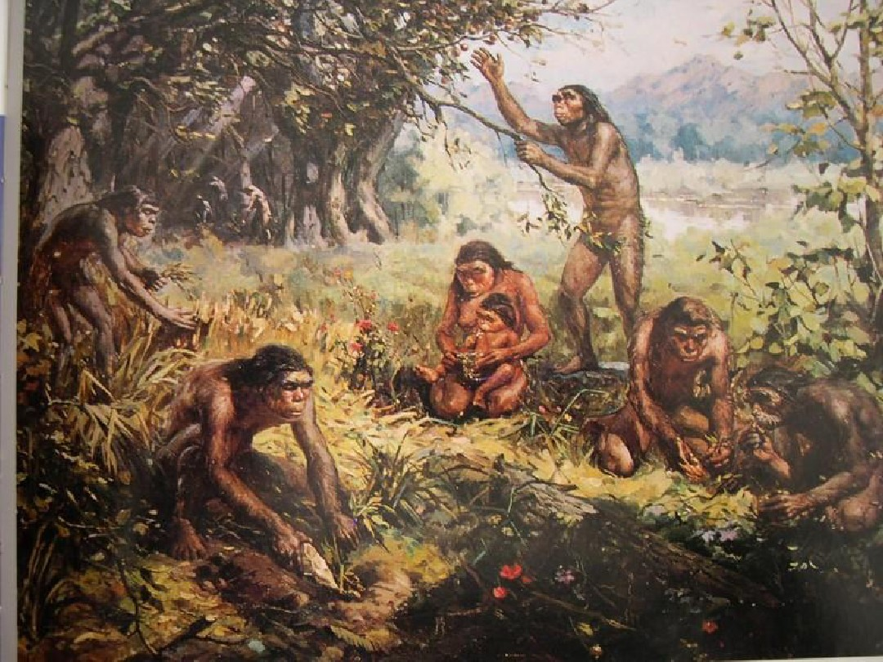
Step1: Viewing and thinking
What can you see from the picture?
Try to make tentative guesses about the topic .

Slide 4
cooking in the cave
doing chores
wearing clothes made of animal skin
ancestors' life
people in ancient times
preparing meals
Maybe it is about Zhoukoudian caves.
The text is likely to talk about Sanxingdui ruins.
Perhaps it is about the history of human beings.

Slide 5
Try to perfect the title .
who do you expect to help us understand our ancestors?
_________ your ancestors
Meeting
Who?
How?
Where?
archaeologist
make archaeological discoveries
heritage Sites
excavating
analyzing
by

Slide 6
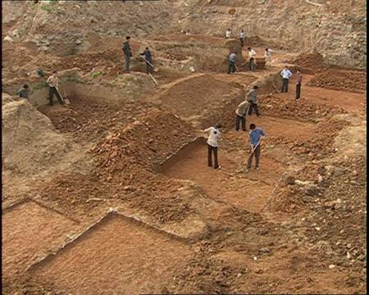
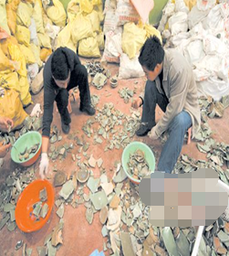
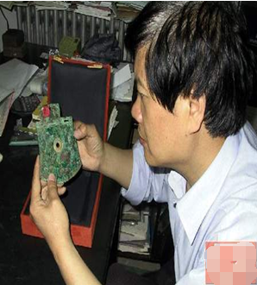
archaeologists' way of study
excavate
collect
identify and
analyze

Slide 7
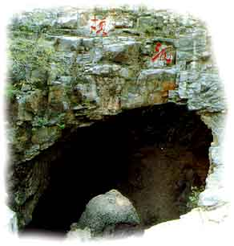
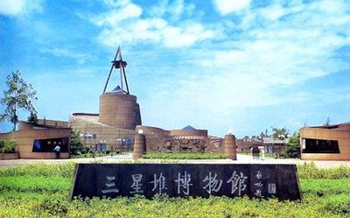
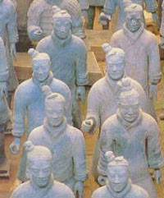
Zhoukoudian Caves
Emperor Qin Shihuang’s Terracotta warriors
Sanxingdui Museum

Slide 8
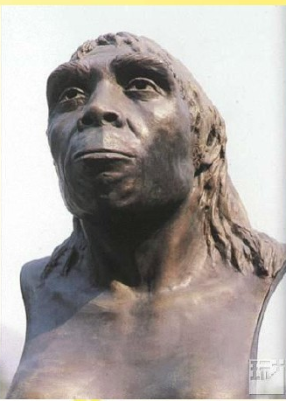
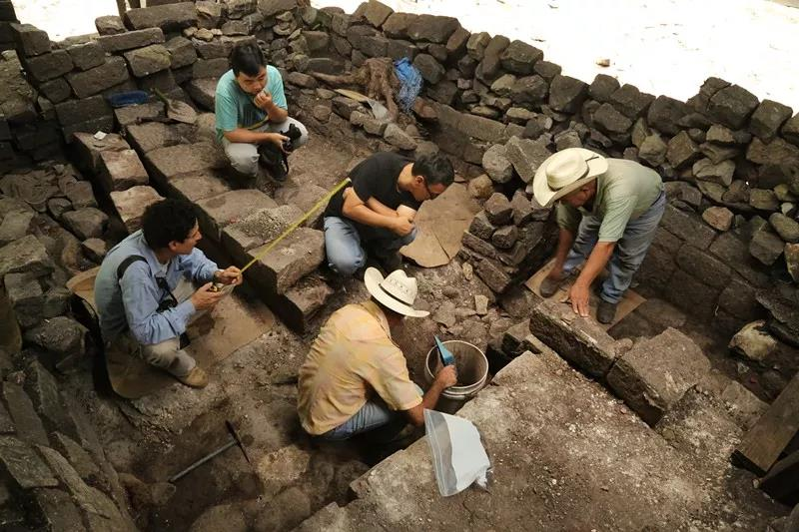
Step 2 speaking
What is archaeology?
Archaeology is the study of cultures of our ancestors （祖先）by examining and i_________ the
remaining objects e__________ from the ground after an e_____________(挖掘）.
dentifying
xcavated
xcavation

Slide 9
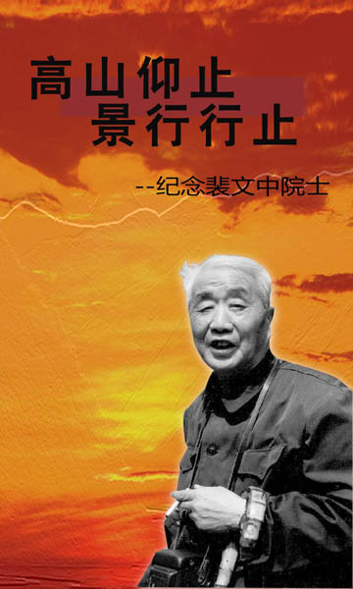
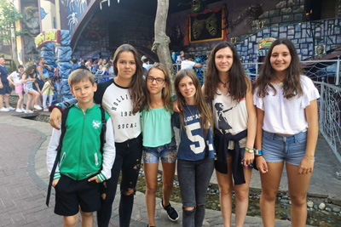
Step2:speaking
Assuming that a group of students from England come to visit the Zhoukoudian caves , you are the archaeologist to welcome them. Please prepare a small speech.
裴文中

Slide 10
checking
语言不符合身份
On behalf of our country, I feel greatly honored to welcome you. hearing that you are interested in archaeology, I am very excited. Here in the Zhoukoudian caves , you can learn much about how our ancestors live. Now, follow me.
强调句和定语从句，使语言丰富
得体又具体
Welcome to the Zhoukoudian caves here in China. It is a great pleasure to meet you students from England, who are interested in archaeology. You must be aware that it's here that we found evidence of some of the earliest people who lived in this part of the world. We've been excavating here for many years and ...
earliest和have been excavating激发学生的好奇心。

Slide 11
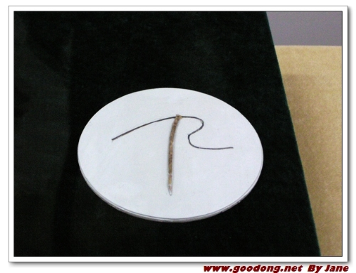
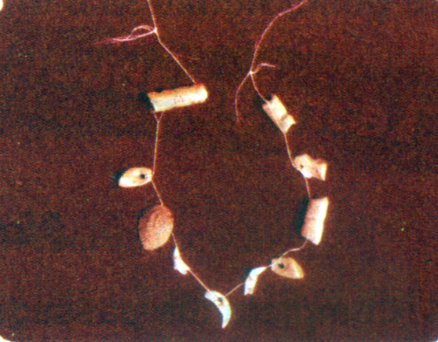
Step3: Identification of archaeological objects
Assuming that you are an archaeologist, would you please make a tentative analysis about what the following primitive items might have been used for ? and what else can you infer from them
If
Suppose
It might have been used for
It must have been made of ---
I think that the primitive people must have ---

Slide 12
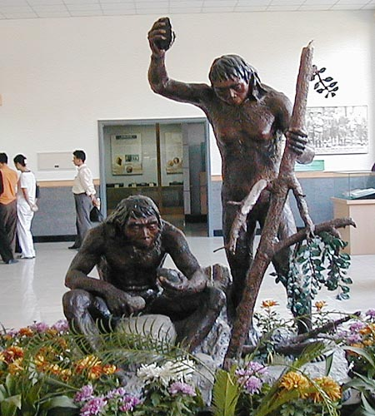
Step4: Thinking and asking
Assuming that you are the students,what questions would you like to ask the archaeologist about Peking Man’s life?

Slide 13
Step5: Reading and checking
how could they live here?
live
Check the questions
Summarize the topics
Life in the cave
How did they keep warm?
keep warm
What wild animals were there
What wild animals were there all that time ago?
That's a needle. Goodness, does that mean they repaired things?
analyses from a needle
Do you mean that they made their own clothes? Where did they get the material?
Why, it's a primitive necklace. Did early people really care about their appearance like we do?
inferences from a necklace
This one looks very much like a fish bone. Is that reasonable?
We are miles from the sea, so how did the seashells get here?

Slide 14

What are the archaeologists' answers to these questions?
Objects | analyses
would have kept them warm, cooked the food and scared wild beasts away
fireplaces
might have kept the fire burning all winter
layers of ash
might have hung animal skins at the cave mouth to keep out the cold
no doors
might have been
bones of tiger
_____________most dangerous enemies
might have been used for sewing clothes
needle and thread
sharpeners scrapers
might have been used to cut up animals and remove skins
necklace

Slide 15
Object | What can be deduced from it?
necklace | 1. They cared about their ____________. 2. Some of the beads were made of ___________. Guess: So early people killed, _______ and most probably ate animals 3. Some of the bead were made of __________. Guess: So early people ________ and probably _____ fish in the _______ lake 4. Some of the beads were made of _________. Guess: So early people may have ________ to the sea or ________ with people who had seashells.
appearance
animal bones
cut up
fish bones
caught
ate
nearby
seashells
travelled
traded

Slide 16
Step6: Comparing and thinking
Compare your life with that of the Peking Man.
 | Peking man | Modern people | trendency
homes
tools
dress
furniture
recreation
food
caves, with skins to keep out the cold
stone, wooden or brick house
What is the significance of archaeology?
more convenient
scrapers, axe-heads, needle
plough, saw, knife, hoe---
more advanced
animal skins sewn together
natural and man-made fibres
more fashionable
specially designed for each room
more practical
a fireplace
meals together
more colorful
TV, films, games---
berries and fruit in season
fruit, vegetables, processed meat
more varied

Slide 17
It helps us understand what these archaological objects mean for the human story.
It arouses people's awareness of the conservation of the world's cultural heritage against looting and careless harm.
The mixture of danger and detective work is the perfect script for fiction writers and film-makers.
It fuels our eagerness for knowledge about ourselves and our past.
To learn about the past enables us better see the development of human beings.
The discovery of an ancient sites can become a scenic spot, which can boost the local economy. The world's cultural heritage is a diminishing resource which holds different meanings for different people.

Slide 18
Would you like to major in archaeology in the university? or would you choose it as a selective course? Why?
Yes
No
full of imagination,
creative in interpreting,
unexpected results,
learn about ancient people's life,
explore exotic culture,
----
The excavating work is dull;
The identifying calls for broad knowledge;
Archaeologists usually work in the remote sites.
----

Slide 19
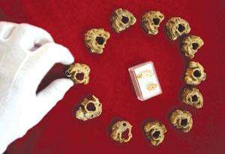
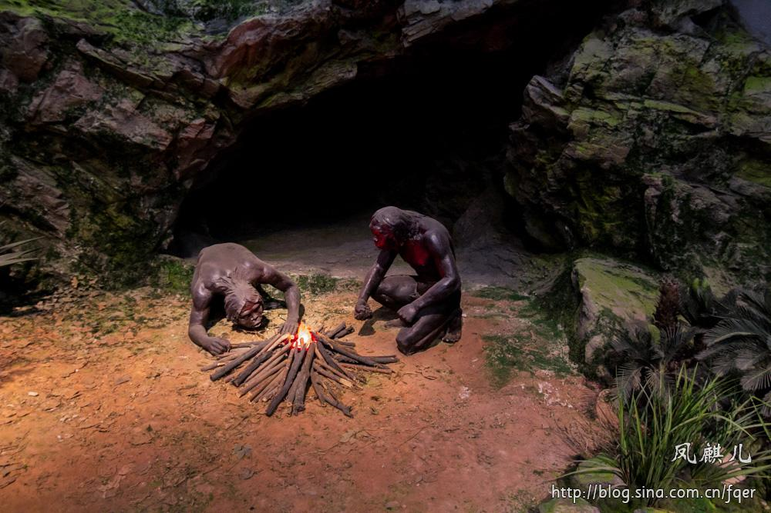
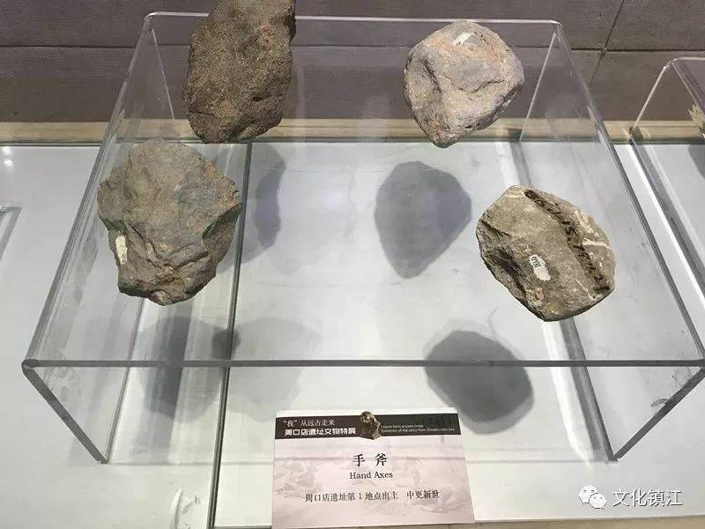
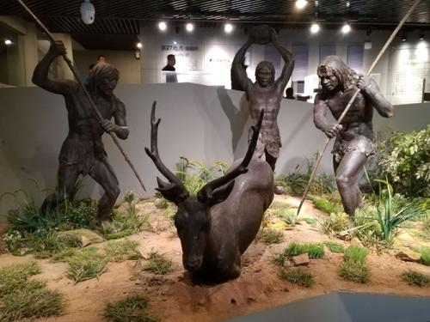
假如你是周口店博物馆的导游李华，5月15日来自美国某中学的学生访问团将来参加“看文物，学历史”活动，请你从以下文物中选择一项做详细介绍。

Slide 20
学生作品1
本话题词汇
Welcome to the Zhoukoudian caves!
I'm Lihua,your guide for the visit. The archaeological excavation here has yielded the largest known collection of fossils of the extinct Peking man. Now, turn your attention to this setting. It can be deduced that they lived in groups and hunted together.They might have learned to use tools , like the stones or branches of trees to fight against wild animals. Probably stone scrapers have been used to cut up animals and remove skins. At the same time,
we can learned that some wild
animals which has become extinct
could have existed at that time.
本单元表推测的情态动词

Slide 21
学生作品2
亲切得体的问候
本话题词汇
Boys and girls,
You are warmly welcome to the Zhoukoudian caves! Hope you will have a nice stay here.
I'm Lihua, your guide for the visit. It is here that some
pre-historic human bones were unearthed, which changed China’s knowledge of its history. Now let's start with this necklace. It suggests that they cared about their appearance and there might have been some kind of get-together. Plus,there being holes in the bones, the necklace must have been strung
up with something like vines. Hence, it
goes without saying that they may have
been able to make full use of the tools
from nature and even get them improved.
本单元的考古分析思维

