Slide 1

感恩遇见，相互成就，本课件资料仅供您个人参考、教学使用，严禁自行在网络传播，违者依知识产权法追究法律责任。
更多教学资源请关注
公众号：溯恩高中英语
知识产权声明

Slide 2
M6U1 Using Language
The Best Of Manhattan’s Art Galleries
桐乡市高级中学 俞莺婕

Slide 3
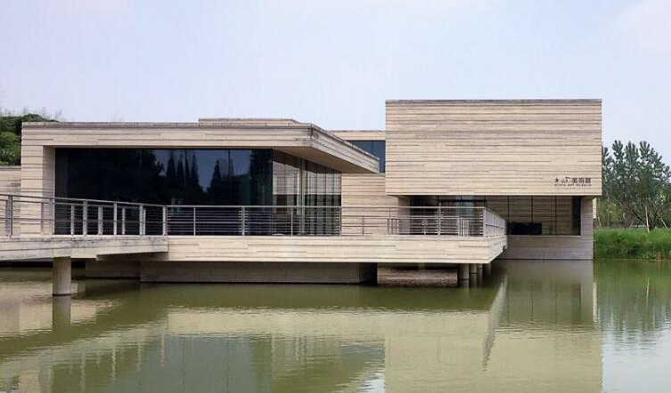
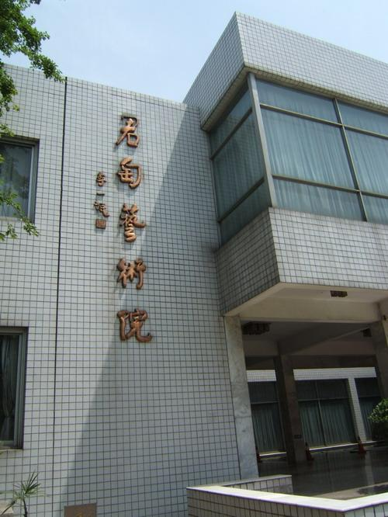
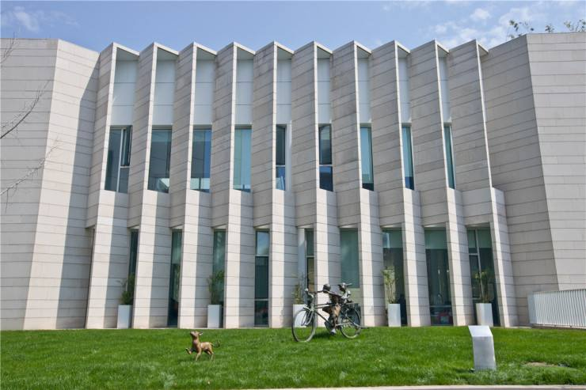
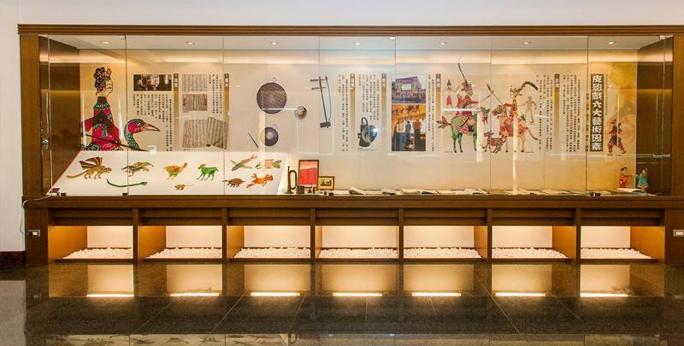
Activity 1 Lead-in
1. Have you ever been to an art gallary?
Mu Xin art gallary
Jun Tao art gallary
Di Yuan art gallary
2. What were/ will be on display?
paintings
handcrafts
sculptures
calligraphy works
photographs
...

Slide 4

Activity 2 Reading for basic facts
1. Scan the passage and locate the five galleries on the map(Page 6).
Guggenheim Museum
Metropolitan Museum Of Art
The Frick Collection
Whitney Museum of American Art
Museum of Modern Art
What are displayed in each gallery?

Slide 5

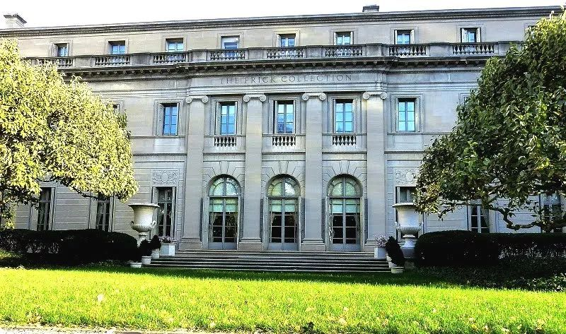
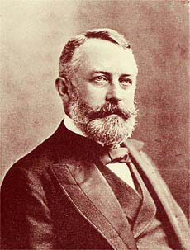
Activity 3 Reading for details
a steelmaking giant
Many art lovers would rather visit this small art gallery than any other in New York.
Why?
Henry Clay Frick, a rich New Yorker, died in 1919, leaving his house, furniture, and art collection to the American people.
The Frick Collection
What's special about it?
5th Avenues and E.70th Street
Frick had a preference for pre-twentieth century Western paintings, and these are well-represented in this excellent collection. You can also explore Frick’s beautiful home and garden which are well worth a visit.
=tour around

Slide 6
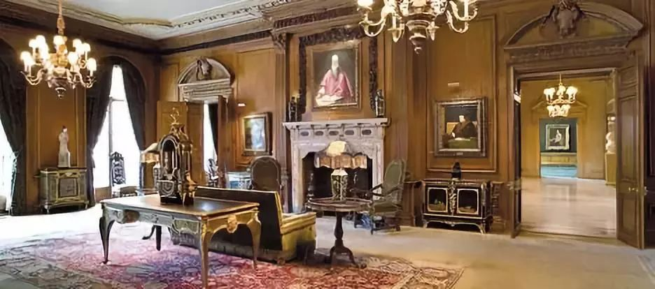

Slide 7
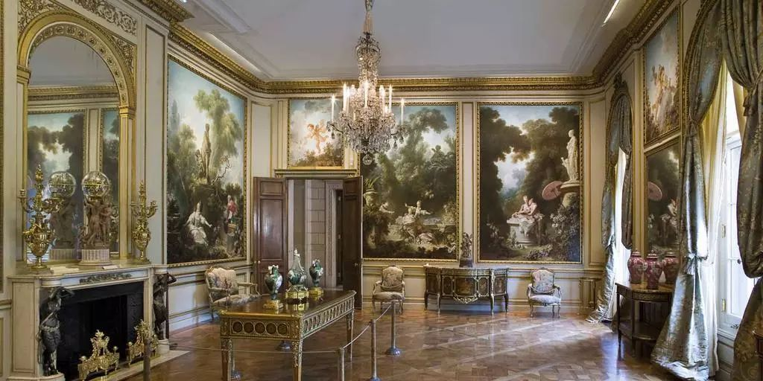

Slide 8
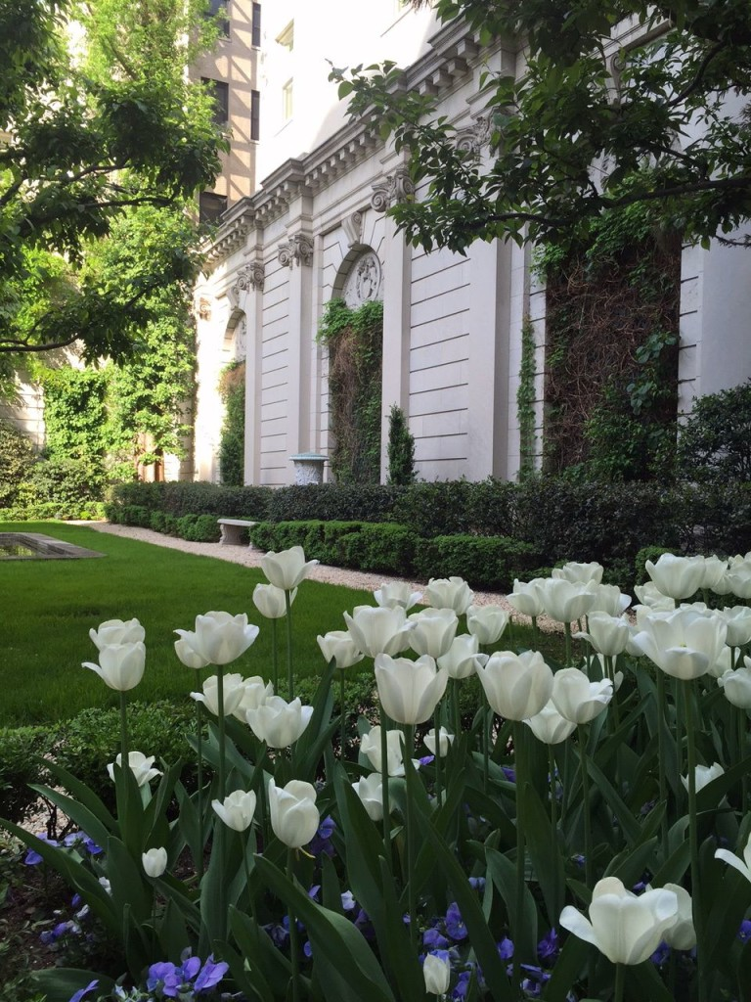
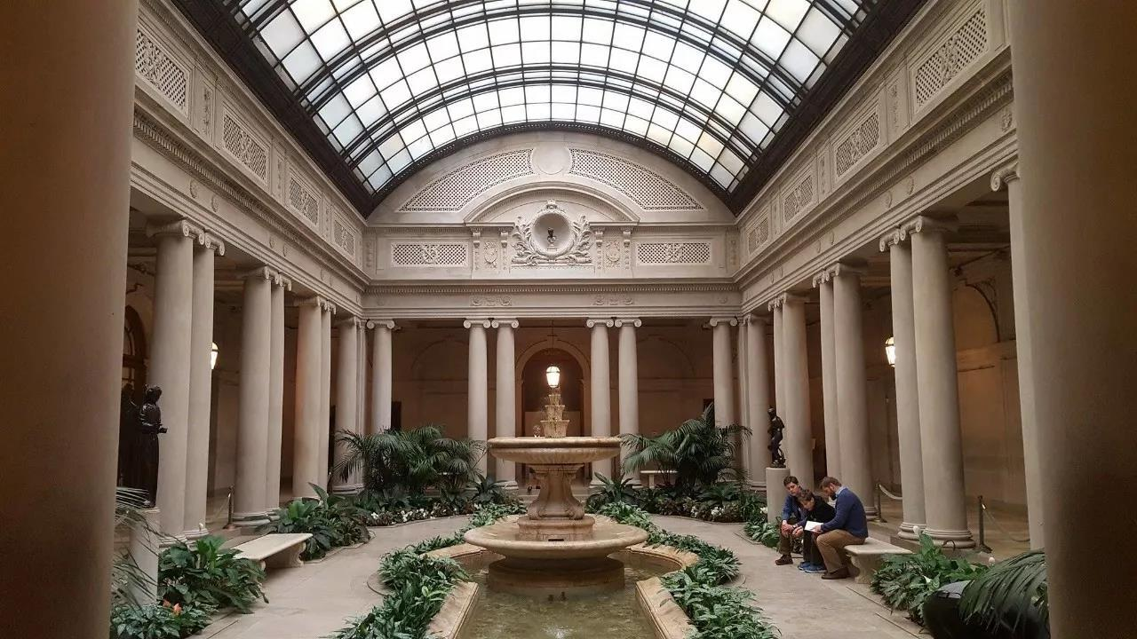
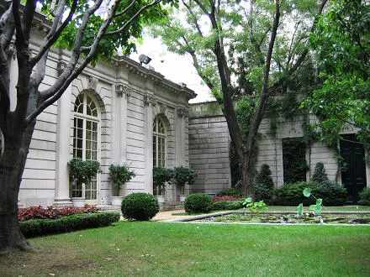

Slide 9
Frick had a preference for pre-twentieth century Western paintings, and these are well-represented in this excellent collection. You can also explore Frick’s beautiful home and garden which are well worth a visit.
The Frick Collection
学以致用——应用文：
久负盛名的木心的艺术作品被很好地展现在这个极佳的展览中，值得你到此一游。作为参观者，你可以在此欣赏令人惊叹的画作、探索艺术馆的布局、（甚至）在吧台品尝一些小吃。
5th Avenues and E.70th Street
The prestigious art works of Mu Xin are well-represented in this excellent collection, which are well worth a visit. As a visitor, you could appreciate the awe-inspiring paintings, explore the layout of the gallery and take some snacks in the bar.

Slide 10
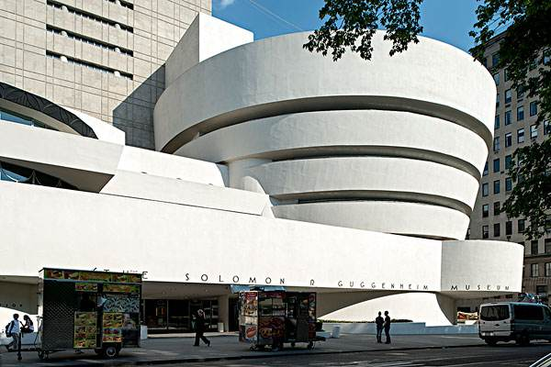
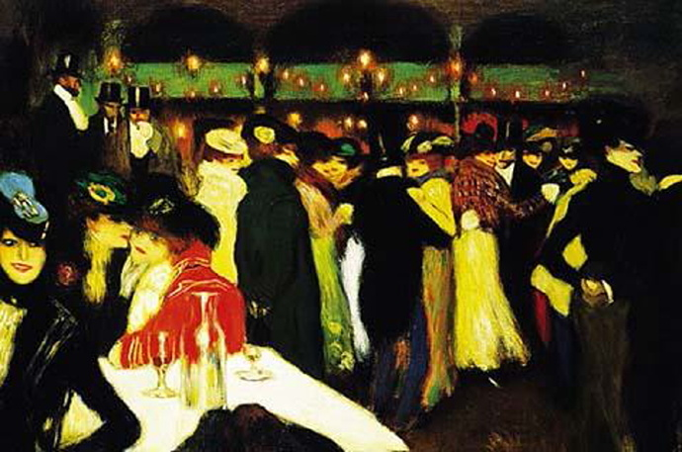
Who will be attracted to this museum and what will he/she see?
personification
=fantastic/terrific
This museum owns 5,000 superb modern paintings, sculptures and drawings. These art works are not all displayed at the same time. The exhibition is always changing. It will appeal to those who love Impressionist and Post-Impressionist paintings.
=exhibited
=attract
Guggenheim Museum
学以致用——应用文：
木心美术馆拥有600余件极好的绘画与文学作品，这些作品将吸引那些对艺术和文学有所追求的人前来欣赏。
5th Avenue and 88th Street
Mu Xin Art Gallery owns more than 600 superb /fantastic / terrific paintings and literary works, which appeals to those who love arts and literature.

Slide 11
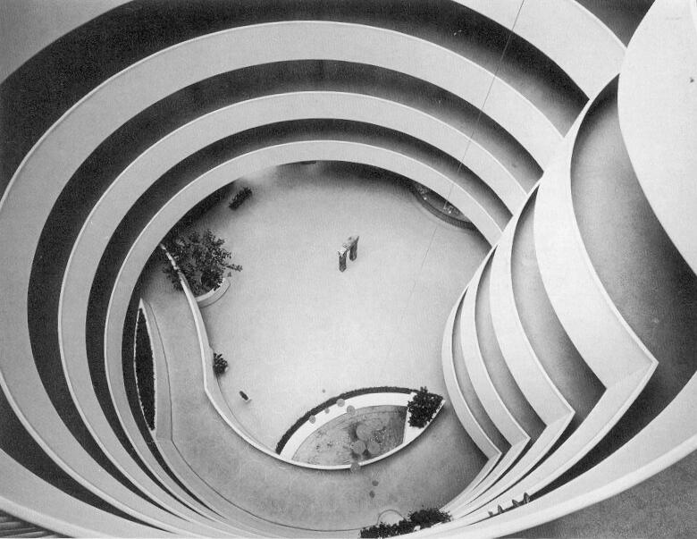
What else are the museum famous for?
The Guggenheim Museum building is also world-famous. When you walk into the gallery, you feel as if you were inside a fragile, white seashell. The best way to see the paintings is to start from the top floor and walk down to the bottom. There are no stairs, just a circular path. The museum also has an excellent restaurant.
Guggenheim Museum
学以致用——应用文：
木心美术馆的设计以“桥”为特色，是由举世闻名的设计师设计的。所以当你走在连接展馆间的小路上，就好像走在了桥上。
5th Avenue and 88th Street
The design of Mu Xin Art Gallery is featured with “bridges” and is conducted by world-famous designers. Therefore, you would feel as if you were walking on bridges when you are stepping on the paths connecting the buildings.

Slide 12
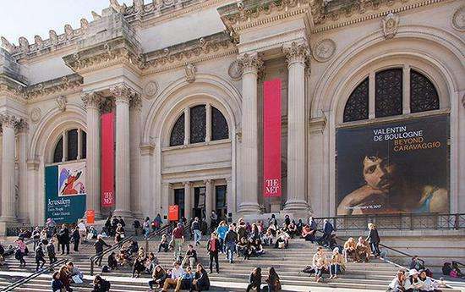
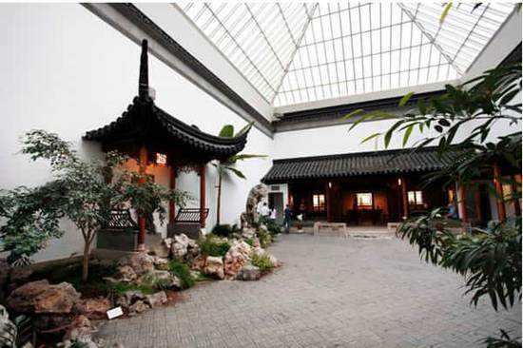
The reputation of this museum lies in the variety of its art collection.
How did the author show the “variety” ?
This covers more than 5,000 years of civilization from many parts of the world, including America, Europe, China, Egypt, other African countries and South America.
In Time span:
Metropolitan Museum Of Art
In regional disparity:
5th Avenue and 82nd Street
In ways of exhibition:
艺术带给视觉的愉悦
The museum displays more than just visual delights of art. It introduces you to ancient ways of living. You can visit an Egyptian temple, a fragrant Ming garden, a typical room in an 18th century French house and many other special exhibitions.

Slide 13
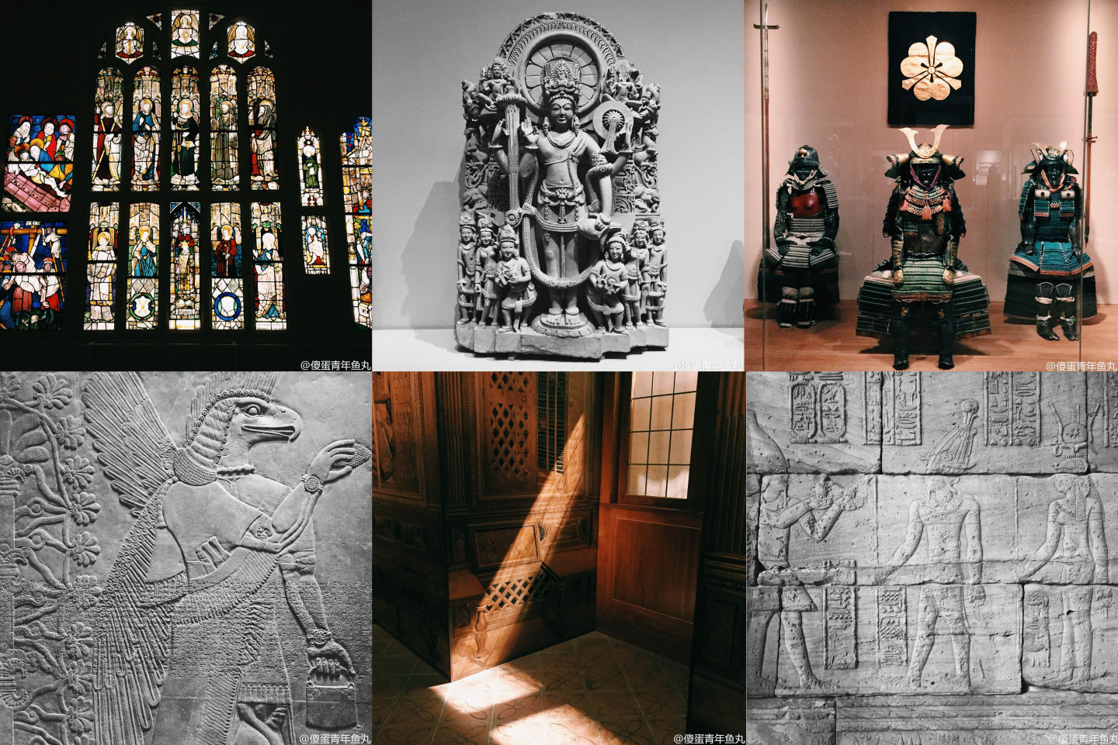
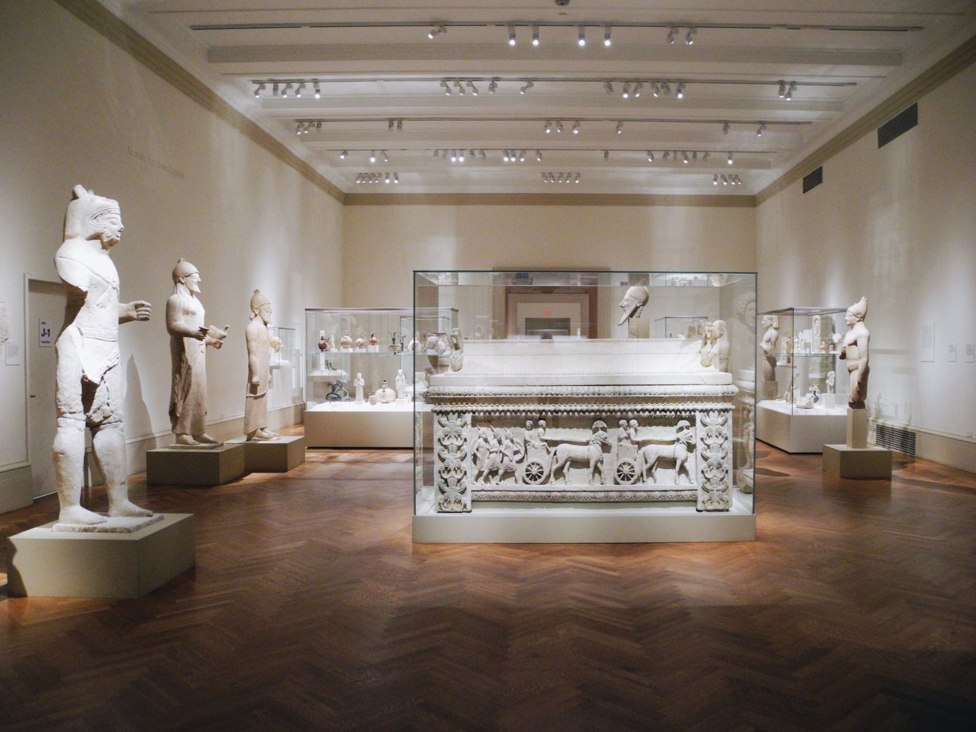
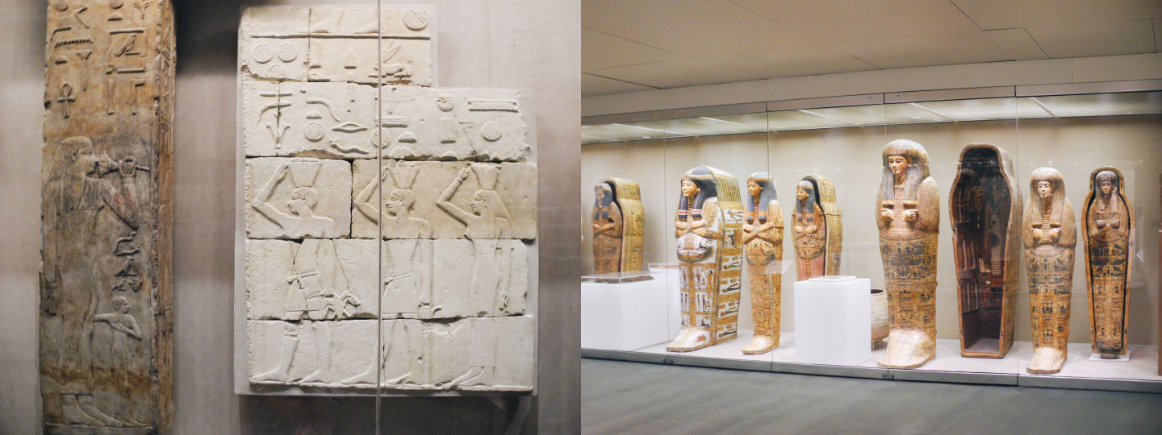
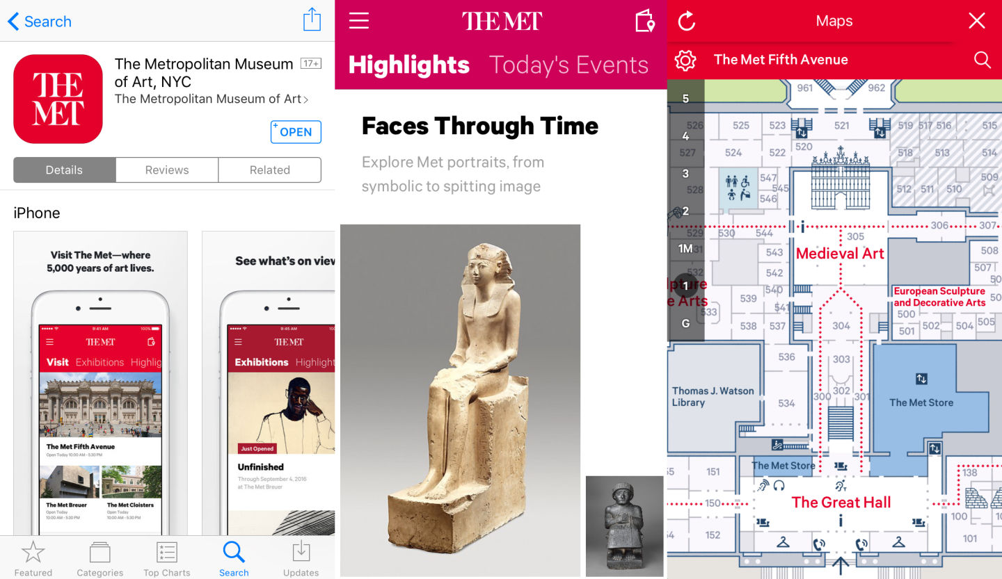
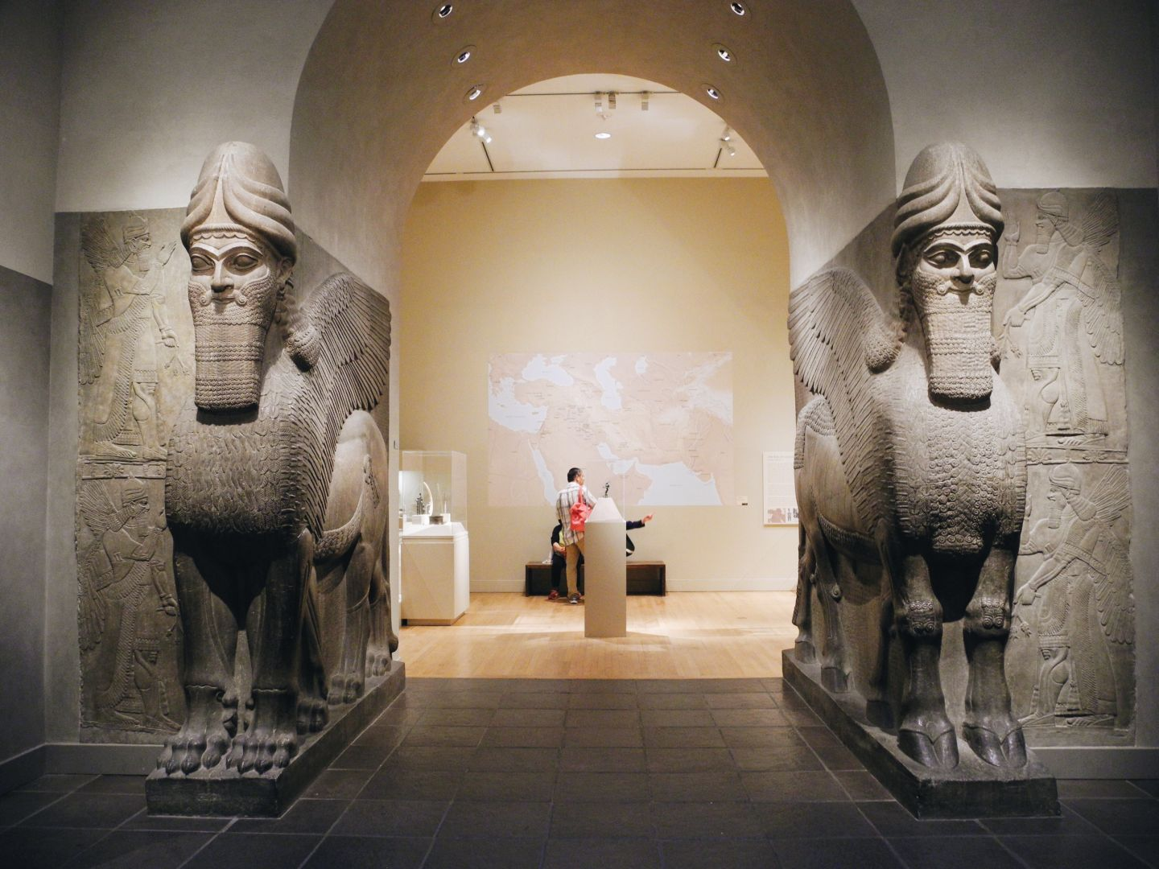
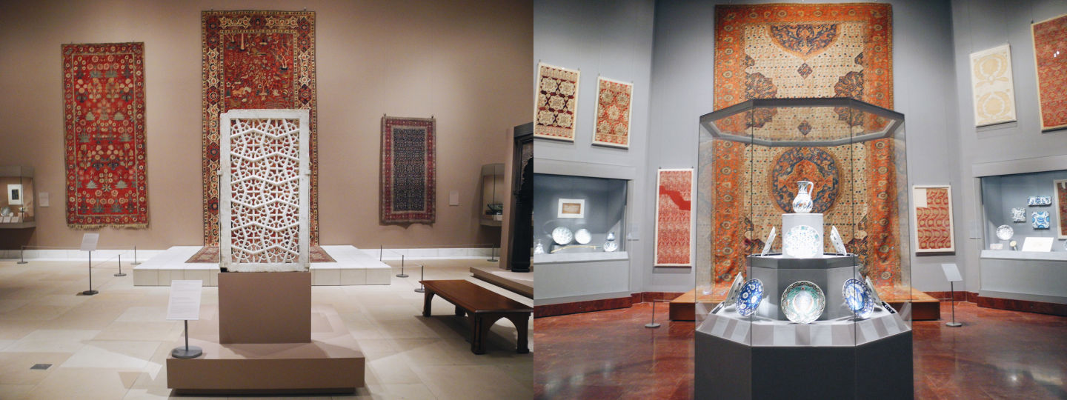

Slide 14
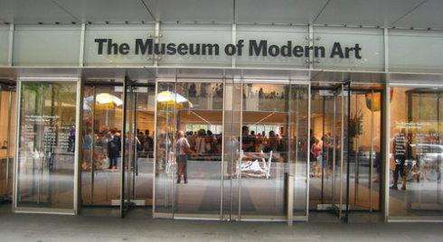
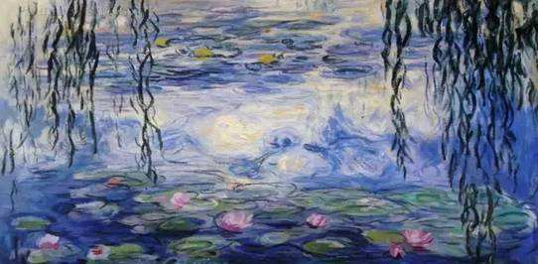
Which style(s) of western art are you expected to see in MOMA? How did you infer from the text?
It is amazing that so many great works of art from the late 19th century to the 21st century are housed in the same museum.The collection of Western art includes paintings by such famous artists as Monet, Van Gogh, Picasso, and Matisse. A few words of warning: admission price is not cheap and the museum is often very crowded.
It is amazing that so many great works of art from the late 19th century to the 21st century are housed in the same museum.The collection of Western art includes paintings by such famous artists as Monet, Van Gogh, Picasso, and Matisse. A few words of warning: admission price is not cheap and the museum is often very crowded.
Museum of Modern Art ( MOMA)
53rd Street, between 5th and 6th Avenues
impressionism
modern art

Slide 15
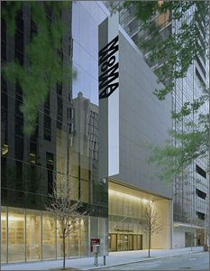

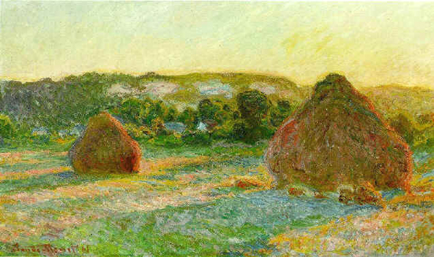

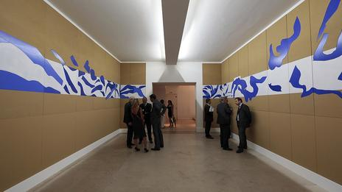
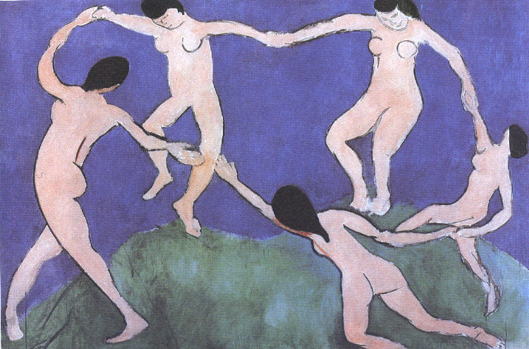
Museum of Modern Art
现代艺术博物馆

Slide 16
It is amazing that so many great works of art from the late 19th century to the 21st century are housed in the same museum.The collection of Western art includes paintings by such famous artists as Monet, Van Gogh, Picasso, and Matisse. A few words of warning: admission price is not cheap and the museum is often very crowded.
house sth: to be the place where sth is kept.
Museum of Modern Art ( MOMA)
学以致用——应用文：
令人惊叹的是木心美术馆还收藏了尼采(Nietzsche)的手稿(manuscripts)。因为门票价格不贵，参观的人很多，所以你要来的话要提前订票。
53rd Street, between 5th and 6th Avenues
It's amazing that Mu Xin Art Gallery even houses Nietzsche's manuscripts. As the admission price isn't expensive, the museum is constantly crowded. Therefore, if you plan to pay a visit here, you have to book for tickets in advance.

Slide 17
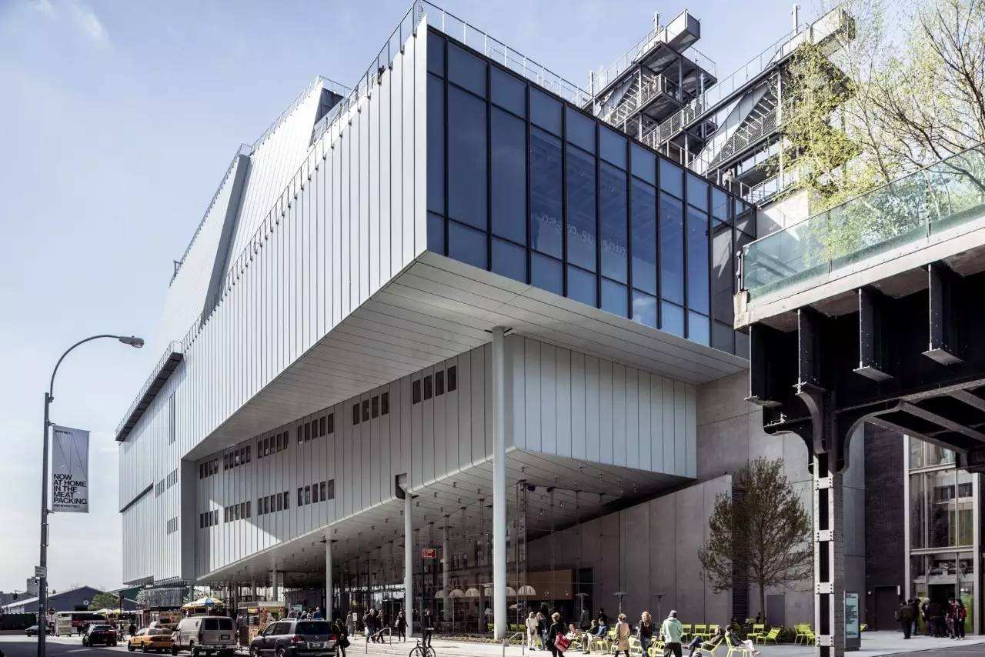
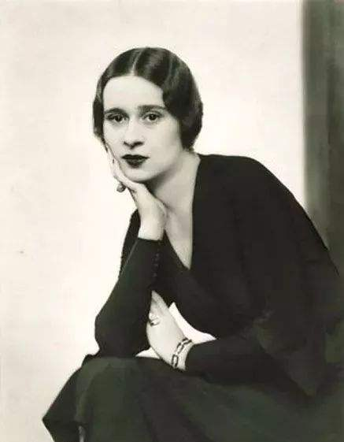
Do you know much about the founder?
Gertrude Vanderbilt Whitney, daughter of Cornelius Vanderbilt, became a sculptor in early 20th century New York where she was raised, and, rather than having a reputation for her own creativity, was better known as heiress to a fortune, sponsor of the arts, and founder of the Whitney Museum of American Art.
How does the exhibition in Whitney Museum different from that in other museums?
Whitney Museum of American Art
Can you guess what will be exhibited in this museum?
The Whitney holds an excellent collection of contemporary American painting and sculpture. There are no permanent displays in this museum and exhibitions change all the time. Every two years, the Whitney holds a special exhibition of new art by living artists. The museum also shows videos and films by contemporary video artists.
945 Madison Avenue, near 75th St.
当代艺术家
Whitney Biennial惠特尼双年展

Slide 18
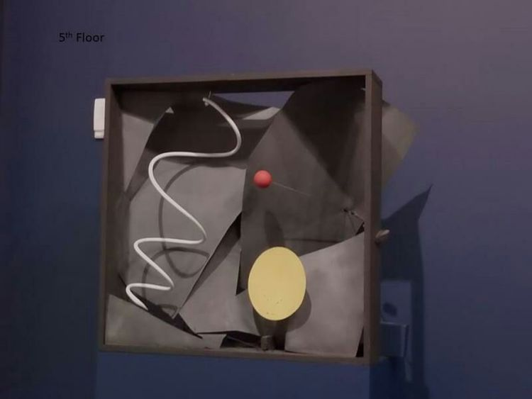
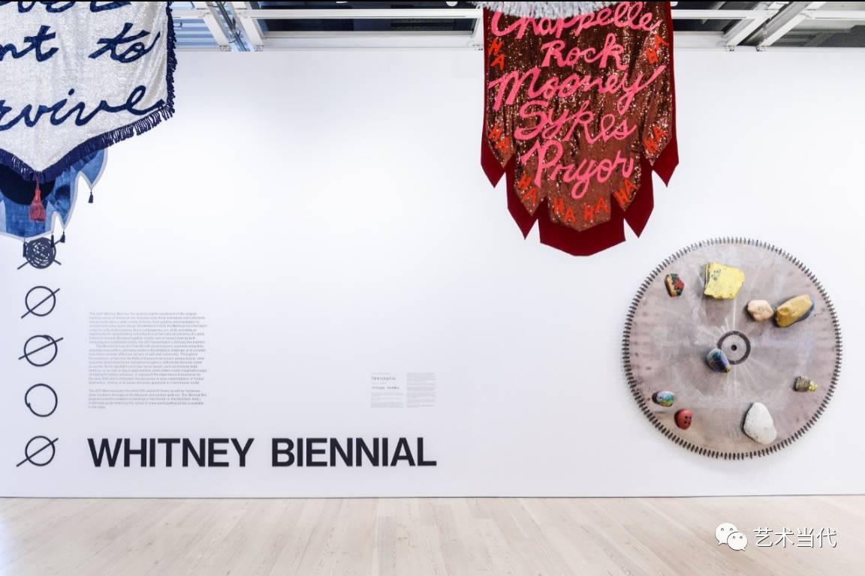
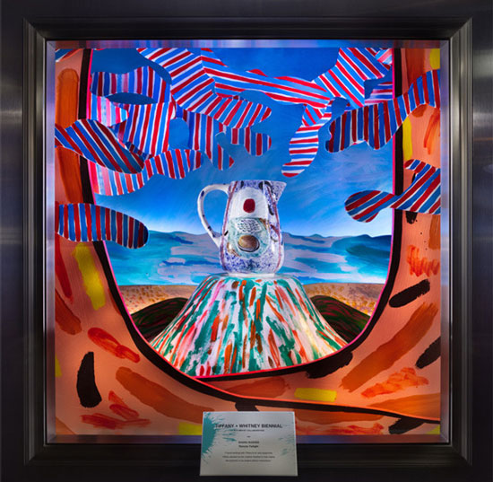

Slide 19
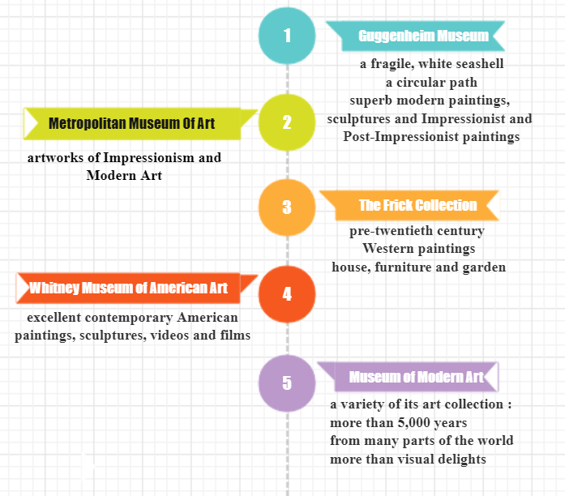
Activity 4 Summary
What are housed in the best of Manhattan's art galleries?

Slide 20
Activity 3 Writing
假定你是李华，你的德国朋友Nick想来参观木心美术馆，向你咨询参观事宜，请给他写一封回信，内容包括：1. 欢迎观展； 2. 展馆特色和展览内容。注意：1. 字数80左右；2.可适当增加细节，使行文连贯。
Reference
The prestigious art works of Mu Xin are well-represented in this excellent collection, which are well worth a visit. As a visitor, you could appreciate the awe-inspiring paintings, explore the layout of the gallery and take some snacks in the bar.
Mu Xin Art Gallery owns more than 600 superb /fantastic / terrific paintings and literary works, which appeals to those who love arts and literature.
The design of Mu Xin Art Gallery is featured with “bridges” and is conducted by world-famous designers. Therefore, you would feel as if you were walking on bridges when you are stepping on the paths connecting the buildings.
It's amazing that Mu Xin Art Gallery even houses Nietzsche's manuscripts. As the admission price isn't expensive, the museum is constantly crowded. Therefore, if you plan to pay a visit here, you have to book for tickets in advance.

Slide 21

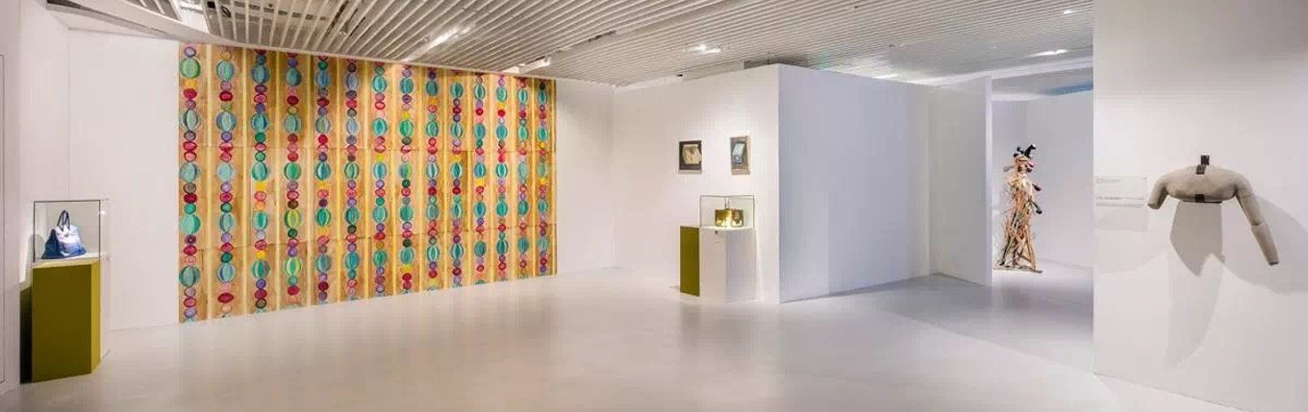
Assignment
1. Polish your writing and share it with your classmate, asking them to help you improve it. 2. Consolidate the useful expressions, use them in your future writings as many as possible.

