Slide 1

感恩遇见，相互成就，本课件资料仅供您个人参考、教学使用，严禁自行在网络传播，违者依知识产权法追究法律责任。
更多教学资源请关注
公众号：溯恩高中英语
知识产权声明

Slide 2


I’m depressed
台州市第一中学 周 媚
台州市第一中学 陈泓静

Slide 3
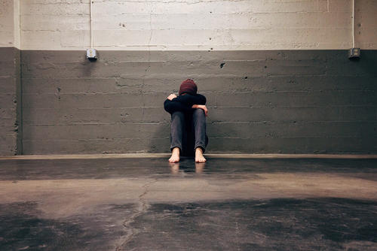

Slide 4


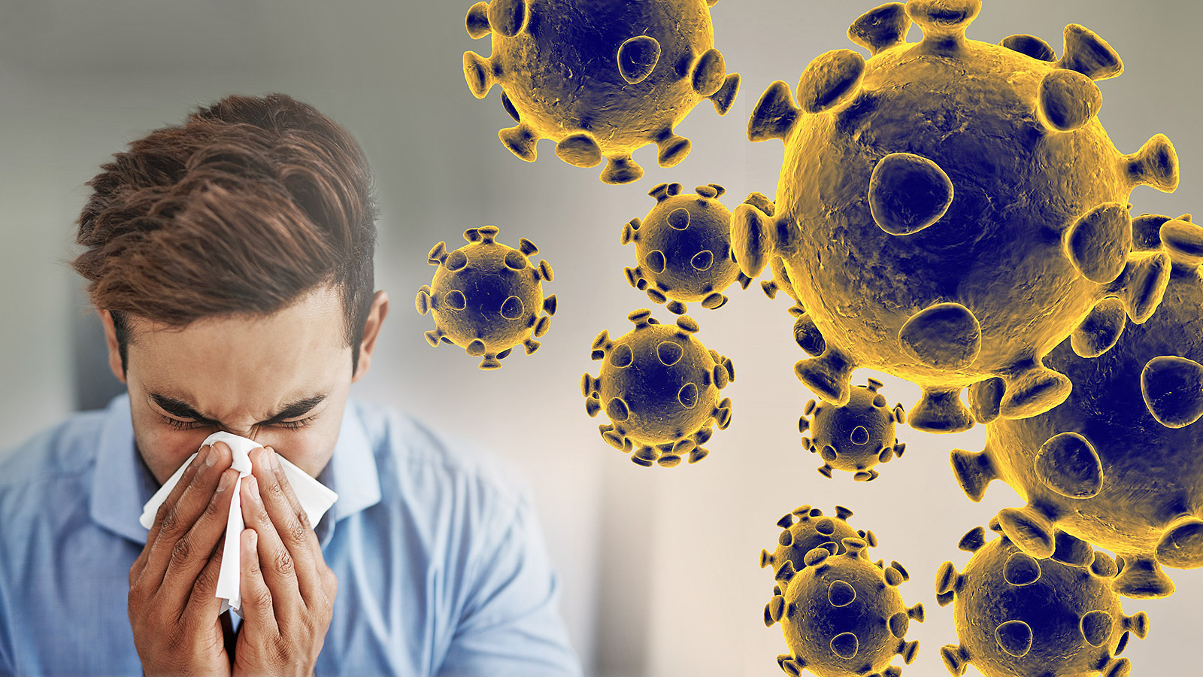
The world is facing a pandemic!
Postponed celebrations
Abandoned classrooms
a hug from close friends
a walk in the sunshine
a face-to-face chat
……
Nationwide panic
lockdown
Distant education
Empty streets
self-quarantine
Mad hoarding
Isolated family members
Closed restaurants
out of reach
Depression

Slide 5

Kids

Slide 6
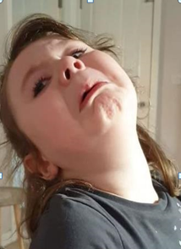



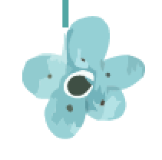
Four-year-old Layla from Britain, was particularly shocked to learn that the coronavirus pandemic had caused all her favourite takeaways to shut. Her mum, explained these restaurants wouldn’t be available for a little while and filmed the young girl’s reaction. Then, the video has go viral on social media, in which the little girl nearly broke down over the whole thing. She can be seen drowning her sorrows in cola with sobbing on and on. Struggling to calm herself down, Layla then asks "are Chinese closed too?" When finally getting her mother’s answer “Yes”, she lowered her head and became more painful, depressed.
1. What does the underlined word mean?
Could you list some well-known names?
2. How does the passage show the girl’s depression step by step?
shocked
break down
drown her sorrows in cola
sobbing
lower her head
more painful

Slide 7

Students

Slide 8
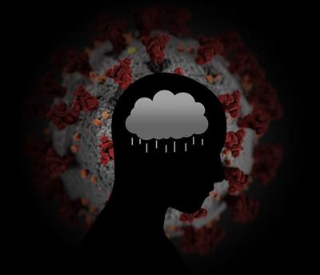
studies & scores

Slide 9
News of COVID-19 has made students’ mental health even worse. Campus closing ___________(make) students lose the sense of belonging gradually. Under the circumstances, the feeling of depression has risen rapidly. For instance, ______________
(graduate) from universities without any job offer can be a hopeless nightmare for them.
Some high school students, especially senior 3, ____________(face) with learning problems. During the quarantine time, they may not realize the importance of discipline until the day of returning to school_________________(approach). ____________(keep)
worrying about the coming exams and their unbearable scores _______(leave) students at a loss all day, regretting for ______________(be)distracted in front of the screens.
Other youngsters are staying with grandparents during this __________(extend) break since their parents must go to work ________(have) no time to take care of both groups. “I’ve been stressed out not only for myself, but also for my grandparents.” Ann said, “I’m saddened that I can’t be on campus with my peers anymore, and I’m also upset for fear that they may get _________(infect)by the virus.”
has made
graduating
are faced
is approaching
Keeping
leaves
having been
extended
having
infected
What makes students depressed?
How do you know?
Students are depressed for the uncertainty of future, terrible studies and families’ health.

Slide 10
Workers

Slide 11
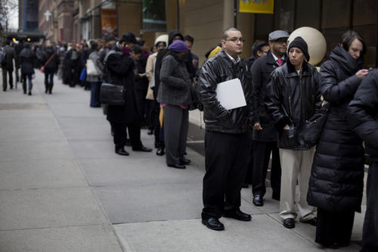
Financial difficulties is causing depression
_____________________________________________________
A large number of working-age adults have lost their jobs. U_____________(失业) and economic l______(损失)are becoming more and more severe. Researches suggest that rising financial i________(不安全性) and heavy d_____(债务) lead to increased rates of depression and s______ (自杀). “If I’m not at work, I’ll concern whether I’m able to pay for necessity such as rent and food,” A man knelt on the ground, crying. “It’s a very profound t_____(威胁). ” Obviously adults’ depression is caused by their financial d_________(困难), which makes them in heavy burden.
nemployment
osses
nsecurity
ebt
uicide
hreat
line for
unemployment benefits
ifficulties
Pay attention to the negative words and think out a title.

Slide 12
Doctors

Slide 13
Health care workers face depression as they battle the pandemic
Lorna Breen, a New York City emergency room doctor _______________________
(从新冠肺炎中康复) and continued to treat patients died by suicide.----NBC
She worked in the emergency department and had been on the front lines for weeks,___________________________________________________(在此期间她的医院出现大量的病例). New York City has been the US' pandemic center, recording nearly 300,000 cases and more than 22,000 deaths.
Breen had developed Covid-19 and took a week and a half off to recover. Still, she felt like she had to get back to her working place _______________________________(在那里她的同事工作) 18 hours per day. She once told her father she and her colleagues were sleeping in hallways, and ____________________________(救护车进不来) because it was so busy. Unfortunately, she was hospitalized again and treated for depression. Yesterday, she committed suicide, ____________________________. (这令她的家人都震惊了)
“On a daily basis, frontline healthcare professionals are facing too much and under such heavy psychological pressure ____________________(以至于他们不能承受). ”
who recovered from Covid-19
during which a great number of cases arose in her hospital
why?
where her colleagues were working
that ambulances couldn't get in
which made her family shocked
that they cannot stand

Slide 14
Do You Know the Symptoms of depression?
Feeling sad, anxious, or empty
Feeling hopeless or pessimistic
Feeling guilty, worthless, or helpless
Feeling restless or irritable
Feeling tired or exhausted
Changing appetite or eating habits suddenly
Not enjoying things you used to enjoy
Sleeping too much or too little
Gaining or losing weight rapidly
Trouble with concentration, memory, or making decisions
Having no interest in anything
Thinking of suicide or death
Brainstorm
If the symptoms last for at least 2 weeks…

Slide 15

How to beat depression/the blues?
A. So keep it tidy.
B. Talk to a professional.
C. Chat with your fellows.
D. It means that a chaotic mind will sure
affect your health.
E. Wake up and go to bed around the same
time, eat meals, and shower.
F. Doing one productive thing per day can
lead to a more positive attitude
G. So it’s important to think about positive
ways to keep our minds healthy.

Slide 16
During the COVID-19 outbreak, being stuck inside for a long time can be stressful and make people depressed. _________
Change “I am stuck inside” to “I can finally focus on myself ”.
________. Set your sights on long-avoided tasks, reorganize, or create something you’ve always wanted to. This is your chance to slow down and focus on yourself.
Stay close to your normal routine
Try and maintain some things that you always do before the outbreak. _______ Not only will sticking to your normal routine keep you active, it will be easier to readjust to the outside world when back.
Clean your home to clear your chaotic mind
With all the uncertainly happening outside your home, keep the inside organized, predictable and clean. For example, try not to eat in bed, and eat at the kitchen table and work at your desk. Additionally, a home in a mess can cause you to become uneasy and upset ._________.
_________
Remember to reach out for help if your depression is uncontrolled without professional help. you can talk with counseling services and people from university psychology departments, Depending on your location, you can call one of these 24-hour hotlines for psychological support and general advice if you’re experiencing anxiety, depression or panic attacks.
G
F
E
A
B

Slide 17

If you develop depression,
you have to know…

Slide 18


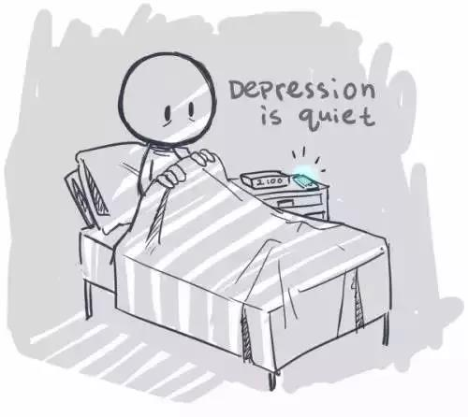
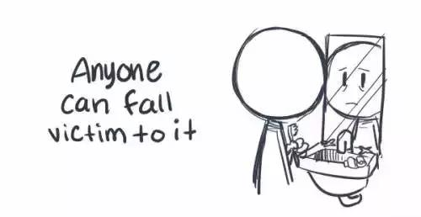

Slide 19
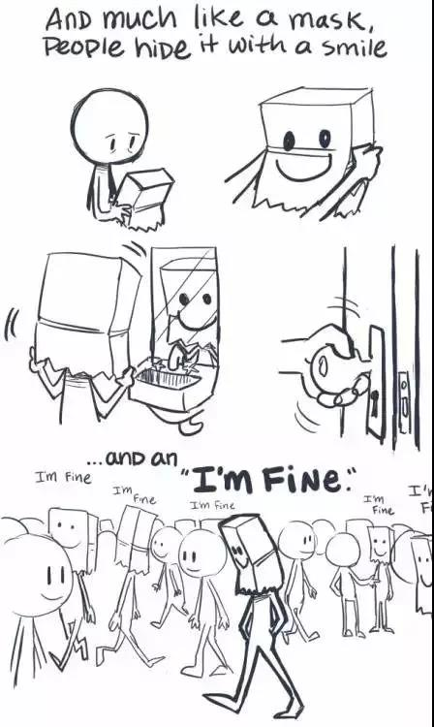
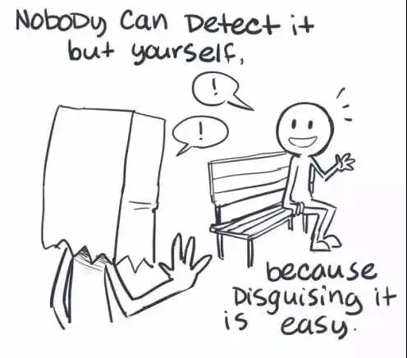

Slide 20
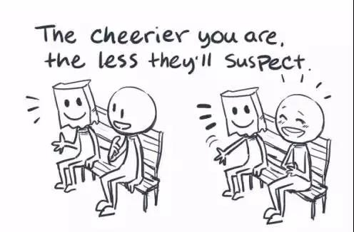
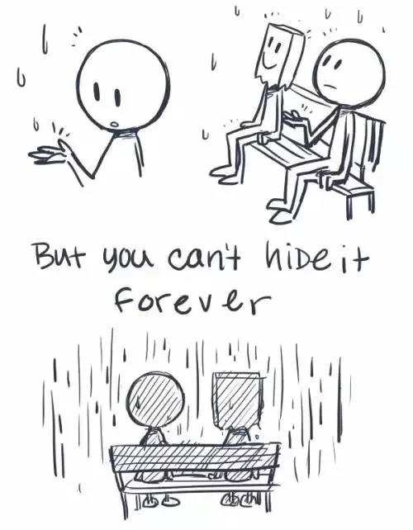

Slide 21
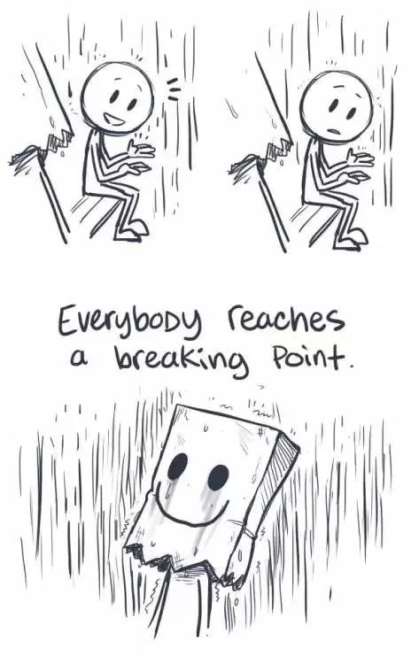
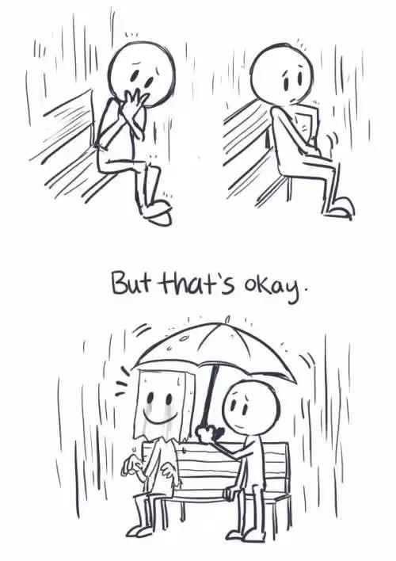


Slide 22
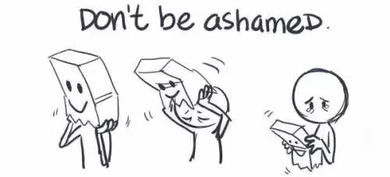
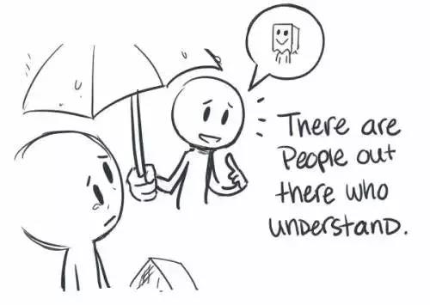

Slide 23
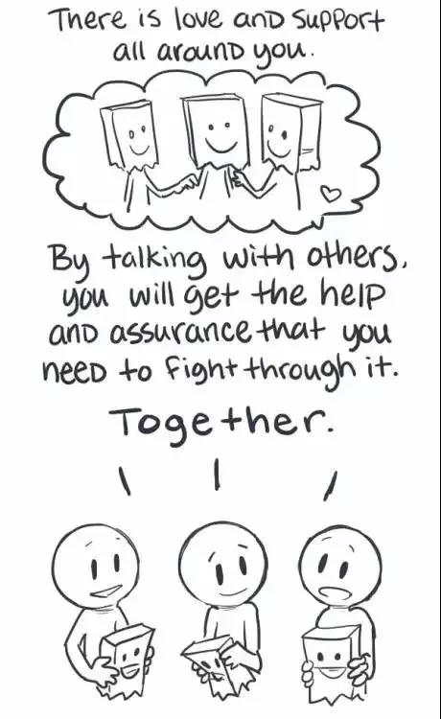
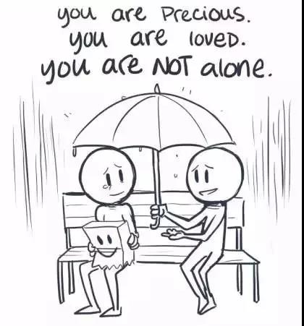

Slide 24
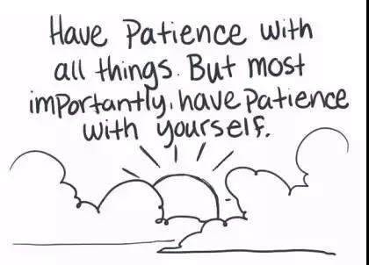
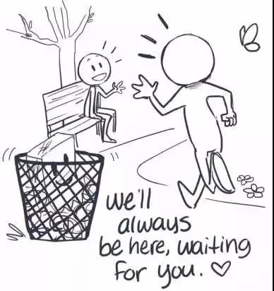
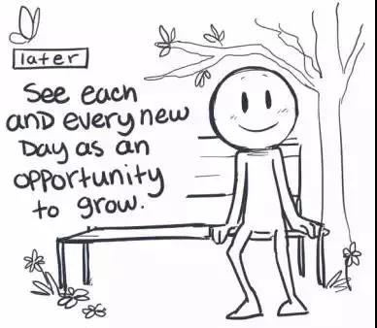

Slide 25

Life comes first !
Treat your mind well,
and your body will follow.

Slide 26
THANK YOU
DESIGHED BY WENCY

