Slide 1

感恩遇见，相互成就，本课件资料仅供您个人参考、教学使用，严禁自行在网络传播，违者依知识产权法追究法律责任。
更多教学资源请关注
公众号：溯恩高中英语
知识产权声明

Slide 2

2021届9+1联盟考试
客观题讲评
桐乡市高级中学 俞莺婕

Slide 3
阅读理解
PART 01

Slide 4


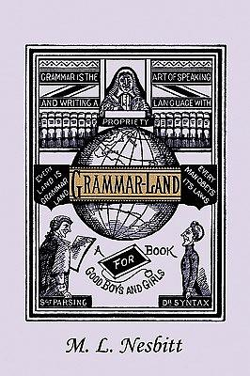
Passage A
21. What is this reading about?
Source of the text:
from a grammar book designed for children, which is written in 1877. Readers will be introduced to the nine parts of speech(词性) and learn about the rules that govern them in Grammar-Land.
"Judge Grammar is far mightier than any King or Queen, for he rules over them down here in Matter-of-fact-land. Kings and queens have to obey Judge Grammar's laws, or else they would talk what is called bad grammar; and then, even their own subjects would laugh at them, and would say: “Poor things!”
The nine Parts-of-Speech are funny fellows. There is rich Mr. Noun, and his useful friend Pronoun(代词); little ragged Article(冠词), and talkative Adjective; busy Dr. Verb, and Adverb; perky Preposition(介词), convenient Conjunction(连词), and that tiresome Interjection(感叹词), the oddest of them all.

Slide 5
Mr. Noun was on the trial on the court (Para 1)
Settings of Passage A:
Main Characters :
What kind of person is Mr. Noun?
Appearance:
Personality:
Possesions:
Mr. Noun and Judge Grammar
a rich show-off
A stout(肥胖的) big fellow, very well dressed (Para2)
he does not mind showing that he is very rich (Para2)
22. He probably has the largest number of words in the Grammar land.
The name of everything belongs to me ( (Para2)
“Actually,”replied Mr. Noun, drawing himself proudly up(骄傲地挺起胸膛)，“I have not mentioned nearly all my words.” (Para3)
the name of everything including proper nouns(专有名词) and common nouns(普通名词)
23. which of the following words belongs to him?
A. Judge B. Rich C. Actually D. Repeat

Slide 6
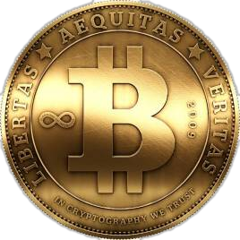
Passage B
Bitcoin is a decentralized (去中心化) digital currency that enables instant payments to anyone, anywhere in the world. Bitcoin uses peer-to-peer technology to operate with no central authority: transaction(交易) management and money issuance(发行) are carried out collectively by the network.
比特币（Bitcoin）于2009年1月3日正式诞生。比特币是一种点对点形式的虚拟的加密数字货币。点对点的传输意味着一个去中心化的支付系统。
•与所有的货币不同，比特币不依靠特定货币机构发行，它依据特定算法，通过大量的计算产生。比特币与其他虚拟货币最大的不同，是其总数量非常有限，具有极强的稀缺性。
•2017年12月17日，比特币达到历史最高价19850美元。
•2020年2月10日，比特币价格突破10000美元。
bitcoin 比特币

Slide 7
24. What is the nature of bitcoin?
Bitcoins:
Para1:
Para2:
Para3:
a digital currency fit for use by drug dealers, murderers etc.
against rules
there may be a limited market for bitcoin trade
allow people to ignore banks and traditional payment process to pay for goods and services
hasn't been adopted by any government
【知识拓展】Bitcoin Transactions are:
Permissionless and borderless. The software can be installed by anybody worldwide.
Do not require any ID to use.
Are censorship-resistant (防审查的) Nobody is able to block or freeze a transaction of any amount.
Irreversible(不可逆转的) once settled, like cash.
Fast. Transactions are broadcasted in seconds.
Convenient. Online and available 24 hours a day, 365 days per year.

Slide 8
郁金香狂热（Tulpenmanie）
1637年发生在荷兰，是世界上最早的泡沫经济事件。当时由鄂图曼土耳其引进的郁金香球根异常吸引人，引起大众抢购导致价格疯狂飙高，在泡沫化过后价格仅剩下原本的百分之一，让荷兰各大都市陷入混乱。
1593年一位荷兰商人，将郁金香的球茎带到了荷兰，荷兰人对这个新品种充满了喜爱。当郁金香开始在荷兰流传后，一些投机商就开始大量囤积郁金香球茎以待价格上涨。在舆论的鼓吹之下, 人们开始竞相抢购郁金香球茎，把它当成炙手可热的投资产品。对财富的狂热追求，让这些人卖地、卖房、甚至向银行贷款来买入郁金香。1634年，炒郁金香的热潮蔓延为荷兰的全民运动。当时1000元一朵的郁金香花根，不到一个月后就升值为2万元了。
在M.戴许所著的《郁金香狂热》一书中有以下的描写：“1636年，一棵价值三千荷兰盾的郁金香，可以交换八只肥猪、四只肥公牛、两吨奶油、一千磅乳酪、一个银制杯子、一包衣服、一张附有床垫的床外加一条船。”
1637年，郁金香的价格已经涨到了骇人听闻的水平。与上一年相比，郁金香总涨幅高达5900%！1637年2月，一株名为“永远的奥古斯都”的郁金香售价高达6700荷兰盾，这笔钱足以买下阿姆斯特丹运河边的一幢豪宅，而当时荷兰人的平均年收入只有150荷兰盾。

Slide 9
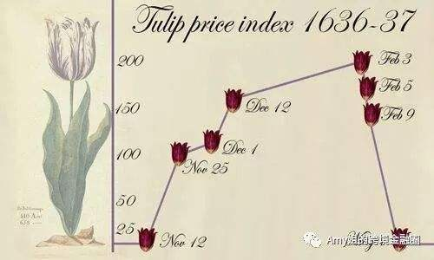
郁金香交易在短时间内让人一掷千金的传言在工匠和农民之间广为流传，吸引他们进入了这个交易市场，他们原本没有资金，所以仅从买得起的程度开始进行，这种情况使得非顶级的品种价格也开始抬升，渐渐出现了因转卖而取得利益的民众。市场的交易模式至此也开始改变，开始出现全年交易和引进了期货交易制度。
这种交易的模式并非前往正式的证券交易所，而是前往酒店。交易也不需要使用现金或是现货的球根，而是提出一份「明年四月支付」「那时候会交付球根」的票据，或是加上少许的预付款即可完成交易。这种预付的制度也吸引了原本完全没有资金的投机者参加，因此需求量再次膨胀，就算是原本便宜的品种也飞涨。但是随着价格飞涨，最初的买家——也就是爱好植物者也不再购买，而民众交易的低价球根，爱好者也看不上眼。
1637年2月初，价格突然暴跌。由于卖方突然大量抛售，公众开始陷入恐慌，导致郁金香市场在1637年2月4日突然崩溃。一夜之间，郁金香球茎的价格一泻千里。虽然荷兰政府发出紧急声明，认为郁金香球茎价格无理由下跌，劝告市民停止抛售，并以合同价格的10%来了结所有的合同，郁金香狂热时代就此结束。

Slide 10
25. By saying “It is worse than tulip bulbs.”, Dimon wanted to tell people_______
Para4: He predicted big losses for those investing in bitcoin.
suffer a severe breakdown
26. At the end of the passage, the writer mentions his daughter to express his _______
Para4: “Honestly, I am just shocked that anyone can't see it for what it is.”
Para4: “It went up and she thinks she's a genius now.”
Dimon was speechless and helpless.
Dimon was against bitcoin.
Para1: “bitcoin is a fraud that will eventually blow up.”

Slide 11
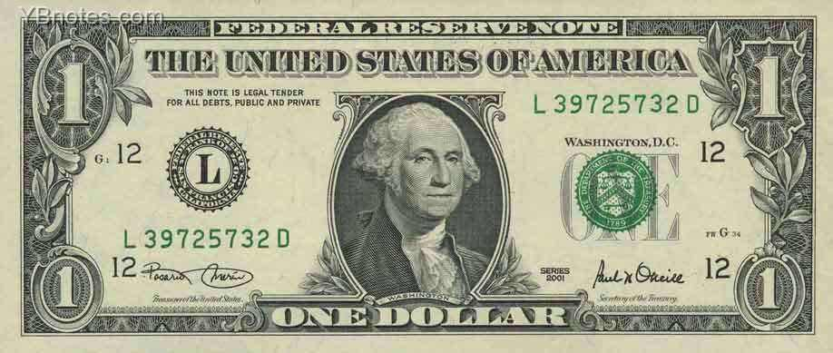
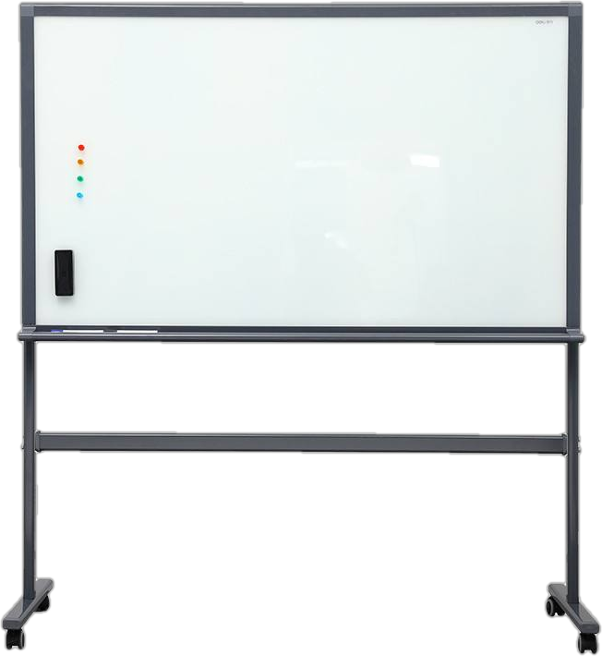
Passage C
a lost and found act
not knowing the owner of the bill
a dollar bill taped to the white board
students not knowing the purpose
taped a second dollar to the white board
29. Best title?
The multiplying
one dollar
the effort snowballed
and the money multiplied
students taped more money to push the amount to $321.06
ask students to donate the money to an institute
Mattison had to decide upon a best resolution

Slide 12
27. What did Mattison plan to do with the bill when she was given it at first?
Para2: Mattison was a little suprised, for lots of people would have just keep it. She suggested that Belscher tape it to the whiteboard at the front of the classroom, where she was alwayse put lost things.
Para3: Mattison was still waiting for the original owner to claim it, so she replied,“ I don't know.”
she has no idea
28. What does the underlined word that in Para 4 refer to?
Para3: Rose took the tape from Mattison's desk and taped a second dollar to the board.
Para4: That got it rolling.
29. Why did the students keep taping bills to the board?
Para5: They believed Mattison had some unspoken goal and that they wanted to be part of whatever this was.

Slide 13
七选五
Part 02

Slide 14
Trinidad-born British author and Nobel Prize winner V.S. Naipaul died at the age of 85 in his London home. 31 He moved to England at 18 after receiving a scholarship to Oxford University. Naipaul received a knighthood(骑士身份) from Queen Elizabeth II in 1989 and was awarded the Nobel Prize in literature in 2001.
时间顺序
A. It was in praise of Naipaul's father.
B. The life of inaction (无所作为) was worthless.
C. Naipaul was born into an Indian family.
D. His views are debatable, but his writing must be celebrated.
E. His talent for essay was as great as his tendency for controversy (争论).
F. The hidden aggression in this sentence hurts the feelings of many readers.
G. His comments about women and Africa were often unjustified, unpleasant and untrue.

Slide 15

In 1961, Naipaul published the celebrated A HouseFor Mr.Biswas (《毕司沃先生的房子》). The novel was about how one man was restricted(限制，束缚) by the limits of colonial (殖民地) society. 32 “If he had been born in another culture, not a colonial agricultural society, his talent would have given him a reasonable chance somewhere and he would have flourished”, Naipaul said.
A. It was in praise of Naipaul's father.
B. The life of inaction (无所作为) was worthless.
C. Naipaul was born into an Indian family.
D. His views are debatable, but his writing must be celebrated.
E. His talent for essay was as great as his tendency for controversy (争论).
F. The hidden aggression in this sentence hurts the feelings of many readers.
G. His comments about women and Africa were often unjustified, unpleasant and untrue.

Slide 16
After writing A Bend in he River (《大河湾》), he said that Africa has no tuture. He was defined by the famous opening words of it: The world is what it is; men who are nothing, who allow themselves to become nothing, have no place in it. 33 Naipaul's response is: People must earn respect on their own. Everyone has the freedom to work hard and the responsibility to work hard. 34 One should not think that he or she can enjoy respect by the natural existence.
response to what?
A. It was in praise of Naipaul's father.
B. The life of inaction (无所作为) was worthless.
C. Naipaul was born into an Indian family.
D. His views are debatable, but his writing must be celebrated.
E. His talent for essay was as great as his tendency for controversy (争论).
F. The hidden aggression in this sentence hurts the feelings of many readers.
G. His comments about women and Africa were often unjustified, unpleasant and untrue.

Slide 17
In the second half of the 20th century, few writers were as praised or looked down upon as Naipaul. 35 “If a writer doesn't generate hate,” Naipaul once said, “he is dead.” In a world that desires to present life in black and white, the complications of Naipaul are a reminder that it is more wisely seen in shades of gray.
A. It was in praise of Naipaul's father.
B. The life of inaction (无所作为) was worthless.
C. Naipaul was born into an Indian family.
D. His views are debatable, but his writing must be celebrated.
E. His talent for essay was as great as his tendency for controversy (争论).
F. The hidden aggression in this sentence hurts the feelings of many readers.
G. His comments about women and Africa were often unjustified, unpleasant and untrue.

Slide 18
完形填空
Part 03

Slide 19

ln the kitchen of my mother's house there has always been a wooden stand with a small notepad(记事本) and a hole for a pencil.
I'm looking for paper on which to note down the name of a book I am 36 to my mother. Over forty years since my 37 memories of the kitchen pad and pencil, the current paper and pencil look the same as they always did. 38 it can't be the same pencil. The pad is more modern, but the 39 is definitely the original one.
36. A. recommending B. mailing
C.writing D. reporting
37. A. best B. earliest
C.longest D. latest
38. A. Surely B. Generally
C. Hardly D. Usually
39. A. kitchen B. paper
C. pencil D. stand

Slide 20
“I'm just amazed you 40 have the same stand after all these years.” I say to her, with a sheet of paper and the pencil in the hand. “You still use a pencil. 41 you afford a pen?”
My mother replies a little sharply. “It 42 perfectly well. I never knew 43 I might want to note down an idea, and I was always in the kitchen in those days.”
40. A. even B. already
C.still D. only
41. A. Won't B. Can't
C.Shouldn't D. Mustn't
42. A. matters B. works
C. does D. counts
43. A. where B. if
C. when D. how
have the desired result or effect

Slide 21
Immediately I can 44 her, hair wild, blue housecoat covered in 45 , a wooden spoon in one hand, the pencil in the other. My mother smiles, “One day I was cooking, and I had a brilliant thought, but the stand was 46 .So I just picked up the 47 and wrote it all down on the 48 . It turned out to be a real breakthrough for solving the mathematical problem I was 49 .”
44. A. paint B. appreciate
C.admire D. picture
45. A. rice B. bread
C.flour D. soup
46. A. empty B. lost
C. broken D. away
47. A. notepad B. stand
C. blackboard D. breadboard
48. A. top B. back
C. cover D. front
49. A.working out B. making out
C. working on D. carrying on
form a mental image of
开始回忆往事，述说notepad的由来。
下文51空有暗示
解决，算出
理解，辨认出
从事，致力于
继续

Slide 22
晋升，推销
启发，引起联想
This story 50 me how extraordinary my mother was, and is. Later that day, I go into her kitchen and 51 the breadboard. Sure enough, on the back of the smallest one, are some 52 marks I recognize as 53 . Those 54 have travelled unaffected through years, 55 in the soil of a cheap wooden breadboard.
50. A. promotes B. inspires
C.promises D. reminds
51. A. turn over B. look over
C.turn around D. look around
52. A. penned B. penciled
C. carved D. decorated
53. A. politics B. physics
C. economics D. mathematics
54. A. words B. letters
C. symbols D. signals
55. A. rooted B. hidden
C. lost D. drowned
承诺
提醒，使想起
翻过来
检查，察看
转身
四处查看
单词
字母
根据49空前的Mathematic problem推测
符号
信号

