Slide 1

感恩遇见，相互成就，本课件资料仅供您个人参考、教学使用，严禁自行在网络传播，违者依知识产权法追究法律责任。
更多教学资源请关注
公众号：溯恩高中英语
知识产权声明

Slide 2

Thank you, virus !
You teach us a lot!
台州市第一中学 周 媚
台州市三梅中学 林梦妮

Slide 3

Watch a video called “You teach us a lot!”
Lead-in

Slide 4
Virus, you teach us a lot !
You teach us to be positive about life;
You teach us to be grateful to others.
Virus, you teach us a lot !
You teach us to be harmonious with nature;
You teach us to be serious about health.

Slide 5
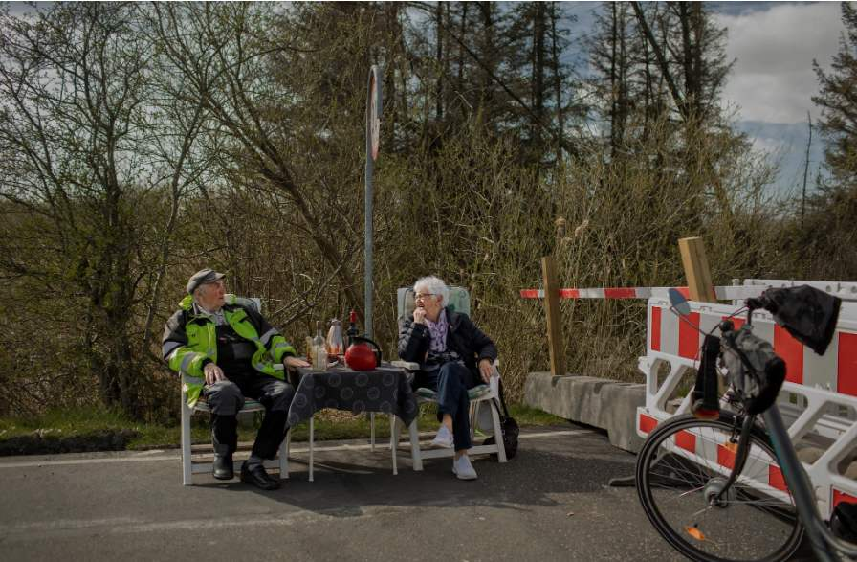
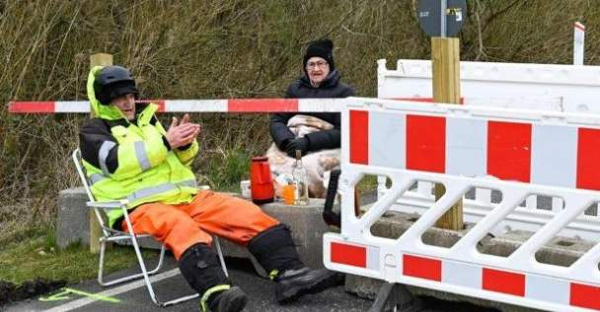
1

Slide 6
Who?
What ?
Where?
Why?

Slide 7
Elderly Couple Meets at Germany-Denmark Border For Daily Coffee Dates During Coronavirus Lockdown
Rasmussen, 85, is from Denmark and Hansen, 89, lives in Germany. They met by chance last year, and fell in love with each other. Since March then, they have spent every day together, since the border towns are typically only a 20-minute drive away from each other.
But almost one year exactly after they met, it became impossible to continue their daily meetings as usual. Between March 14 and 16, both Demark and Germany closed their border crossings. Regardless of this, the couple was determined to see each other. They simply relocated their afternoon coffee plans to the border at Aventoft.
Now, every afternoon, Hansen rides his e-bike and Rasmussen drives to their fence. Inga brings a chair and sits on the Danish side. Karsten settles onto the German side. They open a packet of biscuits and pour each other cups of coffee. Everything is fairly normal — except that they cannot hug or kiss each other.
What does “this” refer to?
Both Demark and Germany closed their border crossings.
Demark and Germany imposed lockdown.
What do these verbs in para.3 imply ?
energetic, calm, active, romantic , love each other deeply …..positive, persist in love

Slide 8
Be positive about life!

Slide 9
2

Slide 10
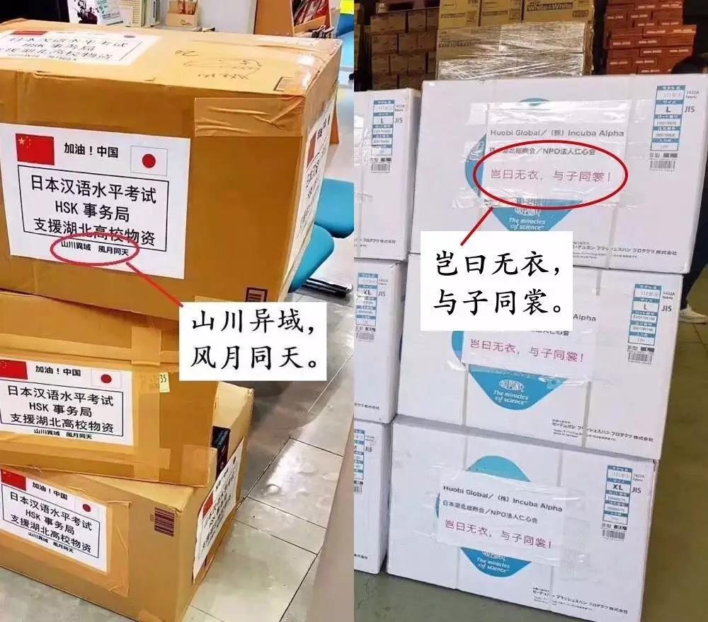
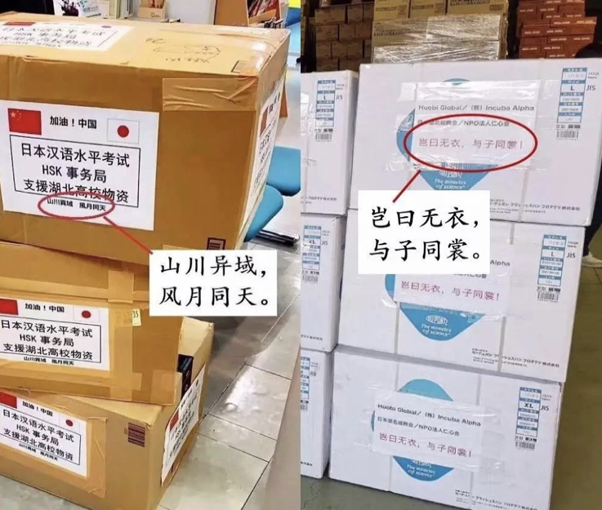

Though miles apart,
we are under the same sky.
Together we stand,
my armors thine.
盔甲

Slide 11
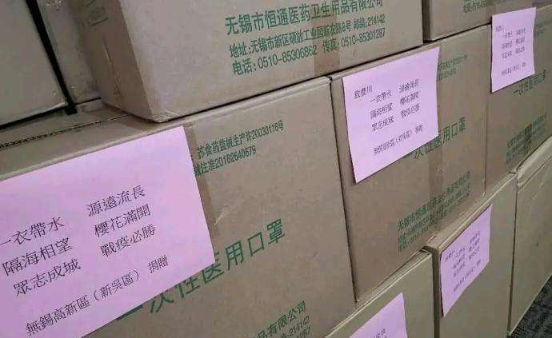

一衣带水，源远流长；
隔海相望，樱花满开；
众志成城，战疫必胜。
With a strip of water and a long history；
Cherry flowers blossom across the sea ；
With unity, the battle against the virus will win.

Slide 12
In early February Toyokawa donated 4,500 masks and other (protect) medical supplies to Wuxi, East China's Jiangsu province, when the Chinese city
(hit) by the novel coronavirus.
the fight against the virus becomes a global struggle, Xinwu kept
close eye on the virus outbreak in Toyokawa and has been making arrangements to provide medical (supply). On March 24 Wuxi's donated a total of 50,000 surgical masks to (it) sister city Toyokawa, Japan _______ (aid) it in the fight against the COVID-19 epidemic.
The Chinese Embassy in Japan made a post on its official Twitter account praising the donations an example of Sino-Japanese friendship. Many netizens praised Xinwu on the Chinese social media platform Sina Weibo.
This is not the (one) time Wuxi, a city of 6.5 million permanent residents,
(provide) support to organizations and cities around the world.
Fill in the blanks
protective
was hit
As/Since/Because
a
supplies
its
to aid
as
first
has provided

Slide 13

Which proverb can well express Wuxi’s act ?
1.不要以貌取人。
2.知人知面不知心。
3.留得青山在，不怕没柴烧。
4.说曹操，曹操就到。
5.三个臭皮匠，顶个诸葛亮。
6.滴水之恩涌泉相报。
√
1. Don’t judge a book by its cover.
2. Cats hide their claws.
3. If I had lost the ring, yet the fingers are still there.
4. Speak of angles, you will hear their wings./
Speak of devil and he will appear.
5. Two heads are better than one.
6. Little help brings much return.
√

Slide 14
Be grateful to others!

Slide 15
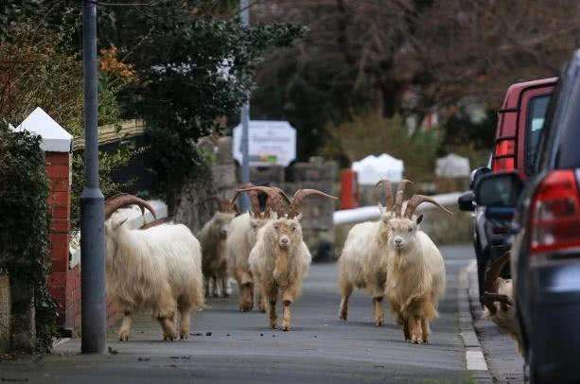
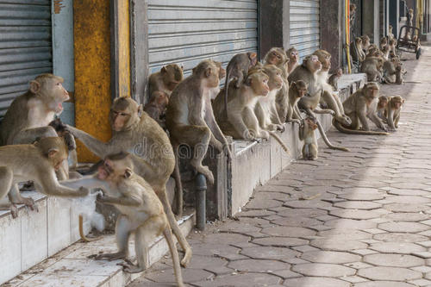
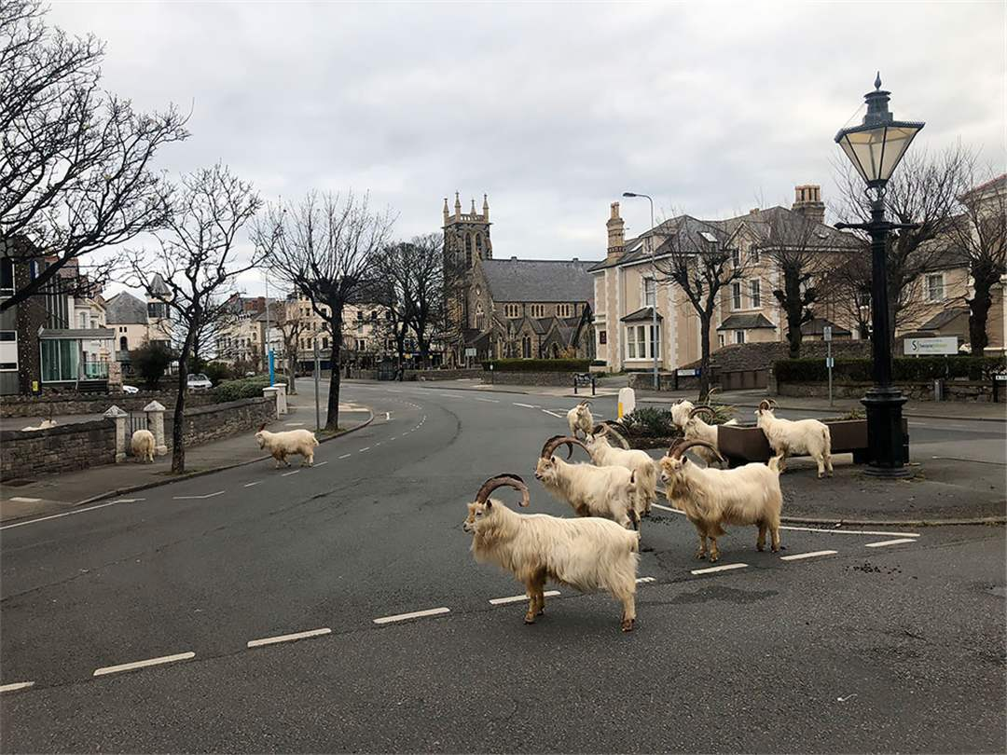
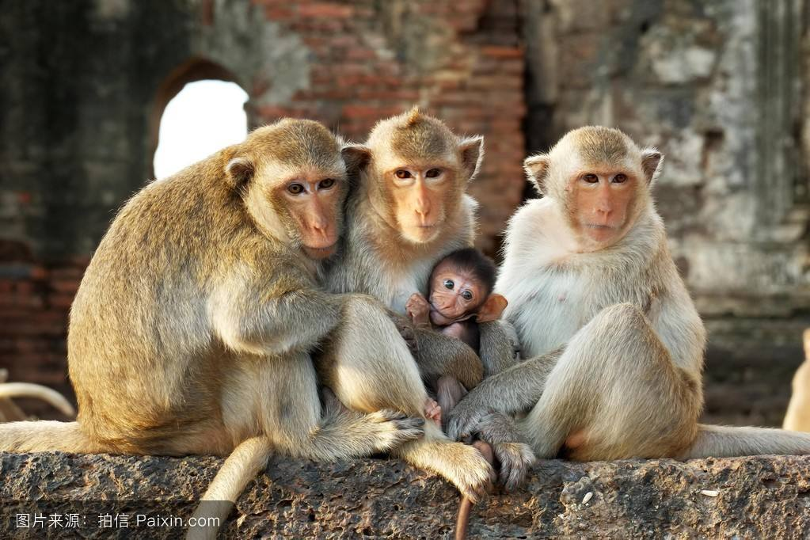
3

Slide 16
Goats are conquering empty streets in a British village. What a strange picture to us humans who are used to only seeing ourselves governing the world. As soon as we withdraw, nature quickly takes over like these monkeys in Thailand as well. Could the corona crisis eventually be good for the environment? Satellite images seem to prove just that. In Italy where people have been living in lockdown for weeks, traffic has nearly stops and nitrogen dioxide levels have clearly dropped. And another study suggests that Germany might even reach its climate goals, as the corona lockdown causes the economy to produce much less CO2.

Slide 17
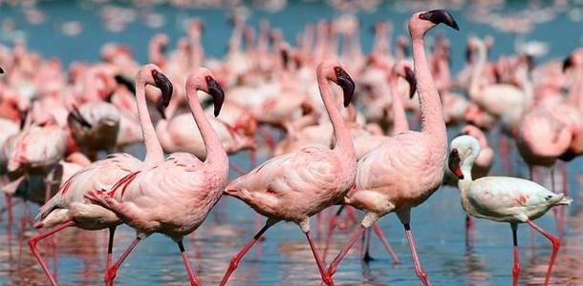
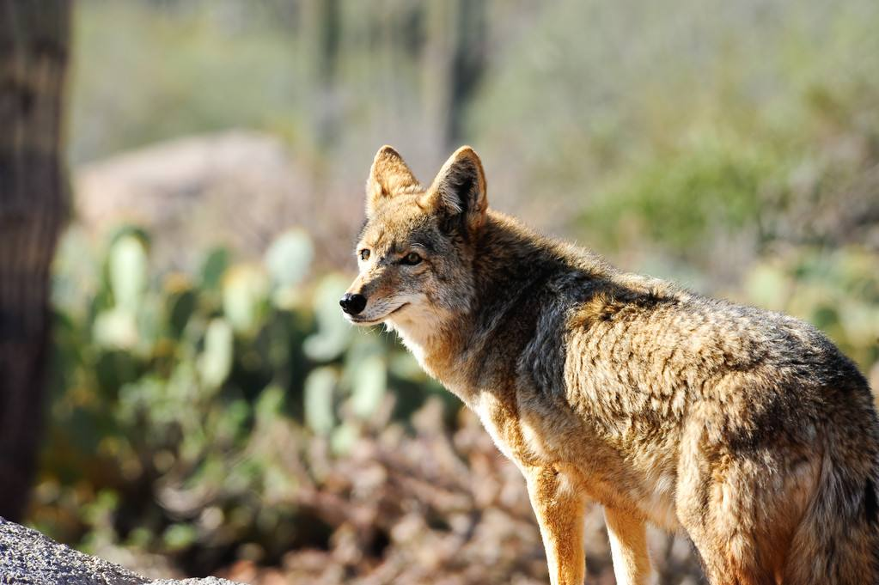
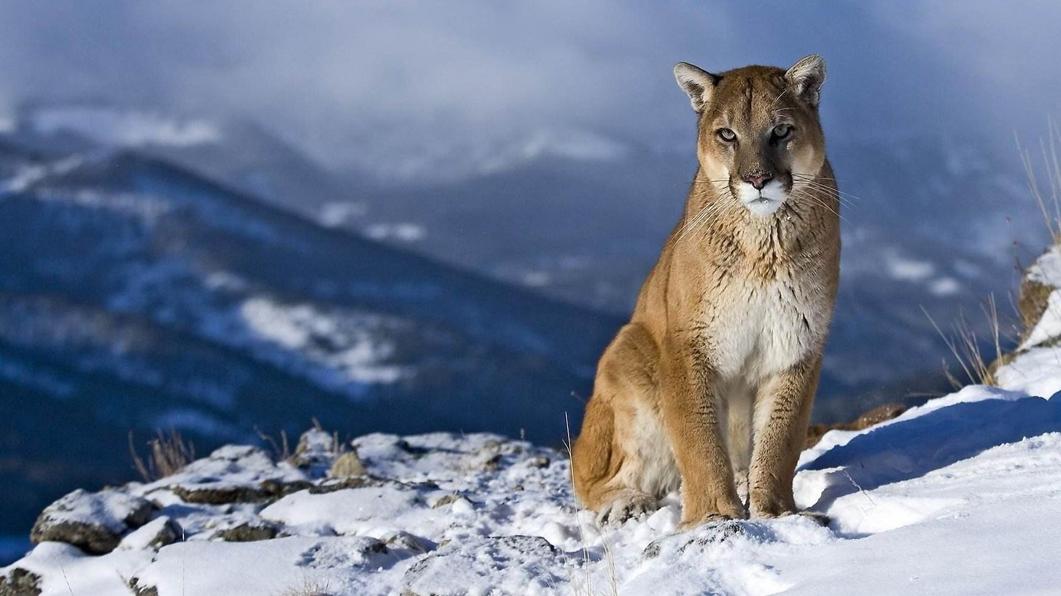
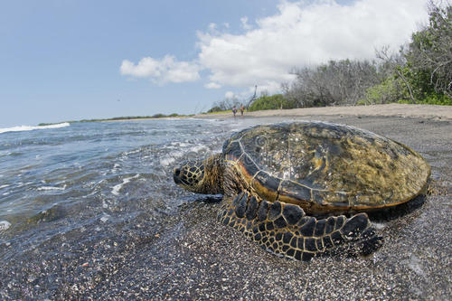
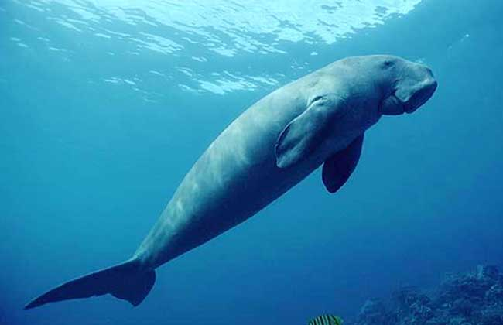
Similar phenomena are emerging round the world. Due to sunny weather and improved water quality, on the 24th, tens of thousands of flamingos were densely lined up by in the center of a lake in Mumbai, India. The whole lake was almost dyed pink. The scene was very spectacular. A coyote roams freely near the Golden Gate Bridge in San Francisco. In Santiago, Chile, cougars run around the city center swiftly. In India, the endangered green turtle, which has not been seen on a beach in the eastern state of Orissa for 10 years, has crawled slowly . In Thailand, 30 Dugong dugon amuse themselves leisurely in the waters of Trang Province .
Therefore, the epidemic has left an eternal topic for human beings:
Without human's interference, which kind of life do these animals live?
(Find some verbs and adverbials)
They live a free life.
火烈鸟
丛林狼
美洲狮
绿龟
儒艮

Slide 18
Mother Nature provides everything for us human beings .
If we treat it badly, Mother Nature is likely to be cruel and punish us seriously .

Slide 19
Be harmonious with nature!

Slide 20
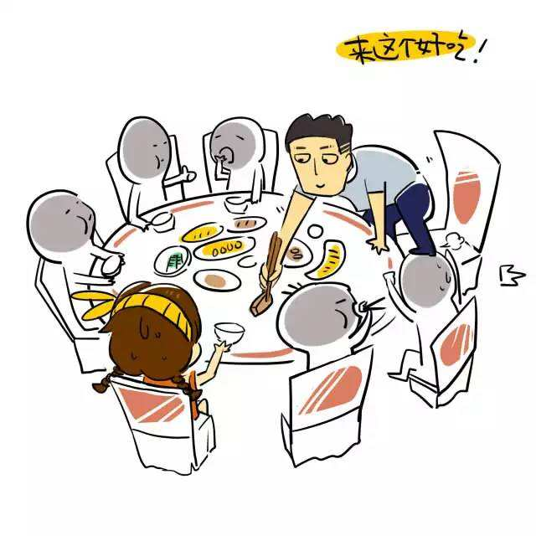
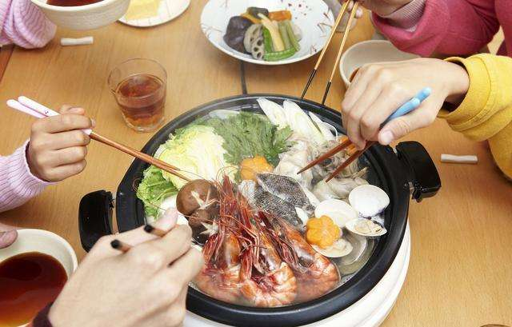
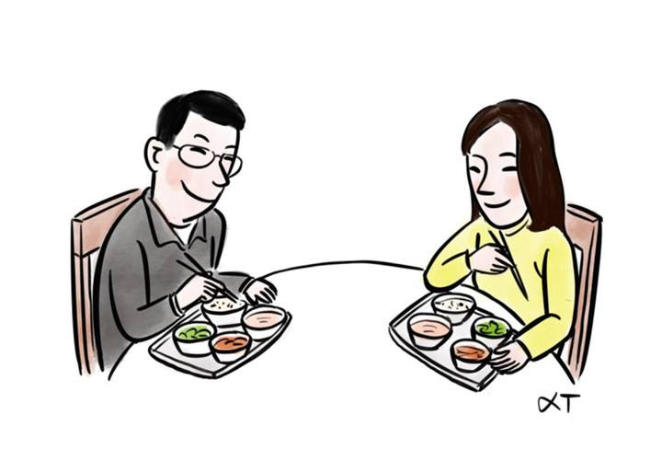
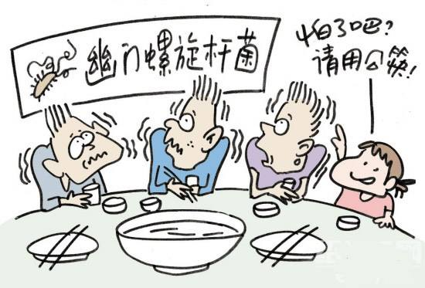
4

Slide 21
合餐制
The origin of communal meals
This tradition of communal meals can date back to as early as the Song Dynasty (960-1279). Chinese cuisine highlights color, aroma and taste, meanwhile Chinese culture emphasizes completeness and family reunion. Thus, chicken and fish are often cooked whole, with people believing the color, shape and flavor of the food will be affected if they are divided into smaller pieces. This led to the popularity of communal meals, as they not only reflect the food culture, but also contain different feelings. At the diner table, elders pass food for their children and grandchildren to express their care and love, while hosts do the same for their guests to extend their welcome and respect.
However, such traditions have indeed increased the risk of spreading diseases.
Find two pairs of verbs with the same meaning.
1. highlight--emphasize
(stress)
2. express--extend
(show/convey)

Slide 22
Dining table revolution takes place in China
Across the country, lot’s of famous people including celebrities, business tycoons, public health experts have taken part in educating the public. “Divide meals, not love,”
In Ningxia, a video tells residents in local dialect of a “new trend in civilized dining”. “Dividing meals and chopsticks is not dividing love,” it assures viewers.
In Hangzhou, a local party member has called for 11 November to be designated指定 “People’s Chopsticks Action Day,” considering the date’s similarity to two sets of chopsticks.
In Beijing, billboards call for citizens to join the campaign under the slogan口号: “Love is one more pair of chopsticks.” Starting in June, restaurants will be required to provide serving utensils餐具 and when possible to offer separate portions(份).
The campaign appears to be working at restaurants. A manager at a chopstick factory in Zhejiang province says the company has seen orders for gongkuai, which are longer and decorated differently, go up as much as 30%.
What are the new ideas about food sharing?
(underline some sentences to show the ideas)

Slide 23
Even if we don’t share food, we are still friends.
For the sake of our health, using served meals and serving chopsticks is a good choice .

Slide 24
Be serious about health!

Slide 25
Virus, you teach us a lot ! We will stay aware and stay changed!
grateful
harmonious
serious
positive

Slide 26
Thank you！
Designed by Karen

