Slide 1

感恩遇见，相互成就，本课件资料仅供您个人参考、教学使用，严禁自行在网络传播，违者依知识产权法追究法律责任。
更多教学资源请关注
公众号：溯恩高中英语
知识产权声明

Slide 2
May 13, 2020
2020年1月高考英语试卷
语言知识的考查分析
(客观题部分)
杭州师范大学附属中学
姜建军

Slide 3
《普通高中英语课程标准》P 12
( 以下同)
语言知识
语法知识
词汇知识
语用知识
语音
知识
语篇知识

Slide 4
高考应该在考查学生的英语语言运用能力的同时，渗透对文化意识、思维品质和学习能力的考查。对语音、词汇、语法、语用、语篇和文化知识的考查应渗透在英语理解能力和表达能力的考查之中。
理解能力 | 对口语和书面语篇的理解能力
 | 从口头和书面语篇中获取信息的能力
 | 对口头和书面语篇作出反应的能力
表达能力 | 流利性、准确性和得体性
 | 运用词汇和语法表达特殊意图和效果
 | 语篇的结构、文体特征、衔接性和连贯性
P 99

Slide 5

1. 语音知识
语音
同化
语调
重音
爆破
连读
停顿
节奏
语音和语义密不可分，语言依靠语音实现其社会交际功能。说话者通过语音的变化表达意义和观点，反映其态度、意图、情感等。 (P 19)

Slide 6
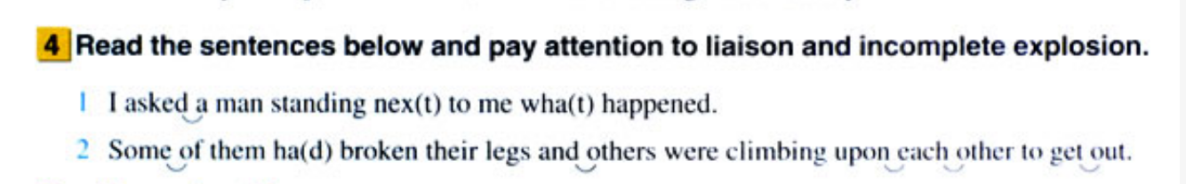
人教版 M1U4 P31

Slide 7
听力部分
典型试题分析

Slide 8
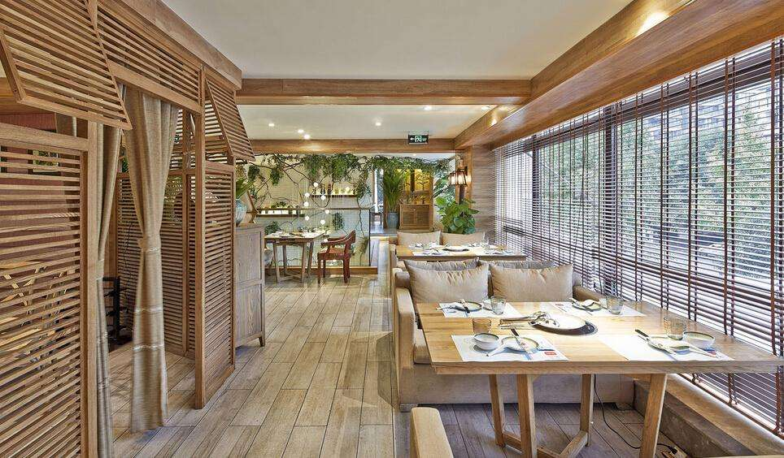
2. What will the man do next?
A. Change some money
B. Take food home.
C. Sit and eat his meal.
Text 2
M: I’d like a chicken roll, an order of fries, and a chocolate shake.
W: For (h)ere or to go?
M: I’ll ea(t) here. And here’s twenty dollars.
C

Slide 9
听第6段材料，回答第6、7题
6. Who is the newcomer?
A. David Cook
B. Joey Sanders
C. Liam Neeson
7. What is the newcomer’s position
in the company?
A. He is a film director.
B. He is a program manager.
C. He is a department head.
Text 6)
W: Hey, Michael. Did you hear about the newcomer?
M: Who?
W: We girls just call him Liam Neeson, because he looks so much like (h)im from the film Schindler’s List.
M: Oh, you mean Joey Sanders. He is the new head of the marketing department.
W: Is he? I thought he was in your department, taking David Cook’s place in charge of the I’m One of Three program.
M: As a matter of fact, I’m head of the I’m One of Three program now.
B
C

Slide 10
13. How does the man sound?
A. Helpful.
B. Nervous.
C. Surprised.
A
Text 8
M: Meg Bank Service, good morning.
M: Hold on a moment. I'll check for you.
M: Yes, one of our customers has just handed it in a passport.
M: When exactly did you lose your passport?
M: Have you lost anything else?
M: Something you used in the bank?
M: Yes, you left your credit card on the counter.
M: That will be fine. Remember to bring some phone identification with you.
M: See you later.
升调 rising tune | 不肯定， 没有结束
降调 falling tune | 结束，肯定

Slide 11
2. 语用知识
语言形式和语体风格会因交际场合的正式程度、行事程序、交际参与人身份的不同而不同。具体而言，语境主要涉及交际的时间、地点、情境等环境因素，也涉及参与人的交际目的、交际身份、处境及心情等个体因素。
（ P 31）

Slide 12
1. Where does the conversation probably take place?
A. At a zoo. B. In a library. C. In a drugstore.
交际地点
Text 1
W: So you need some information on animal cells? Check the tall shelf and you may find what you want.
M: Oh, I see. May I borrow one for a day or two?
W: Sorry! The reference books are not for lending.

Slide 13
Text 7
W: May I come in, sir?
M: Yes. Thanks for coming so quickly.
W: Certainly, sir. How can I help you?
M: I'd like some fresh towels in the bathroom.
W: I'll get them immediately. Would you like me to also change the sheets?
M: Excellent! Oh, by the way, I can never find the light switch when I get back in the evening.
W: ...after I finish cleaning up.
M: That's good to hear. Well, it's time for me to see my friends.
W: Enjoy your day, sir.
M: Oh, I will. Just the second. Could you also take out the plate with this morning's breakfast?
W: Yes, sir. I'll take it with me when I finish tidying up.
8. What does the woman do?
A. She’s a secretary.
B. She’s a hotel maid.
C. She’s a salesperson.
人物身份

Slide 14
Text 9
…M: I'm Adam Watt from the Seven Star Insurance Company. Thank you for your interest in our company. I need some more information from your side.
W: Oh, sure, Mr Watt, please go ahead.
M: You've got a degree in finance. Why did you apply for this job?
W: I read the job description and discovered a few interesting programs that I'd like to be a part of. They are challenging yet rewarding, just the sort of things that I can consider to fit me best.
M: I see. But given your educational background, wouldn't you want to work for some big companies?
14. What is the man doing?
A. Placing an order.
B. Selling insurance.
C. Conducting an interview.
C
交际目的

Slide 15
听力部分话题和考点分布
题号 | 话题 | 考点
1 | 借阅书籍 | 推理判断
2 | 餐馆点餐 | 推理判断
3 | 业务发展 | 事实细节
4 | 大风尘土 | 主旨大意
5 | 观看电影 | 事实细节
题号 | 话题 | 考点
6 | 谈新同事 | 事实细节
7 |  | 事实细节
8 | 酒店服务 | 推理判断
9 |  | 事实细节
10 |  | 事实细节

Slide 16
听力部分话题和考点分布
题号 | 话题 | 考点
11 | 找回物品 | 推理判断
12 |  | 推理判断
13 |  | 观点态度
14 | 电话面试 | 主旨大意
15 |  | 事实细节
16 |  | 事实细节
17 |  | 事实细节
题号 | 话题 | 考点
18 | 睡眠专家 | 推理判断
19 |  | 事实细节
20 |  | 观点态度

Slide 17
3. 词汇知识
词汇又称语汇，是一种语言中所有词和词组的总和。词是语言的建构材料，也是最小的能够独立运用的语言单位。词汇中的任何词语都是通过一定的句法关系和语义关系与其他词语建立起一定的联系的，并在语境中传递信息。
（ P 21）

Slide 18
词汇知识内容要求 （选择性必修） | 在语境中，理解具体词语的功能、词义的内涵和外延以及使用者的意图和态度等；
 | 根据不同主题，梳理词语，并用于理解和表达相关的信息；
 | 学习形容词与名词、动词与副词、动词与名词等的习惯搭配，逐渐积累词块，确切表达意思、描述事物；
 | 在比较复杂的语境中，运用恰当词汇命名事物，进行指称，描述事件发生、发展的过程，描述特征，说明概念等。
P 22

Slide 19
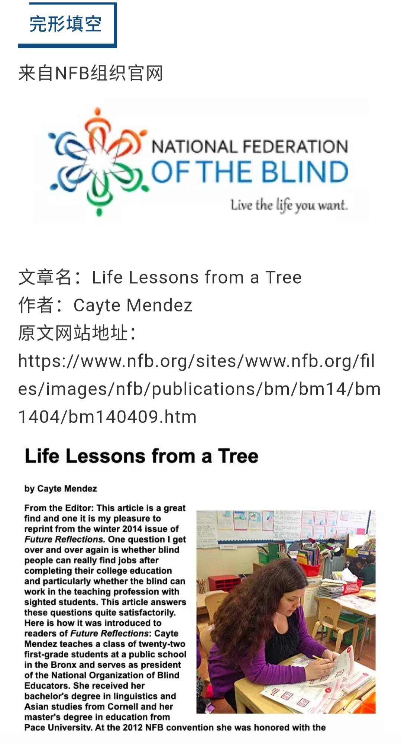
完形填空

Slide 20
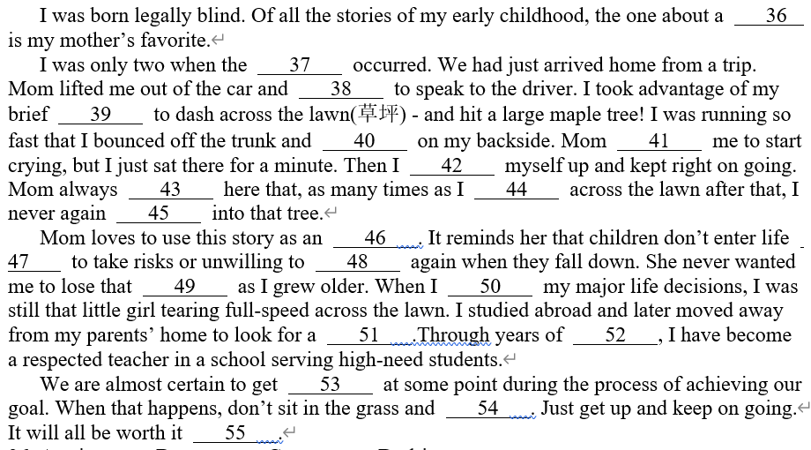

Slide 21
完形填空
典型试题分析

Slide 22
story: n account of past events, incidents
（实有的）故事; 记事
词义的内涵
I was born legally blind. Of all the stories of my early childhood, the one about a 36 is my mother‘s favorite.
I was only two when the 37 occurred….
37. A. incident B. change C. illness D. problem
incident
第二段的主题句，承上启下
incident n. event or happening 事情, 发生的事
I was running so fast that I bounced off the trunk and 40 on my backside.
40. landed B. slept C. laughed D. wept
landed
reach the ground after a fall
跌落地面

Slide 23
Mom 41 me to start crying, but I just sat there for a minute.
A. promised B. encouraged C. allowed D. expected
expected
expect v. think or believe that sth will happen or that sb/sth will come
预料, 预计
Mom always adds here that, as many times as I 44 across the lawn after that, I never again crashed into that tree.
44. A. drove B. lived C. stood D. zoomed
zoomed
zoom v. move very quickly 急速移动
Para 2 …I took advantage of my brief freedom to dash across the lawn (草坪)—and hit a large maple tree!
Para 3 I was still that little girl tearing full-speed across the laws.

Slide 24
It reminds her that children don’t enter life afraid to take risks or unwilling to try again when they fall down. She never wanted me to lose that 49 as I grew older.
49. A. honesty B. toughness C. kindness D. curiosity
tough adj. able to endure hardship; not easily defeated or injured 能耐劳苦的; 不易击败的

Slide 25
词汇的搭配
Then I 42 myself up and kept right on going.
42. A. woke B. picked C. warmed D. gave
picked
pick oneself up: get to one's feet, esp. after a fall 站起来（尤指跌倒後）
get mixed up: become confused 把某人弄糊涂
get fed up: get tired 厌烦
get knocked down： be stricken to the ground 被击倒或撞倒在地上
get settled down： become calm, less restless 安静﹑ 安顿﹑ 安心等:
knocked down
We are almost certain to get 53 at some point during the process of achieving our goal.
53. A. mixed up B. fed up C. knocked down D. settled down
Mom loves to use this story as an 46 . It reminds her that children don’t enter life 47 to take risks or unwilling to 48 again when they fall down.

Slide 26
完形填空试题词汇考查分布
动词及动词短语 | 名词 | 形容词 | 介词短语
11处 | 7处 | 1处 | 1处

Slide 27
4. 语篇知识
语篇知识是关于语篇如何构成、语篇是如何表达意义以及人们在交流过程中如何使用语篇的知识。
语篇中各要素之间存在复杂的关系，如句与句、段与段、标题与正文、文字与图表之间的关系。
微观结构 | 句子内部的语法结构、词语搭配、指代关系、句子的信息展开方式等。
宏观结构 | 语篇中段与段的关系以及语篇各部分与语篇主题之间的关系，语篇类型和语篇格式等。
（ P 26）

Slide 28
研读语篇
（ P 39）
对语篇的主题、内容、文体结构、语言特点、作者观点等进行深入的解读。关注语篇的选材出处和发表时间，分析作者和说话人的立场、观点和写作或表述风格，以及特定时期的语言特点和时代印记等。
What 的问题 | 语篇的主题和内容是什么？
Why的问题 | 语篇的深层含义是什么？作者或说话人的意图、情感态度或价值取向是什么？
How的问题 | 语篇具有什么样的文体特征、内容结构和语言特点？为了恰当表达主题意义选择了什么样的文体形式、语篇结构和修辞手段？

Slide 29
第一节阅读理解
典型试题分析

Slide 30
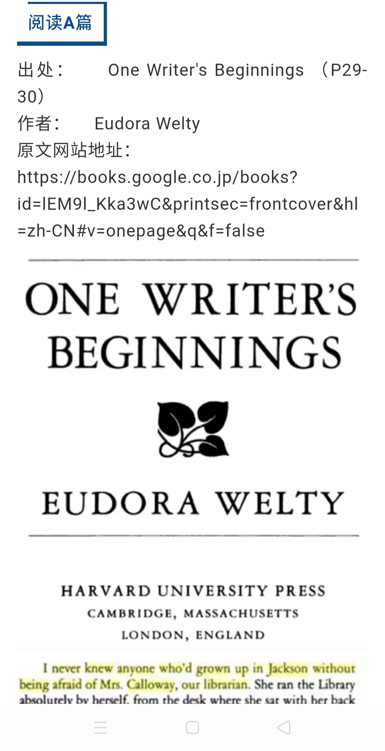
A篇
语篇类型 | 记叙文 (Narrative )
叙事视角 | 第一人称视角 (First-person point of view)
主要内容 | 孩童时期阅读的快乐体验：严厉的图书馆员，我如痴如醉地阅读，同样爱好读书的妈妈。

Slide 31
23. Where is the text probably from?
A. A guidebook. B. An autobiography.
C. A news report. D. A book review.
必修 语篇知识内容要求：
记叙文和说明文语篇的主要写作目的（如：再现经历、传递信息、说明事实、想象创作）以及这类语篇结构特征（如：该类语篇的必要组成部分和可选组成部分、各组成部分的顺序等。
（P27）
考查文本出处，理解语篇结构，了解写作手法与特点
a book in which someone writes about their own life
A guidebook | a book which gives information for visitors about a place, such as a city or country
A book review | a piece of article that goes through the content and form of a book, usually with the author's own opinions.
A news report | an article that tells something that has happened recently

Slide 32
...So two by two, I read library books as fast as I could go, rushing them home in the basket of my bicycle. From the minute I reached our house,
I started to read. I knew this was extreme happiness, knew it at the time.
My mother shared this feeling of mine. Now, I think of her as reading so much of the time while doing something else. I remember her reading a magazine while taking the part of the Wolf in a game of “Little Red Riding Hood” with my brother’s two daughters. She’d just look up at the right time, long enough to answer—in character—“The better to eat you with, my dear,” and go back to her place in the magazine article.
语篇中的显性衔接和连贯手段：通过使用代词、连接词、省略句、替代等手段来实现的指代、连接、省略、替代等衔接关系。（P27）
22. What do the underlined words “this felling” refer to in
the last paragraph?
A. Desire to read. B. Love for Mrs. Calloway.
C. Interest in games. D. Fear of the library rules.

Slide 33
I never knew anyone who’d grown up in Jackson without being afraid of Mrs. Calloway, our librarian. She ran Jackson’s Carnegie Library absolutely by herself. SILENCE in big black letters was on signs hung everywhere. If she thought you were dressed improperly, she sent you straight back home to change your clothes. I was willing; I would do anything to read.
...
Mrs. Calloway made her own rules about books. You could not take back a book to the library on the same day you’d taken it out; it made no difference to her that you’d read every word in it and needed another to start. You could take out two books at a time and two only...
叙事类文本中人物性格特征由具体的语言来表现。
21. Which of the following best describes Mrs. Calloway?
A. Quiet. B. Strict C. Humorous. D. Considerate.

Slide 34
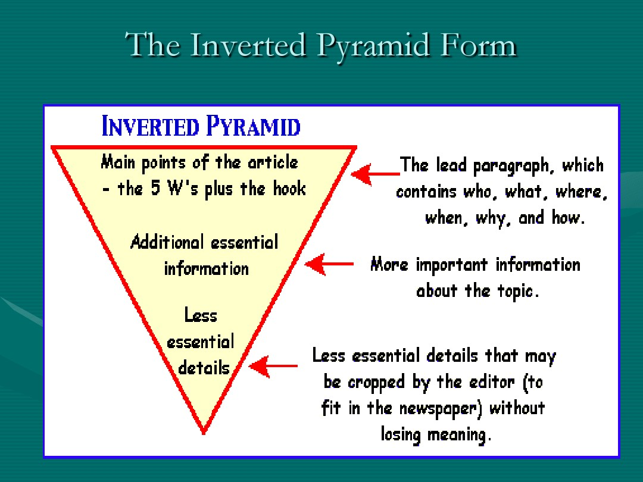
Milwaukee, Wisconsin, is road testing a new way to keep winter roads ice-free - by spreading on them cheese brine, the salty liquid used to make soft cheeses, like mozzarella.
Wisconsin. also called “America’s Dairyland,” is famous for its cheese. The state produced 2.8 billion pounds of cheese last year! As a result, there was a lot of leftover cheese brine. Disposing of (处置) the brine can be expensive. So what should cheese makers do with the waste?
Normally, towns use rock salt to de-ice streets. The salt lowers water’s freezing point, causing ice to melt (融化). But using cheese brine could help both cheese producers and cities save money, while keeping roads safe. Cheese brine has salt in it, which, like the rock salt, helps lower water’s freezing point.
In addition to saving money, cheese brine could also be a more eco-friendly option. Many people suspect that all the rock salt used every winter is harming the environment.
Rock salt is made of sodium chloride，the same compound (化合物) in ordinary table salt. Sounds harmless, right? But while you probably add only a small amount of salt to your food, road crews spread about 20 million tons of salt on U. S. roads every year!
The chemical washes off roads and goes into the ground. There it can pollute drinking water, harm plants, and eat away soil. By spreading cheese brine on streets before adding a layer of rock salt, Milwaukee may be able to cut its rock salt use by 30 percent.
Cheese brine has a downside too—a smell similar to that of bad milk. “I don’t really mind it,” Emil Norby told Modern Farmer magazine. He works for one of Wisconsin’s county highway commissions and came up with the idea of using cheese brine. “Our roads smell like Wisconsin!” he said.
B篇– 新闻报道（说明文）

Slide 35
Normally, towns use rock salt to de-ice streets. The salt lowers water’s freezing point, causing ice to melt (融化). But using cheese brine could help both cheese producers and cities save money, while keeping roads safe. Cheese brine has salt in it, which, like the rock salt, helps lower water’s freezing point.
In addition to saving money, cheese brine could also be a more eco-friendly option. Many people suspect that all the rock salt used every winter is harming the environment...
26. Milwaukee’s new way to de-ice streets may be an example of ______.
A. barking up the wrong tree
B. putting the cart before the horse
C. robbing Peter to pay Paul
D. killing two birds with one stone
例子总是为要点内容服务。

Slide 36
Idiomatic expressions and proverbs
barking up the wrong tree | making a wrong assumption about someone or something. | 白费力气； 找错对象
putting the cart before the horse | having things in the wrong order | 本末倒置、 因果倒置
robbing Peter to pay Paul | taking or borrow from one in order to give or pay something owed to another. | 拆 东 墙 补 西 墙
killing two birds with one stone | achieving two with the one action. | 一举两得

Slide 37
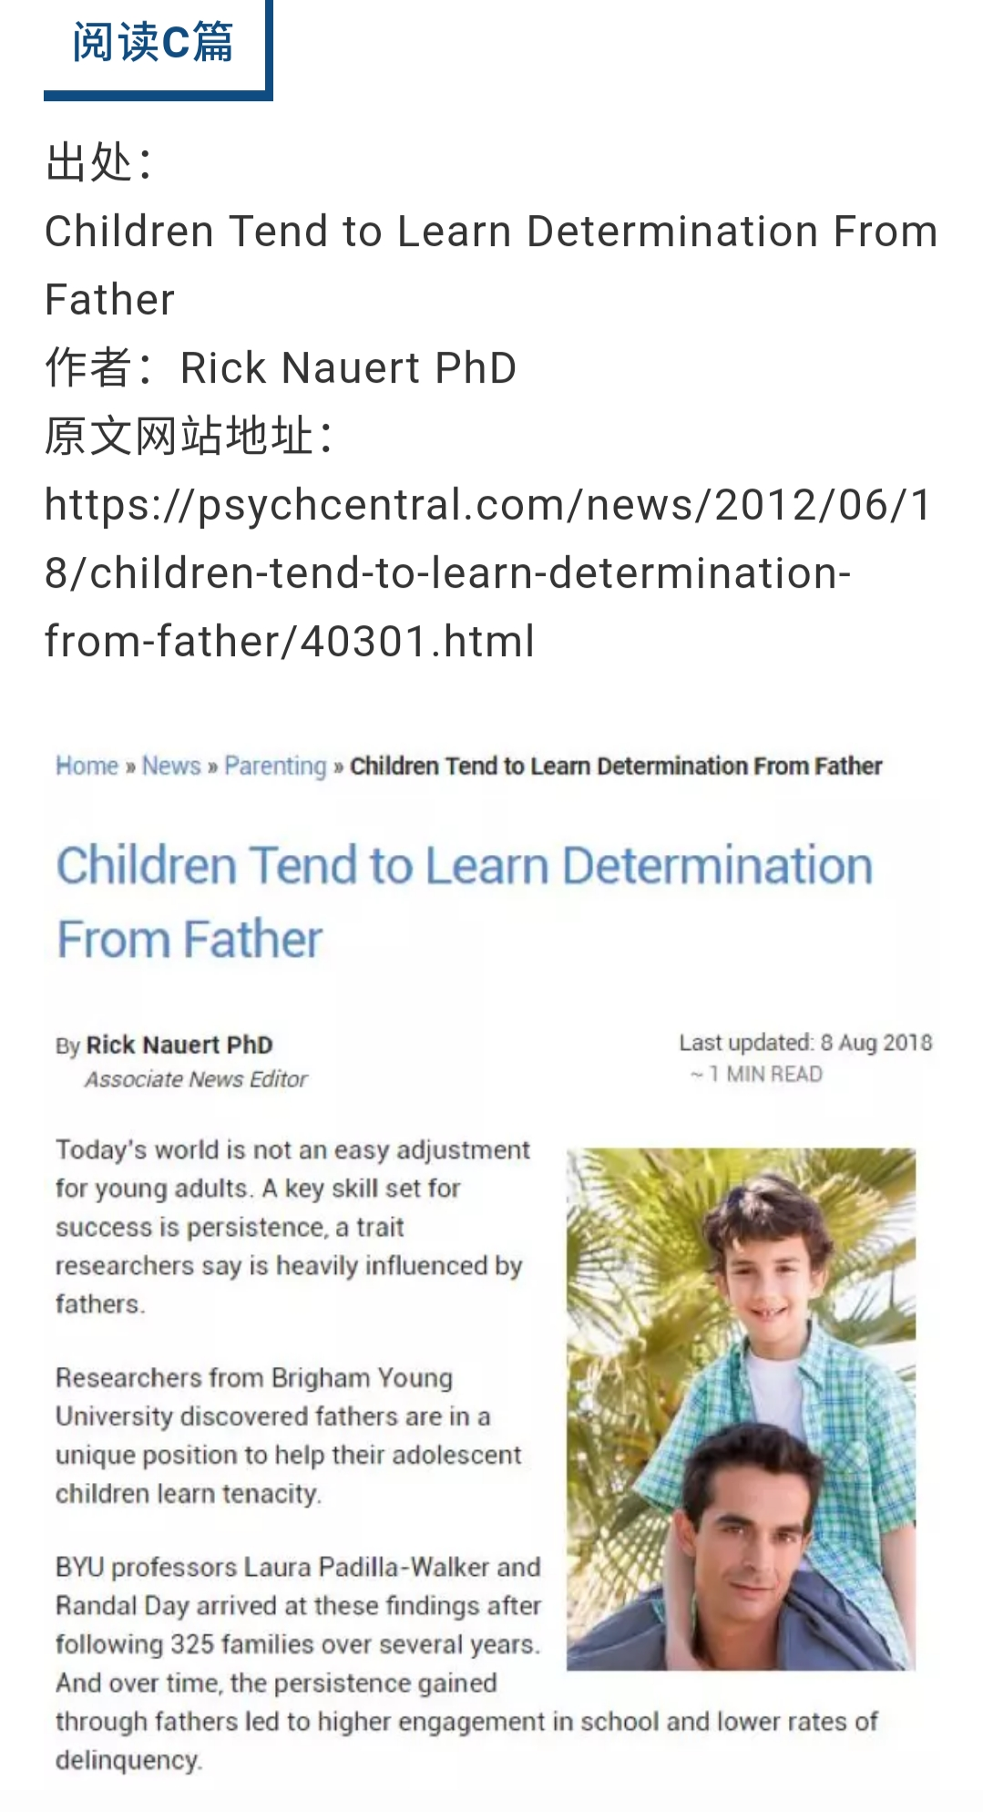
C篇—科学研究
（说明文）

Slide 38
Today’s world is not an easy adjustment for young adults. A key skill set for success is persistence (毅力)，a characteristic that researchers say is heavily influenced by fathers. Researchers from Brigham Young University discovered that fathers are in a unique position to help their adolescent children learn persistence.
BYU professors Laura Padilla-Walker and Randal Day arrived at these findings after following 325 American families over several years. And over time, the persistence gained through fathers led to higher achievement in school.
“There are relatively few studies that stress the unique role of fathers.” Padilla-Walker said. “This research also helps to prove that characteristics such as persistence—which can he taught—are key to a child’s life success.”
Researchers determined that dads need to practice an “authoritative” parenting style. Authoritative parenting is not authoritarian: rigid, demanding or controlling. Rather, an authoritative parenting style includes some of the following characteristics: children feel warmth and love from their father; responsibility and the reasons behind rules are stressed; children are given an appropriate level of autonomy (自主权).
In the study, about 52 percent of the dads exhibited above-average levels of authoritative parenting. A key finding is that over time, children raised by an authoritative father were significantly more likely to develop persistence, which leads to better outcomes in school.
This particular study examined 11 to 14-year-olds living in two-parent homes. Yet the researchers suggest that single parents still may play a role in teaching the benefits of persistence, which is an avenue of future research.
Research finding
Research process
Further research

Slide 39
Translational word 引出新的信息
This particular study examined 11 to 14-year-olds living in two-parent homes. Yet the researchers suggest that single parents still may play a role in teaching the benefits of persistence, which is an avenue of future research.
29. Which group can be a focus of future studies according to the researchers?
A. Single parents.
B. Children aged from 11 to 14.
C. Authoritarian fathers.
D. Mothers in two-parent homes.
way of approaching or making progress towards sth 途径; 手段

Slide 40
Today’s world is not an easy adjustment for young adults. A key skill set for success is persistence (毅力)，a characteristic that researchers say is heavily influenced by fathers. Researchers from Brigham Young University discovered that fathers are in a unique position to help their adolescent children learn persistence.
科学研究类说明文往往第一段呈现研究发现或结论（本文中心）
30. Which of the following is the best title for the text?
A. Three Characteristics of Authoritative Fathers
B. Key Skills for Young Adults to Succeed in Future
C. Children Tend to Learn Determination from Father
D. Family Relationship Influences School Performance

Slide 41
第一节阅读理解试题考点分布
题号 | 考查焦点
21 | 观点意图
22 | 推理判断
23 | 推理判断
24 | 事实细节
25 | 推理判断
题号 | 考查焦点
26 | 推理判断
27 | 推理判断
28 | 事实细节
29 | 推理判断
30 | 主旨大意

Slide 42
第二节阅读理解
典型试题分析

Slide 43
第二节—说明文
A. We use water indirectly too.
B. Every system in our body depends on water to function.
C. It is to inspire people to learn more about water-related problems.
D. If children walk many hours a day to get water, they can’t go to school.
E. Did you know that around 750 million people do not have clean water to drink?
F. In 1993 the United Nations decided that March 22nd is the World Day for Water.
G. In this way, they know how it feels to walk a long distance carrying heavy bottles.
Let’s take a minute to think about the water we use. The human body is 60% water and we need to drink lots of water to be healthy. When we are thirsty we just go to the kitchen and fill a glass with clean water.
31 For example, farmers, who produce the food we eat, use water to make the plants grow. When we turn on a light or switch on a TV or a computer we use energy and we need water to produce this energy.
The truth is that we are lucky enough to have clean water whenever we want, but this is not the case for many people around the world. 32 That’s around one in 10 people in the world. If we drink dirty water, we can catch diseases from the bacteria and become ill. Every year over 500,000 children die from diarrhoea (腹泻) from dirty water. That’s around 1,400 children every day! Also, in some countries children walk many kilometres every day to get water. 33 Therefore, they don’t have time to learn how to read or write and don’t get an education.
34 On this day every year, countries around the world hold events to educate people about the problems of dirty water and that clean water is something that everyone should have around the world. At one school in the UK, children between the ages of 10 and 15 walk 6km with six litres of water. 35 People give them money to do this and all the money helps get clean water to as many people as possible around the world.

Slide 44
Let’s take a minute to think about the water we use. The human body is 60% water and we need to drink lots of water to be healthy. When we are thirsty we just go to the kitchen and fill a glass with clean water.
31 For example, farmers, who produce the food we eat, use water to make the plants grow. When we turn on a light or switch on a TV or a computer we use energy and we need water to produce this energy.
directly
We use water indirectly too.
32 That’s around one in 10 people in the world.
Did you know that around 750 million people do not
have clean water to drink?

Slide 45
Also, in some countries children walk many kilometres every day to get water. 33 Therefore, they don’t have time to learn how to read or write and don’t get an education.
If children walk many hours a day to get water, they can’t go to school.
34 On this day every year, countries around the world hold events to educate people about the problems of dirty water and that clean water is something that everyone should have around the world.
In 1993 the United Nations decided that March 22nd is the World Day for Water.

Slide 46
第二节阅读理解试题考点分布
题号 | 语篇逻辑
31 | 例证关系
32 | 重述关系
33 | 因果关系
34 | 指代关系
35 | 指代关系

Slide 47
5. 语法知识
使用
use
意义
meaning
形式
form
语法知识
语法 知识 | 词法知识 | 词的形态变化，如名词的数、格、动词的时、态（体）等。
 | 句法知识 | 关注句子结构，如句子的成分、语序、种类等。
（P 23）

Slide 48
Mom always 43 here that, as many times as I 44 across the lawn after that, I never again 45 into that tree.
连接词，引导宾语从句
指示代词
指示代词，代替那件事情
例如：完形填空

Slide 49
再如：阅读理解B篇
Normally, towns use rock salt to de-ice streets. The salt lowers water’s freezing point, causing ice to melt (融化). But using cheese brine could help both cheese producers and cities save money, while keeping roads safe. Cheese brine has salt in it, which, like the rock salt, helps lower water’s freezing point.
定语从句，补充说明
24. Why can cheese brine help keep winter roads ice-free?
A. It is soft. B. It contains salt.
C. It is warm. D. It has milk in it.
文章出现定语从句、同位语从句等比较特殊的语法现象处是命题的信息点。

Slide 50
再如：阅读理解C篇
“There are relatively few studies that stress the unique role of fathers.” Padilla-Walker said. “This research also helps to prove that characteristics such as persistence—which can he taught—are key to a child’s life success.”
否定词修饰名词加定语从句强调作者肯定的语气
27.What is special about the RYU professors’ study?
A. It centered on fathers’ role in parenting.
B. It was based on a number of large families.
C. It analyzed different kinds of parenting styles.
D. It aimed to improve kids’ achievement in school.
A

Slide 51
Thanks for listening!

