Slide 1

感恩遇见，相互成就，本课件资料仅供您个人参考、教学使用，严禁自行在网络传播，违者依知识产权法追究法律责任。
更多教学资源请关注
公众号：溯恩高中英语
知识产权声明

Slide 2
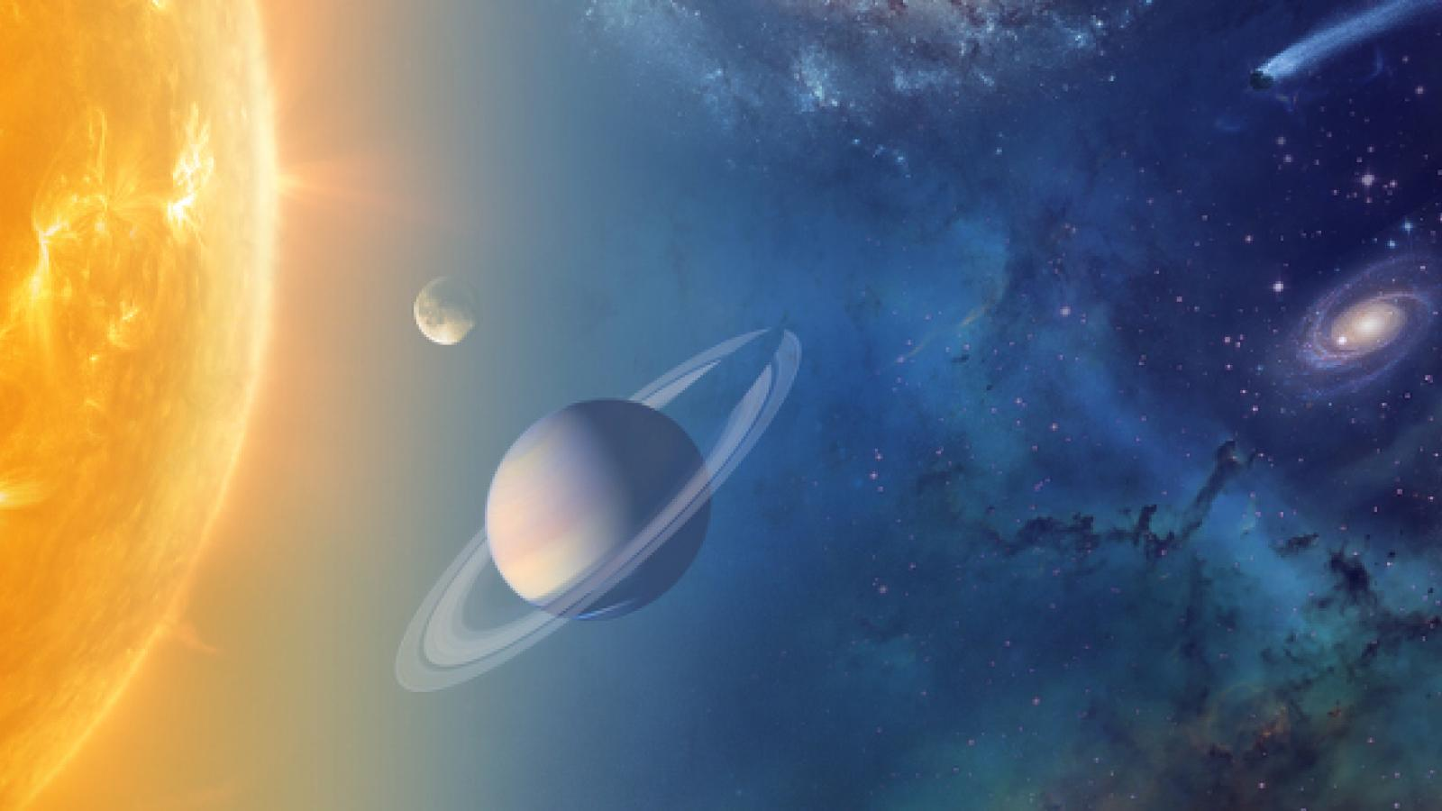
M5U1 Reading and writing
Copernicus’ Revolutionary Theory
桐乡市凤鸣高级中学 邓薇

Slide 3
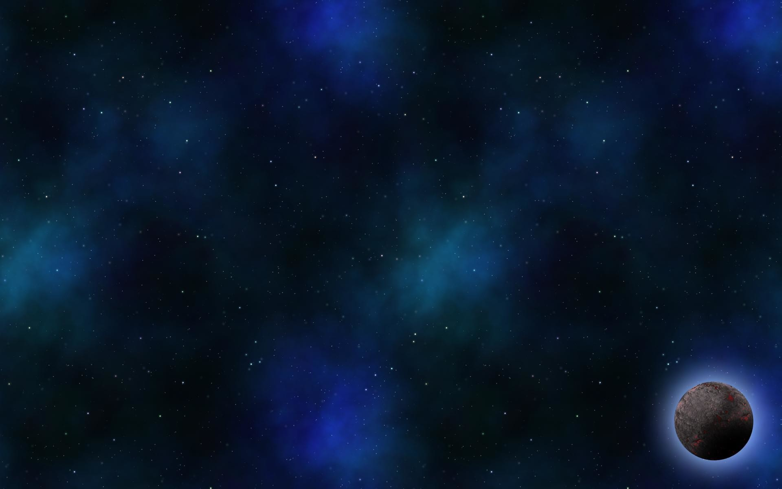

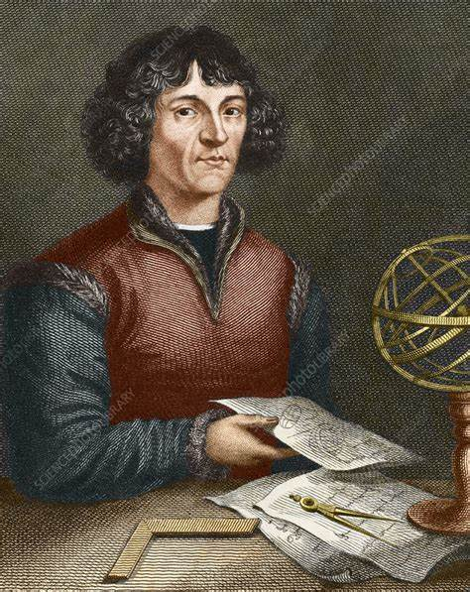
Raise questions based on the title
Who is Nicolaus Copernicus?
What’s his theory about?
How did he prove his theory?
Why was his theory revolutionary?

Slide 4

·
was born on February 19, 1473, in Poland
A brief introduction to Nicolaus Copernicus
·
studied at various universities in Poland and Italy
·
physician, mathematician, astronomer…
·
On the Revolutions of the Celestial
Notes:
使用方法：
【更改文字】：将标题框及正文框中的文字可直接改为您所需文字
【更改图片】：点中图片》绘图工具》格式》填充》图片》选择您需要展示的图片
【增加减少图片】：直接复制粘贴图片来增加图片数，复制后更改方法见【更改图片】
【更改图片色彩】：点中图片》图片工具》格式》色彩（重新着色）》选择您喜欢的色彩
下载更多模板、视频教程：http://www.mysoeasy.com

Slide 5
Read for structure and fill in each blank with one word
Para.1 the ______
problem
Para.2 something ___
strange
Copernicus’ revolutionary theory
observations
Para.3 the _______
new
Para.4 Copernicus’ ___ theory
contributions
Para.5 __________

Slide 6
Para. 1 the problem
Circle two adjectives that describe Copernicus’ feelings.
Nicolaus Copernicus was frightened and his mind was confused.
？
？
Appositive Clause:
give information
All his mathematical calculations led to the same conclusion: that earth was not the centre of the solar system. Only if you put the sun there did the movements of the other planets in the sky make sense.
The Christian church believed God had made the world and for that reason the earth was special and must be the centre of the solar system.
vs
powerful
punish him for even suggesting such an idea
Partial Inversion:
stress the importance

Slide 7
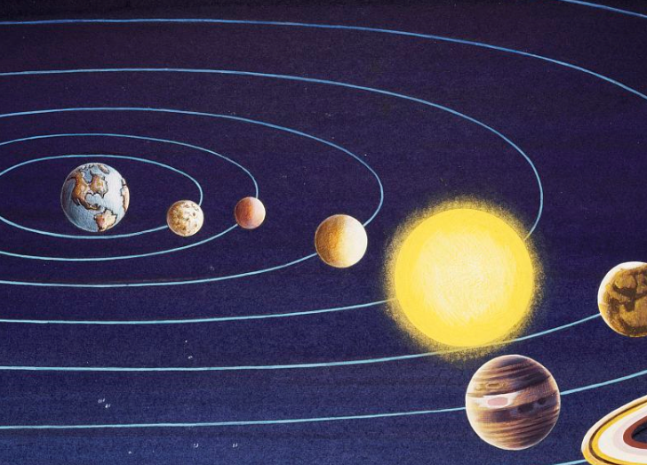

Para. 2 the problem
Para. 2 something strange
Q: What had astronomers found strange?
Some planets in the sky seemed to stop, move backward and then go forward in a loop.
__________ in the movements of the planets
changes
Others appeared brighter at times and less bright at other.
____________ of the stars
brightness

Slide 8
Para. 3 the observations
Circle the verbs that show Copernicus’ research.
Copernicus had thought long and hard about these problems and tried to find an answer. He had collected observations of the stars and used all his mathematical knowledge to explain them. But only his new theory could do that. So between 1510 and 1514 he worked on it, gradually improving his theory until he felt it was complete.
What do these verbs tell you about Copernicus’ qualities?

Slide 9
Para. 2 the problem
Para. 4 the new theory
Q: What was Copernicus’ theory?
The sun is the centre of the solar system.
The planets go round the sun, including the earth.
The earth is spinning as it went round the sun.
The moon goes round the earth.
Q: When did he show it privately to his friend? Why?
Q: When did Copernicus publish his theory?
Q: Do you think he was right or not to be cautious?

Slide 10
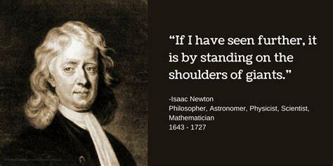
Para. 5 contributions
Q: Why was he right to be careful?
Q: Why was his theory revolutionary?
replaced the Christian idea of gravity which said things fell to earth because God created the earth as the centre of the universe
His theory is now the basis on which all our ideas of the universe are built.
There is a direct link between his theory and the work of Issac Newton, Albert Einstein and Stephen Hawking.
revolutionary
changed the old theory
founder of modern astronomy

Slide 11

Discussion:
Q: If you were Nicolaus Copernicus, would you have hidden your theory for so many years? Give your reasons.

Slide 12
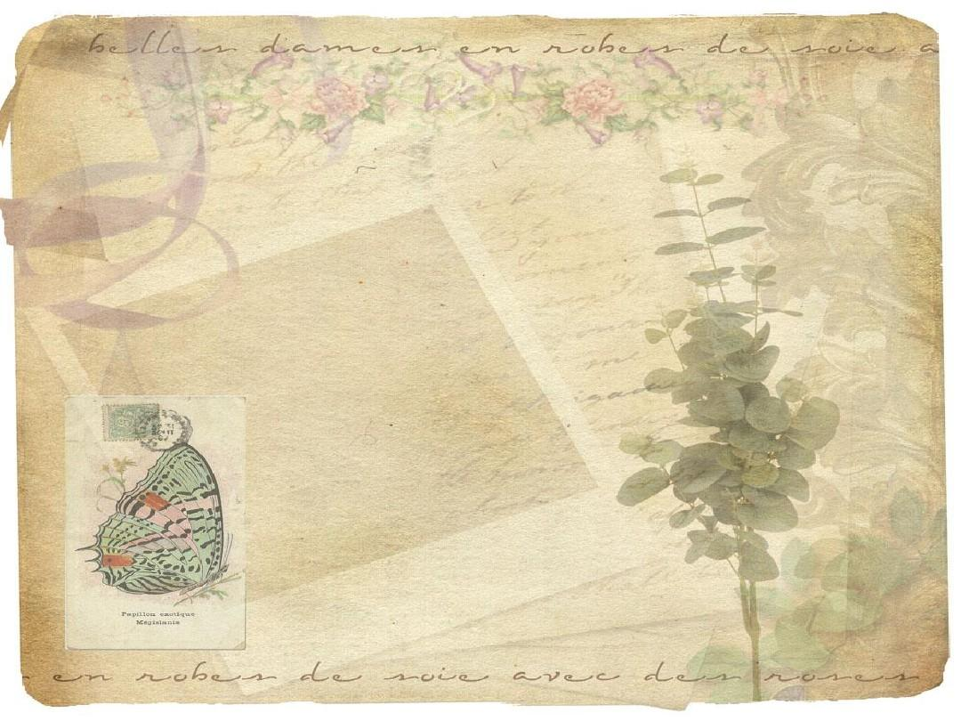
Writing:
Now write a short letter asking Copernicus to publish his ideas so everyone can read them.
Dear Nicolaus Copernicus,
I am a student…
________________________________________________________________________________________________________________________________________________________________________
So I hope you will feel you can publish your new theory.
Yours sincerely,
(your name)

Slide 13
Writing:
Be persuasive and logical !
Now write a short letter asking Copernicus to publish his ideas so everyone can read them.
First, in pairs brainstorm some reasons why he should publish his theory.
there are problems with the present theory
he has done many years of observations to prove his new theory is true
science cannot develop unless people publish their ideas
Second, make a plan.
Para.1: Tell Copernicus who you are and why you want him to publish his ideas.
Para.2: The first reason
Para.3: The second reason
Para.4: Ask him again to reconsider publishing his idea.

Slide 14
Homework
Write the letter after class and polish it.
surf the internet to know more about Nicolaus Copernicus

Slide 15
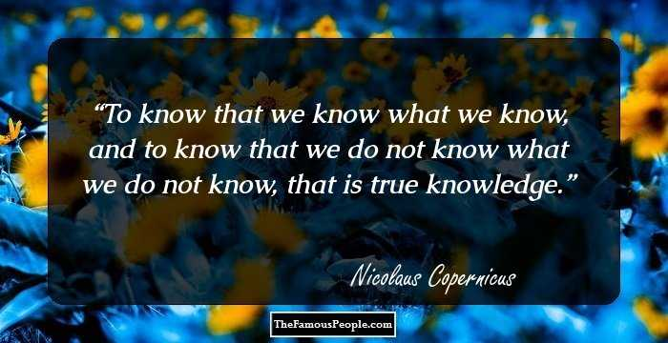

Slide 16
A possible version for reference
Dear Nicolaus Copernicus,
I’m a student studying astronomy and I would like to read your new theory about the solar system. I hope you will publish it for several reasons.
I understand the problems with the present theory. The way the planets move is not what you would expect if the earth was the centre of the universe. It is also odd that the brightness of some stars seems to change. So I agree with you that we need a new theory.
I know your observations have been very carefully carried out over many years. Now you must have the courage to publish them. Never can science advance unless people have the courage of their beliefs. I know you worry about what will happen if you publish your new theory. No matter how people oppose it, time will show whether your ideas are right or wrong.
So I hope you will feel you can publish your new theory.
Yours sincerely,
Li Hua

