Slide 1

感恩遇见，相互成就，本课件资料仅供您个人参考、教学使用，严禁自行在网络传播，违者依知识产权法追究法律责任。
更多教学资源请关注
公众号：溯恩高中英语
知识产权声明

Slide 2
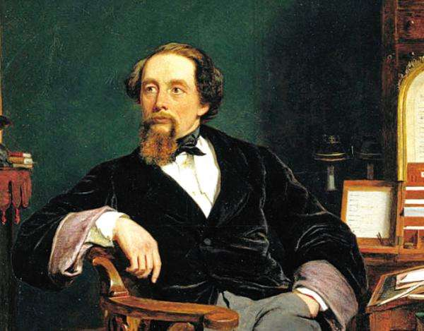
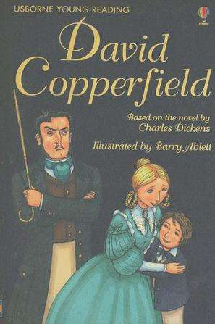
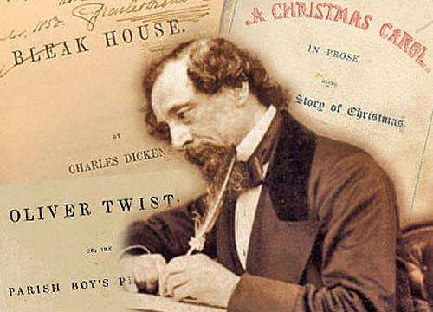
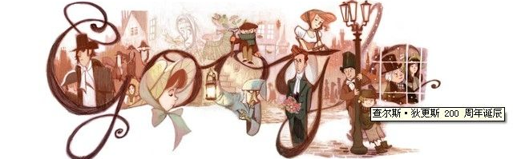
David Copperfield

Slide 3
Chapter 1
A Bad Child

Slide 4

II. Chapter 1: A Bad Child
1
1. What’s the function of this paragraph in Chapter 1?
1
2. How do you understand “ups and downs”?
1
3. Try to translate the first sentence.
My life has been full of ups and downs, and during my childhood the downs seemed to rain on me like a never-ending storm. When I look back on those years, I can’t believe that any grown-up would behave in that way to a child. But they did.
to lead the following content; to set the narrative tone
Miserable and
tragic childhood
happy and miserable time

Slide 5

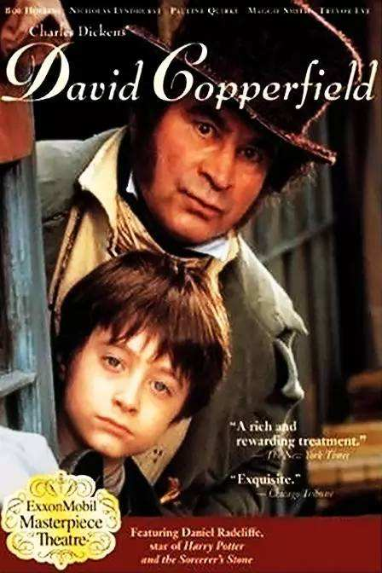





4. Read Chapter 1 and figure out who they are.
1
Name | Who they are
Betsey Trotwood
Peggotty
Clara
Mr. Murdstone
Dan Peggotty
Emily
Ham
Miss. Murdstone

Slide 6
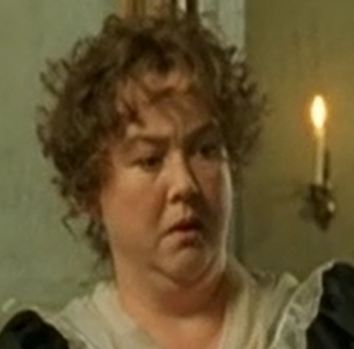
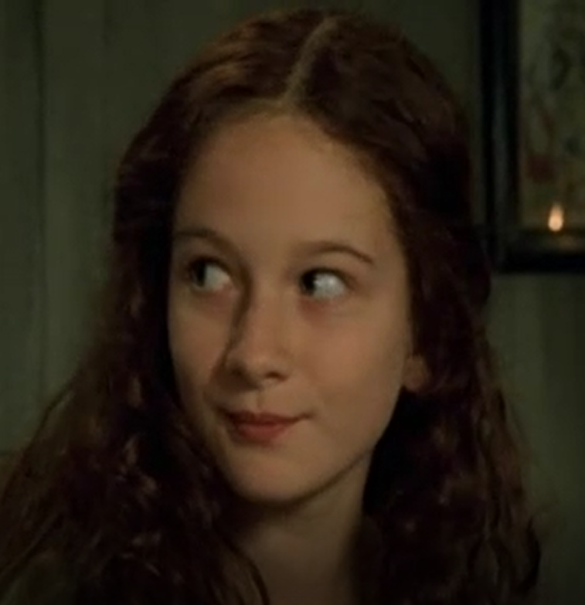
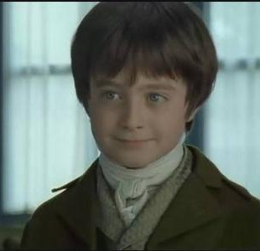
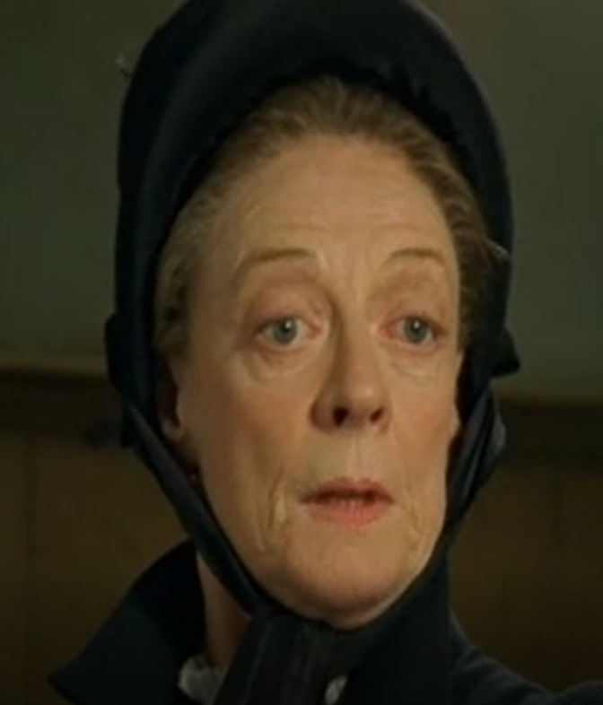
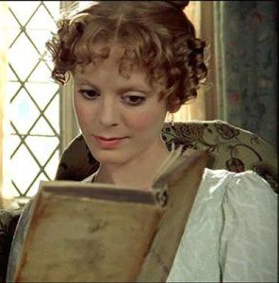
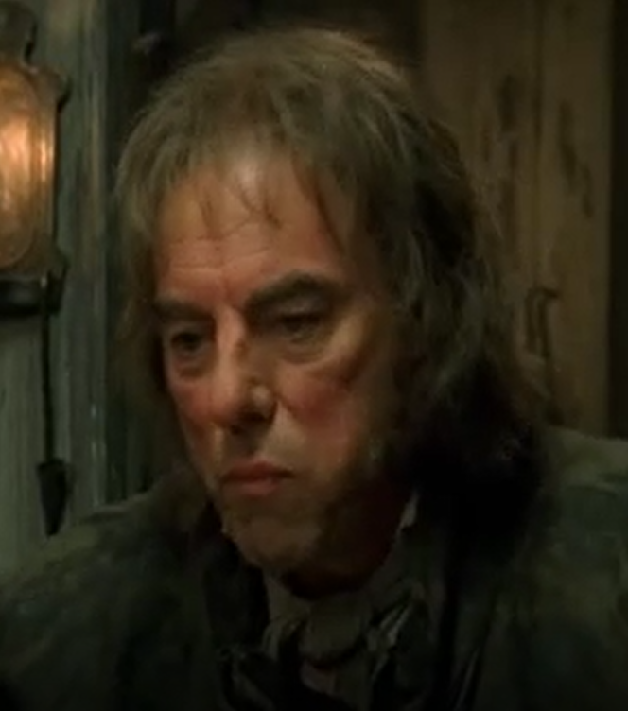
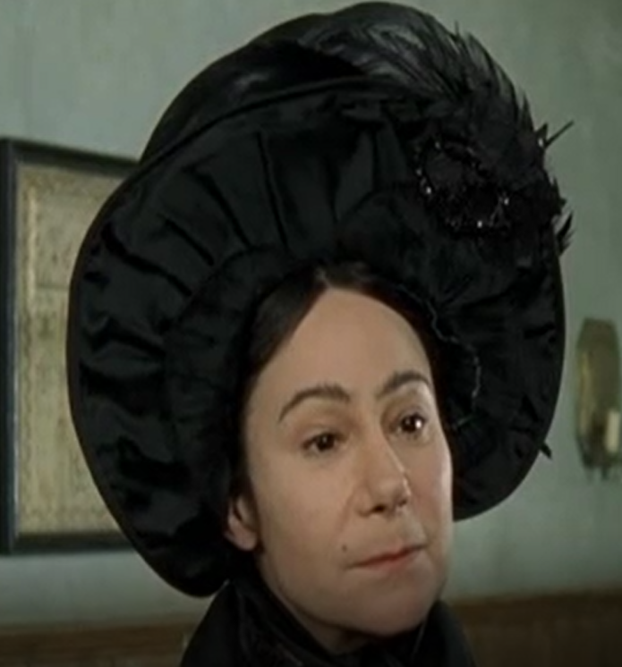
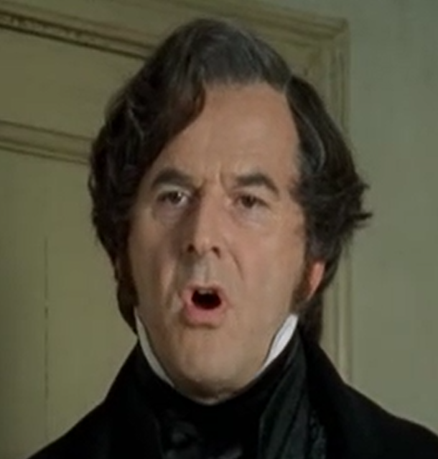
Peggotty
Emily
David Copperfield
Betsey Trotwood
Clara
Dan Peggotty
Miss Murdstone
Mr Murdstone

Slide 7

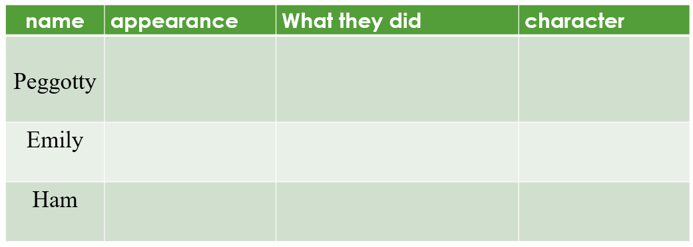
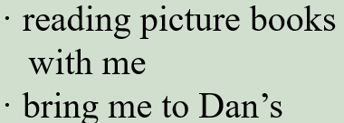








5. What does David think of his early childhood?
1
1
6. Why was David’s early childhood happy?
happy and full of joy
(direct and explicit)

Slide 8




7. What did David’s childhood become unhappy later?
1
1
8. How does the writer describe them?
1
9. What was David’s feeling toward them? How does he describe it?
Mr. Murdstone—his stepfather—entered our happy life with his sister Miss Murdstone.
Name | appearance | character
Mr. Murdstone
Miss. Murdstone
He was very afraid of them.

Slide 9
David was afraid of them.
actions
I walked up the stairs with my knees trembling. (para. 26)
I shook with terror. (para. 27)
“I don’t know,” I whispered nervously. (para. 12)
words
“I…I…can’t do my work,” I spluttered. (para. 28)
He had black hair and a hard, cold, handsome face.
(para. 4)
appearance

Slide 10
10. Why was I so afraid of Mr. Murdstone? What did he do to me?
① Mr. Murdstone said I was a bad child and that he was determined to crush me. (para. 10)
verbal abuse
② “…What do you think I do if I have a dog or horse that doesn’t do what I tell them? I beat it.” he replied, with an evil glint in his eyes. (para. 11)
harsh, stern,
cruel, unpleasant,
③ I wasn’t allowed to play with other children. (para. 18)
physical
abuse
④ Mr. Murdstone insisted I did lessons with my mother, but he and Miss Murdstone would stand over me, frowning and telling my mother to be firmer, and even beat me on one occasion. (para. 19)
11. Did I subject myself to his cruelty? What did I do?
No. I fought back on one occasion.

Slide 11
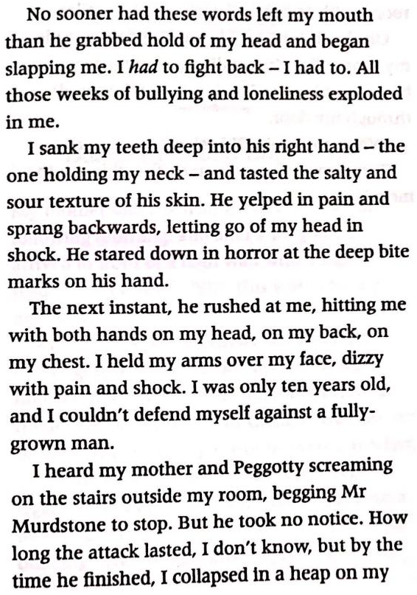
12. Try to find the phrases indicating time.
13. How does the writer describe such a fierce fight?
1
14. What’s the advantage of using many verbs in a
scene?
15. Appreciate the two underlined words and
sentences
No sooner…than…→the next instant→by the time…
Actions. By mainly using verbs.
left→grabbed hold of→slapping→sank teeth into→
tasted→yelped→sprang backward→stared down→ rushed→hitting→held arms→screaming→begging →took no notice→collapsed in a heap (15 verbs)

Slide 12
16. Try to find the sentence describing the following feelings: “happy”,
“unhappy”, “angry”, “desperate”, and “frightened”
happy
My mother seemed to light up in his company.
I had a very heavy heart when Peggotty and I had to return home.
unhappy
She got up in a rage and stormed out, with the slamming of the door.
angry
I felt as if the air had been strangled out of me. Mr. Murdstone was the kind of man that smothers all hope and happiness.
desperate

Slide 13
I shivered with fear, knowing that if I gave him the slightest excuse, he would beat me.
My body was shaking with fear.
frightened
I walked up the stairs with my knees trembling.
SHOW and
not TELL
I shook with terror.
He stared down in horror at the deep bite marks on his had.

Slide 14
17. Try to find the words indicating “say sth”.
whisper
“I don’t know,” I whispered nervously.
reply
“I beat it,” he replied, with an evil glint in his eyes.
shout
Mr. Murdstone jumped up, shouting, “We can’t expect…”
order
“Stop it at once, Clara!” ordered Mr. Murdstone.
demand
“Why are you doing so badly in your lessons?” he demanded.
splutter
“I…I...can’t do my work,” I spluttered.
Expressing
different feelings
beg
I heard my mother begging Mr. Murdstone to stop.
ask
answer
—“When am I going?” I asked.
—“Tomorrow,” she answered, “first thing in the morning.”

Slide 15
Chapter 2
Banished to Boarding School

Slide 16
III. Chapter 2: Banished to Boarding School
1
1. How did Mr. Murdstone do with me after the fighting?
1
2.Why does the writer use “banish” instead of “send”?
1
“They’re sending you to a boarding school in London,” she whispered through my door.
“When am I going?” I asked.
“Tomorrow,” she answered, “first thing in the morning.”
I was banished to a boarding school.
send someone away from a country or place as an official punishment
e.g. The children were banished from the dining room

Slide 17
2. How does the writer describe the boarding school?
① Salem House was a shabby, square, brick building. (para. 2)
/ˈfɪlθi/ ① very dirty and unpleasant
e.g. It’s absolutely filthy in here!
② very rude and offensive and usually connected with sex
e.g. That's enough of your filthy language!
(of buildings, clothes, objects, etc.) in poor condition because they have been used a lot
e.g. She wore shabby old jeans and a T-shirt.
② The classrooms had long rows of desks, and their floors were filthy and littered with old scraps of paper. The dormitory where I was to sleep was bare and unwelcoming . (para. 2)
3. How did I feel about the boarding school?
Everything I saw dragged my spirits down further.

Slide 18



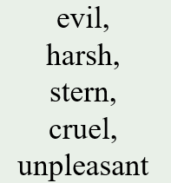


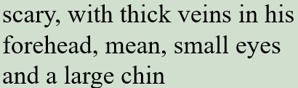




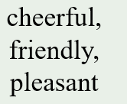



4. Who did I meet in the boarding school?
Name | What | appearance | character
 |  | / | /
 |  | /

Slide 19
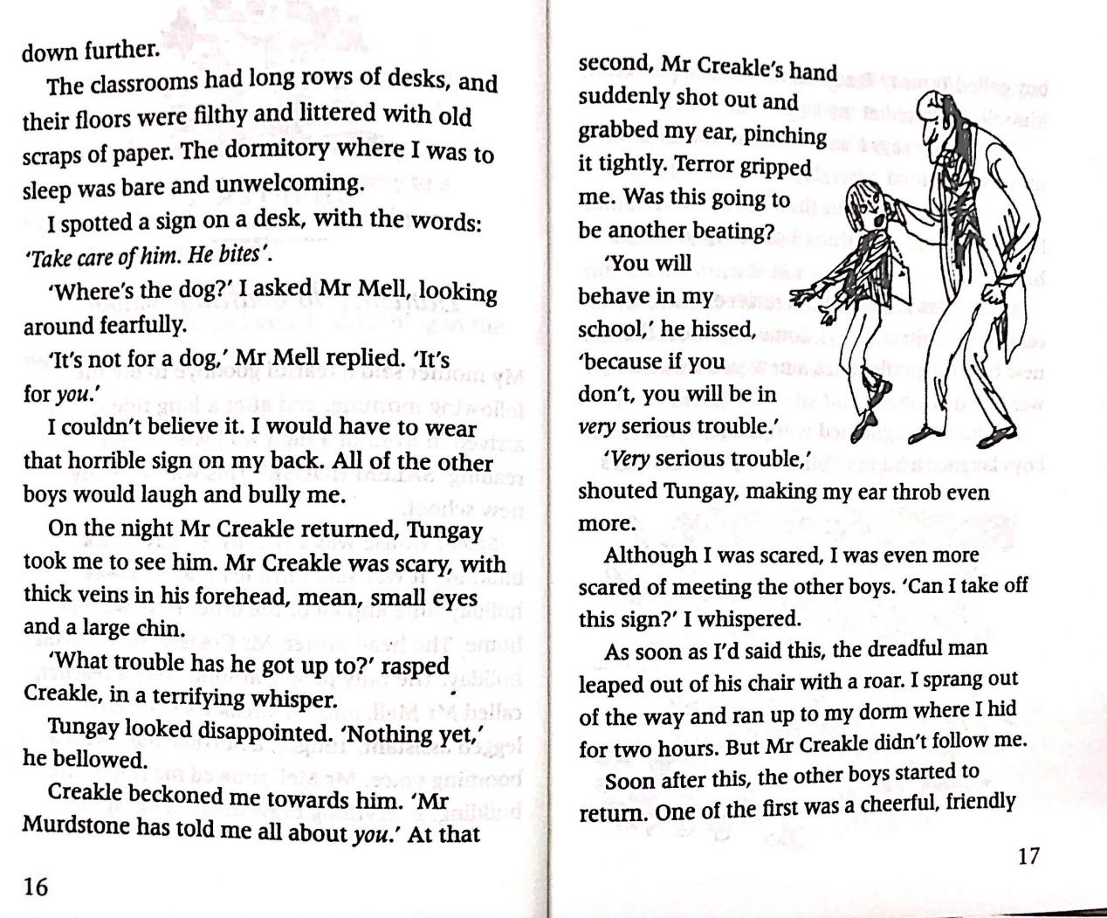
5. What did Mr. Mell, Tungay and Mr. Creakle do to me?
① Mr. Mell ordered me to wear a horrible sign that wrote “Take care of him.
He bites”. (para. 7)
② Mr. Creakle grabbled my ear, pinching it tightly, and warned me that if I didn’t behave well I will get into serious trouble . (para. 11~12)
6. What can you infer about the way
the boarding school treat students?
The boarding school didn’t treat students in a humane way. What it did crushed students both physically and mentally.

Slide 20
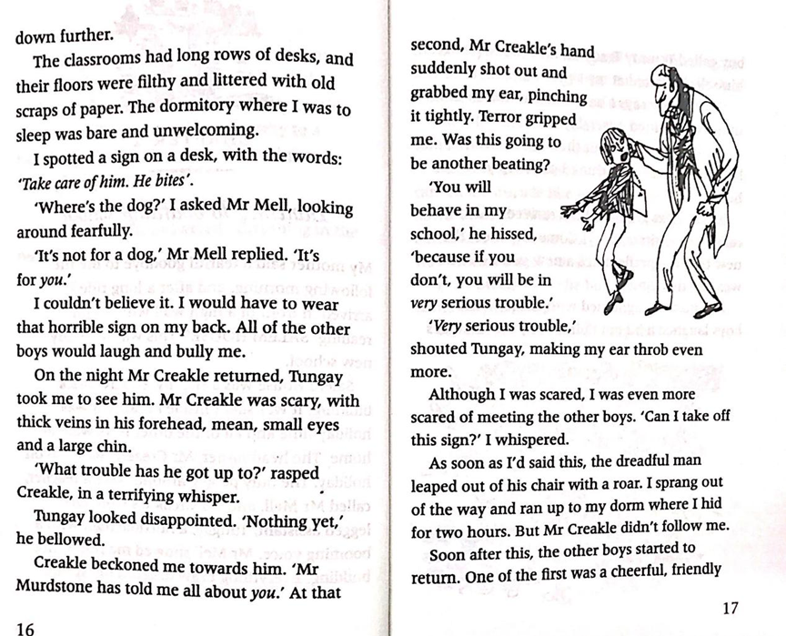
7. Try to find the phrases indicating time.
8. How does the writer show Mr. Creakle’s cruelty?
1
9. How did I feel about Mr. Creakle?
at that second→as soon as…
By actions
beckon→shoot out→grab→pinch→leap out→roar
By language
…rasped Creakle, in a terrifying whisper;
…he hissed;
I was terrified/scared/frightened.

Slide 21
10. How did Tommy Traddles and Steerforth help me?
11. How did I felt about Steerforth?
① Tommy helped me avoid much trouble by claiming the horrible sign was
just a game I was playing. (para. 18~20)
② Tommy introduced me to Steerforth. (para. 21)
③ Steerforth helped me buy many treats with the seven shillings. (para. 34)
④ Steerforth protected me from other boys’ bullying and teachers’
punishment. (para. 40)
I was grateful to his help and protection and sometimes told him stories.

Slide 22
12. What happened to my mom during my stay in the boarding school?
① My mother gave birth to a new boy baby. (para. 46)
My mother started crying and reached out toward me. My mother fell silent as Mr. Murdstone turned his steely gaze on me.
I heard my mother and Peggotty screaming on the stairs outside my room, begging Mr. Murdstone to stop.
“You will NEVER touch it again,” yelled Miss Murdstone. “Do you understand me?”
Instead of standing up for me, my mother took the baby back. “You are right, my dear Jane,” she nodded nervously at Miss Murdstone. “David won’t hold the baby again.”
Change
Dead
② My mother was made pale and weak, and fearful. She was crushed both
physically and mentally. (para. 54)

Slide 23
13. How did my feelings change in Chapter 2?
When I arrived at the school…
When I meet Mr. Creakle…
When I meet Steerforth…
When I returned home…
When I returned to the school…
When I heard my mom’s death…
My life has been full of ups and downs, and during my childhood the downs seemed to rain on me like a never-ending storm.
happy
optimistic
happy
lighthearted
unhappy
astonished
angry
terrified
pessimistic
depressed
sad
shocked

Slide 24
14. Try to find the sentence describing the following feelings.
unhappy
Everything I saw dragged my spirits down further. (para. 2)
surprised
I couldn’t believe it. (para. 7)
frightened
Terror gripped me. (para. 11)
Traddles frowned, but then his face slowly broke into a smile. (para. 18)
happy
Sometimes I laughed till my sides ached. (para. 68)
My stomach tightened with anxiety. (para. 20)
worried
Living with Mr. Creakle lurking round every corner was a nerve-racking experience. (para. 20)

Slide 25
17. Try to find the words indicating “say sth”.
rasp
“What trouble…?” rasped Mr. Creakle, in a terrifying voice.
bellow
“Nothing yet,” he bellowed.
hiss
“You will behave in my school,” he hissed…
greet
“I’m J Steerforth,” the boy greeted me.
insist
“You must come down Yarmouth…,” insisted Dan Peggotty.
scream
“He’s got it.” She screamed.
shriek
“Give it back.” she shrieked.
snap
“How long do we have to put up with you,” snapped Miss Mur.
falter
“A month,” I faltered.

Slide 26
15. Appreciate the following sentences.
keep talking in a very boring way
e.g. Chambers droned on, maddening as an insect around his head.
School began the next day. The teachers droned on and on…Living with Mr. Creakle lurking round every corner was a nerve-racking experience.
figurative amaze or overwhelm with an impressive quality
e.g. He was dazzled by the warmth of her smile.
to wait somewhere secretly, especially to do sth. bad or illegal
e.g. A crocodile was lurking just below the surface
And they did like him. They were both dazzled by his gentleman’s appearance and by the way he spoke.

