Slide 1


感恩遇见，相互成就，本课件资料仅供您个人参考、教学使用，严禁自行在网络传播，违者依知识产权法追究法律责任。
更多教学资源请关注
公众号：溯恩高中英语
知识产权声明

Slide 2

Continuation writing
Emily’s story
宁波市5月高三适应性考试
宁波市鄞州高级中学 李丹

Slide 3

Part I — Reading
(1) Emily White was born seventeen years ago with so many birth problems in her body. Some of her organs, bones and muscles were out of shape. No one expected her to survive. She did make it but with her strange body figure, everyone could recognize her, even from a distance.
(2) In Emily White’s hometown, there was a yearly outdoor performance in the school auditorium(大礼堂). It had been performed for so many years and actually had become one of the most important events of the Christmas season for many of the town’s people.
(3) Many people tried out each year for it, but so many were turned away. It can only include the most excellent people in the field.
(4) Emily had a beautiful singing voice. Last year she went to Mrs. Owens – her music teacher to ask to join in the performance. Without letting her sing, Mrs. Owens took a look at Amy’s body and said, “Child, you just don’t fit. Everyone would stare at you and that would make you uncomfortable. It would make them uncomfortable, too.”
(5) Without singing a single not, Emily was sent back through the door of the choral room. Hurt and upset, she decided never to try out again. But Mrs. Owens then retired.
(6) This year, there came a new music teacher, Mr. Buttler. He heard about Emily and suggested that she have a try.
(7) Emily didn’t want to be rejected again, so she hesitated a little about it. As Emily struggled, the door was pushed open and Mr. Buttler called, “Emily, you’re next.” Although kind of nervous, Emily did as Mr. Buttler told her to do. Mr. Buttler sat by the piano to keep Emily company. When Emily finished her testing performance, she thanked Mr. Buttler and knew the result would be posted on the door of the choral room the next day.
(8) Emily couldn’t sleep that night. She was suffering from the feelings that she didn’t fit and the great need to be accepted. By the next morning, her stomach was even in pain because of stress.

Slide 4


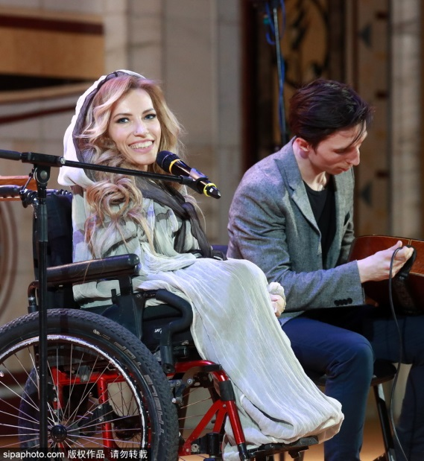
01
Read for main idea
A girl, Emily, suffered a lot since she was born and got __________________ afterwards. However, she _________
_______ in the school auditorium. After she failed at the first attempt, she met Mr. Buttler who _________________
________________. So she ......
a strange body figure
was eager
to sing
encouraged her to
realize the dream

Slide 5
02
Read for plot
(1) Emily White was born seventeen years ago with so many birth problems in her body. Some of her organs, bones and muscles were out of shape. No one expected her to survive. She did make it but with her strange body figure, everyone could recognize her, even from a distance.
(2) In Emily White’s hometown, there was a yearly outdoor performance in the school auditorium(大礼堂). It had been performed for so many years and actually had become one of the most important events of the Christmas season for many of the town’s people.
(3) Many people tried out each year for it, but so many were turned away. It can only include the most excellent people in the field.
(4) Emily had a beautiful singing voice. Last year she went to Mrs. Owens – her music teacher to ask to join in the performance. Without letting her sing, Mrs. Owens took a look at Amy’s body and said, “Child, you just don’t fit. Everyone would stare at you and that would make you uncomfortable. It would make them uncomfortable, too.”
(5) Without singing a single not, Emily was sent back through the door of the choral room. Hurt and upset, she decided never to try out again. But Mrs. Owens then retired.
(6) This year, there came a new music teacher, Mr. Buttler. He heard about Emily and suggested that she have a try.
(7) Emily didn’t want to be rejected again, so she hesitated a little about it. As Emily struggled, the door was pushed open and Mr. Buttler called, “Emily, you’re next.” Although kind of nervous, Emily did as Mr. Buttler told her to do. Mr. Buttler sat by the piano to keep Emily company. When Emily finished her testing performance, she thanked Mr. Buttler and knew the result would be posted on the door of the choral room the next day.
(8) Emily couldn’t sleep that night. She was suffering from the feelings that she didn’t fit and the great need to be accepted. By the next morning, her stomach was even in pain because of stress.
Para. 1 ---The introduction of Emily
Para. 2&3 --- The introduction of a yearly performance in the town
Para. 4&5 --- Emily’s first attempt to sing
Para. 6&7&8 --- Emily’s second attempt to sing

Slide 6

Development of the plot
Para.1
Para.2-3
Para.4-5
Para.6-8
Para.9-10
The introduction of Emily —— a strange-looking girl
Beginning(Setting)
The introduction of a yearly performance in the town
Development
Emily’s first attempt to sing (Mrs. Owens)
Conflict
Emily’s second attempt to sing(Mr. Buttler)
Ending?
Develop the plot logically and rationally!

Slide 7
03
Read for characters
(1) Emily White was born seventeen years ago with so many birth problems in her body. Some of her organs, bones and muscles were out of shape. No one expected her to survive. She did make it but with her strange body figure, everyone could recognize her, even from a distance.
(4) Emily had a beautiful singing voice. Last year she went to Mrs. Owens – her music teacher to ask to join in the performance. Without letting her sing, Mrs. Owens took a look at Amy’s body and said, “Child, you just don’t fit. Everyone would stare at you and that would make you uncomfortable. It would make them uncomfortable, too.”
(5) Without singing a single not, Emily was sent back through the door of the choral room. Hurt and upset, she decided never to try out again. But Mrs. Owens then retired.
(6) This year, there came a new music teacher, Mr. Buttler. He heard about Emily and suggested that she have a try.
(7) Emily didn’t want to be rejected again, so she hesitated a little about it. As Emily struggled, the door was pushed open and Mr. Buttler called, “Emily, you’re next.” Although kind of nervous, Emily did as Mr. Buttler told her to do. Mr. Buttler sat by the piano to keep Emily company. When Emily finished her testing performance, she thanked Mr. Buttler and knew the result would be posted on the door of the choral room the next day.
(8) Emily couldn’t sleep that night. She was suffering from the feelings that she didn’t fit and the great need to be accepted. By the next morning, her stomach was even in pain because of stress.
Emily's strange figure
confident
Main characters:
Emily and Mr. Buttler
not supportive
depressed
supportive
self-doubt
considerate
stressed/nervous

Slide 8
04
Read the given hints
(7) ......the result would be posted on the door of the choral room the next day.
(8) Emily couldn’t sleep that night. She was suffering from the feelings that she didn’t fit and the great need to be accepted. By the next morning, her stomach was even in pain because of stress.
Paragraph 1:
(9) The next day, Emily nervously glanced at the list on the door of the choral room. ____________________________________________
success ？
！
Paragraph 2:
(10) Finally, the day of performance came. __________________

Slide 9
Prediction
Paragraph 1:
The next day, Emily nervously glanced at the list on the door of the choral room. ______________________________________
__________________________________________
Paragraph 2:
Finally, the day of performance came. ___________________
__________________________________________________
1. How did she find her name posted on the list?
2. What about her reaction to the result?
3. What about Mr. Buttler's reaction?
4. What did they do afterward?
5. ......
心理描写
神态描写
动作描写
1. How about Emily's feelings before performance?
2. What about her performance?
3. What about audience's reaction?
4. The theme?
心理描写

Slide 10
05
Read for theme
clue 1:
a strange body figure
comparision
beautiful songs
a brave heart
1. Don't judge a person by his appearance!
clue 2:
comparision
Mrs. Owens: not supportive
Mr. Buttler: supportive
2. The power of encouragement is out of imagination.
clue 3:
3. Confidence makes everything!

Slide 11
Part II. Writing
评分标准
第五档 (21－25) | ·与所给短文融洽度高，与所提供各段落开头语衔接合理。 ·内容丰富，应用了5个以上短文中标出的关键词语。 ·所使用语法结构和词汇丰富、准确，可能有些许错误，但完全不影响意义表达。 ·有效使用了语句间的连接成分，使所续写短文结构紧凑。

Slide 12
思维严密连贯，符合逻辑，与前文融洽度高。
情节内容丰富合理，一定要有发展性。
语法丰富正确，意义传达不受影响。
词汇使用不宜夸大，语言风格要与前文保持一致。
情节逻辑
语言逻辑

Slide 13
Part III Appreciation
参考范文和学生作品评析

Slide 14
参考范文
The next day, Emily nervously glanced at the list on the door of the choral room. She was not rejected this time. Her name was posted at the top of the list. She, Emily White, was chosen to be the leading singer! She would sing alone in the performance. Emily couldn't believe her eyes. There must be some mistake. But Mr. Buttler said to her with determined eyes, “ Emily, I choose you because you should perform the part — your voice is unusual. Believe in yourself ” Greatly encouraged, Emily practiced really hard.
Finally, the day of performance came. Standing in front of the line, Emily felt her throat tight and her palms sweating. When the curtain opened up, the eyes of the whole audience fell upon Emily. "Emily White!" Someone whispered. Then, along with the first note of music, Emily began to sing her heart out. Her voice was like a nightingale ringing in the auditorium. Applause! Emily felt so happy and comfortable. She was shining on the stage. Emily White, with so many birth problems in her body, was an angel!

Slide 15
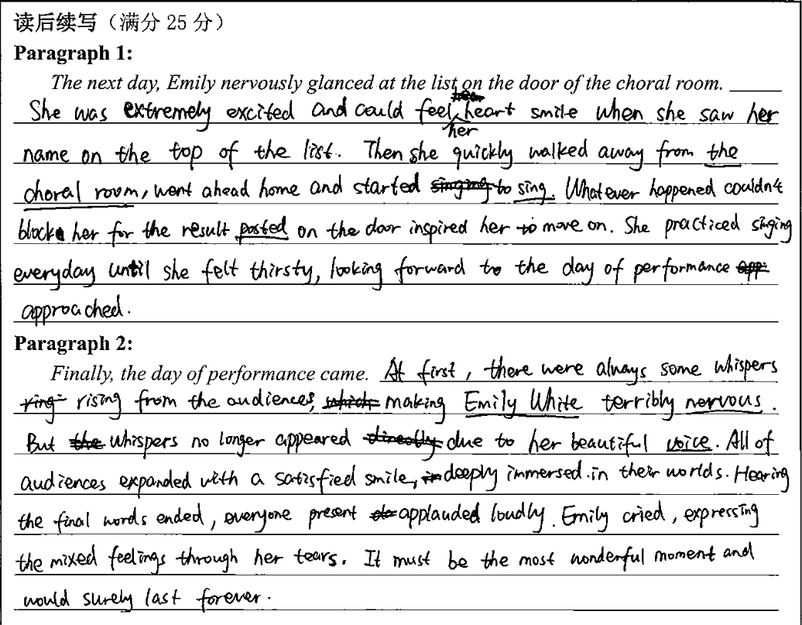
tip1:关注第二段段首句进行合理衔接。
第一段心理描写恰当合理，划线句也与前文有一定呼应，最后一句与第二段首句的衔接漂亮！
第二段情节设计曲折但合理，人物情绪的转变也符合逻辑，表达虽有失误，但可以理解，书写欠佳。

Slide 16
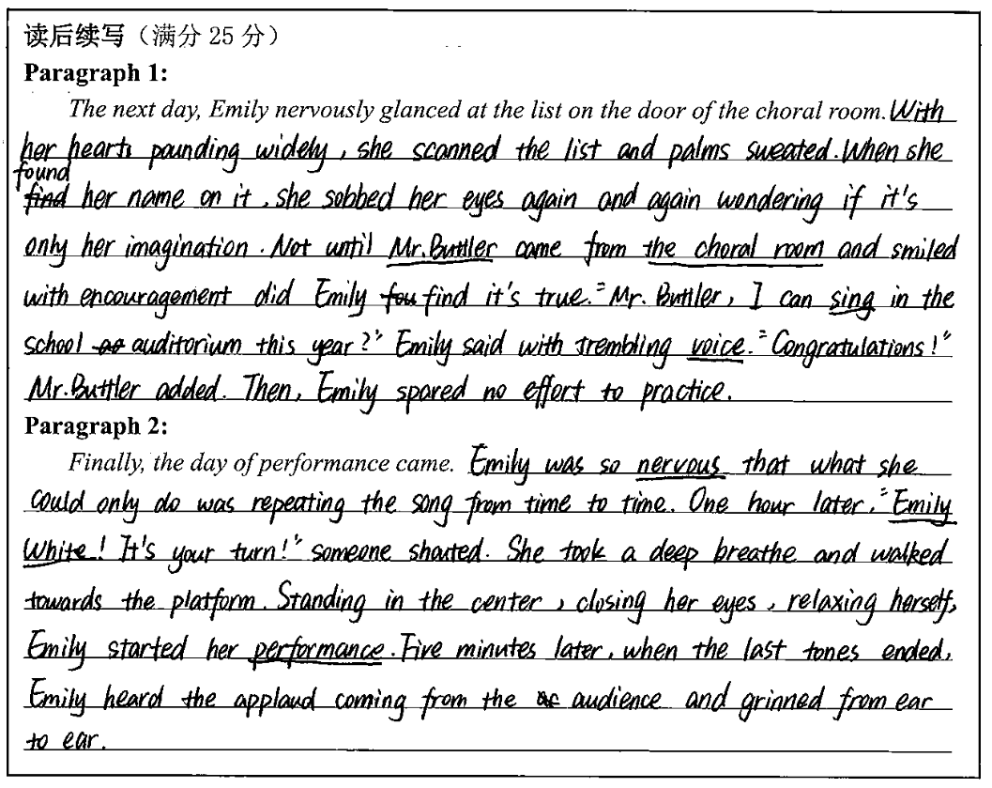
tip2:用细腻的神态，动作描述来刻画画面感。
第一段描写心理紧张很成功(分别从heart, palms, voice入手)，情节铺设合理，并且用了倒装结构。
第二段从描写手法来看，表达逊色一些，且出现一些词汇与语法错误；结尾意犹未尽，内容不够丰满。

Slide 17
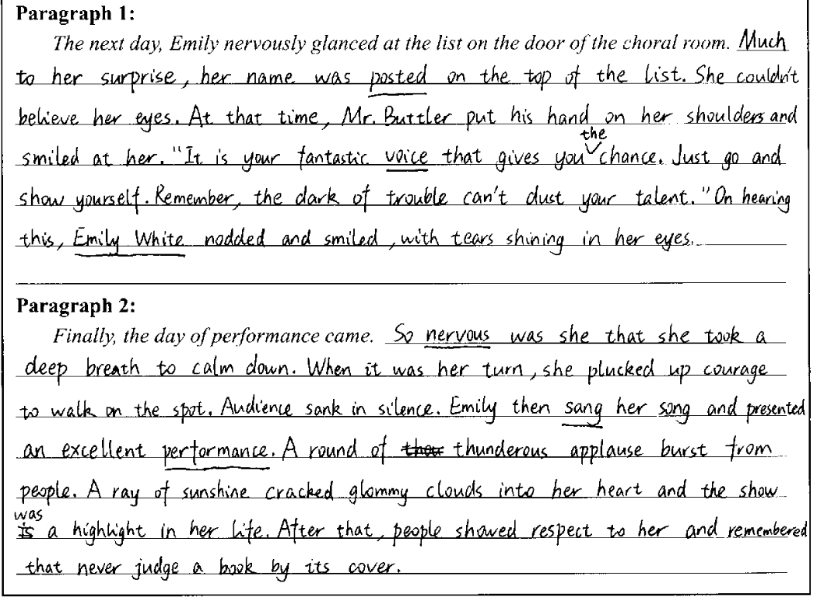
tip3:用隐喻修辞手法使情感表达更显生动
本文情节合理，内容紧凑，语言使用恰当，句法丰富，亮点是两句隐喻的修辞句让文章更鲜活。

Slide 18
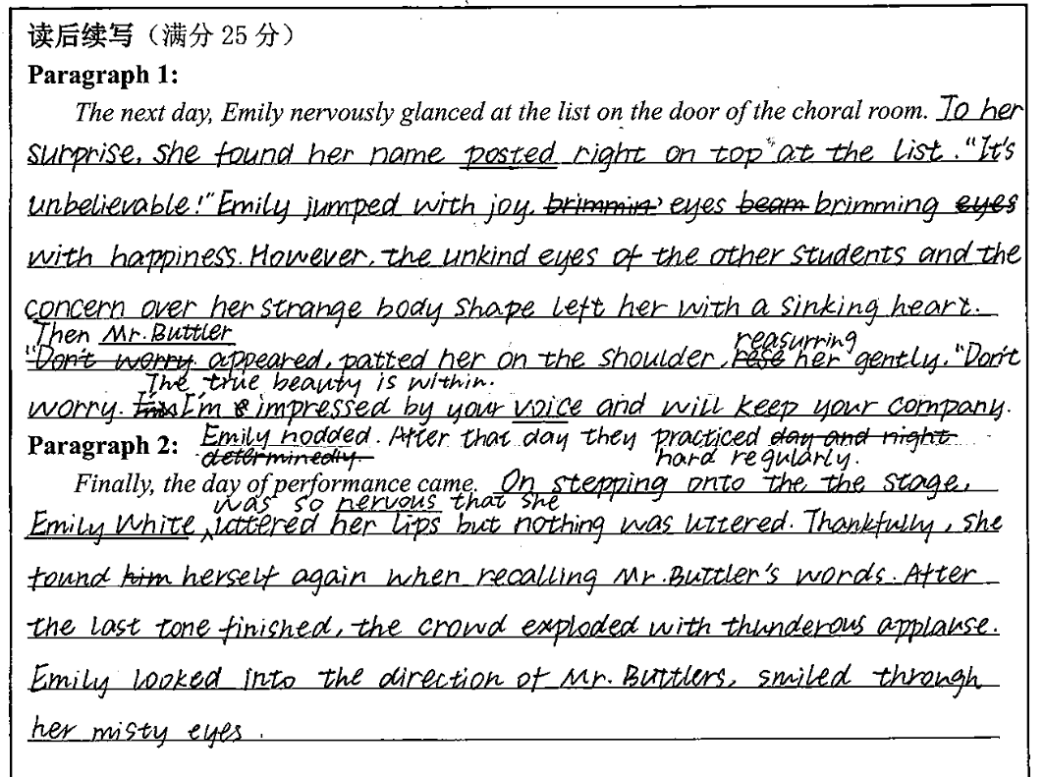
tip4:写前后文相呼应的句子使文章更融洽。
本文是一篇很优秀的作品，情节设计符合逻辑，语言表达细腻，而且画圈句子与前文相呼应，与前文融洽度高。主体明确，表达了Mr. Buttler对Emily的人生的影响和Emily对他的感激之情。

Slide 19
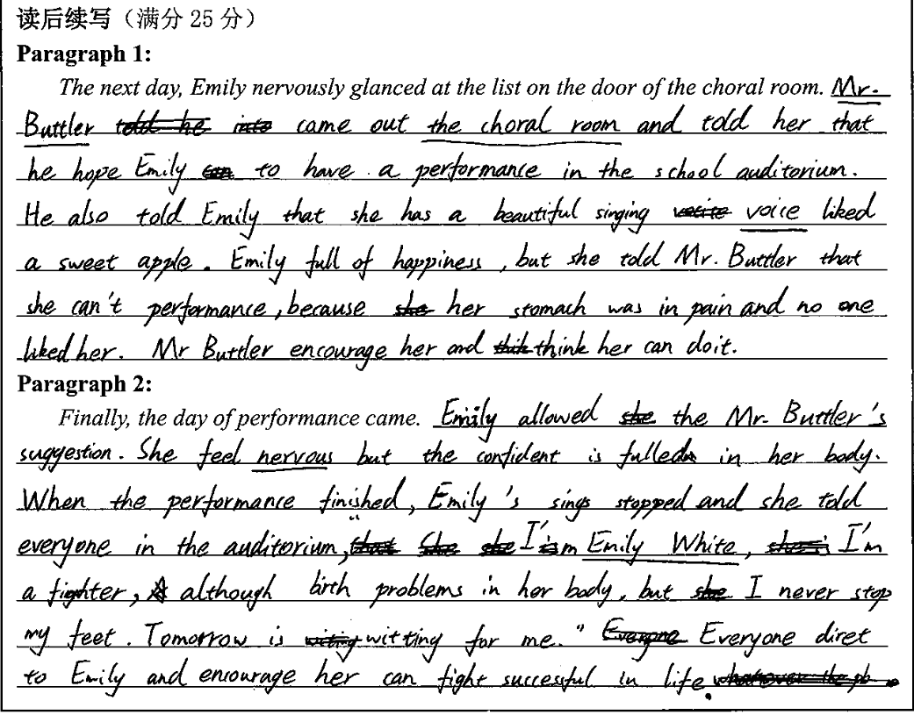
tip5:以读促写，千万不可在情节逻辑上失误。
第一段中的情节不符合逻辑，与前文的内容不匹配，该考生没有做到先读后写。
语言表达能力弱，词性和搭配都有很大问题，有些表达不能让人理解，语言逻辑不清。

Slide 20
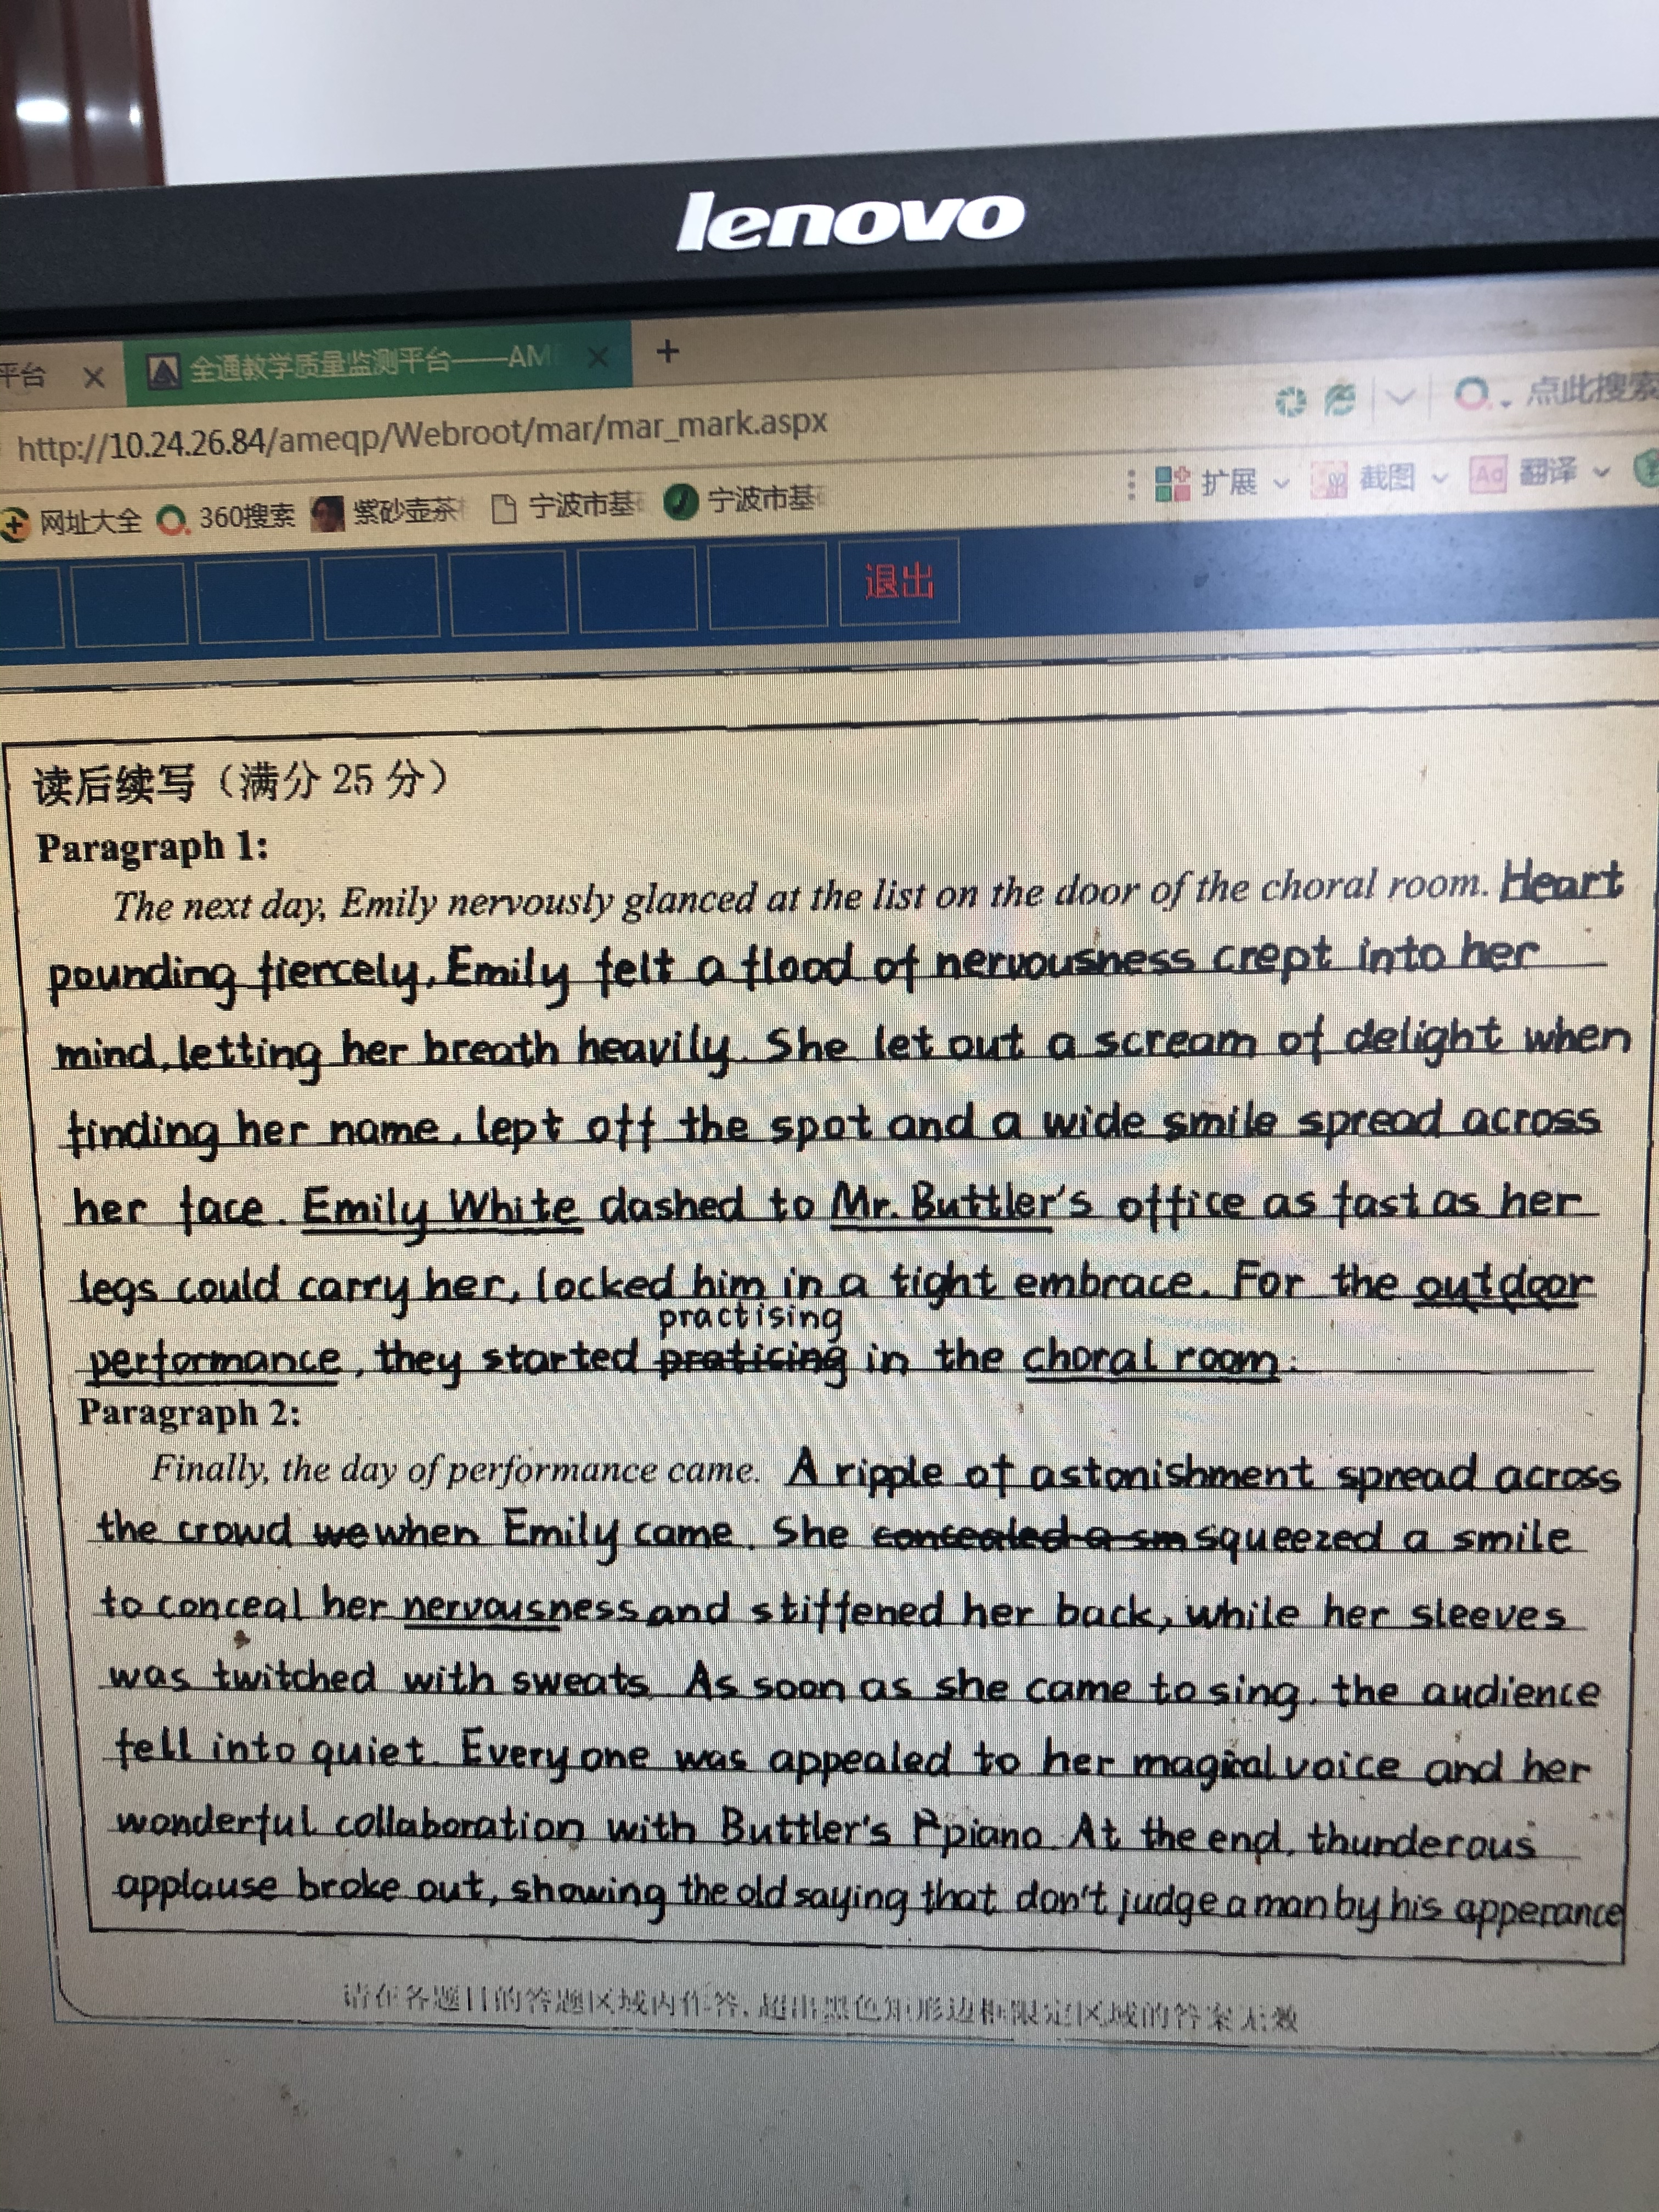
优秀范文赏析一
从本文这么多表达细致入微的句子可以得知作者是一位语言功底深厚的学生，描述性语言丰富；美中不足的是文章的内容不够丰富，故事情节发展不多，故上五档比较勉强。

Slide 21
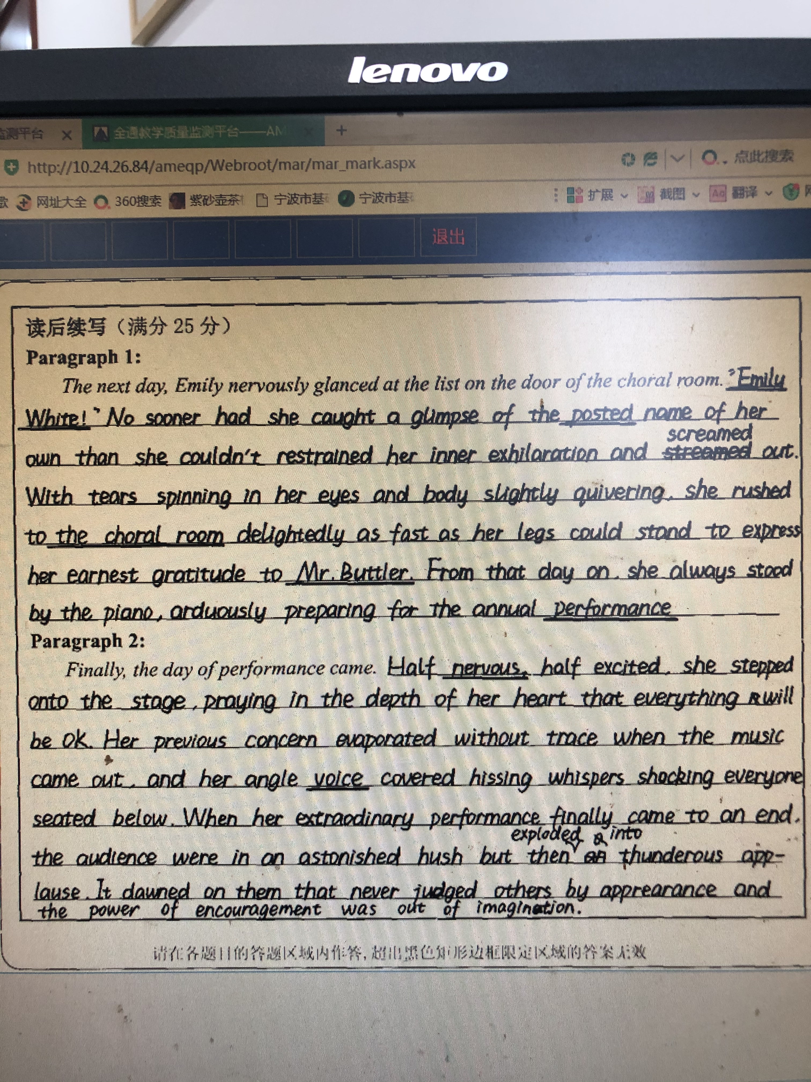
优秀范文赏析二
本文从情节内容，情感输出，前后文衔接，细节描写，语言表达，书写卷面等方面都很优秀，极个别词汇有误(angle--angelical，等)，主题升华有点牵强。
建议五档。

Slide 22
An appealing ending?
1. 哲理性结尾
Life is full of dilemmas and conflicts, but we should smile and never give up, just like Emily.
2. 叙述式结尾
Many years has gone, when Emily looked back to that day, she was still grateful to Mr. Buttler for his encouragement and company.
3. 自然结尾
Tears of gratitude pouring down Emily’s cheeks, she did nothing but bowed to Mr. Buttler, “Thank you, my life guide.”

Slide 23
An appealing ending?
4. 前文呼应结尾
It was the most unforgettable Christmas season during the seventeen years for Emily, for whom her strange body figure would never make her ashamed but be accepted.
5. 情景交融结尾
Snowflakes fell gently in the air, making the world white; appause echoed in the school auditorium, warming Emily's heart.
故事结尾情节符合逻辑，自然合理，切忌刻意升华主题。

Slide 24

Even for a withered flower, it longs to contribute all of its fragrance.
Even it is a broken tree, it longs to contribute all of its shade.
哪怕是一朵残缺的花，也想献出全部芬芳；
哪怕是一棵受伤的树，也要献出一片绿荫。
Thanks！

