Slide 1


感恩遇见，相互成就，本课件资料仅供您个人参考、教学使用，严禁自行在网络传播，违者依知识产权法追究法律责任。
更多教学资源请关注
公众号：溯恩高中英语
知识产权声明

Slide 2
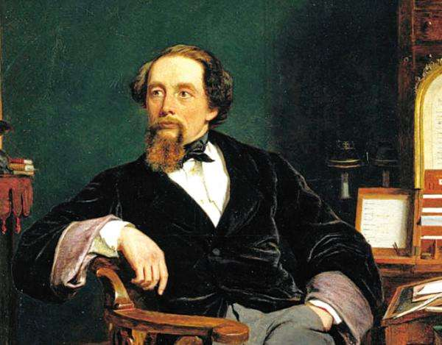
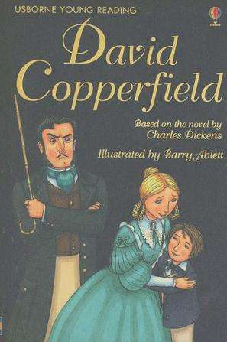
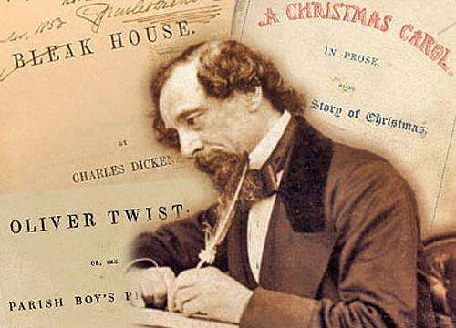
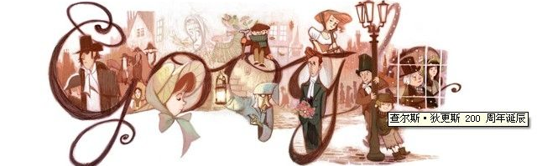
David Copperfield
鲁周焕
杭州市余杭高级中学

Slide 3
Chapter 1
Historical Background

Slide 4
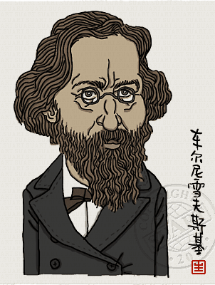
I. Chapter I: A Bad Child
1. How do you understand the following sentence?
Art comes from life and goes beyond it.
Military
Economy
Religion
Politics
Culture

Slide 5
The 19th century is the century of greatest change in the history of Western civilization. The French revolution broke up the older of Europe. Almost all over Europe, the middle class established their effective rule, with monarchs having less power. The great political events caused great social and economic changes.
The great social chaos and urban poverty brought about by the social and economic changes created severe problems to which the political leaders reacted in many ways. They called for voting rights, freedom of speech, wanted independent countries and so on.
During 1830s and 1840s, the reformers led several revolutions, but all failed. Thus followed a time of loss of hope, and brought about revulsion (恶心) against Romanticism. The need was felt for a return to what was plain and real.
2. Why did people feel a return for the real and plain?

Slide 6
After the great wave of the international romantic movement had spent its force in the fourth decade of the 19th century, Europe literature moved in the direction of realism.
The realists wanted a truthful representation (表现) in their works of contemporary life. They thought of their method as observational and objective. “A novel is a mirror walking along the road,” said one writer.
If romanticism allows full play to the imagination and stress love of beauty and interest in the past, the realists focus on the real and plain life. Its language is usually simple, clear and direct, while the tone was often comic, frequently satiric (讽刺的).
3. What’s the difference between romanticism and realism?
(You can compare them from the perspective of content and language)

Slide 7

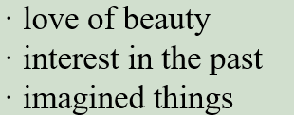




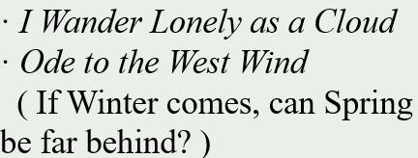

3. Comparison between Romanticism and Realism.
/ | Realism | Romanticism
Content
Language
Representative writers
Works

Slide 8
· Charles Dickens (1812-1870)
1. Social Background
The period of realism in English literature corresponds roughly to the latter half of the reign of Queen Victoria (1837-1900). This is the period when England was at the peak of its power, rapidly growing into a strong, industrialized nation.
In spite of its stable government and greatly increased population, the country suffered severe economic depression. A revolt (反抗) began against optimism that had characterized the early days of the Victorian rule. Both the prosperity (繁荣) and the social troubles like unemployment left marks on the literature of the period.

Slide 9
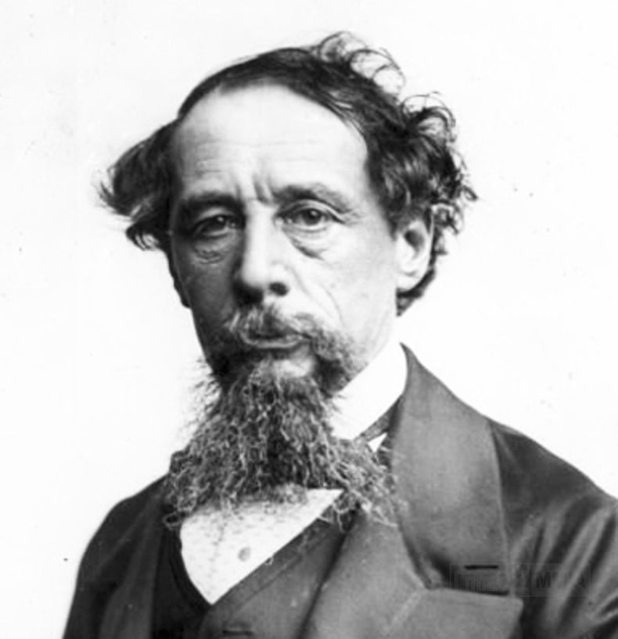
2. Charles Dickens (1812-1870)
·
· a son of an impoverished government clerk
· father put into prison for debt
· little schooling
· working in a blacking factory at 12
miserable
tragic
unhappy
“He is a sympathizer to the poor, the suffering, the oppressed; and by his death, one of England’s greatest writers is lost to the world.”
· inheriting money from his uncle
· paying off his father’s debt
· learning shorthand and becoming a reporter
· starting writing fiction in his spare time

Slide 10
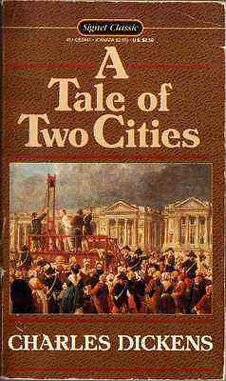
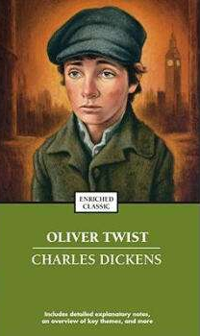
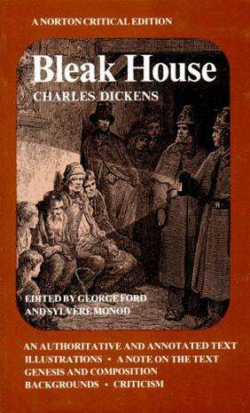
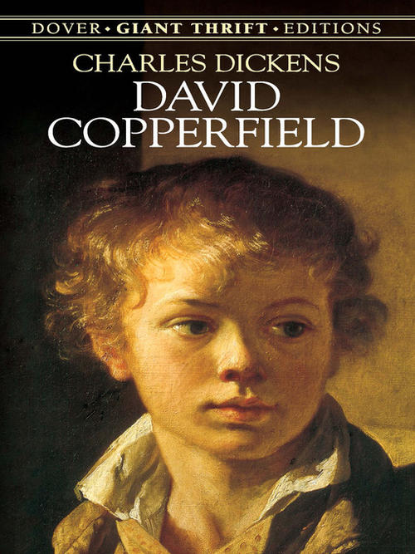
3. Works by Charles Dickens

Slide 11
…Of all my books, I like this the best…But, like many fond parents I have in my heart of hearts a favorite child. And his name is DAVID COPPERFIELD. ——Charles Dickens
Charles Dickens’ best book is David Copperfield, a kind of autobiographical romance, in which his power over our everyday emotion is unrivalled. Within one page he can make the reader burst with laughter and soon wet the book with honest tears.
But whatever he wrote he has some basis on his own experience. In his youth he had been familiar with the most humble surroundings and the most poverty-stricken districts.
As a novelist of genius, he has created a whole world of beings mirroring the movement of life, with unforgettable scenes and full of good humor, tender emotions and loving-kindness. ——European Culture: An Introduction

Slide 12
Chapter 2
A Bad Child

Slide 13
II. Chapter 2: A Bad Child
1
1. What’s the function of this paragraph in Chapter 1?
1
2. How do you understand “ups and downs”?
1
3. Try to translate the first sentence.
My life has been full of ups and downs, and during my childhood the downs seemed to rain on me like a never-ending storm. When I look back on those years, I can’t believe that any grown-up would behave in that way to a child. But they did.
to lead the following content; to set the narrative tone
Miserable and
tragic childhood
happy and miserable time

Slide 14

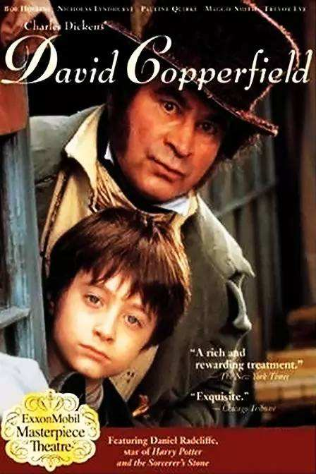





4. Read Chapter 1 and figure out who they are.
1
Name | Who they are
Betsey Trotwood
Peggotty
Clara
Mr. Murdstone
Dan Peggotty
Emily
Ham
Miss. Murdstone

Slide 15
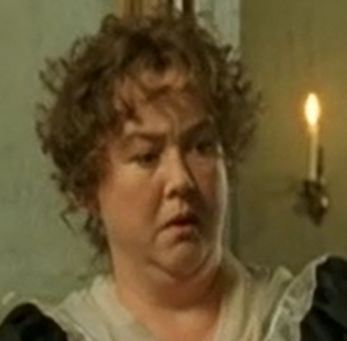
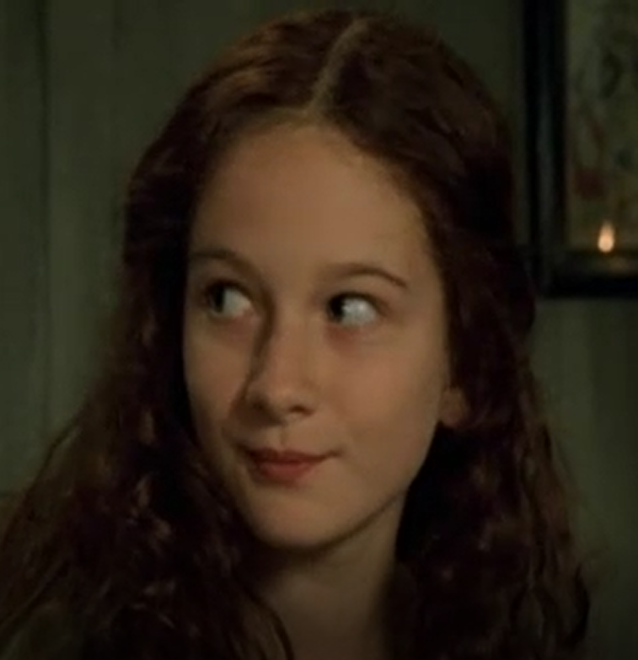
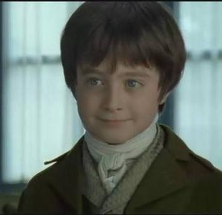
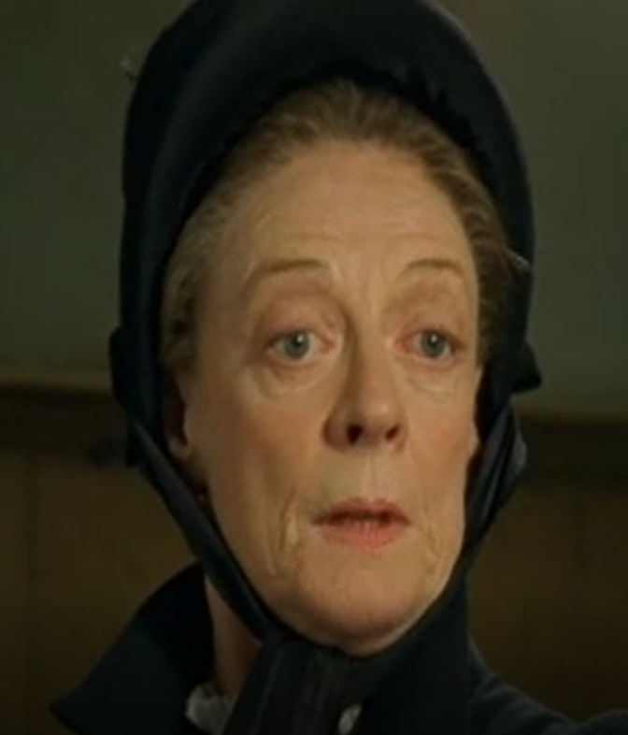
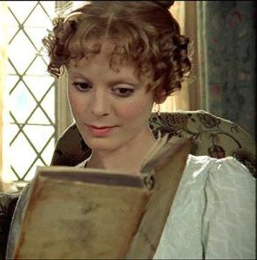
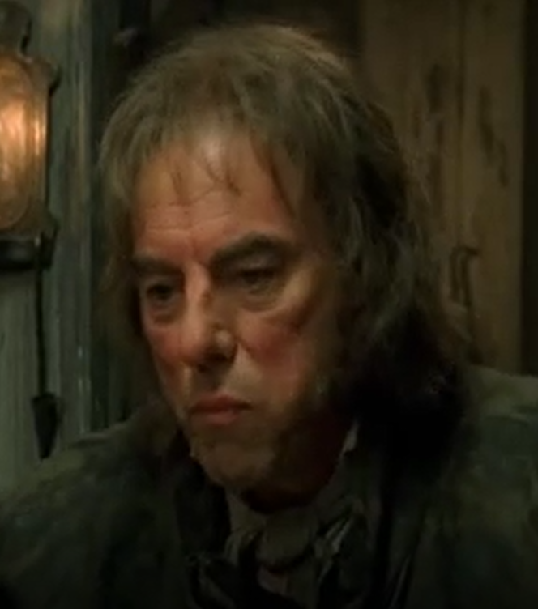
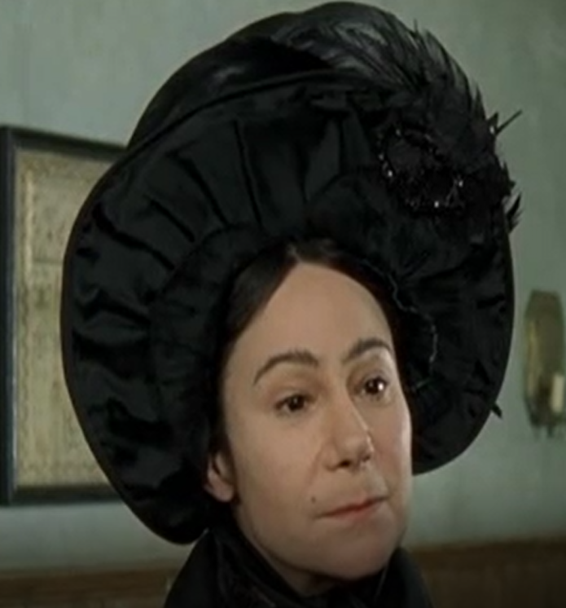
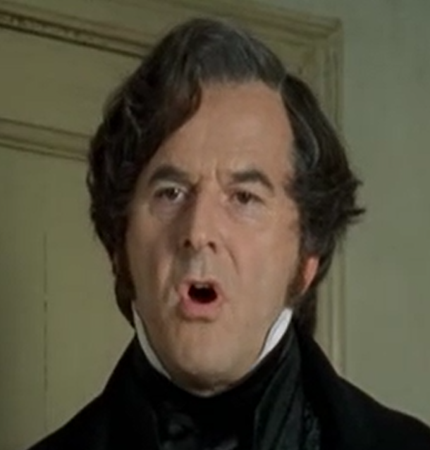
Peggotty
Emily
David Copperfield
Betsey Trotwood
Clara
Dan Peggotty
Miss Murdstone
Mr Murdstone

Slide 16

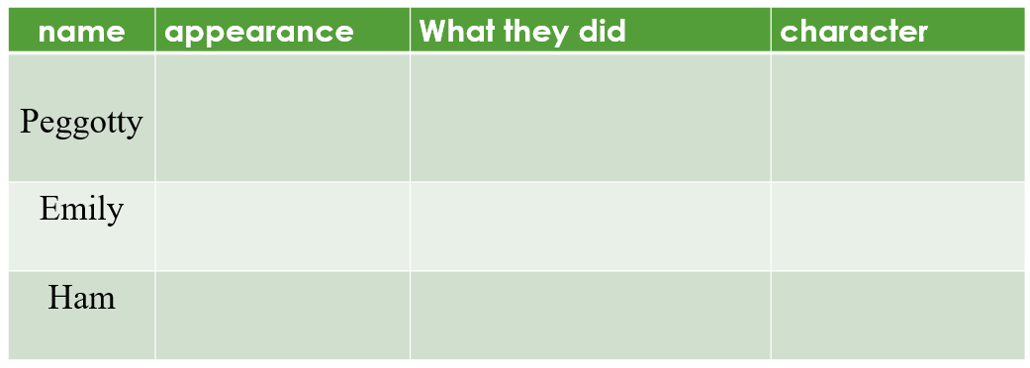
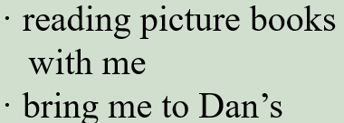








5. What does David think of his early childhood?
1
1
6. Why was David’s early childhood happy?
happy and full of joy
(direct and explicit)

Slide 17




7. What did David’s childhood become unhappy later?
1
1
8. How does the writer describe them?
1
9. What was David’s feeling toward them? How does he describe it?
Mr. Murdstone—his stepfather—entered our happy life with his sister Miss Murdstone.
Name | appearance | character
Mr. Murdstone
Miss. Murdstone
He was very afraid of them.

Slide 18
David was afraid of them.
actions
I walked up the stairs with my knees trembling. (para. 26)
I shook with terror. (para. 27)
“I don’t know,” I whispered nervously. (para. 12)
words
“I…I…can’t do my work,” I spluttered. (para. 28)
He had black hair and a hard, cold, handsome face.
(para. 4)
appearance

Slide 19
10. Why was I so afraid of Mr. Murdstone? What did he do to me?
① Mr. Murdstone said I was a bad child and that he was determined to crush me. (para. 10)
verbal abuse
② “…What do you think I do if I have a dog or horse that doesn’t do what I tell them? I beat it.” he replied, with an evil glint in his eyes. (para. 11)
harsh, stern,
cruel, unpleasant,
③ I wasn’t allowed to play with other children. (para. 18)
physical
abuse
④ Mr. Murdstone insisted I did lessons with my mother, but he and Miss Murdstone would stand over me, frowning and telling my mother to be firmer, and even beat me on one occasion. (para. 19)
11. Did I subject myself to his cruelty? What did I do?
No. I fought back on one occasion.

Slide 20
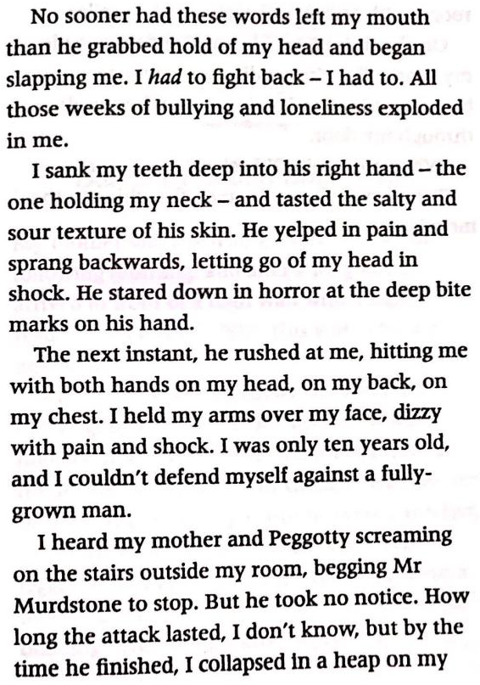
12. Try to find the phrases indicating time.
13. How does the writer describe such a fierce fight?
1
14. What’s the advantage of using many verbs in a
scene?
15. Appreciate the two underlined words and
sentences
No sooner…than…→the next instant→by the time…
Actions. By mainly using verbs.
left→grabbed hold of→slapping→sank teeth into→
tasted→yelped→sprang backward→stared down→ rushed→hitting→held arms→screaming→begging →took no notice→collapsed in a heap (15 verbs)

Slide 21
16. Try to find the sentence describing the following feelings: “happy”,
“unhappy”, “angry”, “desperate”, and “frightened”
happy
My mother seemed to light up in his company.
I had a very heavy heart when Peggotty and I had to return home.
unhappy
She got up in a rage and stormed out, with the slamming of the door.
angry
I felt as if the air had been strangled out of me. Mr. Murdstone was the kind of man that smothers all hope and happiness.
desperate

Slide 22
I shivered with fear, knowing that if I gave him the slightest excuse, he would beat me.
My body was shaking with fear.
frightened
I walked up the stairs with my knees trembling.
SHOW and
not TELL
I shook with terror.
He stared down in horror at the deep bite marks on his had.

Slide 23
17. Try to find the words indicating “say sth”.
whisper
“I don’t know,” I whispered nervously.
reply
“I beat it,” he replied, with an evil glint in his eyes.
shout
Mr. Murdstone jumped up, shouting, “We can’t expect…”
order
“Stop it at once, Clara!” ordered Mr. Murdstone.
demand
“Why are you doing so badly in your lessons?” he demanded.
splutter
“I…I...can’t do my work,” I spluttered.
Expressing
different feelings
beg
I heard my mother begging Mr. Murdstone to stop.
ask
answer
—“When am I going?” I asked.
—“Tomorrow,” she answered, “first thing in the morning.”

