Slide 1

感恩遇见，相互成就，本课件资料仅供您个人参考、教学使用，严禁自行在网络传播，违者依知识产权法追究法律责任。
更多教学资源请关注
公众号：溯恩高中英语
知识产权声明

Slide 2
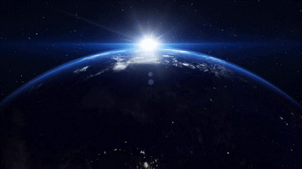
Module3 Unit 4 Astronomy:
How life began on the earth
Huaiji No.1 Middle School Ling Chan(陈剑玲)

Slide 3
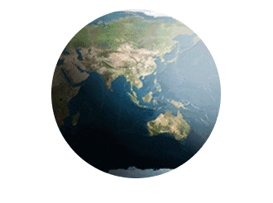
Language application（语言能力）：
learn to know how life developed on the earth.
Learning abilities
（学习能力）：
learn to know how the passage was organized and how to summarize it.
Learning
goals
Cultural awareness
（文化意识）：
learn to care about the earth and know about different religions' opinions on the earth.
Thinking quality
（思维品质）：
learn to put forward some effective measures to protect the earth.

Slide 4

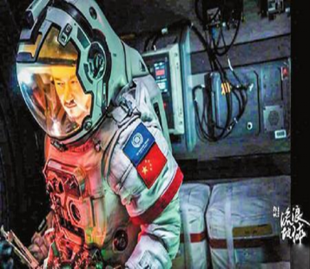
Pre-reading
The hit Chinese science fiction film “The Wandering Earth” dominated （领先）this year’s Lunar New Year box office. The movie currently has a score of 7.9 out of 10 on the review site Douban. It tells the story of a group of Chinese astronauts working to save the Earth from a dying and rapidly expanding sun by pushing the earth out of the solar system.

Slide 5

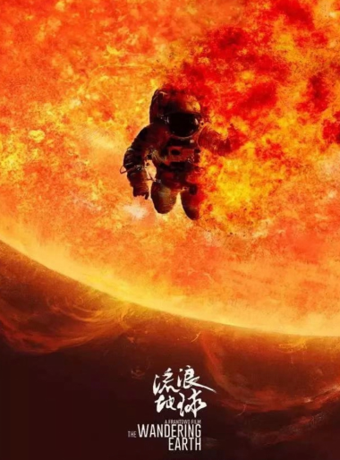
Critical thinking
If you were one of the characters in the movie, would you choose to save the earth?

Slide 6
How much do you know about the earth?
Pre-reading
The earth is our home.

Slide 7
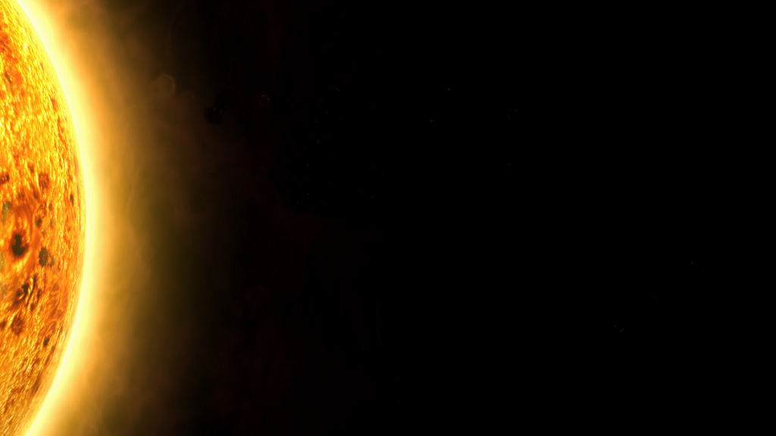
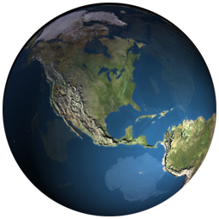








Earth
1.Is this a planet?
2. Is the earth the only planet in the solar system which has living creatures?
Navigation

Slide 8
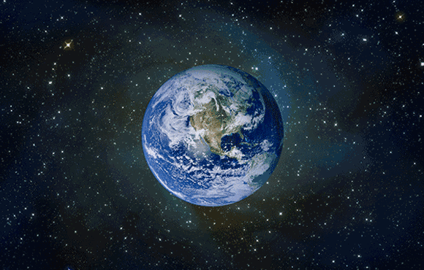
While-reading
Reading passage：
How Life Began On The Earth

Slide 9

1
What is the passage about?
PART ONE

Slide 10
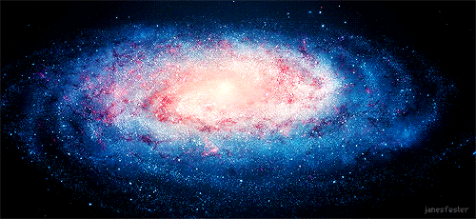
Para 1： What is the widely accepted theory?
A widely accepted theory from scientists
The universe began with a Big Bang.

Slide 11
Para 2： How did the earth come into being?
“Big Bang”
stars
formed& combined
________
formed& combined
other bodies
atoms
Earth: a cloud of _____
dust
settled into
globe
exploded with fire and rock
a solid _____
produced
Carbon dioxide
gases
nitrogen
water vapour
other _____
atmosphere
the earth’s _____________
fundamental
Water: ____________ to the development of life

Slide 12
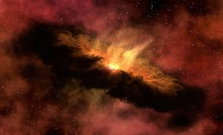
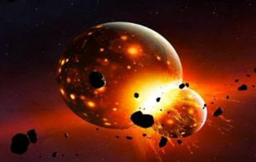
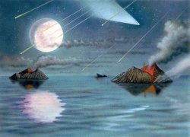
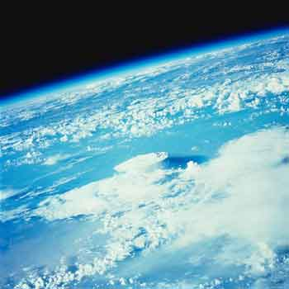
The earth suitable for living came into being.
combined into
A solid ball
A cloud of energetic dust
exploded with fire and rock
4
3
Cool down
A world full of water
Atmosphere
dissolved harmful gases

Slide 13
Para 3 water
Why was water fundamental to the development of life？
The continued presence of water allowed the earth to dissolve harmful gases and acids into the oceans and seas. This produced a chain reaction, which made it possible for life to develop.

Slide 14
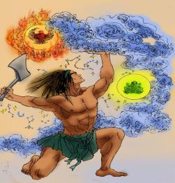
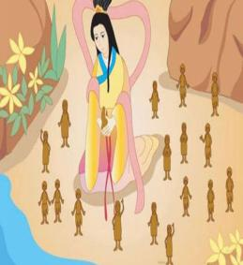
para 4：How did life begin on the earth?
Chinese culture:
Pangu separated the sky from the earth.
The Goddess Nvwa mended the sky and created human beings.

Slide 15
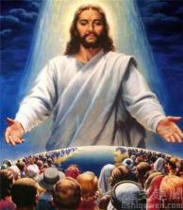
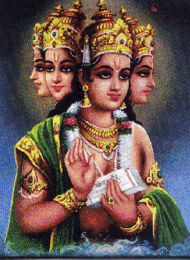
How did life begin on the earth?
western culture
God created the world in seven days.
Indian culture
Brahma（梵天） is the god and is the creator of the universe and all living beings .
Each religion has different opinions about it.

Slide 16
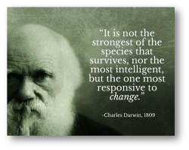
Para 4：How did life begin on the earth?
Natural Science : evolution
water
plants
Millions years later
small ________ in water
shellfish
_________ and all sorts of fish
green plants
Next
___________on land
insects
Follow
________ (on land)
amphibians
___________(on land and in water)
reptiles
Later
Forests and _______

Slide 17


After that
dinosaurs (on land)
mammals
65million years ago
_________(on land)
small clever animals
with ______________
2.6 million years ago
hands and feet

Slide 18
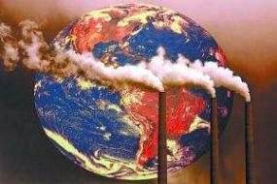
Para 5
1. What were those clever animals with hands and feet?
2. What have “the clever animals” done to the earth?
Human beings
They are not looking after the earth very well.

Slide 19

2
Why did the writer write this passage?
PART TWO

Slide 20
What’s the purpose of the writer？
arouse people's interest in science and astronomy
1
purposes
raise people's awareness of protecting the earth
2

Slide 21
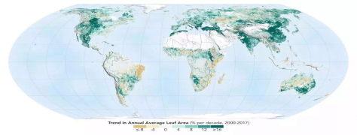

How to protect the earth
How can we protect the earth and make it a better place to live on?

Slide 22

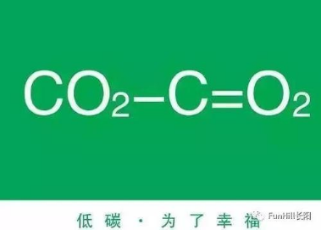
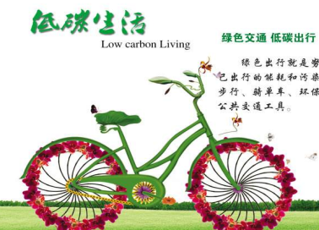

Plant more trees
Cut down the emission of carbon dioxide
Live a low-carbon life
Save resources

Slide 23

3
How was the passage organized?
PART THREE

Slide 24
1. What’s the writing style（genre） of the text?
A. Narrative 记叙文
B. Expository 说明文
C. Essay 散文
2. In what order did the writer write this passage?
In time order.

Slide 25
Main idea of each paragraph
1
A widely accepted theory about the formation of the universe.
How
Life
Began
On the earth
2
How did the earth form.
The importance of water for life.
3
How did the plants and animals on the earth develop.
4
5
How humans appeared and what effects they had on the earth.

Slide 26
Post-reading
Pair-work: Summarize this reading passage in about 60 words according to the given key points.
(tips: find - paraphrase-connect -write)
Para. | Key points
1 | a widely accepted theory from scientists; The universe began with a Big Bang.
2 | “Big Bang”; the earth; the earth's atmosphere; water
3 | water made it possible for life to develop
4 | plants; shellfish and fish; insects; amphibians; reptiles; dinosaurs;mamals;
5 | human beings; not looking after the earth very well
1.According to a widely accepted theory, the earth began with a Big Bang.
2. Most people believe that the earth bagan with a Big Bang.
The earth exploded and produced water vapour and many gases, making the earth’s atmosphere.
The presence of water made it possible for life to develop.
Plants encouraged the development of the fish and then the animals.
1.With the rise of mammals, human appeared and spread, which also has bad effect on the earth.

Slide 27
Connect and write
possible version 1
Most people believe that the earth bagan with a Big Bang. Then the earth exploded and produced water vapour and many gases, making the earth’s atmosphere. And then the presence of water made it possible for life to develop. Gradually, plants encouraged the development of the fish and then the animals. With the rise of mammals, human appeared and spread, which also has bad effect on the earth.（70 words）

Slide 28
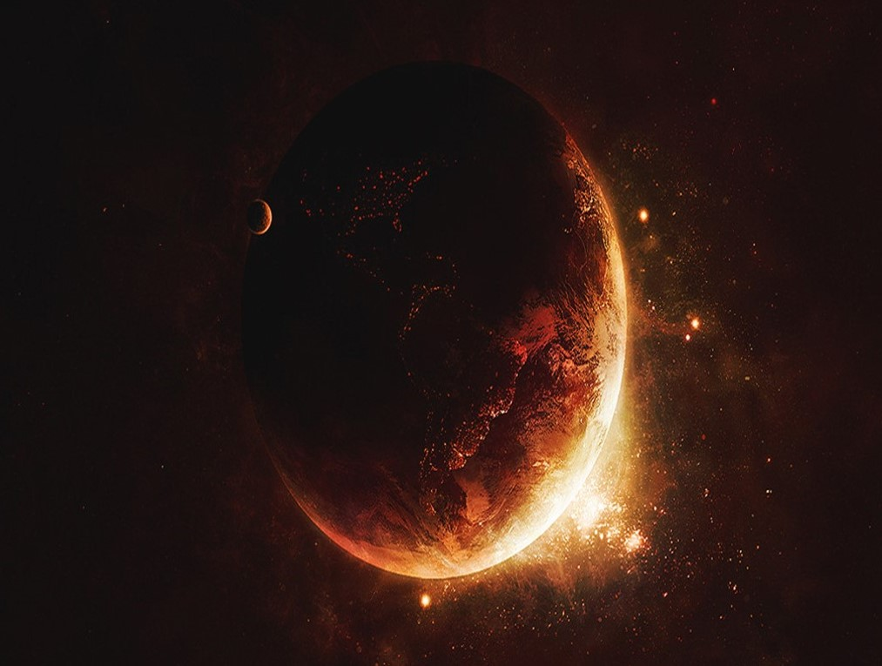
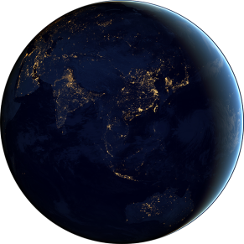
Homework
1.Polish the summary writing;
2.Review what we have learnt today.

