Slide 1

感恩遇见，相互成就，本课件资料仅供您个人参考、教学使用，严禁自行在网络传播，违者依知识产权法追究法律责任。
更多教学资源请关注
公众号：溯恩高中英语
知识产权声明

Slide 2


Unit 3 Inventors and inventions
The problem of the snakes
赖会娣(Moon Lai)

Slide 3
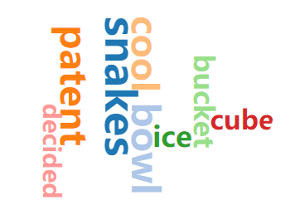



Slide 4
I. Read for structure
Part I (Para 1):
the requirements of getting a patent
Part II (Paras 2-3):
the approaches to solve the problem
Part III (Paras 4-6):
the discovery of the problem of the snakes
Part IV (Paras 7, 8):
the attempts to catch the snakes

Slide 5
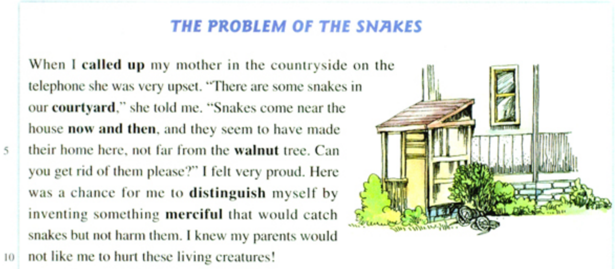


II. Read for
details
1
1. How did “my mother” feel when I called her up?
Confident, brave, creative, kind, eco-friendly…
2. Why did “my mother” feel upset?
3. How did “I” feel about mother’s asking for help?
4. Why did “I” feel proud?
5. What kind of person of “me” can we infer from the reason?
6. But how?

Slide 6

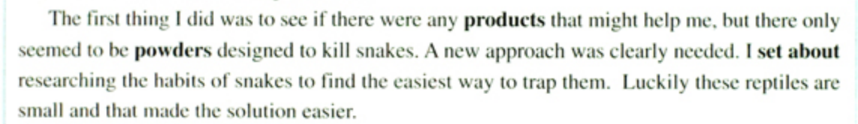



2
2. So what is the solution?
1. Because “I” promised “my” parents only to use merciful solutions in order not to hurt the snakes.
1. Why didn’t the powder products work?

Slide 7
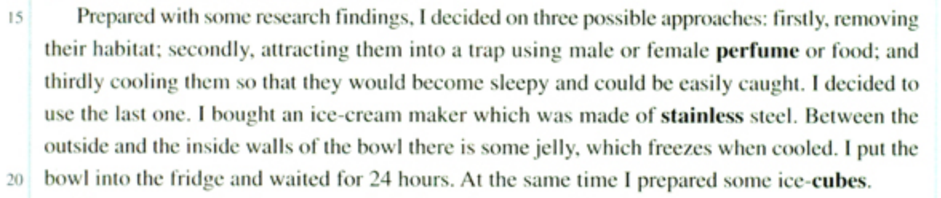
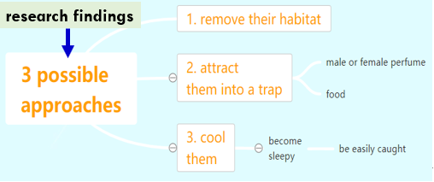
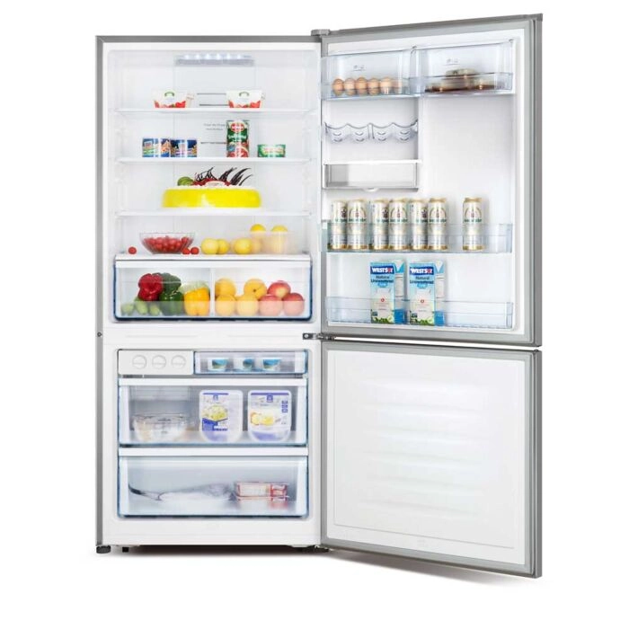
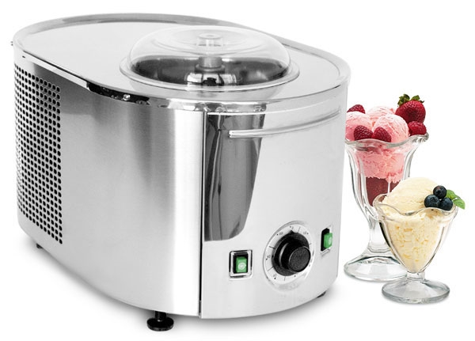
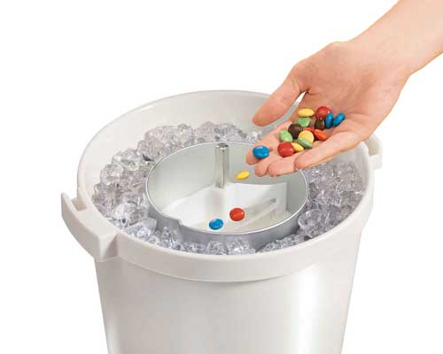
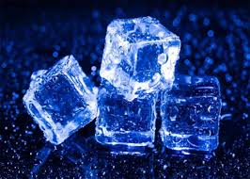

3
1. So what is the solution?
2. What are the words and expressions about the preparation of “cooling”?

Slide 8
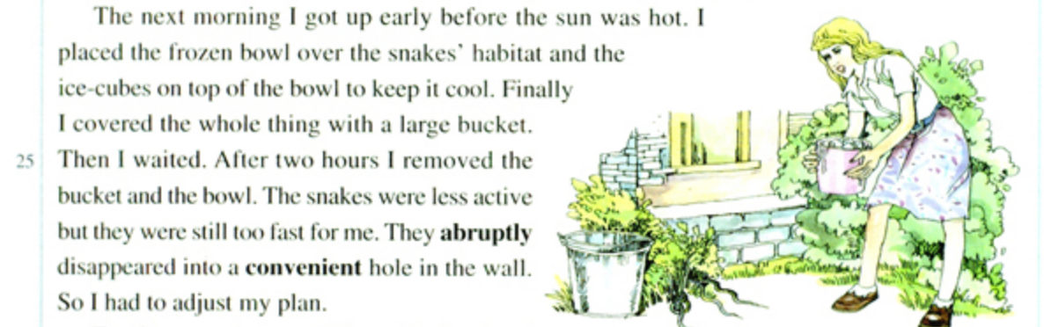
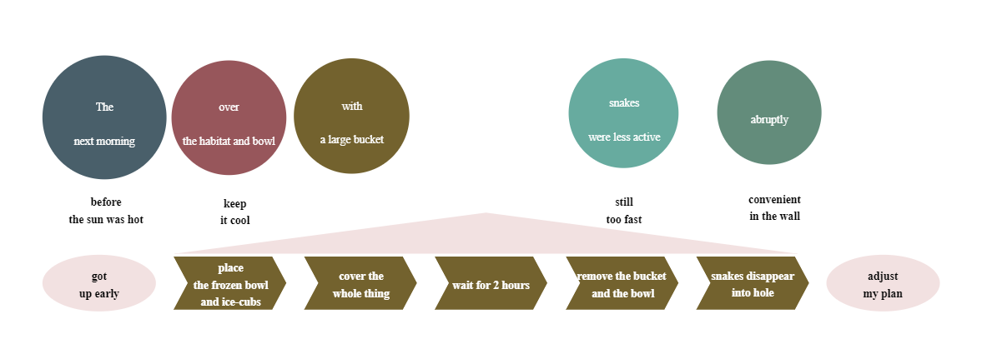

4
1. Could you sort out the sequence of the “cooling” approach?
2. Did the “cooling” approach work?
4. But how?
3. What might be the causes of the failure?

Slide 9
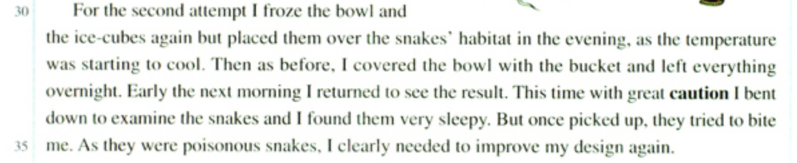


5
1. What adjustments were made?
2. Did the adjusted approach work or not?
4. But how?
3. If you were “me”, would you choose to give up or to make some improvement then?

Slide 10
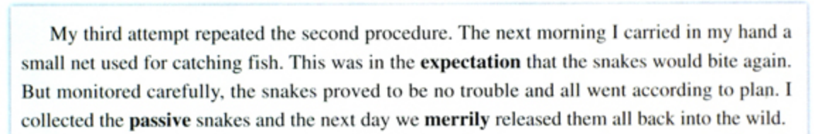



6
1. What was the newest change?
2. Did the improved approach work in the end?
3. Why didn’t the story end here?

Slide 11
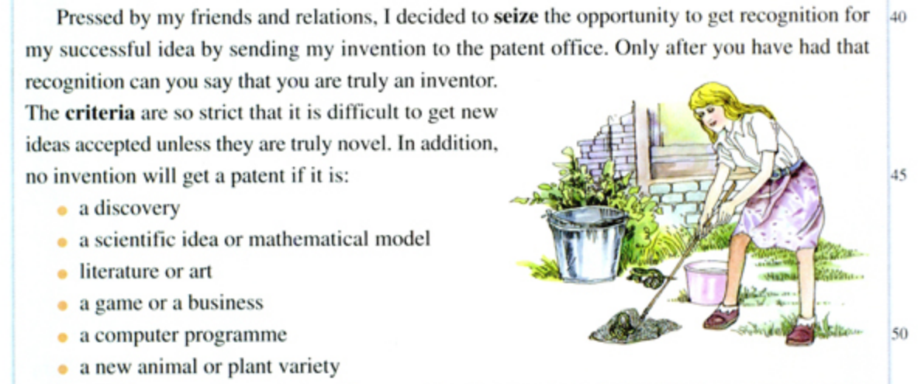
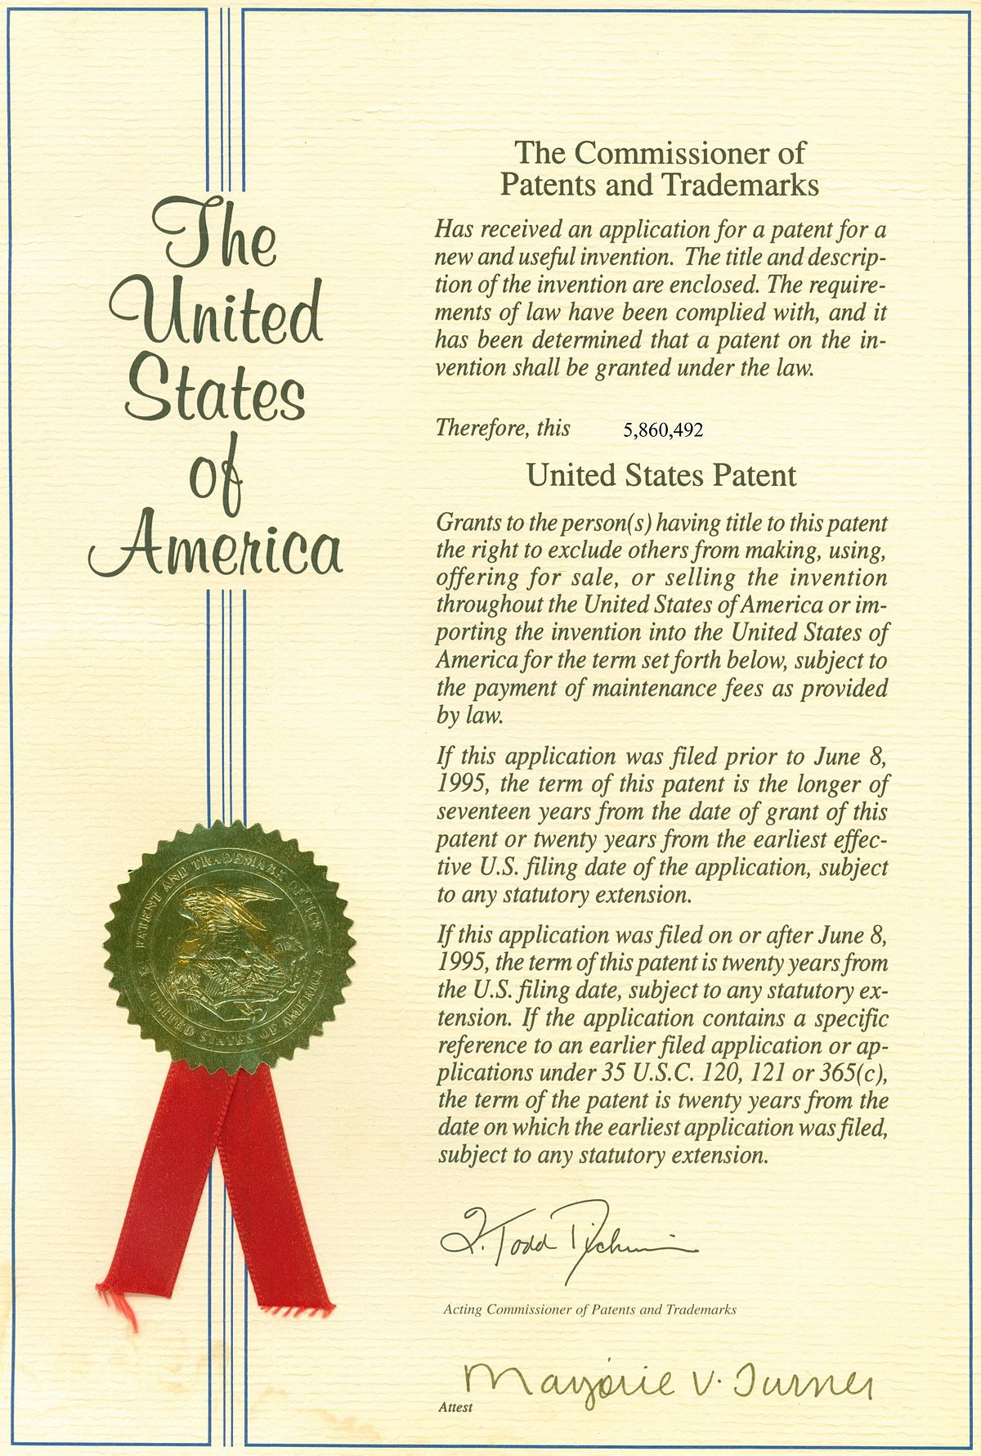
7
2. Is it EASY to get a patent?
1. What was the reason to continue the story?
3. What does “novel” mean here?
not like anything known before, and unusual
E.g., novel idea/approach/method

Slide 12
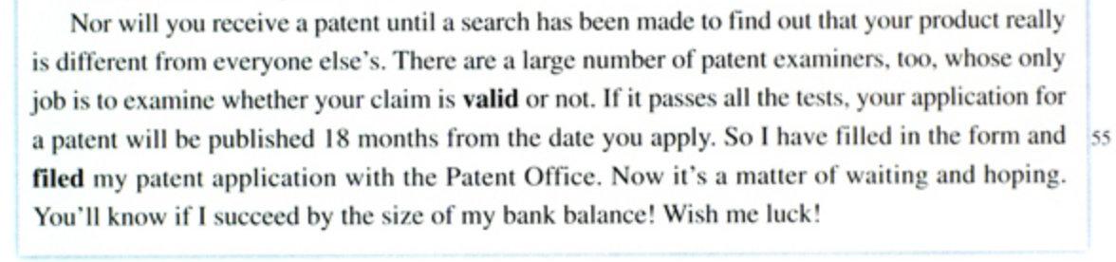

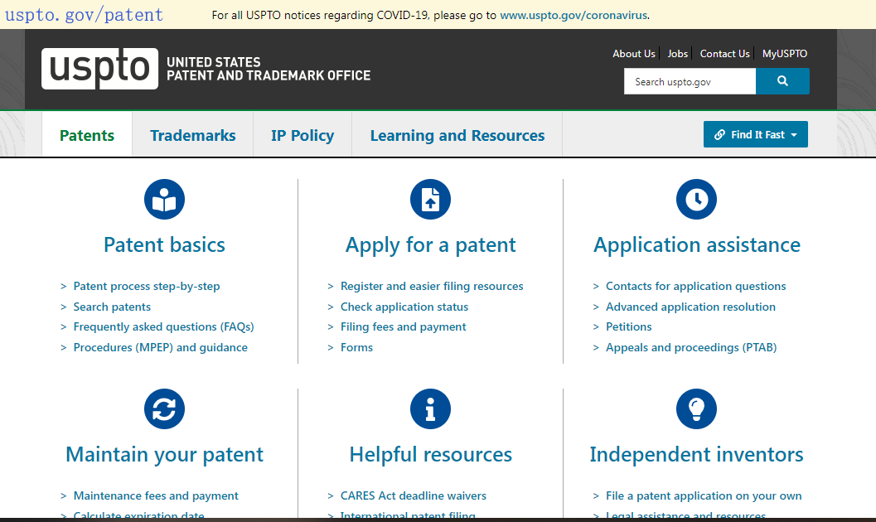
8
Do you think “I” can get the patent approved?

Slide 13
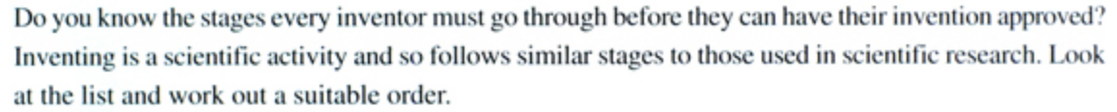


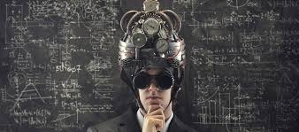



Finding a problem
Deciding on the invention
Applying for a patent
Doing research
Thinking of a creative solution
Testing solution

Slide 14
III. Discussion: What did you learn from the passage?
I learnt
perseverance
benevolence
copyright
rigorousness
How？

Slide 15
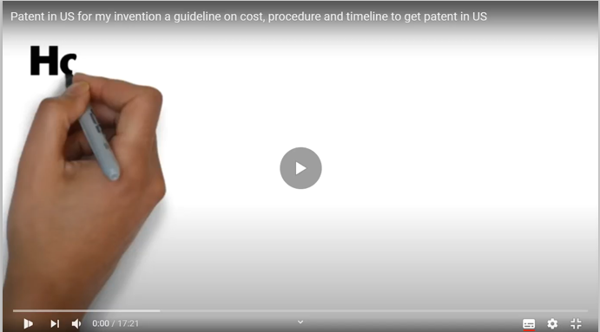

Slide 16
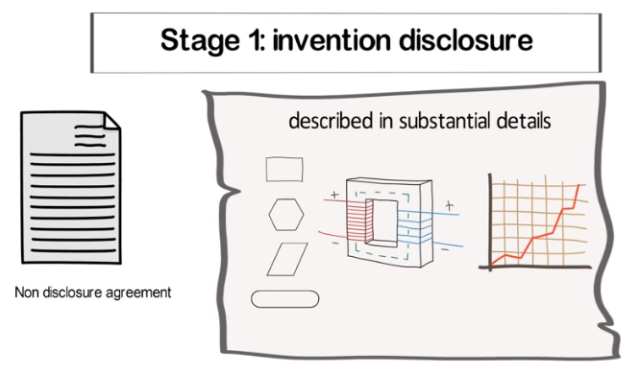
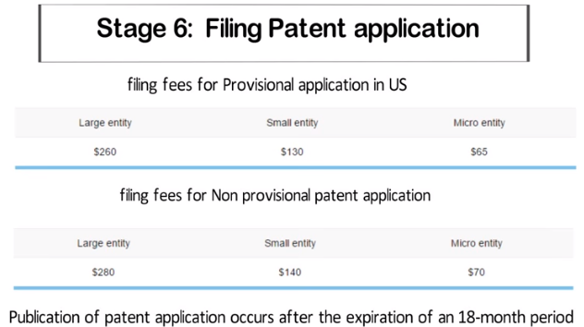
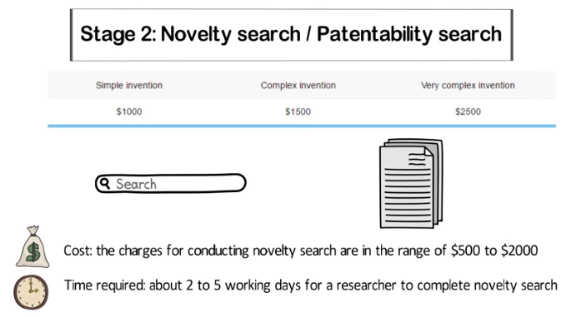
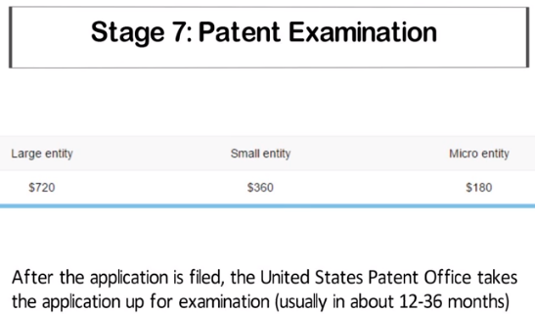
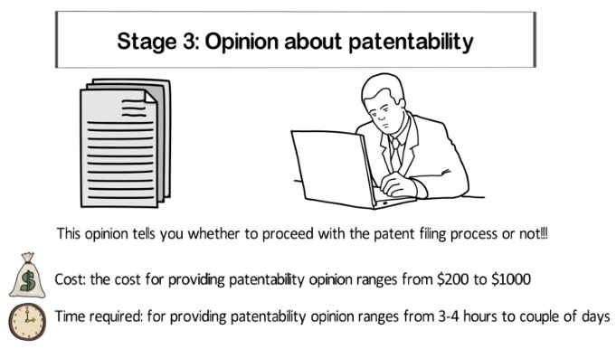
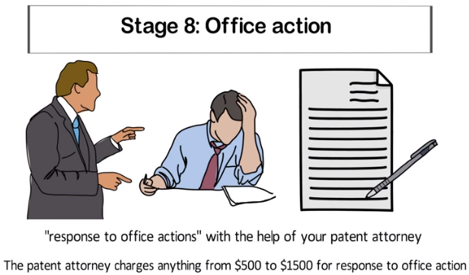
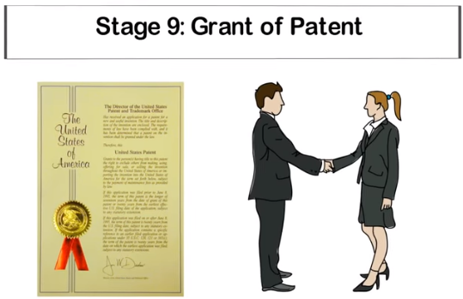
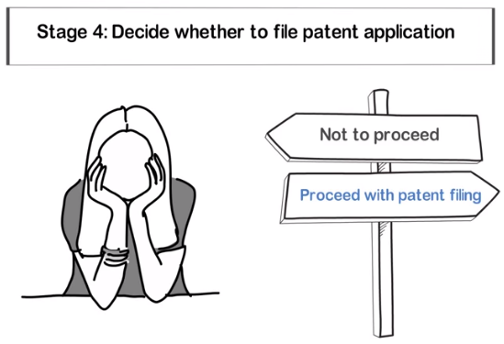
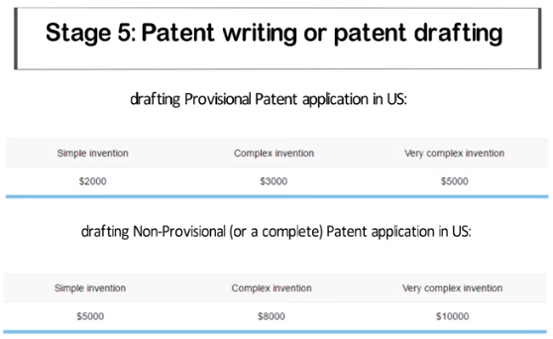
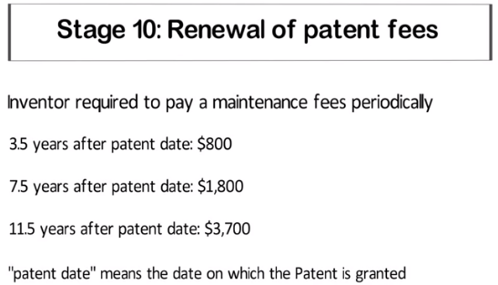
How can I get patent in US for my invention, product, software or concept?

Slide 17
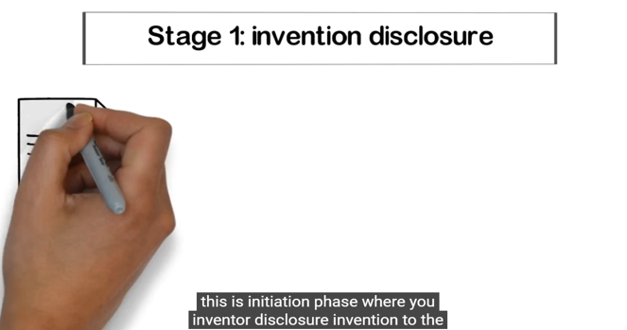
For more information, please go to https://www.youtube.com/watch?v=_oTJ4L0XAYE

Slide 18

The way to invention requires us to …
创造
革新
启发
参与

Slide 19

Enjoy learning. Enjoy homework.
Review and find out the golden expressions in the passage.

