Slide 1

感恩遇见，相互成就，本课件资料仅供您个人参考、教学使用，严禁自行在网络传播，违者依知识产权法追究法律责任。
更多教学资源请关注
公众号：溯恩高中英语
知识产权声明

Slide 2
从“契诃夫法则”看读后续写
隐藏线索的利用
周萍 浙江省湖州市第二中学

Slide 3
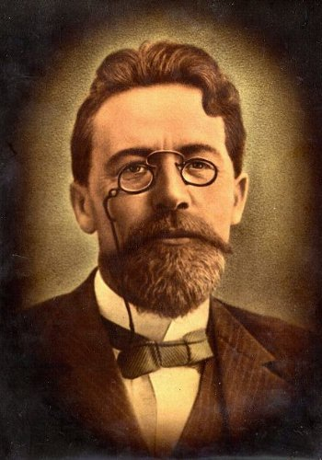
契诃夫（Chekhov），19世纪末俄国伟大的批判现实主义作家，情趣隽永、文笔犀利的幽默讽刺大师，短篇小说之王，著名戏剧作家。他创作态度严谨，重视文学的写生，笔下一草一木无不栩栩如生，刻画心理亦往往入木三分，是世界短篇小说巅峰之一，并成为短篇小说的代名词。
Chekhov 1860-1904

Slide 4
Chekhov’s Law
契诃夫法则是一种文学技巧，在故事早期出现的某一元素，直至最后才显现出它的重要性。
换言之，在故事开头出现过的物品一定要在后面的故事情节中用到，否则，它就不应该出现。

Slide 5
“契诃夫法则”对读后续写的启示
1.故事前面隐藏的线索为故事后续的发展指明了方向；
2.在阅读故事时应重视隐藏的线索；
3. 隐藏的线索在后续的故事发展中应有所交代。

Slide 6
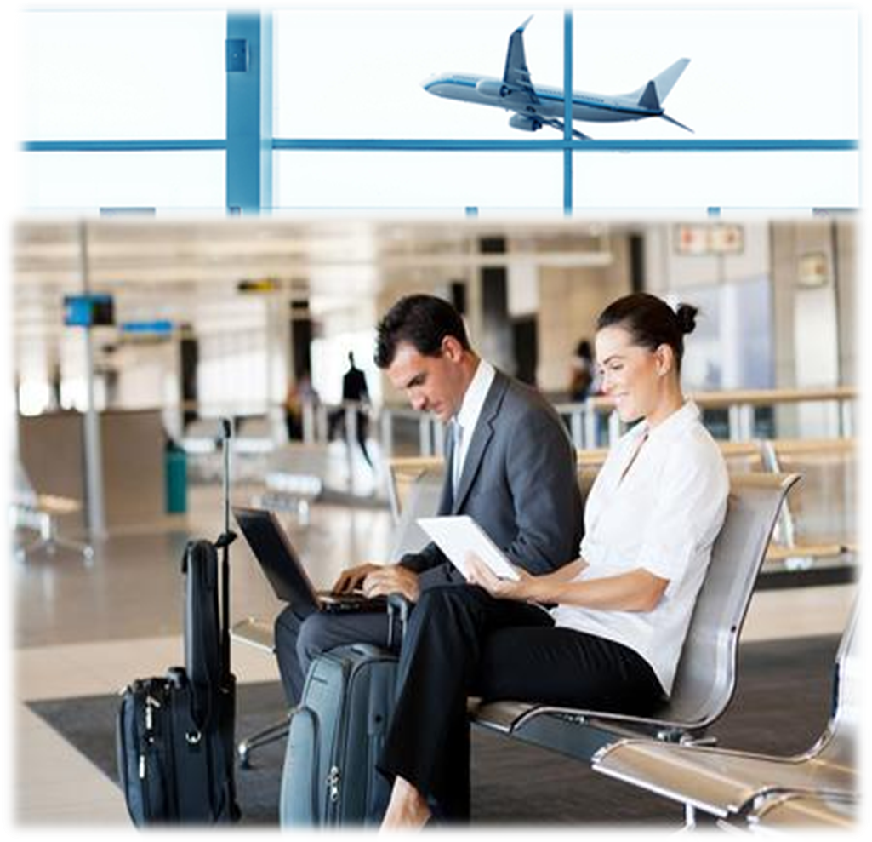
Cookie Thief
课例（读后续写讲评课）

Slide 7

It was late and raining heavily one night. A young woman was waiting for her flight at an airport. She was leaving for London because she got a new job there. It was said that her new boss was a typical English gentleman—polite, modest, humorous and considerate. She was excited as well as a little nervous about her new life.
With several long hours before her flight, the woman hunted for a book in the airport shops, bought a packet of cookies and found a place to sit. She took out a book and started to read. Although she was absorbed in her book, she happened to see that the man sitting beside her, as bold as he could be, grabbed a cookie or two from the bag in between them. Educated to be well-mannered, she tried to ignore it to avoid an argument. But to show that she was the owner, she started to take cookies from that bag too. Unfortunately, the man didn’t get that hint（暗示）, since he didn’t stop grabbing the cookies.
“How annoying!” She thought. As the greedy cookie thief kept eating, the woman munched(用力咀嚼) some cookies and watched the clock.
She was getting angrier as the minutes went by, thinking, “If I weren't so nice, I would blacken his eyes.” With each cookie she took, he took one, too; when only one was left, she wondered what he would do.
With a smile on his face, and a nervous laugh, he took the last cookie and broke it in half. He offered her a half, and ate the other. She grabbed it from him, glared at him and thought, “Oh, brother. This guy has some nerve and he is so rude! Why he didn't even show any gratefulness?”
She had never known when she had been so angry, and sighed in relief when her flight was called. She gathered her belongings and headed to the gate quickly, refusing to look back at the rude thief. She boarded the plane, sank in her seat, and looked for her book, which was almost complete.

Slide 8
Divide the underlined words into 4 groups:
gentleman；the woman; a packet of cookies; the man; cookie thief ; a nervous laugh; ate; thought; rude; the plane
gentleman; the woman; the man; cookie thief
人物
事物
动作
特性
a packet of cookie; a nervous laugh; the plane
ate; thought
rude
Which underlined words will you choose? Why?

Slide 9
The underlined words most likely to be used
the woman
the man
cookie thief
a packet of cookies
the plane
main characters
important name
important object
place where the story would go on

Slide 10
Read the story again and find out
two hidden clues in it.

Slide 11
The hidden clues in the given part
❶ It’s said that her new boss was a typical English gentleman-polite, modest, humorous and considerate.
Thinking：When and where would she meet her new boss?
How would she meet him?
❷The woman thought that man was a cookie thief and she was angry with him.
Reverse 反转
In fact, the man was not a cookie thief and the woman made a mistake. That was a misunderstanding.
Thinking：How would the story go on to bring it to light?

Slide 12
特别说明（此说明不出现在上课的课件中）
如果新老板不是作者留下的线索，无需在故事的后续发展中出现，前面就不会提到，或者即使提到也会处理得更加含糊，以淡化留给读者的印象，如It’s said that her new boss was a kind man.而不是着重提到a typical English gentleman，并且还特别列出绅士的品质：polite, modest, humorous and considerate。
作者用了5个段落来描写那位女士的愤怒。可以自问一下：作者写这些，是为了讲一位女士因为旁边的男士吃了“她” 的饼干而愤怒的故事吗？答案显然是否定的。所以故事发生反转是必然的，女士的怒气也就是故事反转所需要事先埋下的另一条线索。

Slide 13
Trends in the story’s development
She would meet her new boss.
She would find that not the man but herself was a cookie thief.

Slide 14
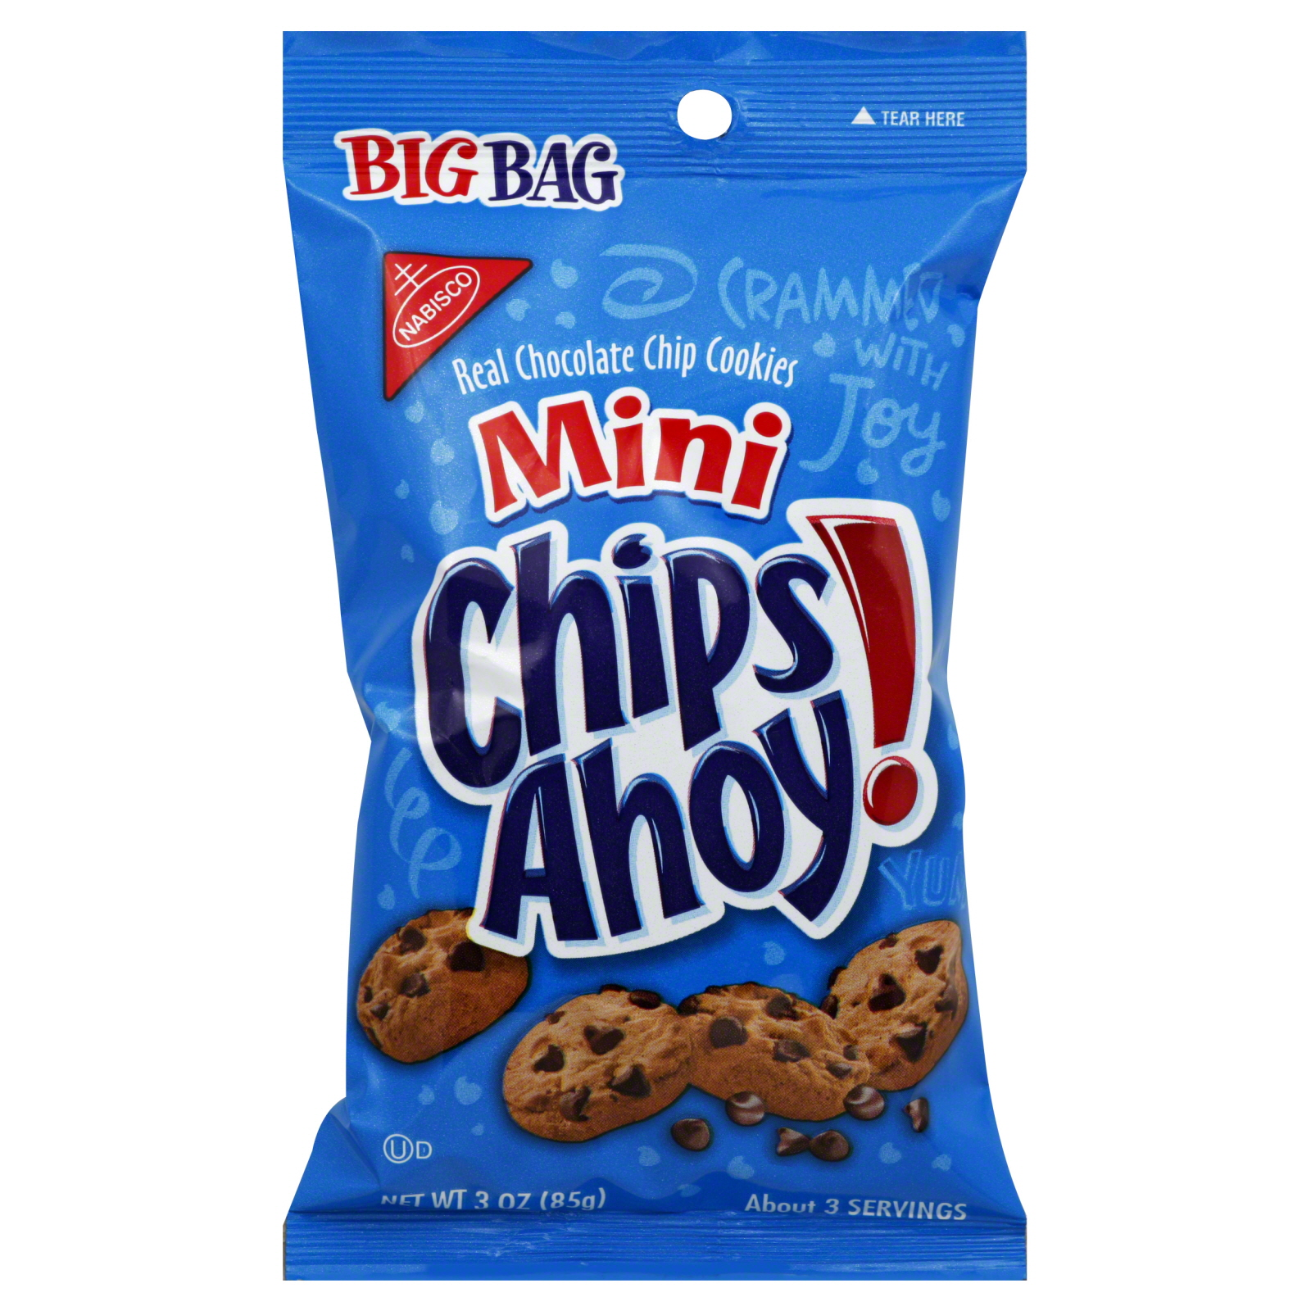
The hidden clues in the given sentences
Paragraph 1
As she reached in her baggage, she gasped(喘气) with surprise. ________________________________________________________
Para 2：With several long hours before her flight, the woman hunted for a book in the airport shops, bought a packet of cookies and found a place to sit. She took out a book and started to read.
NOT cookies
She would find that the man was not a cookie thief but herself.
She would feel guilty and wanted to apologize to the man.

Slide 15
The hidden clues in the given sentences
Paragraph 2
Surprisingly, she found the man sitting just behind her.___________________________________________
It was said that her new boss was a typical English gentleman — polite, modest, humorous and considerate.
She apologized to the man.
She knew that the man was her new boss by accident.

Slide 16
How to describe the woman’s feeling（anger）
#…tried to ignore it to avoid an argument.
#“How annoying!” She thought.
#…munched some cookies and watched the clock.
#…thinking, “If I weren’t so nice, I would blacken his eyes.”
#She grabbed it from him, glared at him and thought, ”Oh, brother… Why he
didn’t even show any gratefulness?”
#She had never known when she had been so angry, and sighed in relief when…
#…and headed to the gate quickly, refusing to look back at the rude thief.
action and body language
facial expressions
subjunctive mood(虚拟语气) ---（wish，guilt，regret）
exclamatory sentences(感叹句) and questions

Slide 17
Polish your writing

Slide 18
A sample
As she reached into her baggage, she gasped with surprise. She found a packet of cookies lying in her handbag. It had been only a few seconds before she realized that she herself was the real cookie thief. Feeling extremely ashamed, the woman covered her mouth with her hands. How she wished that she hadn't eaten the man's cookies so carelessly. She looked around to make sure that nobody noticed her unusual behaviors.

Slide 19
Surprisingly, she found the man sitting just behind her. What made the atmosphere more delicate was that the man apparently recognized her. Her face was mottled red and white with embarrassment and she made an apology to him. He grinned amiably at her, saying, “I’m glad you like it.” After the plane arrived, the woman hurried to see her new boss. What a coincidence! He was the very gentleman.

Slide 20
别忘了：故事隐藏的线索！
周萍 浙江省湖州市第二中学

