Slide 1

感恩遇见，相互成就，本课件资料仅供您个人参考、教学使用，严禁自行在网络传播，违者依知识产权法追究法律责任。
更多教学资源请关注
公众号：溯恩高中英语
知识产权声明

Slide 2

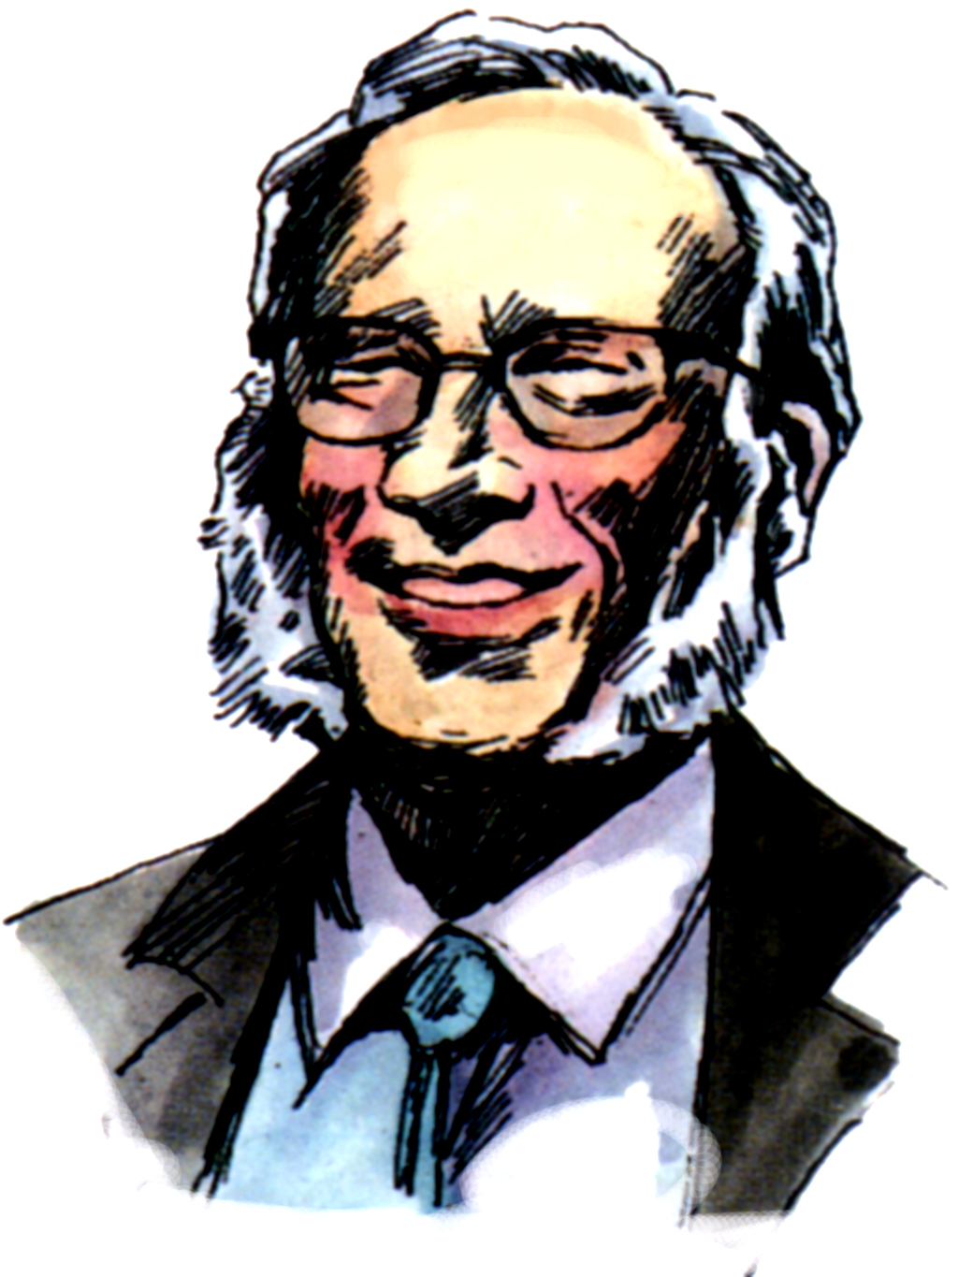
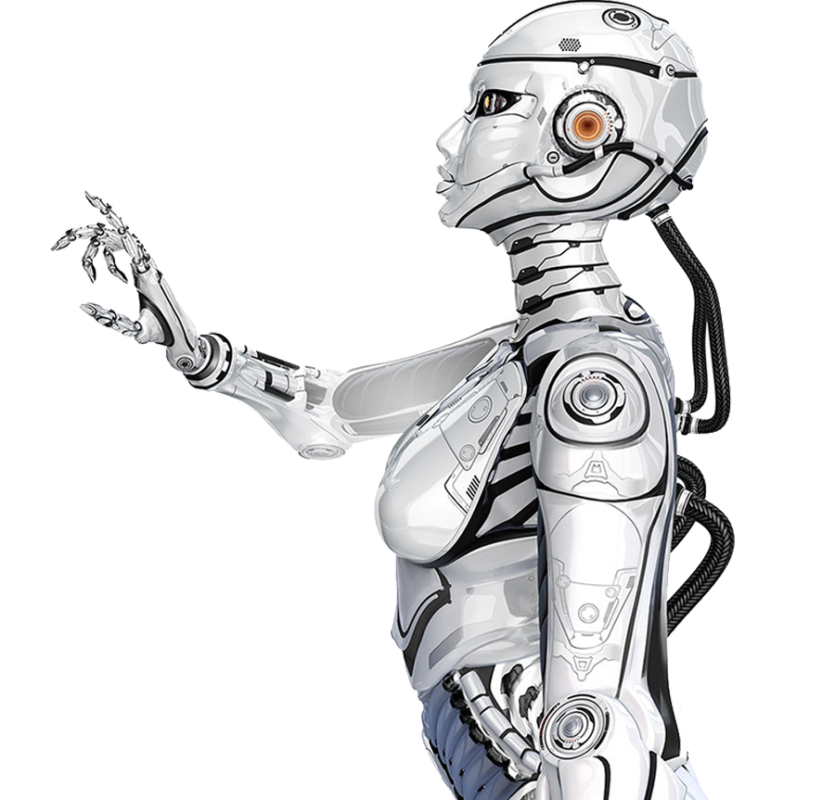
选修七 Unit 2 Using Language
A Biography of Isaac Asimov
授课教师：李文娟
云南民族大学附属中学

Slide 3
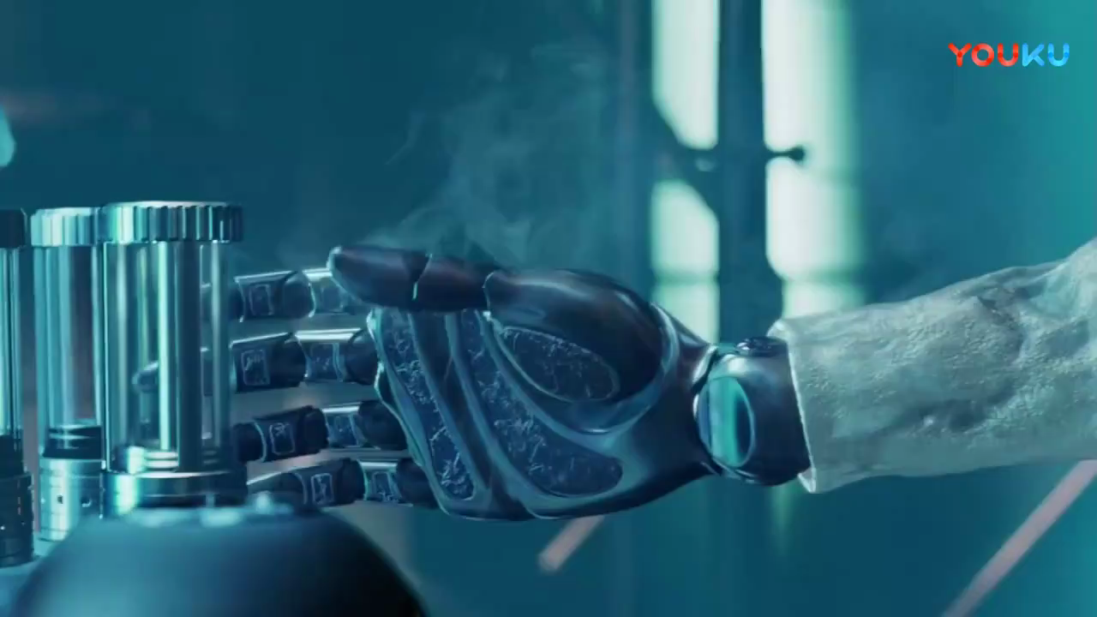
Lead-in
I, Robot (2004)
1. Who is writer of this story?

Slide 4
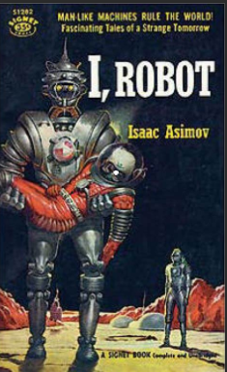
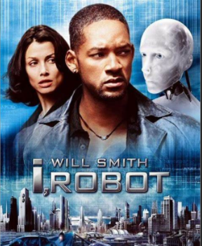
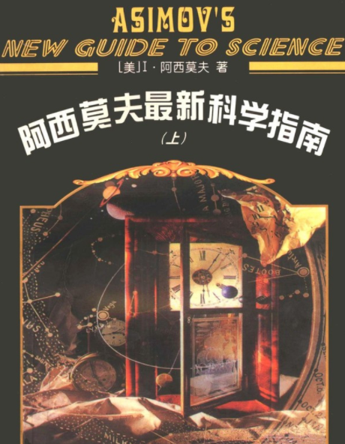
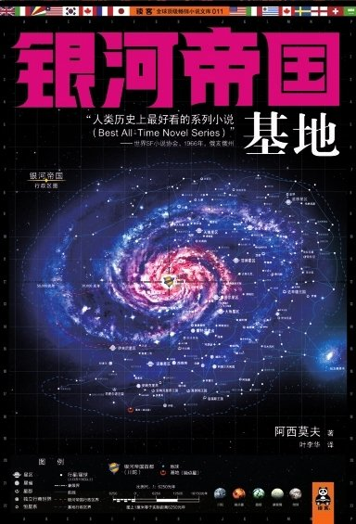

Lead-in
1. Who is writer of this story?
Isaac Asimov
.
.

Slide 5

Lead-in
2. Who's Isaac Asimov?
3. Woud you like to learn more about him?

Slide 6
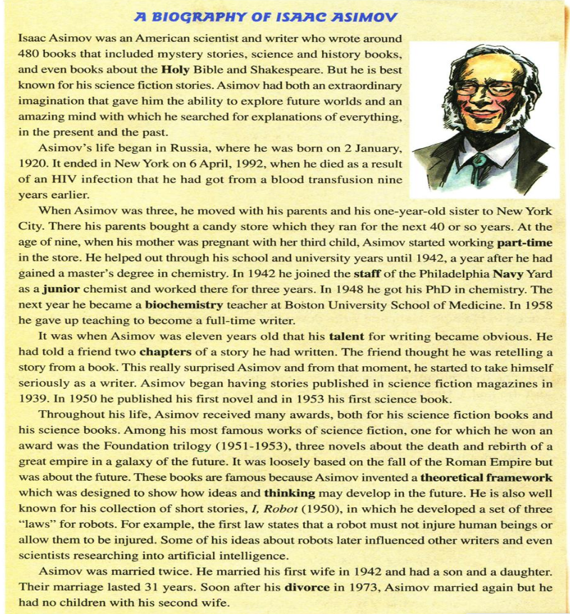
Reading
Task 1 Text analysis
1. What’s the writing style?
Biography (narrative)
2. What’s the main idea of this passage?
An introduction of Isaac Asimov's life and works.

Slide 7
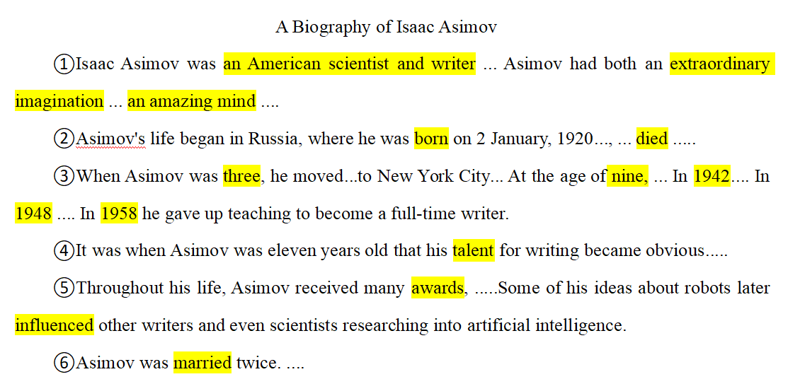
Task 2 Read for the main idea of each paragraph
Reading
Para. 1 The awards Asimov received
Para. 2 Asimov’s growth and education
Para. 3 The assessment of Asimov as a writer
Para. 4 The birth and death of Asimov
Para. 5 Asimov’s marriage
Para. 6 The beginning of Asimov’s writing

Slide 8
Task 3 Draw a timeline of Isaac Asimov's life.
master's degree.
full-time
writer.
born in Russia.
Began writing as a writer .
got PhD.
first novel.
died.
1920
1931
1941
1948
1950
1958
1992
1923
1939
1942
1949
1953
1973
moved to New York.
got married
first book.
divorced
remarried.
began publishing stories.
a biochemistry teacher.

Slide 9
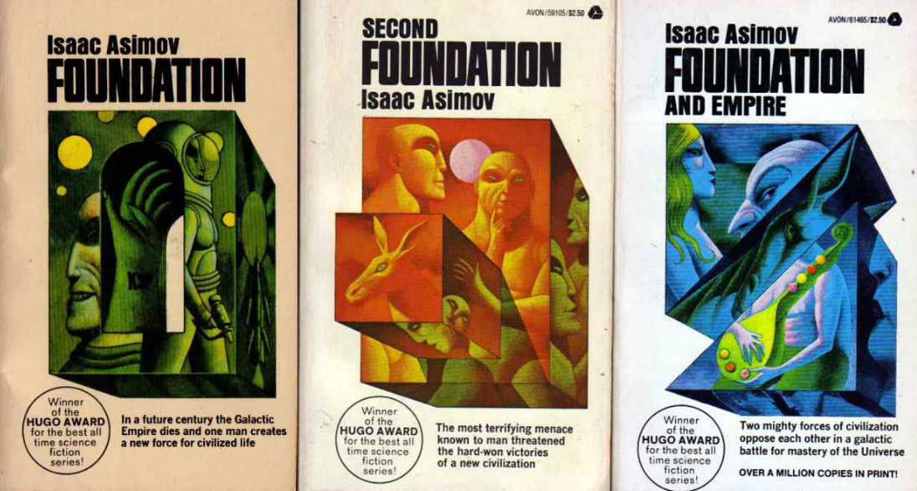
Task 4 What are his works?
the Foundation triology
I, Robot

Slide 10
Task 5 Summary
para 1: brief introduction (profession, talent)
para 2: birth and death
para 3: life experience and education
para 4: talent for writing
para 5: achievements and influence
para 6: marriage

Slide 11
Task 5 Summary
Isaac Asimov was an American ___________ and _______, who had both an extraordinary __________ and an amazing ________. Through his whole, he won many _______ and his famous works are __________________ and ___________.
He was born in ______ and died in _______. When he was ______, he showed his _______ for writing, but he didn't become a full-time writer until ______. He was well educated, getting not only a _______ degree in chemistry but also _______. During his whole life, he married ___________ and had _______ children.
scientist
writer
imagination
mind
awards
the Foundation triology
I, Robot
1920
1992
11
talent
1958
master's
PhD
twice
2

Slide 12
Post reading
Task 6 Imitating Writing 仿写
brief introduction
01
achievements
05
02
birth and death
biography
04
03
life experiences
marriage

Slide 13
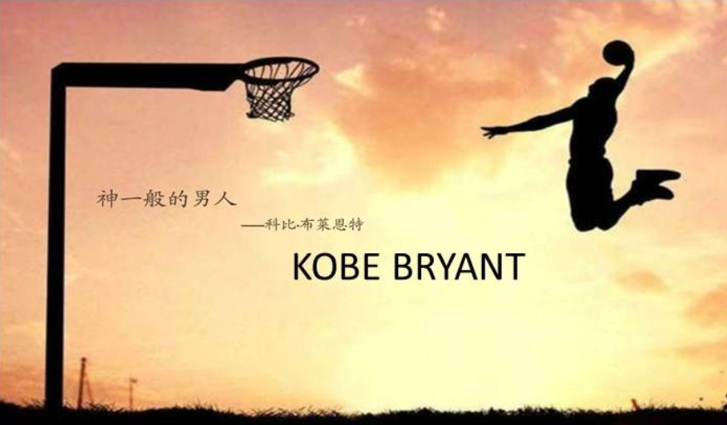
A Biography of Kobe Bryant
Task 6 Imitating Writing 仿写

Slide 14
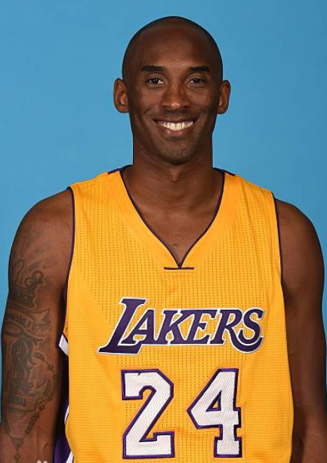
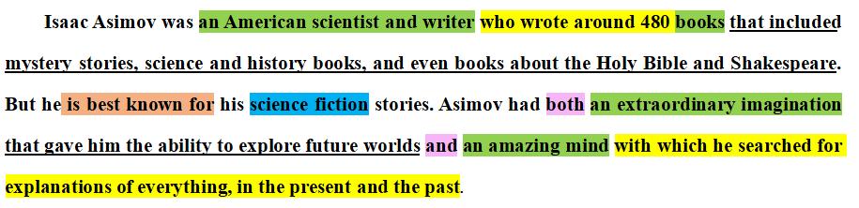
Para.1 Brief introduction
科比·布莱恩特是一名美国职业篮球运动员，绰号“黑曼巴”。他不仅天赋异禀，而且毅力惊人，天赋让他早早崭露头角，而毅力让他成为一代传奇巨星。
Kobe Bryant was an American professional basketball player, whose nickname is Black Mamba. Kobe had both an extraordinary talent that enabled him to be an early bloomer and amazing perseverance with which he became a legendary superstar.

Slide 15
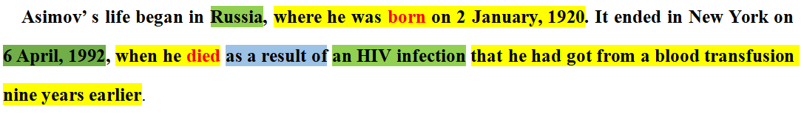
Para.2 Birth and death
Philadelphia, Pennsylvania
科比于1978年8月23日出生在宾夕法尼亚州费城。2020年1月26日，科比在加利福尼亚州卡拉巴萨斯市发生的直升机坠毁事故中遇难，年仅41岁。
Calabasas, California
Kobe's life began in Philadelphia, Pennsylvania, where he was born on August 23rd, 1978. It ended in Calabasas, California on January 26, 2020, when he died as a result of a helicopter crash at the age of 41.

Slide 16
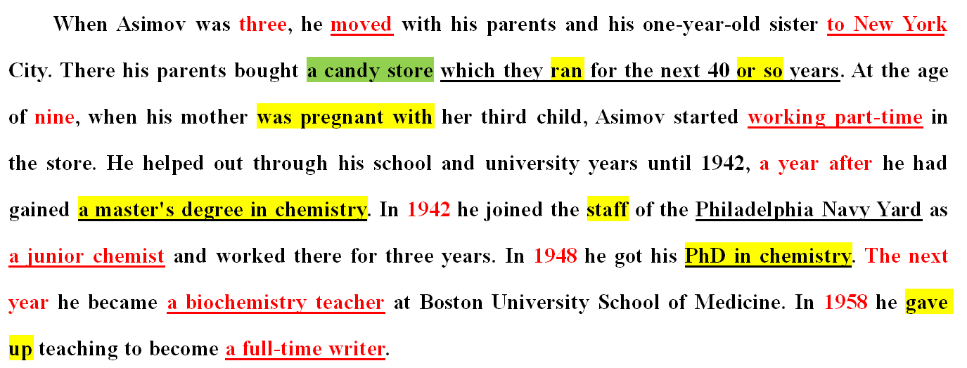
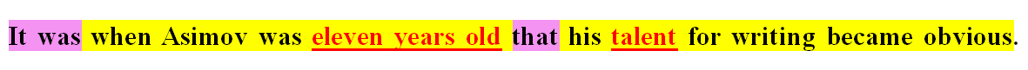
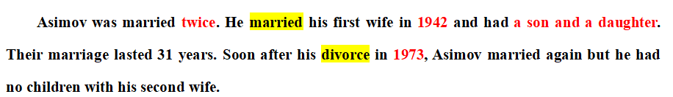
Para.3 Life experiences & Marriage
科比是前NBA球员乔·布莱恩特的儿子。科比6岁的时候, 全家搬到了意大利,直到1991年，才搬回了美国。在劳尔梅里恩高中毕业之后，17岁的他就直接进入了NBA。2001年，科比和瓦妮莎结婚，两人育有4个女儿。2016年,宣布退役。
Lower Merion High School
Kobe was the son of former NBA player Joe Bryant. When Kobe was six, he moved with him family to Italy and moved back to America in 1991. It was after graduating from Lower Merion High School that 17-year-old Kobe entered the NBA directly. He married Vanessa in 2001 and had four daughters. In 2016, he announced his retirement from the NBA.

Slide 17
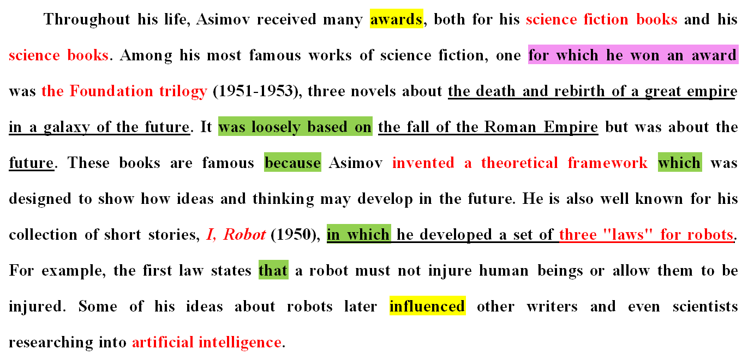
Para.4 Achievements
在为湖人队效力的20年里, 他曾获得5届NBA总冠军，18届NBA全明星，15届NBA最佳阵容，12届NBA最佳防守阵容，2008年NBA最有价值球员奖。||此外，他的“曼巴精神”在全世界都具有一定影响力。令人惊讶的是，2018年，他还获得奥斯卡最佳动画短片奖。
During his entire 20-year career with the Los Angeles Lakers, Kobe won five NBA championships, was an 18-time All-Star, 15-time member of the All-NBA Team, 12-time member of the All-Defensive team and was the NBA's Most Valuable Player in 2008. Besides, Kobe was famous because he invented “Mamba Mentality” which influenced the world. Surprisingly, he received an Oscar for "Best Animated Short" in 2018.

Slide 18


Task 6 Imitating Writing 仿写
peer response
同伴互评
works presentation
成果展示

Slide 19
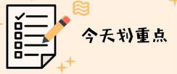
A biography of Kobe Bryant
Kobe Bryant was an American professional basketball player, whose nickname is Black Mamba. Kobe had both an extraordinary talent that enabled him to be an early bloomer and amazing perseverance with which he became a legendary superstar.
Kobe's life began in Philadelphia, Pennsylvania, where he was born on August 23rd, 1978. It ended in Calabasas, California on January 26, 2020, when he died as a result of a helicopter crash at the age of 41.
Kobe was the son of former NBA player Joe Bryant. When Kobe was six, he moved with him family to Italy and moved back to America in 1991. After graduating from Lower Merion High School , 17-year-old Kobe entered the NBA directly. He married Vanessa in 2001 and had four daughters. In 2016, he announced his retirement from the NBA.
During his entire 20-year career with the Los Angeles Lakers, Kobe won five NBA championships, was an 18-time All-Star, 15-time member of the All-NBA Team, 12-time member of the All-Defensive team and was the NBA's Most Valuable Player in 2008. Besides, his “Mamba Mentality” is influential around the world. Surprisingly, he won an Oscar for "Best Animated Short" in 2018.
Imitating Writing
· layout
· sentence structures
· phrases

Slide 20
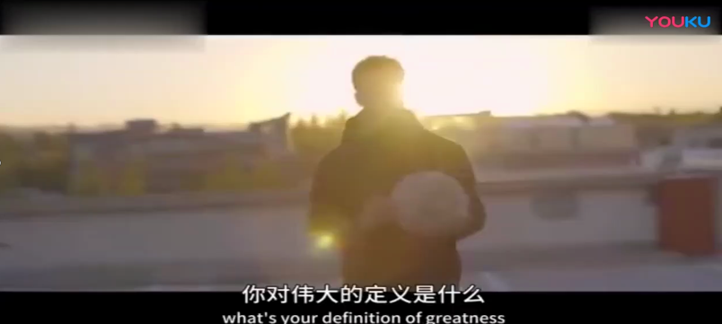

你见过凌晨四点的洛杉矶吗？
“凌晨四点的洛杉矶，满天的繁星，灯光寥落，行人很少”。
Learn from those great persons!

Slide 21
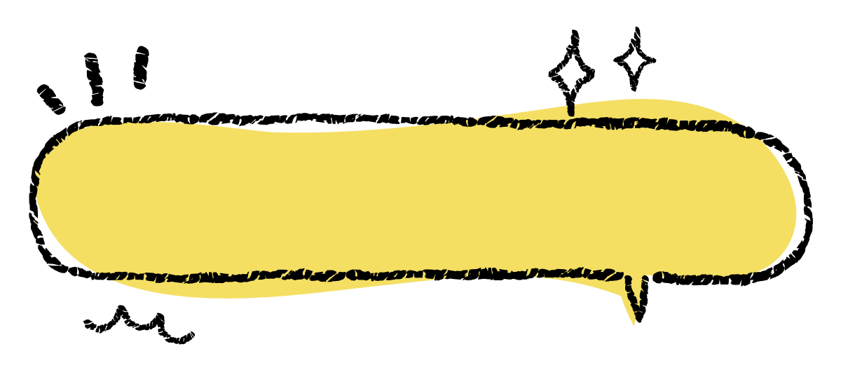
Homework
1. Polish your writing.
2. Write a biography of your idol based on what you have
learned today.

Slide 22



