Slide 1

感恩遇见，相互成就，本课件资料仅供您个人参考、教学使用，严禁自行在网络传播，违者依知识产权法追究法律责任。
更多教学资源请关注
公众号：溯恩高中英语
知识产权声明

Slide 2

2019学年高一第二学期浙南名校联盟期中联考 应用文写作 邀请信 端午节
浙江永嘉中学 朱迁苗

Slide 3

Enjoy the Video: Hello，China - Dragon Boat Festival

Slide 4
语法填空：端午节
or
Many traditional Chinese foods are intended to honour either the gods 1 extraordinary persons in history. Zongzi is no exception. It is designed 2 (honour) Qu Yuan, the pioneer poet of ancient China. Qu Yuan was a famous poet who was also concerned about the fortune of his government. Unfortunately he was distrusted by the king, 3 forced him to go to a remote area. The poet felt 4 ( hope) about the government and its policies. When the state’s capital 5 (seize) by its enemies, he drowned himself in the Miluo River (on May 5th according to the Chinese lunar calendar). People felt this loss deeply, as he was 6 respected poet. Local people searched 7 him in the river. Meanwhile, they dropped dumplings of sticky rice wrapped in bamboo 8 (leaf) into the river in order to keep the fishes from attacking Qu Yuan’s body. Since that time, it 9 (be) a custom to enjoy zongzi as a memorial to Qu Yuan. In addition, there is also a festival 10 (call) the Duanwu Festival or the Dragon Boat Festival, when there is a nationwide practice of enjoying zongzi.
to honour/honor
who
hopeless
was seized
a
for
leaves
has been
called

Slide 5
应用文：端午节
假如你是李华，你班将举行端午节 (the Dragon Boat Festival) 庆祝活动，请你给外教Lucy写封邮件邀请她参加，内容包括： 1. 写信目的； 2. 活动时间和地点； 3. 活动内容。 注意：1. 词数80左右； 2. 可适当增加细节，使行文连贯。
What to write ABOUT the festival:
1. When to celebrate? May 5th in the lunar calendar
2. Why to celebrate? To honour Qu Yuan
3. How to celebrate?
what to eat? Zongzi
what to do? Dragon Boat Race

Slide 6
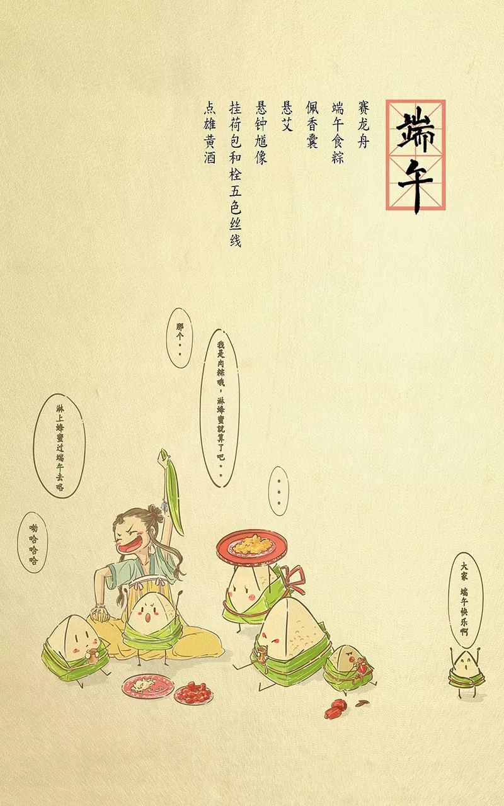
关于节日日期
【一句多译】端午节在农历五月初五。
1. The Dragon Boat Festival falls on May 5th in the lunar calendar.
2. The Dragon Boat Festival falls on the 5th day of the 5th lunar month.
3. The Dragon Boat Festival is celebrated/observed on the 5th day of the 5th month according to the Chinese calendar.

Slide 7
【翻译】端午节是中国的传统节日,在每年的农历五月初五,是为了纪念中国古代爱国诗人屈原。(the Double Fifth Festival)
→ The Dragon Boat Festival, on the 5th day of the 5th lunar month, is a traditional Chinese festival in memory of Qu Yuan, a patriotic poet of ancient China. (同位语)
句式小结：
节日（主语）+日期（插入定语）+介绍（谓语）（同位语）
【句式仿写】
七夕节，即每年农历七月初七, 是一个充满浪漫爱情的传统节日，也被称作“中国的情人节”, 来纪念牛郎织女的爱情故事。
→ The Double Seventh Festival, on the 7th day of the 7th lunar month and also called as Chinese Valentine's Day, is a traditional festival full of romance in honor of the love story of Niulang and Zhinv，the herd boy and the weaving girl.

Slide 8
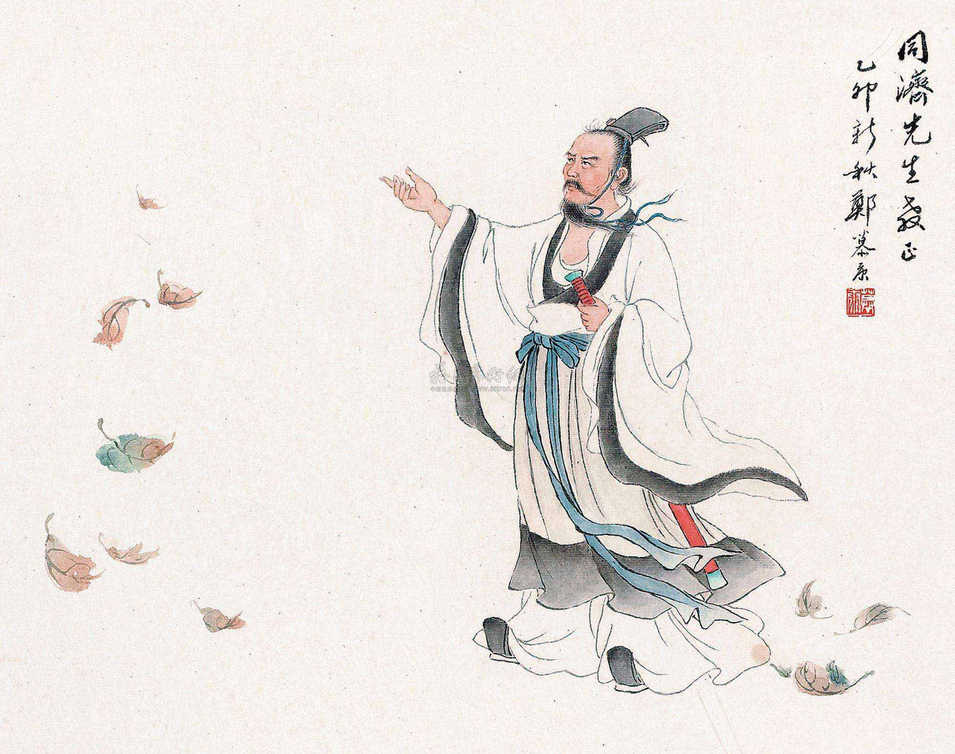
关于屈原
【一句多译】端午节是纪念屈原的节日。
1. Dragon Boat Festival is in honor of/in memory of Qu Yuan.
2. Dragon Boat Festival is for commemorating Qu Yuan.
【翻译】他是一名忠臣和爱国诗人，据说他在汨罗河里投河自尽了。
→ He is an honest minister and patriotic poet who is said to have drowned himself in the Miluo River river. (定语从句)
【拓展】屈原 的诗被称作“楚辞”，充满了浪漫主义的夸张和想象，揭露了当时社会的黑暗，表达了对人民的 热爱。
Qu Yuan's poetry, called Chu Ci, is full of romantic hyperbole and imagination, laying bare the current ills of the society, showing deep love for his people.
People in China will hold a variety of activities to honor him, such as dragon boat racing,eating zongzi and so on.

Slide 9
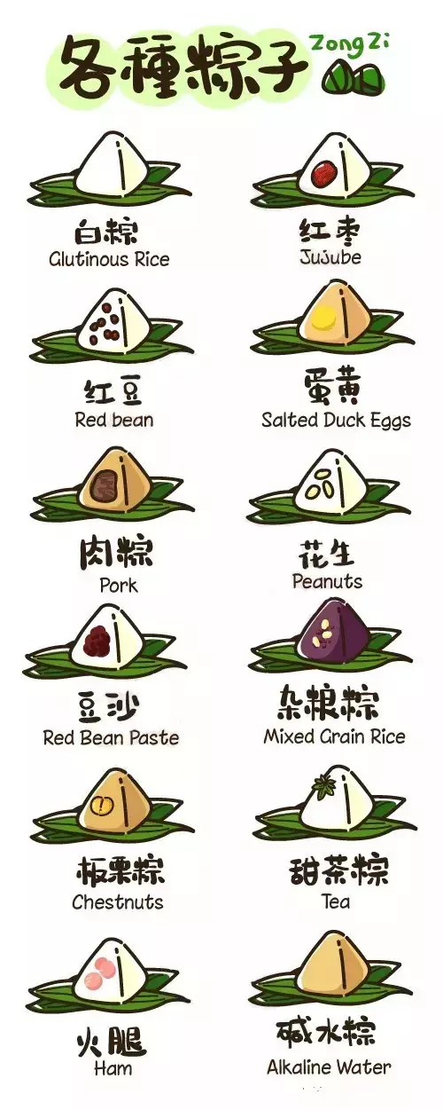
关于粽子 rice-dumpling / zongzi
【翻译】制作和食用传统的食物粽子，把它扔进河流和湖泊，以纪念屈原，这是一个习俗。
→ It is a custom to make and eat the traditional food zongzi, throw it into rivers and lakes in memory of Qu Yuan.
【拓展】粽子是由糯米制成的金字塔状的团子，塞满了不同的馅料, 由竹叶或芦苹叶裹着，令其有种特别的味道。
Zongzi is a pyramid-shaped dumpling made of glutinous rice, stuffed with different fillings and wrapped in bamboo or reed leaves to give it a special flavor.
每年，哀悼屈原的人都会把粽子扔到河里喂他的鬼魂。
People who mourned the death of Qu threw Zongzi into the river to feed his ghost every year.
Notes:
Pyramid: 金字塔
Pyramid-shaped：做成金字塔形状的
（pyramid可以换成其他名词，apple-shaped,苹果形状的）
Glutinous rice: 字面义为黏黏的米，即糯米
Stuffed: 此处可以理解为动词stuff的被动态
stuff作名词为东西，作动词为装满、塞满
Stuffed，被动，即被塞满了...
Filling: 名词，来自动词fill，filling为名词，填的东西，即馅儿
Wrapped: 来自动词wrap，包裹

Slide 10
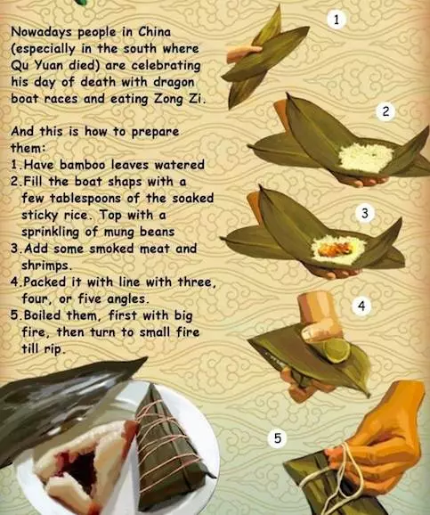
【拓展】
1）have bamboo leaves watered.
粽叶先浸水。
2）Fill the boat shape with a few tablespoons of the soaked sticky rice. Top with a sprinkling of mung beans.
在船型粽叶中填入几勺浸湿的糯米，再加少许绿豆。
3）Add some smoked meat and shrimps.
再加入腌制过的肉和虾。
4）Pack it with line with three, four, or five angles.
用线把粽子裹起来，可以做成三角、四角或五角。
5）Boil them, first with big fire, then turn to small fire till rip.
然后再进行蒸煮，先用大火，再转成小火直到粽子壳开裂。

Slide 11

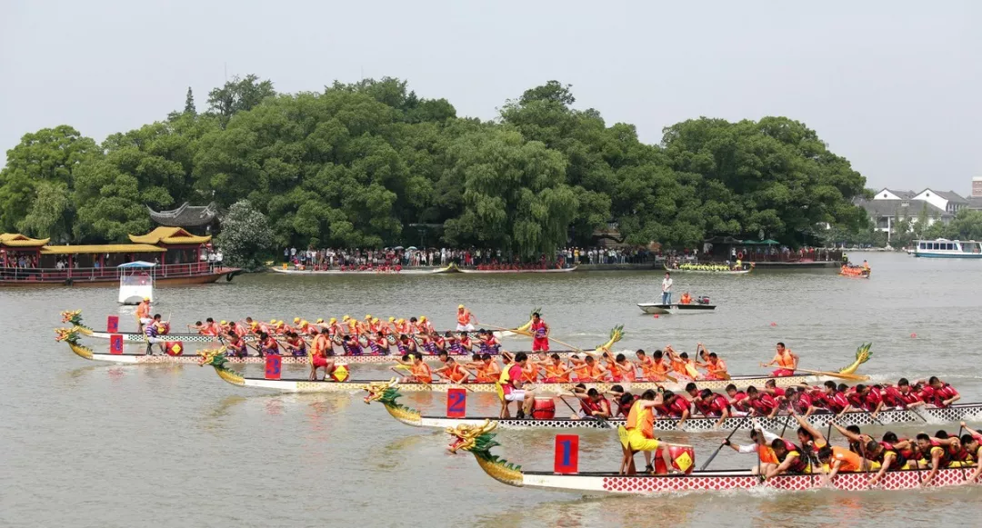
关于赛龙舟 Dragon boat racing
【翻译】为了庆祝端午节，人们通常吃粽子，参加或观看龙舟比赛，参赛队伍伴随着鼓声节奏划着龙舟奋勇向前。
→ To celebrate the Dragon Boat Festival, people usually eat zongzi, have or watch dragon boat racing, in which competing teams drive their dragon boats forward to the rhythm of beating drums.
【拓展】赛龙舟是一项传统娱乐活动。它象征着人们拯救屈原的努力。在当今时代，这些比赛也展示了合作和团队合作的优点。
Dragon boat racing is a traditional pastime.It symbolizes people's attempts to rescue Qu Yuan. In the current period, these races also demonstrate the virtues of cooperation and teamwork.
22名队员坐在像龙一样的长长的船里，比赛划2000米。
Crews of 22 people in long, dragon-shaped boats race lengths of 2000 meters.
Notes:
pastime：名词，消遣，娱乐
业余时间我们如何pass our time，就是我们的日常消遣啦
Crew：成员、队员
Dragon-shaped: 形状像龙一样的
名词-shaped，像...一样的，这个构词法超级常见，建议大家熟悉
Race: 动词，比赛、竞赛

Slide 12
假如你是李华，你班将举行端午节 (the Dragon Boat Festival) 庆祝活动，请你给外教Lucy写封邮件邀请她参加，内容包括： 1. 写信目的； 2. 活动时间和地点； 3. 活动内容。 注意：1. 词数80左右； 2. 可适当增加细节，使行文连贯。
体裁：邀请信 A letter of invitation
谋篇布局（三段式）：
开头段 — 写信目的，发出邀请
主体段 — 活动具体介绍，说明邀请理由
结尾段 — 期待对方接受邀请，盼回复并致谢

Slide 13

【词汇梳理：以下易错单词, 请写出正确形式】
1. apreciate → ____________
2. earlist/ earlest → ____________
3. invition → ____________
4.convinence → ____________
5. partipate → ____________
appreciate
earliest
invitation
convenience
participate

Slide 14
【词汇梳理：关于邀请的话题词汇】 1. 邀请vt. ___________ → n. __________ 诚挚地邀请 __________/ ___________（adv.）invite sb. to do 2. 参加vi. p___________ → n. p__________ 3. 方便 adj. ___________ → n. __________ 得便务请尽早(介词短语) ____________________________________ 感谢 vt. a___________ → n. __________
invite
invitation
sincerely
cordially
participate
participation
convenient
convenience
at your earliest convenience
appreciate
appreciation

Slide 15
【词汇梳理：关于节日活动的话题词汇】 1.庆祝vt. ____________ → n. ____________ 2. 传统 n. ____________ → adj. ____________ →adv. ____________
3. 安排，预定 n./vt. s_________ 根据安排,.... __________________________ 4. 举例 ...., ___________as A and B. .... , ___________ (include)A and B. ______________(range) from A to B, .... 5. 喜欢，享受 vt. enjoy → adj. ____________ → n. ____________ 6. 表演 vt. ___________→ n. ___________ 7.大饱口福__________________________ 大开眼界__________________________ 开阔视野__________________________
加深了解__________________________
celebrate
celebration
tradition
traditional
traditionally
schedule
As is scheduled, ...
such as
including
Ranging
enjoyable
enjoyment
perform
performance
have a good taste of / a feast for your appetite
have a grand feast for your eyes
broaden/widen your horizon on
deepen your insight into

Slide 16
1. 开头段 — 写信目的，发出邀请
我代表全班邀请你参加我们的端午节庆祝活动（participate in, celebration）
→ I am writing to cordially invite you to participate in the celebration of the Dragon Boat Festival in our class.
内容升级(非谓语动词v-ing作状语)(more passuasive)：
得知你对中国文化非常感兴趣，我写信诚挚地邀请你参加我们班即将到来的端午节的庆祝活动。
→ Learning that you show great interest in Chinese culture, I am writing to cordially invite you to participate in the celebration of the approaching Dragon Boat Festival in our class.

Slide 17
2. 主体段 — 活动具体介绍，说明邀请理由
活动时间地点
庆祝活动定于下周六下午2:00-4:00， 在教室201举行。（schedule）(一句多译)
→The celebration will start at 2 o'clock next Saturday in Room 201 and lasted about 2 hours.
→The celebration is scheduled from 2 to 4 p.m. next Saturday in Room 201.
内容升级(非谓语动词v-ed作状语)(more passuasive)：
定于下周六下午2点至4点在201房间举行的庆祝活动将是一场中国文化的盛宴。
→Scheduled from 2 to 4 p.m. next Saturday in Room 201, the celebration will be a feast of the Chinese culture.
→As is scheduled, the celebration will be held / take place at 2 o'clock next Saturday in Room 201 and lasted about 2 hours.

Slide 18
2. 主体段 — 活动具体介绍，说明邀请理由
活动内容
到时将会有，比如包粽子，看电视直播节目赛龙舟。there be , such as// range from...to...
→ There will be several/ various / a variety of activities, such as making zongzi and watching the dragon boat race live on TV.
→ The activities range from making zongzi to watching the dragon boat race live on TV.
内容升级1(非谓语动词v-ed作状语)(more passuasive)：
从包粽子到在电视上观看激动人心的龙舟比赛，这些活动无疑会帮助你了解独特的中国传统和习俗。
→Ranging from making zongzi to watching the breathtaking dragon boat race on TV, the activities will undoubtedly help you gain a glimpse into the unique Chinese traditions and customs. (形容词和副词的使用，使邀请更有说服力)
内容升级2(非限制性定语从句)(more passuasive)：
如果天气允许，我们将在户外观看龙舟赛，这一定会加深你对中国文化的了解。
→Weather permitting, we'll watch the dragon boat race outside，which will surely deepen your insight into the Chinese culture.

Slide 19
3. 结尾段 — 期待对方接受邀请，盼回复并致谢
期待参加
Are you available to join us?
We are anticipating your coming.
Your presence/arrival / participation will surely/definitely add to our enjoyment.（无灵主语句）
期盼回复并致谢
Looking forward to your earliest reply!
I would appreciate it if you could accept our invitation at your earliest convenience.
Your favorable reply at your earliest convenience will be highly appreciated.（被动语态）

Slide 20
参考范文1 Possible version 1(86words)
Dear Lucy, I’m writing to invite you to our Dragon Boat Festival celebration, which will take place next Saturday afternoon. The celebration will start at two o’clock in Room 201 and last about two hours. There will be several activities, such as making zongzi and watching the dragon boat race on TV. If you come, you will certainly have a taste of the typical Chinese culture and customs. I would appreciate it if you could accept our invitation. Looking forward to your early reply! Yours,
Li Hua

Slide 21
参考范文2 Possible Version 2 (94 words)
Dear Lucy, I’m writing to invite you to participate in the celebration of the Dragon Boat Festival in our class. Scheduled from 2 to 4 pm. next Saturday in Room 201, the celebration will be a feast of the Chinese culture. Ranging from making zongzi to watching the breathtaking dragon boat race on TV, the activities will undoubtedly help you gain a glimpse into the unique Chinese traditions and customs. And your presence will also add to our enjoyment. I would appreciate it if you could accept our invitation. Please reply at your earliest convenience. Yours, Li Hua

Slide 22
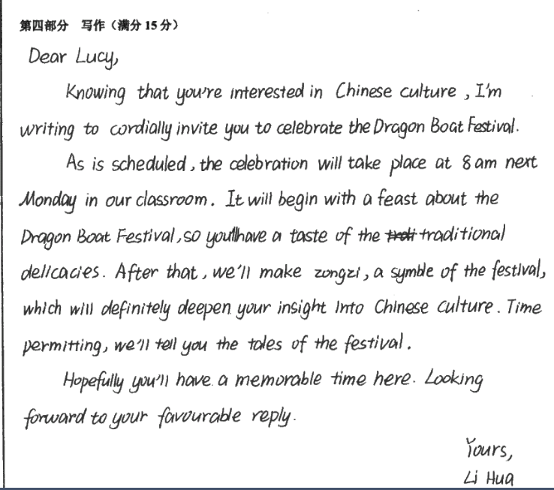
学生佳作 1

Slide 23
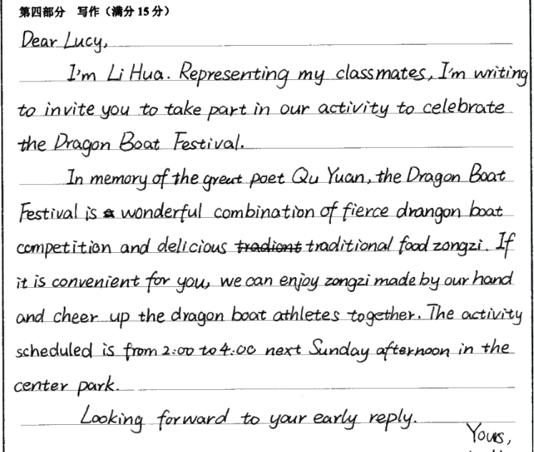
学生佳作 2

Slide 24
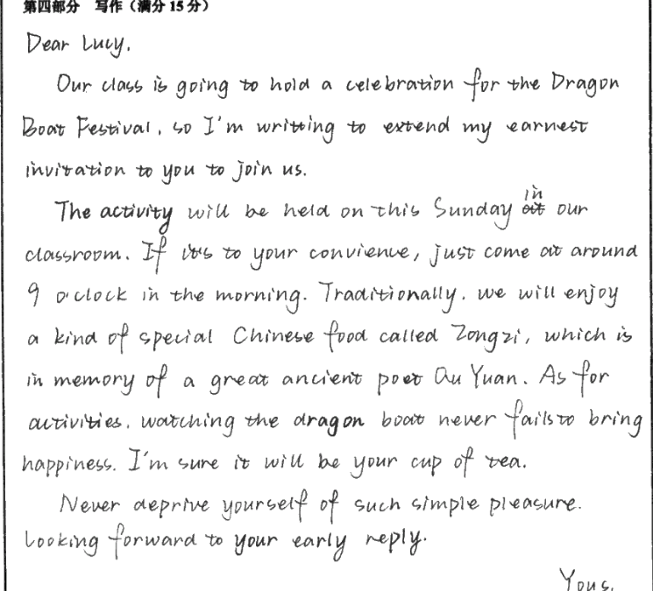
学生佳作 3

Slide 25

写作巩固训练
假定你是李华，你的留学生同学
Smith对中国传统文化很感兴趣，想要了解
端午节。请你写信向他介绍这一中国的传统节日，
包括以下要点：
(1)端午节的时间及起源（农历五月初五）；
(2) 端午节的习俗；
(3)邀请他端午节那天和你一起过节。
注意：
(1)词数100左右；
(2)可适当增加细节，以使行文连贯。

Slide 26
参考范文
Dear Smith,
Knowing that you are interested in a traditional Chinese festival,which is called Dragon Boat Festival by Chinese,I am writing to introduce it to you.
The dragon boat festival falls on the 5th day of the 5th lunar month in honor of the great poet,Qu Yuan. As is known to us, in order to warn the king, Qu yuan sacrifice his life to jump into the Miluo river. People were touched by his behavior and set the day he died as a festival to show honor to him. On that day,we often eat rice-dumplings and drink a special wine. Besides,what should be stressed is the dragon-boat racing,which is very interesting and exciting.people gather on the both sides of the river to watch the participators spare no effort to make for the finishing line.
The dragon boat festivalis approaching. Would you like to join us to spend it?
Looking forward to your coming.
Yours, Li Hua

