Slide 1

感恩遇见，相互成就，本课件资料仅供您个人参考、教学使用，严禁自行在网络传播，违者依知识产权法追究法律责任。
更多教学资源请关注
公众号：溯恩高中英语
知识产权声明

Slide 2

人教版选修7 Unit1 Living Well Reading (1)
东北师大附中朝阳学校 李秋爽

Slide 3
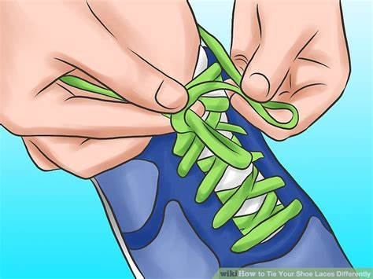
Game
Step1 Untie your shoelace!
Step2 Now, tie it with only ONE hand!
Notes:
Is it easy? Actually this is what some people have to do every day. Today, we’ll read a story of such a person whose name is Marty.

Slide 4
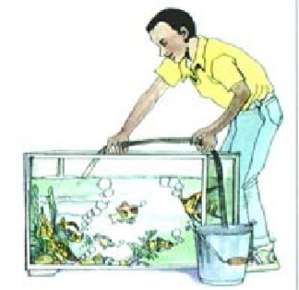
Marty’s story

Slide 5
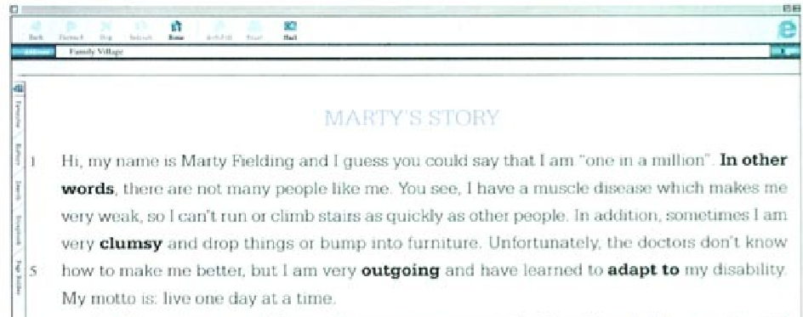
At the first glance, where probable does the passage come from?
An entry on a website.
Notes:
判断文本来源（推断题偶尔常考，类似还有 newspaper report, science fiction, advertisement, magazine article, diary，等等）

Slide 6
What genre may the passage be? What do you expect to read in the passage?
Pre-reading
请按下暂停键，思考并列在学案上。
A narrative.
…
the help he received from others.
his disability
Marty’s story
his spirit/attitude
his problem/trouble
his experiences
his feelings & thoughts
how he got disabled
Notes:
判断文体，根据标题和文体预测文本内容。

Slide 7
What can you learn about Marty from each paragraph?
While-Reading
请按下暂停键，阅读并把大意批注在书边。
Notes:
验证预测。5mins

Slide 8
Para. 1
请按下暂停键，思考并在学案上写出答案。
special; rare; different
one
Hi, my name is Marty Fielding and I guess you could say that I am "one in a million". In other words, there are not many people like me. You see, I have a muscle disease which makes me very weak, so I can't run or climb stairs as quickly as other people. In addition, sometimes I am very clumsy and drop things or bump into furniture. Unfortunately, the doctors don't know how to make me better, but I am very outgoing and have learned to adapt to my disability. My motto is: live one day at a time.
in a million
In other words
awkward; not flexible
clumsy
and
Unfortunately
but
live one day at a
time.
活在当下/珍惜每一天
Notes:
What aspects about Marty can we know from paragraph one?
What’s the meaning of one in a million?
From outgoing and adapt to, what can we see about Marty? (Attitude)

Slide 9
Para. 1
An introduction
name is Marty Fielding and I guess you could say that I am "one in a million". In other words, there are not many people like me. You see, I have a muscle disease which makes me very weak, so I can't run or climb stairs as quickly as other people. In addition, sometimes I am very clumsy and drop things or bump into furniture. Unfortunately, the doctors don't know how to make me better, but I am very outgoing and have learned to adapt to my disability. My motto is: live One day at a time.
Notes:
Can one of them summarize all the others?
We have to draw a main idea out of them.

Slide 10
Check your main ideas for Para.2-5
请按下暂停键，思考并调整书空白处的答案。
Notes:
3mins

Slide 11
Para. 2
请按下暂停键，思考并在学案上写出答案。
The development of his disease
Until I was ten years old
Until I was ten years old I was the same as everyone else. I used to climb trees, swim and play football. In fact, I used to dream about playing professional football and possibly representing my country in the World Cup. Then I started to get weaker and weaker, until I could only enjoy football from a bench at the stadium. In the end I went into hospital for medical tests. I stayed there for nearly three months. I think I had at least a billion tests, including one in which they cut out a piece of muscle from my leg and looked at it under a microscope. Even after all that, no one could give my disease a name and it is difficult to know what the future holds.
Then
In the end
what will happen in the future
after all that
what the future holds
Notes:
What can you learn about Marty here? How Marty developed the disease and how serious the disease is.
How do you understand “it is difficult to know what the future holds”?

Slide 12
Para. 3
请按下暂停键，思考并在学案上写出答案。
His problems
One problem is that I don't look any different from other people. So sometimes some children in my primary school would laugh, when I got out of breath after running a short way or had to stop and rest halfway up the stairs. Sometimes, too, I was too weak to go to school so my education suffered. Every time I returned after an absence, I felt stupid because I was behind the others.
sometimes
Sometimes, too
so
my education suffered
I had a poor performance over schoolwork.

Slide 13
Para. 4
His good life
My life is a lot easier at high school because my fellow students have accepted me. The few who cannot see the real person inside my body do not make me annoyed, and I just ignore them. All in all I have a good life. I am happy to have found many things I can do, like writing and computer programming. My ambition is to work for a firm that develops computer software when I grow up. Last year invented a computer football game and a big company has decided to buy it from me. I have a very busy life with no time to sit around feeling sorry for myself. As well as going to the movies and football matches with my friends, I spend a lot of time with my pets. I have two rabbits, a parrot, a tank full of fish and a tortoise. To look after my pets properly takes a lot of time but I find it worthwhile. I also have to do a lot of work, especially if I have been away for a while.
All in all
Generally speaking; considering everything

Slide 14
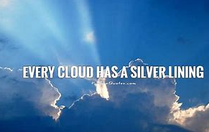
Para. 5
The “silver lining(困境中的积极乐观)” of his disease and his hope/suggestion/expectation
In many ways my disability has helped me grow stronger psychologically and become more independent. I have to work hard to live a normal life but it has been worth it. If I had a chance to say one thing to healthy children, it would be this: having a disability does not mean your life is not satisfying. So don't feel sorry for the disabled or make fun of them, and don't ignore them either. Just accept them for who they are, and give them encouragement to live as rich and full a life as you do.

Slide 15
Draw a mind map of Marty’s story. Retell Marty’s story with your mind map.
While-Reading
请按下暂停键，思考并在学案上画出导图。
introduction
The development and severity of his disease
His problems
His good life
The “silver lining” of his disease and his hope/suggestion/expectation
Notes:
Dig deeper into more details, based on these key words.

Slide 16
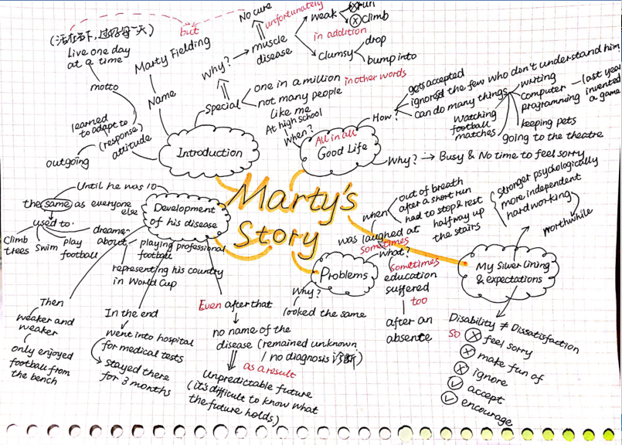

Slide 17
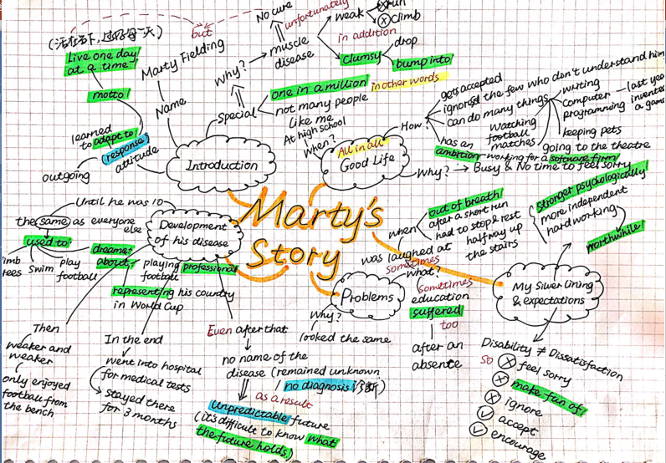

Slide 18

Assignment
Perfect your mind map to include the transitions and improve its logic.
Write a summary of Marty’s story with the help of your bettered mind map.

Slide 19
谢谢您的观看

