Slide 1

感恩遇见，相互成就，本课件资料仅供您个人参考、教学使用，严禁自行在网络传播，违者依知识产权法追究法律责任。
更多教学资源请关注
公众号：溯恩高中英语
知识产权声明

Slide 2

人教版选修7 Unit1 Living Well Reading (2)
东北师大附中朝阳学校 李秋爽

Slide 3
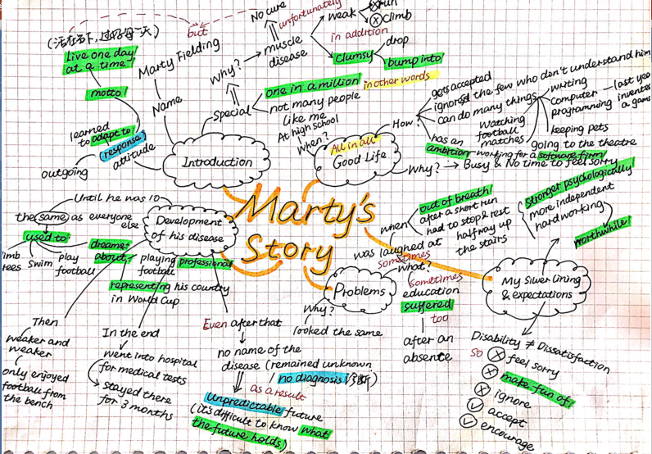
Summary Sharing Time
请按下暂停键，找到两个伙伴在线交换你们的summary。

Slide 4
What make a good summary?
请按下暂停键，思考一下吧！
1. Informative
2. Accurate
3. Coherent
4. Well-organized

Slide 5
Marty, a disabled young boy _________ a special muscle disease, has learned to adapt to his ______________(disable). With the motto: live a day at a time, this outgoing teenager is living a good life, busy with all kinds of hobbies. In spite of the fact that he can be clumsy and bump into things, he managed ______________ (invent)a computer game last year and now his ___________(ambitious) is to work for a software firm.
However, this didn’t come easy. He used to be normal before ten. Then he gradually became so weak _____________ he could only watch football from a bench. Finally he had to give up his dream of ____________(play) professional football and representing his country in World Cup. After a billion tests, no diagnosis could ____________ (give). He didn’t know ____________ the future held. His classmates would laugh at him for being out of breath after a short run. In addition, his education suffered as well.
After struggle and hard work, he is now accepted and is stronger ___________________ (psychological) and more independent. He expects others to stop feeling sorry, making fun of or ignoring the disabled. ____________, he hopes that people accept them as who they are and encourage them.
with
disability
to invent
ambition
that
playing
be given
what
psychologically
Instead

Slide 6
In what order does Marty develop his story?
While-Reading
请按下暂停键，完成学案上的相应任务吧
What happened and how did/does he feel at each point?
In time order
carefree
happy
satisfied
hopeful
fulfilled
happy
hopeful
optimistic
Before ten
Then
In the end
in the primary school years to follow
in the high school
the same as others
weaker and weaker
went into hospital; medical test;
no result
good life
is accepted; ignore
able to do many things
ambition
busy life
hobbies
dream about
was laughed at
education suffered
terrible
afraid
annoyed
humiliated
shameful
uneasy
bored;
hopeless;
desperate

Slide 7
What qualities of Marty do you see?
While-Reading
请按下暂停键，完成学案上的相应任务吧
tough(strong-willed, resilient); brave; courageous; passionate; diligent; independent; tolerant; positive; enthusiastic; caring and loving; determined; ambitious
carefree
happy
satisfied
hopeful
fulfilled
happy
hopeful
optimistic
Before ten
Then
In the end
in the primary school years to follow
in the high school
the same as others
weaker and weaker
went into hospital; medical test;
no result
good life
is accepted; ignore
able to do many things
ambition
busy life
hobbies
dream about
was laughed at
education suffered
terrible
afraid
annoyed
humiliated
shameful
uneasy
bored;
hopeless;
desperate

Slide 8
What lessons can we draw from Marty’s story?
Post-Reading
请按下暂停键，完成学案上的相应任务吧
tough(strong-willed, resilient); brave; courageous; passionate; diligent; independent; tolerant; positive; enthusiastic; caring and loving; determined; ambitious
carefree
happy
satisfied
hopeful
fulfilled
happy
hopeful
optimistic
Before ten
Then
In the end
in the primary school years to follow
in the high school
the same as others
weaker and weaker
went into hospital; medical test;
no result
good life
is accepted; ignore
able to do many things
ambition
busy life
hobbies
dream about
was laughed at
education suffered
terrible
afraid
annoyed
humiliated
shameful
uneasy
bored;
hopeless;
desperate
Life is never a bed of roses, ups and downs along the way. When in trouble, we are supposed to stay optimistic and seek for our own silver linings.

Slide 9
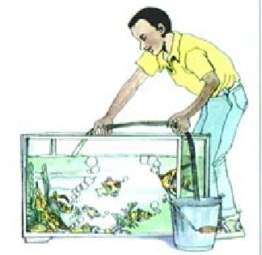
请按下暂停键，完成学案上的相应任务吧
Post-reading
Create another title for the passage!
My Silver Lining

Slide 10
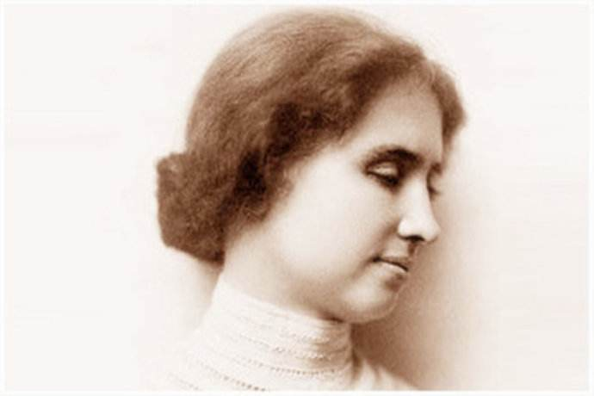
We should never learn to be brave and patient if there were only joys in the world. Although the world is full of suffering, it’s also full of the overcoming of it.
——Helen Keller
Notes:
Everything that downs me makes me wanna fly ------Counting Stars.

Slide 11
谢谢您的观看

