Slide 1

知识产权声明
感恩遇见，相互成就，本课件资料仅供您个人参考、教学使用，严禁自行在网络传播，违者依知识产权法追究法律责任。
更多教学资源请关注
公众号：溯恩高中英语

Slide 2
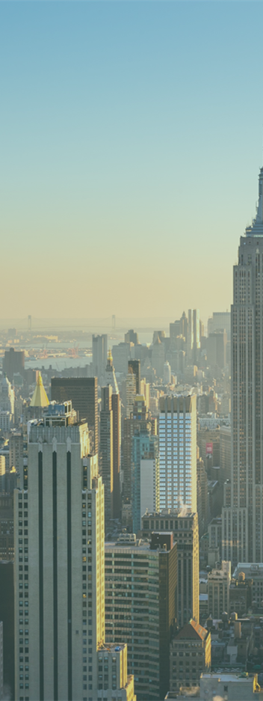
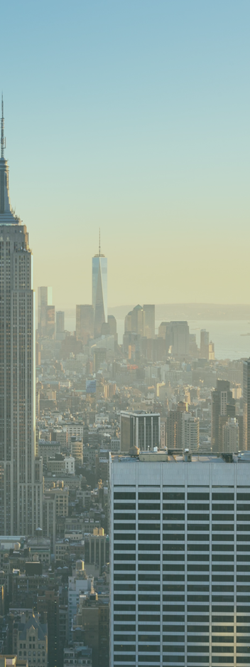

Buzzwords & Pun-demic
浙江省台州市第一中学 周媚 董妮娅
南京理工大学紫金学院 马梦晓

Slide 4
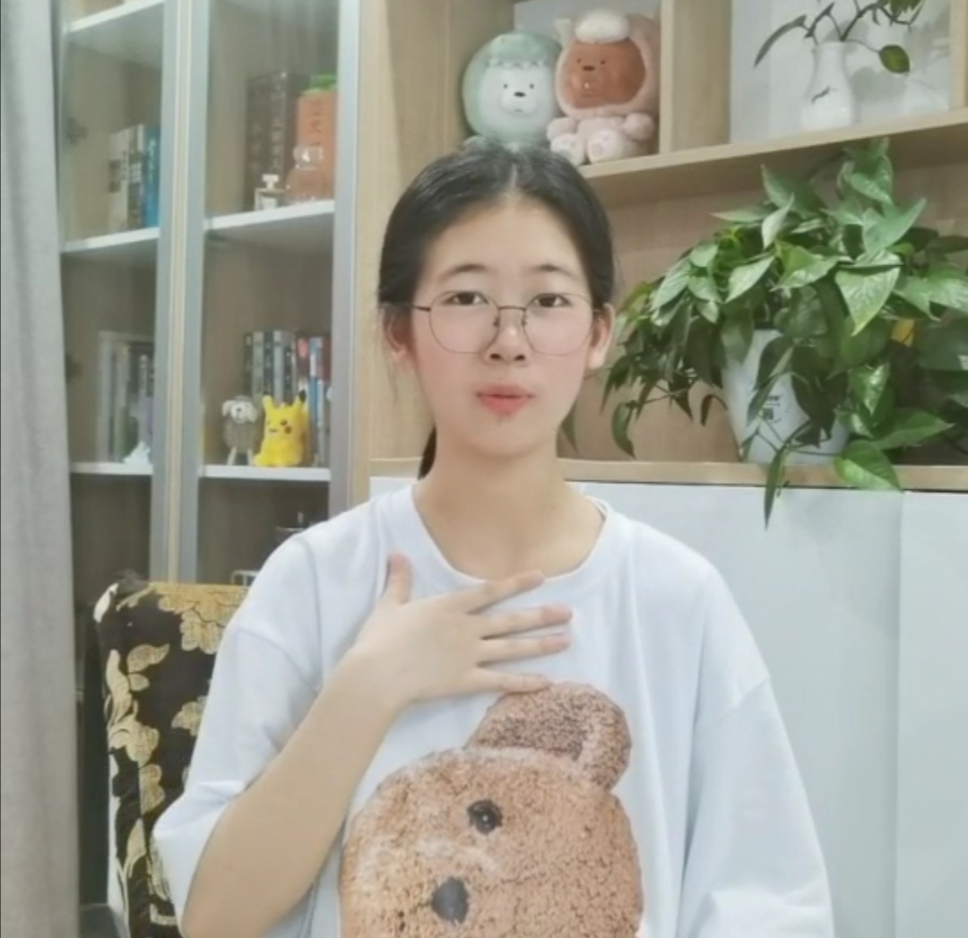
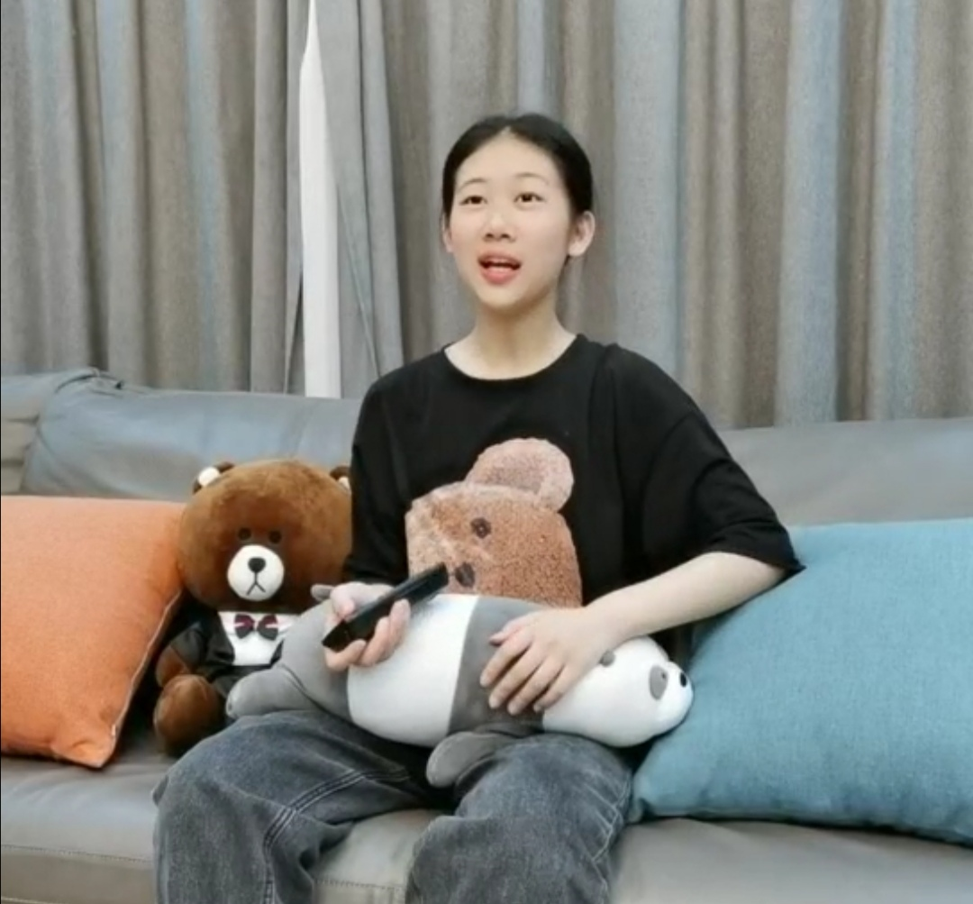
Rona visited her “past self”
to warn about Covid-19
Now
Jan 2020
girl?
Rona
virus!
Notes:
January , 2020 Rona turned on the TV, and was amazed to see Rona in the screen.

Slide 5

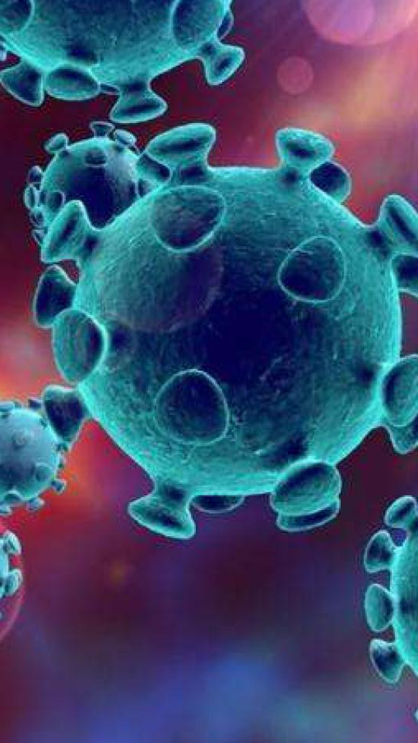
Fill in the blanks with the proper form of the given words by adding a prefix or suffix.
informal
Rona is an __________ (formal) shortening of coronavirus. Coronavirus is popularly shortened to corona, which was obviously further cut down to rona.
Rona is often used as a playful way to refer to COVID-19, especially when commenting on __________ (humor) challenges of social distancing during the pandemic. However, it is generally not used when it comes to very serious loss and panic COVID-19 has caused. Nor is it meant to ____________ (estimate) the life-saving service of so many essential workers. Some people __________ (person) the virus as Miss Rona or Aunt Rona. For example, oh my God! Homeschooling my kids during the rona ends up in a lot of TV programmes and computer games.
humorous
underestimate
personify
（拟人化）
(inappropriate, inaccurate)
in-: -ous:
under-: -fy:
not
adj.
(courageous, dangerous)
below
(underground, underline)
v.
(beautify, simplify)

Slide 6
Buzzwords
a word or expression that has become fashionable in a particular field and is being used a lot by the media

Slide 7
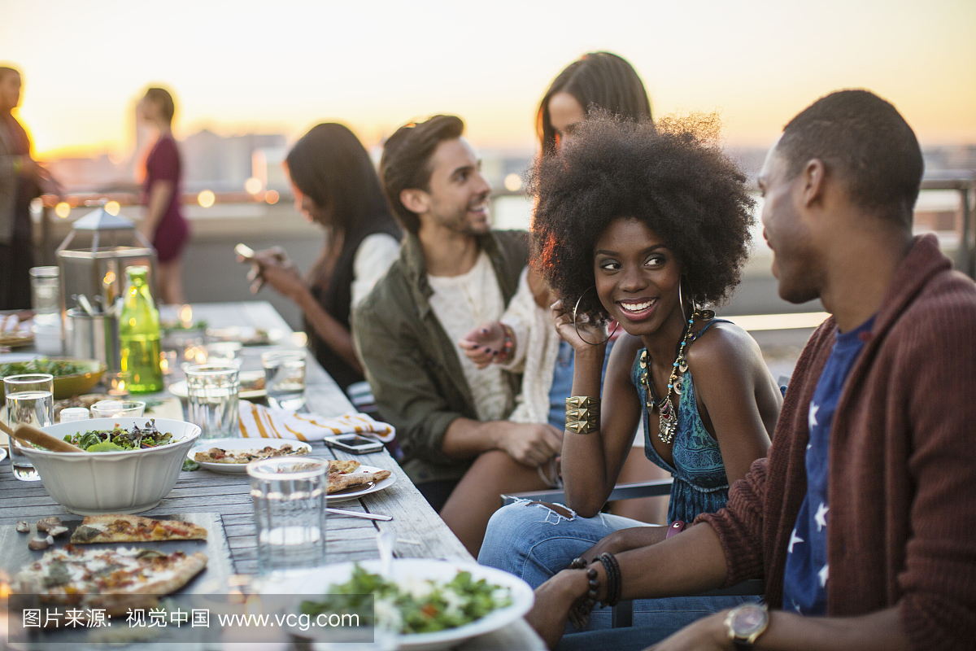
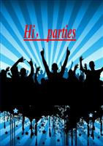
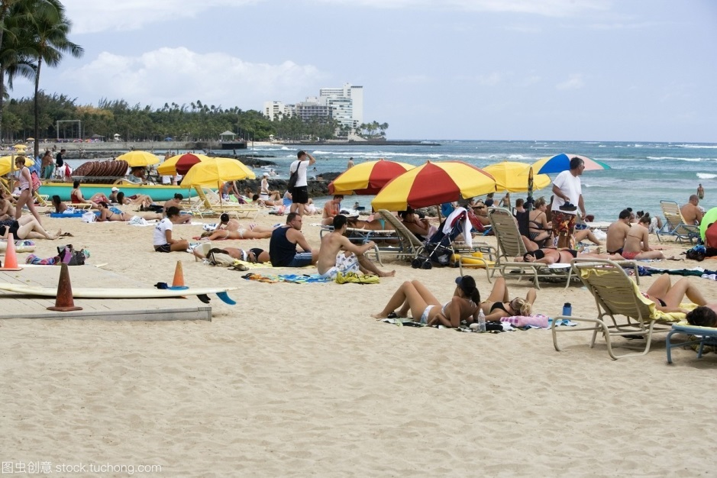
covidiot
Covidiot is a combination of _______ and _______.
covid-19
idiot
Let Rona go to hell! Let’s go to the party!
On memorial Day (the last Monday in May), Americans flocked to beaches and lakes.
In Florida, hundreds of people gathered in Daytona Beach without permission.
In Missouri, bars were packed with merrymakers, who violated social-distancing rules.
It’s irresponsible and dangerous to engage in such high risk behavior just to have some fun over the holiday weekend.
What covidiots!
Let’s go to the beach! Nothing can stop us having fun.
synonyms
violated
=break/go against
A stupid person who stubbornly _________(无视) 'social distancing policy', thus helping to further spread COVID-19
ignores
Notes:
Americans, especially the young, think highly of their party culture. Nothing can stop them from having the party even during the covid-19 pandemic.

Slide 8
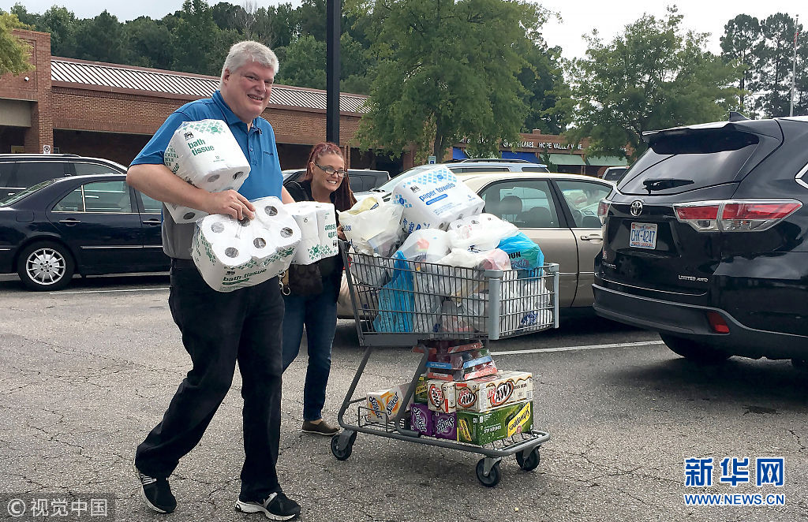
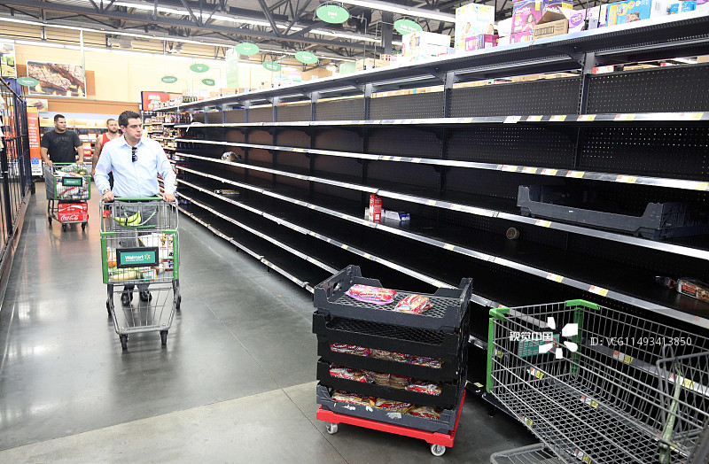
covidiot
Covidiot is a combination of _______ and _______.
covid-19
idiot
Oh! There is nothing left!
A stupid person who ______________________ (储存) groceries needlessly, thus spreading covid-19 fears and depriving others of vital supplies.
Let’ buy buy buy!
stores/stockpiles/hoards
Why do foreigners buy so many tissue papers?
Every time some one coughs, 10 people shit their pants.
empty the shelves
一有人咳嗽（新冠），周围10个人被吓到尿裤子。
panic buying

Slide 9
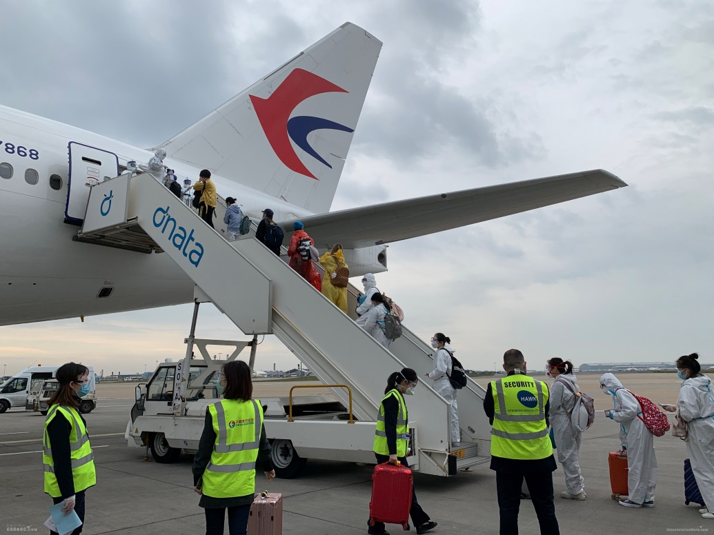
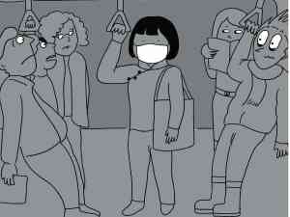
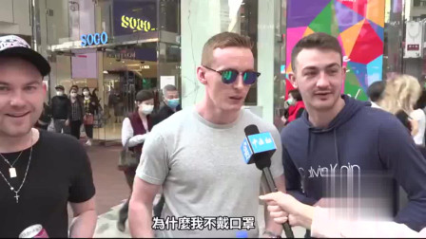
maskaphobia
口罩恐惧症
Maskaphobia refers to the fear of
① wearing face masks
②racists targeting Chinese people wearing face masks in the coronavirus crisis.
Chinese students at UK universities are “______________ (逃离) back to China”
because they are concerned about
①the British government‘s handling of the spread of the virus
②an increase in racist attacks caused by so-called maskaphobia.
fleeing/escaping
Who wears the face masks? Only the patient does!
Look at that Chinese wearing the face mask, the virus spreader!
The Chinese airline takes Chinese students studying in the UK back to China.

Slide 10
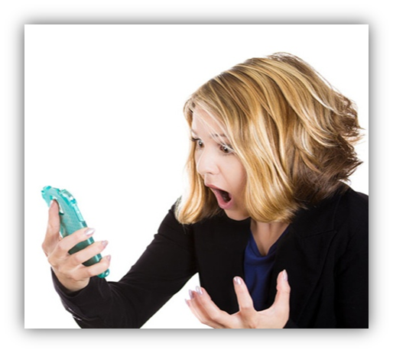
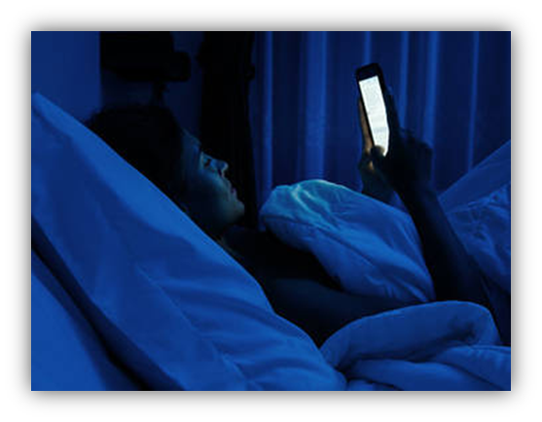
doomscrolling
=doomsurfing
Fill in the blanks with the given words, changing the form if necessary.
feel scan tear put erase stay
Doom-scrolling Life under the rona has meant that it’s even harder to ______ our eyes away from our phones and computers, constantly _______ for the latest news about the pandemic.
Scrolling refers to scrolling down on our smartphones for the latest posts on social media. And as for “doom”, a lot of the news we’re seeing online ______ full of depression and death.
As a New Yorker ______ it in her dairy, I ______ up to 2 a.m. last night doom-scrolling about coronavirus news in my state, pushing myself to the point of physical discomfort and _______ any hope of a good night's sleep.
tear
scanning
feels
put
stayed
erasing

Slide 11

coronacation
Coronacation is from coronavirus-compelled(强制的) staycations, due to cancelled classes, shifts, and the like. It’s usually an ironic term. As for the parents working from home while teaching their kids, they must have _________________________ (对…有了解) the term. Just as a mother puts it, my teen thinks a coronacation means less school work , more relaxation and entertainment. Oh, he will know he is completely wrong when he sees how I am going to _________________ (使他忙于) all kinds of learning resources.
had a good understanding of
had a good insight into
keep him busy with
=busy(vt.) himself with
keep him occupied with
keep him engaged in

Slide 12
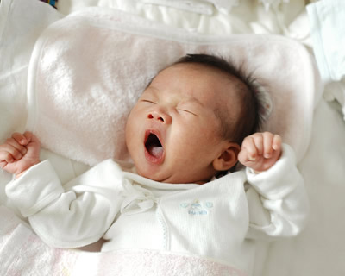
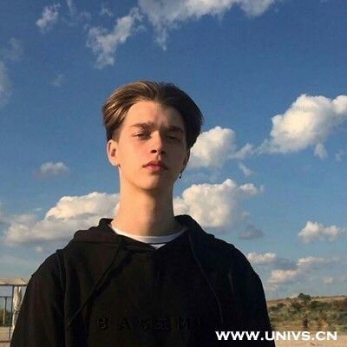
coronennial
Coronennial refers to either a baby or a member of the generation.
Coronennial refers to either a baby who is born during the Covid-19 Pandemic or a member of the generation who reach adulthood around Covid-19 Pandemic.
the millennial generation
千禧世代
the persons who were born in the last two decades of the 20th century (from 1980 to 1999), also regarded as the Y generation, for they are children of the X generation who were born just after the Second World War.
Notes:
People tend to use –generation to call persons who were born in a certain period.

Slide 13
coronennial
Is the baby boom coming?
Any time people __________ (stick) at home for disasters and lockdowns, the guess seems to start: Will there be a baby boom in nine months? This time, with quarantine orders ________ (keep) millions of people inside to slow ________ spread of the coronavirus, the answer is clear: Don’t expect a lot of newborns in the next year.
That may disappoint those ________ are worried about the United States’ declined birthrate. But the truth is that the coronavirus will ________ (probable) give couples even more causes not to have children. Since the outbreak in America, nearly 10 million Americans __________ (lose) their jobs, with more ________ (loss) expected. Some couples say, “If you’re running ________ your life, you’re not making babies.”
are stuck
keeping
the
who
probably
have lost
losses
for
Notes:
People tend to use –generation to call persons who were born in a certain period.

Slide 14
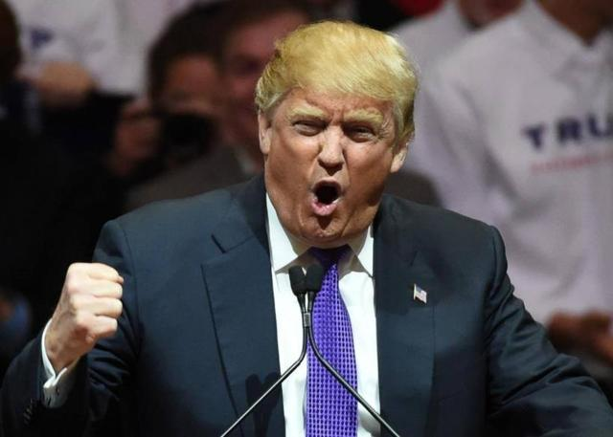

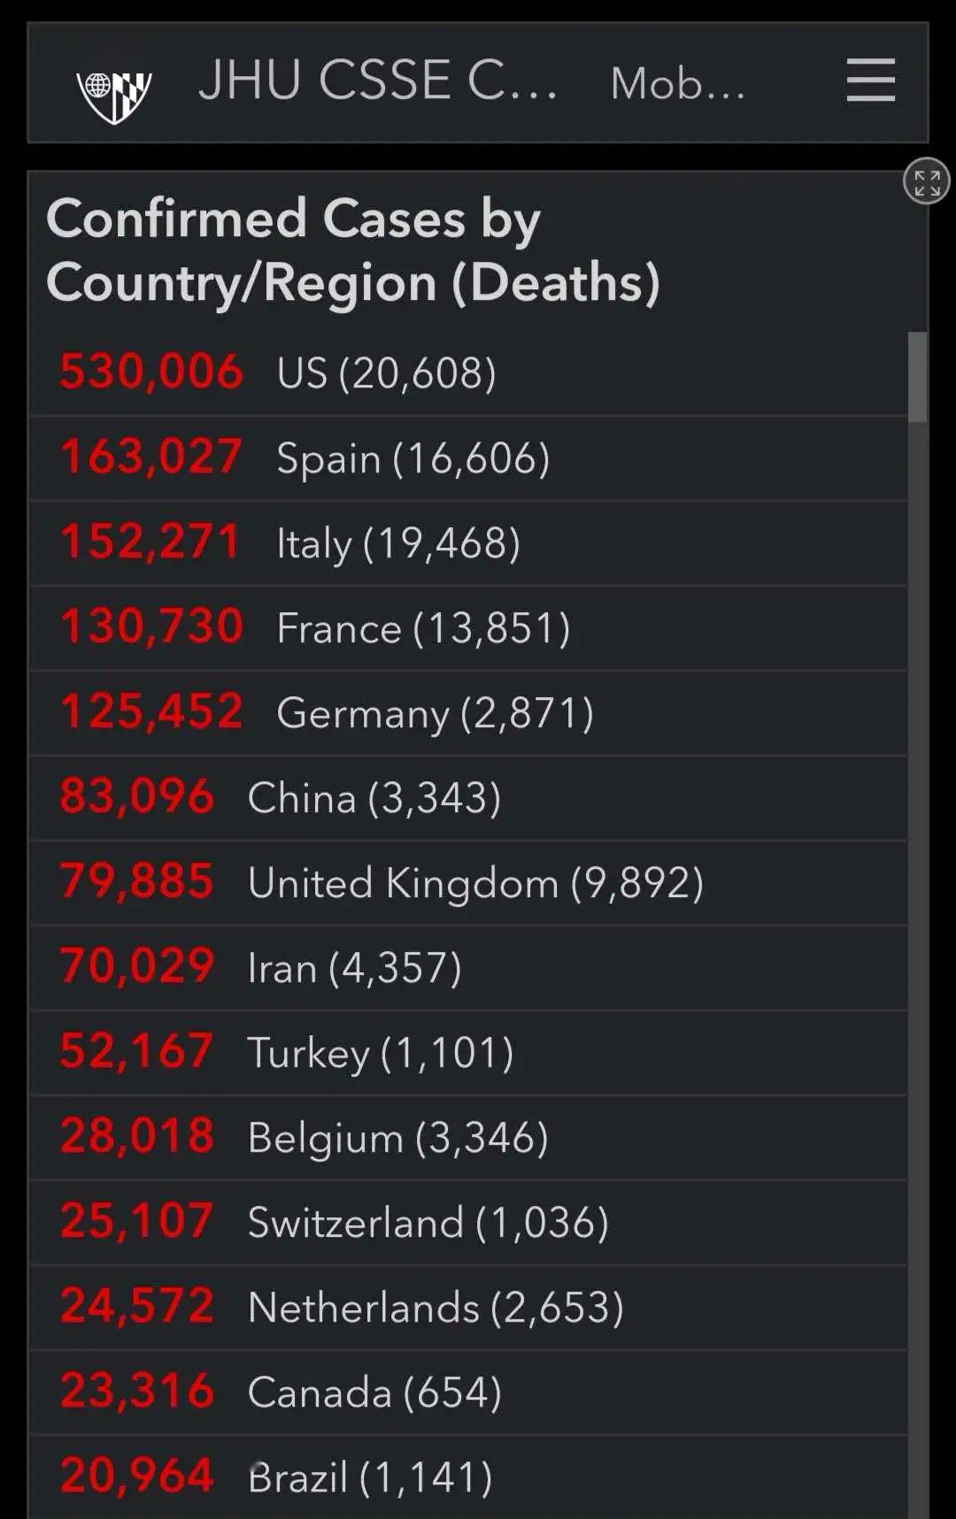
The current situation of the pandemic in America
The number of the confirmed cases and deaths is still increasing in America.
Who is to blame?
Many foreigners, including President Trump call the virus Chinese virus or Wuhan virus.
The United States will be powerfully supporting those industries that are particularly affected by the Chinese Virus.
Funny Mud Pee
A curse Chinglish phrase created by Chinese social media users to show anger of the Chinese

Slide 15
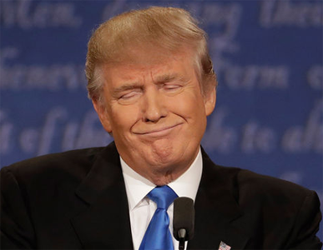
Trump has two parts of brains, “left” and “right”.
In the left side, there’s nothing ______.
In the right side, there’s nothing ______.
right
left

Slide 16
Pun-demic

Slide 17
Where does the word come from?
A man called Graeme Parsons is using humor to boost spirits in his neighborhood during the COVID-19 pandemic. He writes a new joke on a big whiteboard every day, and sets the board up at the end of his driveway for people to see as they walk, bike or drive by. “There’s enough negative news going on, and so much fear in the world right now,” Parsons said. “I just try to figure out something that’s going to brighten people’s days, make them laugh because they’re all good jokes.” He calls it a “pun-demic” board.
Why did Greame Parsons create the word pun-demic ?
He is using humor to boost people’s spirits and brighten their days.

Slide 18
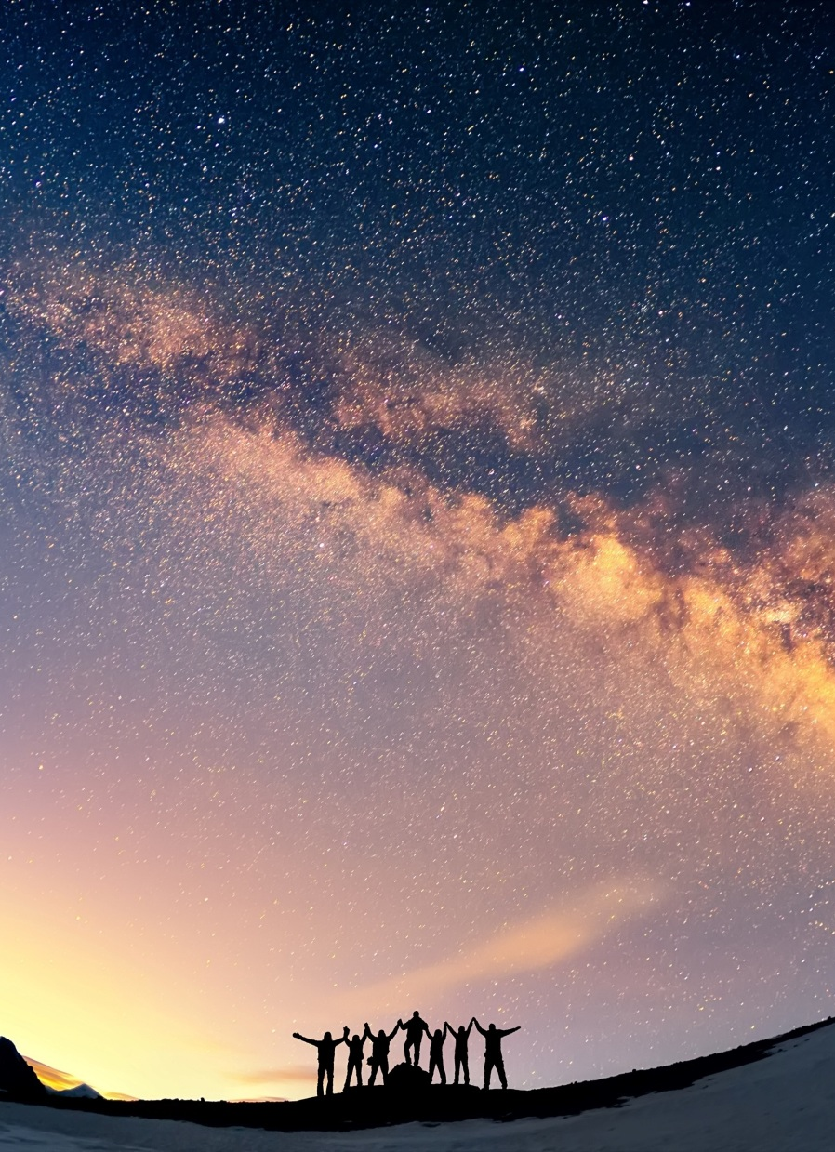
Pun-demic
01
Advertisement
02
Public sign
03
Joke

Slide 19
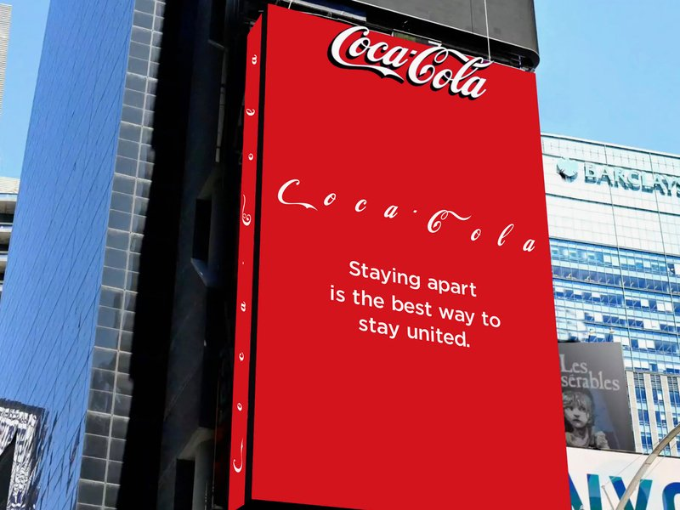
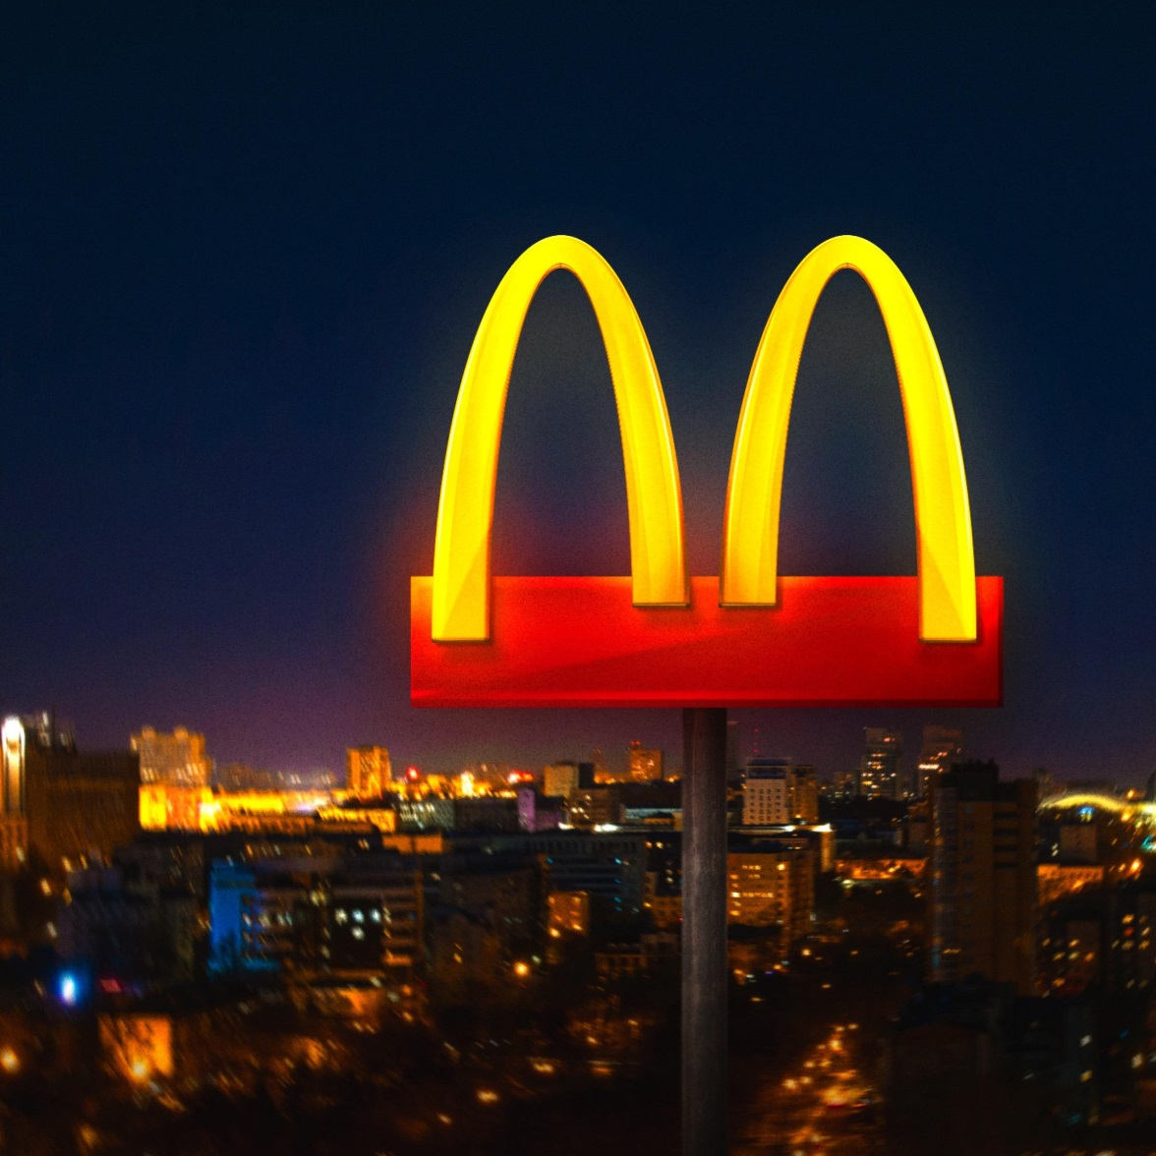
Advertisement
The Coca-Cola and McDonald’s signs are normally connected letters. Now the letters spread apart, with the tag line saying “Staying ______ is the best way to stay ________________.”
apart
united/connected
Notes:
Coca-Cola has changed its ad that is featured on its Times Square billboard

Slide 20
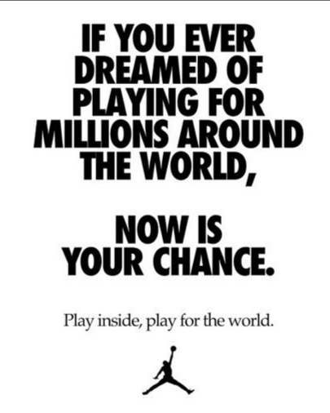
Advertisement
Nike also is promoting social distancing. It has released a new advertisement that focuses on staying apart, saying, “If you ever dreamed of playing for millions around the world, now is your chance. Play inside, play for the world.”
How do you understand the underlined sentence?
Staying inside is just your contribution to the world.

Slide 21
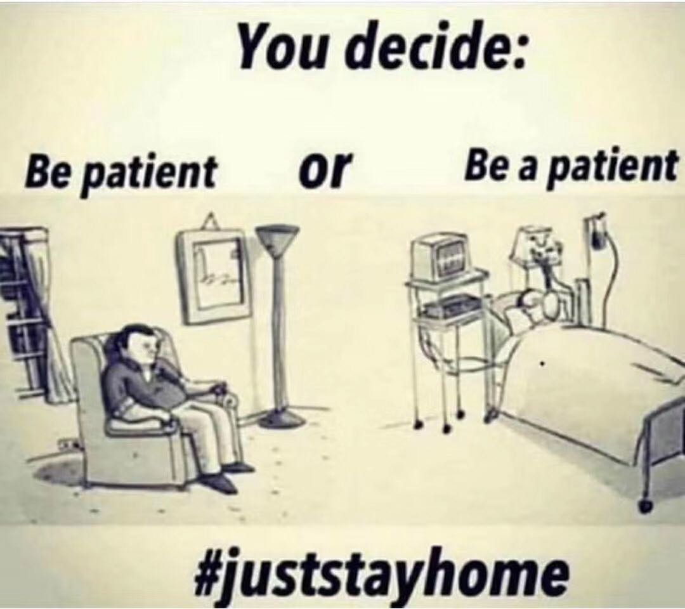

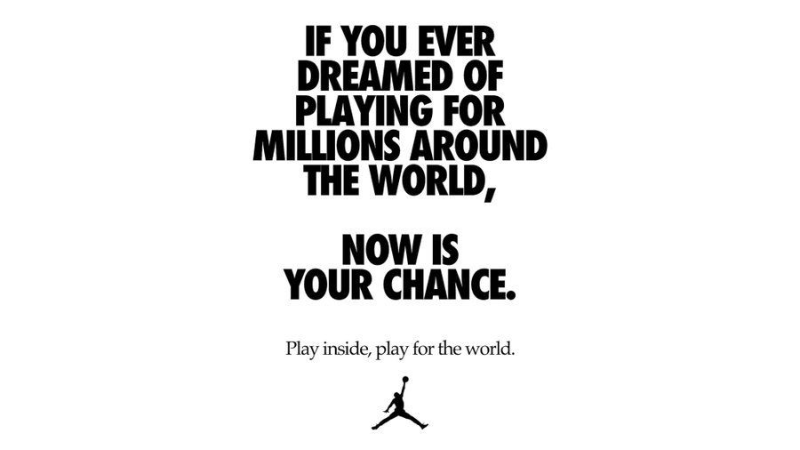
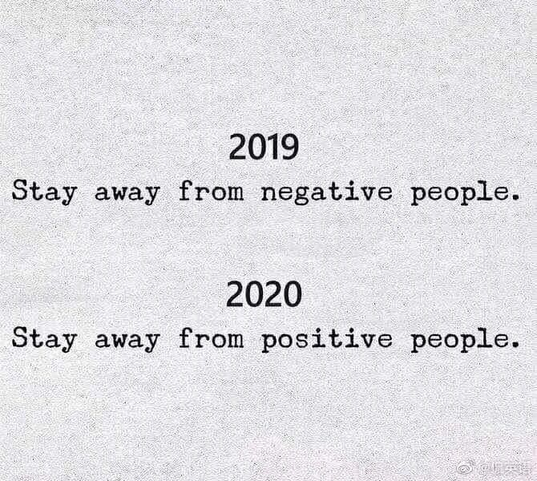
Public Sign
(隔离)
Quarantine, no human right.
No quarantine, no human left.

Slide 22
Public Sign
Avoid touching MEN to stop the spread of Covid-19.
M-
E-
N-
Follow WOMEN
to prevent Covid-19.
W-
O-
M-
E-
N-
Wear masks properly
Mouth
Obey social distancing
Eye
Make sure to wash hands frequently
Nose
Exercise regularly
Never ignore above four rules

Slide 23
Joke
Lockdown MAY END by MAY END or MAY NOT END by MAY END as it May EXTEND. But MAY will END by MAY END even if lockdown MAY NOT END.
People keep asking me, “Is Covid-19 really that serous?” “Listen! The casinos(赌场) and the churches are closed. When Heaven and Hell agree on the same thing, it’s probably pretty serious.”
Does “MAY END” mean the same?
What does Heaven and Hell refer to?
What do they agree on?

Slide 24
Joke
―What do you tell yourself when you wake up late for work and realize you have a fever?
― Self, I so late.
0 1
(self-isolate)
0 2
― Why do they call it the novel coronavirus?
― It’s a ____________….
long story
0 3
― Finland just closed its borders. You know what that means.
― No one will be crossing ______________.
the finish line

Slide 25
The Covid-19 pandemic has brought so much depression. But what can’t be forgotten is to enjoy life through hardship.
May we all have fun!

Slide 26
THANKS

