Slide 1

感恩遇见，相互成就，本课件资料仅供您个人参考、教学使用，严禁自行在网络传播，违者依知识产权法追究法律责任。
更多教学资源请关注
公众号：溯恩高中英语
知识产权声明

Slide 2
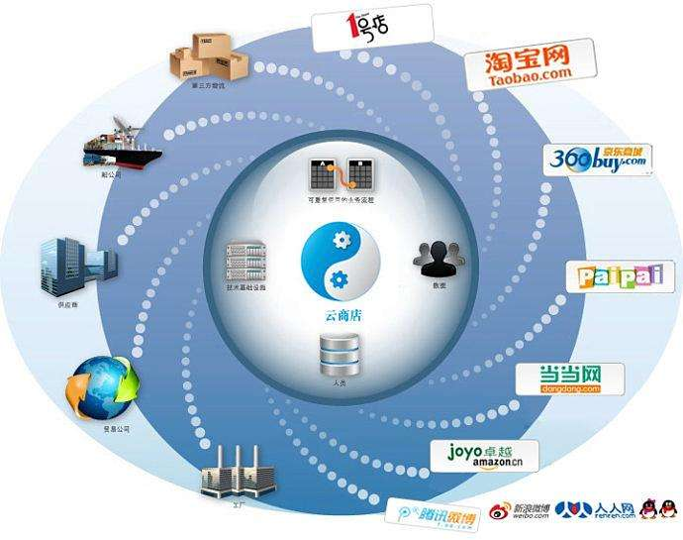
2020年5月名校协作概要
农村电子经济

Slide 3


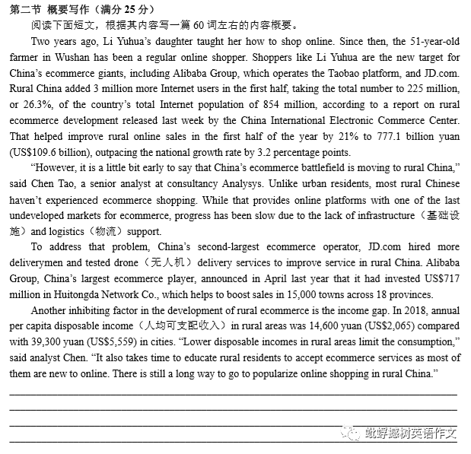

Slide 4
概要写作疑难点
如何进行概要写作改写句子
如何用自己的语言来概写句子

Slide 5
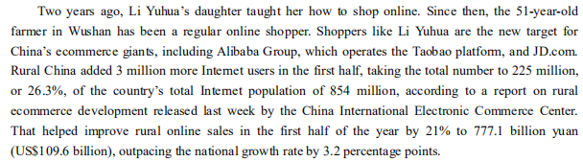
Part 1
key words
introduction
rural online shopping increases quickly / sharply
the number of rural online shoppers/ users is increasing/ rising

Slide 6
要点1
有效整合信息，删除无用细节
China's ecommerce giants, JD and Alibaba, are competing for rural market, as the growing rural Internet population boosts online sales.
The growth of rural Internet users boosts online sales, causing the ecommerce giants' fierce competition.
The number of Internet users in rural China has increased sharply, which contributes to boosting rural online sales.
Currently, China's ecommerce giants set foot on the rural areas, which makes the online sales there delevop rapidly.

Slide 7
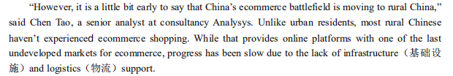
Part 2
key sentences

Slide 8
同义词替换 however
nevertheless ; whereas
同义词替换 due to
owing to, as a result of
contribute to; give rise to ; lead to; result in;
result from; lie in...
同义词替换 the lack of
insufficient
lacking
for lack of
the shortage of
同义词替换 slow progress
slow ...down; develop slowly
stop/ prevent ...from doing...quickly...

Slide 9
要点2
理清逻辑关系，注意转折、解析信息
However, lacking necessary infrastructure and logistic support, rural China market develops slowly.
The lack of online shopping experience, infrastructure and logistic supports lead to the slow progress of rural ecommerce marketing.
Nevertheless, the shortage of infrastructure and logistic support contibutes to slowing down the rural online sales.
For lack of infrastructure and logistic support, rural China ecommerce market develops slowly.
However, insufficient infrastructure and logistic support stops/ prevents rural China ecommerce market developing quickly.

Slide 10

Part 3
to handle/ solve/ tackle the problem
measures
increase/improve/ promote
investment
要点3: 紧扣要点，转换句型
To tackle that problem, relevant measures are taken to promote rural online sales, including more deliverymen, tested drones and investment.
The giants adopt various measures to solve the problem, including more financial investment, deliverymen involvement, and drone delivery tests.

Slide 11
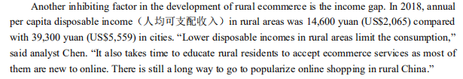
Part 4
another barrier
example
合理处理要点中的例子，例子可以一笔带过，如要点1中的JD和Alibaba,以及要点3中的deliverymen, tested drones and investment。但是要点4中的例子可以不提。

Slide 12
要点4 一句多译，多元组合
The future remains uncertain due to the comparatively low income and unpopular online shopping in rural area.
Another barrier is the income gap and people's insufficient knowledge of it. Thus, it's still challenging to boost rural online shopping.
Still, there remains much to be done, considering the low income and the time needed to generalize online shopping in rural areas.
Besides, low income and unpopular online shopping in rural area are also barriers. Therefore, popularizing online sales still needs more endeavours.

Slide 13
参考范文
China's ecommerce giants, JD and Alibaba, are competing for rural market, as the growing rural Internet population boosts online sales.(要点①) However, lacking necessary infrastructure and logistic support, rural China market develops slowly. (要点②) To handle that problem, relevant measures are taken to promote service and sales, including more deliverymen, tested drones and investment. (要点③) Still, there remains much to be done, considering the low income and the time needed to generalize online shopping in rural areas. (要点④)

Slide 14
Samples from students

Slide 15
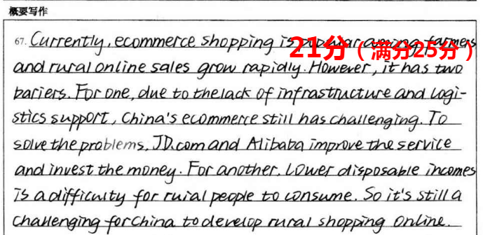

Slide 16
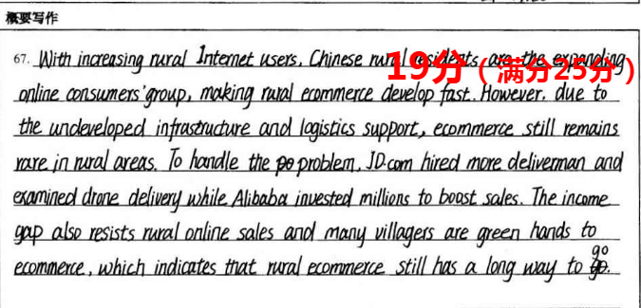

Slide 17
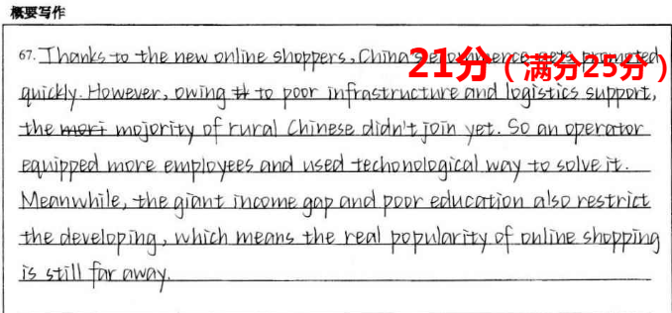

Slide 18
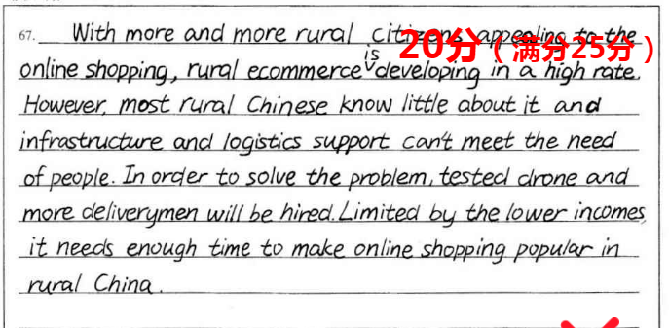

Slide 19
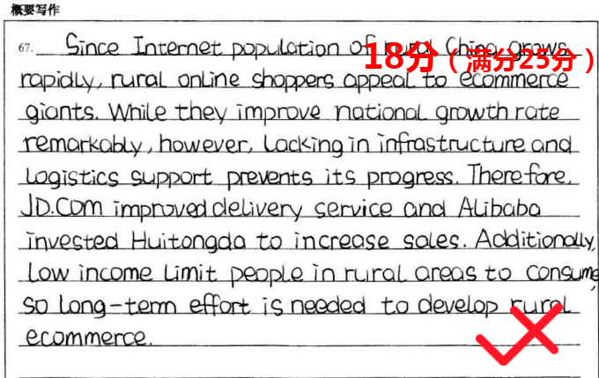

Slide 20
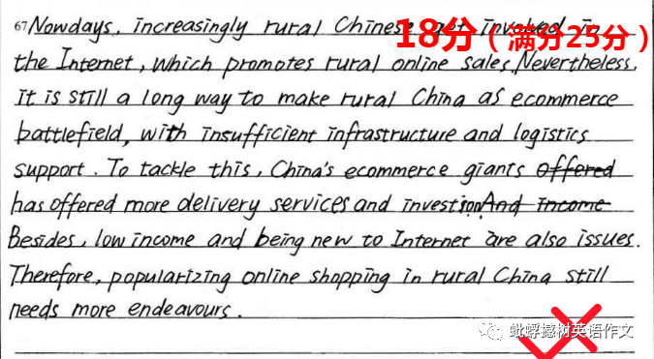

Slide 21
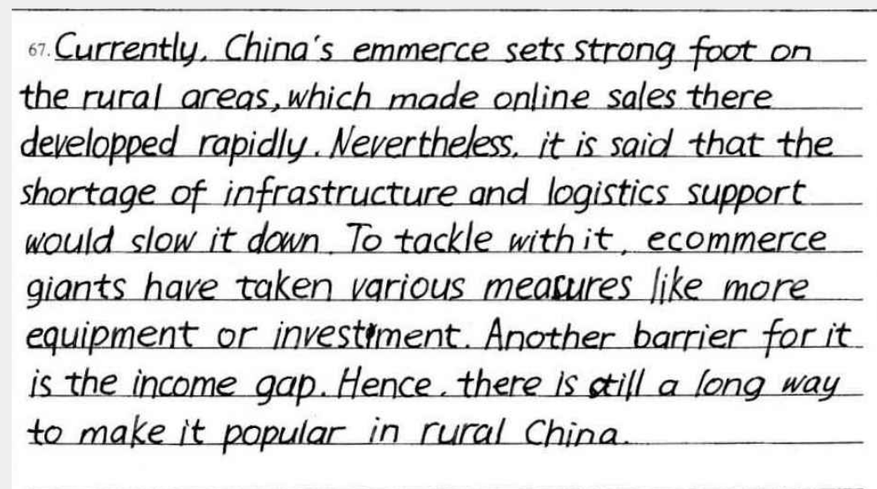

Slide 22
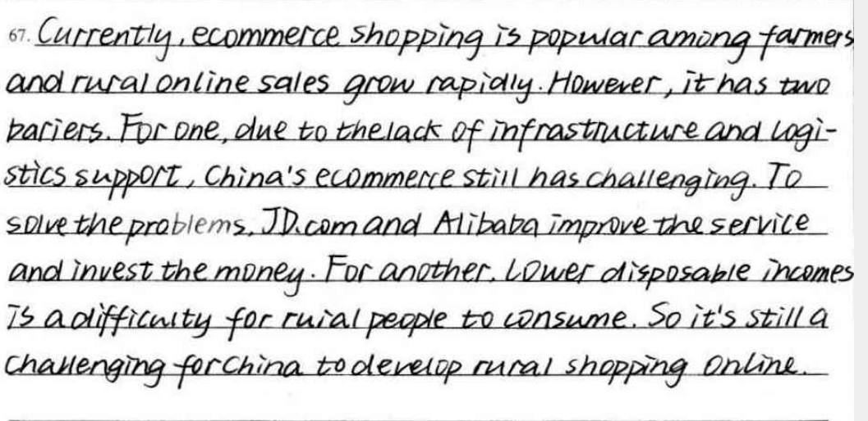

Slide 23

Better your summary and enjoy it.

