Slide 1

感恩遇见，相互成就，本课件资料仅供您个人参考、教学使用，严禁自行在网络传播，违者依知识产权法追究法律责任。
更多教学资源请关注
公众号：溯恩高中英语
知识产权声明

Slide 2
2020年5月名校协作体
概要写作考场作文高分揭秘
桐乡市高级中学
冯燕娜

Slide 3

1
Summary Exercise
2
Possible Version
Contents
3
Impressive Work
4
Expression Focus

Slide 4
1
Summary Exercise

Slide 5
第二节 概要写作（满分 25 分）
阅读下面短文，根据其内容写一篇 60 词左右的内容概要。
Two years ago, Li Yuhua’s daughter taught her how to shop online. Since then, the 51-year-old farmer in Wushan has been a regular online shopper. Shoppers like Li Yuhua are the new target for China's ecommerce giants, including Alibaba Group, which operates the Taobao platform, and JD.com. Rural China added 3 million more Internet users in the first half, taking the total number to 225 million, or 26.3%, of the country's total Internet population of 854 million, according to a report on rural ecommerce development released last week by the China International Electronic Commerce Center. That helped improve rural online sales in the first half of the year by 21% to 777.1 billion yuan (US$109.6 billion), outpacing the national growth rate by 3.2 percentage points.

Slide 6
“However, it is a little bit early to say that China’s ecommerce battlefield is moving to rural China,”said Chen Tao, a senior analyst at consultancy Analysys. Unlike urban residents, most rural Chinese haven't experienced ecommerce shopping. While that provides online platforms with one of the last undeveloped markets for ecommerce, progress has been slow due to the lack of infrastructure（基础设施）and logistics（物流）support.
To address that problem, China’s second-largest ecommerce operator, JD.com hired more deliverymen and tested drone（ 无人机） delivery services to improve service in rural China. Alibaba Group, China's largest ecommerce player, announced in April last year that it had invested US$717 million in Huitongda Network Co., which helps to boost sales in 15,000 towns across 18 provinces.

Slide 7
Another inhibiting factor in the development of rural ecommerce is the income gap. In 2018, annual per capita disposable income（人均可支配收入）in rural areas was 14,600 yuan (US$2,065) compared with 39,300 yuan (US$5,559) in cities. “Lower disposable incomes in rural areas limit the consumption,” said analyst Chen. “It also takes time to educate rural residents to accept ecommerce services as most of them are new to online. There is still a long way to go to popularize online shopping in rural China.”
344 words

Slide 8
2
Possible Version

Slide 9
China's ecommerce giants, JD and Alibaba, are competing for rural market, as the growing rural Internet population boosts online sales. (要点1) However, lacking necessary infrastructure and logistic support, rural China market develops slowly. （要点2）To handle that problem, relevant measures are taken respectively to promote service and sales.（要点3） Still, there remains much to be done, considering the low income and the time needed to generalize online shopping in rural areas. (要点4)
70 words

Slide 10
3
Impressive Work

Slide 11
概要写作题型
  提供一篇350词以内的短文，要求考生基于该短文写出一篇60词左右的内容概要。(所选材料体裁没有限制，以说明文、议论文和记叙文为主)
评分原则
  1.本题总分为25分，按5个档次给分。
  2.评分时，先根据所写概要的内容和语言初步确定其所属档次，然后以该档次的要求来衡量、确定或调整档次，最后给分。
  3.词数少于40和多于80的，从总分中减去2分。
  4.评分时，应主要从以下四个方面考虑:
    (1 )对原文要点的理解和呈现情况;
    (2)应用语法结构和词汇的准确性;
    (3)上下文的连贯性;
    (4)对各要点表达的独立性情况。
  5.拼写与标点符号是语言准确性的一个重要方面，评分时，应视其对交际的影响程度予以考虑。
  6.如书写较差以致影响交际，可将分数降低一个档次。

Slide 12
各档次的给分范围和要求 档次[高分参照标准]
档次 | 描述
第五档 （21——25） | ——理解准确，涵盖全部要点。 ——能准确使用相应的语法结构和词汇。 ——有效地使用了语句间连接成分，使所完成的概要结构紧凑。 ——完全使用自己的语言。
第四档 （16——20） | ——理解准确，涵盖绝大部分要点。 ——所使用语法结构和词汇可能有些许错误，但完全不影响意义表达。 ——比较有效地使用了语句间的连接成分，使所完成的概要结构紧凑。 ——有个别整句抄自原文。

Slide 13


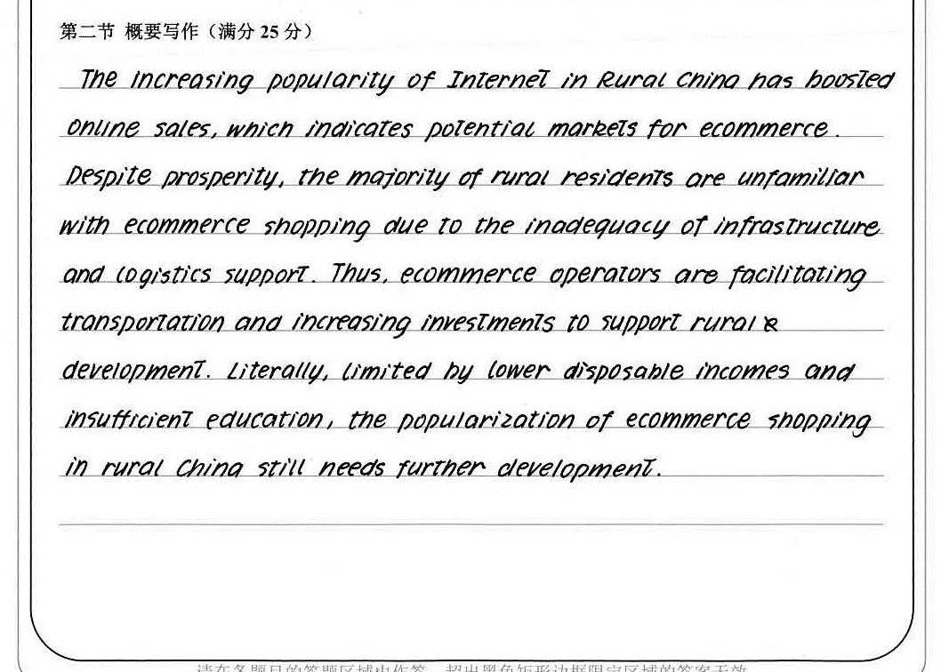
高分揭秘
理解准确，涵盖全部要点。
高级表达：boost, indicate, potential, prosperity, resident, inadequancy, facilitate
高级句型：…which indicates potential markts…(定语从句); limited by …, (非谓语作状语）
衔接：despite (让步); thus(因果); literally(强调)
得分：22.5
73 words

Slide 14
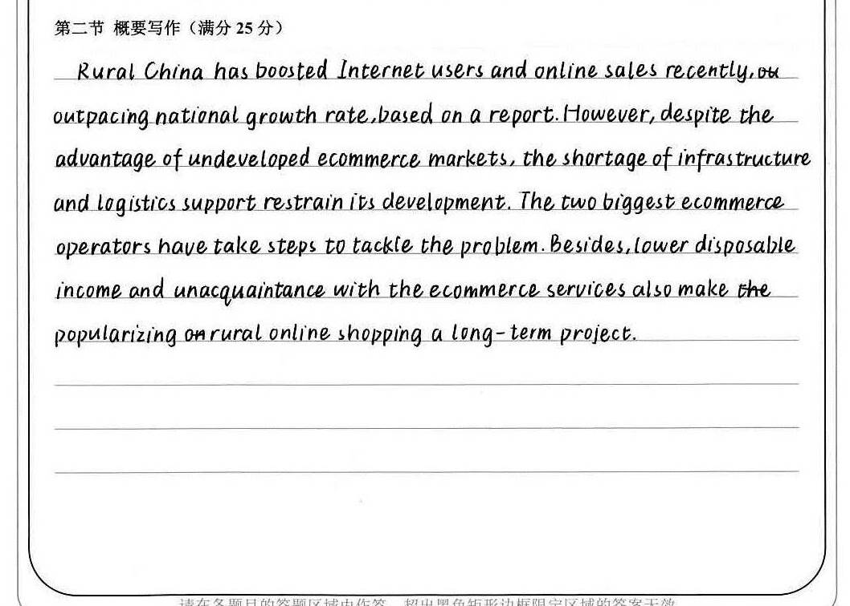
高分揭秘
理解准确，涵盖全部要点。
高级表达：boost, restrain, tackle, unacquaintance, long-term
高级句型：…, based on…（非谓语作状语）
衔接：however (转折); besides(并列); also(并列)
得分：22
67 words

Slide 15
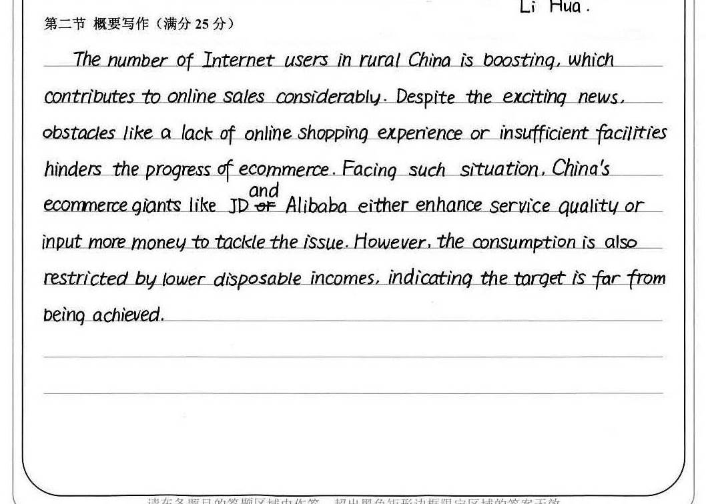
高分揭秘
booming,
理解准确，涵盖全部要点。
高级表达：considerably, obstacle, prosperity, resident, insufficient facilities, hinder, enhance; tackle; consumption; restrict, indicate; far from
高级句型：…which contributes to…(定语从句); Facing such situation,… (非谓语作状语）; …indicating the target…(非谓语作状语)
衔接：despite (让步)；however(转折)
得分：21
put in
75 words

Slide 16
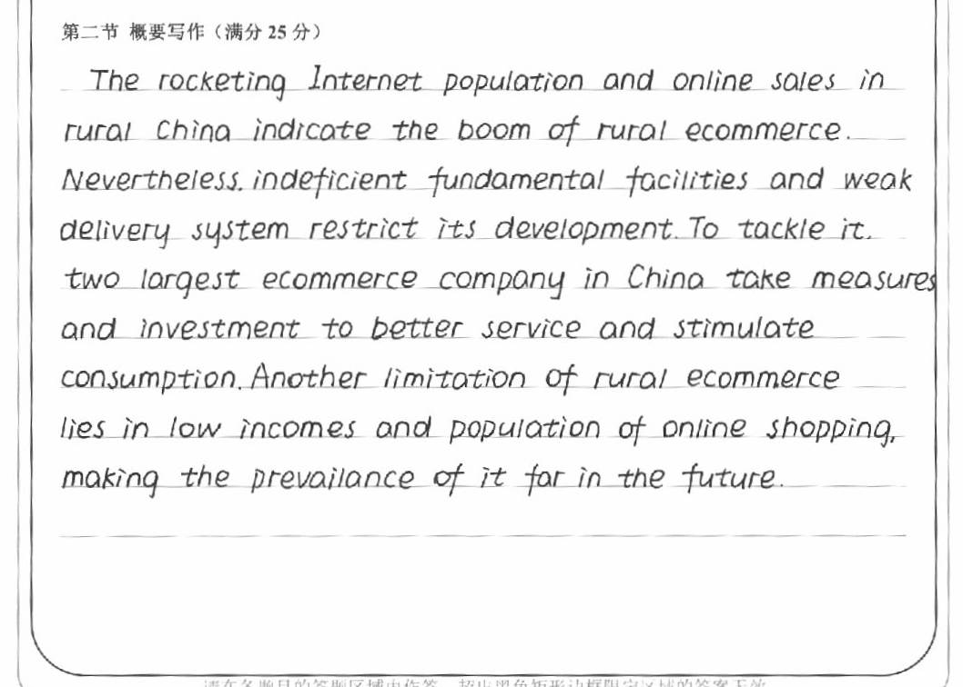
高分揭秘
理解较准确，涵盖绝大部分要点。
要点4中，限制 ecommerce in rural China的因素，遗漏lack of knowlege on online shopping。
高级表达：rocket, indicate, boom, indeficient, restrict, tackle, stimulate consumption; limitation; lie in; prevailance
高级句型：…, making… (非谓语作状语）
衔接：Nevertheless (让步); Another(并列)
得分：21
69 words

Slide 17
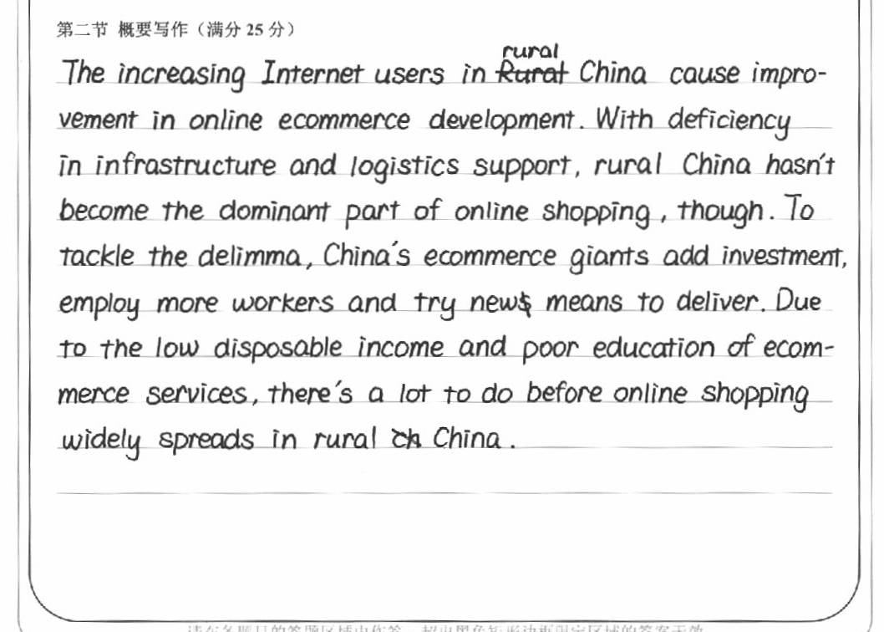
高分揭秘
理解较准确，涵盖全部要点。要点3中，两大电商巨头采取的两方面的举措improve service和put in investment欠清晰。
高级表达：deficiency, dominant, tackle
高级句型：with sth, …(固定句型); there be, (固定句型
衔接：…, though(转折); to do…（表目的）due to…(因果)
得分：20
dilemma
74 words

Slide 18
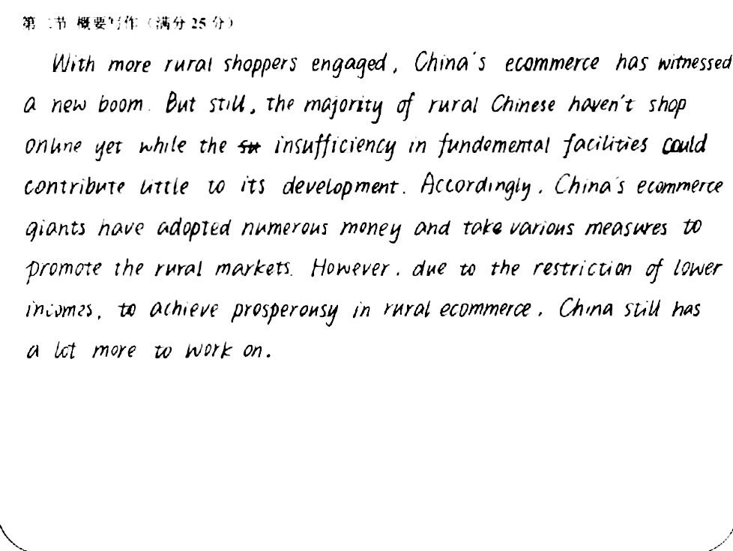
高分揭秘
理解较准确，涵盖全部要点。要点3中，概括两大电商巨头的举措不够明确，且numerrous, various表达欠客观。
高级表达：engage, witness, boom, insufficiency, adopt, promote, restriction, prosperity
衔接：With more rural shoppers engaged,…(with的复合结构); Accordingly,（因果）; However,(转折)
得分：20
75 words

Slide 19
4
Expression Focus

Slide 20
1
促进，增长
promote
vt. to help sth to happen or develop 促进；推动 【SYN】 encourage
  促进经济增长的政策
  policies to promote economic growth
  提高环保意识的运动
  a campaign to promote awareness of environmental issues

Slide 21
1
促进，增长
boost
1) vt. to make sth increase, or become better or more successful 使增长；使兴旺
  增加出口；提高利润
  boost exports/profits
  增强某人的信心/士气
  boost sb's confidence/morale
2) n. an increase in sth 增长；提高
  汽车销售额的增长
  a boost in car sales

Slide 22
1
促进，增长
boom
1) vi. to have a period of rapid growth; to become bigger, more successful, etc.
迅速发展；激增；繁荣昌盛
  到20世纪80年代时，计算机行业迅猛发展。
  By the 1980s, the computer industry was booming.
2) n. a sudden increase in trade and economic activity; a period of wealth and succes（贸易和经济活动的）激增，繁荣
  汽车销售额的增长
  a boost in car sales

Slide 23
1
促进，增长
prosper
vi. to develop in a successful way; to be successful, especially in making money
繁荣；兴旺；成功；发达 【SYN】thrive
  我们需要创造一个有利于生意兴隆的环境气氛。
  We need to create a climate in which business can prosper.
n. prosperity
[U] the state of being successful, especially in making money 兴旺；繁荣；成功
【SYN】affluence
  我们未来的繁荣昌盛依赖经济的发展。
  Our future prosperity depends on economic growth.

Slide 24
1
促进，增长
thrive
vi. to become, and continue to be successful, strong, healthy, etc. 兴旺发达；繁荣
【SYN】flourish
  新企业在这一地区蓬勃兴起。
  New business thrive in this area.
  这些动物栏养起来很少会肥壮。
  These animals rarely thrive in captivity.
adj. thriving
  兴盛的行业
  a thriving industry

Slide 25
1
促进，增长
facilitate
vt.(formal) to make an action or a process possible or easier 促进；促使；使便利
  加快经济发展
  facilitate more rapid economic growth
  有条理的教导有利于学习。
  Structured teaching facilitates learning.

Slide 26
1
促进，增长
rocket
vi. to increase very quickly and suddenly 快速增长；猛增
【SYN】shoot up / skyrocket
  飞涨的价格
  rocketing prices
  失业人数再次猛增。
  Unemployment has rocketed up again.
  总数从376猛增到532.
  The total has rocketed from 376 to 532.

Slide 27
2
阻碍，限制
limit
vt. to stop sth from increasing beyond a particular amount or level 限制，限定
限制汽车二氧化碳排放的措施
measures to limit carbon dioxide emissions from cars
限制某人的选择
limit one's choice
n. limit
a point at which sth stops being possible or existing 限度；限制
    对…作出严格限定
    set strict limits on sth

Slide 28
2
阻碍，限制
hinder
vt. to make it difficult for sb to do sth or for sth to happen 阻碍；妨碍；阻挡 【SYN】 hamper
  阻碍经济发展
  hinder economic growth
  受伤后他无法发挥出最高水平。
  An injury was hindering him from playing his best.

Slide 29
2
阻碍，限制
inhibit
vt. (formal) to prevent sth from happening or make it happen more slowly or less frequently than normal 阻止；阻碍
  缺氧可能阻碍胎儿的大脑发育。
  A lack of oxygen may inhibit brain development in the unborn child.
n. inhibition
[U] (formal) the act of restricting or preventing a process or an action 阻止；抑制
  对生长的抑制
  the inhibition of growth

Slide 30
2
阻碍，限制
impede
vt. [often passive](formal) to delay or stop the progress of sth 阻碍；阻止
【SYN】hinder, hamper
  楼房的施工因天气恶劣而停了下来。
  Work on the building was impeded by severe weather.

Slide 31
2
阻碍，限制
restrict
vt. to limit the size, amount or range of sth 限制，限定（数量/范围等）
  在城里车速不得超过每小时30英里。
  Speed is restricted to 30 mph in towns.
  浓雾严重影响了能见度。
  Fog severely restricted visibility.
n. restriction
[U] the act of limiting or controlling sb/sth 限制；约束
  宽松的运动服
  sports clothes that prevents any restriction of movement

Slide 32
2
阻碍，限制
restrain
vt. to stop sth that is growing or increasing from becoming too large 抑制；控制
【SYN】keep under control
  采取措施控制通货膨胀
  take steps to restrain inflation
n. restraint
[U] (formal) the act of controlling or limiting sth because it is necessary or sensible to do so 控制；限制
  限制工资增长
  wage restraint

Slide 33
2
阻碍，限制
constrain
v. [often passive] to restrict or limit sb/sth 限制；限定；约束
  研究工作因经费不足而受限制。
  Research has been constrained by a lack of funds.
  由于受到失去工作的威胁，她感到很难再坚持下去。
  She felt constrained from continuing by the threat of losing her job.
n. constraint
[C] a thing that limits or restricts sth, or your freedom to do sth 限制；限定；约束
【SYN】restriction
  这项决定将使所有的学校受到各种严格的限制。
  This decision will impose serious constraints on all schools.

Slide 34
3
不足，缺乏
lack
1) vt. to have none or not enough of sth 没有；缺乏；不足；短缺
  他缺乏信心。 He lacks confidence.
2) [U, sing] the state of not having sth or not having enough of sth 缺乏；匮乏；短缺 【SYN】 dearth/shortage
  缺乏食物/金钱/技能 a lack of food/money/skills
  因为缺乏兴趣这次旅行被取消了。The trip was cancelled through/for lack of interest.
  志愿者不乏其人。 There was no lack of volunteers.
adj. lacking
having none or not enough of sth 没有；匮乏；缺乏；不足
  这部书完全没有创意。
  The book is completely lacking in originality.

Slide 35
3
不足，缺乏
deficiency
  n. (formal) the state of not having, or not having enough of, sth that is essential 缺乏；缺少；不足 【SYN】shortage
      缺乏维生素B
      a deficiency of Vitamin B
      饮食中缺乏维生素会导致疾病。
      Vitamin deficiency in the diet can cause illness.
  adj. deficient
  not having enough of sth, especially sth that is essential 缺乏的；缺少的；不足的
    缺乏维生素A的饮食
    a diet that is deficient in Vitamin A

Slide 36
3
不足，缺乏
dearth
  n. [sing.] a lack of sth; the fact of there not being enough of sth 缺乏；不足
  【SYN】scarcity
    关于这个课题缺乏可靠资料。
    There was a dearth of reliable information on the subject.

Slide 37
3
不足，缺乏
insufficient
  adj.(formal) not large, strong or important enough for a particular purpose 不充分的；不足的；不够重要的 【SYN】inadequate
  时间不够
  insufficient time
  他的薪水不够应付需要。
  His salary is insufficient to meet his needs.

Slide 38
4
处理，应付
resolve
  vt. (formal) to find an acceptable solution to a problem or difficulty解决（问题/困难） 【SYN】 settle
    解决问题/争端/冲突/危机
    resolve an issue/a dispute/a conflict/a crisis

Slide 39
4
处理，应付
address
  vt. (formal) to think about a problem or a situation and decide how you are going to deal with it 设法解决；处理；对付
  解决实质性问题
  address the real issues
  我们必须设法解决交通污染问题。
  We must address ourselves to the problem of traffic pollution.

Slide 40
4
处理，应付
manage
  vi. to be able to solve your problems, deal with a difficult situation, etc.
  能解决（问题）；应付（困难局面等）【SYN】cope
  解决这个问题
  manage with/cope with the problem
  你能拿得动这些包吗？
  Can you manage with all those bags?

Slide 41
4
处理，应付
handle
  vt. to deal with a situation, a person, an area of work or a strong emotion
  处理，应付（局势/人/工作、感情）
    处理这场危机
    handle the crisis
    应对压力
    handle stress

Slide 42
4
处理，应付
tackle
  vt. to make a determined effort to deal with a difficult problem or situation
  应付，处理，解决（难题/局面）
    解决通货膨胀的问题
    tackle inflation
    解决问题
    tackle the issue

Slide 43
5
普及，风行
popularize
  1）to make a lot of people know about sth and enjoy it 宣传；宣扬；推广
  2）v. to make a difficult subject easier to understand for ordinary people
  使通俗化；使普及
  普及农村地区网上购物
  popularize online shopping in rural areas
  推广科技创新
  popularize technological innovation

Slide 44
5
普及，风行
prevail
  vi. to exist or be very common at a particular time or in a particular place
  普遍存在；盛行；流行
  那些信念在某些社会群体中仍很盛行。
    Those beliefs still prevail among certain social groups.
  adj. prevalent
  （formal）that exists or is very common at a particular time or in a particular place
  【SYN】common, widespread
    普遍的观点 a prevalent view
    这些偏见在北方人中尤为常见。
    These prejudices are particular prevalent among people living in the North.
  n. [U] prevalence

Slide 45
6
有待…/尚未…
have yet to do
  used for saying that something has not happened or been done up to the present time, especially when you think it should have happened or been done 尚未做；要去做
  有些问题还需要弄清楚。
  Certain questions have yet to be clarified.
  一些软件有待改进。
  Some software applications have yet to be developed.

Slide 46
6
有待…/尚未…
remain
  vi. to still need to be done, said, or dealt with 仍需去做/说/处理
    还有很多事情要去做。
    Much remains to be done.
    你说得对不对还有待证实。
    It remains to be seen whether you're right.
    还有一个重要的问题。
    There remained one significant problem.

Slide 47
Homework
Polish your own version.
Tongxiang High School
Feng Yanna

