Slide 1

感恩遇见，相互成就，本课件资料仅供您个人参考、教学使用，严禁自行在网络传播，违者依知识产权法追究法律责任。
更多教学资源请关注
公众号：溯恩高中英语
知识产权声明

Slide 2


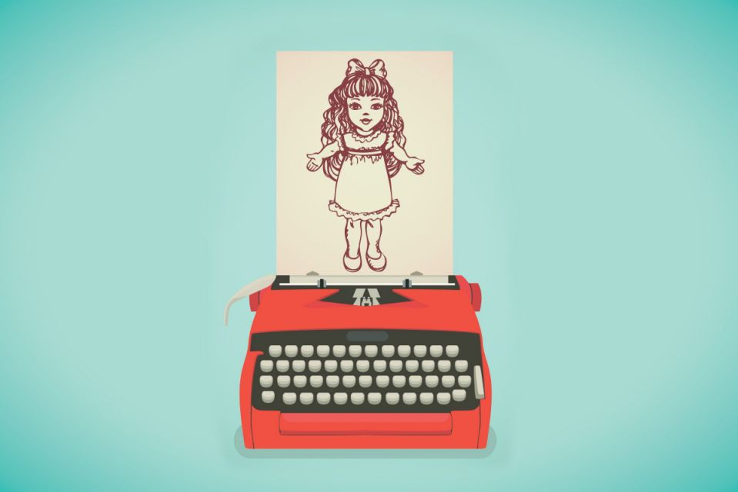

浙江省名校新高考研究联盟2020届第三次联考
读后续写讲评
One Father's Battle Between Working and Giving Attention to His Daughter

Slide 3
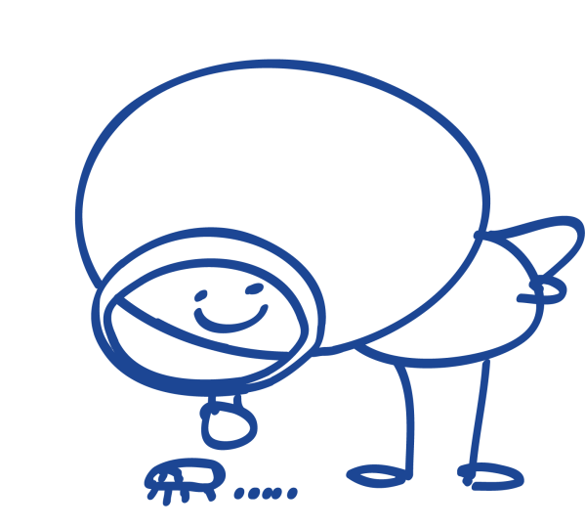
contents:
1
Understand the story
2
Learn the language
3
Design the plot
Write and appreciate your work
4

Slide 4

Reading
“Missy, " I called to my wife, “did you put the banana skin on my desk?” “No, honey, Meghan probably did.” As I’d feared, she had missed my real purpose of the question which was to make it clear to her that she hadn’t done her job: defend my desk against the invader -- our naughty girl. I abandoned the conversation
I sat here at the desk, and stared at the screen. I waited patiently for ideas to come to me, exam questions for a rest I would give my English students. My wife was off to a reunion somewhere, but I was not alone. Meghan, our 22-month-old daughter kept me company. Yet her plans that day seemed to go against mine.
She followed a daily routine that was both time-consuming and challenging. It included certain basic tasks: watching the fish, sweeping the carpet in her room, climbing up and down her bed.
At first I could concentrate on designing my test paper. But I was soon sidetracked(分心的 ). I had not counted on the arrival of the "bib-bibs"("Bib-bibs" were birds).”Bib-bibs, bib-bibs!” Meghan screamed excitedly, her eyes alive with expectation. She insisted that I go with her to the window.
“In a second. Just let me finish this question.” I said. She pulled me by the hand (two

Slide 5
Reading
fingers, actually) towards the window. I saw myself as a fool, being led to watch the bib-bibs. And we did watch them. They chattered and leaped back and forth on the lawn just outside our apartment window. Meghan was absorbed, but as I watched them, I still thought about my work.
Suddenly she rushed out from the room, and I heard her naked feet slapping against the wooden floor outside. She returned with her doll, Dumpty. She held him up to the window, stretching him out by his two arms and whispering into his nonexistent ear, “Bib-bibs, Dumpty, bib-bibs!” Then I left them in conversation and returned to my desk.
Paragraph 1:
Unfortunately, she came again soon, with her shoes in hands and preparing for an outing._________
Paragraph 2:
Out of the corner of my eye I could see the little girl sobbing because I didn’t have time for her. _______

Slide 6
Understanding the story
While my wife was away on a reunion, I was at home __________ a test paper for the next day and having my naughty daughter Meghan for __________. It was a time-consuming and ___________ job to take care of the 22-month-old. I wanted to __________ _____the test paper while she constantly interrupted me by _________ me to the window to watch bib-bibs together. The next moment, she took her doll Dumpty, held it up to the window and _________ what she saw outside the window with the doll, as if communicating something with a live being. Seeing her enjoying the __________ of Dumpty, I took the ____________ and returned to my desk.
designing
company
challenging
concentrate on
leading
sharing
company
chance

Slide 7
Language learning
1.盯着屏幕
2.陪伴
3.违背我的计划安排
4.集中注意力于
5.眼里充满期待
6.偶然瞟见
1.stare at the screen
2.keep sb. company
3.go against my plan
4.concentrate/ focus on
5.One’s eyes were alive with expectation.
6. see out of the corner of one’s eye

Slide 8






Design the plot: Underlined words
$$√$$
Seeing Meghan holding Dumpty close to her chest, feeling abandoned, I felt a ripple of guilt run through my body.
Poor Meghan only had her doll Dumpty for company, which actually should be my job.
I immediately left my work at the desk and rushed over to my lovey daughter, gathering her into my arms.
I realized that I should never make my home my office, concentrating on my school work, but ignoring the family.
When I offered to take a walk with her in the park, the disappointment on her face immediately transformed into excited cheers.
Meghan
Dumpty
company
expectation
work
desk
2. concentrate on
pull
return
3. excitedly
$$√$$
$$√$$
$$√$$
$$√$$
$$√$$
Tip 1:
With the underlined words as possible hints, we can picture the scenes that follow.

Slide 9
Design the plot: Underlined words
I was well aware that it was MY company, rather than Dumpty’s, that mattered most to my daughter.
Reflecting, I realized that my company with Meghan should be the top priority for both me and my daughter, however busy I was.
Looking at Meghan bathed in the sunshine and her laughter flying through the park, I realized that it was the sitting next to each other that meant everything.
Meghan
Dumpty
company
expectation
work
desk
2. concentrate on
pull
return
3. excitedly
$$√$$
Tip 2:
Abstract nouns, like the word company here, can be used at the end of the passage, expressing the message of the story.

Slide 10
Design the plot: First sentence
Unfortunately, she came again soon, with her shoes in hands and preparing for an outing._________
Out of the corner of my eye I could see the little girl sobbing because I didn’t have time for her. _______
1. How did I react to her intention?
2. What further attempts did she make? And my reactions?
I refused Meghan’s request and focused on my test paper.
1.Seeing her sobbing, how did I feel and what did I do?
2.Hearing my idea, how did Meghan react and what did we do afterwards?
3. What was my reflection when Meghan enjoyed my company and the enjoyable outdoor time?

Slide 11
Design the plot: First sentence
Unfortunately, she came again soon, with her shoes in hands and preparing for an outing._________
Out of the corner of my eye I could see the little girl sobbing because I didn’t have time for her. _______
1. I understood what she meant but said no, not wanting to put aside my test paper for a while.
2. She tore at my sleeve and pleaded for my company with her expecting eyes. When refused once more, she felt it didn’t work and left.
3. I returned my attention to my test paper.
1. I immediately dumped my work, ran towards Meghan and suggested that we go to the park for a walk.
2. Excitedly, she took my hand and ran down the stairs. She had a good time in the park.
3. I realized that it was my company, rather than Dumpty’s, that mattered most to Meghan.

Slide 12
A Possible version
Unfortunately, she came again soon, with her shoes in hands and preparing for an outing. “Don’t even ask, Meghan. Not today.” I knew her plan too well: First the shoes. Then the stroller. And pretty soon we were in the park. The way she always did. Having sensed my impatience with her, Meghan put down her shoes, tugged at my sleeves with her free hands and pleaded using her hard-to-understand baby talk. “No, Meghan,” I said again. “Not now. Go away and leave me alone.” Finally, she left. She made no further attempt to bother me. Then I tried to concentrate on the test paper without interference.

Slide 13
A possible version
Out of the corner of my eye I could see the little girl sobbing because I didn’t have time for her. She stood with her back against the sofa, watching me type and slowly brushing the tip of Dumpty’s arm across her nose for comfort. Obviously, Dumpty was doing my job to keep her company. I suddenly felt guilt growing inside me. “Meghan, I feel like taking a walk down to the park. I was wondering if you would care to join me.” Hearing this, she laughed excitedly and began the frantic search for her shoes. I knew I should put aside my work and go right at the moment – while bibs-bibs still sparked wonder and while my girl thought that a walk with her father was a gift beyond measure.

Slide 14
下水作文
Unfortunately, she came again soon, with her shoes in hands and preparing for an outing. I clearly knew that she wanted to go to the park, with me for company. However, with the work in mind, I didn’t have the least intention of leaving the room, leaving the desk or leaving my test paper behind. Pressing a kiss on her forehead, I suggested that she play with Dumpty or watch cartoon for a while. Disappointedly, she pursed her lips and tore at my sleeve, pleading, “Daddy, Daddy, please!” Annoyed at her constant disturbing, I became quite impatient and shouted, “Leave me alone!” Sadly, she left, holding the poor Dumpty in her hands. And my attention returned to the test paper.
点评：
1.本段情节简练，人物设置简单，让读者马上进入故事情景中。
2.语言表达丰富，像press a kiss on, purse her lips等给读者以画面感的体验，也非常符合故事里角色的定位。简短的“Daddy, Daddy, please!”一句对话，吻合一个22个月大的孩子的实际情况。
3.运用了分词结构作状语、句子副词置于句首等，辅之以心理活动、身体动作、情绪描写等手段，使整篇文章简洁而不简单。
4.与第二段的承接水到渠成。

Slide 15
下水作文
Out of the corner of my eye I could see the little girl sobbing because I didn’t have time for her. Immediately, I rose from my seat and dashed towards Meghan. With repeated “sorry”, I scooped her up into my arms and patted gently her on the back until she calmed down. Not wanting to disappoint her any more, I suggested taking a walk in the park and observing bib-bibs with her. Unbelievably excited at my idea, she took my hand and ran down the stairs. The rest time witnessed Meghan’s playing on the swings, running over the lawn and intimate interaction with the bib-bibs, her silver voice flying through the park. I also fully enjoyed the relaxing time with my daughter, totally forgetting the test paper. (101)
Reflecting, I realized that my company with Meghan should be the top priority for both me and my daughter, however busy I was.
点评：
1.采用连动手法，rose, dash, scoop up, pat一系列动词，把爸爸的焦急、爱女的情感刻画得淋漓尽致。
2.使用独立主格结构、拟人手法、分词作状语，使表达变得丰富，文章变得丰满。
3. totally forgetting the test paper.呼应了文本的开头，为整篇文章画了一个满圆。
4.文章最后的点题：陪伴其实是成就双方的，使得立意得到了提升，从而达到了思维和表达的两个高度。

Slide 16
More possible endings
I was well aware that it was MY company, rather than Dumpty’s, that mattered most to my daughter.
Reflecting, I realized that my company with Meghan should be the top priority for both me and my daughter, however busy I was.
Looking at Meghan bathed in the sunshine and her laughter flying through the park, I realized that it is the sitting next to each other that means everything.
I knew that we came at the right time—while bib-bibs still spark wonder and before dandelions become weeds and while a little girl thinks that a leaf from her father is a gift beyond measure.

Slide 17
语料积累：Beautiful sentences from the original work
She makes no further attempt to bother me.
I see her standing quietly with her back against the sofa, tears running down her cheeks.
That means little to either of us, realizing somehow that it is the sitting next to each other that means everything.
So the paper slips gently into the top drawer; the hood slides over the typewriter. The test will get done somehow.
At the word park, the fingers leave the mouth. She laughs excitedly and begins the frantic search for her socks.
Besides, he’d understand why I must go right now—while bib-bibs still spark wonder and before dandelions become weeds and while a little girl thinks that a leaf from her father is a gift beyond measure.

Slide 18


