Slide 1

感恩遇见，相互成就，本课件资料仅供您个人参考、教学使用，严禁自行在网络传播，违者依知识产权法追究法律责任。
更多教学资源请关注
公众号：溯恩高中英语
知识产权声明

Slide 2
金丽衢第二次联考英语试卷讲评
浙师大附中外语组 金雀屏

Slide 3
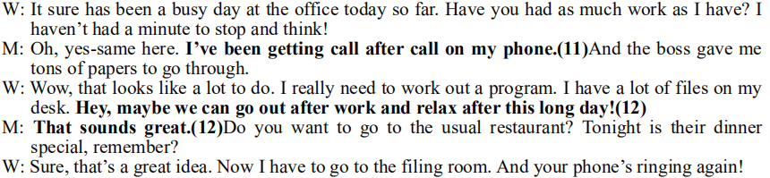
Text 8
听力
第11题
The man needs to _____________ and ________________________ while the woman needs to ___________________ and have __________ to deal with.
answer phones
go through tons of papers
work out a program
lots of files

Slide 4
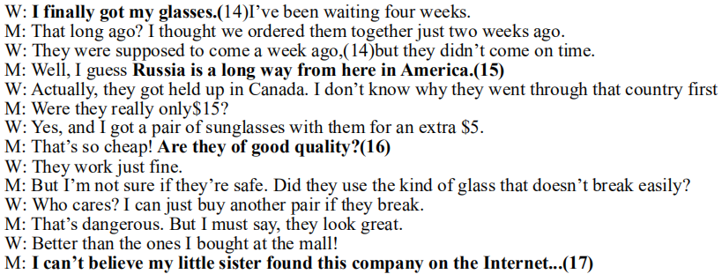
Text 9
第14、15题
The man and the woman are in _______. They ordered some glasses delivered from ______. However, they got held up for some time in _______. So the glasses supposed to arrive _____________ came late.
America
Russia
Canada
one week ago

Slide 5
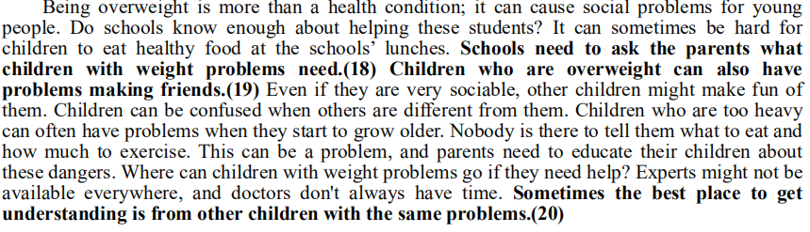
Text 10
第18、20题
To help students with weight problems, schools can ask their parents _____________________. And overweight students themselves can also _______ other children with the same problems.
what their children need
talk to

Slide 6
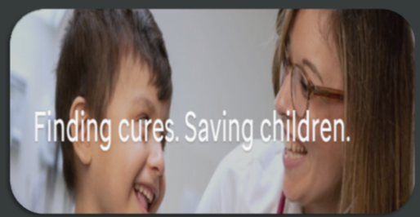

阅读A篇
Para.1: I ______________ St. Jude since I ___ a part of it.
Paras.2-3: I spent a day with _______ Sawyer fighting against cancer.
Paras.4-6: St. Jude is a/an __________ organization and I feel _____
to support it.
have been loving
was
第21题
innocent
remarkable/
extraordinary
honored

Slide 7
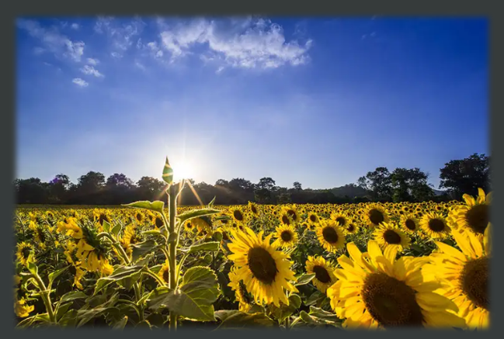
阅读B篇
Artificial sunflowers can automatically lean in the direction of sunlight, thus reusing green energy.

Slide 8
achievement/
breakthrough
Para.1: the _____________ scientists have made
an artificial sunflower to _________________
Paras.2-5: the research p______
meet a c________ o_______ the challenge test the e________
Paras.6-7: the vision for the new technology
Though the practical ___________ will be some way off,
scientists are _________ of its future use.
harvest solar energy
rocess
hallenge
vercome
fficiency
第25题
applictaions
confident

Slide 9

阅读C篇
What is real happiness?

Slide 10
_____(face) the truth that no one can be always happy, the author suggests that we find c___________ in life, for _________________________知足常乐. The author a_____ that contentment is a nice way to __________ life. It is suggested that we r_______ positively despite temporary s_______, which he thinks is a proper life a______.
Facing
contentment
enough is as good as a feast
argues
go through
respond
setbacks
attitude
Paras.1-2: the simple truth of our life
Paras.3-7: the author's solution
第28、29题

Slide 11

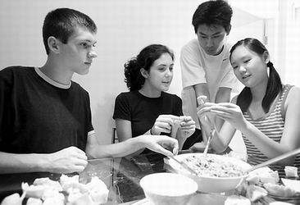
七选五
Study abroad.
Can you make it?

Slide 12
七选五
Para.1: 出国复杂+进一步解释+31建议+我的经历
点拨：承接上句
Para.2: 无大冲突+32但有时觉得自己如无水之鱼+举例
点拨：与上句构成转折，同时引出下文例子
Para.3: 33住宿问题+举例说明
点拨：段首句统领整段，看懂后面例子再答题
Para.4: 我要换寄宿家庭+34爸爸不同意+ 爸爸不同意的原因
点拨：弄清楚空格下句“he”的指代
Para.5: 意识到他们友善+35我学着与之交流+他们也开始更关照我
点拨：上句的realize,下句的also均是提示

Slide 13
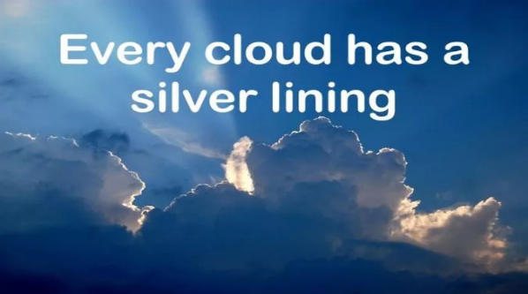
完形
There are some clouds that have silver linings and some that don't.
Do you agree after reading the story?
People say this when things are going _______ or when someone is sad. Clouds stand for _____________. Every bad situation has some good parts to it—you just have to look for them. The proverb is meant to help people feel better and __________勇往直前.
wrong
bad situations
keep going

Slide 14
第37题
Para.1: the r_____ for sharing my story of fighting against cancer
Paras.2-3: how I s________ in battling against cancer
Paras.4-5: my r________ on the painful but m________ experience
reason
succeeded
第40、43题
reflection
meaningful
齐读并口头翻译
What have I learned from the experience?
1. Attitude does matter. With hope, everything is possible.
2. Look on the bright side because every cloud has a silver lining.
3. Having been tested, one will know what matters in life.
4. Some experiences in our life, though bitter, are full of the
significance of growth.

Slide 15
56. activities 名词复数
57. on 介词
58. the 冠词
59. is based 以...为原型 时态语态
60. teaching 动词ing
61. personal 词性转换
62. directly 词性转换
63. will continue 将会继承 时态
64. however/nevertheless 连词
65. Known 过去分词
语法填空
技巧点拨
1. 读懂全文
2. 留做题痕迹
3. 避免单词拼写错
误和大小写错误
4. 考点不重复

Slide 16
Thank you!

