Slide 1


感恩遇见，相互成就，本课件资料仅供您个人参考、教学使用，严禁自行在网络传播，违者依知识产权法追究法律责任。
更多教学资源请关注
公众号：溯恩高中英语
知识产权声明

Slide 2
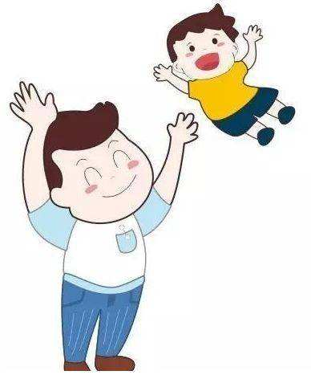
浙江省名校新高考研究联盟（Z20联盟）
2020届第三次联考读后续写
浙江省衢州第一中学 徐荣仙

Slide 3
读后续写的要点
续写
呼应
细节
意境
修辞
写作是一个结合语言、内容和思维的过程。

Slide 4

写作思路分析
1. 确定主题：本续写主题是孩子需要父母的陪伴，而父母却忙于工作疏于顾及孩子的情感需求。故事以第一人称的视角进行叙述。讲述的是我由于工作繁忙，没有时间理会女儿需要父亲陪伴的情感渴求，最后女儿因为得不到我的陪伴大哭，女儿的哭声让我明白工作再忙也记得要匀出一点时间去陪伴孩子，孩子的成长不能缺失父母的情感陪伴和心理呵护。

Slide 5
写作思路分析
2. 认知变化：妻子出去了，丈夫留在家一边工作一边照顾幼小的女儿，丈夫觉得这是一件浪费时间和精力的事（go against my plan, time-consuming and challenging，sidetracked）。当女儿看到“bib-bibs”，女儿非常激动（excitedly，alive with expectation, chatter, leap back, absorbed），而我心不在焉（saw myself as a fool, still thought about my work）。当女儿兴奋地抱着她的布娃娃和“bib-bibs”交谈的时候，父亲觉得这是一个摆脱女儿打扰的好时机（left them in conversation and returned to my desk）。最后女儿在请求父亲和她出去玩遭到拒绝后大哭(unfortunately, sob, have no time for her)，此刻父亲才意识到自己的问题。

Slide 6

写作思路分析
3. 续写难点：该续写的写作有两个难点：一是在第一段女儿提出叫父亲陪她到外面玩，根据第二段的开头句提示，父亲应该是拒绝了女儿的请求，女儿才大哭。要以幼儿（22-month-old）的语言的心理动态去描写，而不是一个大孩子的语气，语气要吻合年龄特征。二是父亲意识到问题后如何安慰幼小的女儿及父亲的感触。

Slide 7
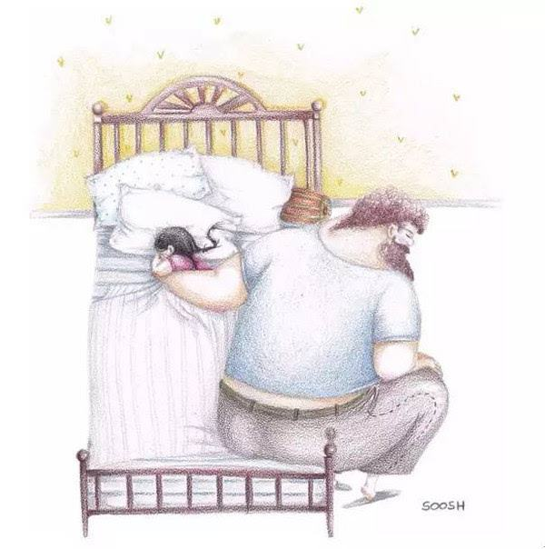
What hints do these underlined words give us?
desk, Meghan, company, concentrate on, excitedly, expectation, pull, work, return, Dumpty

Slide 8
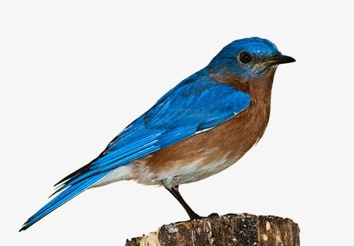
What key information can you get from the given passage?
What’s the author’s feeling about accompanying his daughter?
What’s the little girl’s expectation at the sight of the “bib-bibs”?
Why did the little girl chatter with the “bib-bibs”?
Why did the little girl share her doll with the “bib-bibs?
Did the author really understand his daughter’s excitement about the “bib-bibs?

Slide 9

Hints from the given sentences
Paragraph1:
Unfortunately, she came again soon, with her shoes in hands and preparing for an outing.___________ ________
________________________________________________________________________________________________
Paragraph2:
Out of the corner of my eye I could see the little girl sobbing because I didn’t have time for her._____________________________________________________________________________________________
________________________________________________

Slide 10
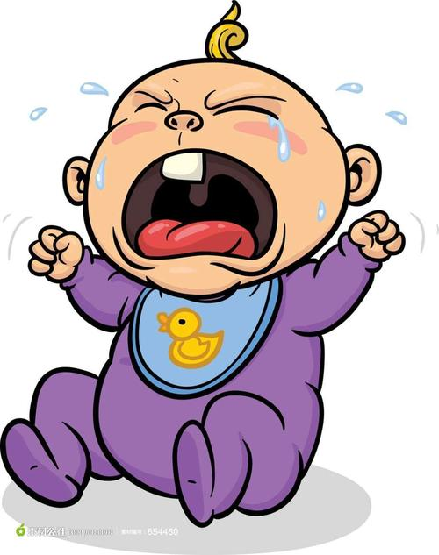
Read for Key Information
What's the main idea of the given passage?
I had to accompany my daughter at home while preparing for a test paper.
When I was with her, I was actually absent-minded.
When her beg for an outing was refused, she began to sob.

Slide 11
Work out possible plots in paragraph1
What expectation did the girl have for her father when she ran for her father?
How did she feel at the beginning?
Did her father accept her beg for an outing?
If not, what’s her father’s excuse for not being able to accompany her?

Slide 12
Work out possible plots in paragraph2
How did the author feel on seeing his daughter crying ?
Did he realize his problem?
What lesson did he learn from the incident?
What will her father do later?

Slide 13
Analyze the Plots in the given Passage
climax
father
daughter
sob
refuse
beg for an outing
absent-minded
still thought about my work
absorbed in her conversation with the bird
alive with expectation???
see myself as a fool
sidetracked
scream excitedly
time-consuming and challenging
go against father’s plan
accompany my daughter

Slide 14
下水作文
Unfortunately, she came again soon, with her shoes in hands and preparing for an outing. “Daddy, I’d like to …” “Not today, Meghan. I’m pretty busy, you see.” Without even lifting my head from my paper, I interrupted her request impatiently. “Just for a moment, please” she tipped towards my desk and plucked at my sleeves timidly. Somehow, a flood of rage took hold of me, which drove me to yell at her, “ Go and play with your Dumpty! I’m busy with my work. ” She opened her mouth to say something but choked. She inched towards the door quietly. Out of the corner of my eye I could see the little girl sobbing because I didn’t have time for her. Suddenly, a ripple of guilt touched my heart. I went over, bent down and embraced her tightly. “How about the park now? ” “Really? ” She raised her head, with uncovered childish thrill in her still red eyes. I nodded and picked up her shoes. In a flash, she stood up and flew out cheerfully like a bird. Her twinkling eyes woke me up to the truth that parents’ simple company can warm children’s heart, even lighting up their life.

Slide 15
Appealing Endings?
√
合情合理，出人意料
√
寓情于景，情景交融
√
设置悬念，留白想象空间
√
合理推断，拔高立意
√
情感真挚，激发共鸣

Slide 16
Possible Appealing Ending
A Narrative Ending
Now, Meghan has been a mother of two babies. When I looked back to that day, I was still guilty about my rudeness at her expectation for my company.
A Philosophic Ending
No matter how busy we are, don't miss the best time to accompany our children. Parents' company will nourish their hopes and happiness.
An Echoing Ending
Her giggle brought every cell of the park to wake up. Surprisingly, I found accompanying her not that time-consuming and challenging, but pretty blessing.

Slide 17

Proper Coherence

Slide 18
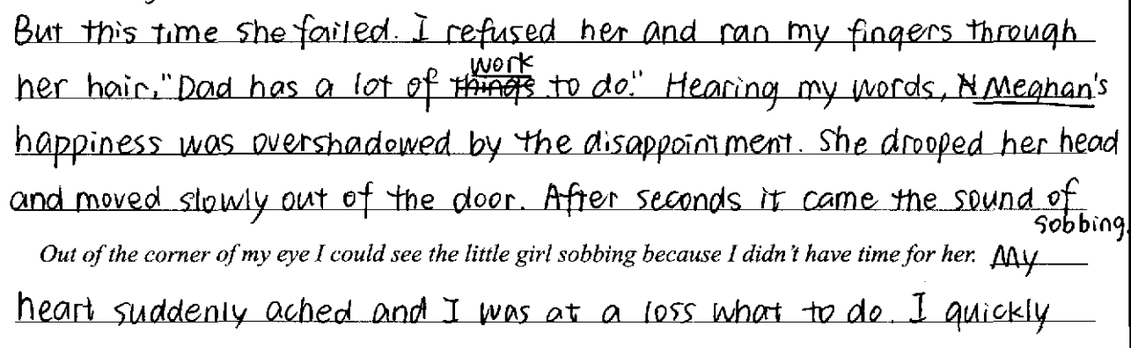
Unreasonable Coherence
剖析： 父亲是在第二段才发现女儿哭泣，所以第一段是不会出现女儿直接哭的场景。属于无效衔接。

Slide 19
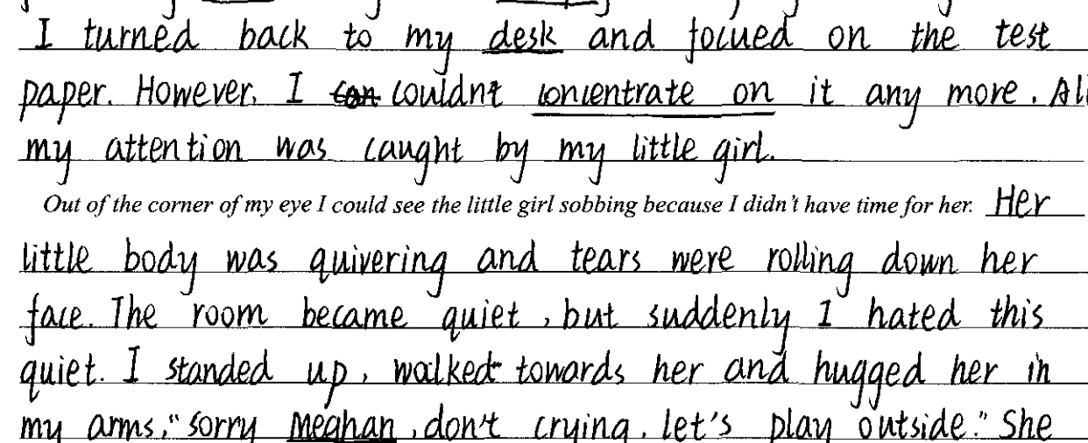
Unreasonable Coherence
剖析： 该生在第一段说父亲的所有注意力都在女儿身上。而根据文本的合理推测父亲是在第二段无意中发现伤害了女儿，所以这也是无效衔接。

Slide 20
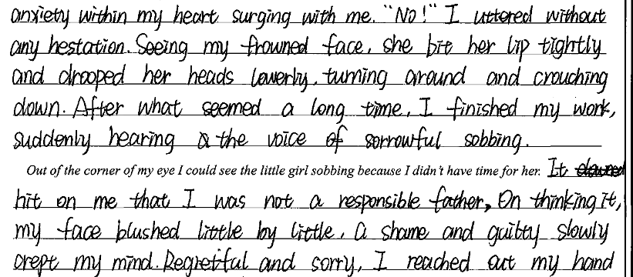
Unreasonable Coherence
剖析：该生在第一段结尾直接说hear the voice of sorrowful sobbing 和第二段段首I could see the little girl sobbing，这种其实严格来说不是衔接，叫做重复在现

Slide 21
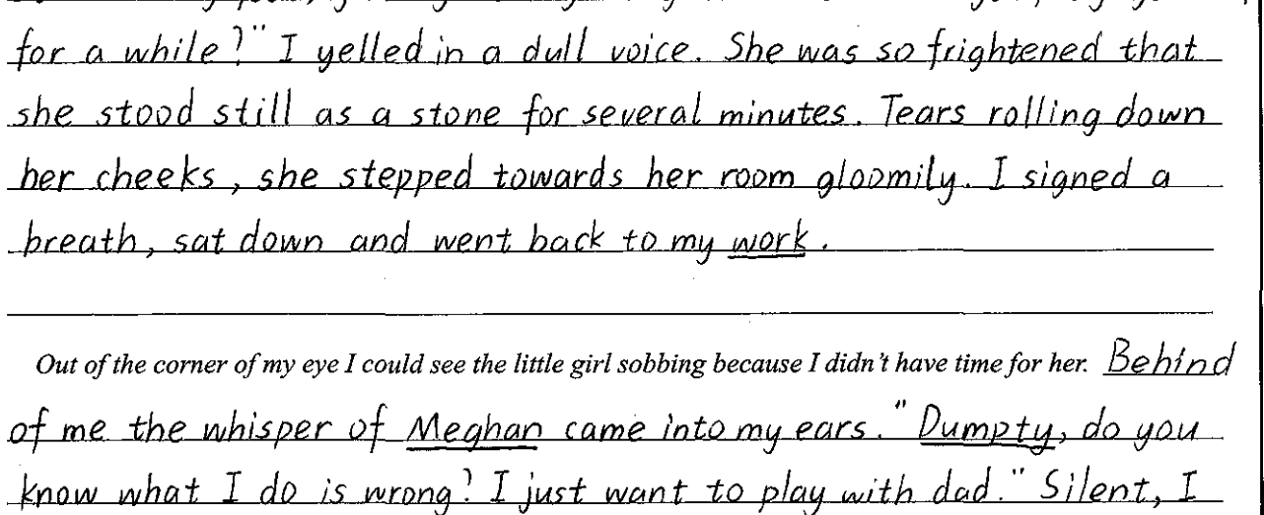
Unreasonable Coherence
剖析： 该生在第一段说父亲专心于他的工作，那父亲是不会发现女儿哭的。所以，这里衔接跳跃太快。可以适当加一句加以衔接，如：Her complete silence drove me to look in her direction.

Slide 22
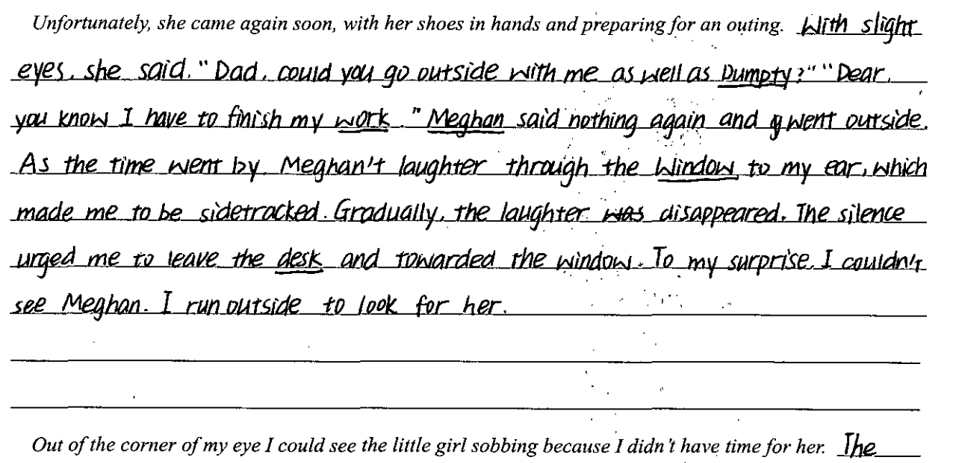
Reasonable Coherence
剖析： 该生在第一段最后说I ran outside to look for her.与第二段段首Out of the corner of my eye I could see the little girl sobbing...非常合理的衔接在一起

Slide 23
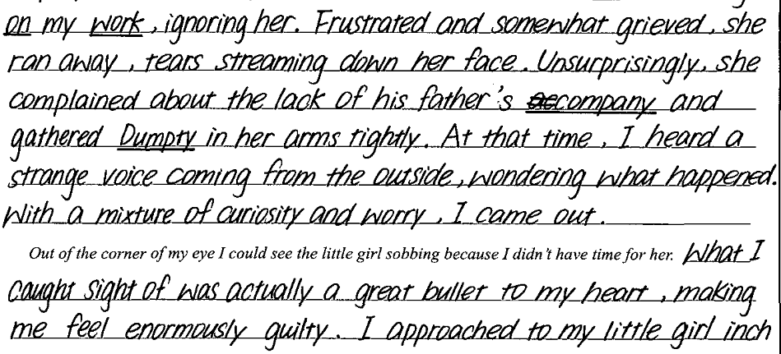
Reasonable Coherence
剖析： 该生在第一段最后说With a mixture of curiosity and worry, I came out.与第二段段首Out of the corner of my eye I could see the little girl sobbing...非常合理的衔接在一起。

Slide 24
Enjoy Some Polished Sentences

Slide 25
Polished Sentences
Her sob was like a needle hurting my heart.
She stood next to me with her eyes glittering with expectation.
My stern expression and impatient frown obviously frightened her, making her hand for mine freeze in the air.
Gone was the smile on her face, and she headed for the doll without a word.
Never have I seen such a gloomy expression on a childish face, which pricked my heart deeply.
It dawns on me that parents' company can never be emphasized too much.

Slide 26
Polished Sentences
What initially started as a challenge turned out to be a bonus.
What I caught sight of was actually a bullet to my heart, making me feel enormously guilty.
With a pile of work to do, I sat in front of the desk, turning a deaf ear to Meghan's beg.
When I diverted my attention from my work, Meghan was no where to be found.
Her gleaming eyes and sunny smile made me realize that it was rewarding to accompany her, even as a “fool”.
Notes:
i

Slide 27

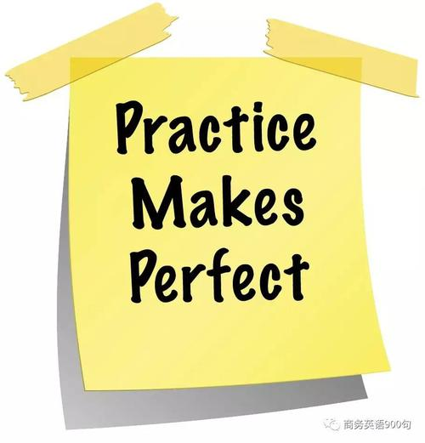
Samples from Students

Slide 28
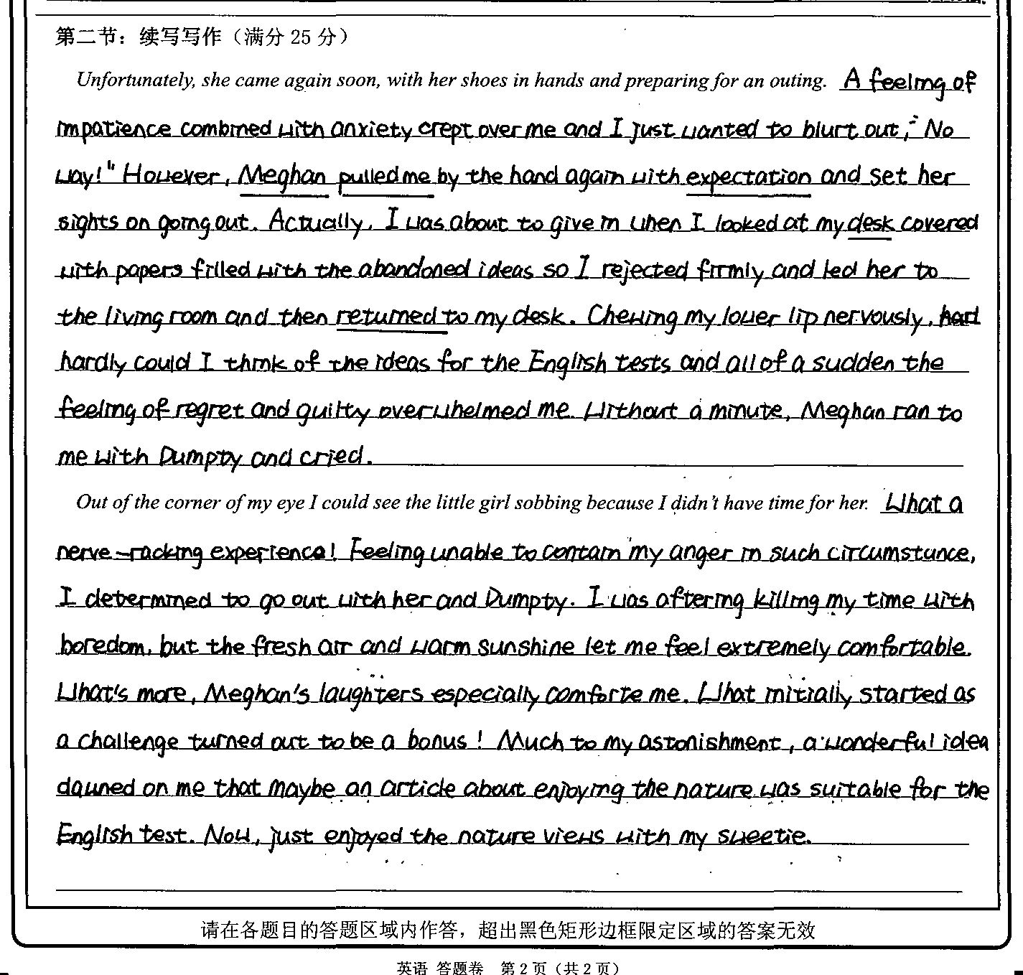

Slide 29
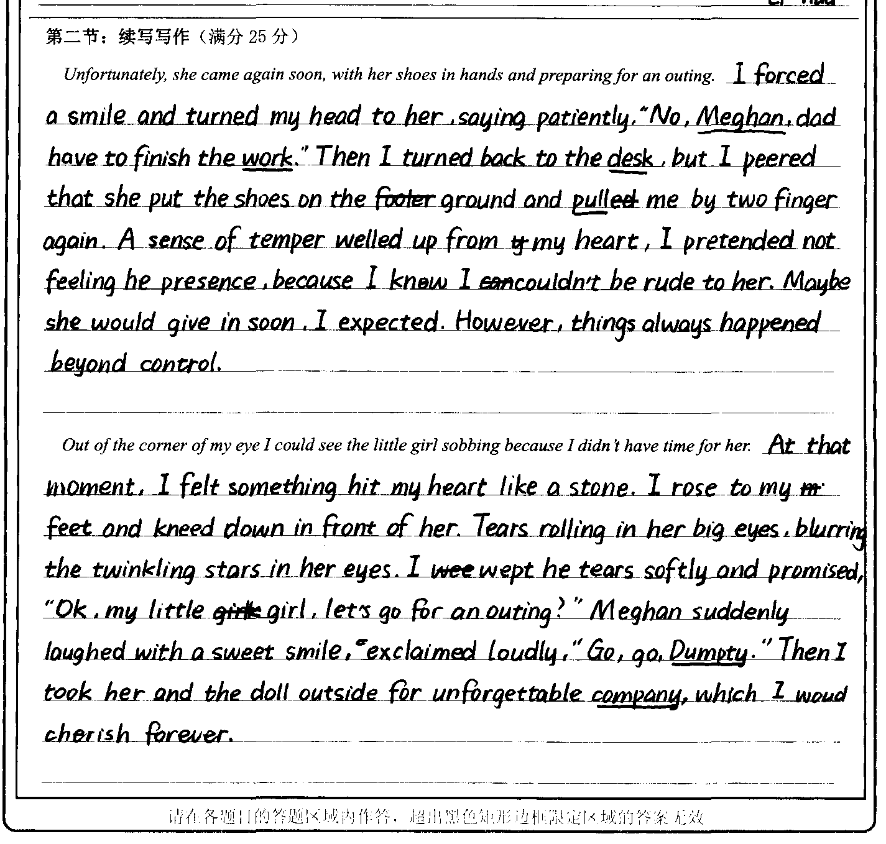

Slide 30
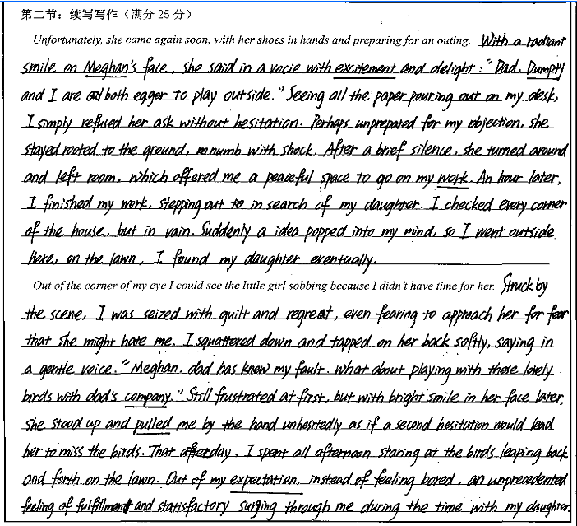

Slide 31
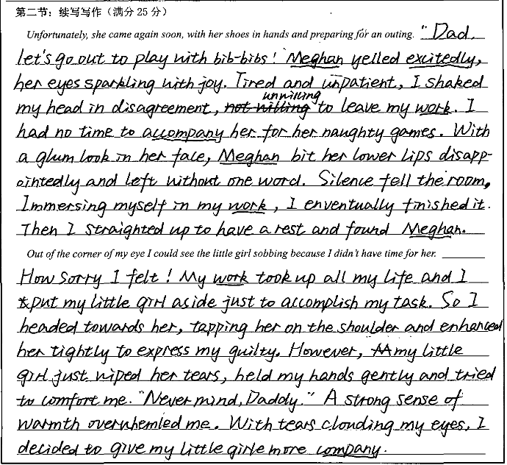

Slide 32
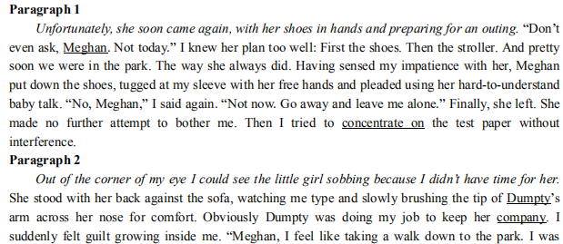
Possible Sample

Slide 33

If you miss the sun you shed tears, you also miss the stars.

