Slide 1
Summary Writing
——期中考试作文讲解
Longquan No.1 High School
Lan Jianzhen

Slide 2
PART ONE
Requirements of summary writing

Slide 3
The“Play”Steps
Point out the main points Step 1
P
List the points in your own words Step2
L
Analyze the structure Step 3
A
Yoke the sentences to a passage (about 60 words)
Step 4
Y
The“Piano”Rule

Slide 4
PART TWO
Further reading of the passage

Slide 5
Para.1
Step 1: Point out the key points.
What is a plant-based diet? Is it just a fashionable new term for a “vegan (严格素食主义者)”? While there is no set definition, a plant-based way of eating focuses on consuming plant-sourced wholefoods (全天然食物) that are least processed in their original form, for example whole grains, fruits, vegetables, nuts and seeds. These are full of vitamins, minerals, and provide an abundance of nutrients for your body. Following a plant-based lifestyle doesn’t necessarily mean fully avoiding animal products like a vegan. For plant-based eaters, animal proteins can happily fit in with the lifestyle, yet they play more of a supporting role. Overall, “plant-based” is more of a broad and flexible way of thinking about nutrition rather than a rigid (严格的，不变的) diet. With a plant-based diet, the focus is on simple, nutritious wholefoods.
While
Overall
?
…focus on nutritious plant-sourced wholefoods.
not a rigid diet.

Slide 6
Para.1
Step 1: Point out the key points.
What is a plant-based diet? Is it just a fashionable new term for a “vegan (严格素食主义者)”? While there is no set definition, a plant-based way of eating focuses on consuming plant-sourced wholefoods (全天然食物) that are least processed in their original form, for example whole grains, fruits, vegetables, nuts and seeds. These are full of vitamins, minerals, and provide an abundance of nutrients for your body. Following a plant-based lifestyle doesn’t necessarily mean fully avoiding animal products like a vegan. For plant-based eaters, animal proteins can happily fit in with the lifestyle, yet they play more of a supporting role. Overall, “plant-based” is more of a broad and flexible way of thinking about nutrition rather than a rigid (严格的，不变的) diet. With a plant-based diet, the focus is on simple, nutritious wholefoods.
Animal proteins are also included but play a supporting role.
?
…focus on nutritious plant-sourced wholefoods but not a rigid diet.

Slide 7
Para.1
Step 2: List the points in your own words .
What is a plant-based diet? Is it just a fashionable new term for a “vegan (严格素食主义者)”? While there is no set definition, a plant-based way of eating focuses on consuming plant-sourced wholefoods (全天然食物) that are least processed in their original form, for example whole grains, fruits, vegetables, nuts and seeds. These are full of vitamins, minerals, and provide an abundance of nutrients for your body. Following a plant-based lifestyle doesn’t necessarily mean fully avoiding animal products like a vegan. For plant-based eaters, animal proteins can happily fit in with the lifestyle, yet they play more of a supporting role. Overall, “plant-based” is more of a broad and flexible way of thinking about nutrition rather than a rigid (严格的，不变的) diet. With a plant-based diet, the focus is on simple, nutritious wholefoods.
…focus on nutritious plant-sourced wholefoods ....
Animal proteins are also included but play a supporting role
1. A plant-based diet mainly considers plant-sourced wholefoods but the
animal proteins are also needed.
2. A plant-based diet not only centers on plant-sourced wholefoods , but it
also needs some animal products like animal proteins.
3. A plant-based diet centers on nutritious wholefoods coming from
plant sources, with animal proteins serving as complements/supplements.
（补充）

Slide 8
Para.2
Step 1: Point out the key points.
Why people start following a plant-based diet? One of the main reasons is the health benefits. Now, more so than ever, research is showing how eating more plants and less meat can positively affect health. Particularly, a plant-based lifestyle has been linked to heart health. In a study of more than 10, 000 adults published in the Journal of the American Heart Association, it was shown that those who followed a more plant-based diet had a 16 percent lower risk of having cardiovascular (心血管的) disease and a 32 percent lower risk of dying of cardiovascular disease.
Particularly

Slide 9
Para.2
Step 2: List the points in your own words .
Why people start following a plant-based diet? One of the main reasons is the health benefits. Now, more so than ever, research is showing how eating more plants and less meat can positively affect health. Particularly, a plant-based lifestyle has been linked to heart health. In a study of more than 10, 000 adults published in the Journal of the American Heart Association, it was shown that those who followed a more plant-based diet had a 16 percent lower risk of having cardiovascular (心血管的) disease and a 32 percent lower risk of dying of cardiovascular disease.
Particularly
Research has shown a plant-based lifestyle is conducive to keeping
healthy, especially reducing the risk of cardiovascular disease.
2. One of the major reasons why people follow a plant-based diet is that
it benefits our health, especially decreasing the rate of the heart disease.

Slide 10
Para.3
Step 1: Point out the key points.
also
A plant-based lifestyle can also help to promote weight loss and help to maintain your goal weight. Weight loss commonly occurs because the diet consists of foods that are full of fiber and have a high-water content, which easily make you feel full up.

Slide 11
Para.3
Step 2: List the points in your own words .
also
A plant-based lifestyle can also help to promote weight loss and help to maintain your goal weight. Weight loss commonly occurs because the diet consists of foods that are full of fiber and have a high-water content, which easily make you feel full up.
Besides, abundant fiber and water in the plant-based diet generate the
feeling of being full, consequently contributing to losing weight.
2. It’s helpful to lose weight by making you feel full up due to the
abundant fibre and water.
3. In addition, abundant fiber and water in the plant-based diet generate
the feeling of being full, consequently resulting in losing weight.

Slide 12
Para.4
Step 1: Point out the key points.
Another major reason
Another major reason to jump at the plant-based eating train is the external (外界的，外部的) benefits. Plant-based foods are loaded with vitamins, which help brighten your skin. One of the plant-based all-star vitamins is vitamin C, which is a powerful antioxidant (抗氧化剂). A large number of fruits and vegetables contain vitamin C. They assist in smoothing lines, and reducing wrinkles.

Slide 13
Para.4
Step 1: Point out the key points.
Another major reason
Another major reason to jump at the plant-based eating train is the external (外界的，外部的) benefits. Plant-based foods are loaded with vitamins, which help brighten your skin. One of the plant-based all-star vitamins is vitamin C, which is a powerful antioxidant (抗氧化剂). A large number of fruits and vegetables contain vitamin C. They assist in smoothing lines, and reducing wrinkles.
example

Slide 14
Para.4
Step 2: List the points in your own words .
Another major reason
Another major reason to jump at the plant-based eating train is the external (外界的，外部的) benefits. Plant-based foods are loaded with vitamins, which help brighten your skin.
Moreover, plant-based eaters may have bright and smooth skin
thanks to the rich vitamins from the diet.
2. In addition, the plant-based foods are rich in vitamins, which will
make your skin bright.
3. Besides, the plant-based foods containing vitamins could brighten
your skin.

Slide 15
Step 3: Analyze the structure.
Plant-Based Diet
① What is a plant-based diet? Is it just a fashionable new term for a “vegan(严格素食主义者)”? While there is no set definition, a plant-based way of eating focuses on consuming plant-sourced wholefoods (全天然食物) that are least processed in their original form, for example whole grains, fruits, vegetables, nuts and seeds. These are full of vitamins, minerals, and provide an abundance of nutrients for your body. Following a plant-based lifestyle doesn’t necessarily mean fully avoiding animal products like a vegan. For plant-based eaters, animal proteins can happily fit in with the lifestyle, yet they play more of a supporting role. Overall, “plant-based” is more of a broad and flexible way of thinking about nutrition rather than a rigid diet. With a plant-based diet, the focus is on simple, nutritious wholefoods.
② Why people start following a plant-based diet? One of the main reasons is the health benefits. Now, more so than ever, research is showing how eating more plants and less meat can positively affect health. Particularly, a plant-based lifestyle has been linked to heart health. In a study of more than 10, 000 adults published in the Journal of the American Heart Association, it was shown that those who followed a more plant-based diet had a 16 percent lower risk of having cardiovascular (心血管的) disease and a 32 percent lower risk of dying of cardiovascular disease.
③ A plant-based lifestyle can also help to promote weight loss and help to maintain your goal weight. Weight loss commonly occurs because the diet consists of foods that are full of fiber and have a high-water content, which easily make you feel full up.
④ Another major reason to jump at the plant-based eating train is the external (外界的，外部的)benefits. Plant-based foods are loaded with vitamins, which help brighten your skin. One of the plant-based all-star vitamins is vitamin C, which is a powerful antioxidant. A large number of fruits and vegetables contain vitamin C. They assist in smoothing lines, and reducing wrinkles.
What’s the type of the passage?
Exposition
B. Argumentation
C. Narration

Slide 16
Step 4: Yoke the sentences to a passage (60 words or so).
A plant-based diet centers on nutritious wholefoods coming from plant sources, with animal proteins serving as complements. (要点1) Research has shown a plant-based lifestyle is conducive to keeping healthy, especially reducing the risk of cardiovascular disease. (要点2) Besides, abundant fiber and water in the plant-based diet generate the feeling of being full, consequently contributing to losing weight. (要点3) Moreover, plant-based eaters may have bright and smooth skin thanks to the rich vitamins from the diet. (要点4)
(72 words)

Slide 17
PART THREE
Consolidation of what’s covered

Slide 18
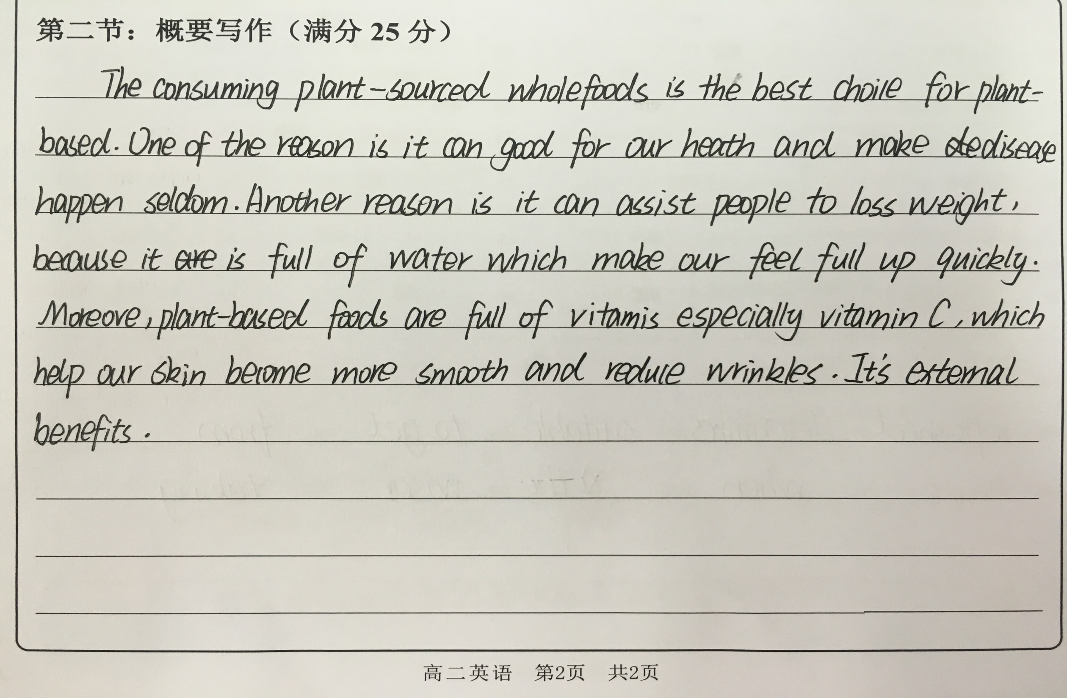
If you were the teacher…

Slide 19
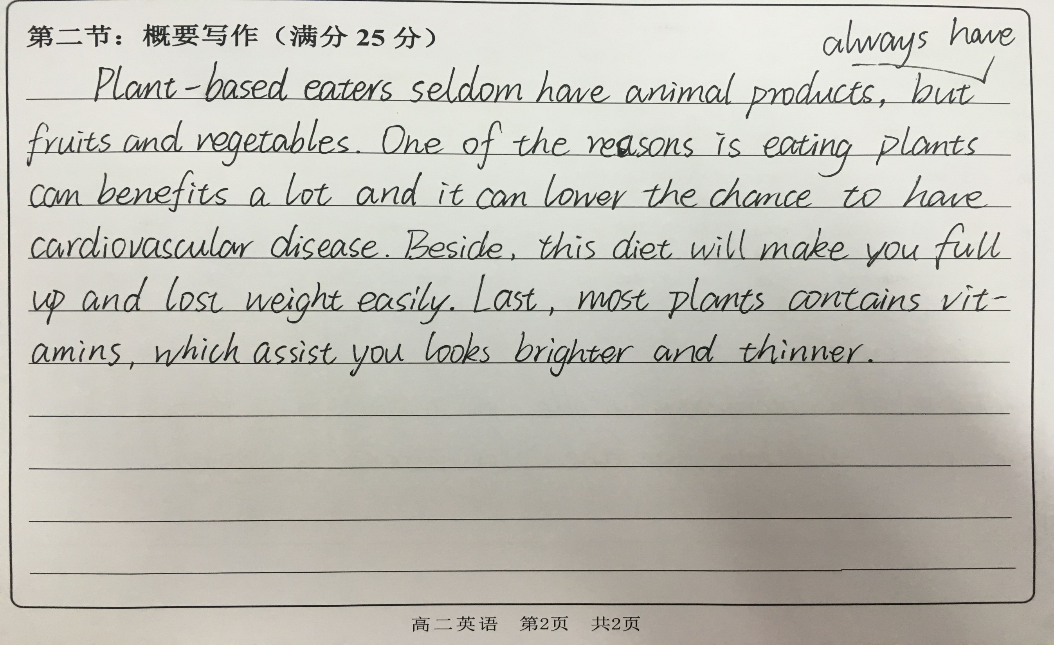
If you were the teacher…

Slide 20
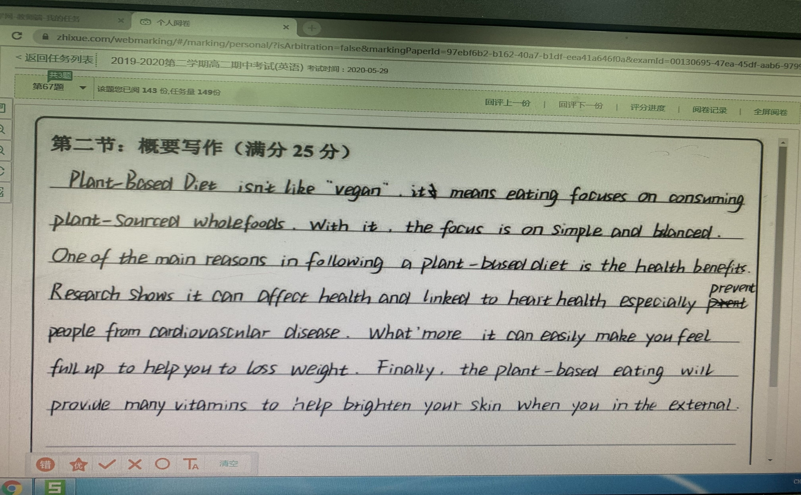
If you were the teacher…

Slide 21
THANKS

