Slide 1

感恩遇见，相互成就，本课件资料仅供您个人参考、教学使用，严禁自行在网络传播，违者依知识产权法追究法律责任。
更多教学资源请关注
公众号：溯恩高中英语
知识产权声明

Slide 2

Z20联盟
2020届第三次联考
试卷讲评
桐乡市高级中学
冯燕娜

Slide 3
Contents
01
阅读理解（含七选五）
Reading Comprehension
02
完型填空
Cloze
03
语法填空
Blank Filling

Slide 4
1
阅读理解
Reading Comprehension

Slide 5


Passage A
A Man in His 60s Working Towards His Masters Proves That You're Never too Old to Learn
原文出处
原文标题
  Never too old to learn.
  活到老，学到老。
  Knowledge is power.
  知识就是力量。
  Time waits for no man.
  岁月不待人。
  An idle youth, a needy age.
  少壮不努力，老大徒伤悲。
Jerry Valencia

Slide 6

Passage A
原文出处
话题词汇
Academic Life
  获得大学文凭
  积极参与课堂讨论
  重新申请（课程）
  准备好助学贷款文件
  获得硕士学位
  社区学院
  辍学
  获得足够的学分
  get one's college degree
  jump into class discussion
  reapply (for classes)
  have one's student-loan papers in order
  earn a master's degree
  community college
  quit school/ drop out
  earn enough credits

Slide 7
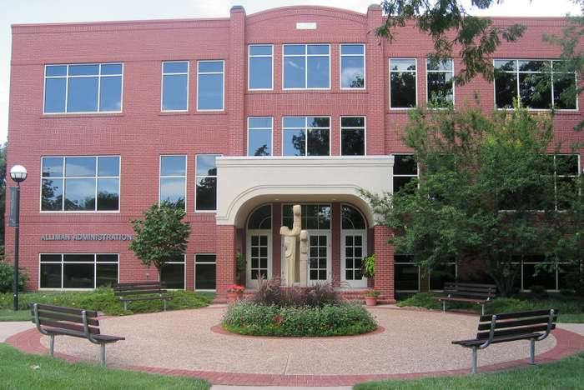
Passage A
A Man in His 60s Working Towards His Masters Proves That You're Never too Old to Learn
原文出处
原文标题
美国社区学院(Community College)：美国的社区学院提供两年制的初级高等教育(two years of academic instruction)，包括职业技术训练(technical and vocational training)，程度相当于中国的大专。
美国共有一千两百多所社区学院，拥有一千多万注册学生。社区学院的学生平均年龄是29岁，40%的学生21岁以下，六十岁以上的老人大学生也十分常见。其中60%的学生是边工作边读书。社区学院38%的资金来自州政府，学费收入占20%左右，自地方政府的资金接近20%，剩余的由其他形式的资金来源补足。
社区学院的年平均学费为两千多美元，不足公立大学的一半，普通公立大学的年均学费接近六千美元。
Community College

Slide 8
Passage A
原文出处
词汇聚焦
Expression Focus
^{overhear（overheard, overheard）}
vt. to hear, especially by accident, a conversation in which you are not involved 偶然听到；无意中听到
  我碰巧听到他们吵嘴。
  We overheard them arguing.
  我无意中听到Valencia说他想一直待在学校里直到拿到硕士学位，但是他花12年才读完了社区大学，他还有很长的路要走。
  I overheard Valencia say he wanted to stay in school until he earned a master's degree, but it had taken him 12 years to finish community college, so he had a long way to go.

Slide 9
Passage A
原文出处
词汇聚焦
Expression Focus
^{splendid}
adj. 1) very impressive; very beautiful 壮丽的；雄伟的；华丽的
  壮丽的风景
  splendid scenery
  岿然独立
  in splendid isolation
2) （old-fashioned) excellent; very good 极佳的；非常好的
【SYN】great
  这主意妙极了！
  What a splendid idea!
  adv. splendidly

Slide 10
Passage A
原文出处
词汇聚焦
Expression Focus
^{unreasonable}
adj. not fair; expecting too much 不合理的；不公正的；期望过高的
【OPP】reasonbale
  他的闲暇时间开始被工作过分地侵占了。
  The job was beginning to make unreasonable demands on his free time.
  他们的收费还算合理。
  The fees they charge are not unreasonable.
  要求人家随传随到，太不近人情了吧。
  It would be unreasonable to expect somebody to come at such short notice.

Slide 11
Passage A
原文出处
词汇聚焦
Expression Focus
^{relevant}
adj. 1) closely connected with the subject you are discussiong or the situation you are thinking about 紧密相关的；切题的
相关的提议/问题/观点
a relevant suggestion/question/point
相关经验
relevant experience
与…有直接联系
be directly relevant to sth
2) having ideas that are valuable and useful to people in their lives and work 有价值的；有意义的
她的小说今天仍有现实意义。
Her novel is still relevant today.

Slide 12
Passage A
原文出处
词汇聚焦
Expression Focus
^{youthful}
adj. typical of young people 年轻人的；青年的；青春的
  青春的激情/活力
  youthful enthusiasm/energy
  Valencia的决心似乎有点匪夷所思。按照他目前的速度，他得学到90岁才能把所有的证书挂上墙。但这似乎并不那么重要。他已经找到了青春的活力和学习的乐趣。
  There is something splendidly unreasonable about Valencia's determination. At his current pace, he'll be 90 when he finally hangs all that paper on the wall. But that doesn't seem especillay relevant. He's found all the youthful energy and the joy of learning.

Slide 13


Passage B
原文出处
原文标题
Do not rely on facial expressions for how people are feeling
Para. 1
  a universal misbelief between facial expression and emotions
Para. 2
  a surprising conclusion uncovered by an analysis of abundant research papers
Para. 3
  questions about the efforts of IT companies to develop AI algorithms
Para. 4
  the reason of such questions
Para. 5
  concerns about the misuse of computers
A smile does not always mean someone is happy.

Slide 14
Passage B
原文出处
词汇聚焦
Expression Focus
^{valid}
adj. based on what is logical or true 符合逻辑的；合理的；有根据的；确凿的
  有效的护照
  a valid passport
  他们有要求赔偿的合法权利。
  They have a valid claim to compensation.
  现在，面部表情仍然被普遍认为是判断他人情感的有效方式，不管对方的年龄、性别和文化差异。
  Today, facial expressions are still commonly thought to be a universally valid way to judge other people's feelings, regardless of age, sex and culture.

Slide 15
Passage B
原文出处
词汇聚焦
Expression Focus
^{underlying}
adj. [only before noun] important in a situation but not always easily noticed or stated clearly 根本的；潜在的；隐含的
  隐含的假设是可用资金有限。
  The underlying assumption is that the amount of money available is limited.失业可能是犯罪率攀升的潜在原因。
  Unemployement may be an underlying cause of the rising crime rate.

Slide 16
Passage B
原文出处
词汇聚焦
Expression Focus
^{context}
n. the situationin which sth happens and that helps you to understand it
（事情发生的）背景，环境，来龙去脉
  只有了解来龙去脉才能明白他的决定。
  His decision can only be understood in context.
  他认为那些试图通过脸部图片来判断情绪的公司没能认识到（表情产生）之来龙去脉的重要性。
  He said that companies attempting to judge emotions from images of faces have failed to understand the importance of context.

Slide 17
Passage B
原文出处
词汇聚焦
Expression Focus
^{zoom}
vi. (informl) to move or go somewhere very fast 快速移动；迅速前往
【SYN】rush, whizz
  车辆从我们身边疾驰而过。
  Traffic zoomed past us.
  他们在欧洲各国马不停蹄地奔波了五个星期。
  For five weeks they zoomed aroung Europe.
zoom in/out
（of a camera摄影机或摄像机）to show the objects that is being photographed from closer/further away, with the use of a zoom lens （用变焦距镜头）拉近，推远；使画面放大/缩小
  镜头拉远，映入眼帘的是一名双臂展开，欢呼进球的足球运动员。
  Then the view zoomed out to show a football player with his arms outstretched, celebrating a goal.

Slide 18
Passage B
原文出处
词汇聚焦
Expression Focus
^{given}
prep. when you consider sth 考虑到；鉴于
  Given his age (= considering how old heis), he's remarkably active.
  考虑到他的年龄，他已是相当活跃的了。Given her interest in children, teachingseems the right job for her.
  考虑到她喜欢孩子，教书看来是很适合她的工作。
given that … conj.
  It was surprising the government was re-elected, given that they had raised taxes so much.
  令人惊奇的是，政府把税收提高这么多仍再次当选了。

Slide 19

Passage C
原文出处
原文标题
The advantages of speaking a second language
Para. 1
  the cause of misbelief that bilingualism is bad for people
Para. 2
  a valid belief that bilingualism is good for people
Para. 3-4
  an assumed reason why bilingual people have a variety of advantages
Para. 5
  the benefits of bilingualism
They are hard to measure. But it is a good idea anyway.

Slide 20
Passage C
原文出处
词汇聚焦
Expression Focus
^{undernourished}
adj. in bad health because of a lack of food or a lack of the right type of food营养不良的；缺乏营养的 【SYN】malnourished
  严重营养不良的儿童
  severely undernourished children
[U] undernourishment

Slide 21
Passage C
原文出处
词汇聚焦
Expression Focus
^{not to mention}
used to introduce extra information and emphasize what you are saying
更不用说；且不说
  他在这个国家有两座大房子，更别提他在法国的别墅了。
  He has two big houses in this country, not to mention his villa in France.
  显然，这些调查实际上是在判定这些移民的物质上的贫困程度；来自这些家庭的成员更有可能营养不良，积极性也没那么强，更不用说他们参加考试时用的是不是最擅长的那门语言。
  Later it became clear that those surveys were actually measuring the material poverty of immigrants; memembers of such families were more likely to be undernourished and less motivated, not to mention the obvious fact that they often took the tests in a language that was not their best.

Slide 22
Passage C
原文出处
词汇聚焦
Expression Focus
^{assmume}
v. to think or accept that sth is true but without having proof of it
假定；假设；认为
  普遍认为，紧张是工作过重所致。
  It is generally assumed that stress is caused by too much work.
  认为经济继续好转是有道理的。
  It is reasonable to assume that the economy will continue to improve.
n. assumption
adj. assumed

Slide 23
Passage C
原文出处
词汇聚焦
Expression Focus
^{keep track of…}
to have information about what is happening or where sb/sth is 了解…的动态
【OPP】 lose track of…
  银行账单有助于你了解你的资金使用情况。
  Bank statements help you keep track of where your money is going.

Slide 24
Passage C
原文出处
词汇聚焦
Expression Focus
^{the bottom line}
n. [sing.] the most important thing that you have to consider or accept; the essential point in a discussion, etc. 要旨；基本论点；底线
  底线是，我们今天必须做出决定。
  The bottom line is that we have to make a decision today.
  关键是学习另外一门语言有时能促进智力，虽然并不是总是这样。
  The bottom line is that learning another language sometimes contributes to an intellectual boost, though not always.

Slide 25
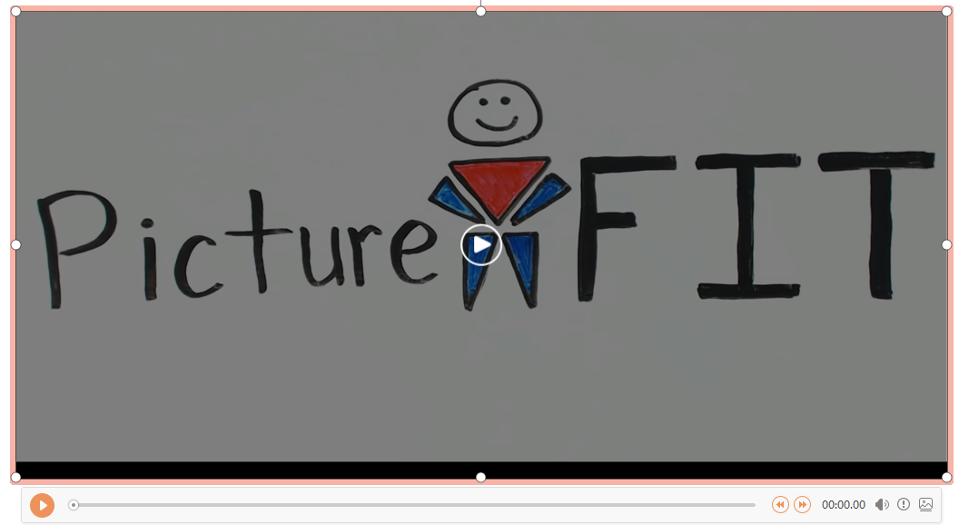
七选五
原文出处 网络科普知识
原文标题
Will Eating Before Bed Make You Fat?

Slide 26
七选五
原文出处 网络科普知识
词汇聚焦
Expression Focus
^{be/have to do with sb/sth}
to be about or connected with sb/sth 关于；与…有关系/联系
  品行和美德与经济状况没有太大关系。
  Character and virtue have little to do with economic circumstances.
  它和你什么时候吃东西没有关系。
  It has little to do with the time when you eat.

Slide 27
七选五
原文出处 网络科普知识
词汇聚焦
Expression Focus
^{snack}
n. (informal) a small meal or amount of food, usually eaten in a hurry
点心；小吃；快餐
  快餐午饭
  a snack lunch
vi. to eat snacks between or instead of main meals 吃点心/快餐/小吃
  作为点心，水果比巧克力更有益于健康。
  It's healthier to snack on fruit rather than chocolate.

Slide 28
七选五
原文出处 网络科普知识
词汇聚焦
Expression Focus
^{consume}
vt. to eat or drink sth 吃；喝；饮
  他死亡前喝了大量的酒。
  Before he died he had consumed a large quantity of alchohol.
  什么时候吃这些点心并不重要。
  The time these snacks are consumed does not matter.

Slide 29
七选五
原文出处 网络科普知识
词汇聚焦
Expression Focus
^{That being said,…}
conj. transitions to the following topic or effect from the prior information that you discussed 因此；所以说；话虽如此
【SYN】that said,/be that as it may,/ having said that,/nevertheless,/ with this in mind, this being said
  所以我们可以说，睡前吃东西并不会变胖。
  That being said, you will not get fat if you eat before bed.

Slide 30
2
完型填空
Cloze

Slide 31

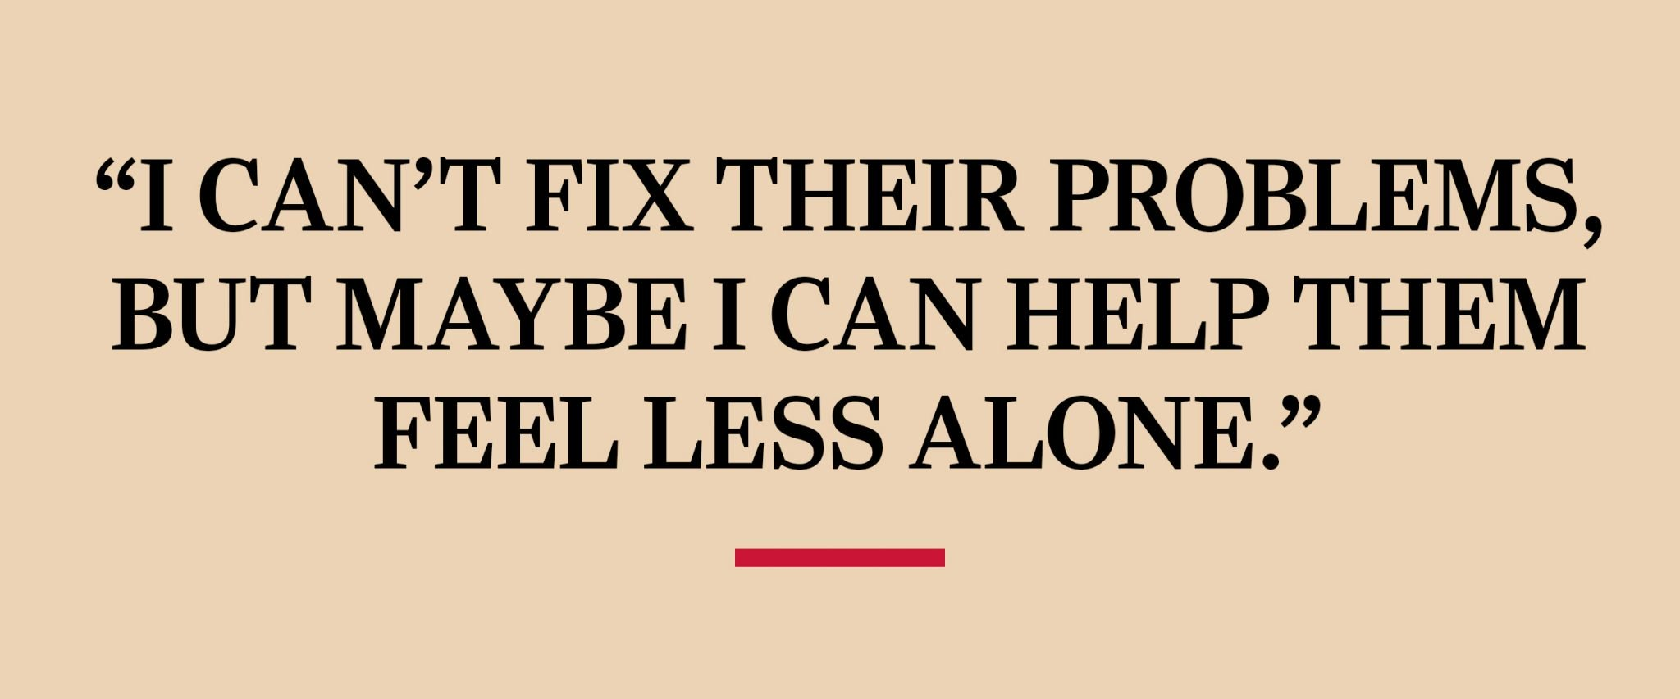
Cloze
This Woman Gives Free Haircuts to Those Less Fortunate and Her Simple Act of Kindness is Starting to Spread
原文出处
原文标题
Stellar and her magic chair, on the road to their next free haircut.

Slide 32
Cloze
原文出处
词汇聚焦
Expression Focus
^{invisible}
adj. that cannot be seen 看不见的；隐形的 【OPP】visible
肉眼看不见的星球
  stars invisible to the naked eye
  她觉得自己淹没在人群中。
  She felt invisible in the crowd.
[U] invisibility
  墨水已褪色看不见了。
  The ink had faded to invisibility.
adv. invisibly

Slide 33
Cloze
原文出处
词汇聚焦
Expression Focus
^{severe}
adj. (severer, severest)
extremely bad or serious 极为恶劣的；十分严重的
  严重残疾
  a severe handicap
  恶劣的天气情况
  severe weather conditions
  他的伤很重。
  His injuries are severe.

Slide 34
Cloze
原文出处
词汇聚焦
Expression Focus
^{arrange}
v. to plan or organize sth in advance 安排；筹备
  聚会很快就安排好了。
  The party was arranged quickly.
  我们按时在六点碰面。
  We met at six, as arranged.
  我们安排了一辆轿车到机场接我们。
  We arranged for a car to collect us from the airport.
  看到这个情况，她妈妈为Steller安排了第一次专业的理发。
  Seeing this, her mother arranged for Steller's first professional haircut.

Slide 35
Cloze
原文出处
词汇聚焦
Expression Focus
^{illness}
[C] a type or period of illness （某种）病；患病期
  小病/重病
  minor/serious illnesses
  坐下来，有个人像对待普通人而不是仅仅把她当病人一样和她聊天，这让她感觉有人关心她，内心也没那么孤单了。
  To sit down and have somebody look at her and talk to her like a person and not just an illness made her feel cared about and less alone.

Slide 36
Cloze
原文出处
词汇聚焦
Expression Focus
^{reach out to sb}
to show sb that you are interested in them and/or want to help them
表示对某人感兴趣；表示愿意提供援助
  教会需要寻找新途径来为年轻人提供帮助。
  The church needs to find new ways of reaching out to young people.
  毕业后不久，她开始了她的“红椅子工程”， 去街上帮助那些需要帮助的人。
  Not long after finishing school, she began her Red Chair Project, reaching out to the people on the streets.

Slide 37
Cloze
原文出处
词汇聚焦
Expression Focus
^{fix}
vt. to repair or correct sth 修理；校准；校正
  我已经解决了这个问题。
  I've fixed the problem.
  我想也许我会走过去问问他们是否需要免费的理发服务，虽然我没法解决他们的问题。
  I thought maybe I'd go around and ask if they want free haircuts, though I couldn't fix their problems.
[C] (informal) a solution to a problem, especially an easy or temporary one
（尤指简单的、暂时的）解决方法
  钢铁工业的问题没有即时解决的办法。
  There is no quick fix for the steel industry.

Slide 38
Cloze
原文出处
词汇聚焦
Expression Focus
^{get back on one's feet}
【SYN】recover 东山再起；重新振作；完全康复
  她听了很多别人那些关于失去、上瘾、努力重新振作的故事。
  She listened to people's stories of loss, addiction, and struggle to get back on their feet.

Slide 39
Cloze
原文出处
词汇聚焦
Expression Focus
^{apparently}
adv. according to what you have heard or read; according to the way sth appears可见；看来；显然
  看样子，他们很快就要离婚。
  Apprarently they are getting divorced soon.
  他停顿下来，显然陷入了沉思。
  He paused, apparently lost in thought.
  看样子她对他人的关注奏效了。
  The attention apparently worked.

Slide 40
Cloze
原文出处
词汇聚焦
Expression Focus
^{to date}
until now 迄今为止；到目前为止；直到现在
  到目前为止，我们已收到200多封回信。
  To date, we have received over 200 replies.

Slide 41
Cloze
原文出处
词汇聚焦
Expression Focus
^{belief}
[U] a strong feeling that sth/sb exists or is true; confident that sth/sb is good/right 相信；信心
  我佩服他对自己工作所抱的坚定信心。
  I admire his passionate belief in what he is doing.
  到目前为止，Steller已经给30多个生活贫困的人理过发，这所有的一切都源于她坚信勿以善小而不为的理念。
  To date, Steller has given over 30 haircuts to people who are all living in poverty, and it all began with a belief in simple acts of kindness.

Slide 42
3
语法填空
Blank Filling

Slide 43

Blank Filling
原文出处
How Successful People Spend the Last Hour of Their Workday
原文标题
Past the 2 p.m. slump, but not quite yet 5? Here's how to capitalize on your last hour at work, according to experts.

Slide 44
Blank Filling
原文出处
How Successful People Spend the Last Hour of Their Workday
原文标题
The last hour of anyone's workday is not always fruitful. As the hours of high productivity starts to fade, most of us begin watching the clock. But ___________(end) the workday with purpose can boost success both inside and outside of the office.
考查非谓语动词
  动名词ending the workday with purpose做主语
ending

Slide 45
Blank Filling
原文出处
How Successful People Spend the Last Hour of Their Workday
原文标题
While many of us spend our last hour of work making a to-do list for tomorrow, __________(success) people review the day they just had, instead. It is suggested that the last hour of a day ____________(spend) on reflection —— the failures and successes, however large or small.…
successful
考查词类转换
  n. success→ adj. successful
be spent
考查谓语动词
  It is suggested that the last hour or day (should) be spent on reflection...
  虚拟语气

Slide 46
Blank Filling
原文出处
How Successful People Spend the Last Hour of Their Workday
原文标题
While many of us spend our last hour of work making a to-do list for tomorrow, __________(success) people review the day they just had, instead. It is suggested that the last hour of a day ____________(spend) on reflection —— the failures and successes, however large or small.…
successful
考查词类转换
  n. success→ adj. successful
be spent
考查谓语动词
  It is suggested that the last hour or day (should) be spent on reflection...
  虚拟语气

Slide 47
Blank Filling
原文出处
How Successful People Spend the Last Hour of Their Workday
原文标题
……Documenting our accomplishments will be helpful to our professional _________(grow) and bring more joy into our job. Besides, ______ action list is highly recommended. Forget the terrible “to-do” list, experts say.…
growth
考查词类转换
  v. grow→n. growth
  professional growth
  职业成长
an
考查冠词
an action [ˈækʃn] list
工作清单

Slide 48
Blank Filling
原文出处
How Successful People Spend the Last Hour of Their Workday
原文标题
…Rather than detailing the tasks that need to get done, action lists can encourage us to focus _____ finding solutions and __________(effective) accomplishing our projects.…
考查动词短语
  focus on sth 关注…
on
effectively
考查词类转换
  adj. effecivean →adv. effectivley
  有效地完成我们的项目
  effectively accomplish our projects

Slide 49
Blank Filling
原文出处
How Successful People Spend the Last Hour of Their Workday
原文标题
……This ____________(provide) us with not only a concrete and positive way to begin tomorrow, but it will allow us _________(see) possibilities that we overlooked before.…
will provide
考查谓语动词
  not only…but also…
  “不但…；而且” 前后并列
  will provide… but it will allow
to see
考查非谓语
allow sb to do
to see做宾语

Slide 50
Blank Filling
原文出处
How Successful People Spend the Last Hour of Their Workday
原文标题
Whether
___________you aim to hit the ground running tomorrow or just want to feel some closure as you leave, learn to end your workday with a bang.
考查连词
  whether…or…
  （表示两种情况都真实）是…（还是）；或者…（或者）；不管…，（还是）
  译：不管你是想明日快马加鞭还是想在下班时能找到一丝宽慰，学着成功地结束你的一天吧。

Slide 51
Thank you!

