Slide 1

感恩遇见，相互成就，本课件资料仅供您个人参考、教学使用，严禁自行在网络传播，违者依知识产权法追究法律责任。
更多教学资源请关注
公众号：溯恩高中英语
知识产权声明

Slide 2
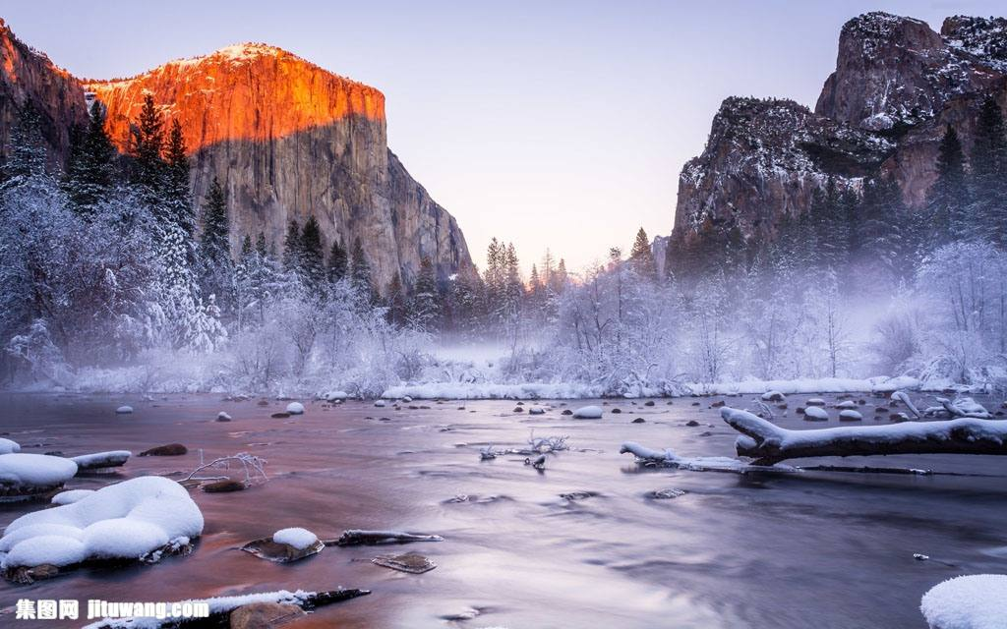
2019学年金丽衢十二校高三第二次联考读后续写
浙江省衢州第一中学 徐荣仙

Slide 3
阅读下面短文，根据所给情节进行续写，使之构成一个完整的故事。 Rescue in a Bottle Curtis Whitson had rafted down the Arroyo Seco, a river in central California, several times before. This year, Curtis Whitson knew the water-fall was coming. He figured he would get out of his raft into the shallow water, get down the rocks along ropes on either side of the falls, and continue on his way, as he had on a previous trip. But this year was different. Heavy snow and spring rains had turned the usually manageable falls into something fierce. And this year, instead of his friends, Whitson's companions were his girlfriend, Krystal Ramirez and his 13-year-old son, Hunter. As the three of them approached the falls late in, the afternoon of the. third day of their camping trip, Whitson could tell from the increasing roar of water in the narrowing canyon(峡谷) that they were in serious trouble. There was no way they'd be able to get down the rocks as planned: “The water was just roaring through there with tremendous force," recalls Whitson, 45. They had no smart phone service, and they hadn’t seen a single person in the past three days. And Whitson knew that they'd be sharing the ground there with rattlesnakes and mountain lions.
As he was thinking what to do, Whitson hit on a bit of luck- -he heard voices coming from the other side of the falls. He yelled, but the sound of the rushing water drowned him out. “We have to get these people a message," Whitson thought. He grabbed a stick and pulled out his pocketknife to carve “Help" in it. Then he tied a rope to it so the people would know it wasn't just any stick. 1Ie tried throwing it over the falls, but it floated away in the wrong direction. “We've got to do something!" Whitson yelled to his son. "Have we got anything else? Then he spotted his water bottle: Whitson grabbed it and carved “Help!" on it. Ramirez also reminded him that he had a pen and paper in his backpack. Whitson knew it was a slim hope But he wrote“6-15 19:00 We are stuck here@ the waterfall. Get help. please" and pushed the note into the bottle. This time, his throw over the waterfall was perfect. “All right, that's all we can do," Whitson told Hunter. 注意: 1.所续写短文的词数应为150左右; 2.应使用5个以上短文中标有下划线的关键词语: 3.续写部分分为两段，每段开头语己为你写好: 4续写完成后，请用下划线标出你所使用的关键词语。 Paragraph 1: It took 30 minutes to get back upstream to the beach where they 'd had lunch._______________
Paragraph 2: The next morning, the helicopter returned.__________________________________________ ____________________________________________________________________________

Slide 4
题型解读：读后续写要求考生首先读懂已有信息，不仅要读懂文本字面含义，还要读出文本背后的深意。作者不仅要理清文章的脉络和人物关系、明白故事情节发展、前因后果、人物特征、时间空间等变化，还要注意三个衔接：续写部分与整理文本故事发展的衔接，所给首句与下一句的衔接，还有第一段段尾与第二段段首的衔接。在此基础上，考生要顺着文章的思路，根据所给的线索，发挥想象力，对其后面的情节进行合理的预测和情节构思。同时要注意能把所给关键词自然恰当地写入续写部分。并且续写部分的味道与原文要保持一致，有系统的流畅性。

Slide 5
通读全文，解决5个W和H
who | 人物（角色） | Curtis Whitson; Krystal Ramirez; Hunter
when | 时间 | spring late in the afternoon
where | 地点 | the Arroyo Seco River
what | 事件 | get in trouble; ask for help
why | 原因 | extreme weather rising water
how | 怎么 | ask for help

Slide 6
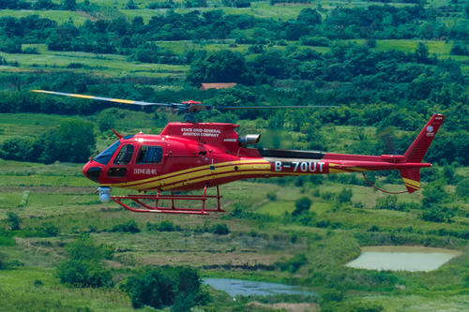
故事主线：
2020金丽衢十二校
涨水－困在岩石上－求救－无果－求救－等待－直升机－飞离……拂晓……
2016年10月的读后续写主线:
吵架－出走－迷路－失联－自救－思念－寻路－直升机－飞离……拂晓……
similar

Slide 7
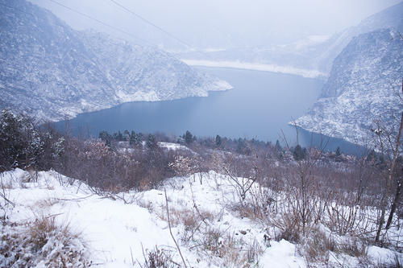
故事发生的时间：
春天（spring rains）,
仍然寒冷（heavy snow）
可续写线索:
焦虑? 坚信? 曲折? 失望? 自救? 获救? 激动?

Slide 8
构思情节、谋篇布局
一般故事的发展特点
1. 描述主要人物及故事背景
2. 呈现矛盾冲突
3. 矛盾冲突进一步复杂化
4. 呈现矛盾冲突的解决措施或结果
总之，第一段是矛盾冲突复杂化的阶段，可以是问题的进一步深化，误会的高潮，悬念的设置。第二段才能让读者释怀。

Slide 9
timetable
Curtis Whitson decided to take a trip as usual
They yelled for help, but
the sound of rushing water drowned them out
They threw a bottle with words for help in it over the waterfall, and made it.
One spring day
The first attempt
In the late afternoon
The third attempt
The second attempt
Rising water
Narrow canyon
In serious trouble
They threw a stick for help but it floated away in the wrong direction.

Slide 10
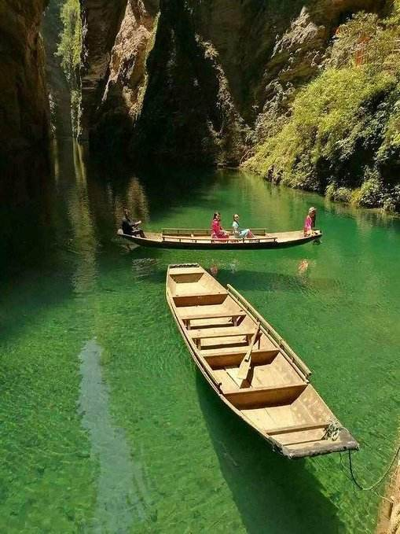
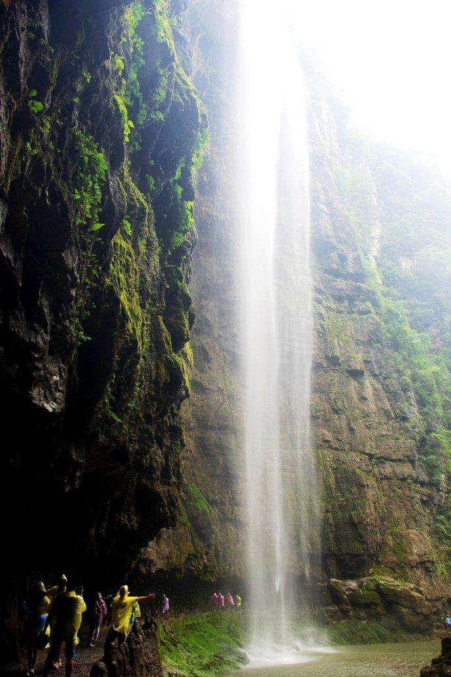
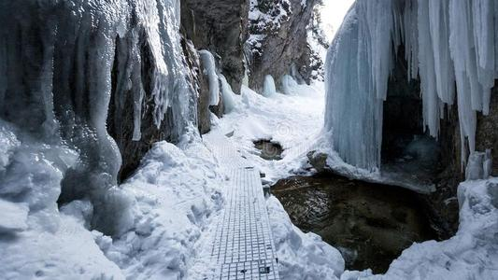
Summary:
The Whitsons went to a valley for a trip. But different from what used to be, they got in trouble. To seek for help, they tried different ways , but whether they could be rescued still remained to be seen.

Slide 11
续写词汇
已给提示词汇:
Whitson, falls, fierce, just, yelled, drowned, message, lions bottle, hope
话题激活词汇：
环境：the dazzling （灿烂的）colors of flowers; the blue sky; the songs of birds; the thundering clouds; the fragile flowers; the dark, raining evening(雨夜交加的夜晚)；the green grass; the fragrant roses; the setting/rising sun.

Slide 12
续写词汇
困难：cold, panic, shelter, broken, hunger, starve, survive, severe, animals
活动：enjoy, wait, climb, lie, attempt, light, comfort, expect
救援：rescue team, helicopter, search for, food, water, medicine, hug
意志品质：curiosity, calm, strong-willed, positive, patient, creative, adventurous
评价：brave, creative, impressive

Slide 13
续写
Paragraph1:
It took 30 minutes to get back upstream to the beach where they’d had lunch._________________________________________________________________________
Paragraph2:
The next morning, the helicopter returned. ______________________________________________________________________________
?
seek for help
trouble

Slide 14
续写
Paragraph1:
It took 30 minutes to get back upstream to the beach where they’d had lunch.__________________________________________________________
Paragraph2:
The next morning, the helicopter returned. ________________________________________________________________________
The content of paragraph1:
How did they spend the night?
How did they feel?
Did the helicopter discover them?
The content of paragraph2:
How were they rescued?
How did they feel after being rescued?

Slide 15
logical
Predict plots in pragraph1
Enjoy the beautiful nature/worry about...
Encourage and comfort each other
Wish for a lucky tomorrow
Enjoy the beautiful nature/worry about...
Encourage and comfort each other
Miss the helicopter
How to spend the night?

Slide 16
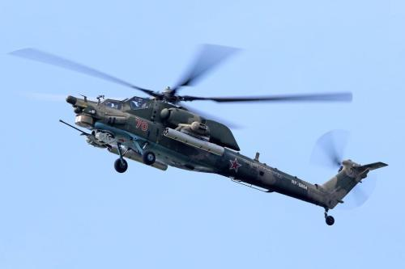
logical
Predict plots in pragraph2
shout loudly
wave their clothe s
make a SOS
Excitement at the sight of the helicopter again
How to attract the attention of the helicopter
Their reflction on the adventure

Slide 17
sentences about nature
山谷的水像奔腾的野马，发出雷鸣般的咆哮声。
The water in the valley dashed down to the plain like hundreds of galloping wild horses.
半夜里，天空变得晴朗了。夜晚很安静，几乎没有风，只有大自然的声音和篝火的火焰与我们作伴。
At midnight the sky became clear and quiet. There was almost no wind-only the sound of nature and the flames of our fire for company.
未知的花香散发出怡人的香气。
The unknown tiny flowers and plants gave off pleasant scents.
芬芳的微风轻轻抚摸着我的脸庞，仿佛抚慰着我所有的的疲惫和恐惧。
The fragrant breeze gently touched my face, as if comforting all the tiredness and terror along the trip.

Slide 18
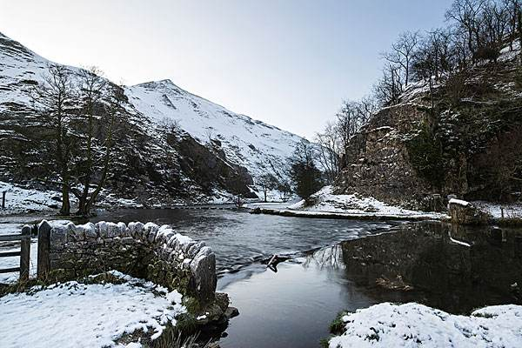
sentences about Hunter
Hunter沉浸在大自然的美丽中
Hunter was totally immersed / absorbed/ lost / drowned in the charm of nature.
Hunter was deeply impressed/ attracted/ amazed by the scene before him.
Hunter从没见过这样美丽的风景
Never has Hunter seen such breath-taking sight.
Hunter马上被眼前的风景虏获，迫不及待的要去探索。
Hunter was immediately captured / seized by the sight in front of him and could not wait to explore it.

Slide 19
Other sentences for you to enjoy
Exhausted and somewhat hopeless, they sank on the rock, staring at each other with blank expressions.
After what seemed like a century, a helicopter did come into their sight. But it flew away without any stop.
With the fierce wind howling like a hungry wolf, they huddled together in their camp for warmth. The sound of the whining lions made their hair stand on end.
I was so exhausted after such a long time wait that I fell asleep the moment my head hit the pillow.

Slide 20
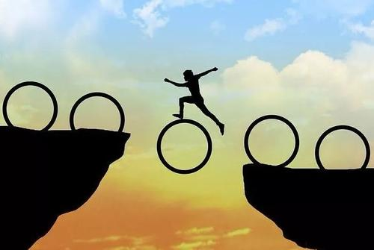
Challenge Yourself
下水作文

Slide 21
It took 30 minutes to get back upstream to the beach where they 'd had lunch. Exhausted and hungry, they sat on the rock. “Honey, will our bottle for help be discovered?” Krystal looked worriedly into Whitson's eyes. “Sure.” he comforted her, trying to ease the tense atmosphere. Suddenly, a helicopter came into their sight. They shouted at the top of their lung to draw its attention ,but it hovered for a while and flew away. They waited until darkness fell in the valley. With the fierce wind howling like a hungry wolf outside their camp, they huddled together for warmth, praying for a miracle with eyes wide open.
The next morning, the helicopter returned. To their great joy, the helicopter was just right over their heads. they yelled with all their strength and waved their clothes widely in a desperate attempt to be noticed. This time, luckily, they were spotted and ultimately saved by the people in the helicopter. While looking down at the valley, all the tiredness and terror along the trip was removed by the blue sky and white clouds. What a different experience! (166字)

Slide 22


