Slide 1


感恩遇见，相互成就，本课件资料仅供您个人参考、教学使用，严禁自行在网络传播，违者依知识产权法追究法律责任。
更多教学资源请关注
公众号：溯恩高中英语
知识产权声明

Slide 2
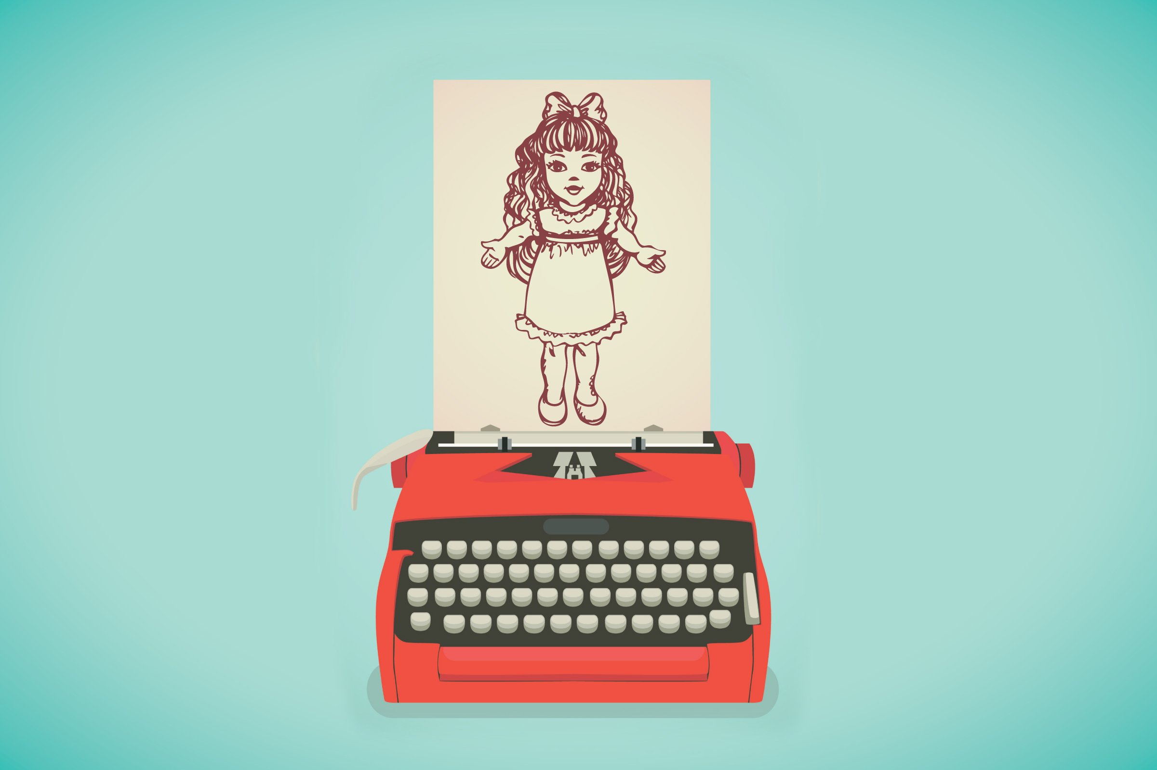

One Father's Battle Between Working and Giving Attention to His Daughter
Z20联盟
2020届第三次联考
读后续写
Z20联盟
桐乡市高级中学
冯燕娜

Slide 3
1
Contents
Continuation Exercise
2
Expression Focus
3
Plot Planning
4
Possible Version
5
Impressive Work

Slide 4
1
Continuation Exercise
“Missy,” I called to my wife, “did you put the banana skin on my desk?” “No, honey. Meghan probably did.” As I'd feared, she had missed my real purpose of the question which was to make it clear to her that she hadn't done her job: defend my desk against the invader —— our naughty girl. I abandoned the conversation.
I sat here at the desk, and stared at the screen. I waited patiently for ideas to come to me, exam questions for a test I would give my English students. My wife was off to a reunion somewhere, but I was not alone. Meghan, our 22-month-old daughter, kept me company. Yet her plans that day seemed to go against mine.
She followed a daily routine that was both time-consuming and challenging. It included certain basic tasks: watching the fish, sweeping the carpet in her room, climbing up and down her bed.

Slide 5
1
Continuation Exercise
At first I could concentrate on designing my test paper. But I was soon sidetracked(分心的). I had not counted on the arrival of the “bib-bibs” (“Bib-bibs” were birds.) “Bib-bibs, bib-bibs!” Meghan screamed excitedly, her eyes alive with expectation. She insisted that I go with her to the window.
“In a second. Just let me finish this question.” I said. She pulled me by the hand (two fingers, actually) toward the window. I saw myself as a fool, being led to watch the bib-bibs. And we did watch them. They chattered and leaped back and forth on the lawn just outside our apartment window. Meghan was absorbed, but as I watched them, I still thought about my work.
Suddenly she rushed out from the room, and I heard her naked feet slapping against the wooden floor outside. She returned with her doll, Dumpty. She held him up to the window, stretching him out by his two arms and whispering into his nonexistent ear, “Bib-bibs, Dumpty, bib-bibs!” Then I left them in conversation and returned to my desk.

Slide 6
1
Continuation Exercise
注意：
1. 所续写短文的词数应为150左右；
2. 至少使用5个短文中标有下划线的关键词语；
3. 续写部分分为两段，每段的开头语已为你写好；
4. 续写完成后，请用下划线标出你所使用的关键词语。
Paragraph 1:
Unfortunately, she came again, with her shoes in hands and preparing for an outing.
Paragraph 2:
Out of the corner of my eye I could see the little girl sobbing because I didn't have time for her.

Slide 7
2
Expression Focus
abandon
vt. to stop doing sth, especially before it is finished; to stop having sth 中止；放弃；不再有
  她对和解已不再抱有希望。
  She abandoned hope of any reconciliation.
  我停止了谈话。
  I abandoned the conversation.

Slide 8
2
Expression Focus
company
[U] the fact of being with sb else and not alone 陪伴；作伴
  和这个年龄的孩子在一起很开心。
  The children are very good company.
  他要陪伴我一起来。
  He's coming with me for company.
  我22个月的女儿Meghan陪着我。
  Meghan, our 22-month-old daughter, kept me company.

Slide 9
2
Expression Focus
accompany
vt. (formal) to travel or go somewhere with sb 陪同；陪伴
  那次旅行他由妻子陪同。
  His wife accompanied him on the trip.
  抱歉今天我没办法陪你出去。
  I'm sorry I can't accompany you out today.

Slide 10
2
Expression Focus
time-consuming
adj. taking or needing a lot of time 费时的；耗时间的
  困难又费时的过程
  a difficult and time-consuming process
  制作蛋糕是一个非常耗时的过程。
  Cake-making is a very time-consuming process.

Slide 11
2
Expression Focus
challenging
adj. difficult in an interesting way that tests your ability
挑战性的；考验能力的
  富有挑战性且有意义的教师职业
  a challenging and rewarding career as a teacher
  她每天做的事既费时又富有挑战性。
  She followed a daily routine that was both time-consuming and challenging.

Slide 12
2
Expression Focus
sidetrack
vt. [usually passive] to make sb start to talk about or do sth that is different from the main thing that they are supposed to be talking about or doing 使转变话题；使转移目标 【SYN】distract
  我本来应该在写信，但后来恐怕是分心干别的去了。
  I was supposed to be writing a letter but I'm afraid I got sidetracked.

Slide 13
2
Expression Focus
expectation
n. a belief that sth will happen because it is likely 预料；预期；期待
  我们满怀信心地期待着完全康复。
  We are confident in our expectation of a full recovery.
  出乎意料的是利率并未上升。
  Contrary to expectation, interest rates did not rise.
  完全没想到的她过得非常快活。
  Against all expectations, she was enjoying herself.
  Meghan兴奋地尖叫，眼里充满了期待。
  Meghan screamed excitedly, her eyes alive with expectation.

Slide 14
2
Expression Focus
chatter
1) vi. (of birds or monkeys禽或猴) to make a series of short high sounds
啼叫；鸣叫
2) vi. to talk quickly and continuously, especially about things that are not important 喋喋不休；唠叨；饶舌
  他们高兴地闲扯了一会儿。
  They chattered away happily for a while.
  孩子们很兴奋，没完没了地谈论着第二天的活动。
  The children chattered to each other excitedly about the next day's events.

Slide 15
2
Expression Focus
leap
v. to jump high or a long way 跳；跳跃；跳越
  海豚跃出水面。
  A dolphin leapt out of the water.
  我们跳过了那条小溪。
  We leapt over the stream.
  那匹马跃过了一道五尺高的墙。
  The horse leapt a five-foot wall.
  他们就在我们公寓窗外的草坪上鸣叫，跳来跳去。
  They chattered and leaped back and forth on the lawn just outside our apartment window.

Slide 16
2
Expression Focus
stretch
v. to put out an arm or a leg in order to reach sth 伸出，伸长（胳膊、腿）
  她伸手到桌子那头去拿黄油。
  She stretched across the table for the butter.
  我伸出一只手，把书捡起来。
  I stretched out a hand and picked up the book.
  她把它举到窗口，展开他的双臂，轻声地对着他并不存在的耳朵说：“Bib-bibs, Dumpty, bib-bibs!”
  She held him up to the window, stretching him out by his two arms and whispering into his nonexistent ear, “Bib-bibs, Dumpty, bib-bibs!”

Slide 17
2
Expression Focus
sob (-bb-)
1) vt. to say sth while you are crying 哭诉；抽噎着说
    “我恨他。”她抽噎着说。
    “I hate him, ” she sobbed.
2) vi. to cry noisily, taking sudden, sharp breaths 抽噎；啜泣；呜咽
    我听见有个孩子在呜呜地哭。
    I heard a child sobbing loudly.
    他不由自主地抽噎起来。
    He started to sob uncontrollably.
    在我的眼角余光中，有个小女孩正在啜泣，因为我没有时间陪她。Out of the corner of my eye I could see the little girl sobbing because I didn't have time for her.

Slide 18
3
Plot Planning
Who are the main characters in the text?
What's your impression on them? Find details to support your idea.
I (father);
Meghan (my 22-month-old daughter);
Dumpty (Meghan's doll)
Charaters | Impression
I
Meghan
Dumpty
a work-oriented father and teacher
a naughty and lively toddler calling for her father's attention
a beloved companion for Meghan

Slide 19
3
Plot Planning
I
(a work-oriented father and teacher)
para.1
para.2
para.5
para.6
… defend my desk against…
I sat here at the desk, and stared at the screen. I waited patiently for ideas to come to me, exam questions for a test I would give my English students.
“In a second. Just let me finish this question” … I still thogught about my work.
… Then I left them in conversation and returned to my desk.

Slide 20
3
Plot Planning
Meghan
(a naughty and lively toddler calling for her father's attention )
para.1
para.4
para.6
“…did you put the banana skin on my desk? ” … “… Meghan probably did.”
“Bib-bibs, bib-bibs!” Meghan screamed…
【manage to express herself only in short and simple words】
…returned with…held him up to the window, stetching him out…whispering into…“Bib-bibs, Dumpty, bib-bibs!”

Slide 21
3
Plot Planning
Dumpty
(a beloved companion for Meghan)
para.6
Suddenly she rushed out from the room, and I heard her naked feet slapping against the wooden floor outside. She returned with her doll, Dumpty. She held him up to the window, stretching him out by his two arms and whispering into his nonexistent ear, “Bib-bibs, Dumpty, bib-bibs!” Then I left them in conversation and returned to my desk.
【Dumpty endeared himself to Meghan who was eager to share her joy with him.】

Slide 22


3
Plot Planning
Yet her plans that day seemed to go against mine.
“…just let me finish the question”
screamed…; insisted…
… still thought about my work…
pulled…
left them…; returned to my desk
rushed out…; returned …; held…; stretch…;whispered
？
came again…; preparing for…
work prevailed
Trigger
？
work surrendered
…sobbing…
the arrival of “bib-bibs”
para.2 Out of the corner of my eye I could see the little girl sobbing because I didn't have time for her.

Slide 23
4
Possible Version
Paragraph 1
Unfortunately, she soon came again, with her shoes in hands and preparing for an outing. “Don't even ask, Meghan. Not today.” I knew her plan too well: First the shoes. Then the stroller. And pretty soon we were in the park. The way she always did. Having sensed my impatience with her, Meghan put down the shoes, tugged at my sleeve with her free hands and pleaded using her hard-to-understand baby talk. “No, Meghan,” I said again. “Not now. Go away and leave me alone.” Finally, she left. She made no further attempt to bother me. Then I tried to concentrate on the test paper without interference.
Paragraph 2
Out of the corner of my eye I could see the little girl sobbing because I didn‘t have time for her. She stood with her back against the sofa, watching me type and slowly brushing the tip of Dumpty’s arm across her nose for comfort. Obviously Dumpty was doing my job to keep her company. I suddenly felt guilt growing inside me. “Meghan, I feel like taking a walk down to the park. I was wondering if you would care to join me.” Hearing this, she laughed excitedly and began the frantic search for her shoes. I knew I should put aside my work and go right at the moment—while bib-bibs still sparked wonder and while my girl thought that a walk with her father was a gift beyond measure.

Slide 24
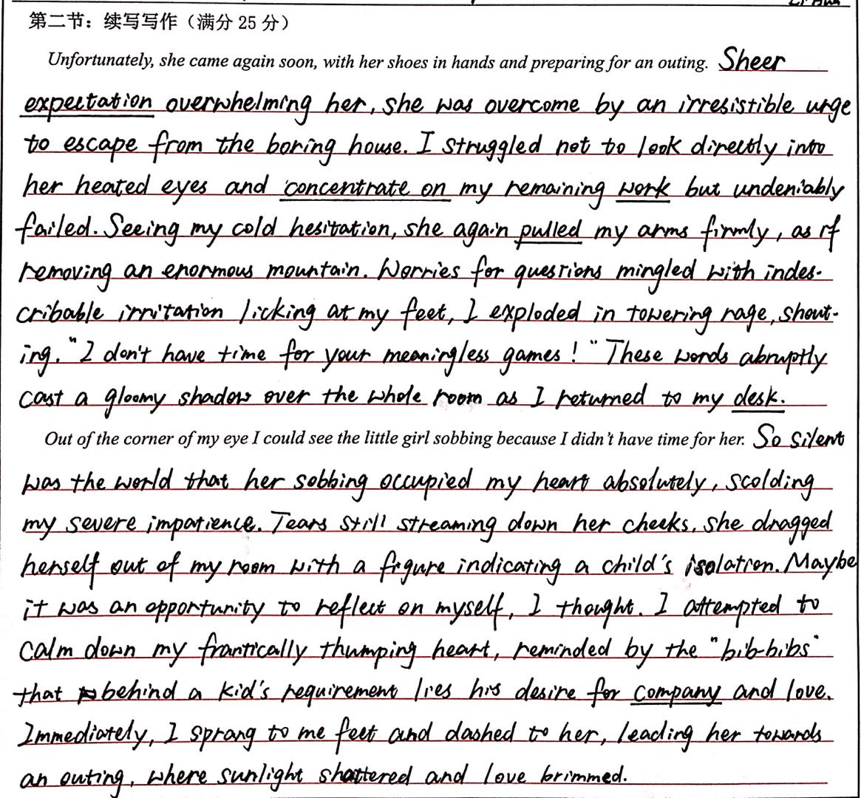
5
Impressive Work
高分作文点评
这篇续写与原文联系十分紧密，第一段顺着提示语点明女儿的意图；接着细致入微地描写了醉心工作的父亲在经历内心挣扎后选择工作；女儿不轻言放弃，继续要求父亲带她出去玩；最终父亲爆发，工作最终战胜了女儿的需求。第二段女儿落泪，父亲心碎。围绕父亲的心理变化展开议论，升华主题，全文聚焦感强。
语言准确，几乎没有错误。使用词汇丰富多样，高级句式信手拈来：
Sheer expectation overwhelming her, she was overcame by an irresistible urge to escape from the boring house. 【独立主格】
So silent was the world that her sobbing occupied my heart absolutely. 【倒装】
lying behind
my
得分：21

Slide 25
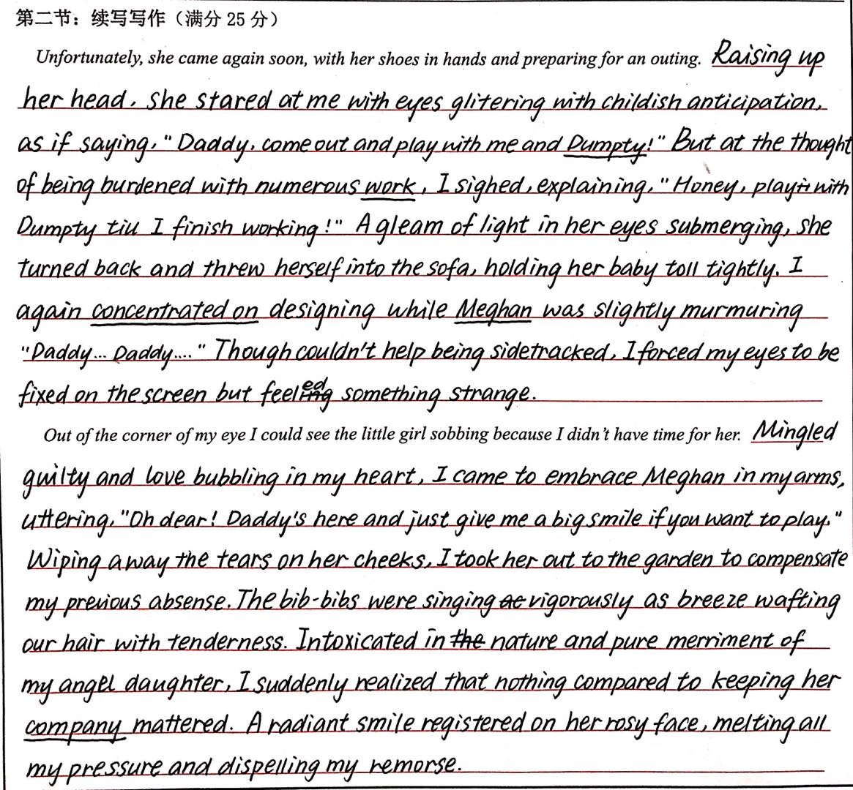
5
Impressive Work
高分作文点评
这篇续写与原文联系较紧密，第一段顺着提示语用一个as if巧妙地点明女儿的意图；接着描绘了一个无奈被工作所累的慈父形象；女儿退到一旁，仍不忘恳求父亲；父亲回归工作。第二段女儿落泪，父亲内疚，决定放下工作陪伴女儿，并通过父亲的心理活动描写进行了主题升华：陪伴女儿才是最重要的事情。
语言准确，有些许错误，但不影响意义表达。词汇丰富多样，高级句式使用娴熟：
Raising up her head, she stared at me with eyes glittering with childish anticipation.
【非谓语作状语；as if 句型】
A gleaming of light in her eyes submerging, she turned back and threw herself into the sofa.
【独立主格】
glittering
doll
I
felt
guilt
for
nothing
得分：20

Slide 26
Homework
  1. Keep the given expressions in mind.
  2. Learn from the impressive works.
  3. Polish your own writing.

