Slide 1

感恩遇见，相互成就，本课件资料仅供您个人参考、教学使用，严禁自行在网络传播，违者依知识产权法追究法律责任。
更多教学资源请关注
公众号：溯恩高中英语
知识产权声明

Slide 2

the Coherence and Distribution of Plots between two paragraphs
续写段落间的情节衔接与分布
Continuation Writing-
-2020/6/15 By Lily

Slide 3

Will you outline the plots before writing?
How do you outline the plots?
How do you distribute the plots into two paragraphs?

Slide 4
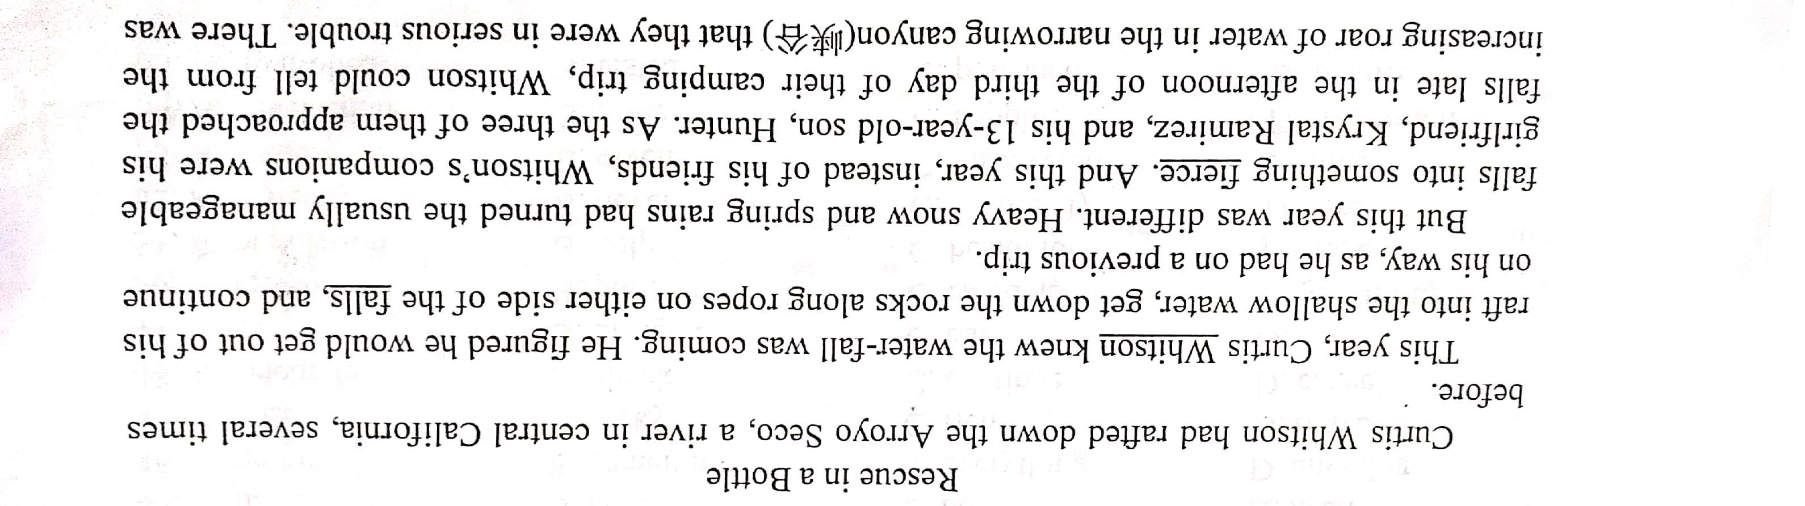
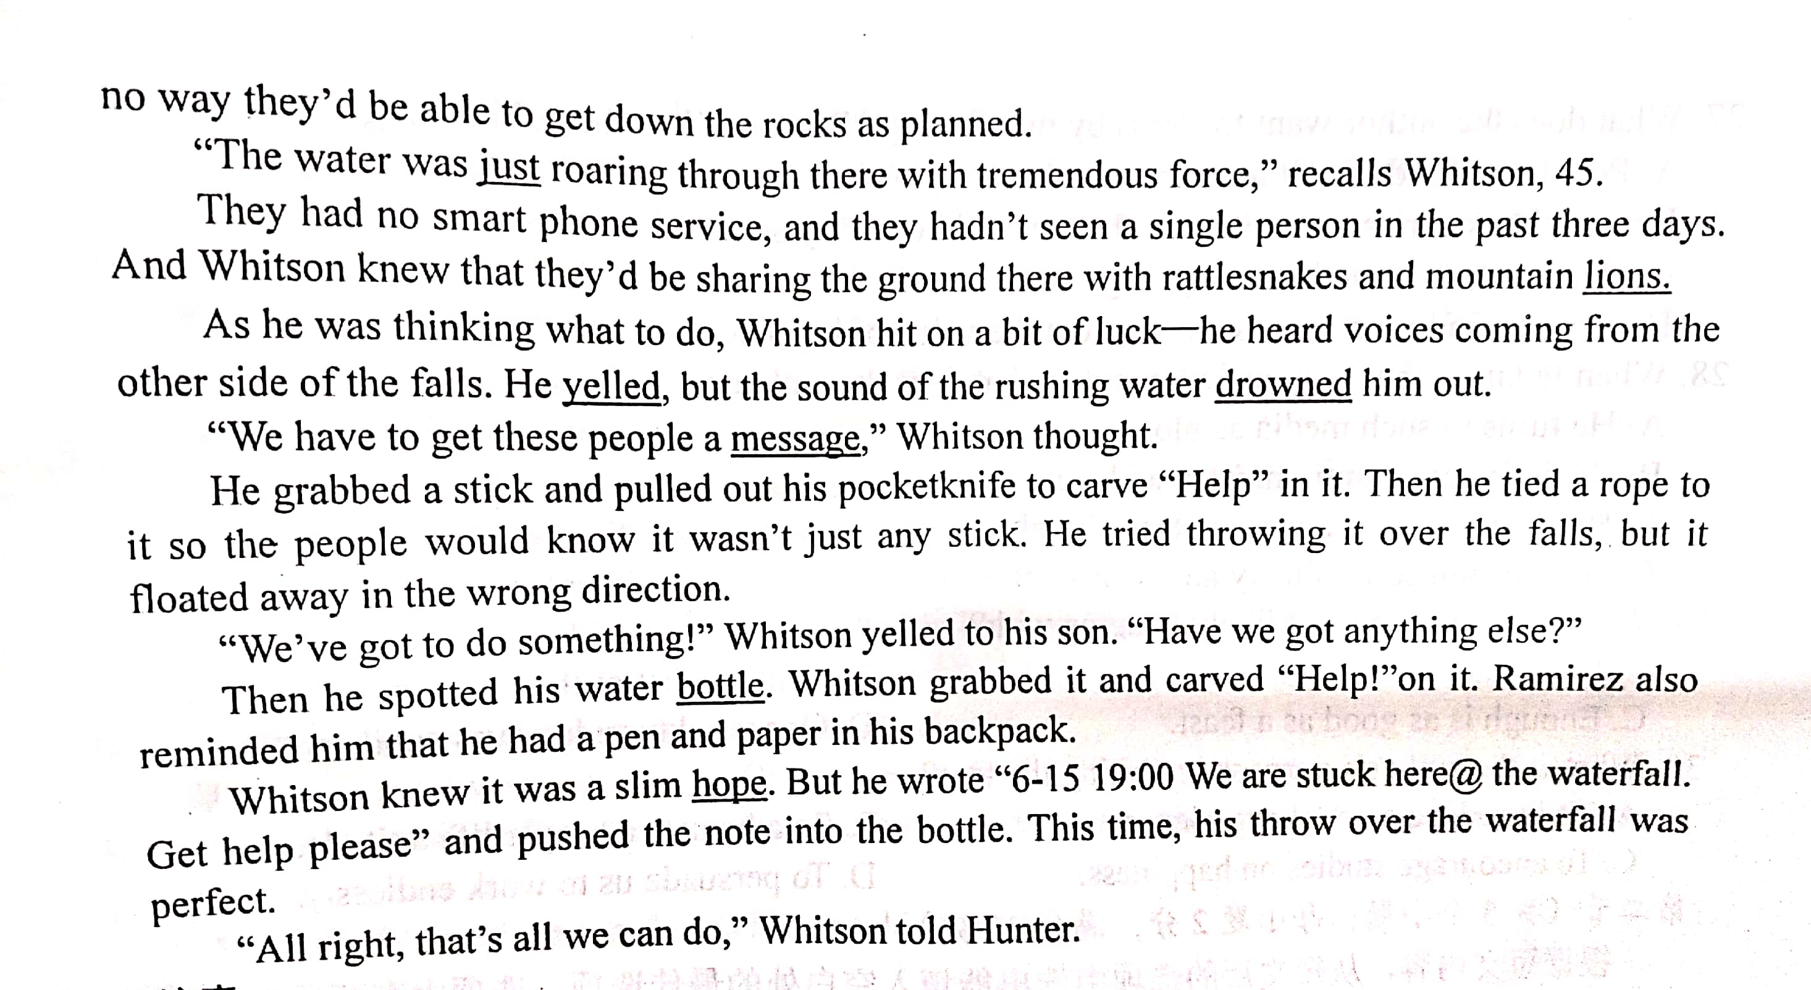
续写原题回顾

Slide 5
Rescue in a Bottle
Review the given Part
Who
Curtis Whitson with his son and girlfriend
What
planned to raft down the river as before but they were trapped
Why
heavy snow and spring rains made the usual trip into something fierce and they couldn't raft down the fall
Where
on the river in California-fall-...
When
In Spring-On the day-lunch time-...
How
Threw the bottle up with messages and waited for the rescue

Slide 6
The Plots of a Story
Time and Space
the main plots
Main Events
Actions and Feelings
the detailed plots
The Hidden Topic

Slide 7
Infer the main plots:(Time and Space+Main Events) in para1 and para2
“All right, that's all we can do,” Whitson told Hunter.
Para1: It took 30 minutes to get back upstream to the beach where they 'd had lunch.
Para2: The next morning, the helicopter returned.
The helicopter tried helping them
but the first rescue failed.
They spent a night staying on the beach.
They were rescued successfully.

Slide 8
Infer the detailed plots (Actions and Feelings)in para1 and para2
Para1: It took 30 minutes to get back upstream to the beach where they 'd had lunch.
Para2: The next morning, the helicopter returned.
How?
make some
preparations
They spent a night staying on the beach.
When?How?
At the midnight...
heard ...Excited...waved and yelled..
The helicopter tried helping them
but the first rescue failed.
Why?
the darkness drowned them
How?
救援过程描述：
spot them-lower the member-lift them-be taken to...
They were rescued successfully.
Why?
得救原因-点题：It was that bottle saved them.

Slide 9
The Distribution of Plots (情节分布)
Time and Space
Actions and Feelings
Time
Para2
Para1
The next morning
found why they
could be found.
rescued them
At midnight
find the helicopter and yell
got saved and excited
Evening wore on
make some
preparations
in the afternoon
wait for rescue
on the plane
on the beach
Space

Slide 10
A Possible Version:
Para1: It took 30 minutes 10 get back upstream t0 the beach where they'd had lunch. With no reasonable expectation that their message in the bottle would find its way to anyone, they prepared to spend a safe night there. As the evening wore on, they decided they probably weren't going to get rescued that night, so they pulled out their sleeping bags. Before turning in, Ramirez added wood to the fire to keep the mountain lions away. However, just after midnight, they heard a helicopter hovering above them. Wild with joy, Whitson, Ramirez, and Hunter waved and yelled like crazy, Unfortunately, the darkness drowned everything. The helicopter circled and got back.
Para2: The next morning, helicopter. After the three were spotted, the helicopter lowered the crew member on a cable. The rescue worker got to the ground and helped the three get saved. The rescuers lifted Hunter, Ramirez, and Whitson out of the mountain one by one. It was not long before they were taken to safety. That was a moment of pure happiness as the three chatted with the rescue workers. Together, they marveled at the unlikelihood of it all. And just at that time, Whitson learned that a hiker spotted the bottle with the message asking for help. It was exactly that bottle that saved them all!

Slide 11
Summary:
How to infer the possible plots in para1 and para2 ?
Last Paragraph+The beginning sentences
the main plots:(Time and Space+Main Events)
the detailed plots: (Actions and Feelings)

Slide 12
The Distribution of Plots (情节分布)
How to make para1 and para2 coherent in plots?
Time
Para1
Para2
Actions and Feelings
Space

Slide 13
One more Example

Slide 14
2016.10高考读后续写真题回顾： One weekend in July, Jane and her husband, Tom, had driven three hours to camp overnight by a lake in the forest. Unfortunately, on the way an unpleasant subject came up and they started to quarrel. By the time they reached the lake, Jane was so angry that she said to Tom. “I'm going to find a better spot for us to camp" and walked away. With no path to follow,Jane just walked on for quite a long time. After she had climbed to a high place. she turned around, hoping to see the lake. To her surprise, she saw nothing but forest and, far beyond, a snow capped mountain top. She suddenly realized that she was lost. “Tom! "she cried. "Help!" No reply. If only she had not left her mobile phone in that bag with Tom. Jane kept moving, but the farther she walked, the more confused she became. As night was beginning to fall, Jane was so tired that she had to stop for the night. Lying awake in the dark, Jane wanted very much to be with Tom and her family. She wanted to hold him and tell him how much she loved him. Jane rose at the break of day, hungry and thirsty. She could hear water trickling (滴落）somewhere at a distance. Quickly she followed the sound to a stream. To her great joy,she also saw some berry bushes. She drank and ate a few berries. Never in her life had she tasted anything better. Feeling stronger now. Jane began to walk along the stream and hope it would lead her to the lake. As she picked her way carefully along the stream, Jane heard a helicopter. Is that for me? Unfortunately, the trees made it impossible for people to see her from above. A few minutes later, another helicopter flew overhead. Jane took off her yellow blouse, thinking that she should go to an open area and flag them if they came back again.
Main Idea：
一对夫妻在野营时吵架，妻子Jane一气之下离开误入森林走失...

Slide 15
The last paragraph:
As she picked her way carefully along the stream, Jane heard a helicopter. Is that for me? Unfortunately, the trees made it impossible for people to see her from above. A few minutes later, another helicopter flew overhead. Jane took off her yellow blouse, thinking that she should go to an open area and flag them if they came back again.
获救方式
When the helicopter__________, Jane would went to ___________and waved with her___________so that she can be spotted by the helicopter.
returned
a big rock/...
yellow blouse

Slide 16
Infer the main plots:(Time and Space+Main Events)
Para1: But no more helicopters came and it was getting dark again. Para2: It was daybreak when Jane woke up.
Jane spent a night in the forest.
Jane tried to find an open area and waited for the helicopter to return.

Slide 17
Infer the detailed plots (Events and Feelings)in para1 and para2
Para1: It took 30 minutes to get back upstream to the beach where they 'd had lunch.
Para2: The next morning, the helicopter returned.
Jane spent a night in the forest.
How?
Actions about preparations for the night
Feelings:
hopeless/frustrated-regretful-regain courage-calm
描述自救的过程：
spot them-climb-wave-yell-..
How?
Jane tried to find an open area and waited for the helicopter to return.
Where?
Feelings: Tired but hopeful-excited-joyful-

Slide 18
The Distribution of Plots (情节分布)
Time and Space
Actions and Feelings
Time
Para2
The next morning
Para1
helicopter returned
and found her;excited
tried to calm down and make some preparations
for the night
meet Tom;
joyful
Evening
found sth to eat
fell asleep
found an open area; tired but hopeful
getting dark
felt desperate and regretful
in the forest
an open area
back to Tom
in the forest
Space

Slide 19
A Possible Version:
Para1: But no more helicopters came and it was getting dark again. Looking through the thick darkness, she felt a strong sense of regret and despair surging through her body. “If only I had not quarreled with Tom.” She thought to herself. However, she didn’t lose heart, keeping shouting in her mind, “Focus! Tom must have called for those helicopters. I have to guide him tomorrow.” She picked up her courage again and managed to find a shelter to stay from the bones-chilling night. Shortly after, she collapsed in fatigue and barely kept her eyes open, sweetly dreaming of seeing Tom. Para2: It was daybreak when Jane woke up. She ate some berries and then made her way along the stream, hoping to find a suitable place to guide the helicopter. Exhausted but full of hope, all of a sudden, she spotted a huge flat rock. She made a great effort to climb onto it and waited with patience. The minute the helicopter came into sight again, she waved the yellow blouse violently and yelled at the helicopter with full-strength. Much to her joy, it did capture the attention of the helicopter and the helicopter landed near the big rock slowly. Without hesitation, Jane jumped off the rock and rushed towards Tom like a flying arrow in floods of tears, hugging tightly in his arms, “please never leave me alone!”

Slide 20
One more Practice

Slide 21
It was summer, and my dad wanted to treat me to a vacation like never before. He decided to take me on a trip to the Wild West. We took a plane to Albuquerque, a big city in the state of New Mexico. We reached Albuquerque in the late afternoon. Uncle Paul, my dad’s friend, picked us up from the airport and drove us up to his farm in Pecos. His wife Tina cooked us a delicious dinner and we got to know his sons Ryan and Kyle. My dad and I spent the night in the guestroom of the farm house listening to the frogs and water rolling down the river nearby. Very early in the morning, Uncle Paul woke us up to have breakfast. "The day starts at dawn on my farm," he said. After breakfast, I went to help Aunt Tina feed the chickens. while my dad went with Uncle Paul to take the sheep out to graze(吃草). I was impressed to see my dad and Uncle Paul riding horses. They looked really cool. In the afternoon, I asked Uncle Paul if I could take a hose ride, and he said yes, as long as my dad went with me. I wasn’t going to take a horse ride by myself anyway. So, my dad and I put on our new cowboy hats, got on our horses, and headed slowly towards the mountains. "Don’t be late for supper," Uncle Paul cried, "and keep to the track so that you don’t get lost!" "OK! " my dad cried back. After a while Uncle Paul and his farm house were out of sight. It was so peaceful and quiet and the colors of the brown rocks, the deep green pine trees, and the late afternoon sun mixed to create a magic scene. It looked like a beautiful woven(编织的）blanket spread out upon the ground just for us.
2018.06 高考读后续写真题回顾：
我和爸爸到叔叔的西部农场度假，从未单独骑过马的我和爸爸一起骑马向西部的山林驰骋，享受着独好的西部美景...

Slide 22
Task: Infer and distribute the plots into these two paragraphs by finishing the plots-distributing form learned today.
Para1: Suddenly a little rabbit jumped out in front of my horse.
Para2: We had no idea where we were and it got dark.
Time
Para1
Para2
Actions and Feelings
Space

Slide 23

